Slide 1

Gore Autonomous Pinecone Collector
Tyler Rottkamp, Elijah Gerstner, Kyle Zarycki, Siyu Yu ​

Slide 2
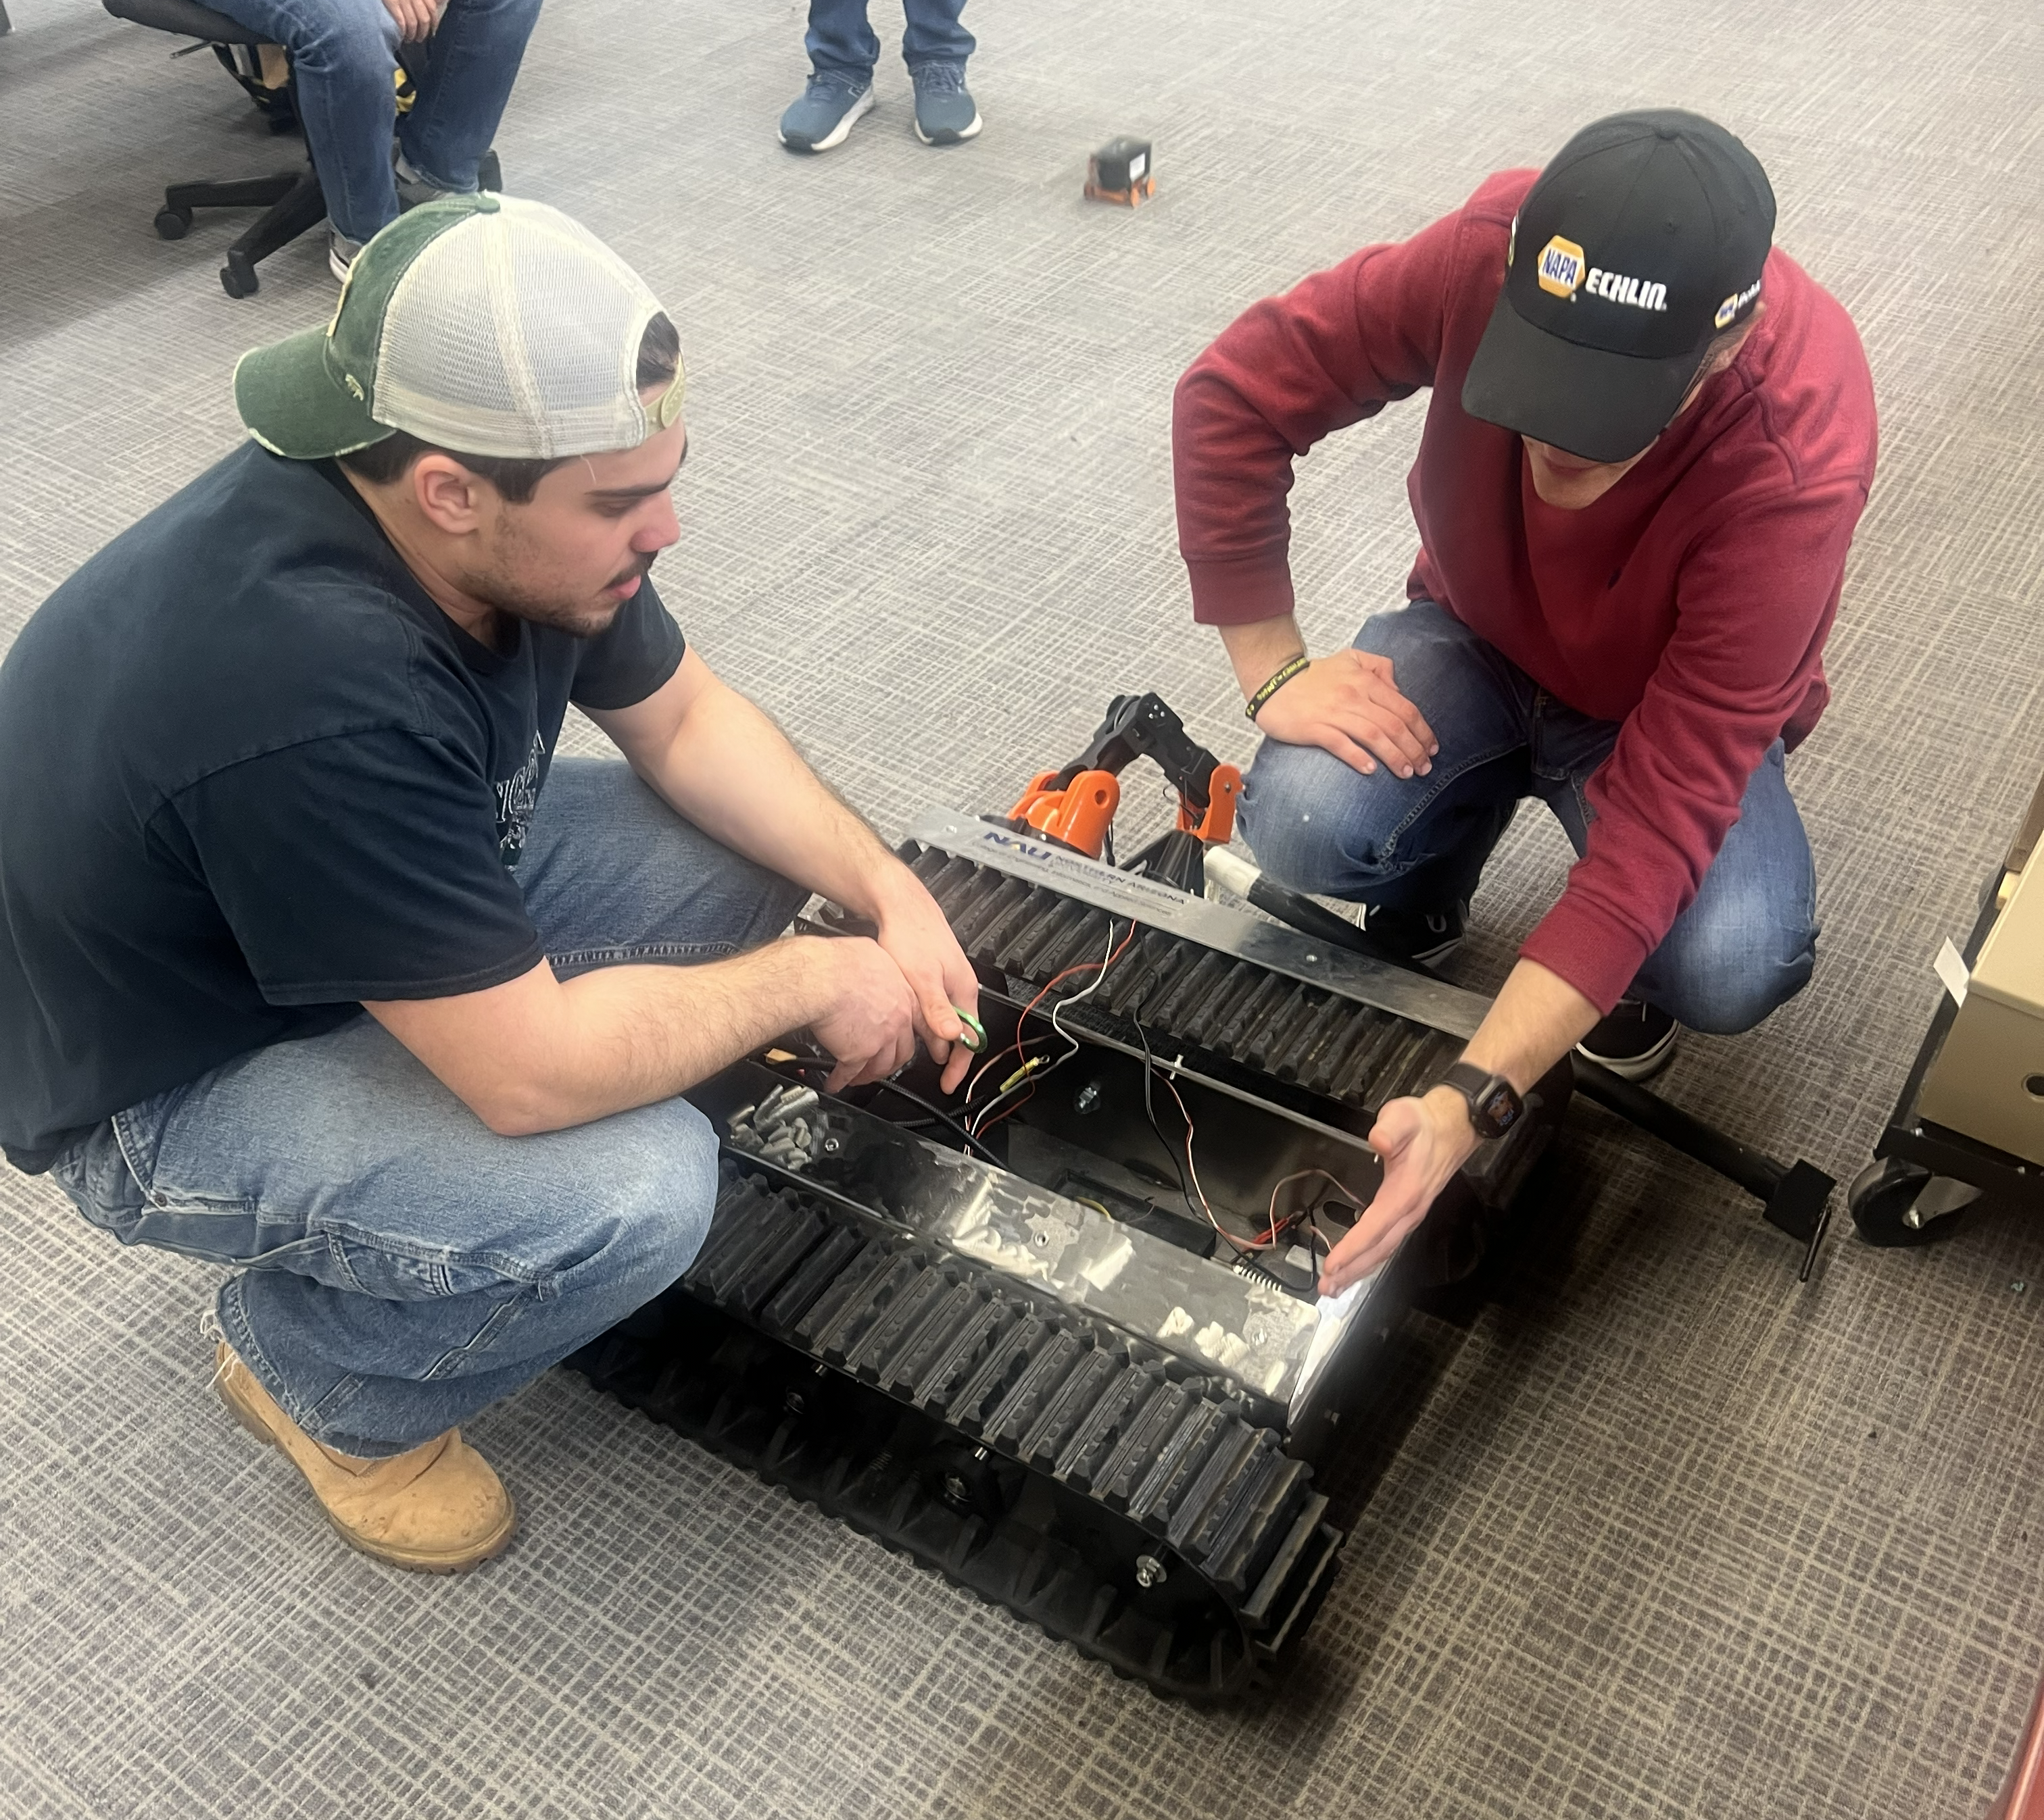
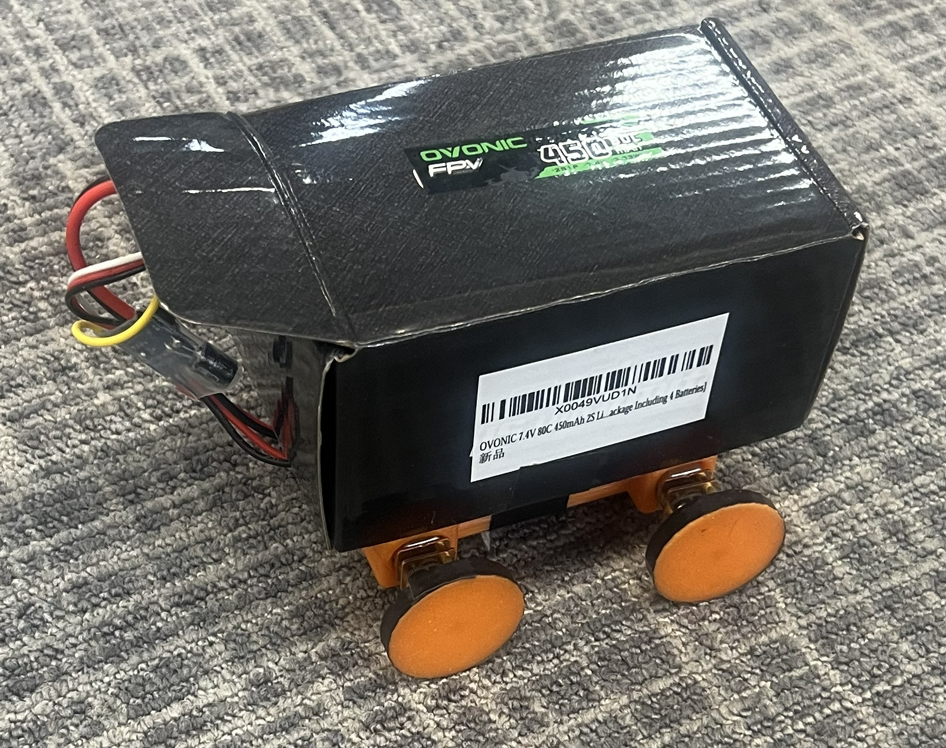

Project Description
g
Goal:
Design a robot to autonomously map and navigate a fenced area of yard or forest terrain, collect pinecones, drop pinecones in base-station, and charge.
Updates:
-Parts ordered & received for prototype 1.
-Currently assembling prototype 1, it will mainly test the collection system and EE team integrations.
-3D printed prong trials have begun.
-Mechanical team website is live and acting as the base for the electrical team site.
EE Team:
Remote Control Test Vehicle
Raz Lab Visit:
Inspecting RUT
Sponsor:
W.L. Gore

Slide 3
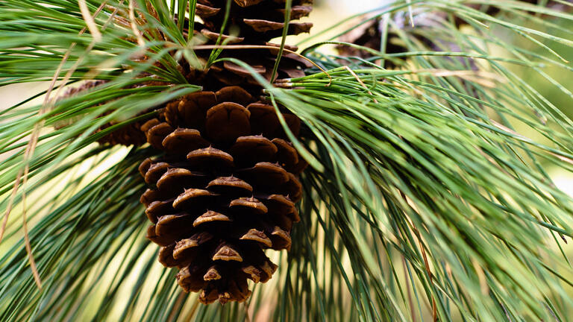
Design Requirements
Customer Requirements:
Collect fallen pinecones effectively within a bounded area.
Avoid jams and minimize non-pinecone debris intake.
Handle expected pinecone size range.
Autonomous operation on yard/forest terrain. Navigate
and collect with minimal supervision.
Operate without causing undue property/environmental damage.
Simple handling and maintenance by one person.
Reasonable size/weight for storage and transport.
Clear a typical area in a single run.
Safe around people, pets, and property.
Engineering Requirement | Target | Units
Pickup efficiency (collected ÷ visible) | ≥ 70 | % collected
Hopper volume | ≥ 2.0 | ft³
Jam rate during operation | ≤ 1 | jams/hr
Terrain handling | ≥ 30 | degree incline
System weight | ≤ 50 | lb
Runtime per charge | ≥ 1.5 | hours
Emergency stop response | ≤ .2 | seconds

Slide 4
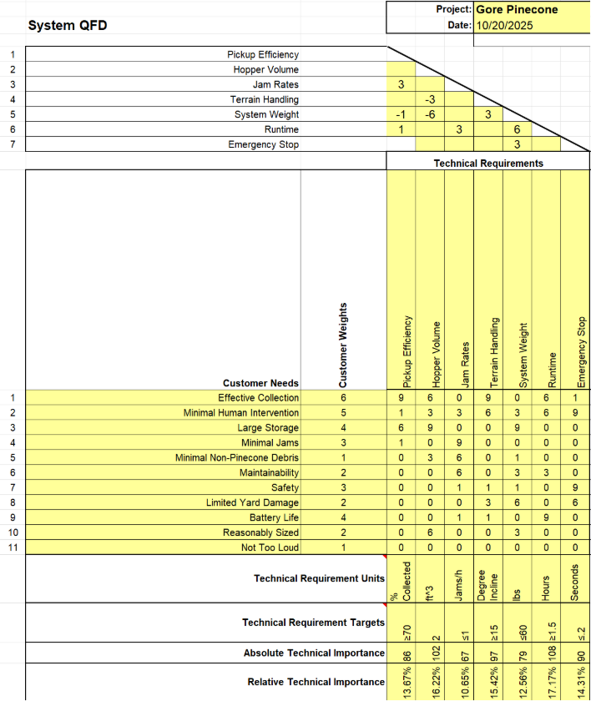
QFD
Largely Unchanged
Shows that maximizing hopper volume and runtime are a priority
System weight and emergency stop are lower priority since they aren’t technically required for minimal functionality
However, all systems are connected to key goals

Slide 5
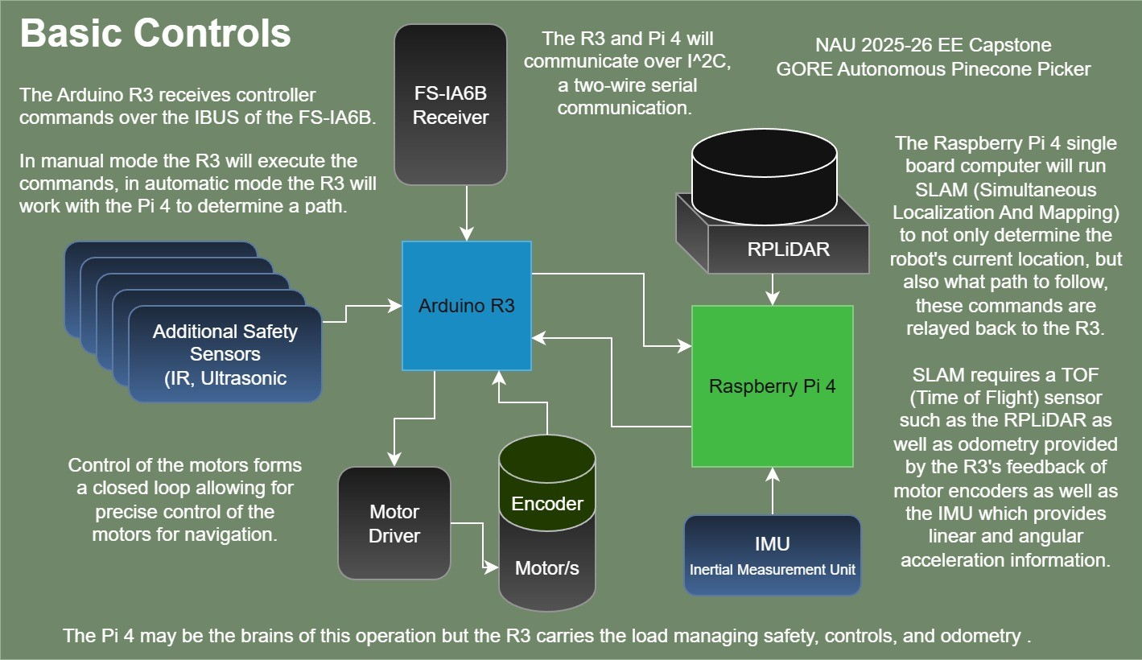
Design Description: Electrical

Slide 6
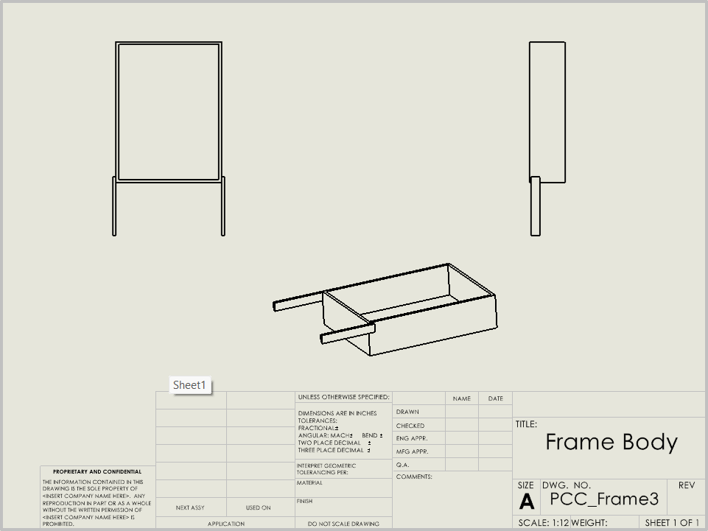
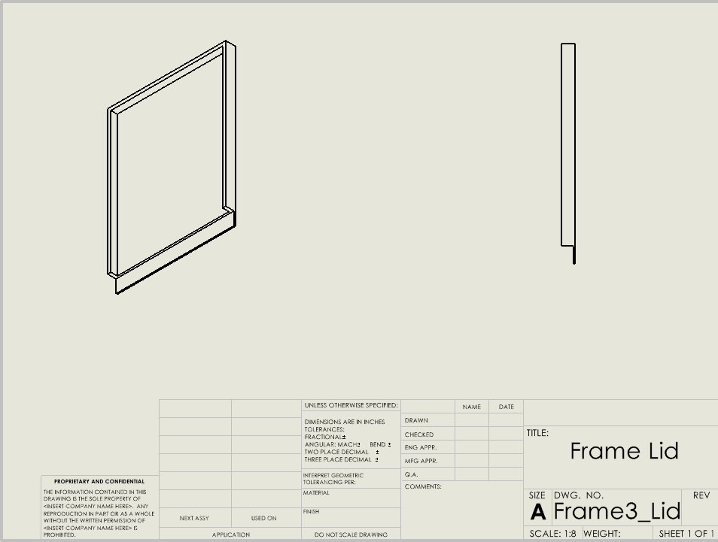
Design Description: Frame
Function:
To act as an anchor to our tracks and inner machinery. We switched the material to 304 stainless steel because of the sheet metal corners. This system was inspired by the RUT Capstone.
Parts:
Sheet metal frame, sheet metal lid, sheet metal bracket arms

Slide 7
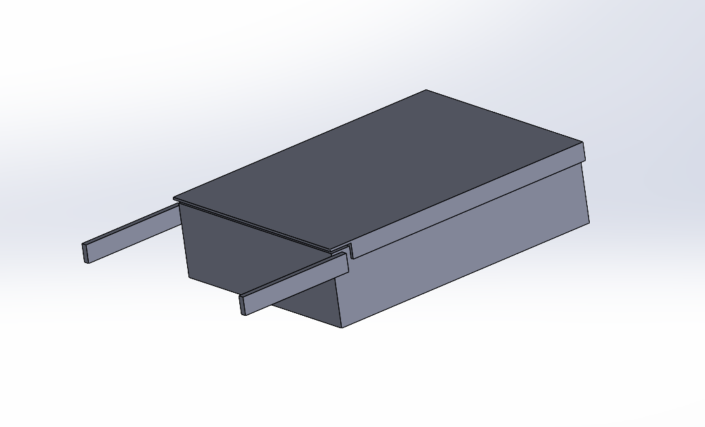
Design Description: Frame
Description:
This design makes attaching the tracks relatively simple. They will be installed on the sides, and bolted through to the inside. Another benefit is the fully enclosed inner machinery. This is important because Flagstaff gets a lot of precipitation. It will also stop falling objects and animals crawling inside. Due to these factors we decided this was the best frame design to move forward with.

Slide 8
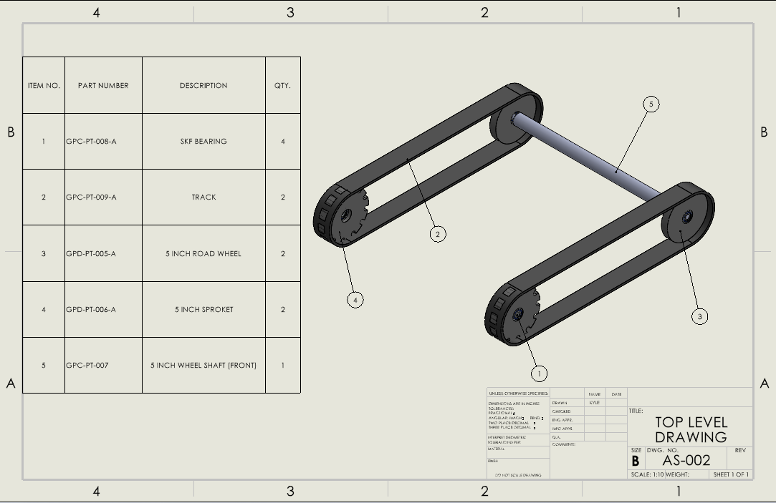
Design Description: Tracks
Function:
Mobility over uneven ground
Prevents sinking into soil
Gives the system grip and stability on slopes

Slide 9
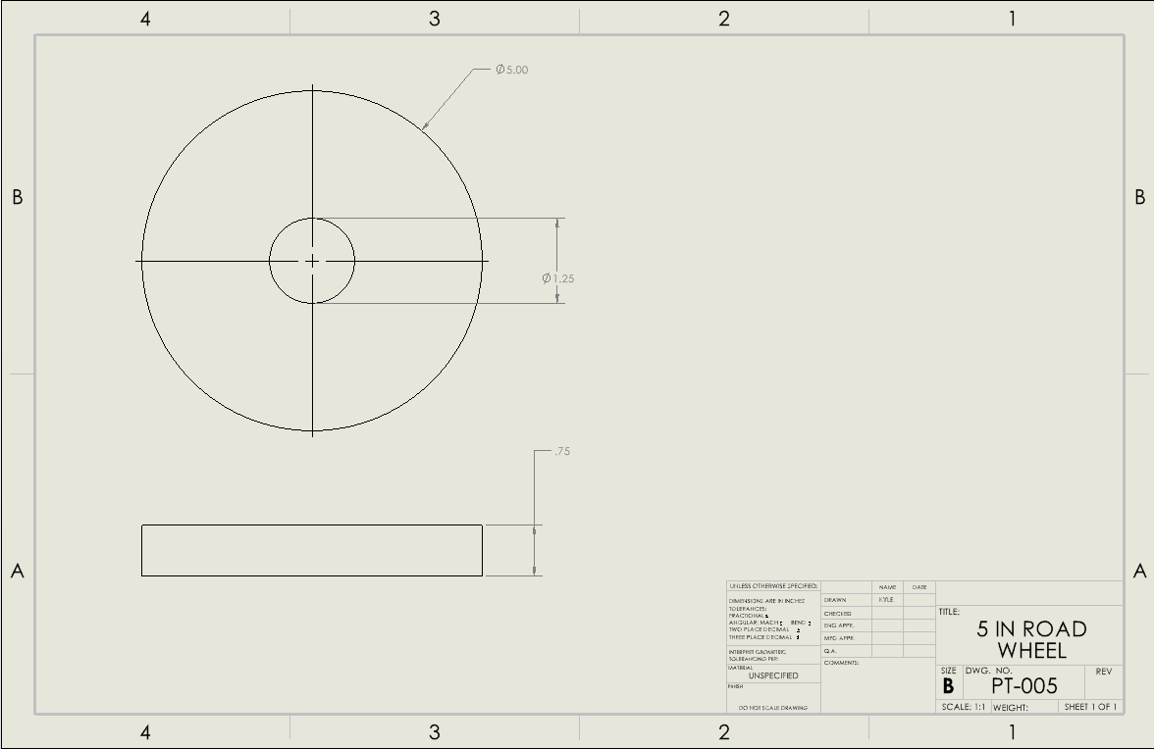
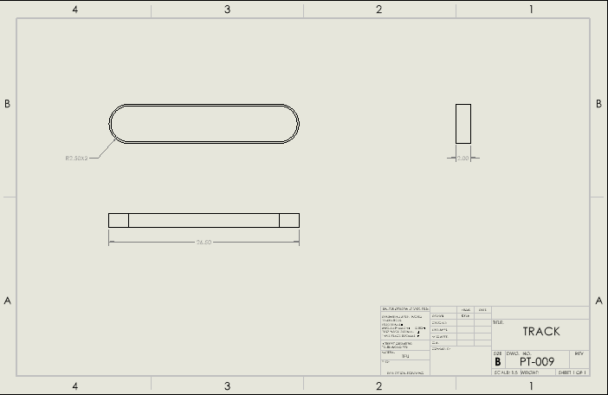
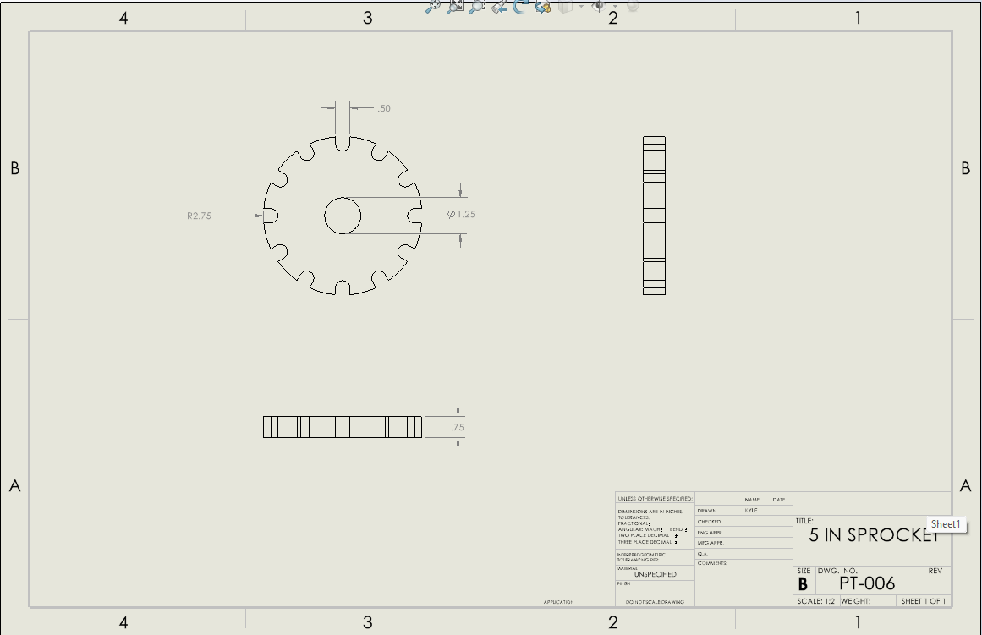

Slide 10
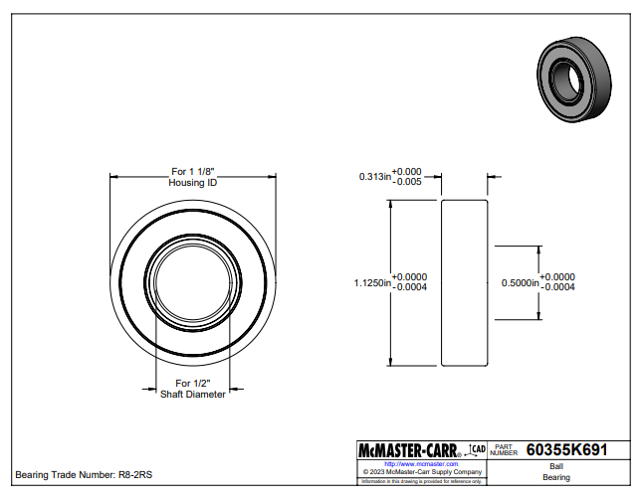
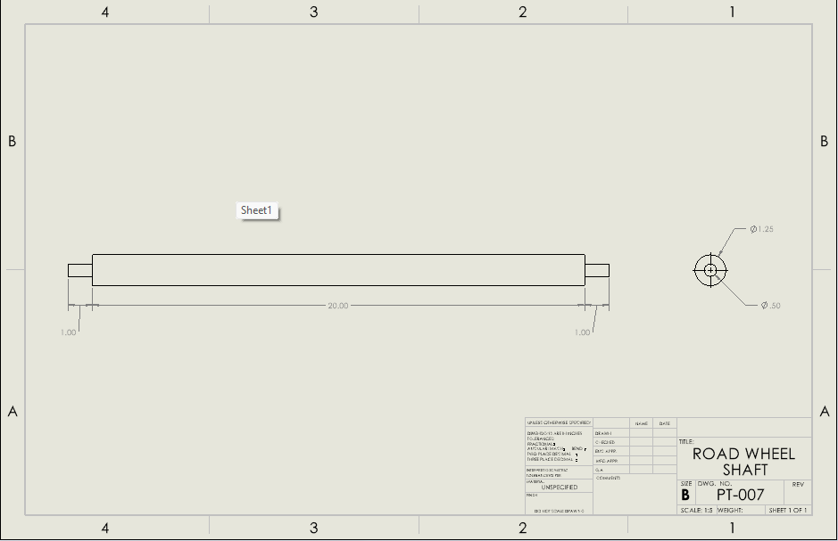
Design Description: Tracks

Slide 11
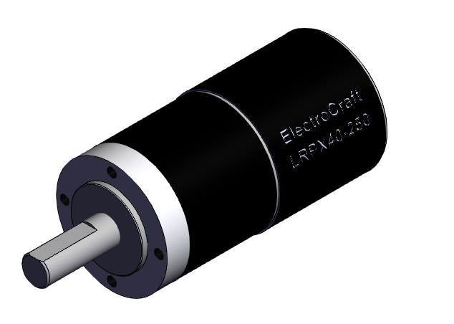
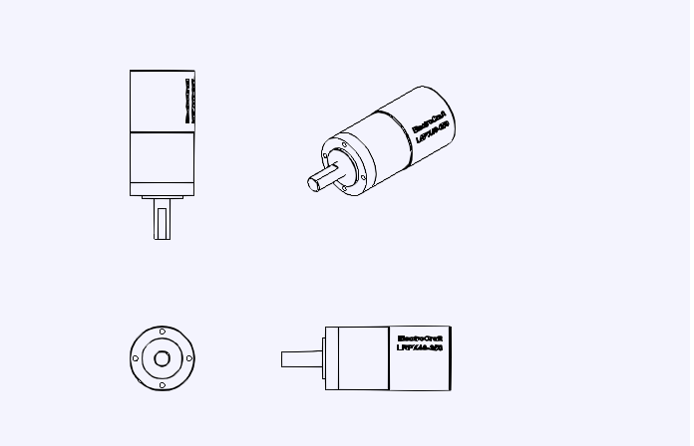
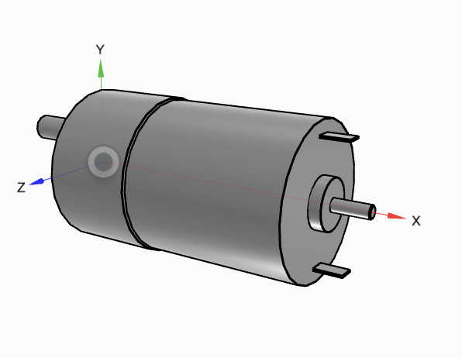
Design Description: Motors
Function:The 24V DC motor provides power to rotate the collection roller and move the Pinecone Collector. It converts electrical energy into mechanical torque, allowing the system to operate smoothly and efficiently. The motor runs reliably at 24 volts and includes protection to prevent overheating and overload.
Parts:24 V DC Motor (2x)
Motor Mount Brackets (2x)
Gearbox / Coupler (2x)
Motor Controller Board
Wiring & Connectors

Slide 12
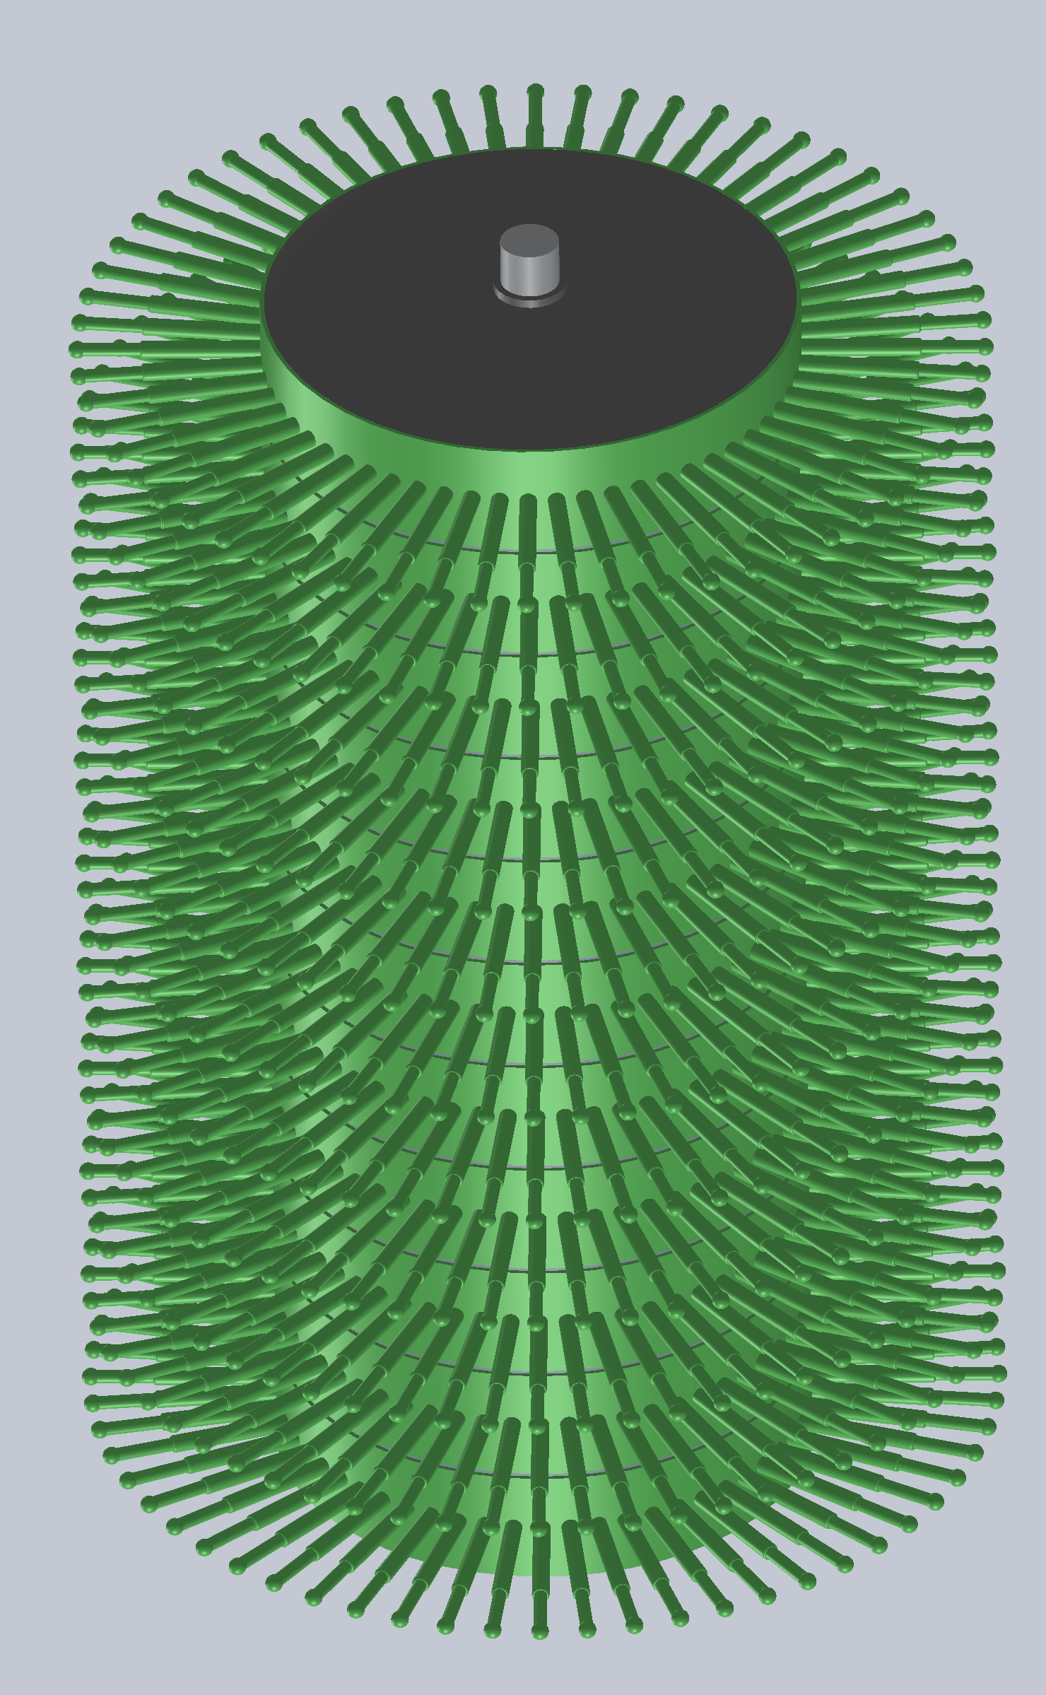
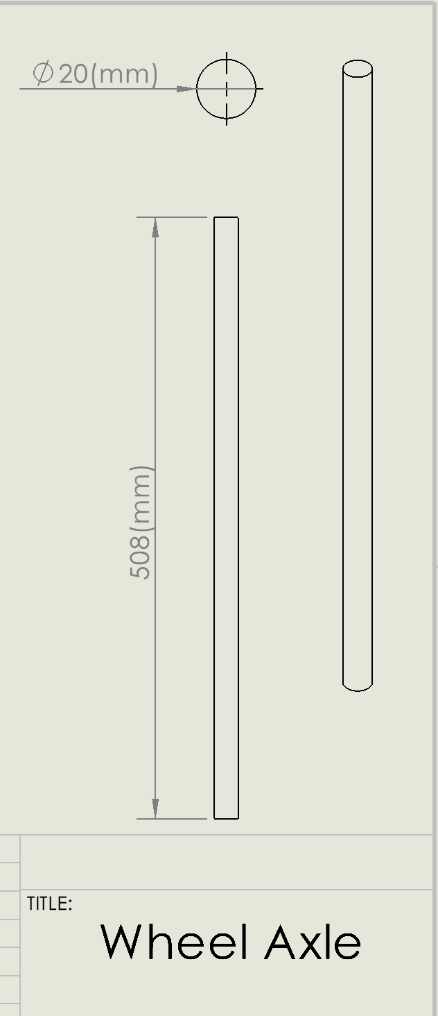
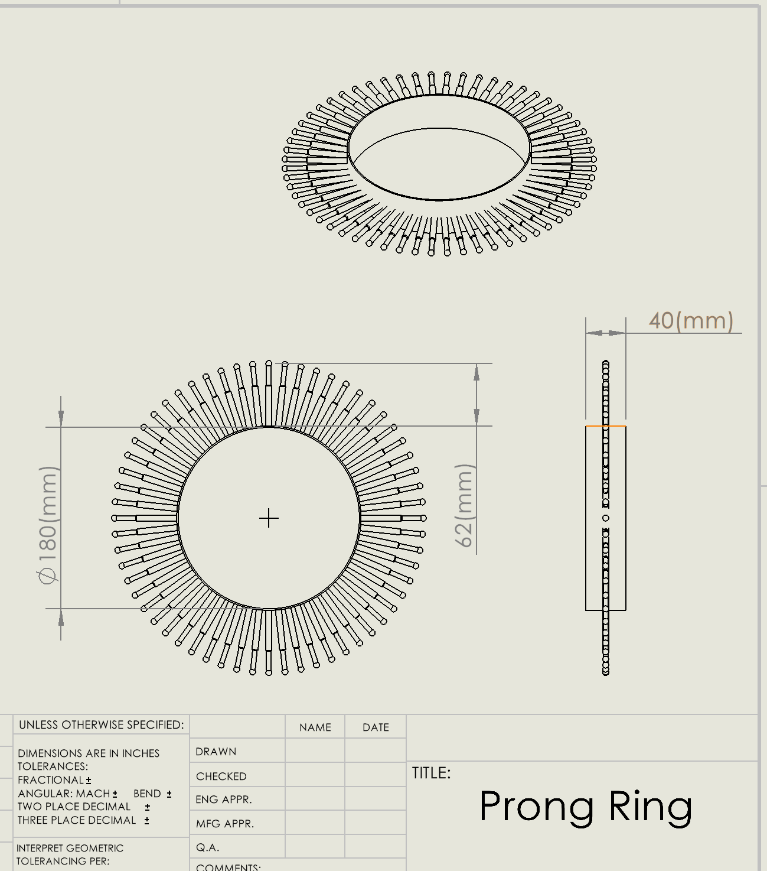
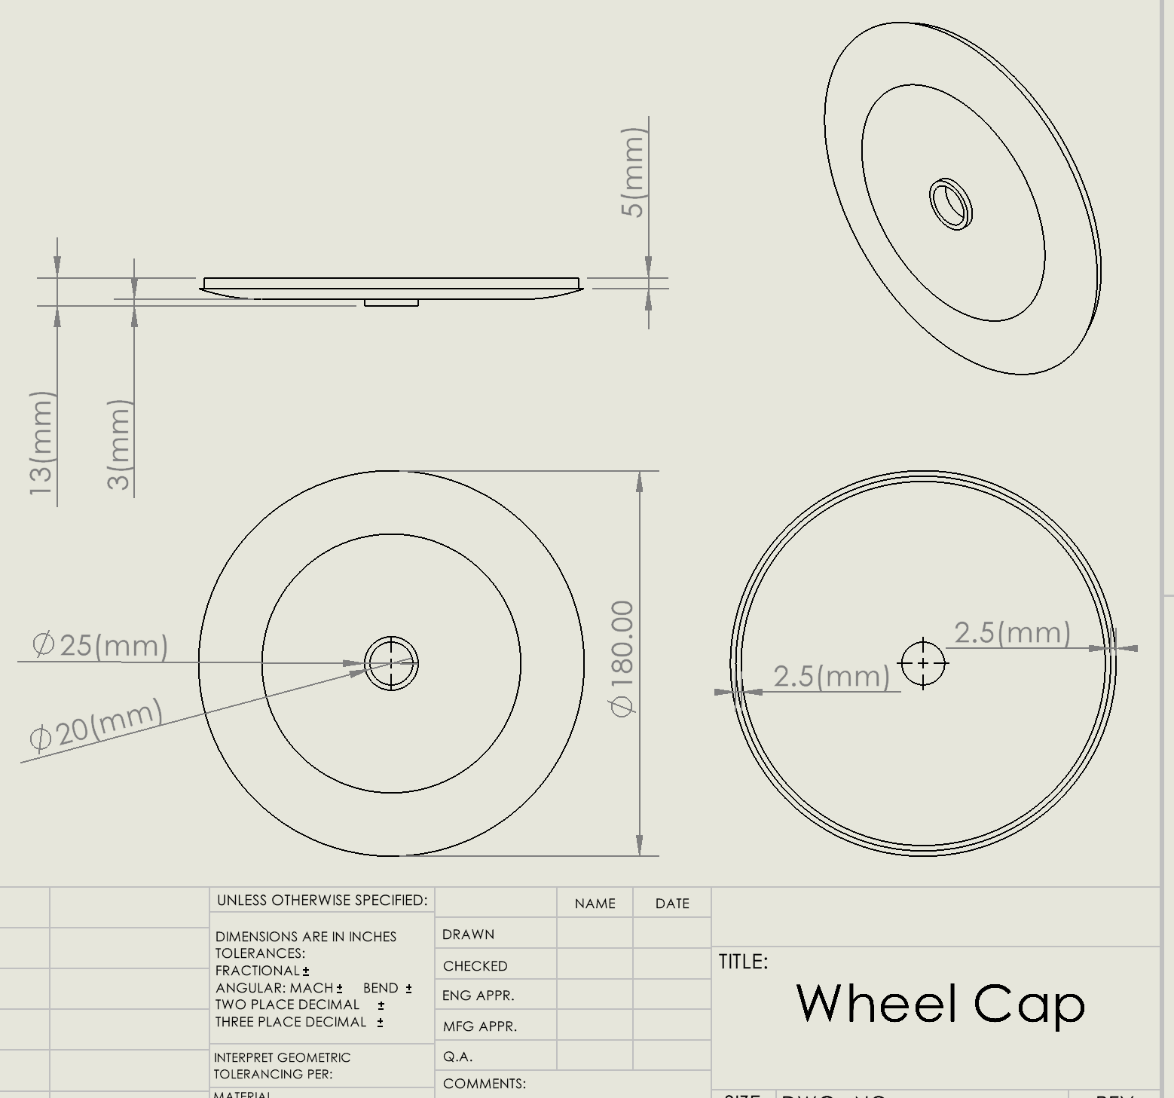
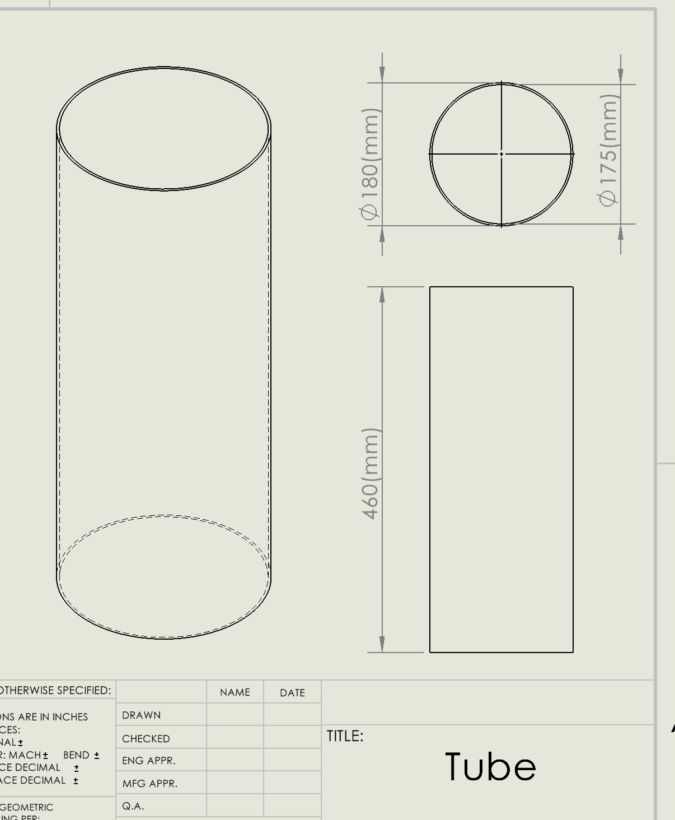
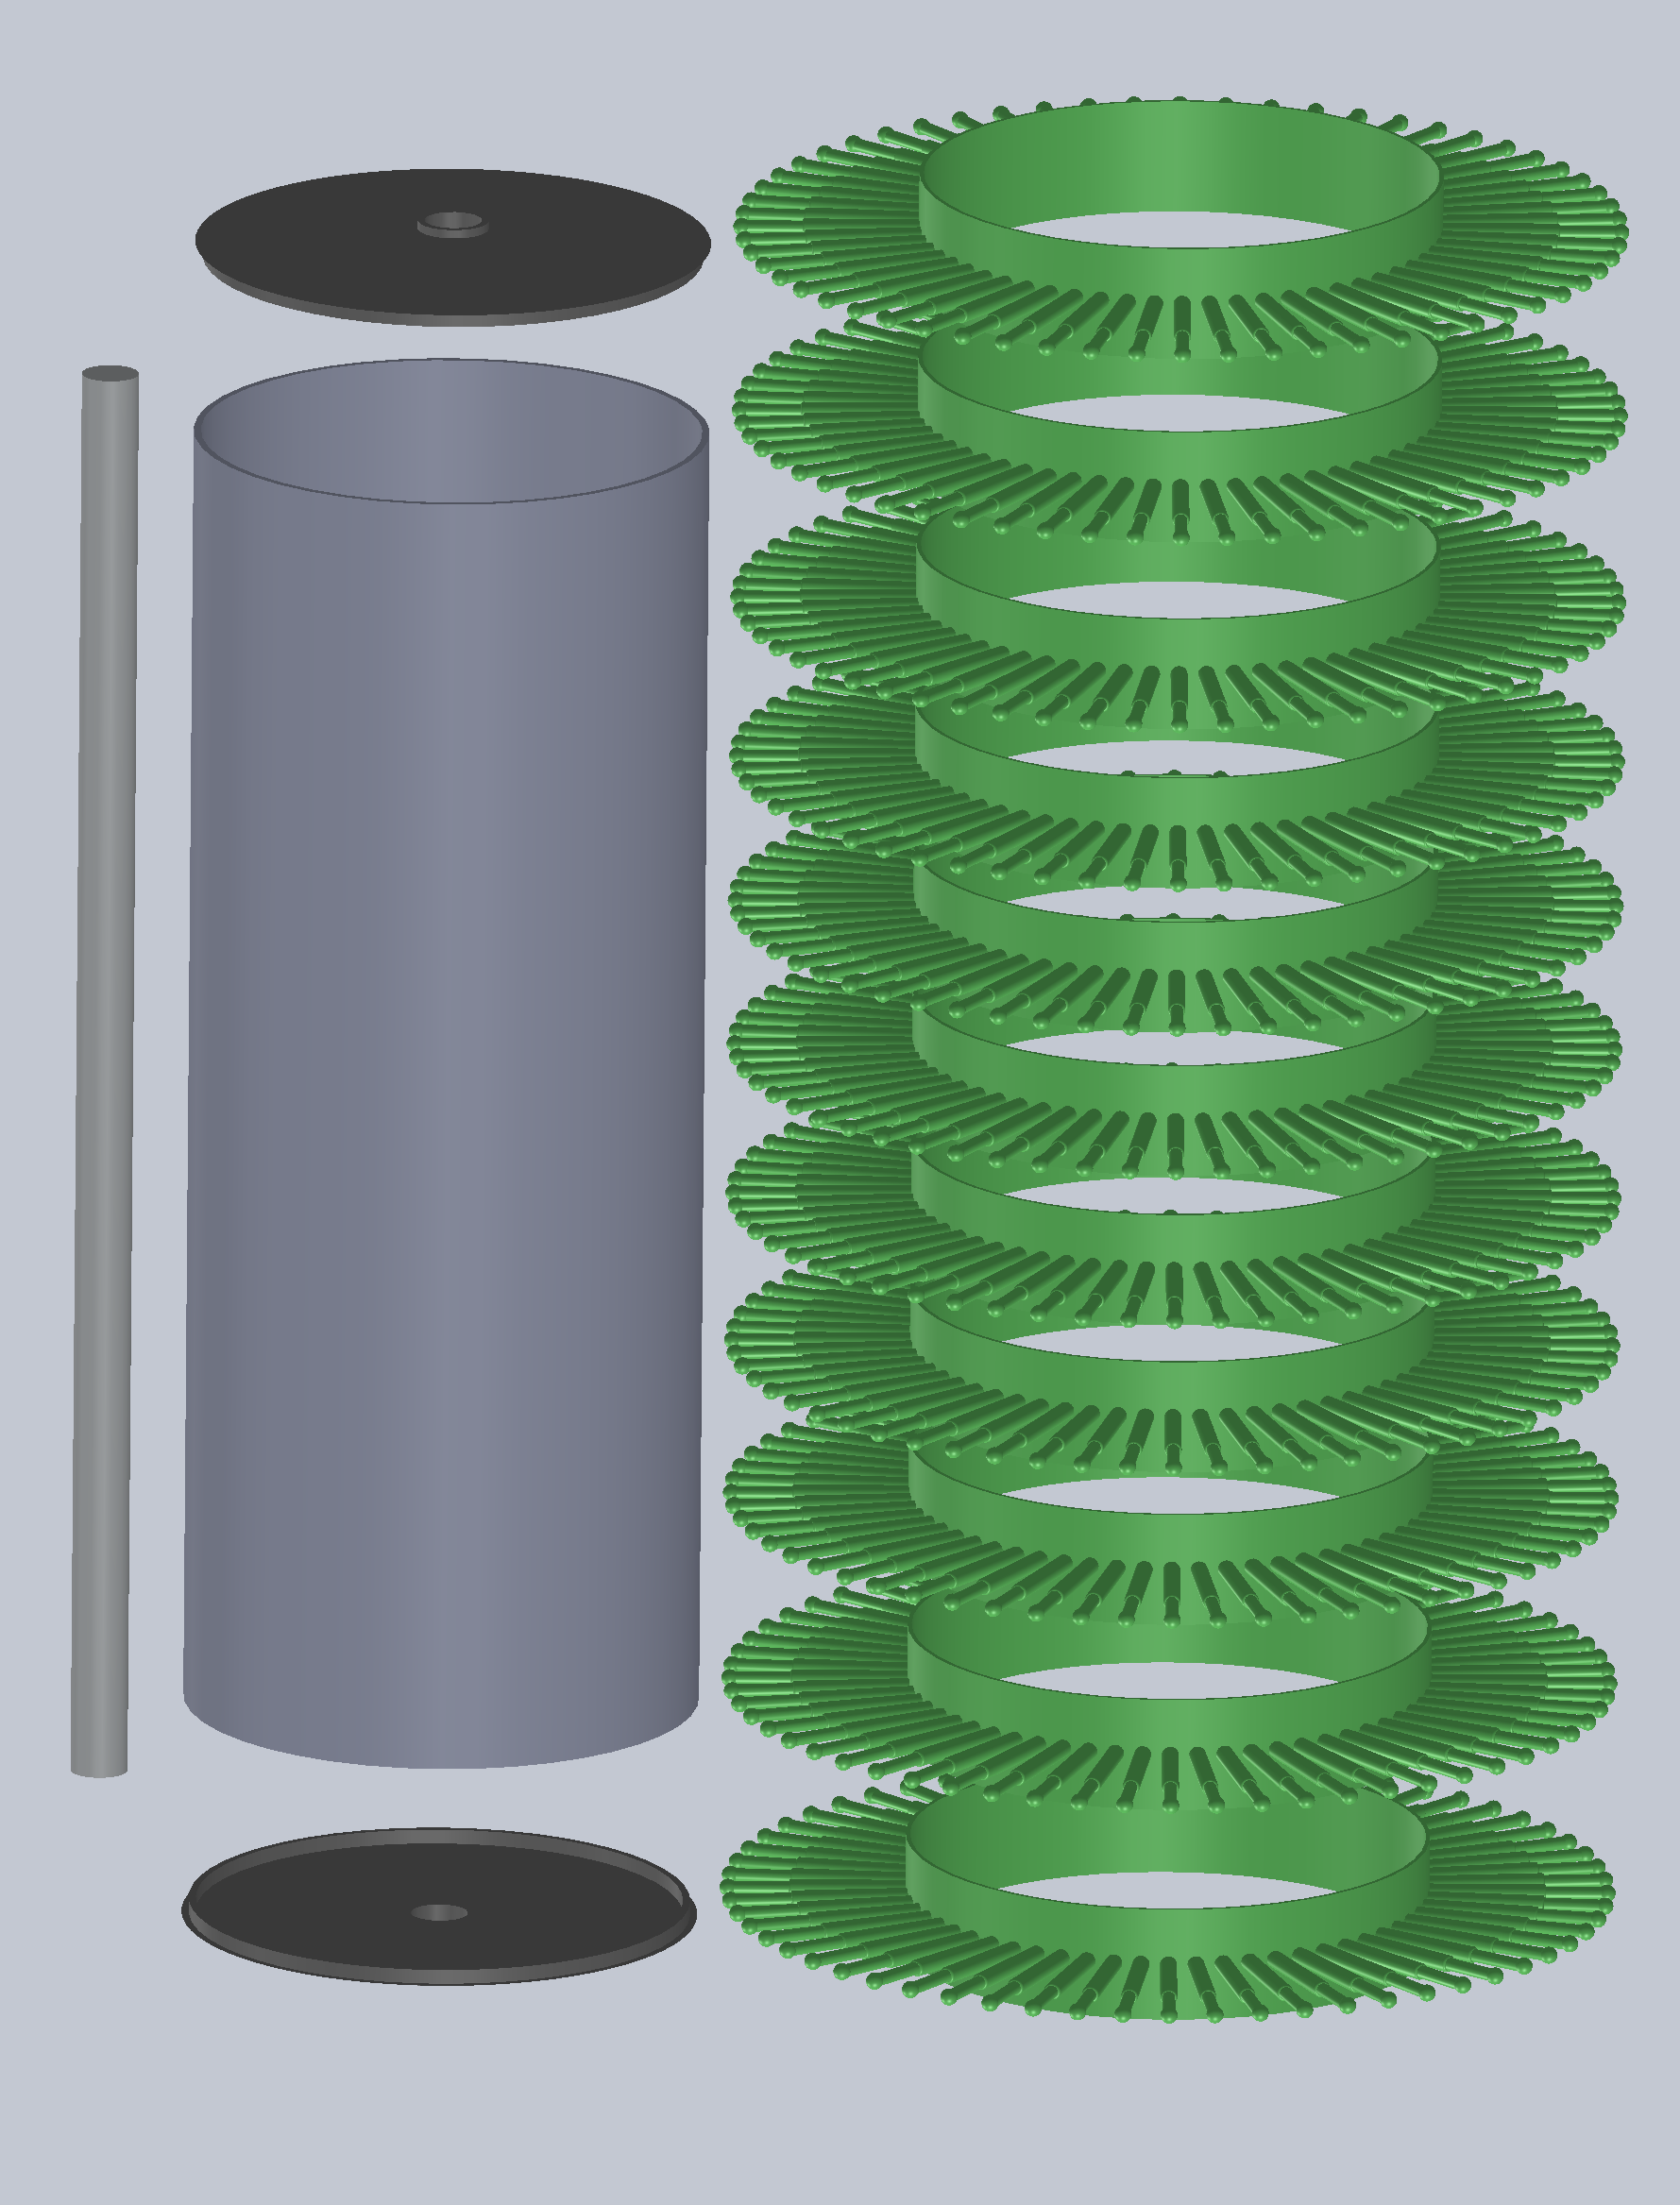
Design Description: Collection System (Wheel)
Function: Contacts ground and spins due to friction as the machine moves forward, acting as a wheel. Pinecones become lodged in-between the flexible prongs, rotate up with the wheel, then are dislodged and directed into the storage system.
Parts: Prong Rings (11x), Wheel Caps (2x), Tube, & Axle

Slide 13
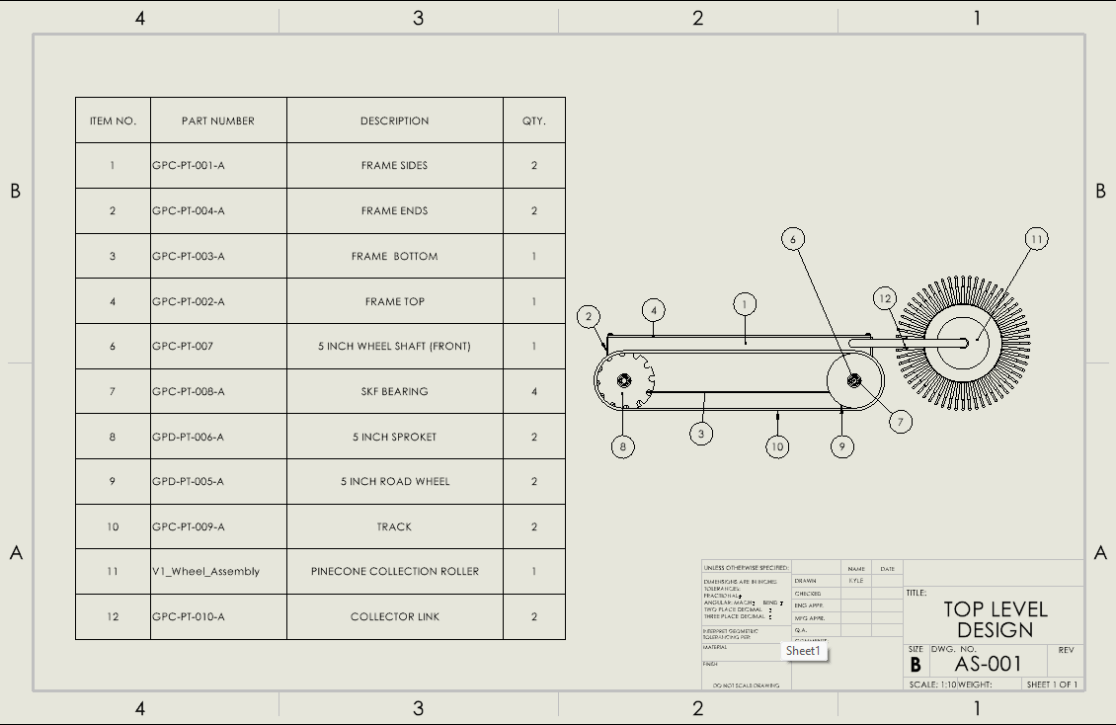

Slide 14
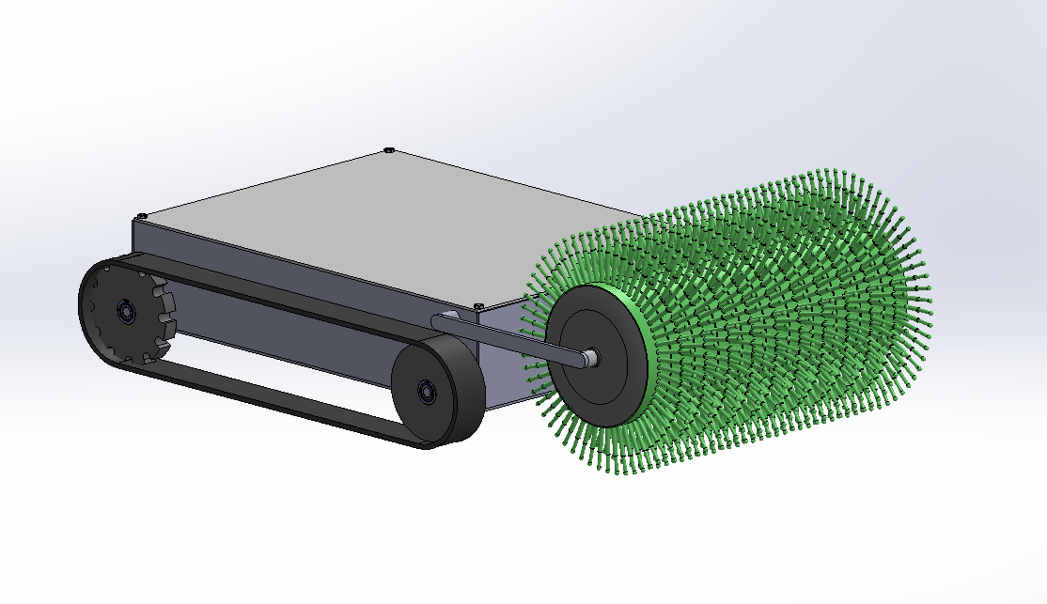

Slide 15
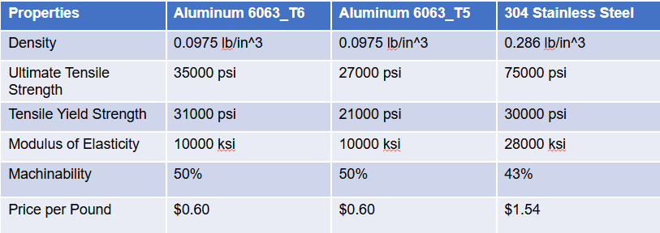


Engineering Calculations: Frame
This calculation was redone due to aluminum being a less desirable metal in sheet metal forming than steel. The volume was obtained from the SolidWorks model of the frame. This number came out to 687.78 in^3. Using these updated values, very different numbers were calculated this time.

Slide 16
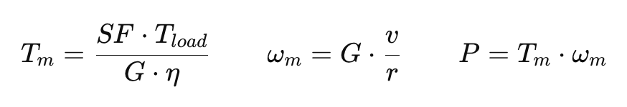
Engineering Calculations:Motors
Purpose:
To estimate the required torque, speed, and power for the 24 V DC motor used in the Pinecone Collector, based on desired roller speed and load conditions.
Assumptions:
Roller radius r=0.05m Target surface speed v=0.4m/s Gear ratio G=25:1, efficiency η=0.6 Required load torque Tload=0.20N⋅m Safety factor SF=5.0 System voltage V=24V
Key Equations:
Parameter | Symbol | Result
Motor speed | ωm | ≈ 2000 rpm
Motor torque | Tm | ≈ 0.13 N·m
Power required | P | ≈ 300 W
Summary:
The 24 V DC motor requires about 0.13 N·m torque, 2000 rpm speed, and 300 W power to drive the collection roller. A 300–400 W motor provides enough power and reliability for the Pinecone Collector.

Slide 17
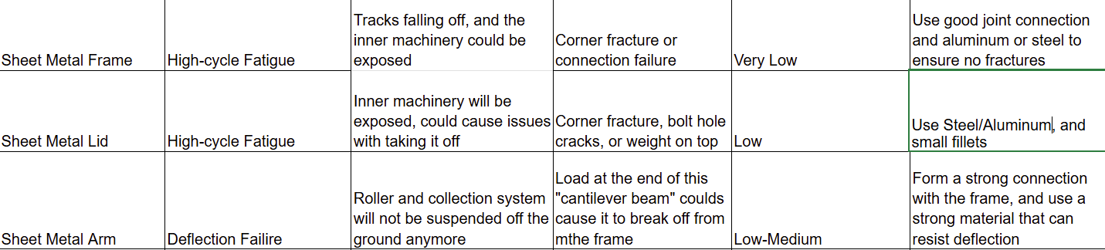
Design Validation: Frame
FMEA Discussion
With the frame, most failure concerns come from the corners.
Ways we can combat this on the frame and lid is by using good joining techniques. Some of these include butt, lap, and fillet welded corner joints.
These joints will help alleviate the stress concentrated at the corners.
For the arms connecting to the roller, we are more worried about it breaking off due to the deflection based at the end.
If we treat this subsystem as a cantilever beam, we can improve it by increasing the moment of inertia, material strength, and by creating a strong connection between the beam and frame.
Resources
Branches or other natural debris
Sheet metal
Small to moderate weight
Slight to moderate rainy day in Flagstaff
Testing Procedures
Weight bearing on top
Topple/fall tests
Roaming tests with tracks attached
Weather testing for the safety of the electronics

Slide 18
Design Validation: Tracks
Component | Major Failure Risk | Impact | Mitigation
Track Assembly | Track break / derailment | Machine stops, damage to undercarriage | Reinforce tracks with a steel core
Sprocket | rocks jam track or sprocket | Sudden stoppage, wear, derailment | Add debris guard, increase ground clearance
Road Rollers / Bearings | Bearing seizure or roller wear | High friction, track wear, failure | Add dust shields and add ease of replacement
Drive shaft / Idler Shaft | Misalignment or fatigue | Slipping, loss of propulsion | Larger diameter shaft, add support brackets
Risk Trade Offs:
Adding more parts or upgrading material
Cost significantly increases
Cost and points failure decreases
Testing Procedures
Test drive over dirt, pine needles and slopes
Operate for 4-6 hours while collecting pinecones
Put sticks and rocks in track system to observe affects of debris
Test machine shutdown if jammed
Equipment
Large volume of pinecones
Outdoor test field

Slide 19
Design Validation:
Motors
Failure Mode | Potential Cause | Effect | Severity (1–10) | Occurrence (1–10) | Detection (1–10) | RPN (S×O×D）
Motor overheating | Excessive load, poor ventilation, high current | Motor burnout, system shutdown | 9 | 5 | 4 | 180
Bearing wear | Long-time operation, insufficient lubrication | Reduced speed, increased noise | 6 | 6 | 5 | 180
Control signal loss | Loose connection, controller malfunction | Motor stops or runs unpredictably | 8 | 4 | 3 | 96
Power fluctuation | Poor wiring contact, external interference | Speed fluctuation, unstable operation | 7 | 3 | 5 | 105
Overload protection failure | Faulty circuit design on controller board | Motor damage due to overcurrent | 9 | 2 | 4 | 72
Testing Procedures:
Test the 24V DC motor speed and torque to confirm performance meets design requirements.
Run a continuous operation test for 10 minutes to ensure no overheating or abnormal vibration occurs.
Measure current and voltage to verify efficiency and power stability.
Test motor control response under different load conditions.
Equipment & Resources:
24V DC power supply
Multimeter and current sensor
Tachometer and torque sensor
Thermal camera or temperature probe
Motor controller and Arduino board
Test bench space in engineering lab

Slide 20
Design Validation: Collection Wheel
Part | Potential Failure Mode | Potential Effect(s) of Failure | Potential Causes | Probability | Mitigation
Collection Wheel Prongs | Deformation Wear | Prong Snapping, Decreased Collection Eficiency | Infill density too high/low, fillament material too stiff, diameter too skinny | High | Preform stress trials on different prong designs, infills, materials, etc.
Collection Wheel Caps | Surface Fatigue Wear | Increased Friction & Vibrations, Cracking | Uneven surface wear | Medium | Add lubrication or fix caps directly to axel
Collection Wheel Axel | Fretting Corrosion | Increased Friction & Vibrations | Loose contacts | Low | Implement bearings at axel contact points
Collection Wheel Tube | High-cycle Fatigue | Deformation, Cracks | Tube wall too thin, tube material too malleable | Very Low | Increase tube thickness or material strength
Most risk comes from high-cycle wear
Essentially all damage would cause decrease efficiency, wear should be visible prior to any critical failures
Extensive testing should be preformed on prongs to find optimal ratio between efficiency and durability

Slide 21
Design Validation: Testing Procedures and Equipment
Testing Procedures:
-Multiple human pinecone collection trials to obtain a “human efficiency” to compare the machine’s efficiency to.
-Multiple machine collection trials to obtain current prototype efficiency rate.
-Use locally collected pinecones to verify storage system capacity.
-Run all electrical components at maximum stress to verify run-time at current battery capacity.
-Test current prototype at multiple incline angles to verify mobility.
-Conduct emergency-stop-time testing under various situations when sensor system is operational.
Resources:
-”Ideal” testing area (flat & grassy), fenced, distributed pinecones.
-”Worst Case” testing area (hills, rocky, many trees & roots, ground debris), fenced, distributed pinecones.
-Fixed-angle incline surfaces.
-Collection of local pinecones (likely from human trials). -Prototype with functional collection system.
-Prototype with functional sensor system, human and simulation-animal volunteers.

Slide 22
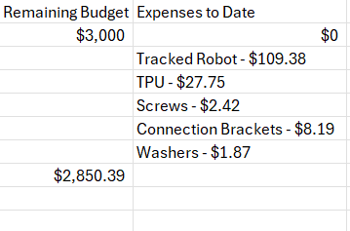
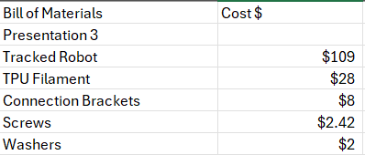
Budget
The fundraising lead, Siyu, is working on reaching out to restaurants/businesses for fundraising.

Slide 23
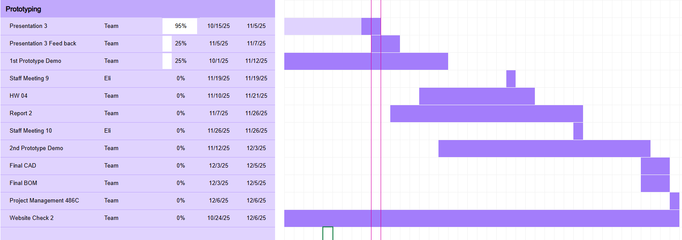
Schedule

Slide 24
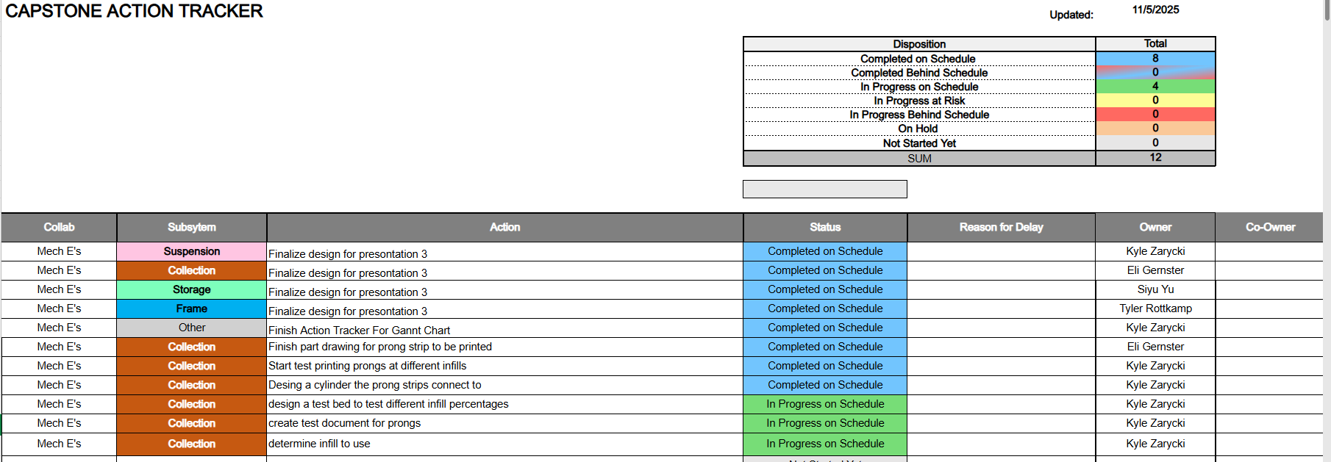
Schedule

Slide 25
References
[1]https://www.3dcontentcentral.com/secure/download-model.aspx?catalogid=11226&id=926642
[2]“Stepper motor,” Wikipedia, accessed October 8, 2025. https://en.wikipedia.org/wiki/Stepper_motor
[3]“Brushless DC electric motor,” Wikipedia, accessed October 8, 2025https://en.wikipedia.org/wiki/Brushless_DC_electric_motor
Notes:
Thanks for your time!

