Slide 1

Gore Autonomous Pinecone Collector
Tyler Rottkamp, Elijah Gerstner, Kyle Zarycki, Siyu Yu

Slide 2

Project Description
• Project: Autonomous Pinecone Collector robot for efficient forest operation
• Sponsor: Gore (supporting innovation in automation & robotics)
• Importance:
Improves efficiency vs. manual collection
Supports forestry research & sustainable practices
Hands-on robotics & mechanical design experience
Siyu 9/17/25, PCC, P1

Slide 3
Customer Requirements
Collects fallen pinecones effectively within a fenced area
Avoids jams and excessive non-pinecone debris collection
Works reliably on uneven yard/forest terrain while not causing damage
Easy for one person to handle and maintain
Safe to operate around people and property
Runs long enough to clear an area in one go and is reasonably sized
Not too loud and doesn't pollute
Tyler, 9/17/25, PCC P1

Slide 4
Engineering Requirements
Pickup efficiency ≥ 70% of visible cones
Hopper volume ≥ 2 ft^3, unload time ≤ 60 s by one operator
Jam rate ≤ 1 per hour, debris ≤ 15% hopper volume
Handles cones sized 3–6 in long, 2–4 in diameter
Terrain handling: slopes up to 15°
System weight ≤ 60 lbs, footprint ≤ 4ft × 3 ft, fits through 36 in doorway (ADA)
Runtime ≥ 1.5 hr/charge, recharge ≤ 4 hr
Emergency stop ≤ 2 s, guards per ANSI/OSHA
Elijah Gerstner, 9/17/2025, Gore PCC P#1

Slide 5
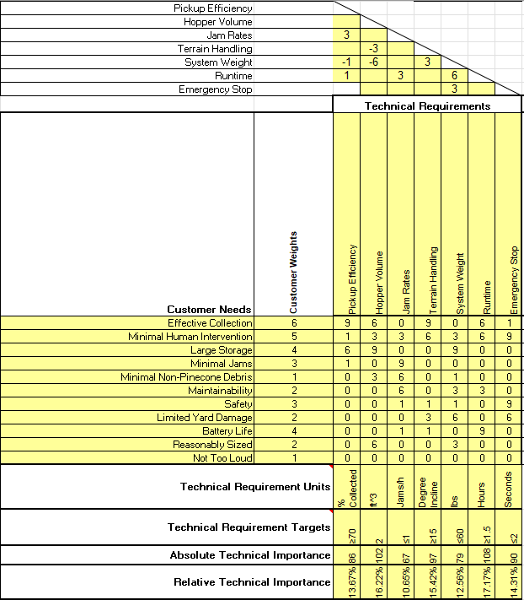
QFD
Importance Ranking:
Runtime (17.17%)
Hopper Volume (16.22%)
Terrain Handling (15.42%)
Emergency Stop (14.31%)
Pickup Efficiency (13.67%)
System Weight (12.56%)
Jam Rates (10.65%)
Elijah Gerstner, 9/17/2025, Gore PCC P#1
Eli

Slide 6
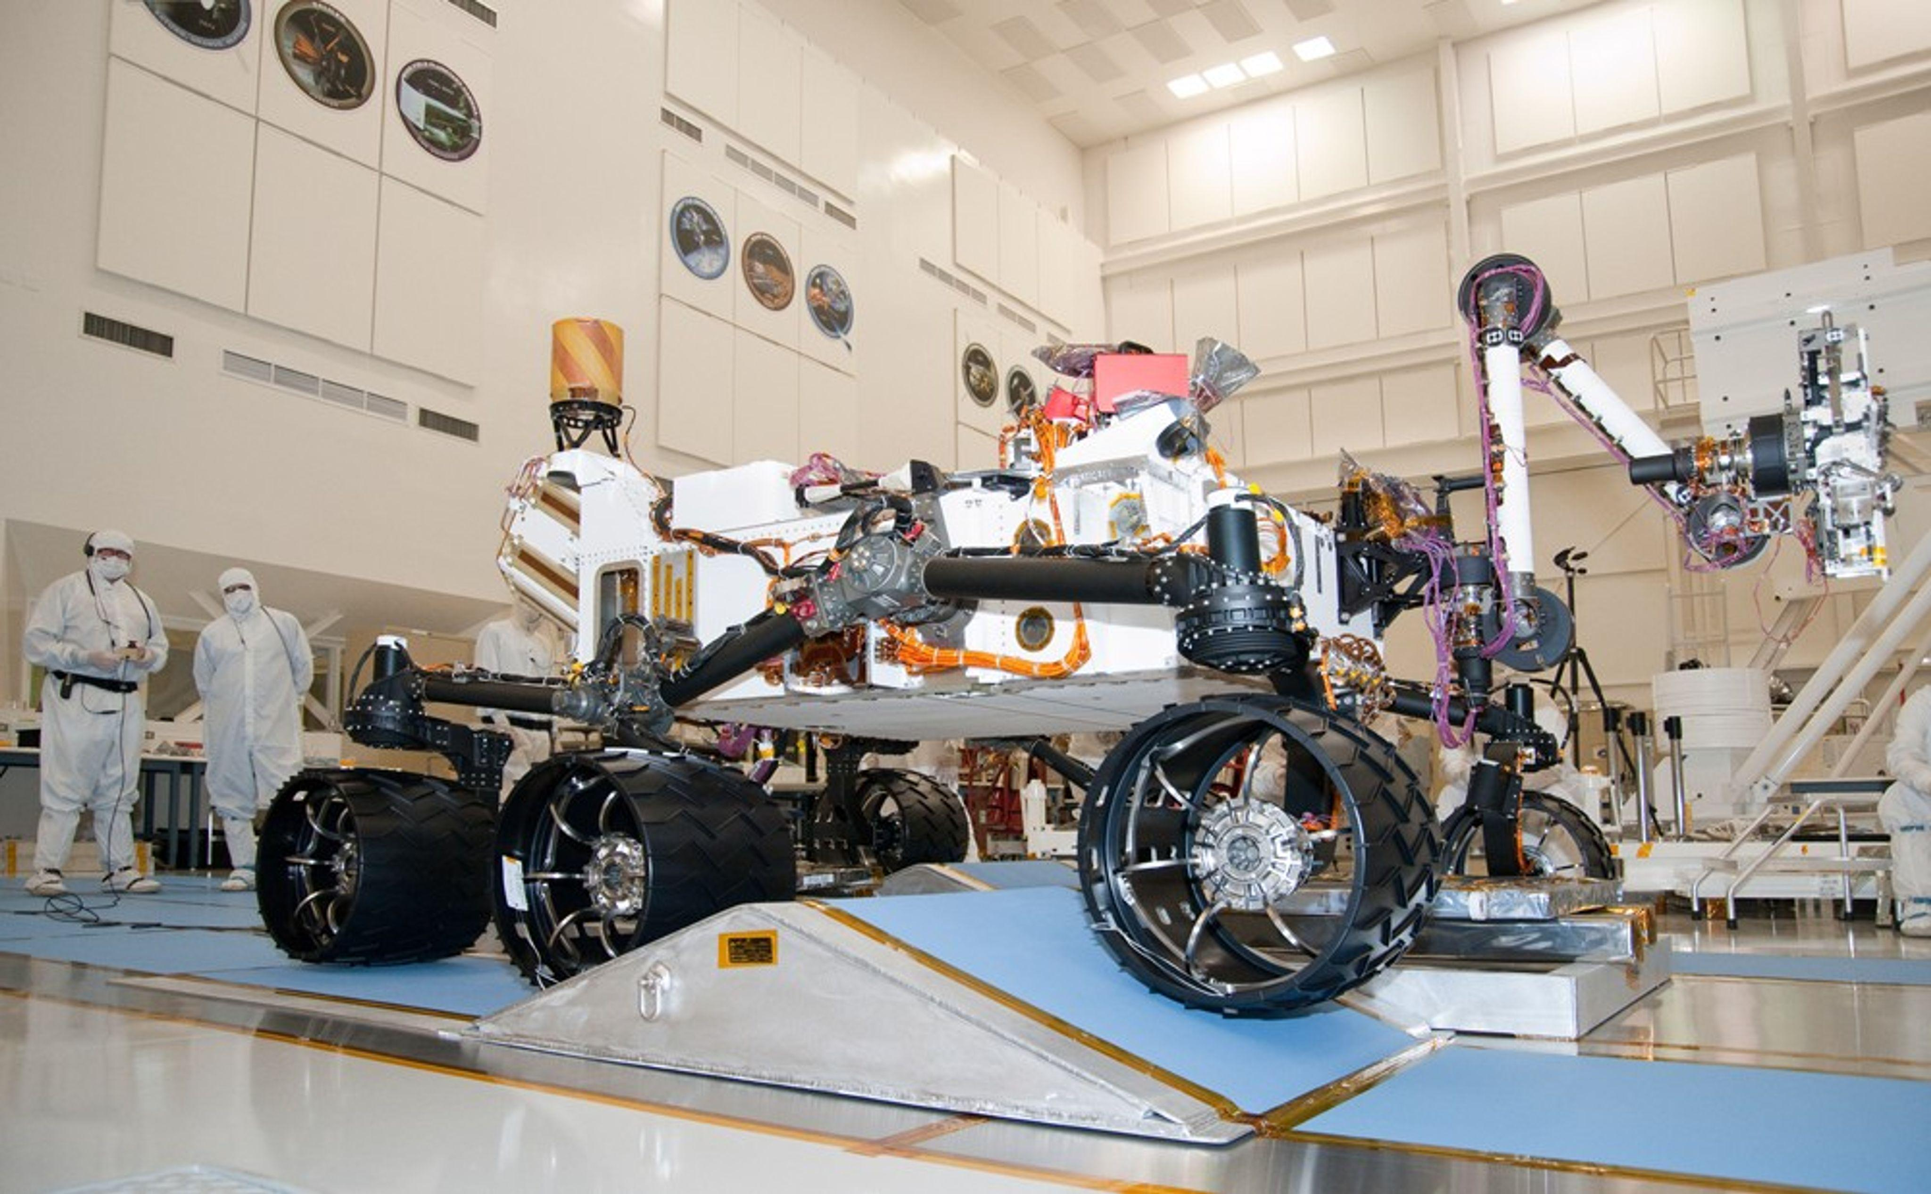
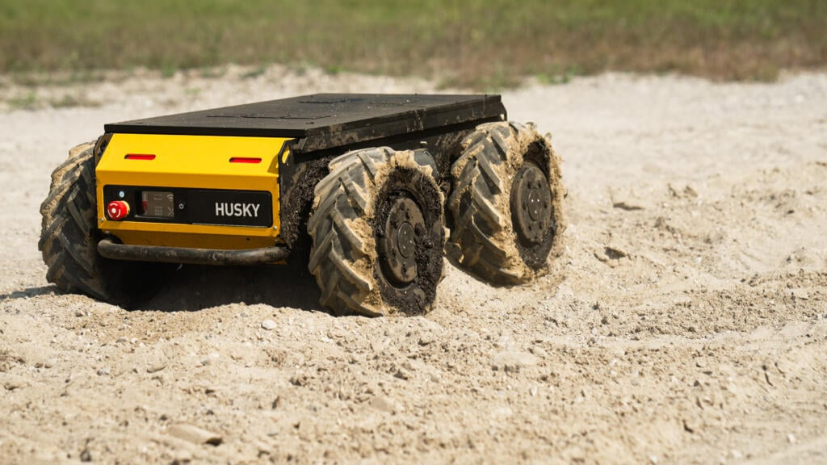
Suspension Benchmark
Rocker Bogie System
Used on NASA exploration rovers
Robust and proven in extreme conditions
Scales down well
Complex
Husky Clearpath UGV
Outdoor robotic platform
Simple design
Faster Speed
Limited Traction
Kyle 9/17/25, PCC, P1

Slide 7
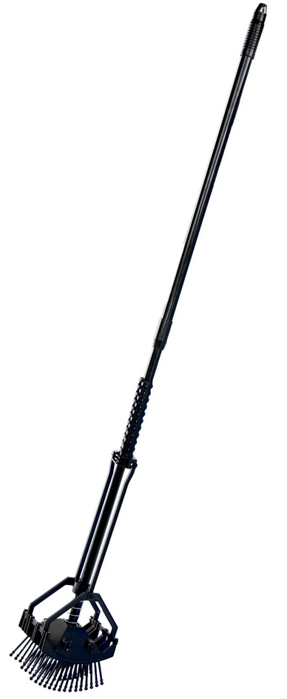
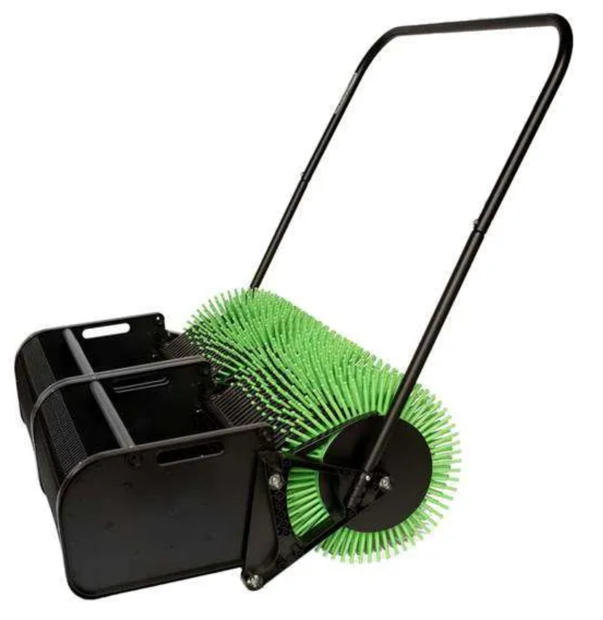
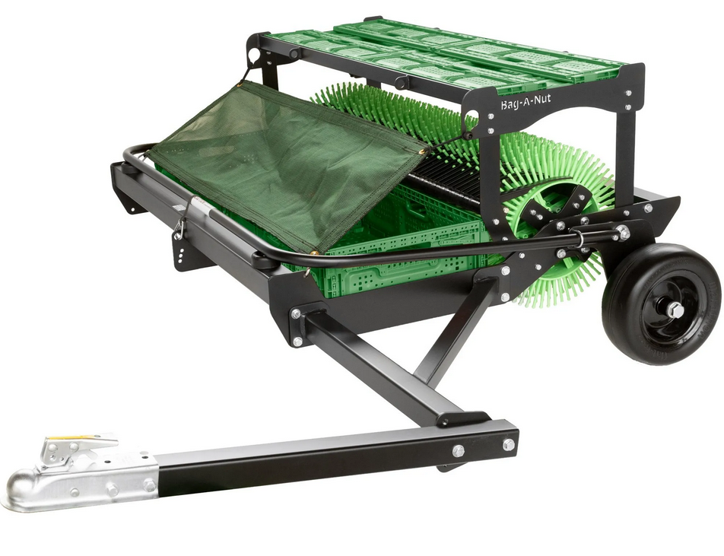
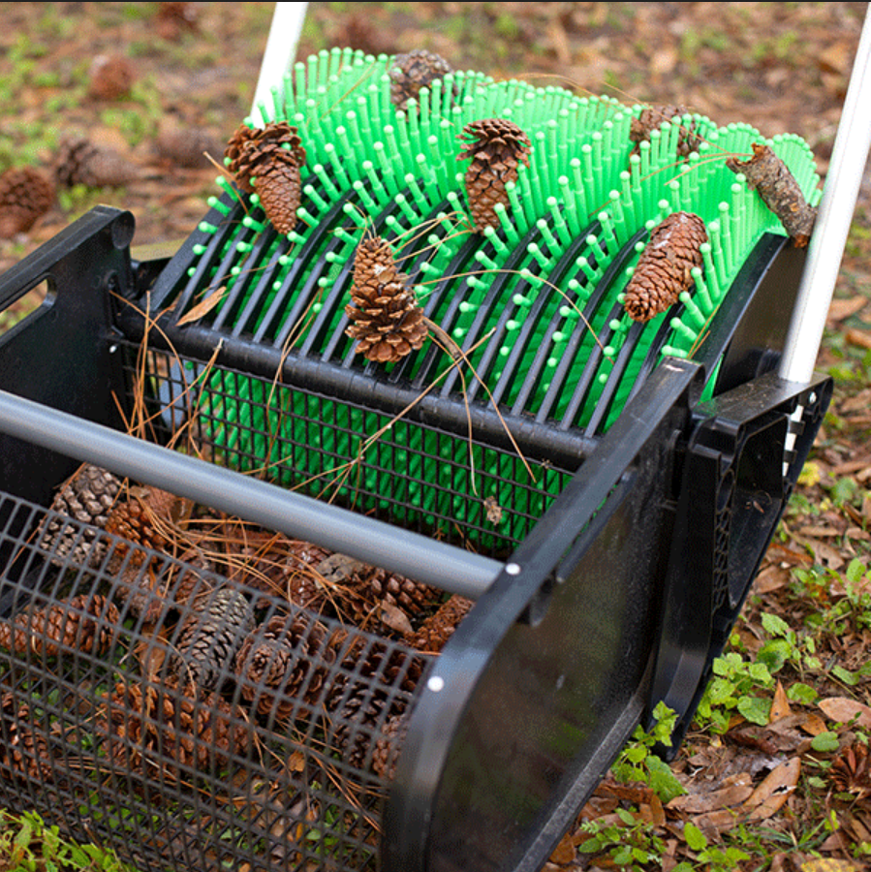
Collection Benchmark
"Bag-A-Nut" is a company that specializes in (non-automated) machines to collect pinecones and nuts from the ground. Most designs utilize a wheel of blunt plastic spikes to stab into the pinecones, which are then dislodged and funneled into a basket.
“Stab-A-Nut” (~$65)
Low cost
Manual
All cone sizes
Push Models
(18″–36″, ~$500–$700)
Walk-behind
Basket collection (10 Gal)
Small–medium cones
Pro Models
(21″–42″, $900–$4,000)
Pull-behind ATV/tractor
Crate storage (5 Gal/per)
High capacity
Elijah Gerstner, 9/17/2025, Gore PCC P#1

Slide 8




Software Benchmark
Grid System
Grid System Result
Optimized Grid System Result
Obstacle Awareness
Tyler, 9/17/25, PCC P1

Slide 9
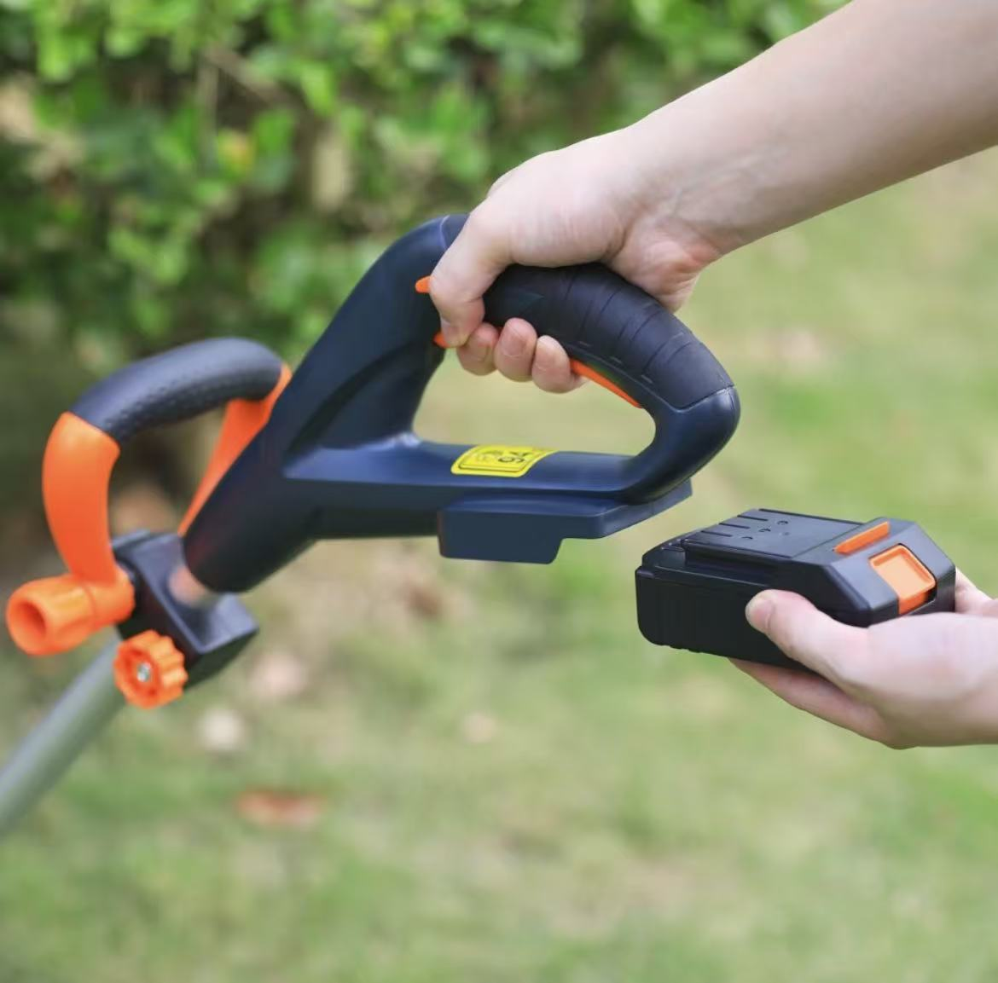
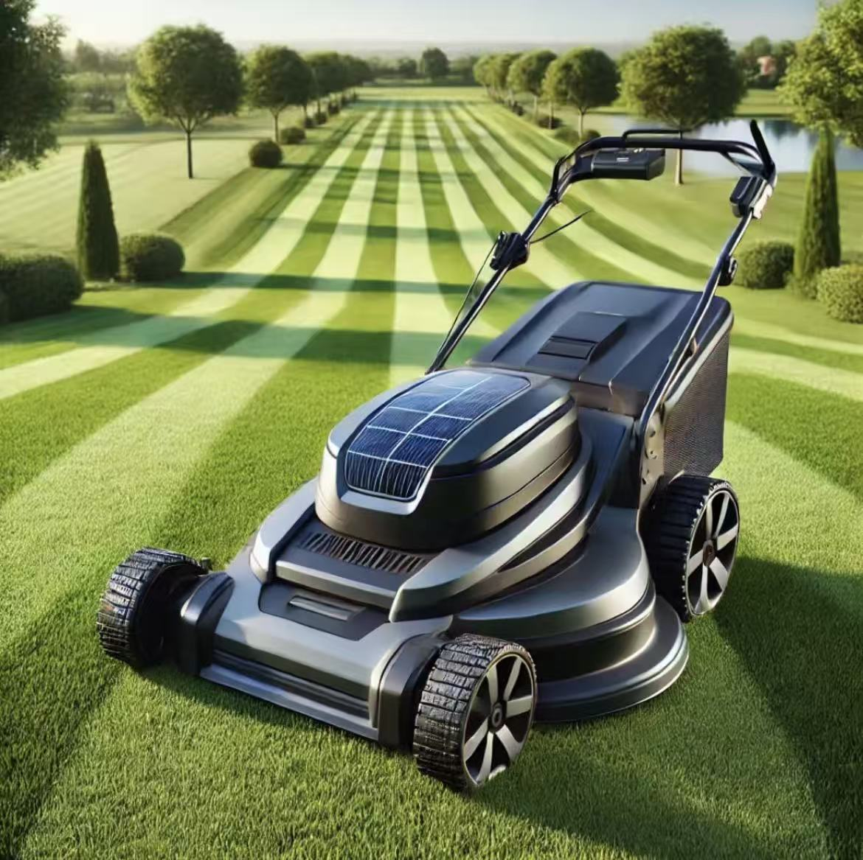
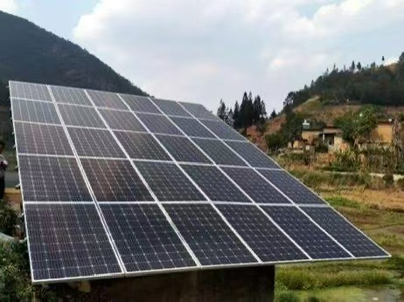
Energy Benchmark
Manual Power
• No energy cost
• High labor demand
• Limited efficiency
Battery Power
• Portable and flexible
• Limited runtime (2–4 hrs typical)
• Requires frequent charging
Solar-Assisted Power
• Sustainable and eco-friendly
• Lower long-term cost
• Weather-dependent, slower charging
Manual power is inefficient and labor-intensive, so we choose battery power as the main source for mobility and flexibility. Since batteries have limited runtime and require frequent charging, solar energy is added as a supplementary source to improve sustainability and reduce long-term cost.
Siyu 9/17/25, PCC, P1

Slide 10
Literature Review
Key Findings
  [17] Szpaczyńska (2025): Multi-tracked systems improve obstacle crossing but increase complexity.
  [18] Ezra (2024): Flexible track design reduces slip and adapts to slopes.
  [19] Feng (2022): Shows how wheel-terrain interactions affect traction and slip.
  [23] Almusawi & Akkad (2023): Omnidirectional wheels provide maneuverability but reduced off-road traction.
  [20] Shafaei & Mousazadeh (2023): Tracks give higher traction under load; wheels are faster and more efficient.
  [21] Harrington & Voorhees (2004): Rocker-bogie suspension maintains wheel contact on rough terrain.
  [32] SAE (J1269_201912): SAE standard for measuring tires and traction3
  .
Kyle 9/17/25, PCC, P1

Slide 11
Literature Review
Elijah Gerstner, 9/17/2025, Gore PCC P#1
"Ponderosa Pinecone Information" (UCANR – Ponderosa Pine) [10]
  Gives average and range of Ponderosa cone sizes for hopper design.
"Frictional Properties of Red Pine Cones Harvested under Different Conditions" [11]
  Provides friction data useful for hopper flow and jamming analysis.
"Longleaf Pine Cone Collection on the Sabine National Forest " [12]
  Real-world cone collection data for yield and logistics.
"Deep Learning Based Robot for Automatically Picking up Garbage on Grass" [13]
  Shows vision-based pickup methods for irregular objects.
"Forest Robot and Datasets for Biomass Collection" [14]
  Describes robotic biomass collection in unstructured forests.
"Tracked Locomotion Systems for Ground Mobile Robots: A Review" [15]
  Reviews tracked mobility options for rough terrain.
"Fully Autonomous Long Endurance Forest Rover" [16]
  Example of a forest rover with autonomous navigation and operation.
"Safety requirements for personal care robots" ISO Standards [32]
  Provides guidance for emergency stops, speed/force limits, and human–robot interaction
Pinecone Info
Collection
Navigation

Slide 12
Literature Review
Occupational Safety and Health Administration, “1910.212 - General requirements for all machines. | Occupational Safety and Health Administration,”
  Safety standard
“Carbon Fiber vs. Aluminium vs. Steel: Which Chassis Material is Best?,” NitPro Composites, 2025.
  Material comparison between two likely options
P. Fromaget, “Raspberry Pi vs Arduino: 7 Differences you Should Know,” Raspberry tips.
  Controller comparison between the two most likely systems
“Dragon Runner Reconnaissance Robot,” Army Technology.
  Real-world example that we can use as inspiration
P. Deepa, P. Kartik, P. Jaiswal, and Y. Kanase, “Bomb Disposal Robot,” International Journal of Current Science, vol. 14, no. 2, pp. 2250–1770, 2024.
  Transmitter block and testing examples
lukegarrigan, “Coding a Roomba - Codeheir,” Codeheir, Oct. 16, 2021.
  Roaming code to mapping with obstacle avoidance
Bastaki, “Drones and Robotics in Forestry: Applications and Innovations | Keshtezar,” Keshtezar.com, 2025.
  How to apply robots to a forest setting
I. Kamal, “Small Robot Drive Trains,” Feb. 2008.
  Drive train example on similar-sized robots
R. Jarema, “Choosing the Right Battery for Your Robot,” Husarion.com, May 23, 2024.
  Battery options based on weight, size, function, etc.
Tyler, 9/17/25, PCC P1

Slide 13
Literature Review
McNulty, “A review of Li-ion batteries for autonomous mobile robots”, Elsevier, 2022.
  Battery capacity and discharge models for runtime estimation
Oliveira et al., “Advances in Forest Robotics: A State-of-the-Art Survey”, Machines, vol. 10, no. 2, 2021.
  Overview of forest robot locomotion, sensors, and navigation strategies
Xiao & Whittaker, “Energy Utilization and Energetic Estimation of Achievable Range for Wheeled Mobile Robots Operating on a Single Battery Discharge”, Univ. of Texas Tech Report.
  Model to estimate robot travel distance per battery cycle
Poskart, “Multi-Parameter Predictive Model of Mobile Robot’s Battery”, Sensors, 2022.
  Predictive model of battery discharge based on weight, speed, and load
Li et al., “Localization in Unstructured Environments: Towards Autonomous Robots in Forests with Delaunay Triangulation”, arXiv preprint, 2020.
  Localization algorithm for robots in forest environments
Pereira et al., “Robots for Forest Maintenance: Vision System for a Forestry Navigation Machine”, Int. Conf. Robotics in Forestry, 2024.
  Vision and obstacle detection for navigation in forest terrain
Robotics in Forestry”, ResearchGate Survey Article, 2016.
  Applications of robotics in forestry; examples of real-world use cases
Siyu 9/17/25, PCC, P1

Slide 14
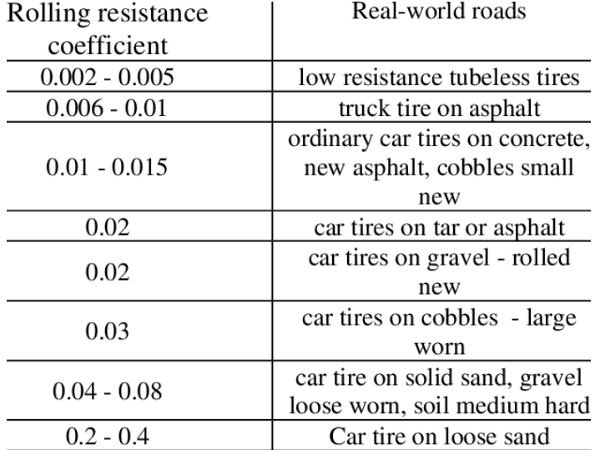
Mathematical Modeling - Suspension
Equations
Load : W = mg
Rolling Resistance : F_{r} = C_{r}W (C_{r} = rolling resistance coefficient)
Climb Force : F_{c} = Wsin(θ)
Total Force : F_{t}=F_{r}+F_{c}
Example
W = 40kg * 9.81 m/s = 392 N
F_{r}=0.2*392N = 78.4 N
F_{c}=245.25*sin(15°) = 101N
F_{t}=101+78.4 = 179N
[31]
Kyle 9/17/25, PCC, P1

Slide 15
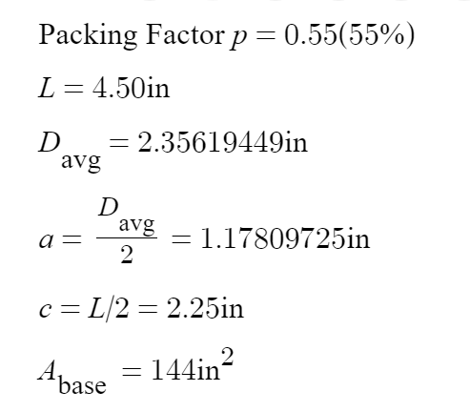
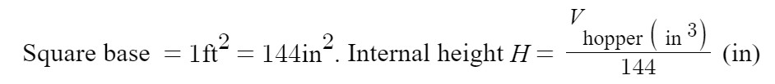
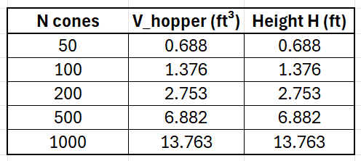

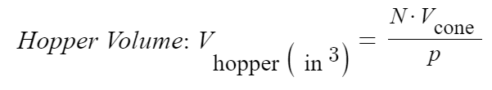
Mathematical Modeling - Hopper Volume
Assume a square container varying in height
Average Values from Sources
Elijah Gerstner, 9/17/2025, Gore PCC P#1

Slide 16
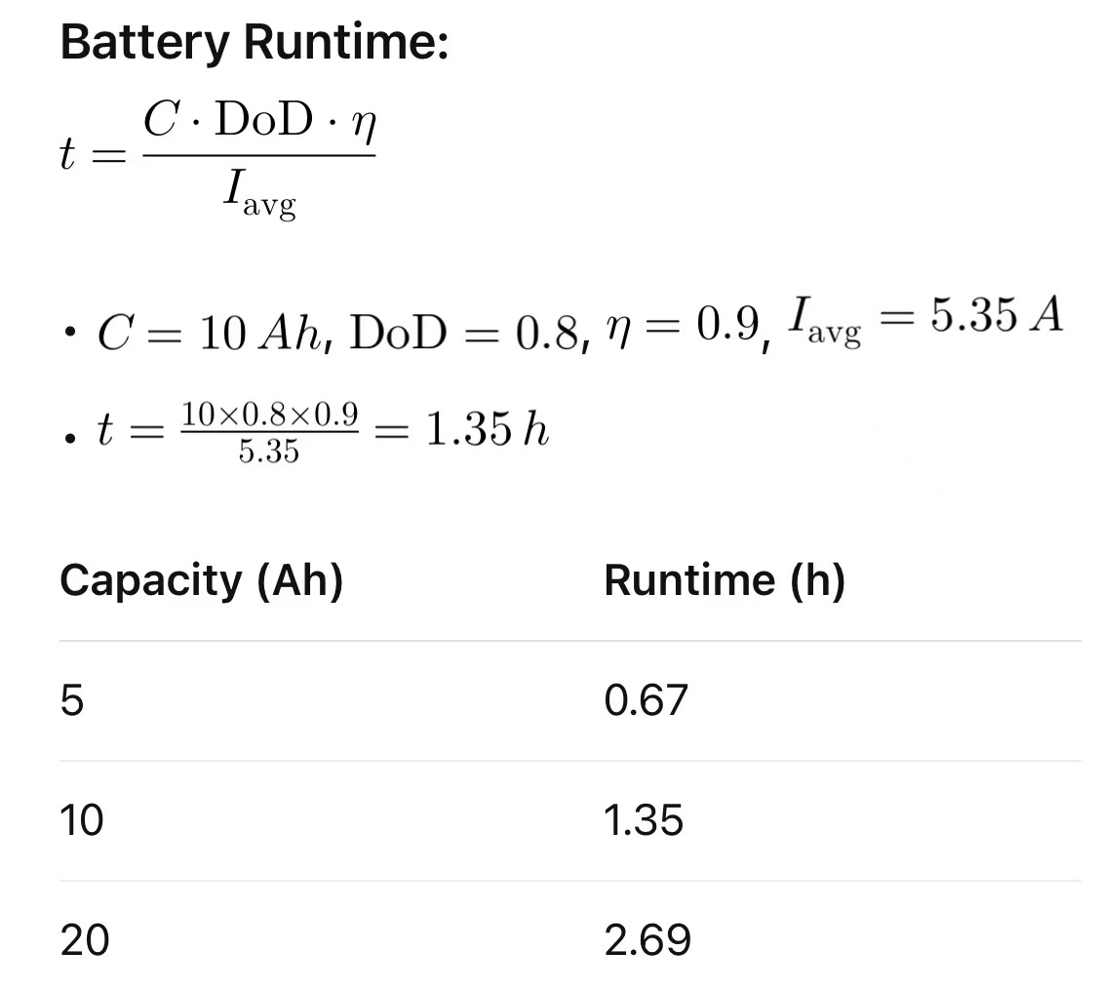
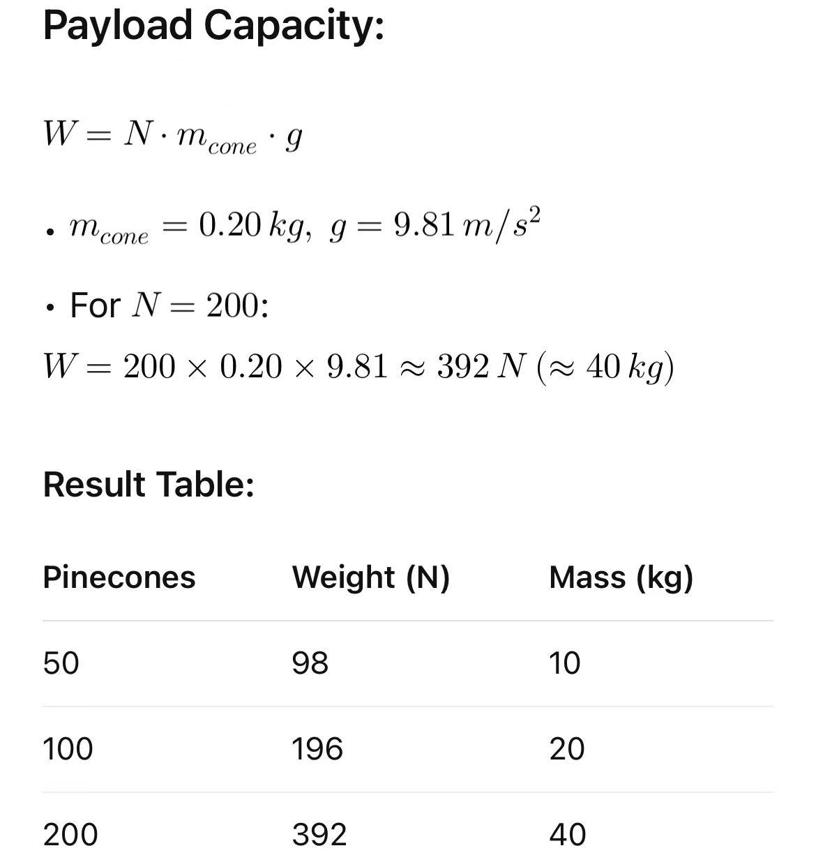
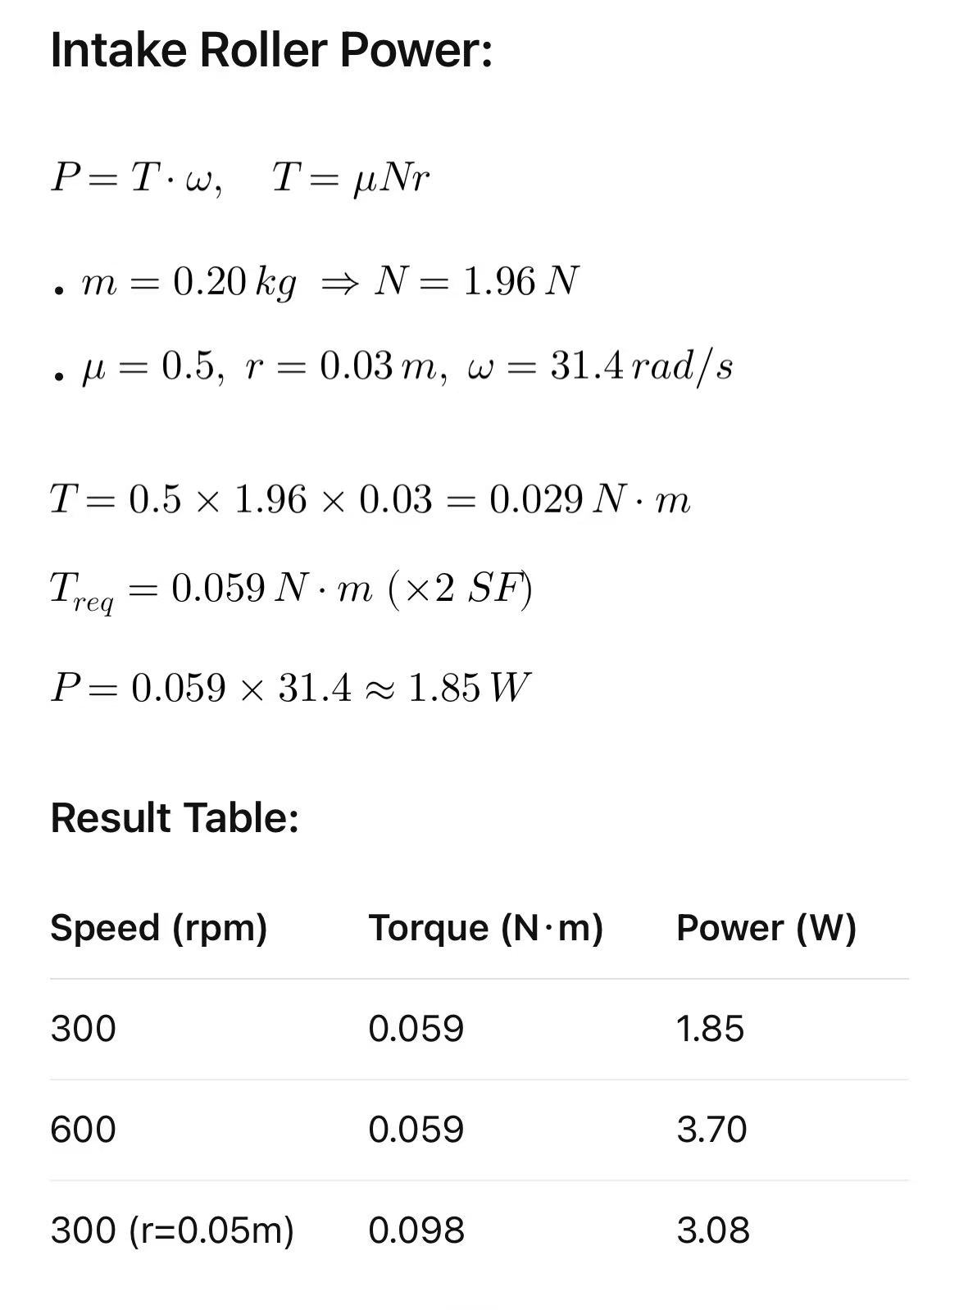
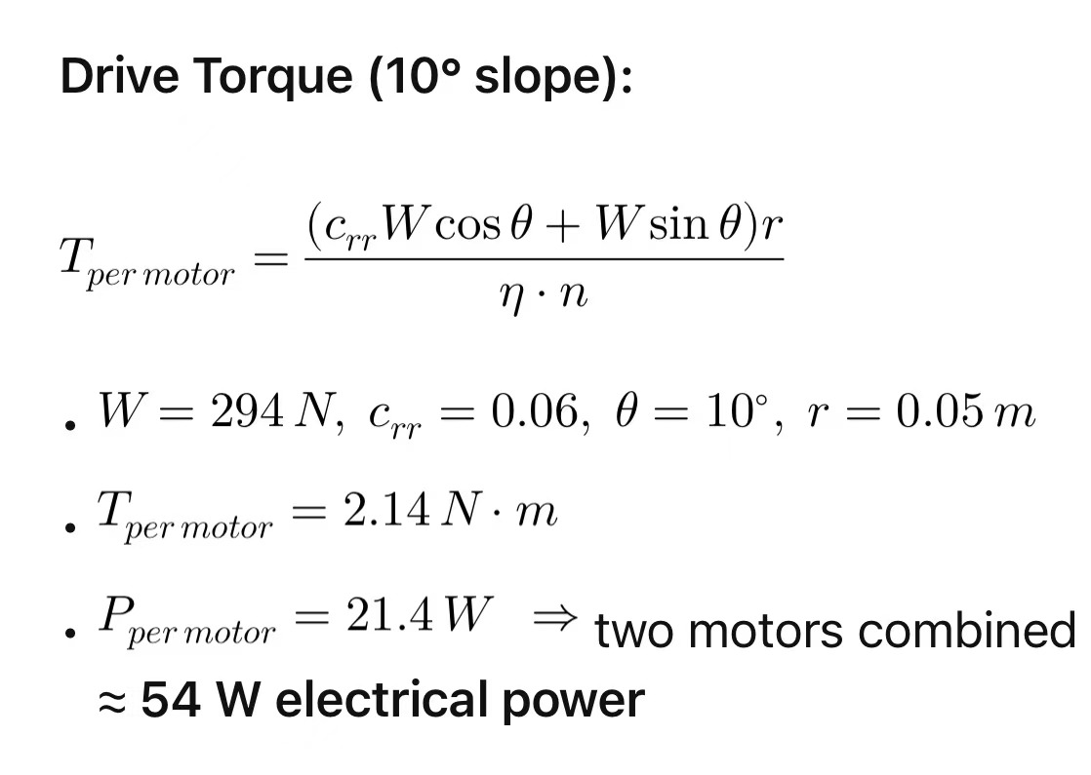
Mathematical Modeling - Energy
Siyu 9/17/25, PCC, P1

Slide 17
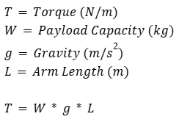
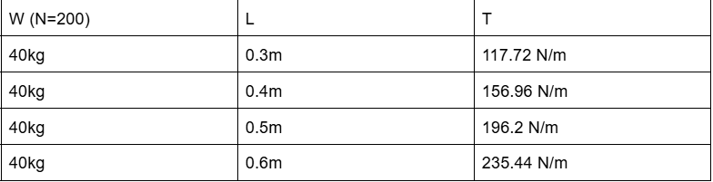
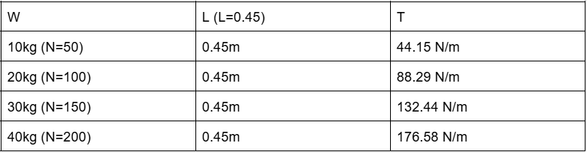
Mathematical Modeling -
Torque Required
Tyler, 9/17/25, PCC P1

Slide 18

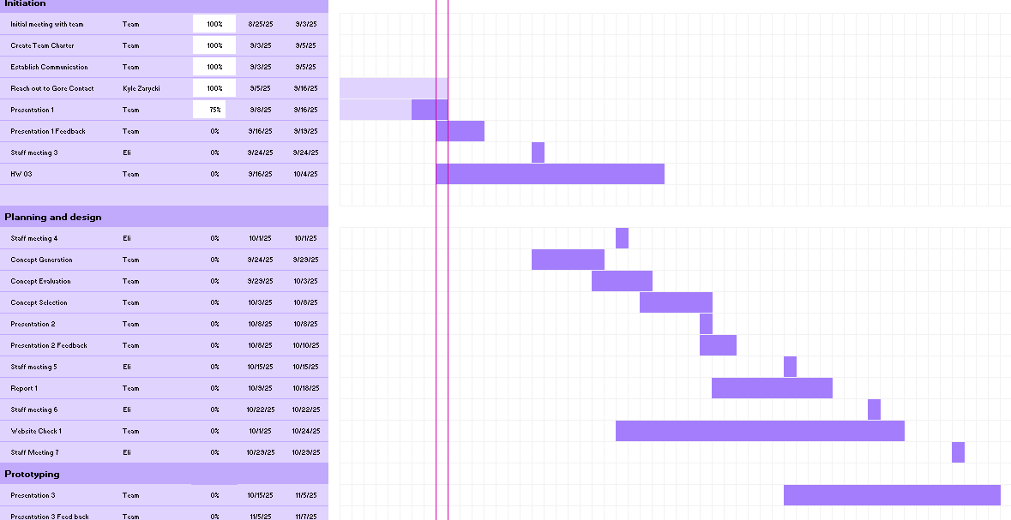
Schedule- Gantt Chart
Kyle 9/17/25, PCC, P1

Slide 19

Kyle 9/17/25, PCC, P1

Slide 20

Budget
Tyler, 9/17/25, PCC P1​

Slide 21
Conclusion
Taking first design steps
Engineering requirements will evolve with prototyping results
Setting goals/Benchmarks that will improve our design
Staying on schedule
Meeting with mentors/EEs
Tyler, 9/17/25, PCC P1

Slide 22
Citations
[1]“Carbon Fiber vs. Aluminium vs. Steel: Which Chassis Material is Best?,” NitPro Composites, 2025. https://www.nitprocomposites.com/blog/carbon-fiber-vs-aluminium-vs-steel
[2]P. Fromaget, “Raspberry Pi vs Arduino: 7 Differences you Should Know,” Raspberry tips. https://raspberrytips.com/raspberry-pi-vs-arduino/
[3]“Dragon Runner Reconnaissance Robot,” Army Technology. https://www.army-technology.com/projects/dragonrunnerrobots/?cf-view
[4]P. Deepa, P. Kartik, P. Jaiswal, and Y. Kanase, “Bomb Disposal Robot,” International Journal of Current Science, vol. 14, no. 2, pp. 2250–1770, 2024, Available: https://rjpn.org/ijcspub/papers/IJCSP24B1087.pdf
[5]lukegarrigan, “Coding a Roomba - Codeheir,” Codeheir, Oct. 16, 2021. https://codeheir.com/2021/10/16/coding-a-roomba/ (accessed Sep. 10, 2025).
[6]Bastaki, “Drones and Robotics in Forestry: Applications and Innovations | Keshtezar,” Keshtezar.com, 2025. https://keshtezar.com/blog/posts/drones-and-robotics-in-forestry-applications-and-innovations/ (accessed Sep. 10, 2025).
[7]I. Kamal, “Small Robot Drive Trains,” Feb. 2008. Accessed: Sep. 11, 2025. [Online]. Available: https://www.idc-online.com/technical_references/pdfs/electronic_engineering/Small_Robot_Drive_Trains.pdf
[8]R. Jarema, “Choosing the Right Battery for Your Robot,” Husarion.com, May 23, 2024. https://husarion.com/blog/batteries-for-mobile-robots/
[9]M. Wright, “Robotics Payload Capacity Calculator - Determine Your Robot’s Lifting Capability,” Awe Robotics, Apr. 20, 2023. https://www.awerobotics.com/robotics-payload-capacity-calculator-easily-determine-your-robots-lifting-capability/ (accessed Sep. 16, 2025).

Slide 23
Citations
[10]“Ponderosa Pine (Pinus ponderosa) | UC Agriculture and Natural Resources,” UC Agriculture and Natural Resources, Feb. 26, 2025. https://ucanr.edu/site/forest-research-and-outreach/ponderosa-pine-pinus-ponderosa
[11]Y. Ren, C. Teng, T. Gao, Y. Zhang, H. Liu, and X. Dong, “Frictional properties of red pine cones harvested under different conditions,” BioResources, vol. 19, no. 1, pp. 766–788, Dec. 2023, doi: https://doi.org/10.15376/biores.19.1.766-788.
[12]G. F. Weick, E. B. Jackson, R. Smith, J. Crooks, B. Crane, and J. M. Guldin, “Longleaf Pine Cone Collection on the Sabine National Forest during October 2014,” Journal of Forestry, vol. 115, no. 3, pp. 238–241, Jul. 2016, doi: https://doi.org/10.5849/jof.15-145.
[13]J. Bai, S. Lian, Z. Liu, K. Wang, and D. Liu, “Deep Learning Based Robot for Automatically Picking Up Garbage on the Grass,” IEEE Transactions on Consumer Electronics, vol. 64, no. 3, pp. 382–389, Aug. 2018, doi: https://doi.org/10.1109/TCE.2018.2859629.
[14]R. Reis, Santos, and L. Santos, “Forest Robot and Datasets for Biomass Collection,” Advances in intelligent systems and computing, pp. 152–163, Nov. 2019, doi: https://doi.org/10.1007/978-3-030-35990-4_13.
[15]L. Bruzzone, S. E. Nodehi, and P. Fanghella, “Tracked Locomotion Systems for Ground Mobile Robots: A Review,” Machines, vol. 10, no. 8, p. 648, Aug. 2022, doi: https://doi.org/10.3390/machines10080648.
[16]“An Unmannd Fully Autonomous Long Endurance Forest Rover for Automated Pine Resin Collection - B & L NAVAL STORES, INC.,” Usda.gov, 2019. https://portal.nifa.usda.gov/web/crisprojectpages/1019669-an-unmannd-fully-autonomous-long-endurance-forest-rover-for-automated-pine-resin-collection.html (accessed Sep. 17, 2025).
Elijah Gerstner, 9/17/2025, Gore PCC P#1

Slide 24
Citations
[17]D. Szpaczyńska, M. Przybysz, and Tomasz Muszyński, “Comparison of Multi-Tracked Running Gears in Terms of Obstacle Negotiation Capabilities,” Applied Sciences, vol. 15, no. 4, pp. 1696–1696, Feb. 2025, doi: https://doi.org/10.3390/app15041696.
[18] N. Ezra, A. Cohen, and D. Zarrouk, “Modeling, simulation, and experiments of a flexible track robot over rigid horizontal and inclined surfaces,” Mechanism and Machine Theory, vol. 199, pp. 105689–105689, May 2024, doi: https://doi.org/10.1016/j.mechmachtheory.2024.105689.
[19]L. Feng, X. Jiang, and A. Song, “An Instrumented Wheel-On-Limb System of Planetary Rovers for Wheel-Terrain Interactions: System Conception and Preliminary Design,” arXiv (Cornell University), pp. 96–101, Mar. 2022, doi: https://doi.org/10.1145/3529261.3529278.
[20]S. M. Shafaei and H. Mousazadeh, “Experimental comparison of locomotion system performance of ground mobile robots in agricultural drawbar works,” Smart Agricultural Technology, vol. 3, p. 100131, Feb. 2023, doi: https://doi.org/10.1016/j.atech.2022.100131.
‌[21]B. D. Harrington and C. Voorhees, “The Challenges of Designing the Rocker-Bogie Suspension for the Mars Exploration Rover,” 37th Aerospace Mechanisms Symposium, May 2004. http://ntrs.nasa.gov/citations/20040084284? (accessed Sep. 17, 2025).
[22]“Tire and Vehicle Dynamics | ScienceDirect,” www.sciencedirect.com. https://www.sciencedirect.com/book/9780080970165/tire-and-vehicle-dynamics
[23]H. A. Almusawi and Hussam Akkad, “A Comparative Review of Omnidirectional Wheel Types for Mobile Robotics,” Aug. 06, 2023. https://www.researchgate.net/publication/372941239_A_Comparative_Review_of_Omnidirectional_Wheel_Types_for_Mobile_Robotics
‌

Slide 25
Citations
[24] J. McNulty, “A review of Li-ion batteries for autonomous mobile robots,” Elsevier, 2022.
[25] R. Oliveira, et al., “Advances in Forest Robotics: A State-of-the-Art Survey,” Machines, vol. 10, no. 2, 2021.
[26] H. Xiao and W. Whittaker, “Energy Utilization and Energetic Estimation of Achievable Range for Wheeled Mobile Robots Operating on a Single Battery Discharge,” Univ. of Texas Tech Report.
[27] M. Poskart, “Multi-Parameter Predictive Model of Mobile Robot’s Battery,” Sensors, 2022.
[28] Y. Li, et al., “Localization in Unstructured Environments: Towards Autonomous Robots in Forests with Delaunay Triangulation,” arXiv preprint, 2020.
[29] J. Pereira, et al., “Robots for Forest Maintenance: Vision System for a Forestry Navigation Machine,” Proc. Int. Conf. Robotics in Forestry, 2024.
[30] “Robotics in Forestry,” ResearchGate Survey Article, 2016.
[31]“Rolling resistance coefficient for real world roads [13],” ResearchGate, 2021. https://www.researchgate.net/figure/Rolling-resistance-coefficient-for-real-world-roads-13_tbl2_351973711
[32]“Robots and robotic devices -Safety requirements for personal care robots.” Available: https://cdn.standards.iteh.ai/samples/53820/5ddca453a6d141e5a558f4f791ea3229/ISO-13482-2014.pdf
[33]“J1269_201912: Rolling Resistance Measurement Procedure for Passenger Car, Light Truck, and Highway Truck and Bus Tires - SAE International,” Sae.org, 2019. https://www.sae.org/standards/content/j1269_201912/ (accessed Sep. 19, 2025).

