Slide 1
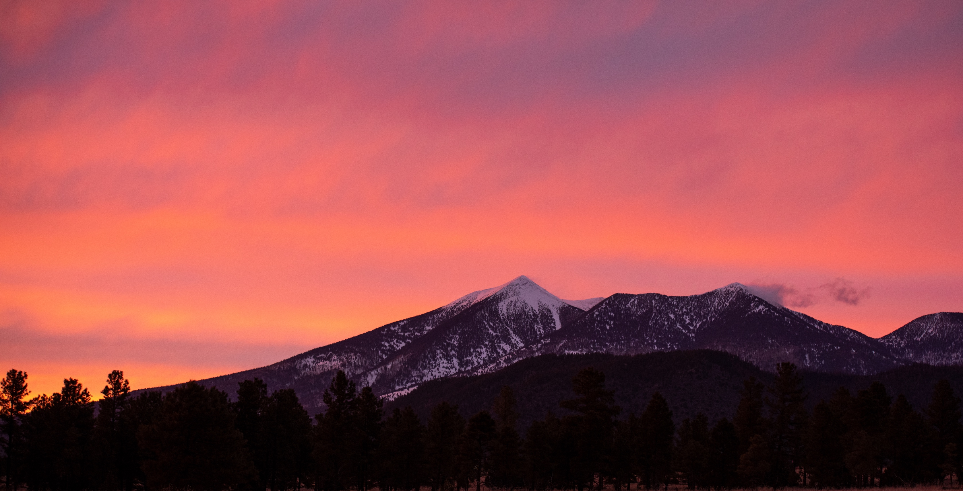
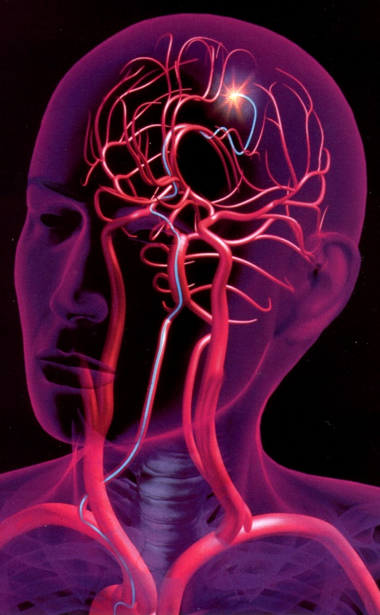
ME476C SP25 – PIV Group
Santiago Gamez
Kian Pack
Christopher Rapoport
Jett Scruggs
Development of a Novel Particle Image Velocimetry System for the NAU Bioengineering Devices Laboratory
Research Area: Translational research on biomaterials, flow modeling, and medical device development for the treatment of aneurysms

Slide 2
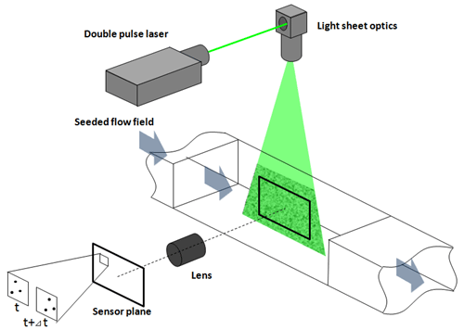
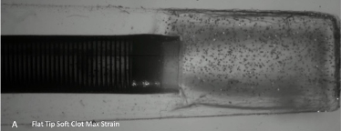
Introduction
Particle Image Velocimetry (PIV):
A system that uses a combination of a laser and an ultra-high-speed camera to track the change in position of fluorescent tracer particles within a fluid flow, allowing the analysis of the velocity field within the fluid.
Fig. 1. Overview of Typical PIV System [1]
Fig. 2. Previous PIV study conducted by the BDL
Chris 1

Slide 3
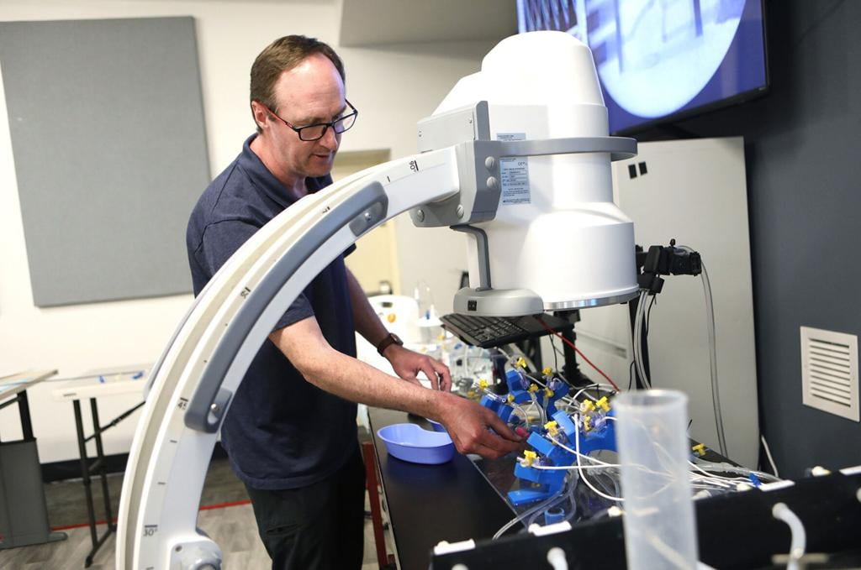
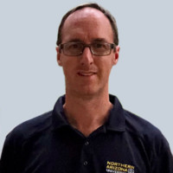
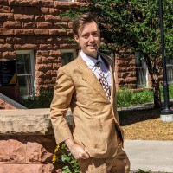
Project Overview
Sponsor: Tim Becker, PhD
Associate Professor
Mechanical Engineering Department
Principle Investigator
Bioengineering Devices Laboratory (BDL)
Chief Technology Officer
Aneuvas Technologies, Inc. (ATI)
Client: Wyatt Clark, M.S.
PhD Candidate
Mechanical Engineering Department
Senior Research Associate
Bioengineering Devices Laboratory (BDL)
Chris 2

Slide 4
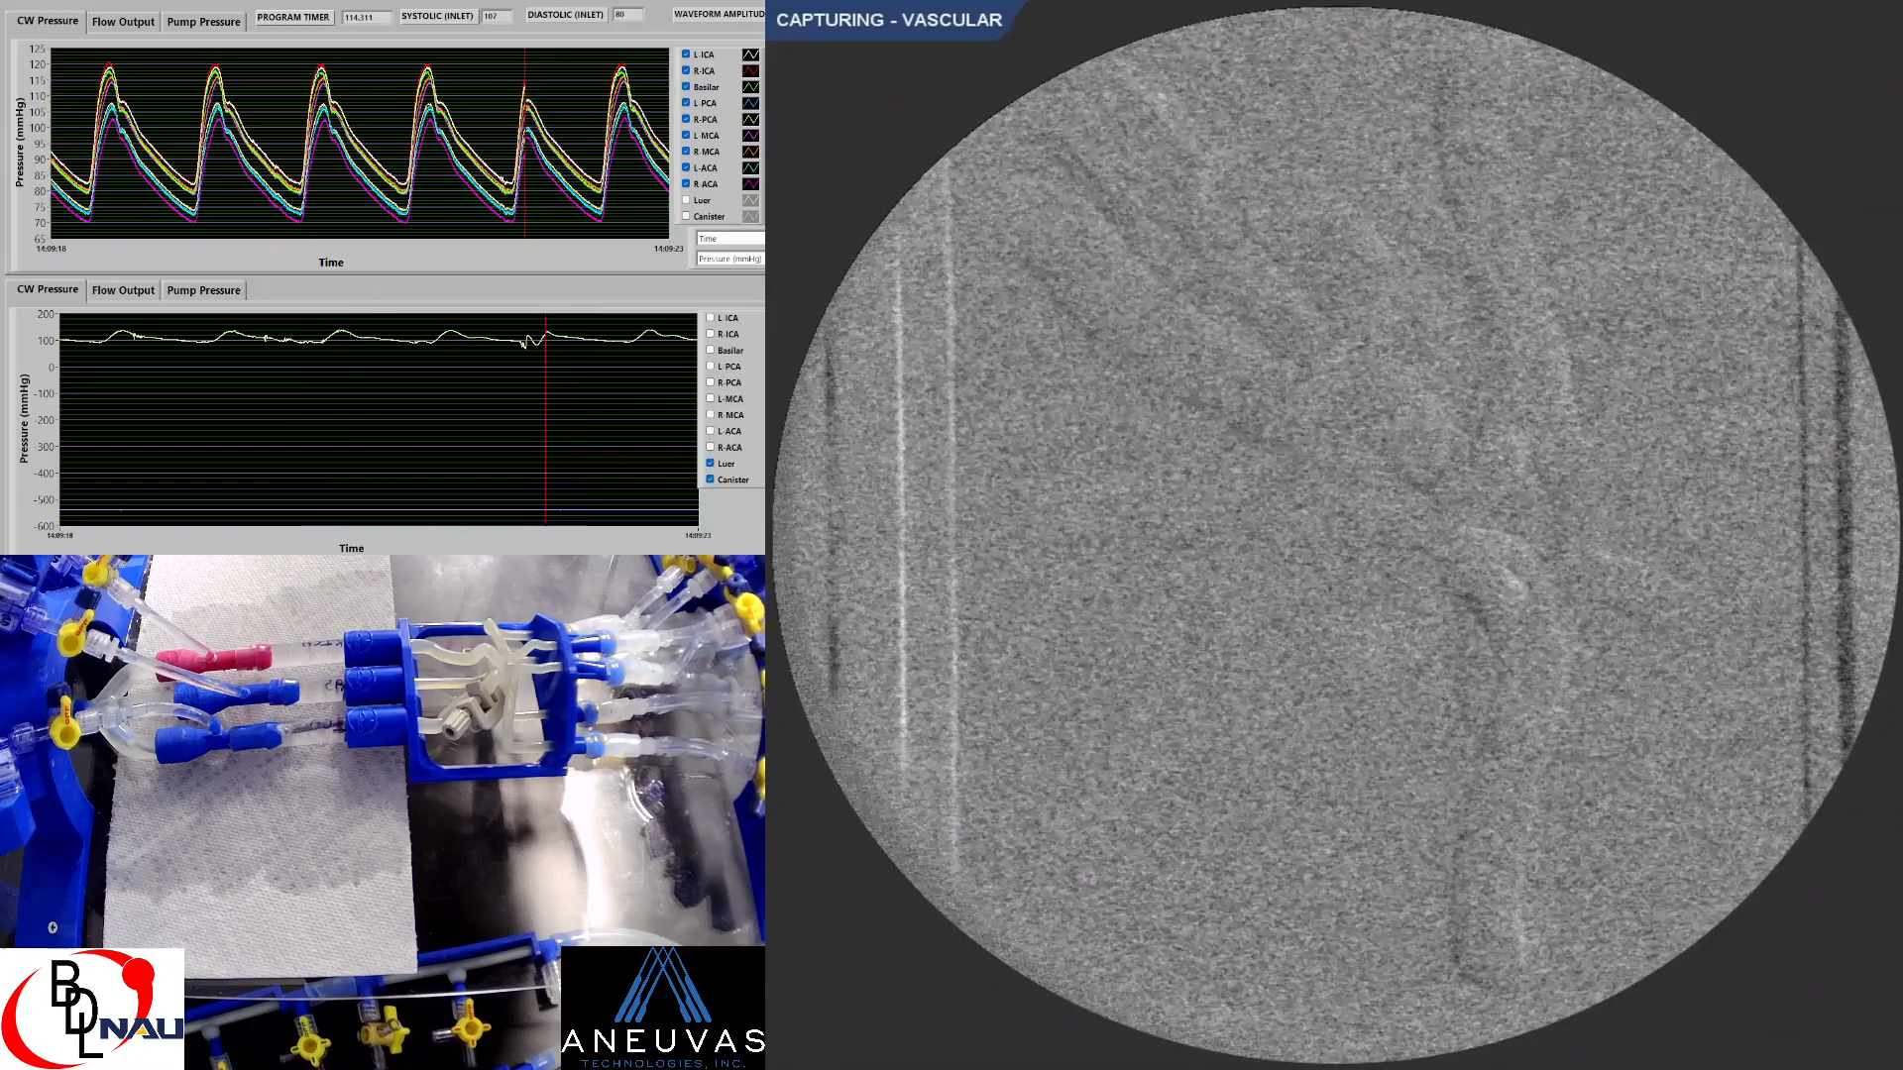
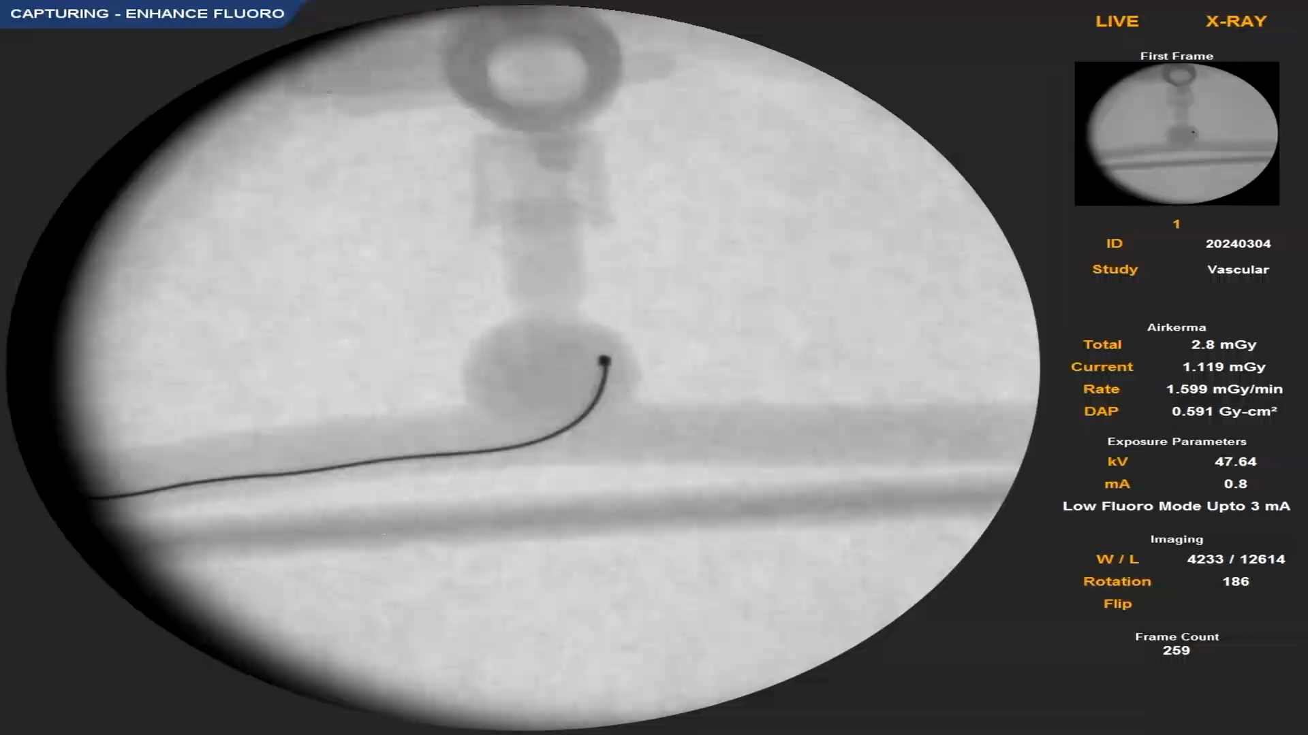
Project Justification
Almost 800,000 strokes occur in the US every year [2].
Ischemic Stroke: blood flow is blocked in the brain – treated with drugs or mechanical thrombectomy.
Hemorrhagic Stroke: rupture of blood vessel in the brain – treated with coiling and stents.
Endovascular treatments currently about 60% effective [3].
Fig. 3. BDL aspiration thrombectomy study (top) BDL coiling study (bottom)
Chris 3

Slide 5
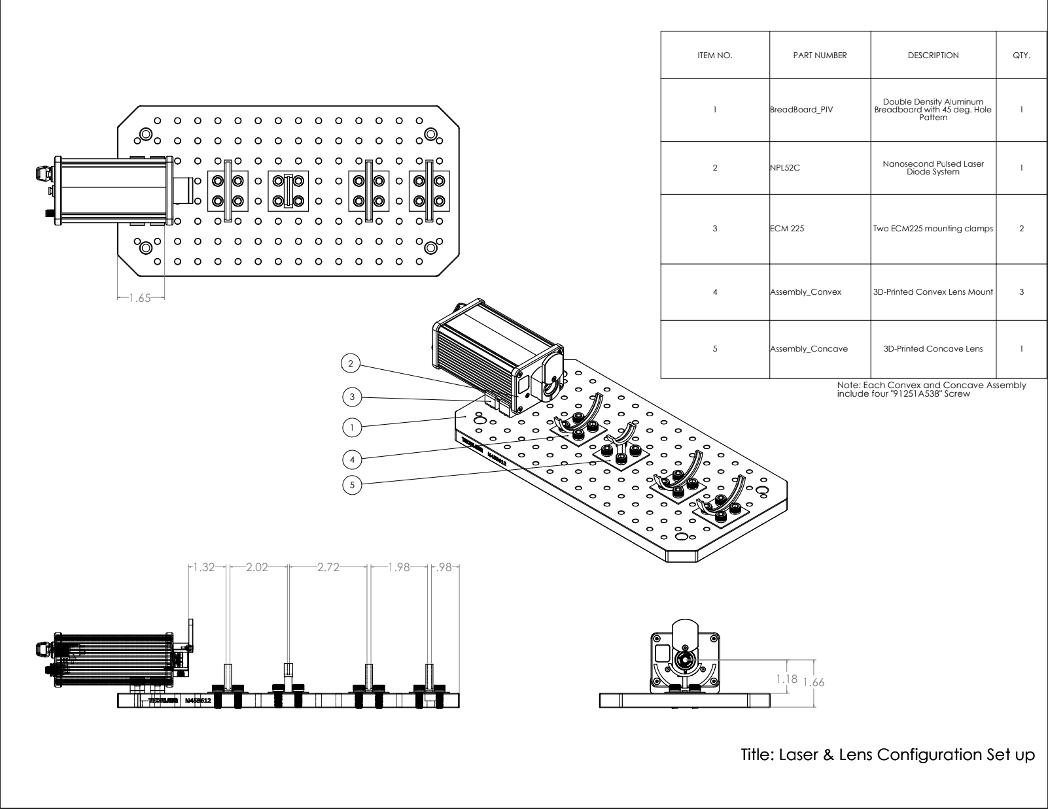
Design Description : Lens & Laser Configuration
Laser turns on
Convex lens contracts beam
Concave Lens expands beam
Cylindrical lens to diverge beam in x-dimension
Cylindrical lens to diverge beam in y-direction
Santiago 4

Slide 6
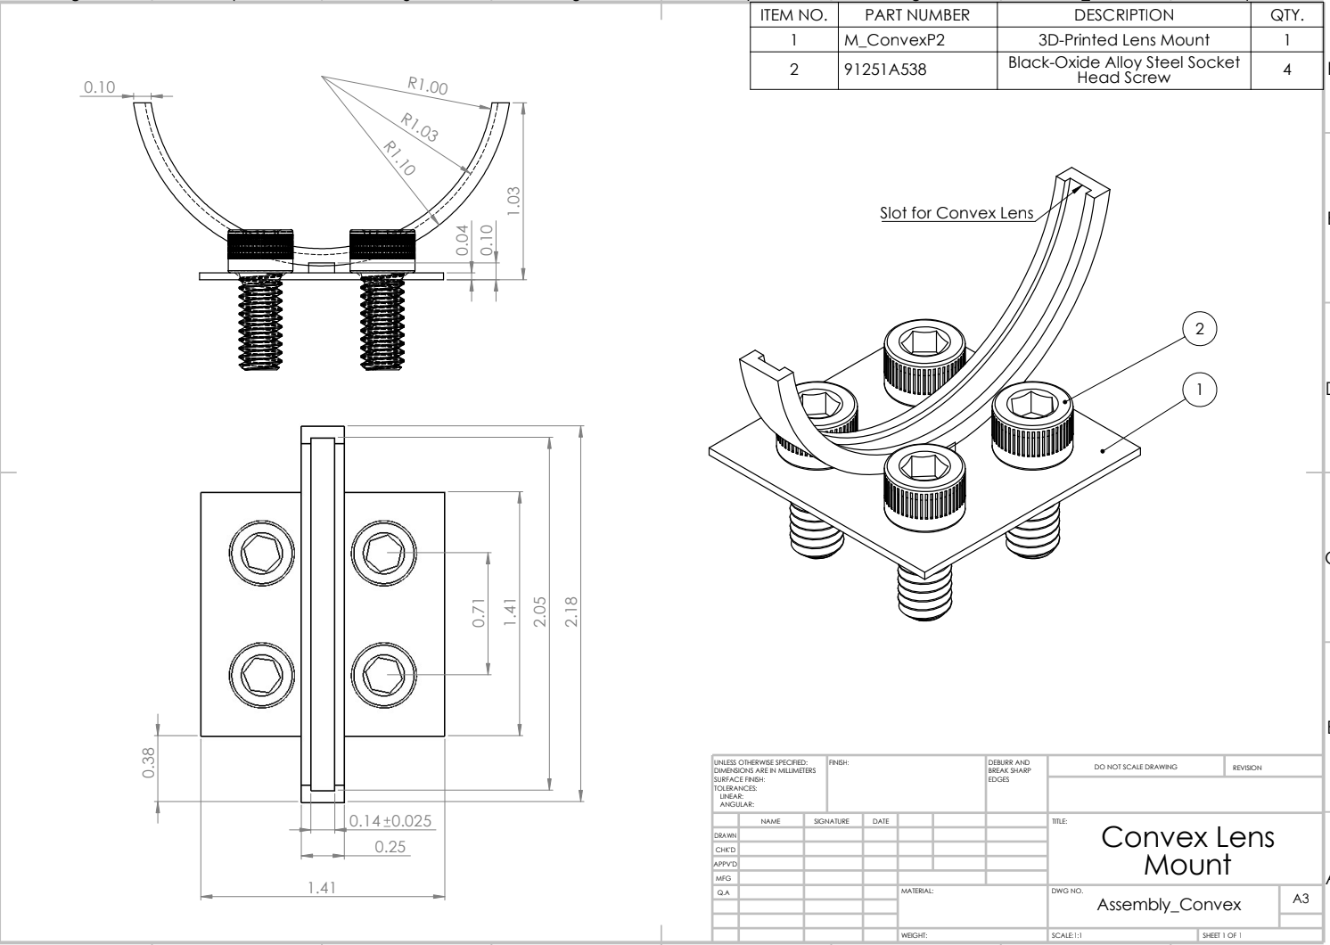
Design Description : Convex Lens Mount
Mount holds convex lens in place
Santiago 5

Slide 7
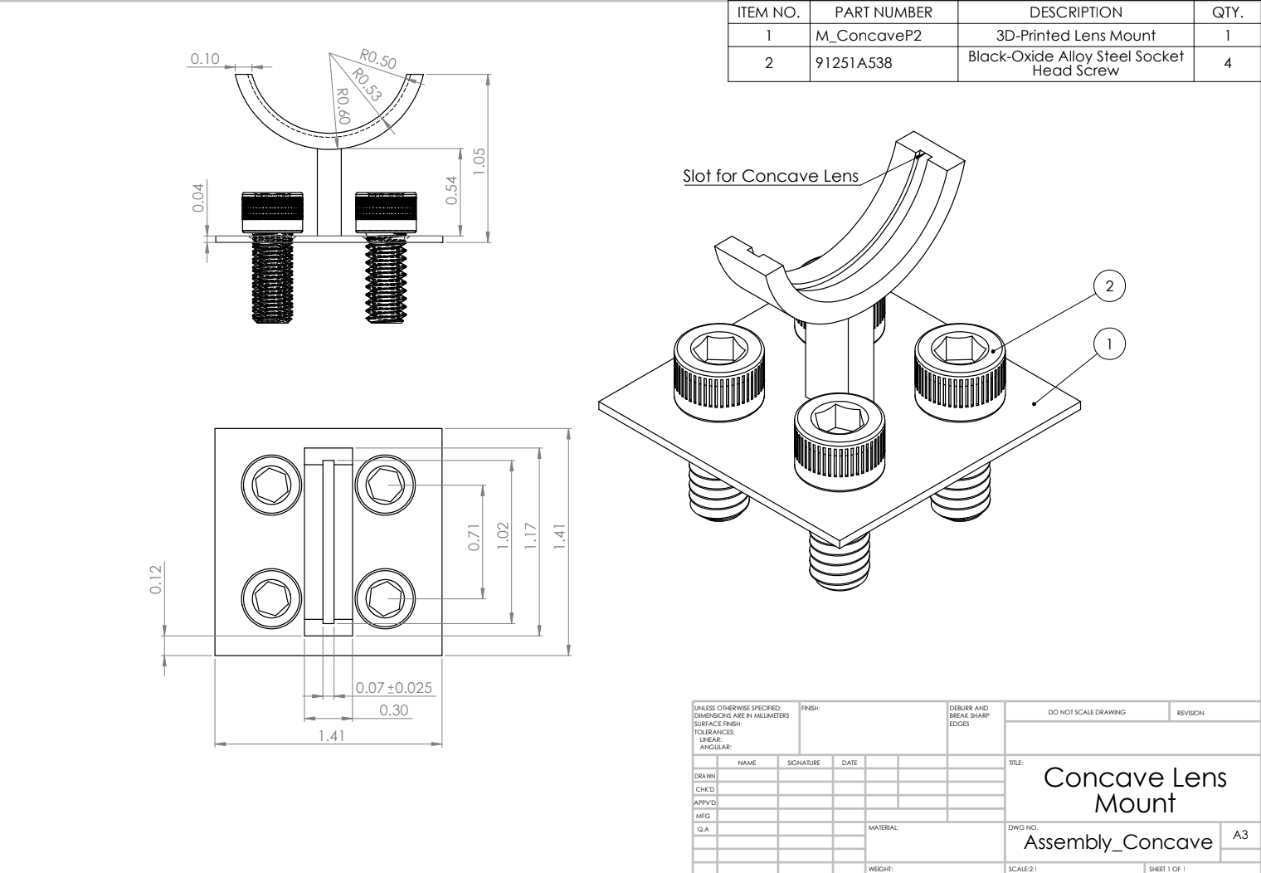
Design Description : Concave Lens Mount
Mount holds concave lens in place
Santiago 6

Slide 8
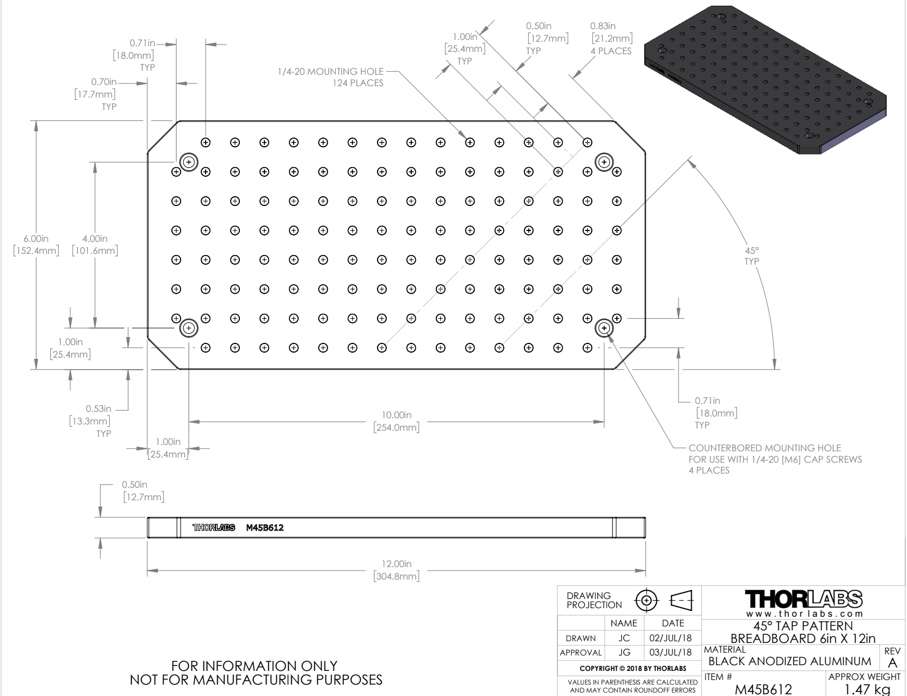
Design Description : Breadboard
Holds all mounting systems in one uniform line
Santiago 7

Slide 9
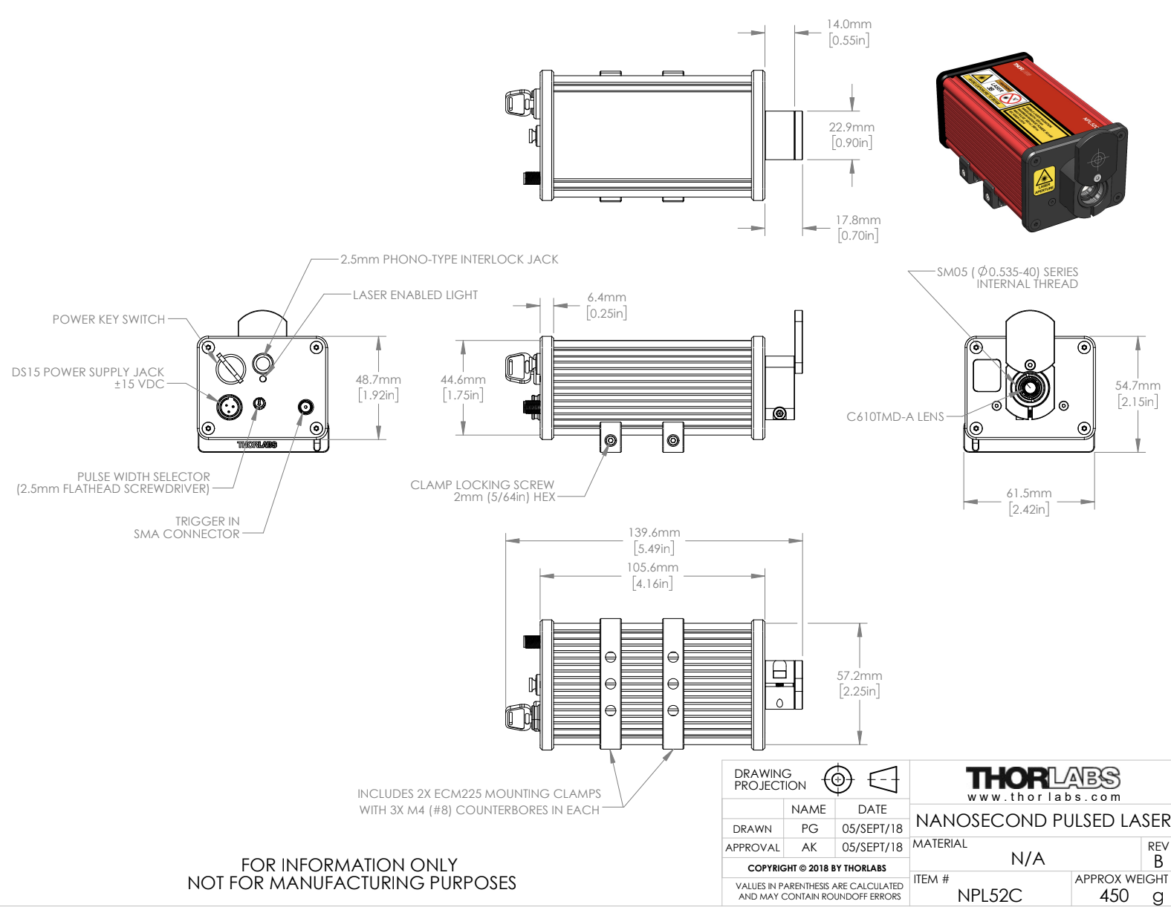
Design Description : Laser
Start: Laser passes through lenses to create sheet size of 0.1 mm
End: Lights up fluorescent particles in flow
Santiago 8

Slide 10
Customer and Engineering Requirements
Customer Requirements
Ease of Setup
Camera Resolution
Camera Frame Rate
Camera Run Time
Strength of Laser
Adherence to Laser Safety Standards
Acceptable Width of Laser Sheet
Use of Multifunction Generator
Engineering Requirements
Setup Time (<60min)
Resolution (~1.3MP) (From ~2.1MP)
Camera Frame Rate (200FPS) (From 1000FPS)
Run Time (10s)
Laser Power (50-150mW)
Risk Assessment Score (1-10)
Sheet Thickness (100-200µm)
Frequency (10ns)
Refractivity Index (1.5RI)
Jett 9

Slide 11
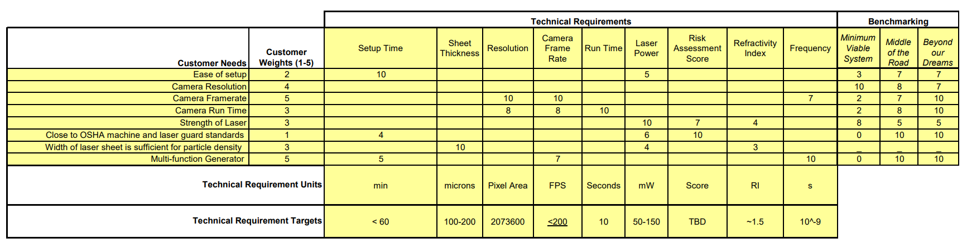
Updated QFD
Table 1: QFD
Jett 10

Slide 12





Engineering Analysis – Optimization of Camera and Lens Setup
Optimization helps to detail how well certain specifications will work together, and what to change
Camera lens has an assumed magnification of 15, a sensor length of 11.3mm.
Laser wavelength of 520nm, a numerical aperture of 2 and medium refractive index of 2.8.
Reference of flow was the Basilar artery, with an average flow velocity of 0.55m/s [5]
$$FOV=\frac{L_{Res}p}{M}=\frac{1920(\frac{11.3}{1920})}{15}=.753mm$$
$$Pixel size=p=\frac{L_{Sen}}{L_{Res}}$$
$$Pixel Resolution=\frac{FOV}{L_{Res}}=\frac{.753}{1920}=3.92E−4mm/pixel$$
$${Resolution Limit=δ}_{r}=\frac{1.22λ}{NA}=\frac{1.22(520)}{.2}=3.17E−3mm$$
$$DOF=\frac{2np(1+M)}{M^{2}}=\frac{2(2.8)(\frac{11.3}{1920})(1+15)}{{15}^{2}}=2.34E−3mm$$
$${Motion Blur=B}_{m,200}=UT_{e}=\left(.55\right)\left(\frac{1}{200}\right)=2.75E−3mm$$
$${Motion Blur=B}_{m,600}=UT_{e}=\left(.55\right)\left(\frac{1}{600}\right)=9.167E−4 mm$$
Jett 11

Slide 13
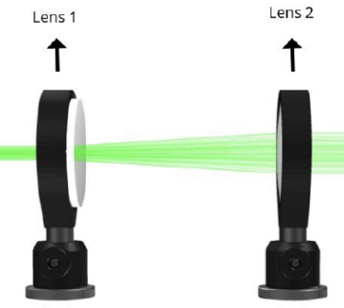


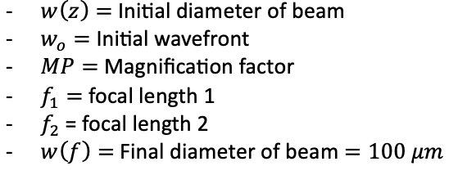
Engineering Analysis – F of Lenses & Length
(1)
(2)
(3)
Figure 4: Two lenses in configuration [6]
Santiago 12

Slide 14
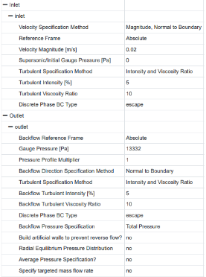
Engineering Analysis – Aneurysm Model
Boundary Conditions:
Velocity Inlet
Specified at 0.23 m/s based on empirical data [6]
Pressure Outlet
Based on averaged healthy systolic and diastolic pressures – 100mmHg from 120/80 mmHg.
Set to 13,332 Pa in CFD
Wall Conditions
No-slip condition as deformation and wall shear stress are ignored in this case.
Material Properties:
Fluid treated as water for this simulation.
Particles treated as a massless discrete phase.
Table 2. Boundary Conditions for CFD as set in ANSYS Fluent.
0.23
Kian 13

Slide 15
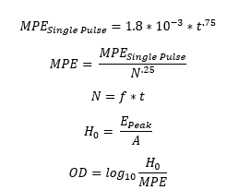
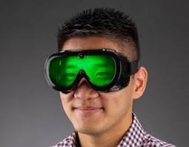
Engineering Analysis – Optical Density for Safety Goggles
Use ANSI Z.136.1 Tables 5-7 to find equations based on laser specifications and application
Required OD – 4.69
Chris 15

Slide 16
Design Validation - FMEA
Laser Potential Modes of Failure:
Diode Overheating
Engineering Controls – Integrated temperature controller in driver.
Diode Overcurrent
Engineering Controls – Overcurrent protection circuit in driver.
Electro-Static Discharge (ESF) to Electronic Components
Elimination via Process Control – Operator must ground before interacting with laser.
PPE – Operators must wear anti-ESD wristbands when interacting with laser
Camera:
Overheating
Engineering Control – Temperature sensor in camera
Overcurrent
Engineering Control – Overcurrent protection circuit in camera
Kian 16

Slide 17
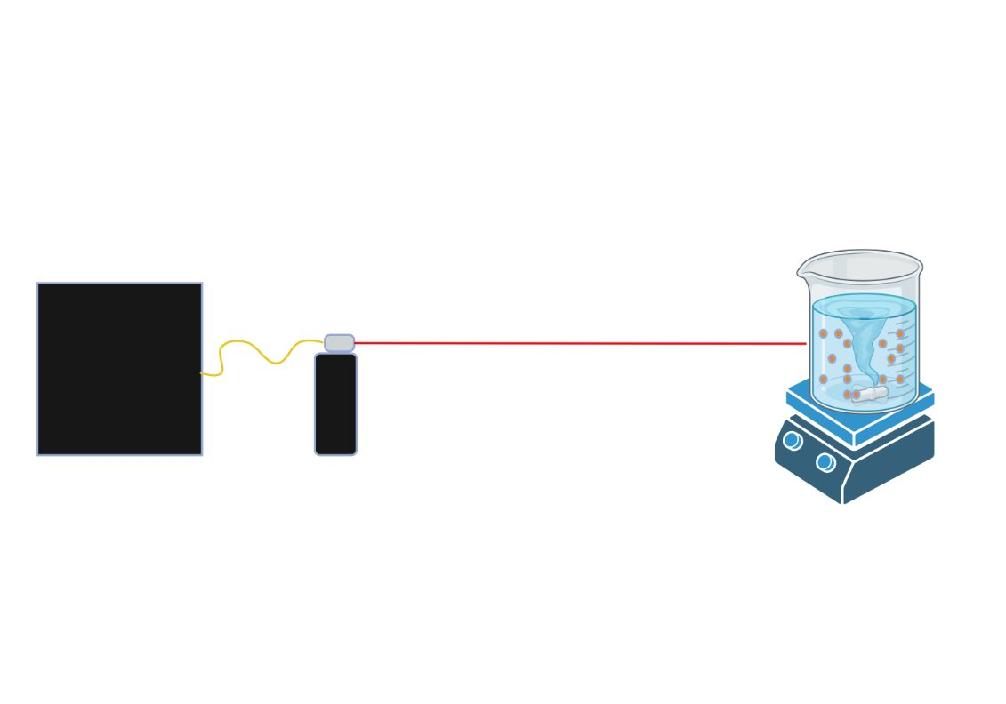
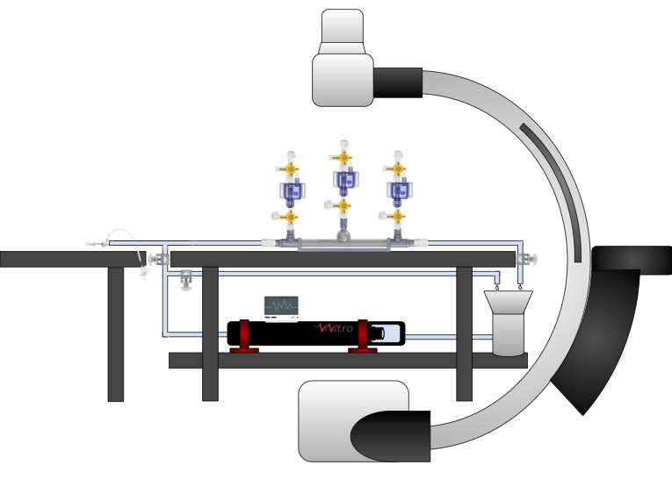
Design Validation - Testing
Performing Experiment with Laser
Timed setup
Comparison of flow studies to CFD and literature
Testing laser safety measures
Testing equipment: BDL comprehensive benchtop model
Fig. 5. Top: Laser Fluorescence Experiment Bottom: BDL Comprehensive Flow Model
Chris 17

Slide 18
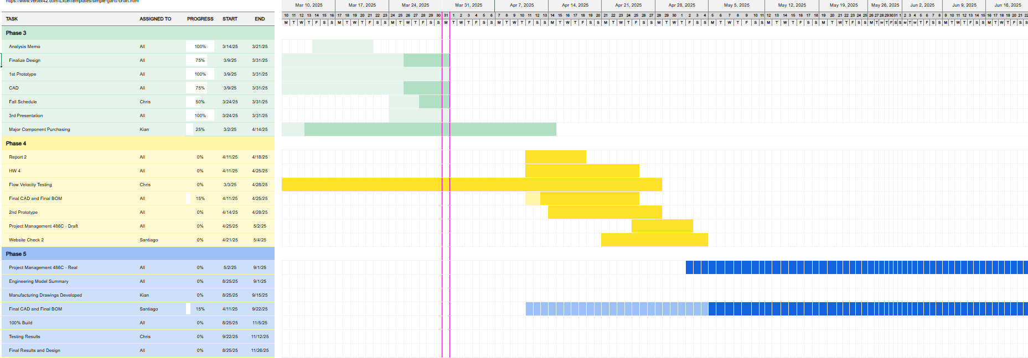
Project Schedule
Kian 18

Slide 19
Budget and Plan
Spend for SP25
Critical Equipment-
ThorLabs NPL52C Pulse Laser -$2,300
R&D Spend (Capstone Budget)-
Laser Safety Goggles: -$538
CLD1010LP DC Power Supply: -$85
Budget Buckets Remaining
Critical Equipment: $12,700
R&D: $2,377
Fundraising Updates
BDL Equipment Donation-
ThorLabs CLD1010LP laser driver and diode combo: ~$3,000
Hooper Undergraduate Research Grant-
Total Potential Equipment Funding: $1,500
Remaining Equipment
Camera (Filter+Lenses)
Mounting Equipment
Laser Optics Train
Function Generator
Kian 19

Slide 20
References
[1] Seika Digital Image Corporation, “PIV ( Particle Image Velocimetry ) | Overview & Principle.” [Online]. Available: https://www.seika-di.com/en/measurement/principle_of_piv.html
[2] M. Katan and A. Luft, “Global Burden of Stroke,” Semin Neurol, vol. 38, no. 02, pp. 208–211, Apr. 2018, doi: 10.1055/s-0038-1649503.
[3] “How many people are affected by/at risk for stroke? | NICHD - Eunice Kennedy Shriver National Institute of Child Health and Human Development.” Accessed: Feb. 26, 2025. [Online]. Available: https://www.nichd.nih.gov/health/topics/stroke/conditioninfo/risk
[4] F. Zigunov, “How bright are my piv particles?,” Zigunov Aero, https://zigunov.com/2023/06/30/how-bright-are-my-piv-particles/ (accessed Mar. 3, 2025).
[5] Allen D Elster, “Expected Velocities,” Questions and Answers in MRI. [Online]. Available: https://mriquestions.com/expected-velocities.html
[6] “Light sheet optics for PIV - HackMD,” HackMD, 2023. https://hackmd.io/@cdcl-rpr/light-sheet-optics
20

Slide 21
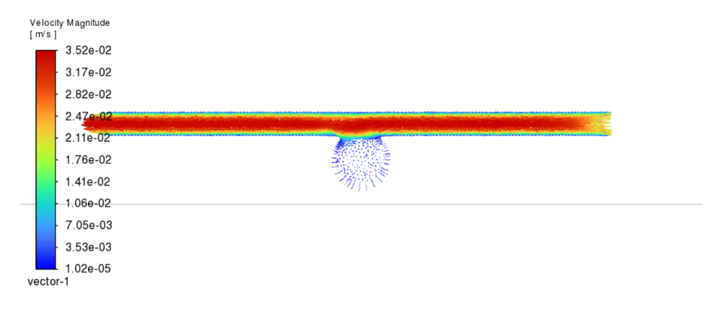
Virtual Prototype Results
Fig. 6. Vector Plot of Simulated Test Flow
13

Slide 22
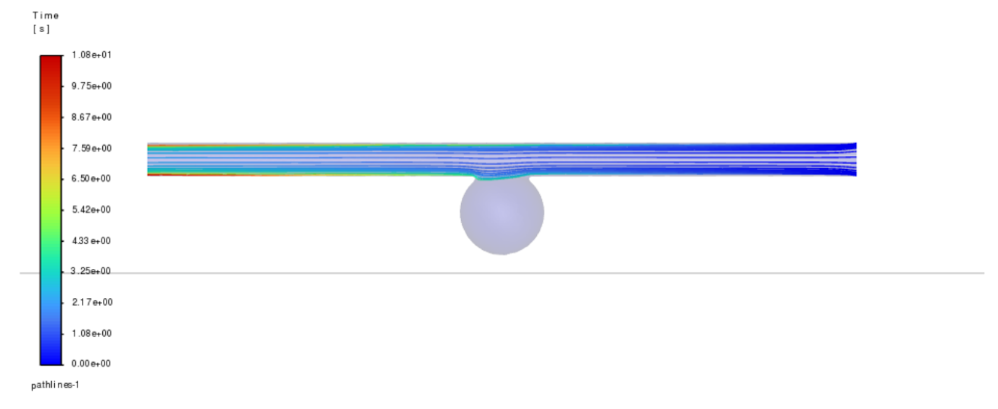
Virtual Prototype Results - Cont'd
Fig. 7. Pathlines Graphic of Simulated Test Flow
13

Slide 23
Thank you! Questions?

