Slide 1
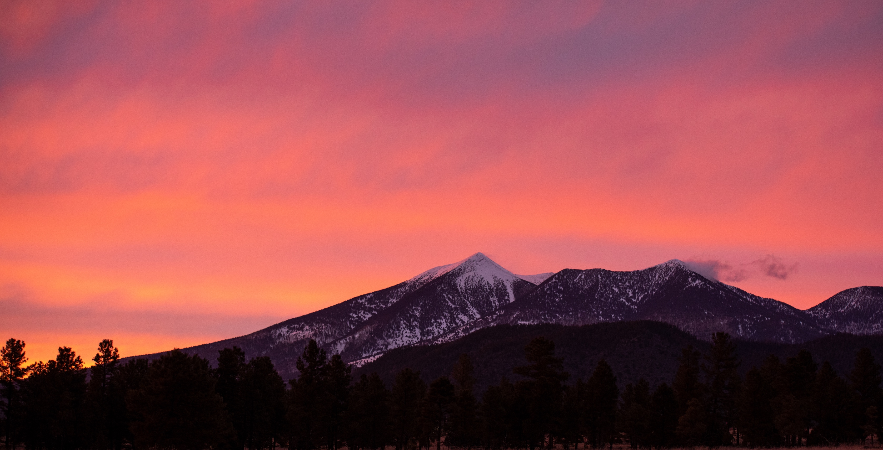
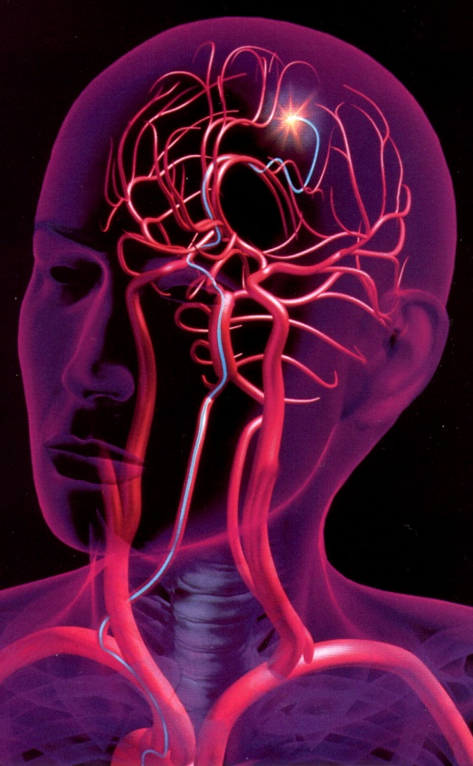
ME476C SP25 – PIV Group
Santiago Gamez
Kian Pack
Christopher Rapoport
Jett Scruggs
Development of a Novel Particle Image Velocimetry System for the NAU Bioengineering Devices Laboratory
Research Area: Translational research on biomaterials, flow modeling, and medical device development for the treatment of aneurysms

Slide 2
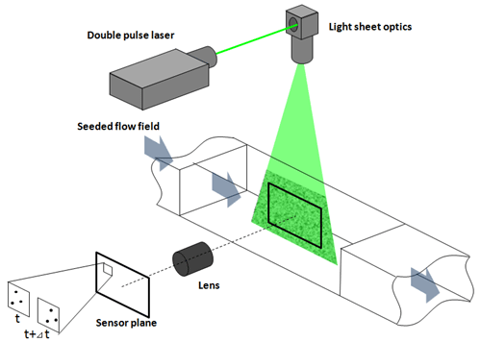
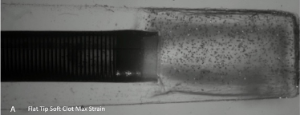
Introduction
Particle Image Velocimetry (PIV):
A system that uses a combination of a laser and an ultra-high-speed camera to track the change in position of fluorescent tracer particles within a fluid flow, allowing the analysis of the velocity field within the fluid.
Fig. 1. Overview of Typical PIV System [1]
Fig. 2. Previous PIV study conducted by the BDL
Chris 1

Slide 3
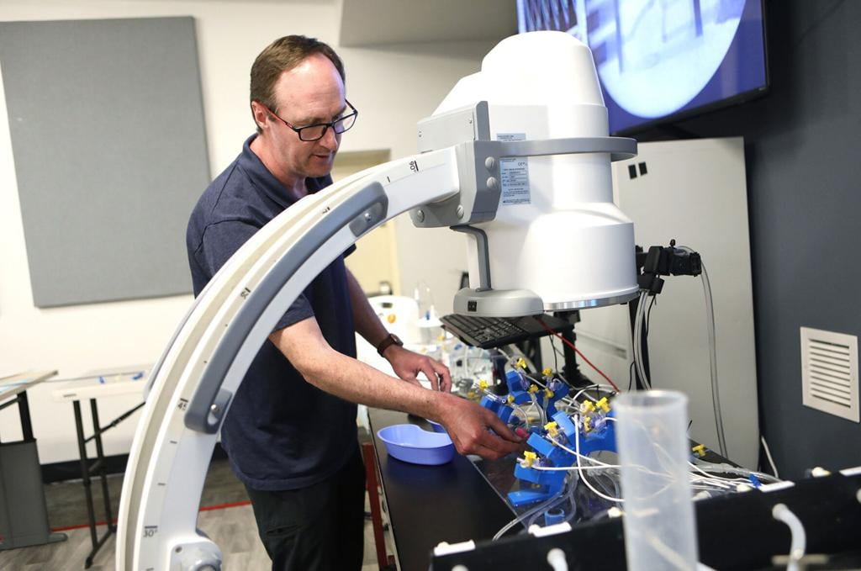
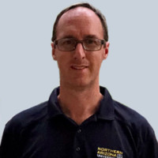

Project Overview
Sponsor: Tim Becker, PhD
Associate Professor
Mechanical Engineering Department
Principle Investigator
Bioengineering Devices Laboratory (BDL)
Chief Technology Officer
Aneuvas Technologies, Inc. (ATI)
Client: Wyatt Clark, M.S.
PhD Candidate
Mechanical Engineering Department
Senior Research Associate
Bioengineering Devices Laboratory (BDL)
Chris 2

Slide 4
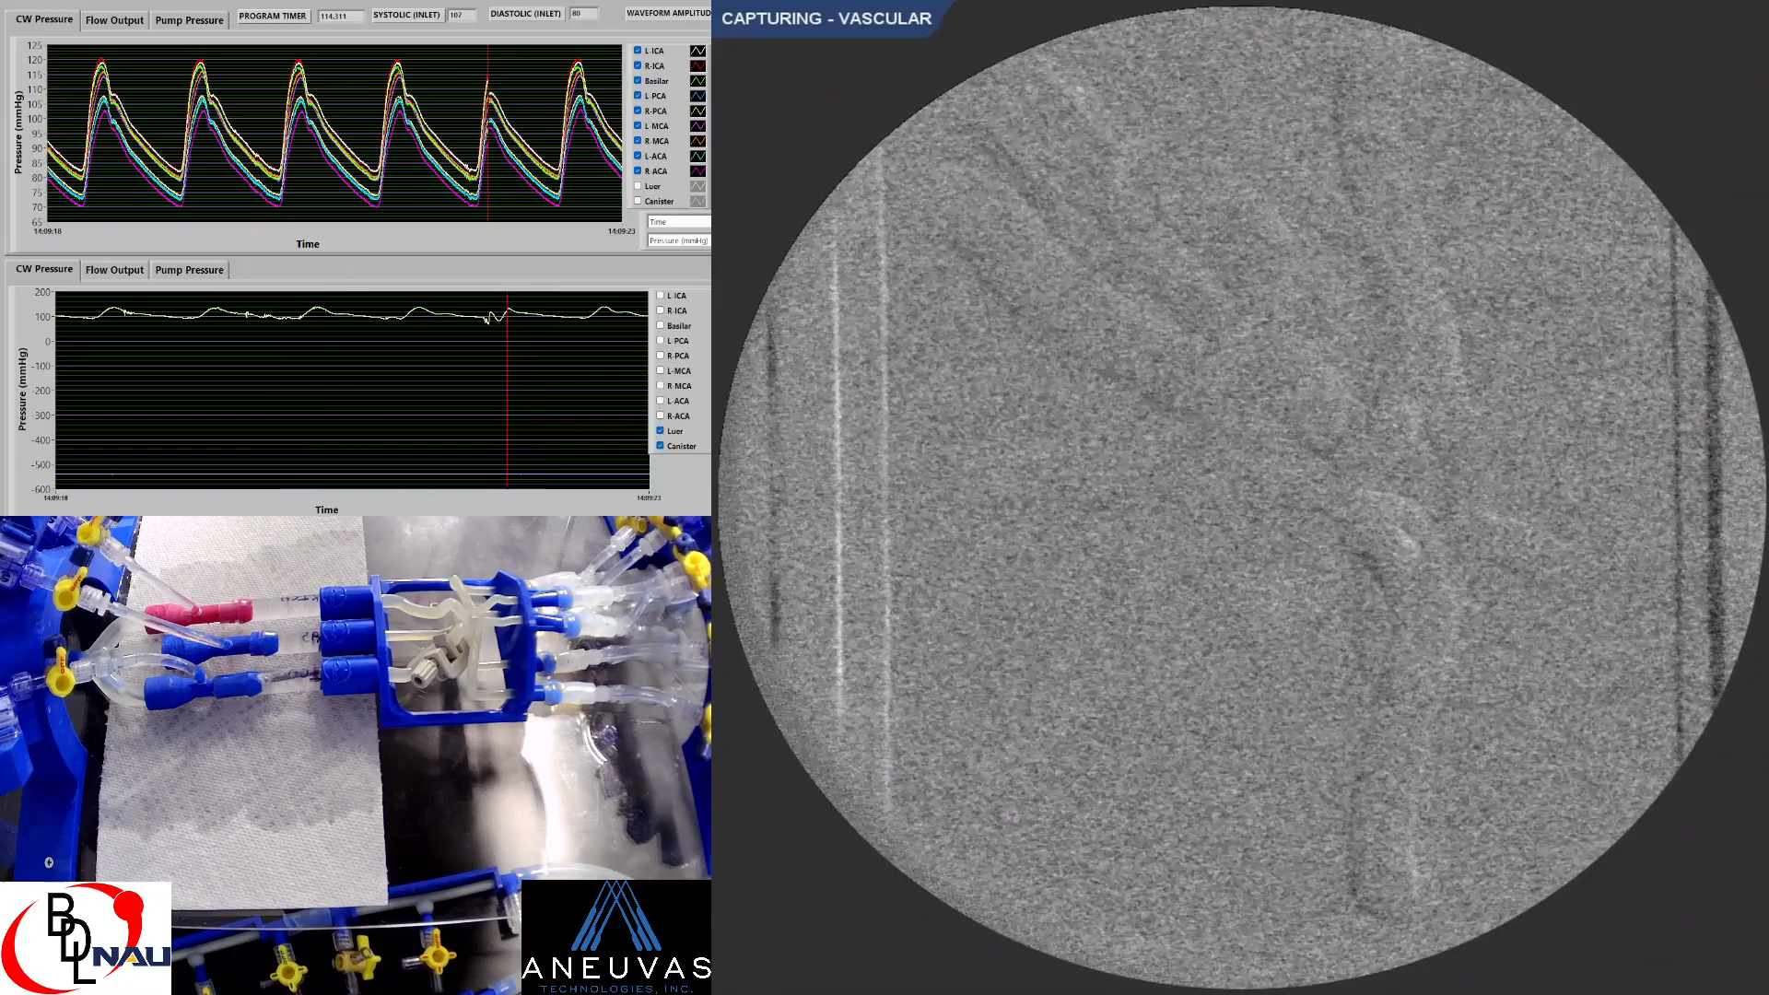
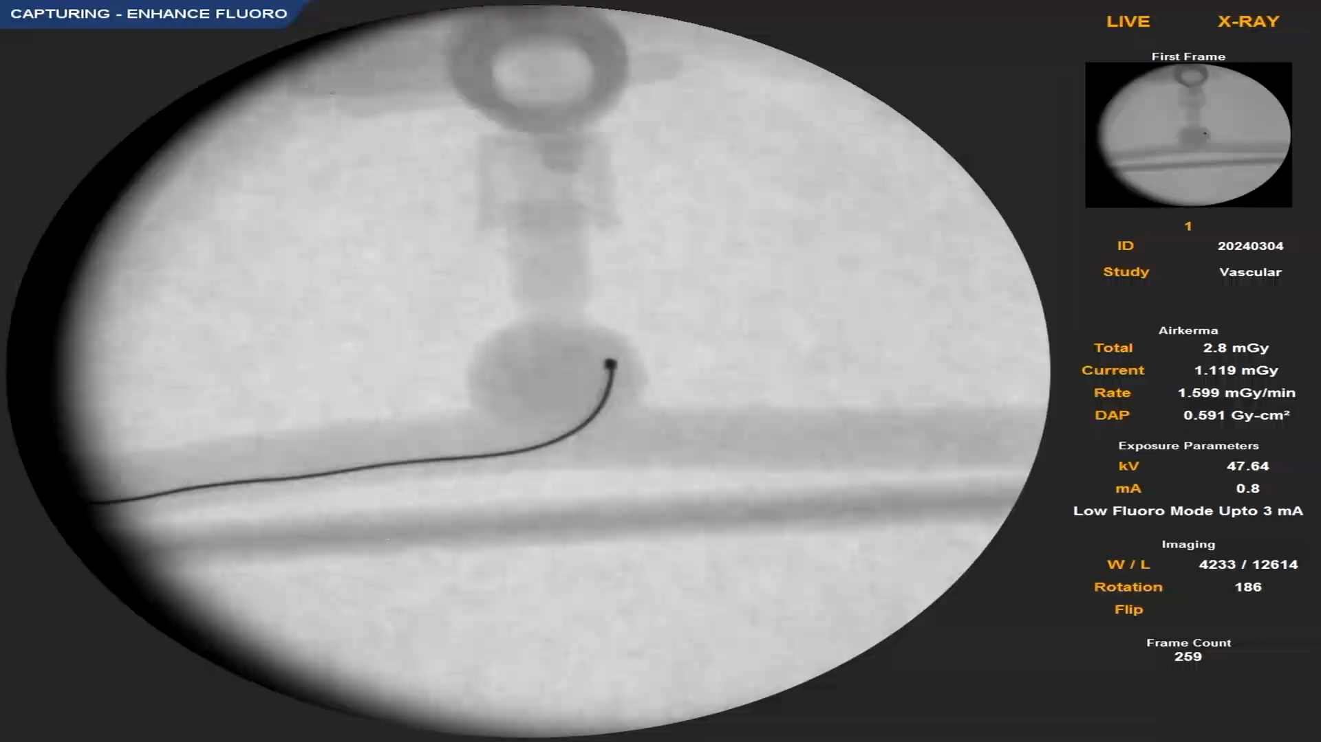
Project Justification
Almost 800,000 strokes occur in the US every year [2].
Ischemic Stroke: blood flow is blocked in the brain – treated with drugs or mechanical thrombectomy.
Hemorrhagic Stroke: rupture of blood vessel in the brain – treated with coiling and stents.
Endovascular treatments currently about 60% effective [3].
Fig. 3. BDL aspiration thrombectomy study (top) BDL coiling study (bottom)
Chris 3

Slide 5
Functional Decomposition – Black Box Model
Laser Reflection,
Electrical Power
Capture Images of Particle Positions
Heat,
Diffuse Light Reflection
Function Generator
Pulse
Image Files
Energy Flow
Signal Flow
Fig. 4. Black Box Model of PIV System
Kian 4

Slide 6
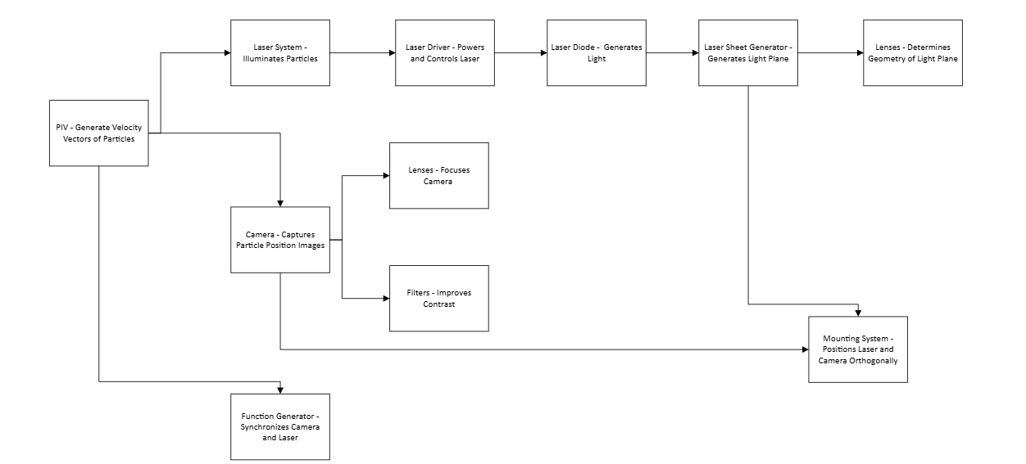
Functional Decomposition – Subsystems
Fig. 5. Subsystem Functional Decomposition
Kian 5

Slide 7
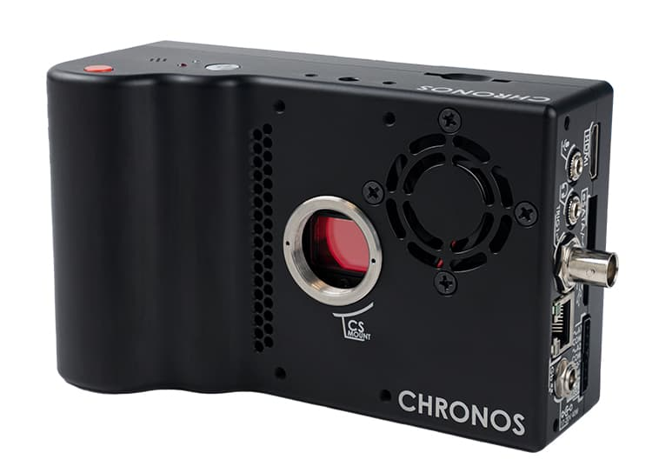
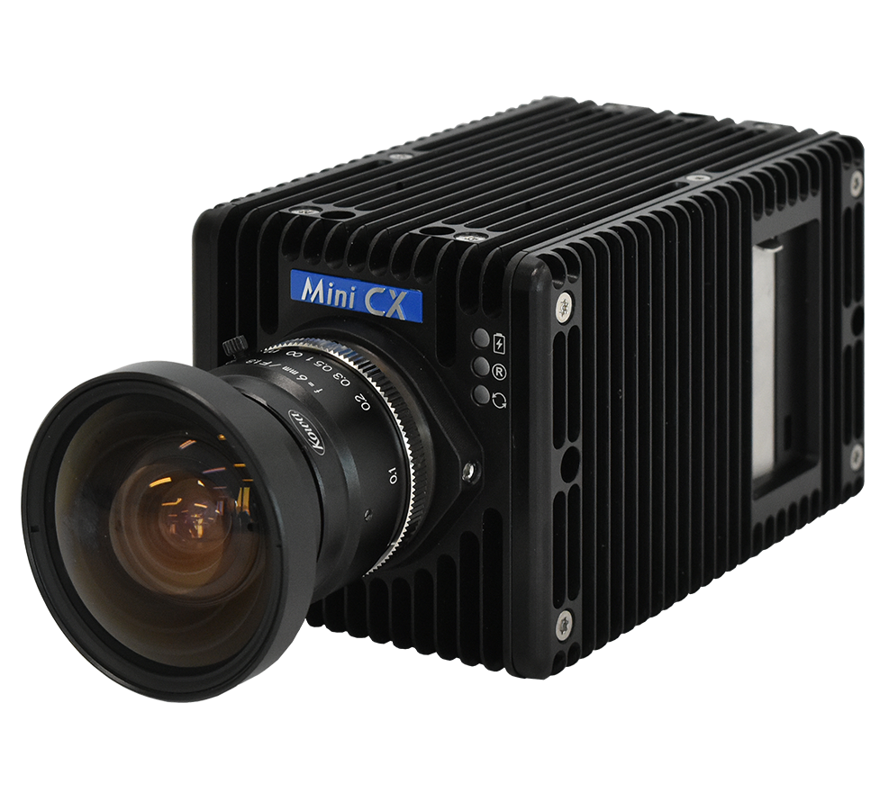
Concept Generation - Camera
Resolution: ~1000 FPS at 1.3MP
Needs to have enough RAM to record for around 10 seconds at given resolution.
Budget: $5000-8000 for camera alone.
Found several new and used options, most being within the price range.
Some options require additional purchases (camera lenses, for example). Can factor into remainder of budget.
Figure 6, Top: Chronos 2.1-HD Camera Bottom: Photron FASTCAM Mini CX100
Jett 6

Slide 8
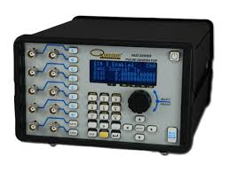
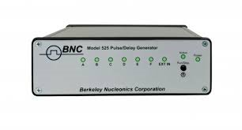
Concept Generation – Function Generator
Resolution: Smallest time-step between pulses
Jitter: Accuracy of timing
Number of Channels: How many devices can be controlled
Trigger Rate: How fast the Generator can trigger an external device
User Friendliness: How easy is it to change the generator's settings, is there a physical interface or does it require a PC to configure?
Figure 7: Top: Quantom Composers 9520 Bottom: BNC 525
Chris 7

Slide 9
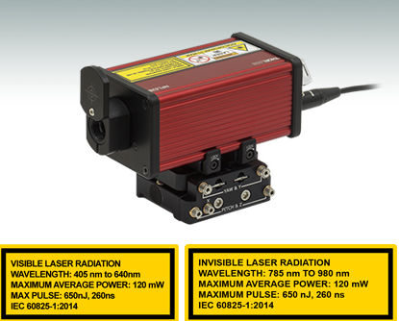
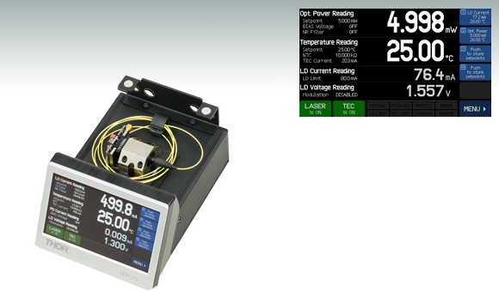
Concept Generation - Laser
Diode for Existing Driver:
Laser Power
Drive Current
Form Factor
Fiber Connection
New Laser System:
Laser Power
Type
Pulsed or CW
Power Supply
Modulation Control
Fig. 8: Left: Thorlabs Dedicated Pulsed Laser. Right: CLD1010LP Laser Driver
Kian 8

Slide 10
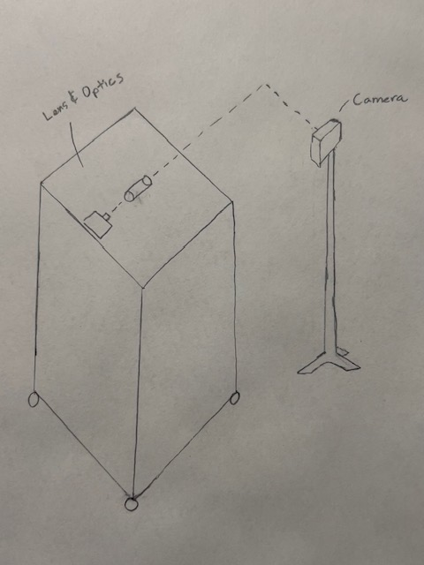
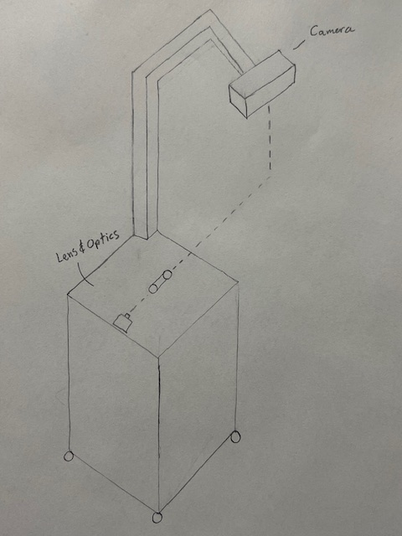
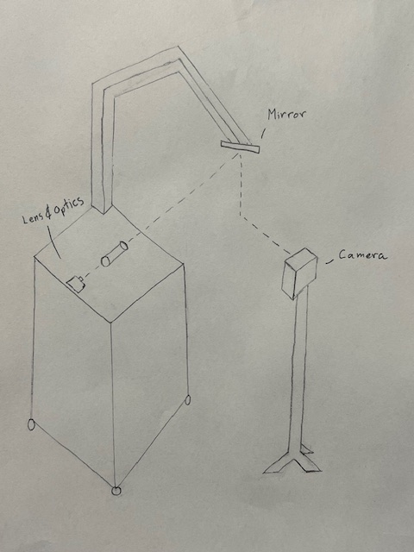
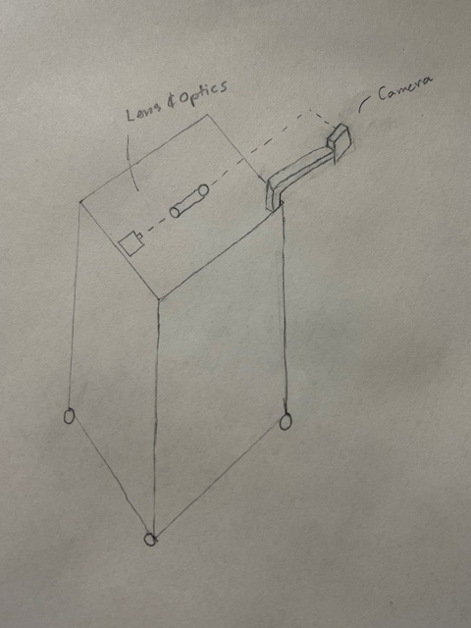
Concept Generation – Configuration
Hanging Camera
Hanging Mirror
Cart and Camera
Rolling Camera
Figure 9: Configuration concept generation
Pros:
Setup Time
Cons:
Cost
Weight
Versatility
Pros:
Versatility
Cons:
Cost
Weight
Setup Time
Pros:
Cost
Setup Time
Weight
Cons:
Versatility
Pros:
Setup Time
Cons:
Cost
Weight
Versatility
Santiago 9

Slide 11
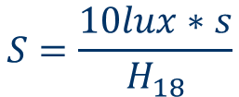
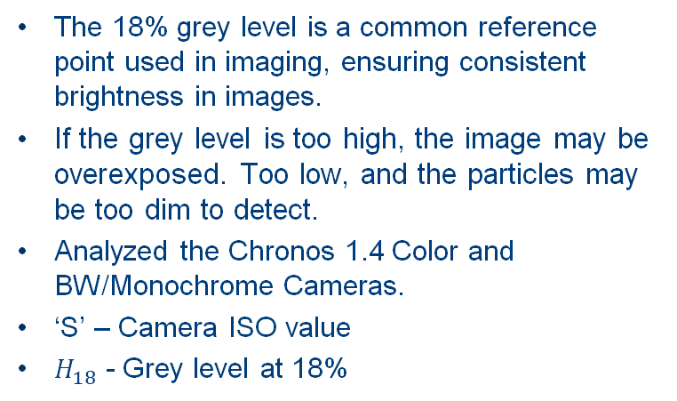



Engineering Analysis – Exposure for 18% Grey Level [4]
The 18% grey level is a common reference point used in imaging, ensuring consistent brightness in images.
If the grey level is too high, the image may be overexposed. Too low, and the particles may be too dim to detect.
Analyzed the Chronos 1.4 Color and BW/Monochrome Cameras.
‘S’ – Camera ISO value
$H_{18}$ - Grey level at 18%
$$S=\frac{10lux∗s}{H_{18}}$$
$$H_{18}=\frac{10lux∗s}{S}$$
$$H_{18,Color}=\frac{10lux∗s}{320}=.03125$$
(1)
$$H_{18,BW}=\frac{10lux∗s}{740}=.01351$$
(2)
The monochrome camera requires half the light exposure to reach the 18% grey level.
ISO generally correlates to a higher camera efficiency, but overexposure tends to occur more easily due to sensitivity to light.
Jett 10

Slide 12


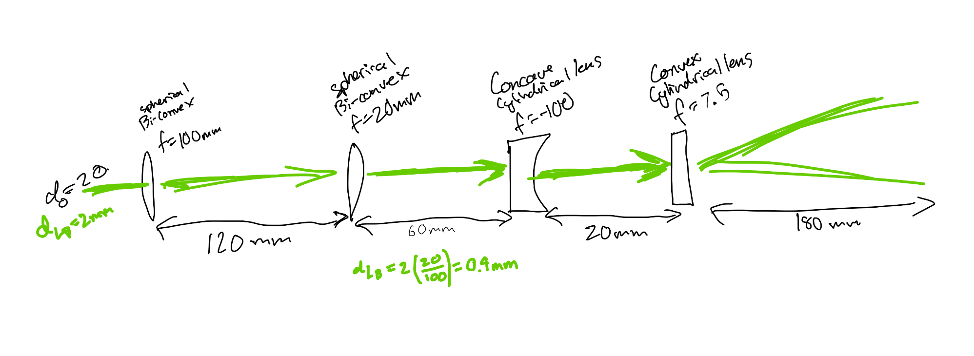


Engineering Analysis – #3
(3)
(4)
(5)
Santiago 11

Slide 13
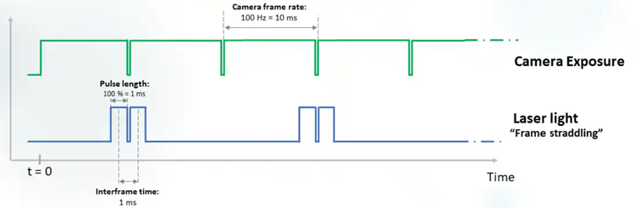
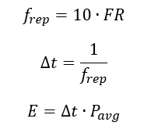
Engineering Analysis – Laser Pulse Energy
(6)
(7)
(8)
Fig. 10. Diagram Displaying "Frame Straddling" in PIV
Kian 12

Slide 14
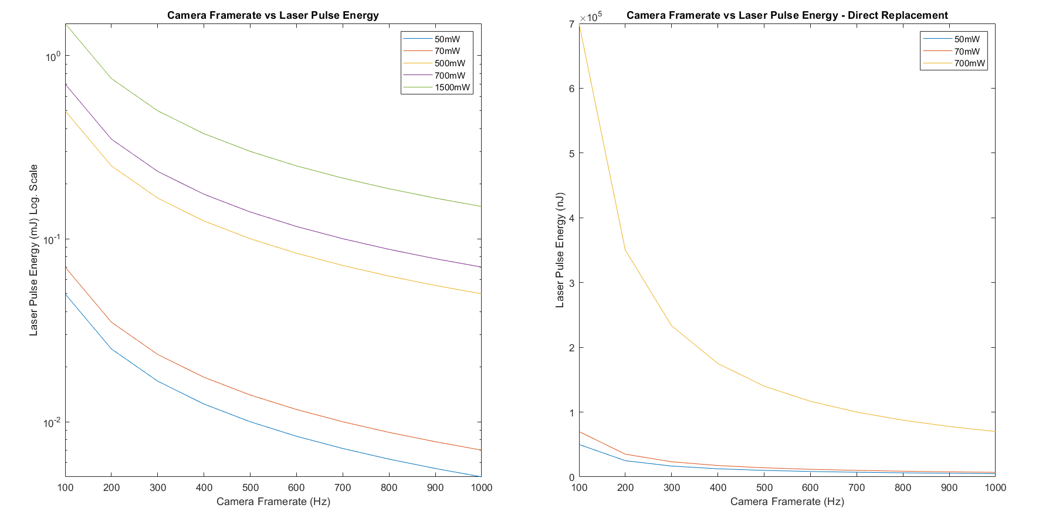
Engineering Analysis – Laser Pulse Energy Cont'd
Fig. 11. Camera Framerate vs Laser Pulse Energy Graphs, Log. Scale on Left, Linear Scale on Right
Kian 13

Slide 15
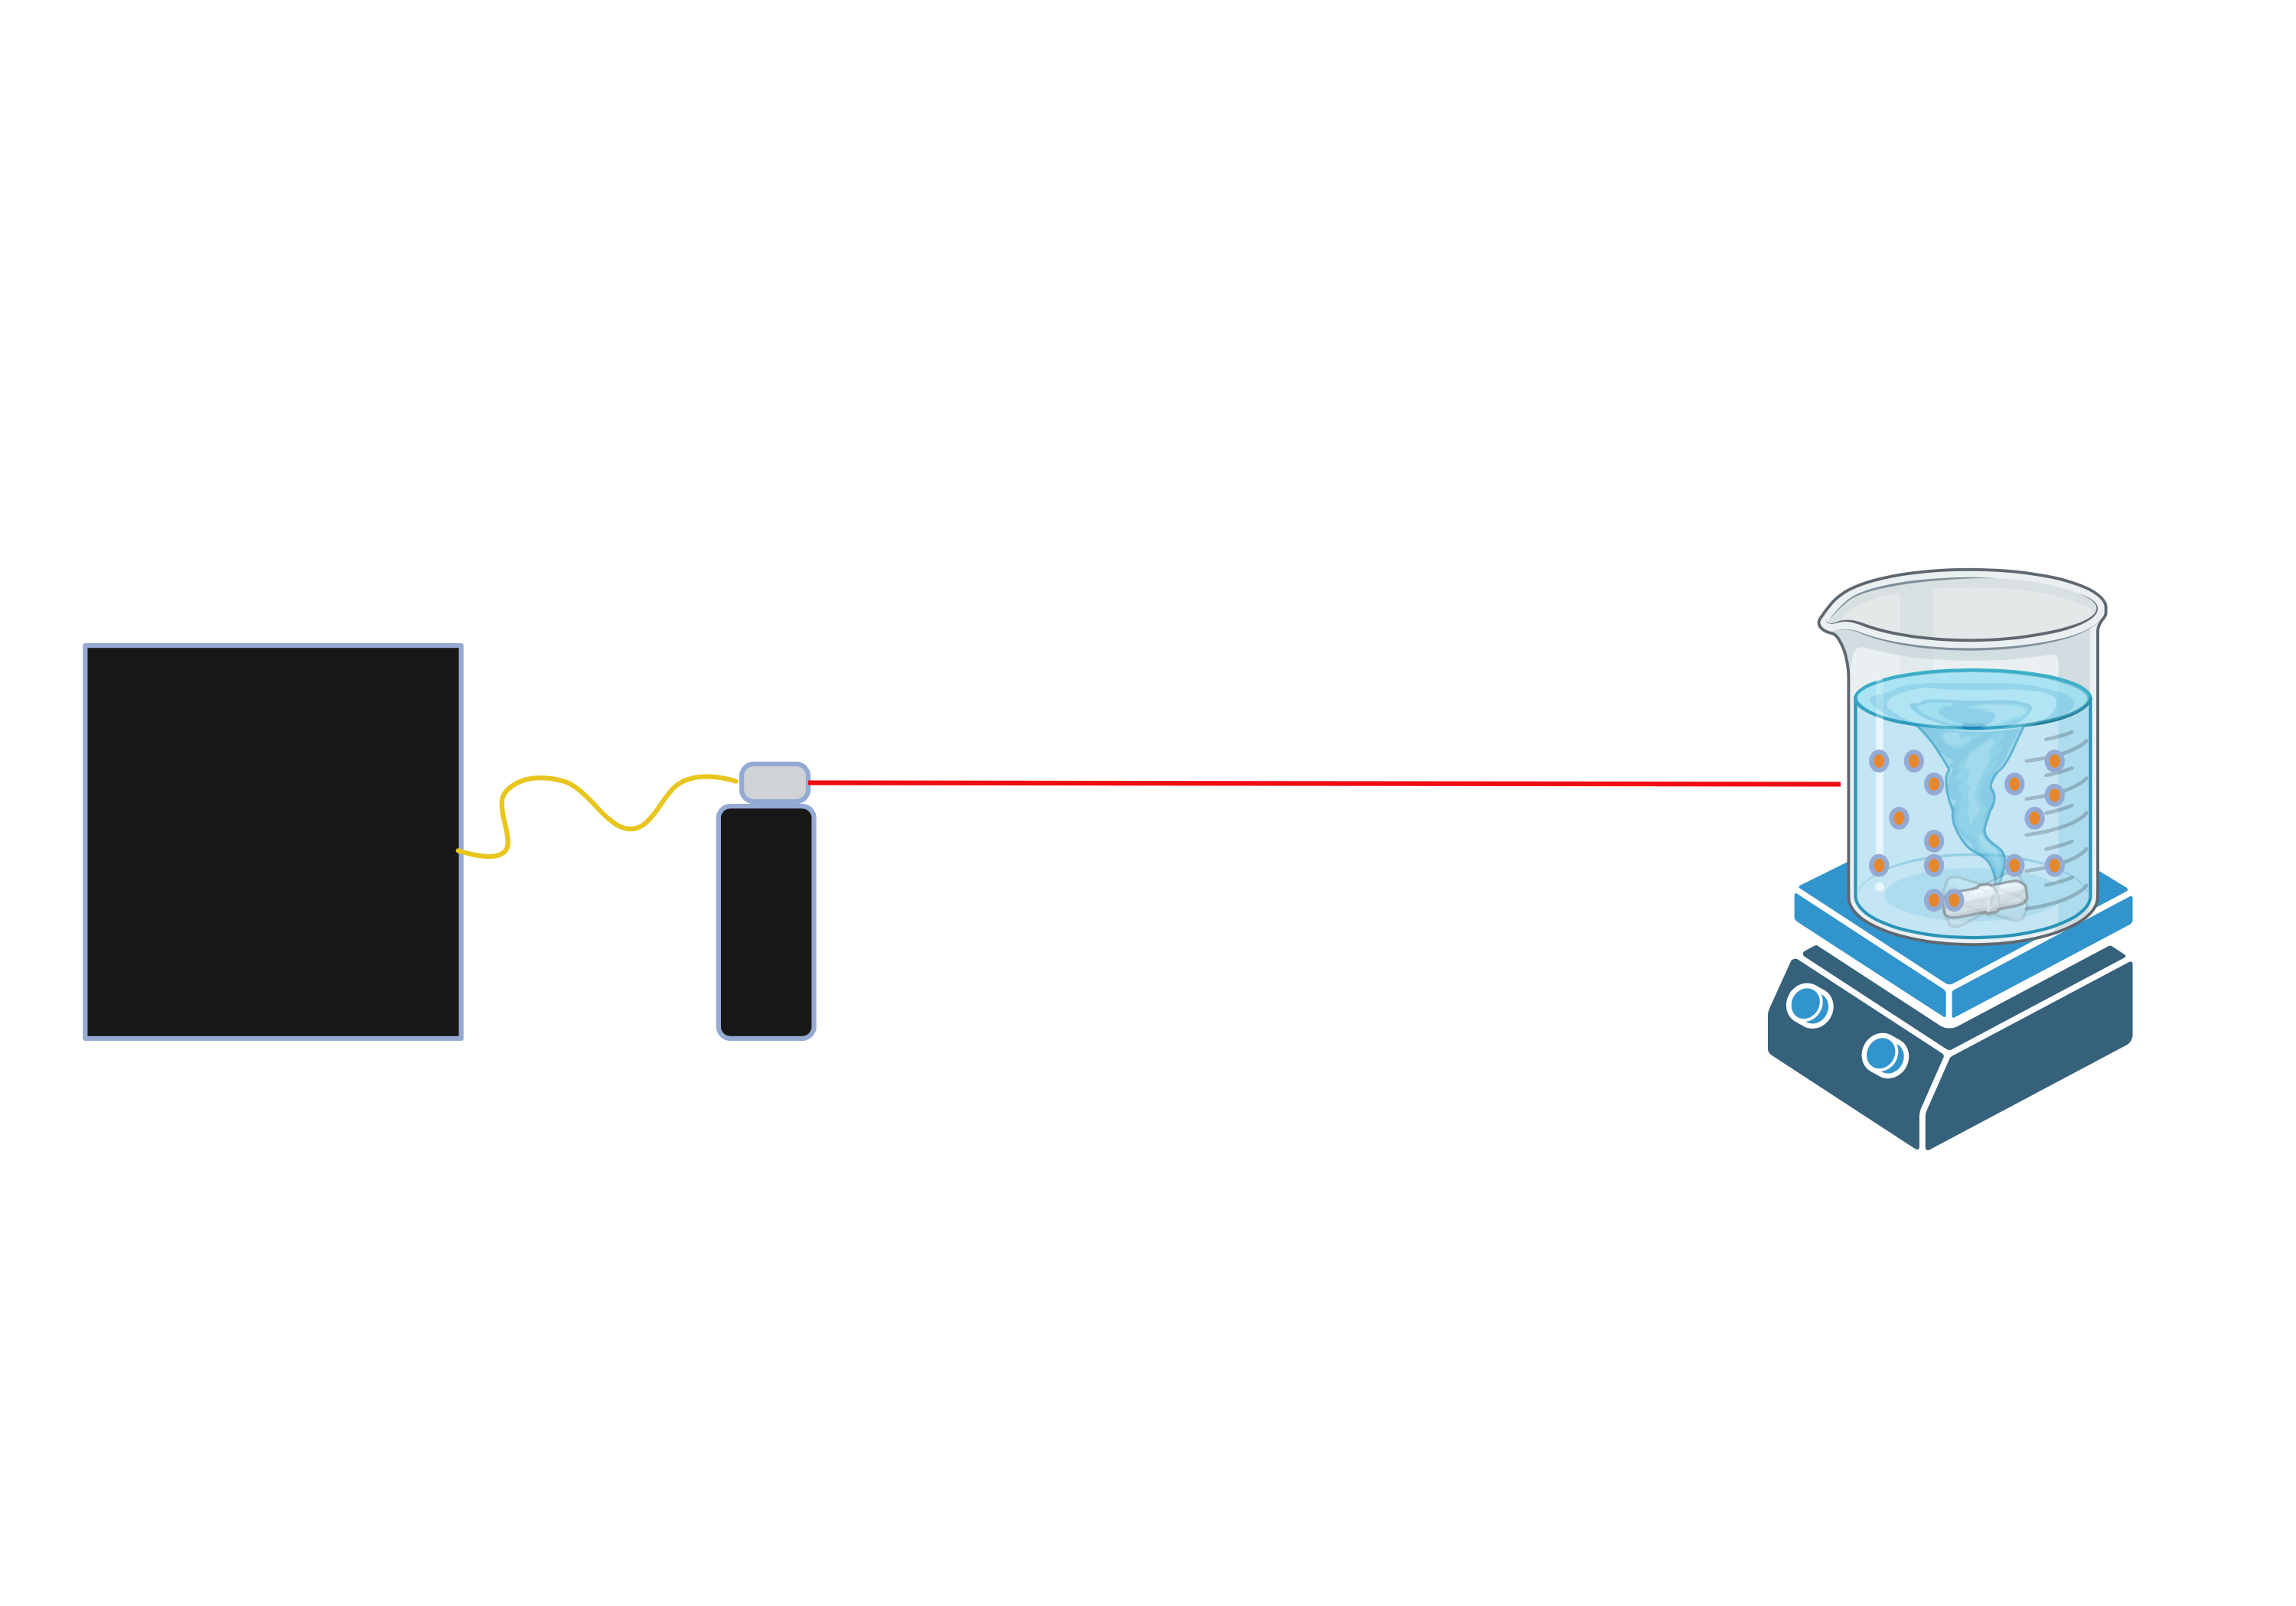
Engineering Analysis – Laser Fluorescence
Fill a 2L Pyrex beaker with water, add PIV particles and stir bar and place on stir plate
Set up laser pointing at beaker
Start stirring beaker at a low RPM
Pulse the laser and observe how particles fluoresce
Increase RPM and pulse laser again. Observe particle fluorescence
Repeat steps 4 and 5 until particles no longer fluoresce
Convert RPM into Velocity
Velocity of flow system: ~ 0.26 m/s
Figure 12: Laser Fluorescence Experiment
Chris 14

Slide 16
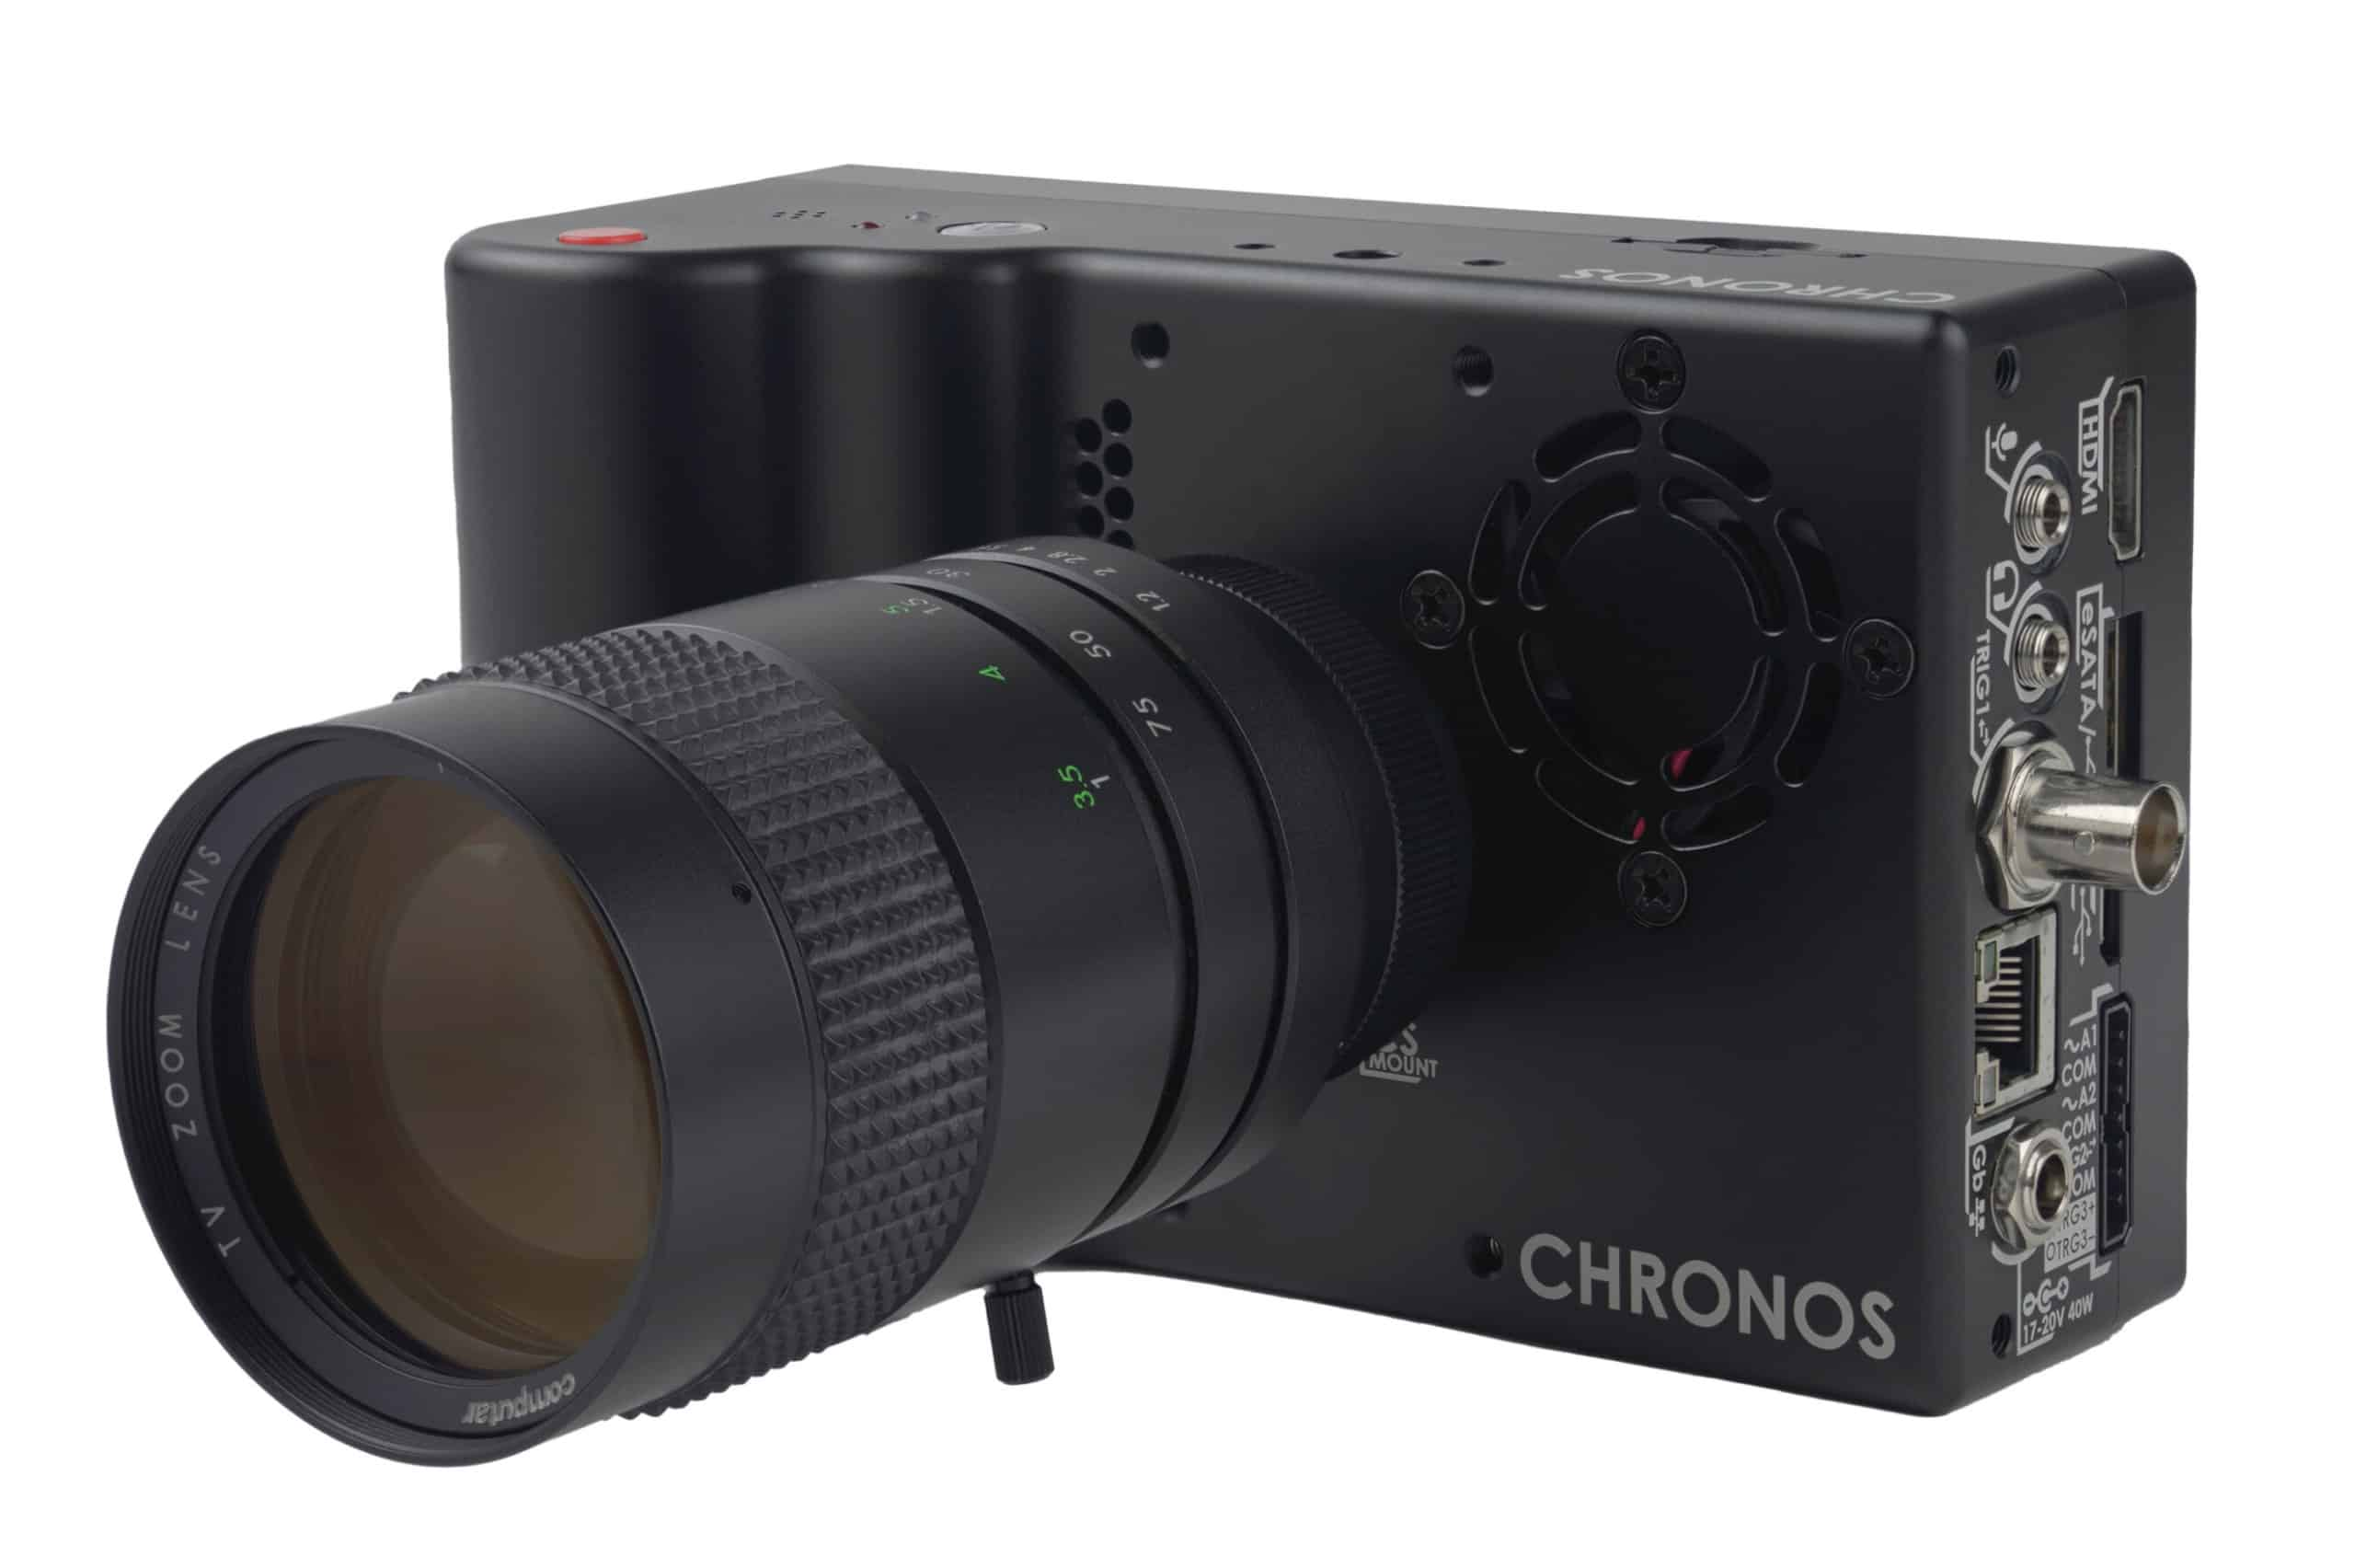
Concept Evaluation- Camera
Table 1: Camera Specifications
Notable Specs. | Chronos 1.4 High Speed Camera | Chronos 2.1-HD High Speed Camera | DITECT 1.3MP, 200 FPS High Speed Camera | DITECT 1.3MP, 1000 FPS High Speed Camera | Photron Fastcam Mini CX100 (Used, B&W) | Photron Fastcam SA8 30K-C2 (Used, Color)
Cost ($) | $5600 | $7900 | $4750 | $9850 | $4625 | $7500
RAM (GB) | 32 | 32 | 2 | 12 | 8 | 8
FPS at Given Resolution | 1069 FPS @ 1.3MP (1280x1040) | 1000 FPS @ 2.1MP (1920x1080) | 200 FPS @ 1.3MP (1280x1040) | 1000 FPS @ 1.3MP (1280x1040) | 1000 FPS @ 2.1MP (1920x1040) | 1000 FPS @ 1.3MP (1280x1040)
ISO (Color/BW) | 320/740 | 500/1000 | ----------------- | ----------------- | ------/10000 | 2500/------
Pixel Size (µm) | 6.6 | 10 | ----------------- | ----------------- | 6.6 | 10
Preference (1-6) | 1 | 2 | 6 | 5 | 3 | 4
Fig. 13. Chronos 1.4 with a camera lens installed (sold separately)
Jett 15

Slide 17
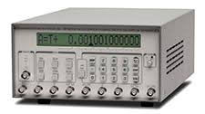
Concept Evaluation– Function Generator
Table 2: Function Generator Specs
 | Stanford Research DG645 | Quantum Composer 9520 | BNC 750 | BNC 725 | BNC 575 | BNC 525
Resolution | 5 ps | 250 ps | 100 ps | 10 ns | 250 ps | 4 ns
Jitter | <100 ps | <50 ps | <50 ps | < 200 ps | <120 ps | <250 ps
Channels | 4 | 4,8 | 4,8 | 8 | 4,8 | 6
Trigger Rates | 1 MHz | 20 MHz | 50 MHz | 100 MHz | 10 MHz | 20 MHz
Price | $4,495 | $4,300-$6,200 | $3,450-$5750 | $6,690 | $4,800-$6,700 | $2875
Comments |  |  | No interface |  | LabView Certified | No Interface LabView Certified
Figure 14: Stanford Research DG645
Chris 16

Slide 18
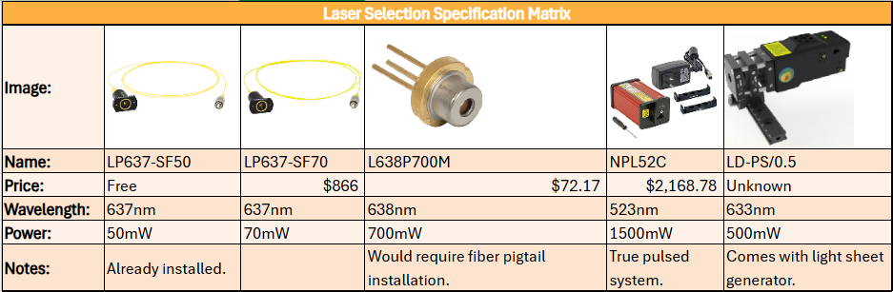
Concept Evaluation- Laser
Table 3 – Breakdown of Laser Generation Components and Specifications
Kian 17

Slide 19
Concept Evaluation– Configuration
 | Hanging Camera | Hanging Mirror | Cart and Camera | Rolling Camera
Cost | - | - | Datum | -
Weight | - | - | Datum | -
Versatility | S | + | Datum | S
Setup Time | + | - | Datum | +
Santiago 18

Slide 20
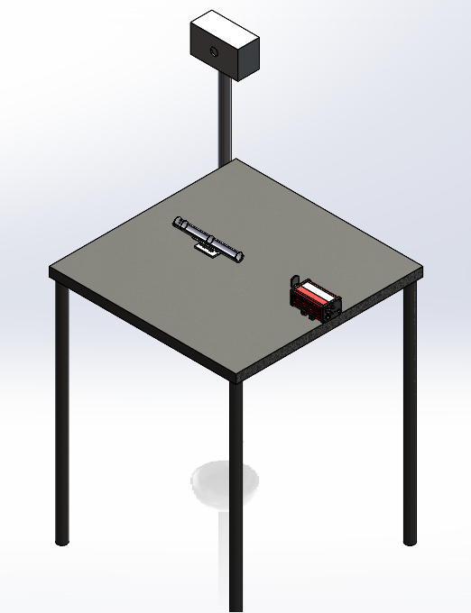
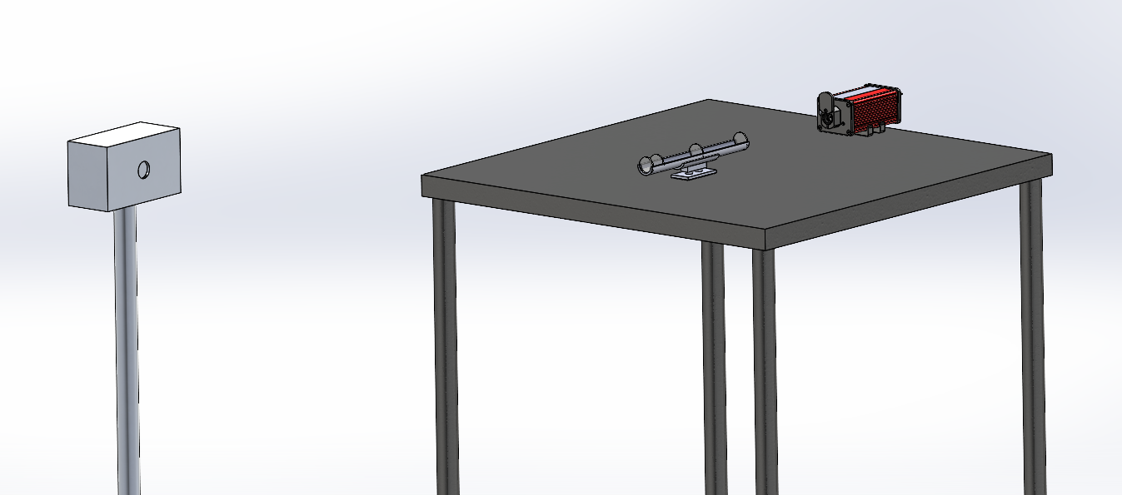
Conceptual CAD Design
Figure 15: CAD of selected configuration
Santiago 19

Slide 21
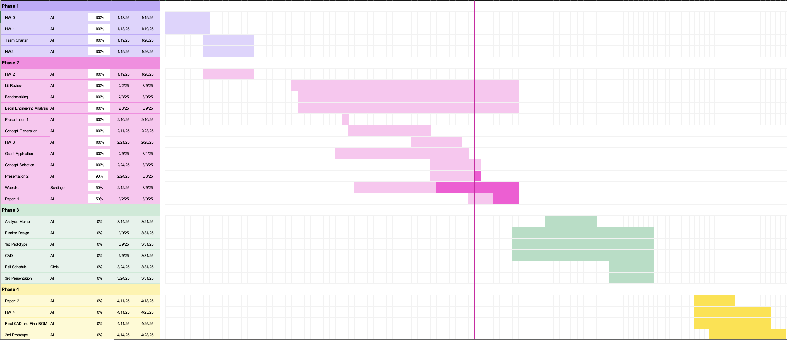
Project Schedule
Santiago 20

Slide 22
Budget and Plan
Committed Spend for SP25
Critical Equipment-
Camera (Incl. S&H + tax): -$6,000
Function Generator (Incl. S&H + tax): -$5,000
R&D Spend (Capstone Budget)-
Laser Safety Goggles: -$900
CLD1010LP DC Power Supply: -$50
Budget Buckets Remaining
Critical Equipment: $4,000
R&D: $2,050
Fundraising Updates
BDL Equipment Donation-
ThorLabs CLD1010LP laser driver and diode combo: ~$3,000
Hooper Undergraduate Research Grant-
Total Potential Equipment Funding: $1,500
Remaining Equipment
Light Sheet Generator
Camera Filter
Camera Lenses
Additional Laser
Mounting Equipment
Kian 21

Slide 23
References
[1] Seika Digital Image Corporation, “PIV ( Particle Image Velocimetry ) | Overview & Principle.” [Online]. Available: https://www.seika-di.com/en/measurement/principle_of_piv.html
[2] M. Katan and A. Luft, “Global Burden of Stroke,” Semin Neurol, vol. 38, no. 02, pp. 208–211, Apr. 2018, doi: 10.1055/s-0038-1649503.
[3] “How many people are affected by/at risk for stroke? | NICHD - Eunice Kennedy Shriver National Institute of Child Health and Human Development.” Accessed: Feb. 26, 2025. [Online]. Available: https://www.nichd.nih.gov/health/topics/stroke/conditioninfo/risk
[4] F. Zigunov, “How bright are my piv particles?,” Zigunov Aero, https://zigunov.com/2023/06/30/how-bright-are-my-piv-particles/ (accessed Mar. 3, 2025).
[5] Published by ronshnapp View all posts by ronshnapp, P. by ronshnapp, Ronshnapp, and V. all posts by ronshnapp, “My milli-micro-PIV setup,” The Fluid Dynamics Lab, https://ronshnapp.wordpress.com/2021/02/15/my-milli-micro-piv-setup/ (accessed Mar. 3, 2025).
13

Slide 24
Thank you! Questions?

