Slide 1

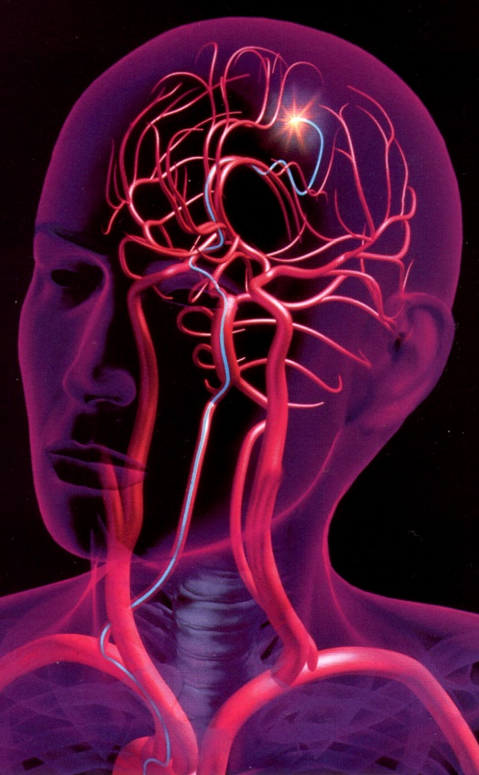
ME476C SP25 – PIV Group
Santiago Gamez
Kian Pack
Christopher Rapoport
Jett Scruggs
Development of a Novel Particle Image Velocimetry System for the NAU Bioengineering Devices Laboratory
Research Area: Translational research on biomaterials, flow modeling, and medical device development for the treatment of aneurysms

Slide 2
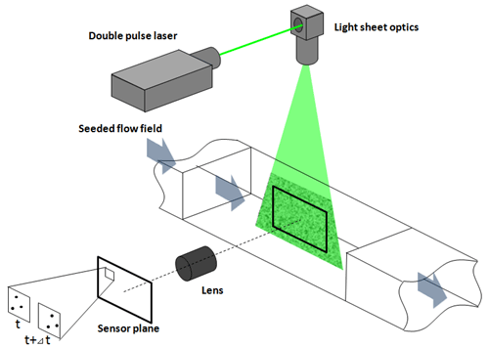
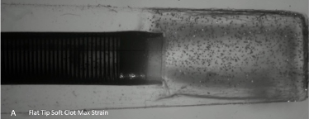
Introduction
Particle Image Velocimetry (PIV):
A system that uses a combination of a laser and an ultra-high-speed camera to track the change in position of fluorescent tracer particles within a fluid flow, allowing the analysis of the velocity field within the fluid.
Figure 1 – Overview of Typical PIV System [1]
Figure 2 – Previous PIV study conducted by the BDL
Chris 1

Slide 3
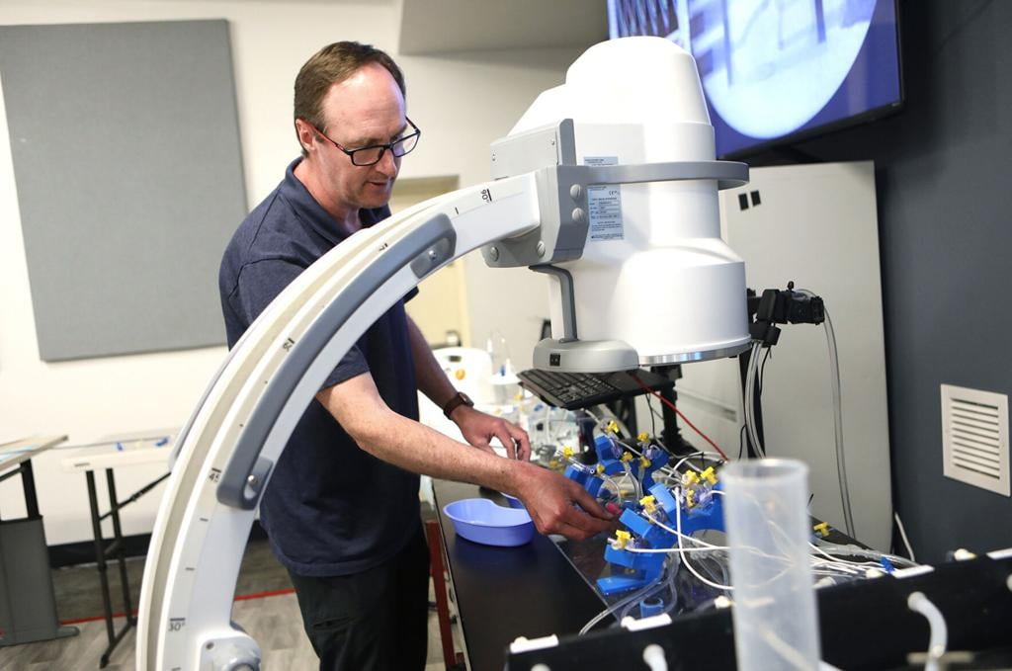
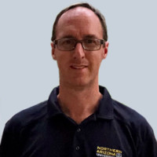

Project Overview
Sponsor: Tim Becker, PhD
Associate Professor
Mechanical Engineering Department
Principle Investigator
Bioengineering Devices Laboratory (BDL)
Chief Technology Officer
Aneuvas Technologies, Inc. (ATI)
Client: Wyatt Clark, M.S.
PhD Candidate
Mechanical Engineering Department
Senior Research Associate
Bioengineering Devices Laboratory (BDL)
Chris 2

Slide 4
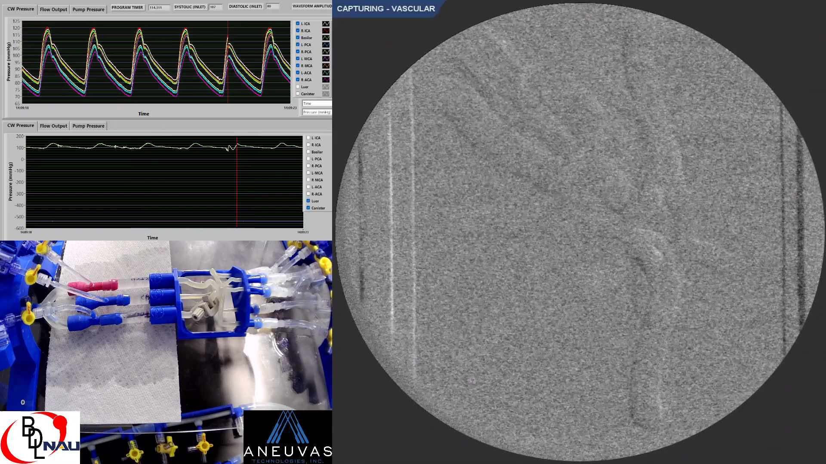
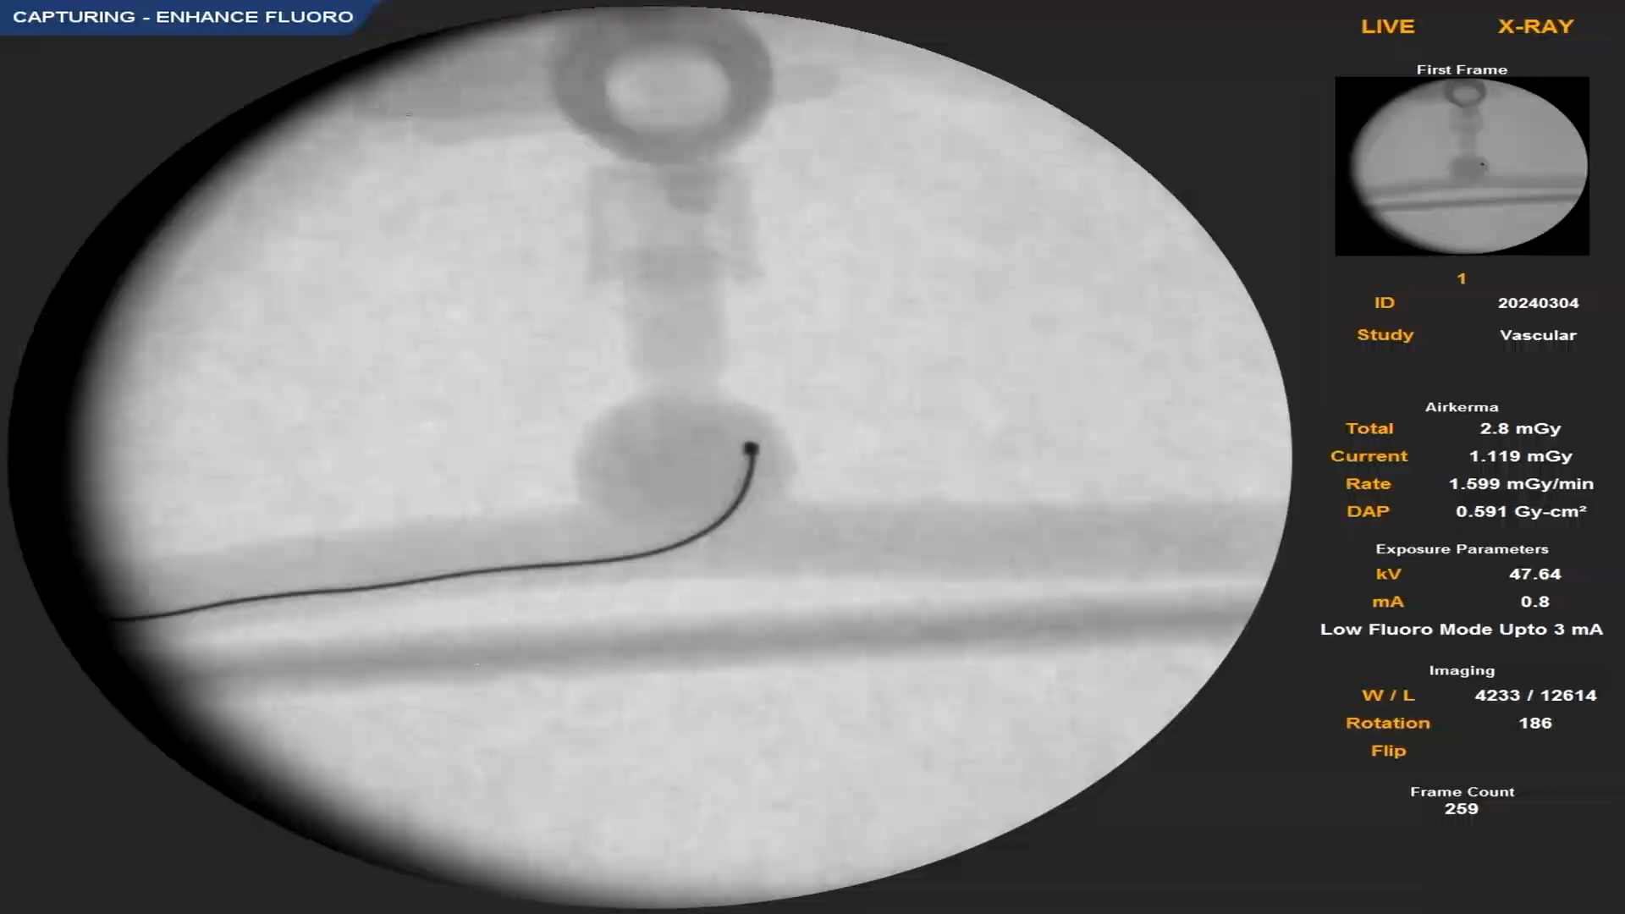
Project Justification
Stroke is the 2nd leading cause of death and a leading cause of disability worldwide [2].
Ischemic Stroke: blood flow is blocked in the brain – treated with drugs or mechanical thrombectomy.
Hemorrhagic Stroke: rupture of blood vessel in the brain – treated with coiling and stents.
Fig. 3 - BDL aspiration thrombectomy study (top) BDL coiling study (bottom)
Chris 3

Slide 5
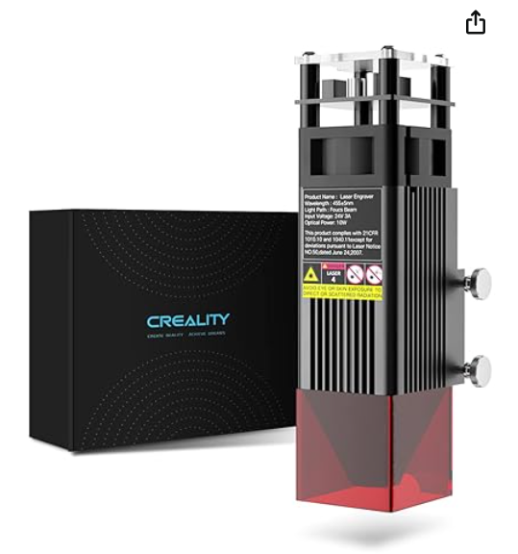
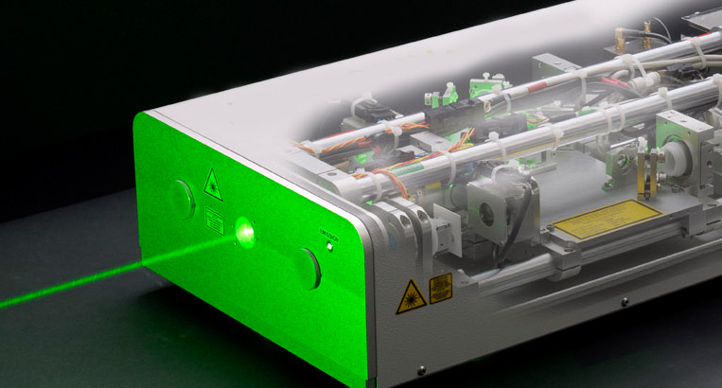
Background & Benchmarking
Three Benchmarking Setups:
Minimum Viable System
  Generic Function Generator, claimed 30MHz frequency
  Laser from CNC Engraver
  200 Hz, 1.7MP Camera
  Cost - $2,314
Middle-of-the-Road
  Tektronix 25MHz Function Generator
  Pulsed Nanosecond Laser, 30mW, 523nm Wavelength
  1kHz, 1.3MP Camera
  Cost - $7,373
Beyond Our Wildest Dreams
  4.5kHz, 1MP Camera
  Variable Pulsed Nanosecond Laser, Built to Order for PIV
  Berkeley Nucleonics 50MHz, 8 Channel Function Generator
  Cost - $56,400
Fig. 4 – Generic Engraver Laser
Fig. 5 – Litron LD-527 PIV Laser
Kian 4

Slide 6
Customer Requirements
Ease of Setup
  How long to assemble? Is it portable? How intensive is the process?
Camera Resolution, Framerate, Runtime
  Better visuals of flow, with less motion blur and a longer time of recording.
Strength of Laser
  Important for tracer particle refractivity, but not powerful enough to wash out imagery.
Close to OSHA machine and laser guard standards
  Laser is powerful enough to cause serious damage to eyes, direct or through refraction.
Width of laser sheet is sufficient for particle density
  Important for uniform illumination of flow field.
  Too narrow could not capture enough particles, while too wide could have poor contrast.
Use of a Multi-Function Generator
  Non-proprietary interface; reduces familiarization issues.
  Controls the entire PIV setup (camera, laser, experimental conditions).
Jett 5

Slide 7
Engineering Requirements
Setup Time
  Must be relatively quick: < 60 minutes.
Resolution, Camera framerate, Run Time
  Resolution needs to be high: Pixel area of ~2073600 (2 megapixels)
  Framerate needs to capture fluid motion over time: <1000 FPS
  High FR and Resolution lead to shorter run times: 10 seconds
Laser Power
  Range of power to cause refractivity without washing out image: 50-150mW
Laser Sheet Thickness
  How thick the laser sheet can be to pick up refraction:100-200 microns
Risk Assessment Score
  A score of 1 (poor) to 10 (safe) that rates the general safety of the PIV setup
Refractivity Index
  Appropriate RI limits distortion of flow measurements/imagery: RI of ~1.5
Frequency
  High frequency prevents motion blur for fast flows.
  Accuracy of particle displacement for velocity equations.
  ~.9 nanoseconds.
Jett 6

Slide 8
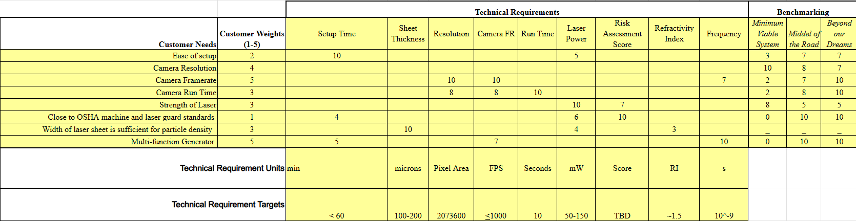
Quality Function Deployment Diagram
Table 1 – Quality Function Deployment Diagram Correlating Customer with Engineering Requirements
Santiago 7

Slide 9
SOTA Literature Review
Main Topics:
PIV Practical Guide [3]
Applications of CFD [4]
Edmund Optics [5]
Phantom Manufacturing Techniques and Cost [6]
  Resin Printing vs Traditional Casting
Optical Studies for Spherical Lenses [7]
Biological Studies [8]
  Circle of Willis
All 8
PIV practical guide
CFD chapter
  J. Tu, G. H. Yeoh, C. Liu, and Y. Tao, Computational fluid dynamics: a practical approach, Fourth edition. Oxford Cambridge, MA: Butterworth-Heinemann, 2024. doi: 10.1016/C2021-0-01771-5.
Edmund optics
NASA presentation (Particle Image Velocimetry Applications of Fluorescent Dye-doped Particles)
Article covering cost of Resin Phantom Manufacturing
  D. P. G. Nilsson et al., “Patient-specific brain arteries molded as a flexible phantom model using 3D printed water-soluble resin,” Sci Rep, vol. 12, no. 1, p. 10172, Jun. 2022, doi: 10.1038/s41598-022-14279-7.
Spherical Lenses
Circle of Willis studies

Slide 10
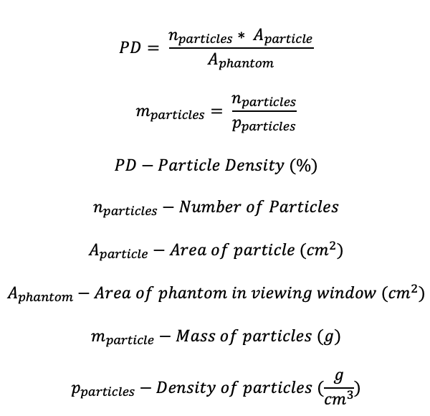
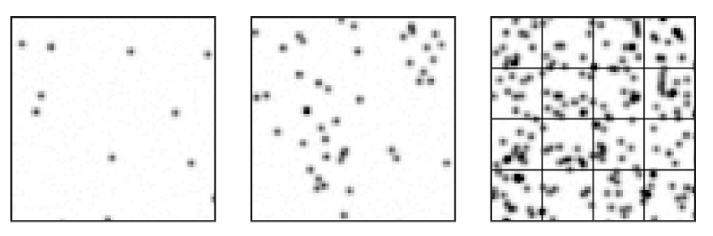
Engineering Analysis – Particle Density
(1)
(2)
Figure 6: Examples of different particle densities [9]
Chris 9

Slide 11
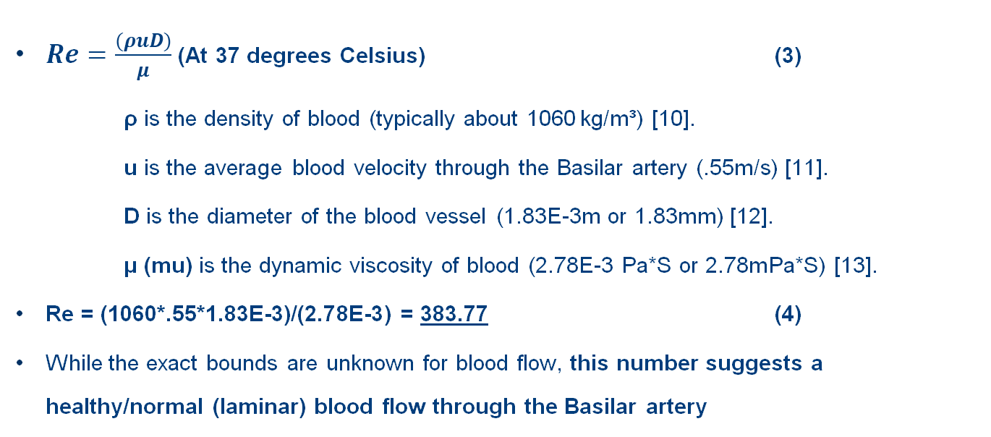
Engineering Analysis – Reynolds Number for Neurovascular Blood Flow
$Re=\frac{(ρuD)}{μ}$ (At 37 degrees Celsius) (3)
ρ is the density of blood (typically about 1060 kg/m³) [10].
u is the average blood velocity through the Basilar artery (.55m/s) [11].
D is the diameter of the blood vessel (1.83E-3m or 1.83mm) [12].
μ (mu) is the dynamic viscosity of blood (2.78E-3 Pa*S or 2.78mPa*S) [13].
Re = (1060*.55*1.83E-3)/(2.78E-3) = 383.77 (4)
While the exact bounds are unknown for blood flow, this number suggests a healthy/normal (laminar) blood flow through the Basilar artery
Jett 10

Slide 12
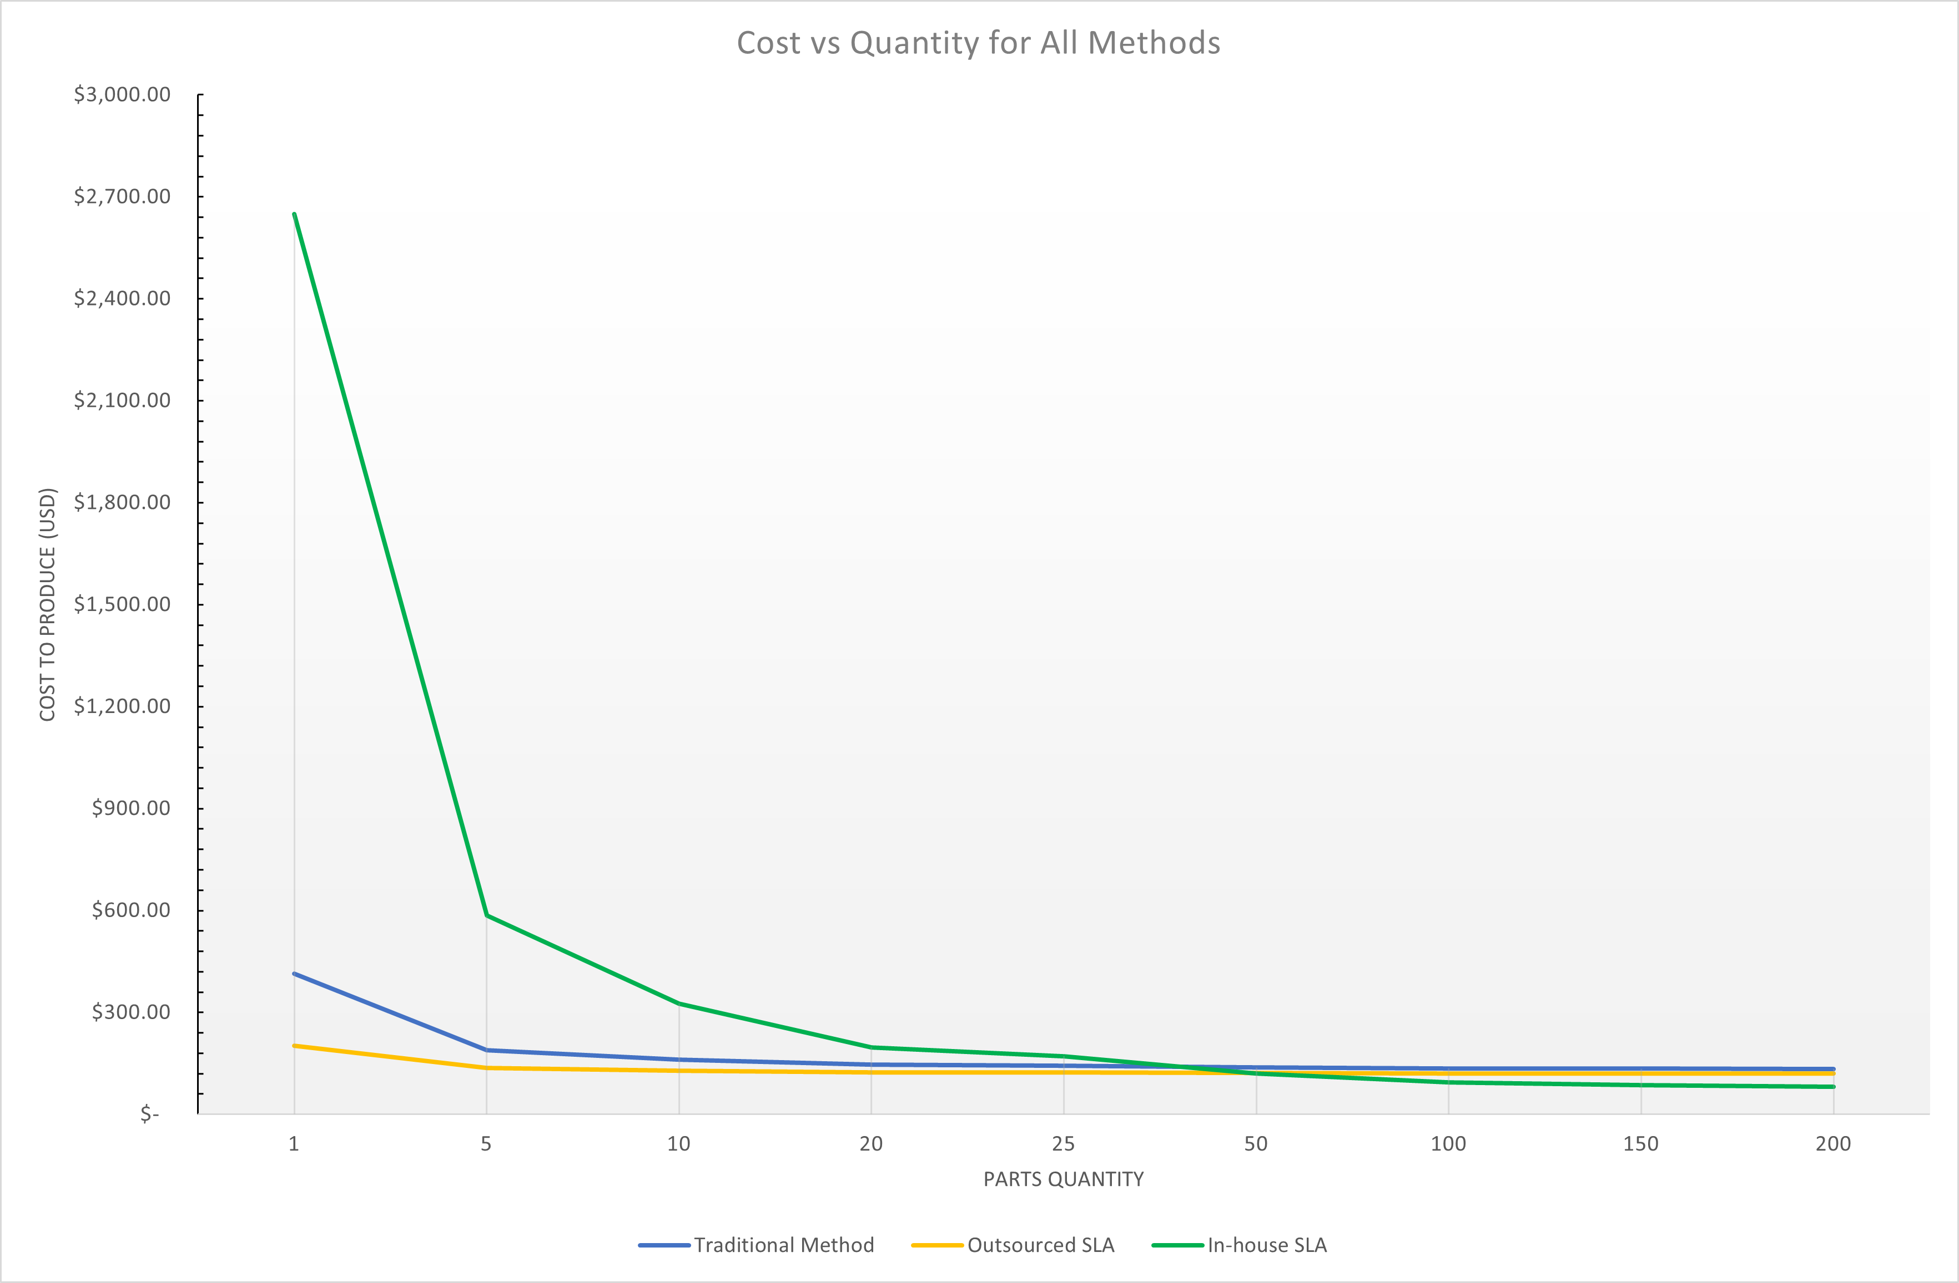
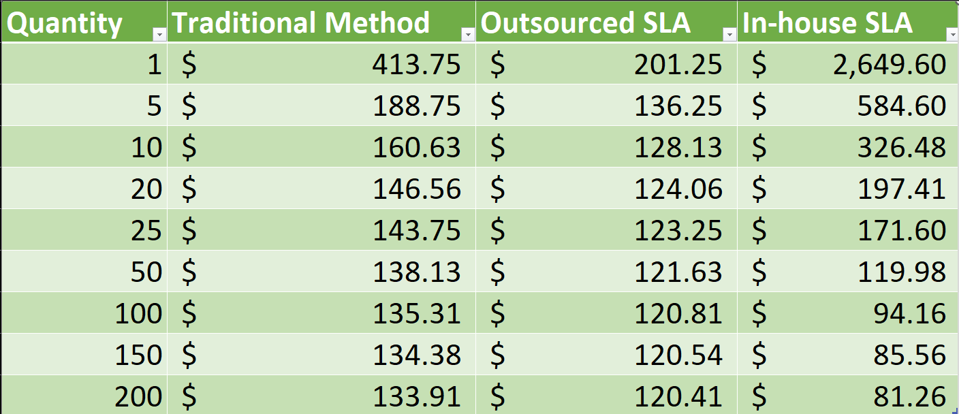
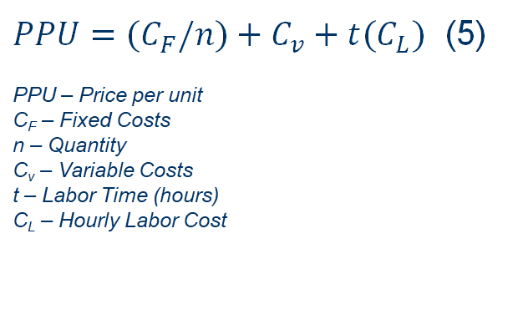
Engineering Analysis – Phantom Manufacturing Cost
$PPU={(C}_{F}/n)+C_{v}+t(C_{L})$ (5)
PPU – Price per unit
C_{F} – Fixed Costs
n – Quantity
C_{v} – Variable Costs
t – Labor Time (hours)
C_{L} – Hourly Labor Cost
Table 2 – PPU for Each Method for Quantities Between 1-200
Fig. 7 – PPU for Each Method as Quantity Increases
Kian 11

Slide 13
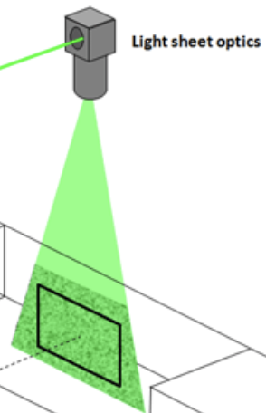
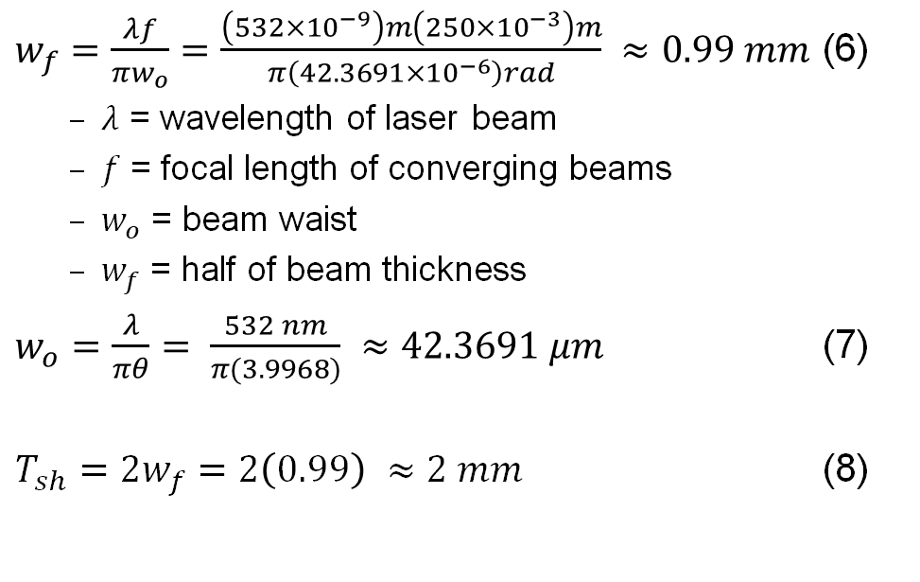
Engineering Analysis – Laser Sheet
$w_{f}=\frac{λf}{πw_{o}}$ $=\frac{\left(532×{10}^{−9}\right)m\left(250×{10}^{−3}\right)m}{π\left(42.3691×{10}^{−6}\right)rad} ≈0.99 mm$ (6)
  $λ$ = wavelength of laser beam
  $f$ = focal length of converging beams
  $w_{o}$ = beam waist
  $w_{f}$ = half of beam thickness
$w_{o}=\frac{λ}{πθ}= \frac{532 nm}{π(3.9968)} ≈42.3691 μm$ (7)
$T_{sh}=2w_{f}=2\left(0.99\right) ≈2 mm$ (8)
Fig. 8 – Light Sheet Detail View [1]
Santiago 12

Slide 14
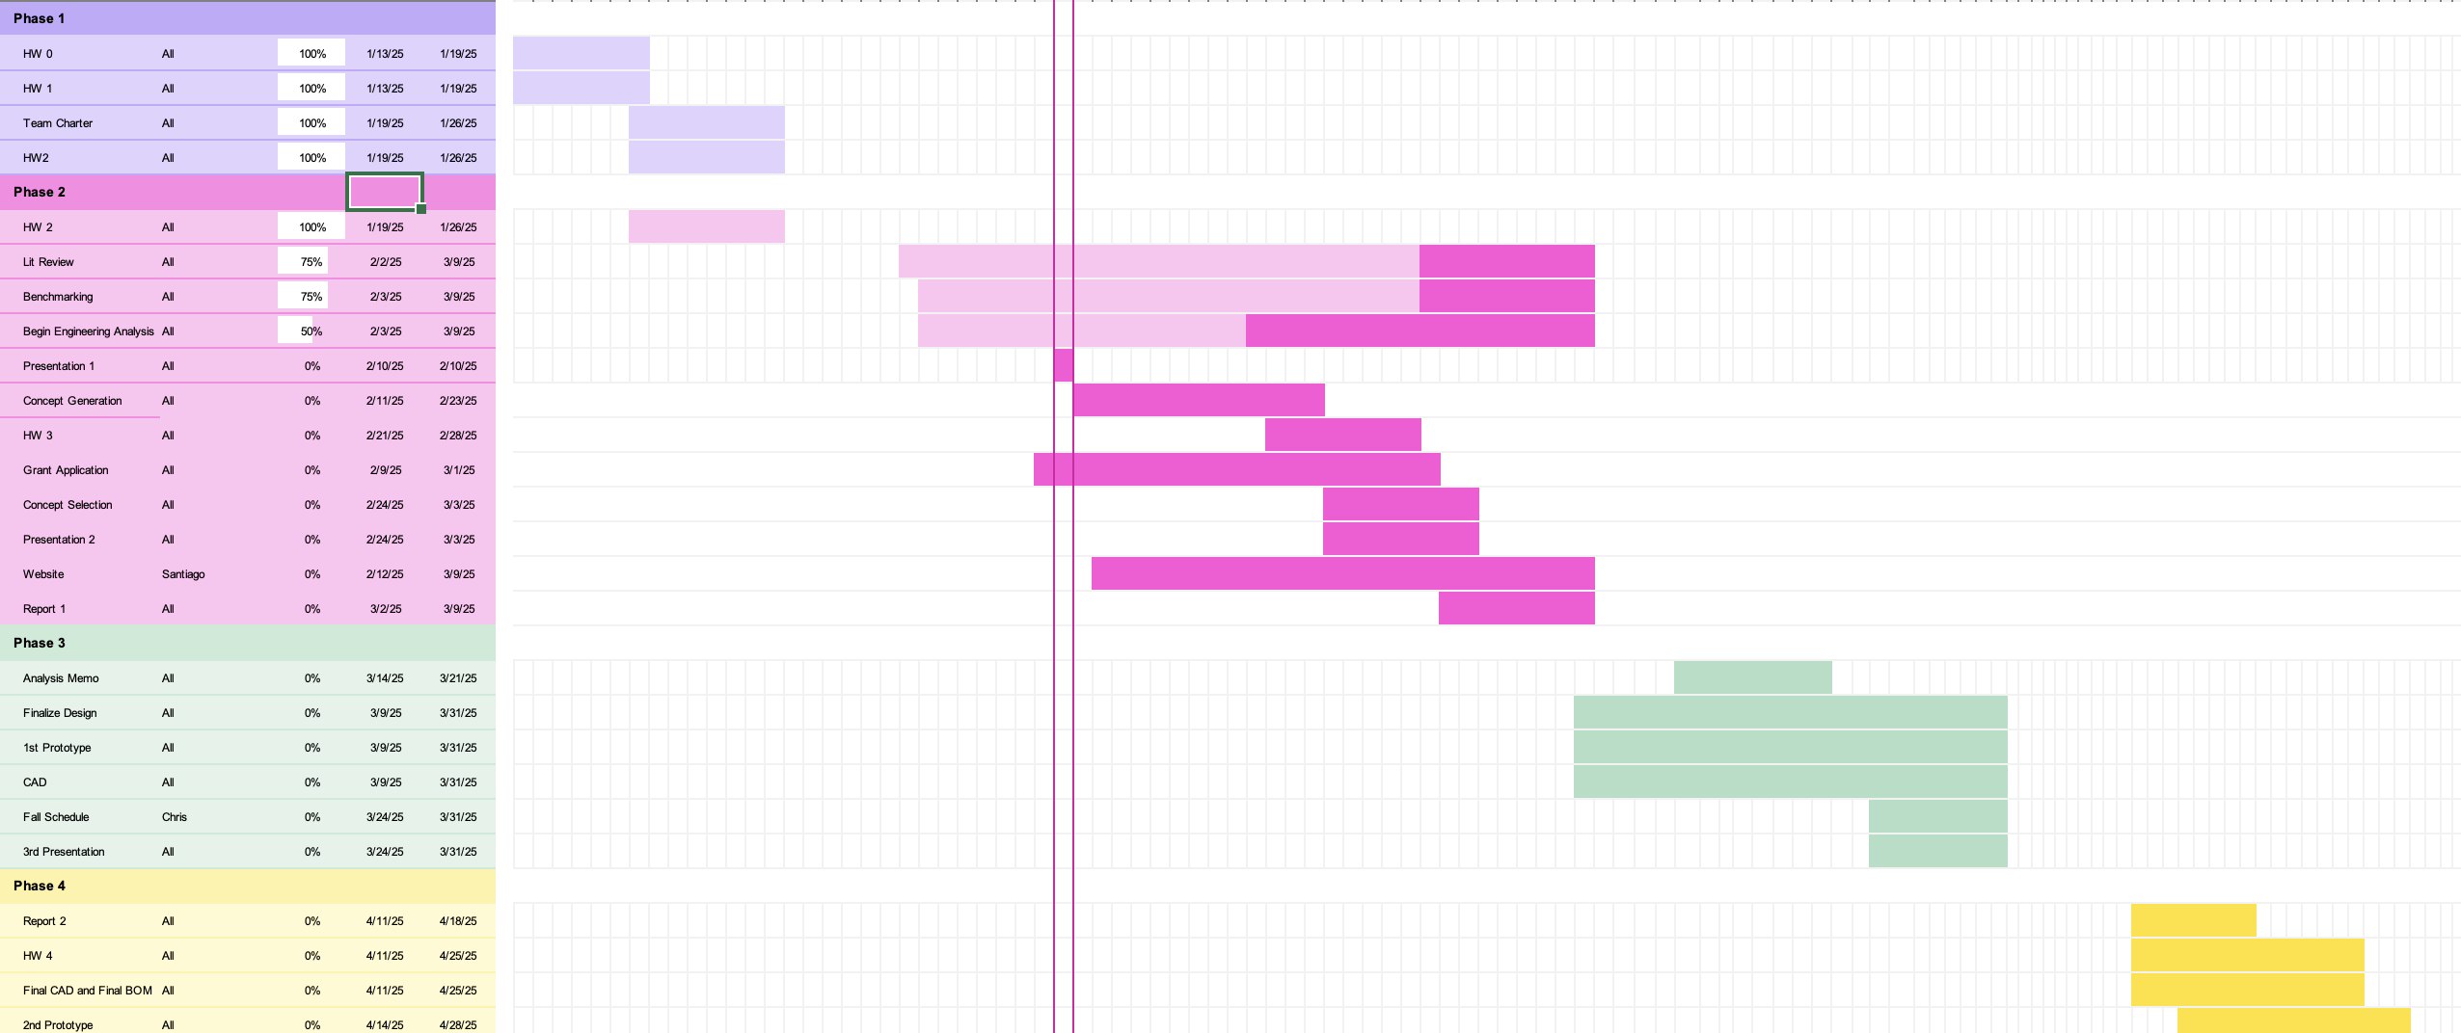
Project Schedule
Santiago 13

Slide 15
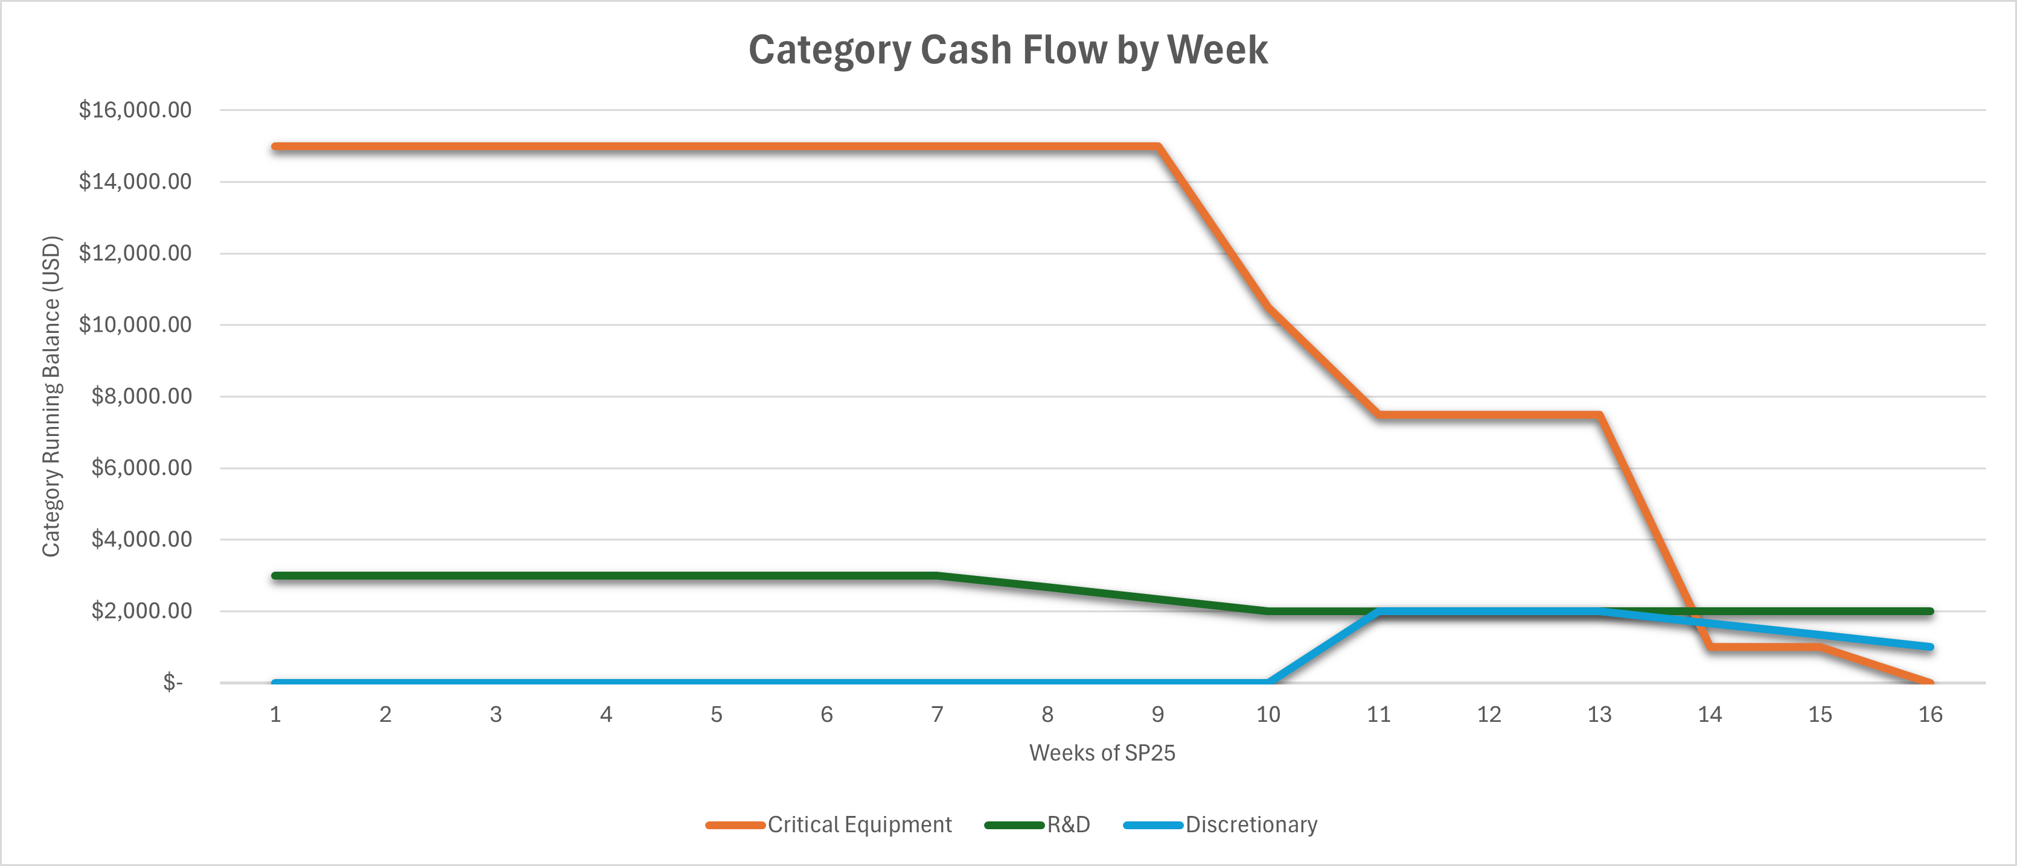
Budget and Plan
Overall Project Budget: $18,300
Design and Manufacture: $3,000
Critical Equipment: $15,000
Group Fundraising: $300 (Min.) - $2,000 (Expected Max)
Planned Expenditure for SP25
Purchase of all Critical Equipment: -$15,000
Prototyping: -$1,000
Discretionary: -$1,000
Final Budget Remaining at EOS: $1,300
Fig. 9 – Running Budget Balance for Each Expenditure Category by Week of Semester
Kian 14

Slide 16
References
[1]
Seika Digital Image Corporation, “PIV ( Particle Image Velocimetry ) | Overview & Principle.” [Online]. Available: https://www.seika-di.com/en/measurement/principle_of_piv.html
[2]
M. Katan and A. Luft, “Global Burden of Stroke,” Semin Neurol, vol. 38, no. 02, pp. 208–211, Apr. 2018, doi: 10.1055/s-0038-1649503.
[3]
M. Raffel, C. E. Willert, F. Scarano, C. J. Kähler, S. T. Wereley, and J. Kompenhans, Particle Image Velocimetry: A Practical Guide. Cham: Springer International Publishing, 2018. Accessed: Feb. 10, 2025. [Online]. Available: https://link.springer.com/10.1007/978-3-319-68852-7
[4]
J. Tu, G. H. Yeoh, C. Liu, and Y. Tao, Computational fluid dynamics: a practical approach, Fourth edition. Oxford Cambridge, MA: Butterworth-Heinemann, 2024.
[5]
“Gaussian Beam Propagation,” Edmund Optics Online. [Online]. Available: https://www.edmundoptics.com/knowledge-center/application-notes/lasers/gaussian-beam-propagation/
[6]
W. H. Ho, I. J. Tshimanga, M. N. Ngoepe, M. C. Jermy, and P. H. Geoghegan, “Evaluation of a Desktop 3D Printed Rigid Refractive-Indexed-Matched Flow Phantom for PIV Measurements on Cerebral Aneurysms,” Cardiovasc Eng Tech, vol. 11, no. 1, pp. 14–23, Feb. 2020, doi: 10.1007/s13239-019-00444-z.
[7]
“Spherical Lenses,” Physics Insights. [Online]. Available: http://www.physicsinsights.org/simple_optics_spherical_lenses-1.html
[8]
C. A. Luisi et al., “Investigation of Cerebral Hemodynamics During Endovascular Aspiration: Development of an Experimental and Numerical Setup,” Cardiovasc Eng Tech, vol. 14, no. 3, pp. 393–403, Jun. 2023, doi: 10.1007/s13239-023-00660-8.
13

Slide 17
References Cont’d
[9]
S. Scharnowski and C. J. Kähler, “Particle image velocimetry - Classical operating rules from today’s perspective,” Optics and Lasers in Engineering, vol. 135, p. 106185, Dec. 2020, doi: 10.1016/j.optlaseng.2020.106185.
[10]
Glenn Elert, “Density of Blood,” The Physics Factbook. [Online]. Available: https://web.archive.org/web/20060919051122/http://hypertextbook.com/facts/2004/MichaelShmukler.shtml
[11]
Allen D Elster, “Expected Velocities,” Questions and Answers in MRI. [Online]. Available: https://mriquestions.com/expected-velocities.html
[12]
P. Sharma, S. Lalchan, S. Kc, M. Gyawali, and N. Kushwaha, “Impact of gender and age on inner diameter of arteries forming circle of Willis assessed by multidetector CT,” J. Brain Spine Fdn Nep., vol. 2, no. 1, pp. 37–41, Aug. 2021, doi: 10.3126/jbsfn.v2i1.39016.
[13]
“Viscosity of Whole Blood,” Anton Paar. [Online]. Available: https://wiki.anton-paar.com/en/whole-blood/
13

Slide 18
Thank you!
Questions?

