Slide 1
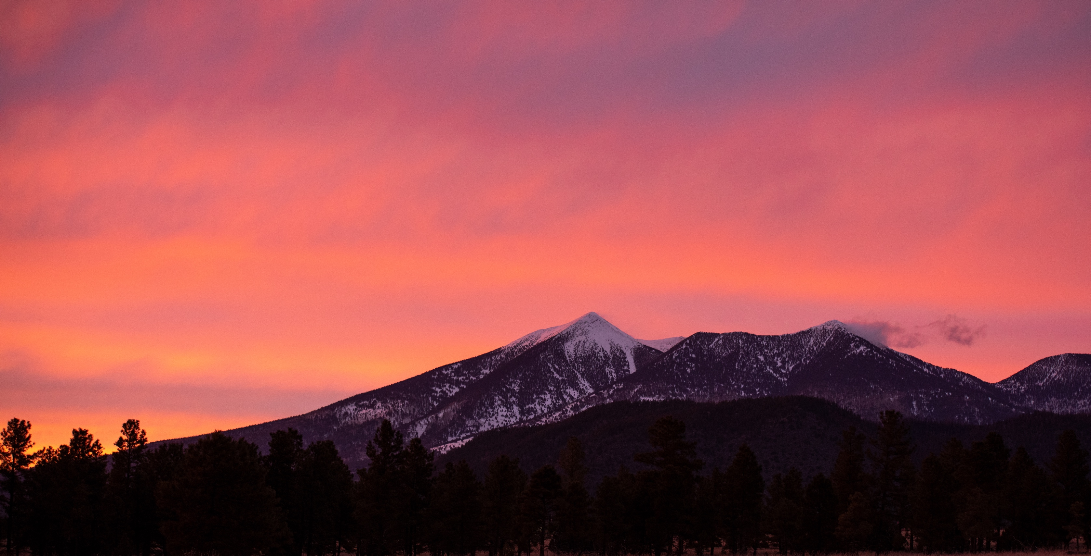
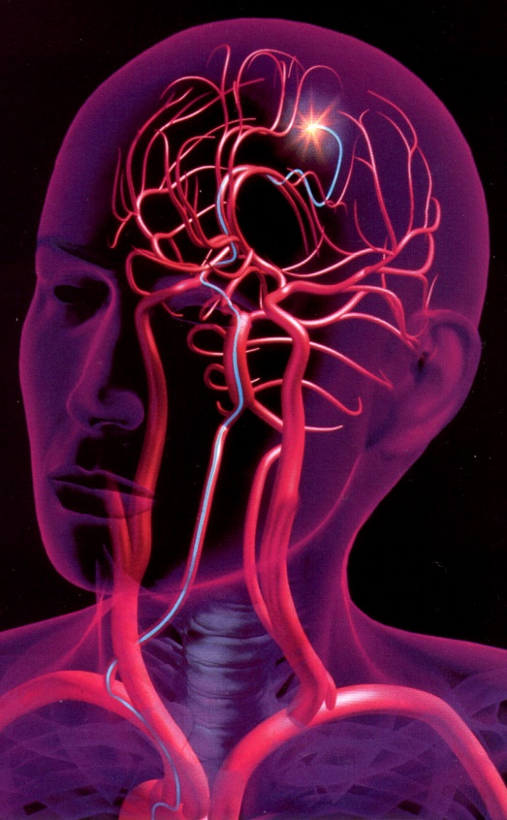
ME486C FA25 – PIV Group
Santiago Gamez
Kian Pack
Christopher Rapoport
Jett Scruggs
Development of a Novel Particle Image Velocimetry System for the NAU Bioengineering Devices Laboratory
Research Area: Translational research on biomaterials, flow modeling, and medical device development for the treatment of aneurysms

Slide 2
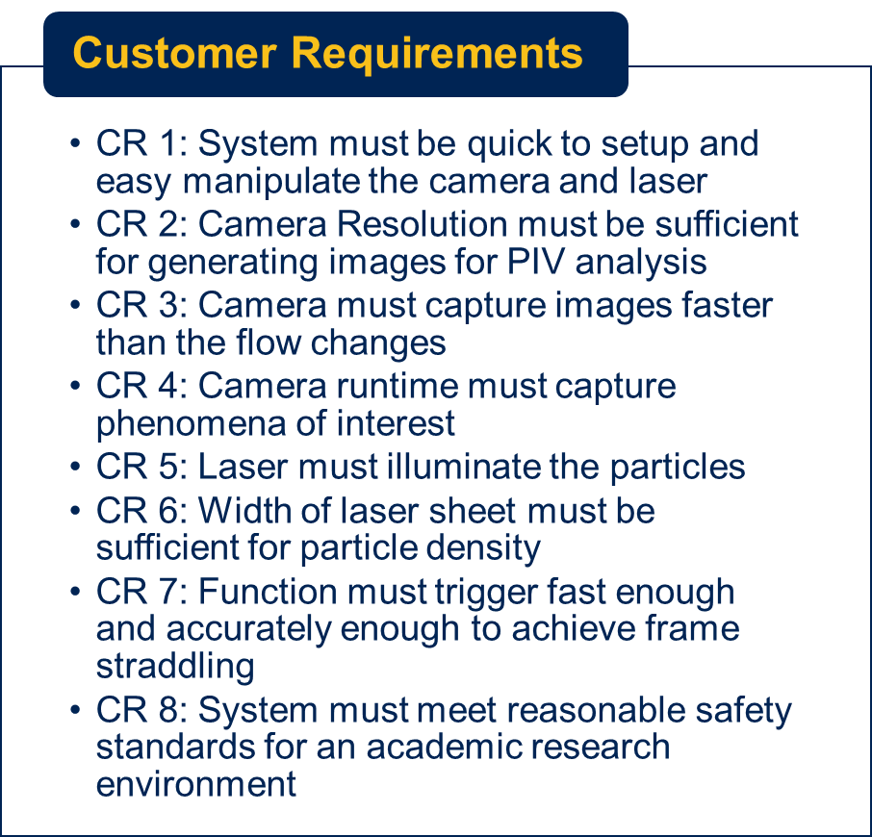
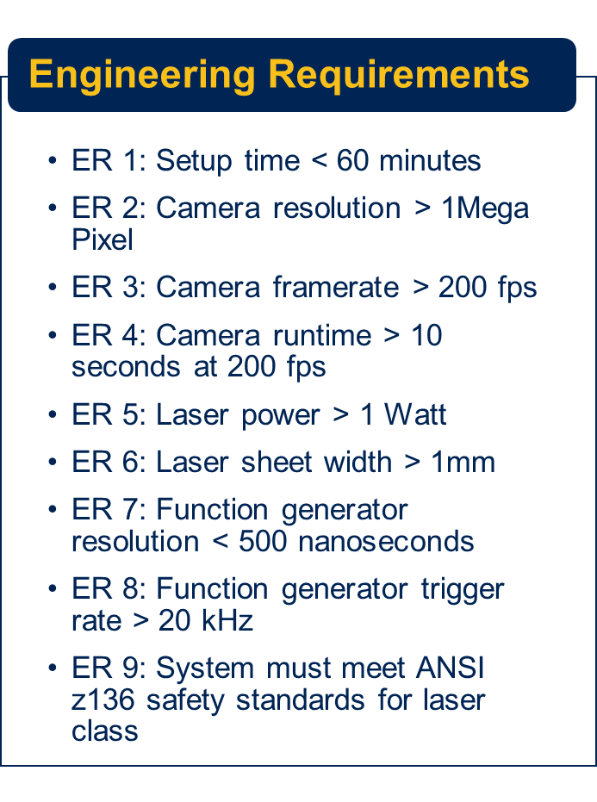
Design Requirement Summary
Chris 1

Slide 3
Top Level Testing
Experiment | Relevant DRs | Equipment Needed | Acceptance Criteria
Ex 1: Flow Study | CR2, CR3, CR4, CR5, CR7, ER2, ER3, ER4, ER5, ER7 and ER8 | Complete PIV Setup, pulsatile pump, tubing, particle solution, graduated cylinder, and stopwatch | System able to accurately analyze clinically relevant flow rates.
Ex 2: Safety Test | CR8 and ER9 | Complete PIV Setup | System meets ANSI Z.136
Ex 3: Laser Sheet Test | CR6 and ER6 | Laser assembly, blank wall, a ruler, protective goggles | Laser Sheet Width >1 mm
Ex 4: Timed Setup Test | CR1 and ER1 | Complete PIV Setup, timer | Setup Time < 60min
Santiago 2

Slide 4
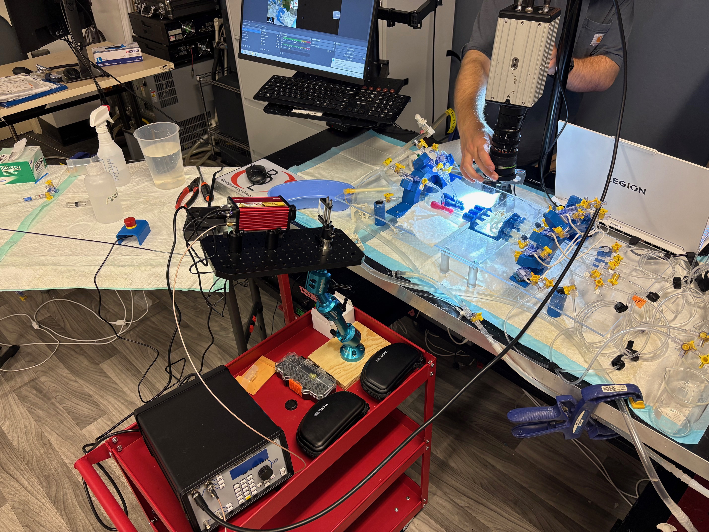
Set-up Test – Procedure & Results
Setup Time Success Metric:
Set up and adjust the PIV setup in under 60 minutes
Fulfills requirement for ease of use
Procedure:
PIV setup is initially positioned as if it were stored
Timer is started, and the components are positioned around the flow model being studied
Once positioned, the components are adjusted to the model
Final adjustments are made, and the timer is stopped
Results:
Combined positioning and adjusting took 20 minutes total
Time of setup is far less than maximum time limit, exceeds goal
Jett 3

Slide 5
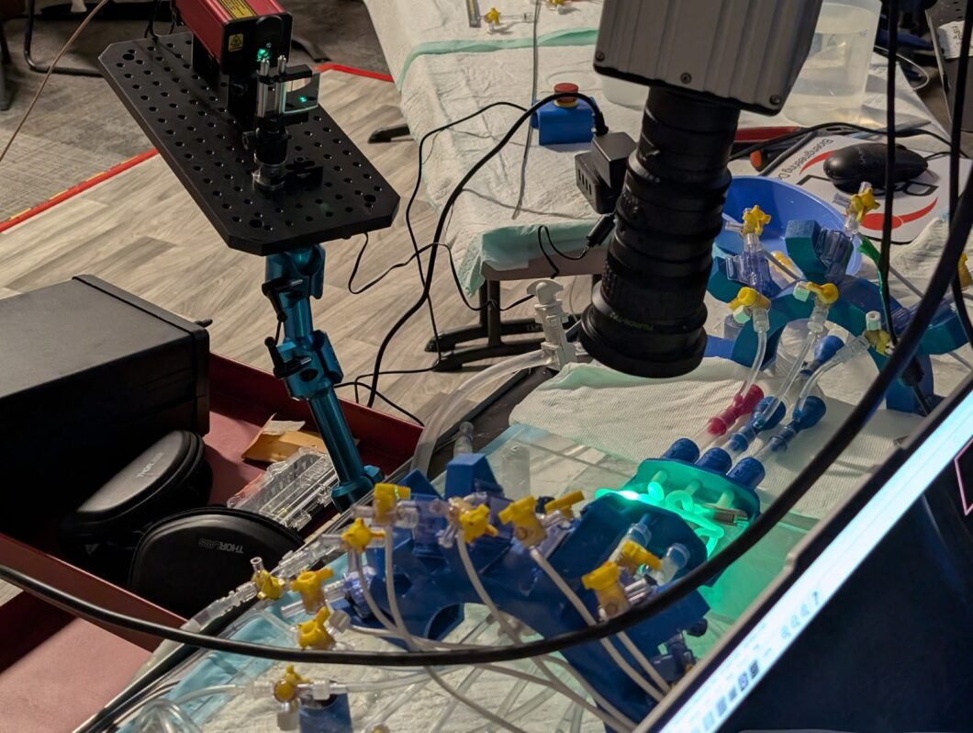
Safety Test - Procedure
Class 3B Laser Definition: "A class 3B laser may be hazardous under direct and specular reflection viewing conditions, but is not normally a diffuse reflection or fire hazard."
Evaluated Safety Features:
Tool Access Master Arm Switch
Positively Actuated Shutter
Accessible Interlocked Emergency Stop
Multiple Shut-Down Controls
Visual Indication of Operation
Extant Safety Controls:
Laser Room Isolation
Proper PPE
Proper Signage
Kian 4

Slide 6
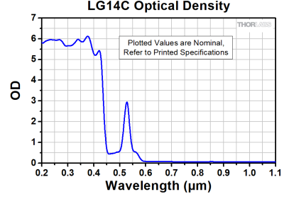
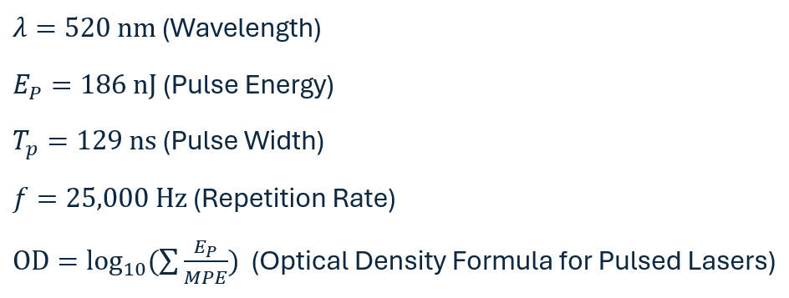
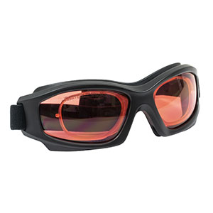
Safety Test – PPE Evaluation
Important Laser Characteristics:
Calculated Required OD: 0.68
LG14C OD at 520nm: >2.0
Kian 5

Slide 7
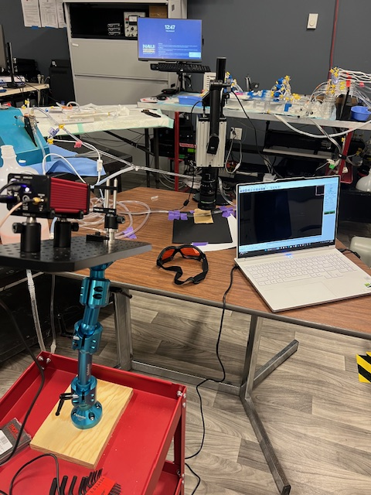
Flow Study
The flow study will determine whether the system is capable of analyzing flow data at the velocities seen in the BDL.
Camera must be able to capture images of adequate quality at a high enough frame rate analysis
The laser must be able to illuminate the particles enough to be tracked by PIVlab
The function generator must be able to synchronize the laser and camera
DRs Tested: CR2, CR3, CR4, CR5, CR7, ER2, ER3, ER4, ER5, ER7 and ER8
A flow loop consisting of a pulsatile pump, ½" OD tubing and a reservoir of PIV solution will be analyzed with our PIV system.
The flow system will be set to a flow rate of 280 mL/min instead of 240 mL/min due to pump contingencies to closely match the velocities in the BDL flow model.
4 Bucket timers will be taken to confirm the flow rate.
Images of the flow will be taken at 1,000 Hz, with the laser being pulsed before and after each frame.
Images will be uploaded to PIVlab for analysis.
Chris 6

Slide 8
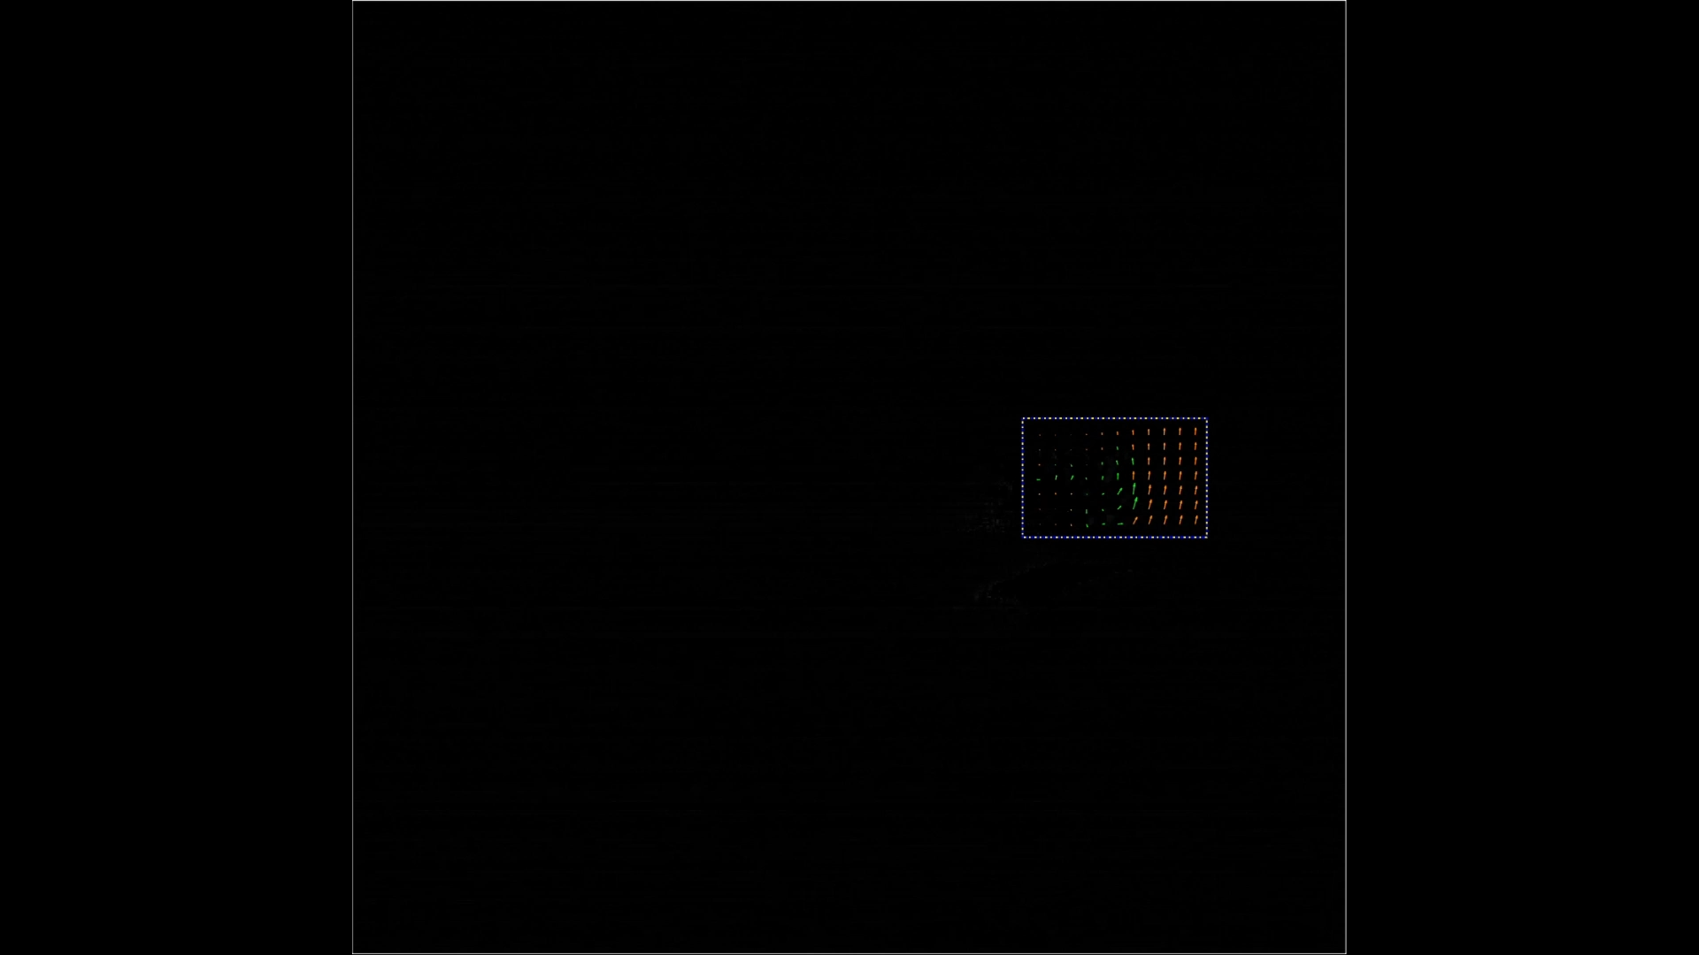
Flow Study Results
Chris 7

Slide 9
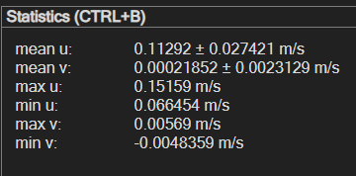
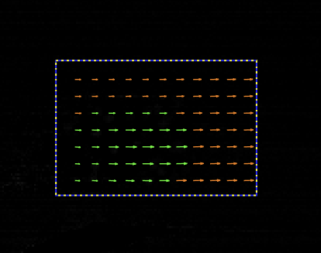
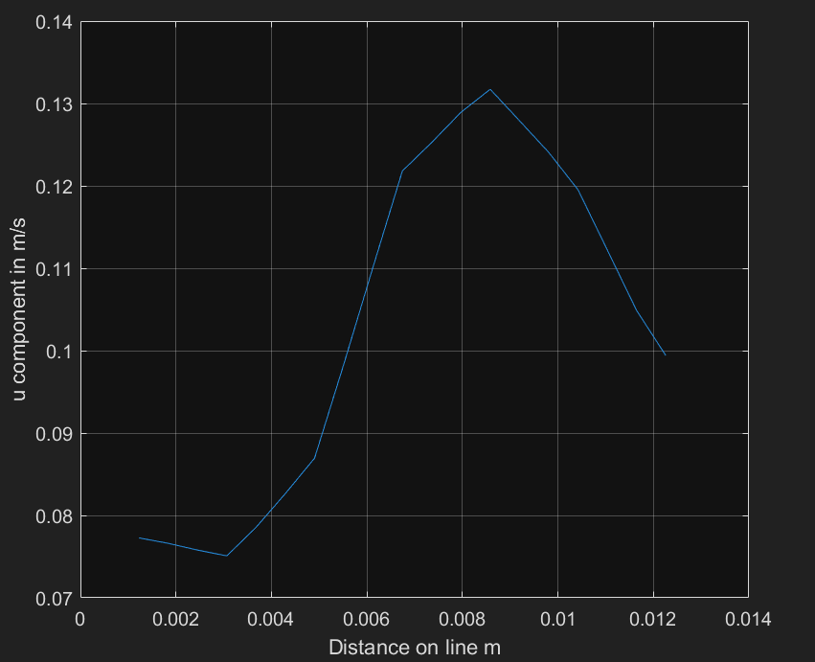
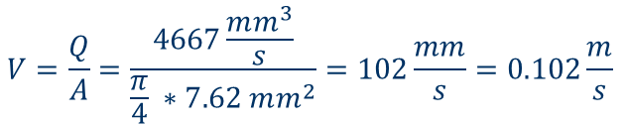

Flow Study Results
$Q=\frac{∆V}{∆T}=\frac{70mL}{15 s}=4.667\frac{mL}{s}=4667\frac{mm^{3}}{s}$
$$V=\frac{Q}{A}=\frac{4667\frac{mm^{3}}{s}}{\frac{π}{4} ∗7.62 mm^{2}}=102\frac{mm}{s}=0.102\frac{m}{s}$$
$$\%_{Error}=\frac{V_{measured}−V_{Actual}}{V_{Actual}} ∗100=\frac{0.113 −0.102}{0.102} ∗100=10.78\%$$
Chris 8

Slide 10
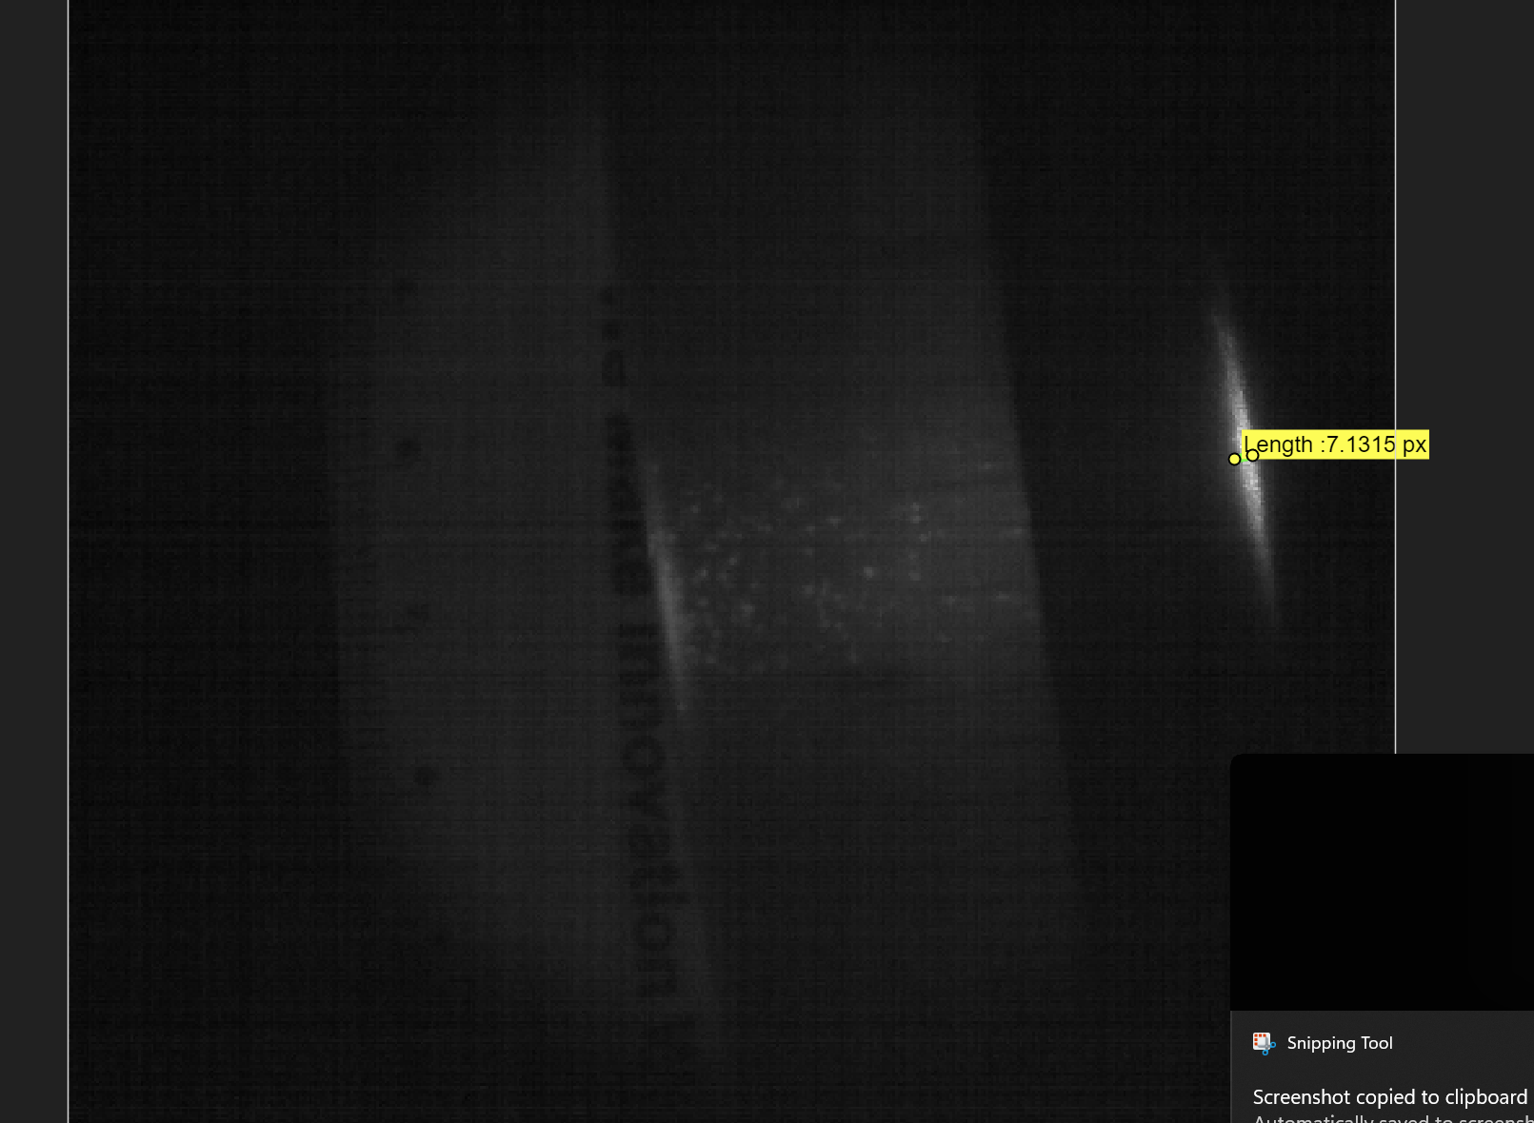

Light Sheet test – Procedure
Light Sheet Success Metric:
Light sheet width of more than 1 mm at operating distance
Procedure:
All standard safety precautions are used for setting up PIV system- only two operators in closed room
Laser is aimed at non-reflective surface
High precision measuring instruments are positioned next to laser beam profile
High resolution camera with sufficiently low exposure setting captures image of beam profile
PIVlabs uses calibration to measure beam profile width from images
7.1315 px * 1.6126e-4 m/s = 1.15 [mm]
Results​:
Width of 1.15 [mm]
No movement of lens necessary
Santiago 8

Slide 11
CR Table
Customer Requirement | CR Met Y/N | Client Acceptable Y/N
CR1: Easy to set up and position camera and laser | Y | Y
CR2: High enough camera resolution | Y | Y
CR3: High enough camera framerate | Y | Y
CR4: Camera runtime long enough to capture phenomena of interest | Y | Y
CR5: High enough laser power | Y | Y
CR6: Light sheet wide enough | Y | Y
CR7: Function generator fast and accurate enough | Y | Y
CR8: System safety | Y | Y
Santiago 9

Slide 12
ER Table
Engineering Requirements | Target | Tolerance | Measured or Calculated Value | ER Met Y/N | Client Acceptable Y/N
ER 1: Setup Time | ≤ 60 min | N/A | 20 min | Y | Y
ER2: Camera Resolution | ≥ 1 MP | N/A | 0.262 MP | N | Y
ER3: Camera Framerate | ≥ 200 FPS | N/A | 5,000 FPS | Y | Y
ER4: Camera Runtime | ≥ 10 s @ 200 FPS | N/A | 12s @ 1,000 FPS | Y | Y
ER5: Laser Energy | ≥ 100 nJ | N/A | 186 nJ | Y | Y
ER6: Light Sheet Width | ≥ 1 mm | N/A | 1.15 mm | Y | Y
ER 7: Function Generator Resolution | ≤ 500 ps | N/A | 250 ps | Y | Y
ER8: Function Generator Trigger Rate | ≥ 20 kHz | N/A | 1 GHz (manufacturer spec.) | Y | Y
ER9: System Safety | ANSI z136 | N/A | In Compliance with ANSI Z.136 | Y | Y
Kian 10

Slide 13
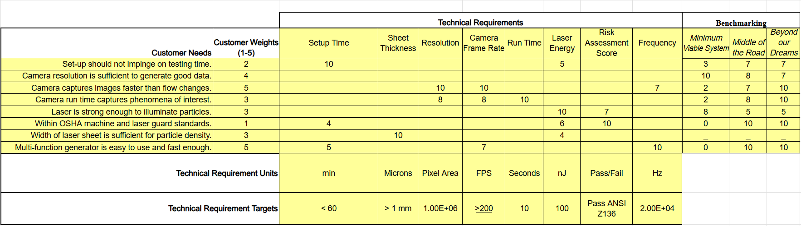
QFD
Jett 11

Slide 14
Thank you! Questions?

