Slide 1




Formula SAE Suspension
Presentation 2
Parker Johnson: Suspension Design Lead
Chris Laney: Brakes Engineer
Garrett Pearson: A-Arm Engineer
Mathew Cusson: Steering Engineer
Joseph Ciao: Pushrod Assembly Engineer
Page 1

Slide 2

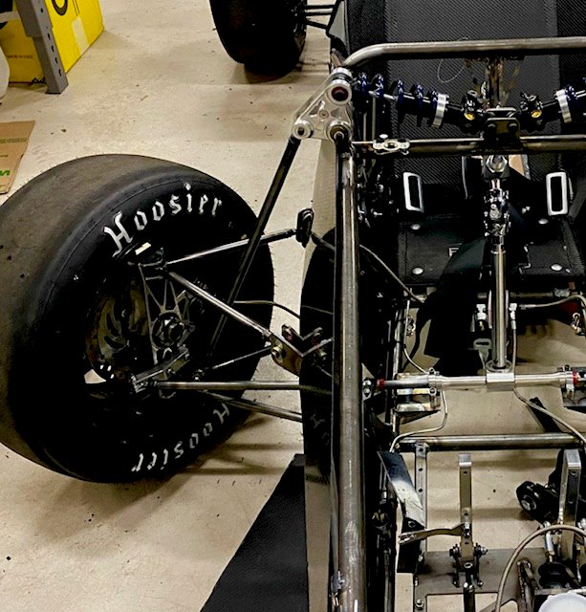
Sub-Team Description/Importance
Focus is on the vehicles overall suspension system
Design of A-arm, Brakes, Knuckles, Pushrod assembly, Steering, among other systems.
Overall goal: improvement from last year's design mostly in adjustability and overall drivability including ease of steering.
Why is this important: Suspension directly effects the car's handling, stability, and overall safety. It plays a vital role in maximizing tire contact, improving cornering speed, and ensuring driver control.
PHOTO
Fig. 1: Picture of 1st year Front Suspension System
Page 2 - Joe

Slide 3
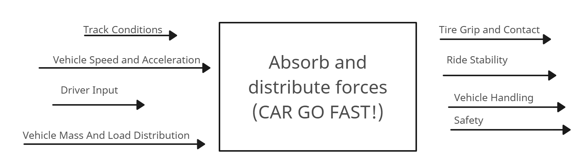
Black Box Model
PHOTO
Fig. 2: Black Box Model Suspension
Page 3- Joe

Slide 4
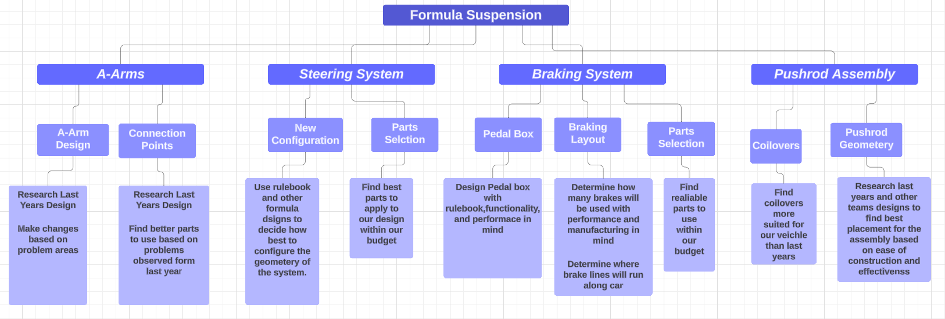
Decomposition Model
PHOTO
Figure 3: Decomp Model
Page 4 - Garrett

Slide 5
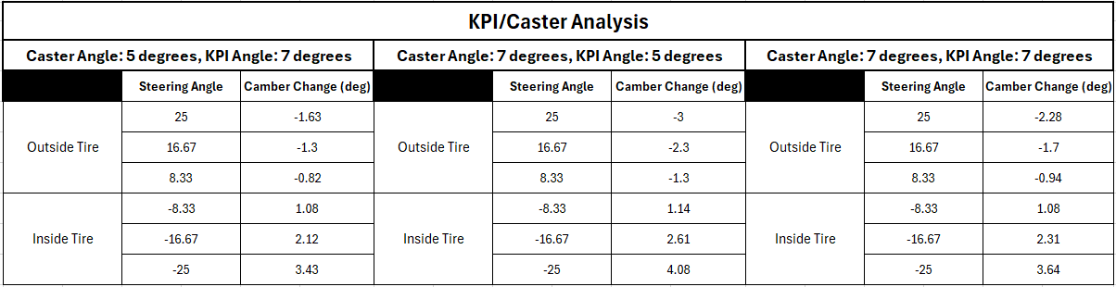
Concept Generations (Knuckles)
The suspension geometry cannot be modeled until values for KPI and caster are achieved. These values directly affect the camber of the tires at different steering angles
3 different sets of values for these parameters were evaluated using a simulation made in SolidWorks, at 6 different steering angles each
Table 1: KPI/Caster Analysis
PHOTO
Page 5 - Parker

Slide 6
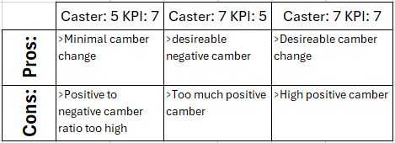
Concept Generations (Knuckles)
Table 2: Steering Axis Evaluation
PHOTO
We want to avoid too much camber change, since we are limited to the amount of camber gain through suspension articulation.
Having a large amount of positive camber change is undesirable in that it decreases handling and increases the steering effort.
The third option of 7 degrees for both parameter gave us the best results, that paired the best with our desired suspension geometry.
Page 6 - Parker

Slide 7
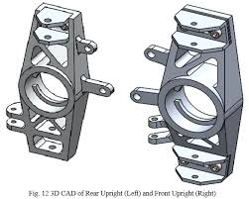
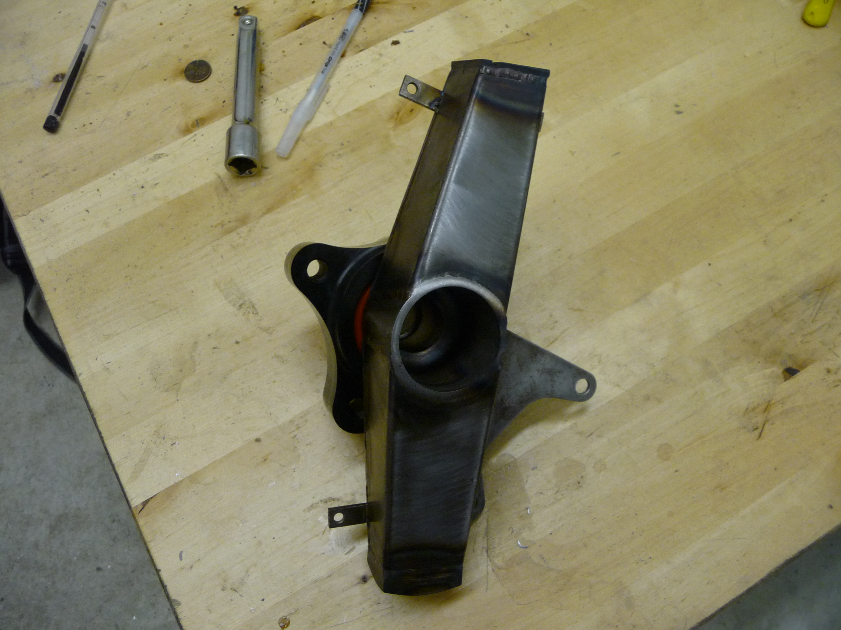
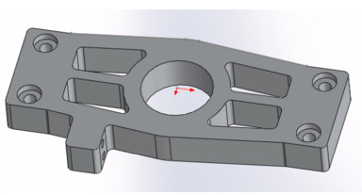
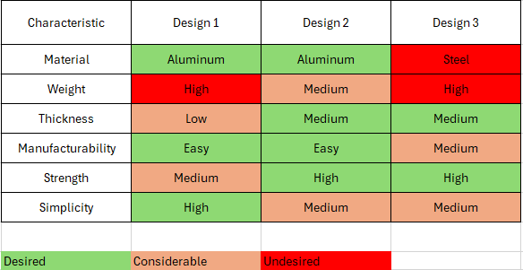
Concept Generations (Knuckles)
These knuckle concepts were based off a few considerations, mainly the machinability, and compactness, and the thickness.
Last years knuckles were a complex design and were thick, which caused a larger scrub radius, which is undesirable. They were also machined on the Haas which is something we won’t have easy access to this year.
Table 3: Morph Chart
PHOTO
Page 7 - Parker

Slide 8
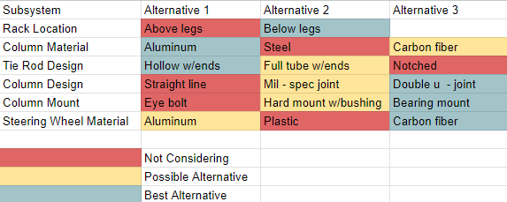
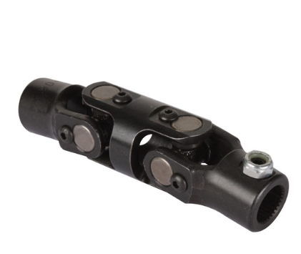
Concept Generations (Steering)
Table 4: Morph Chart
Rules have effectively ruled out above leg configuration
Steel column is far too heavy
Notched rod ends do not have required ability to move on an axis
Straight steering wheel is not possible in this design
Eye bolts cause far too much play in the column
Plastic wheel will not hold force as needed
PHOTO
Figure 4: Double U - Joint
Page 8 - Matt

Slide 9
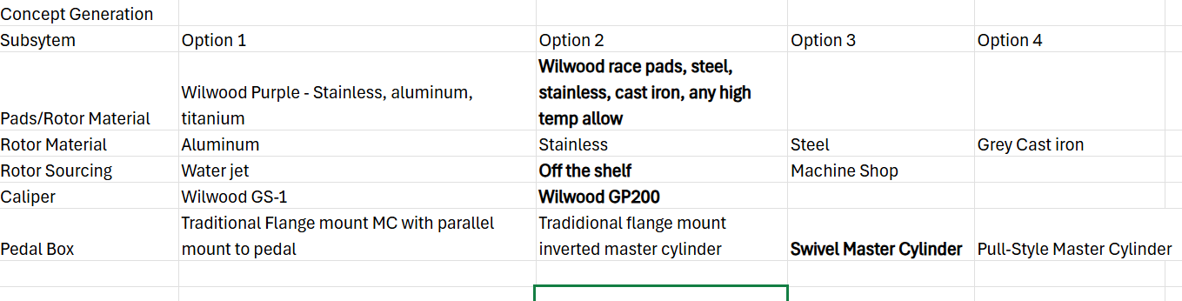
Concept Generations (Brakes)
Table 5: Morph Chart
PHOTO
Page 9 - Chris

Slide 10
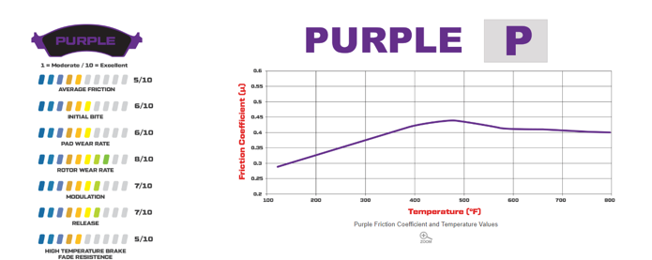
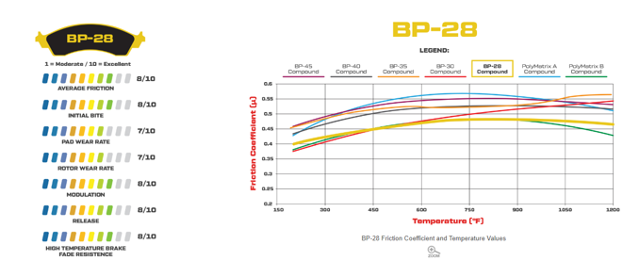
Concept Generations (Brakes)
PHOTO
Page 10 - Chris

Slide 11
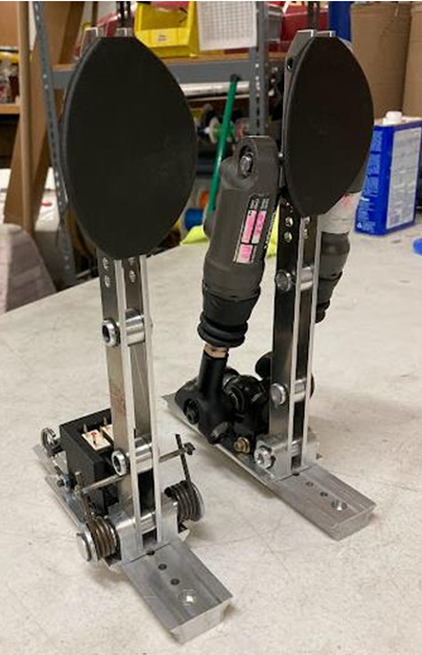
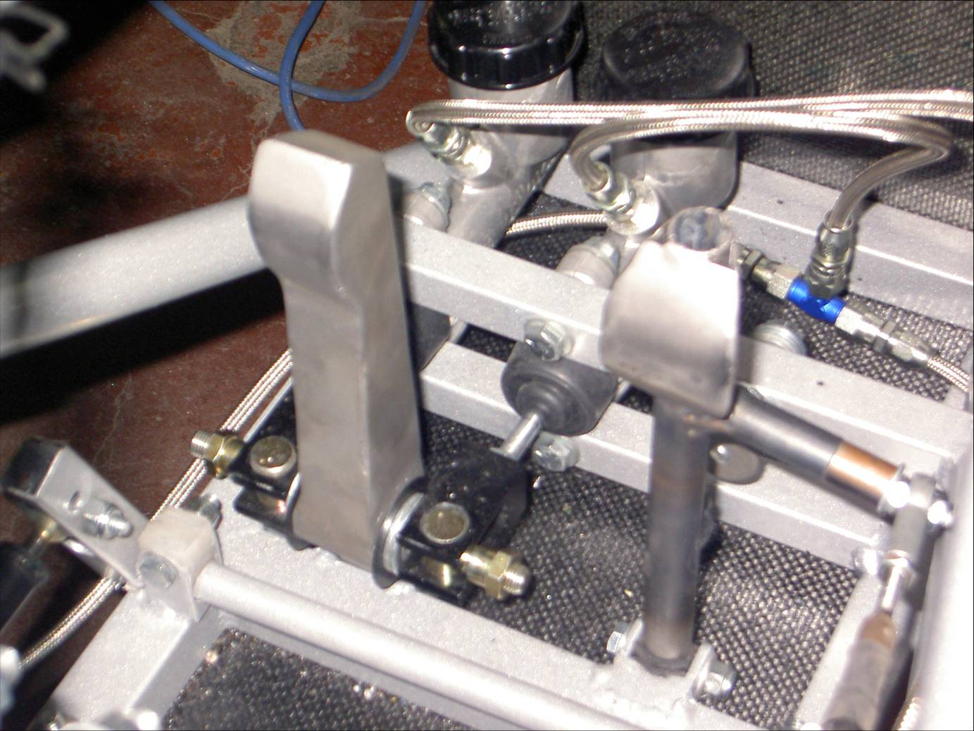
Concept Generation(Brakes)
PHOTO
Page 11 - Chris

Slide 12
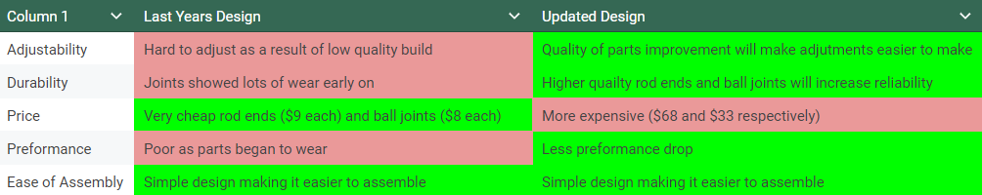
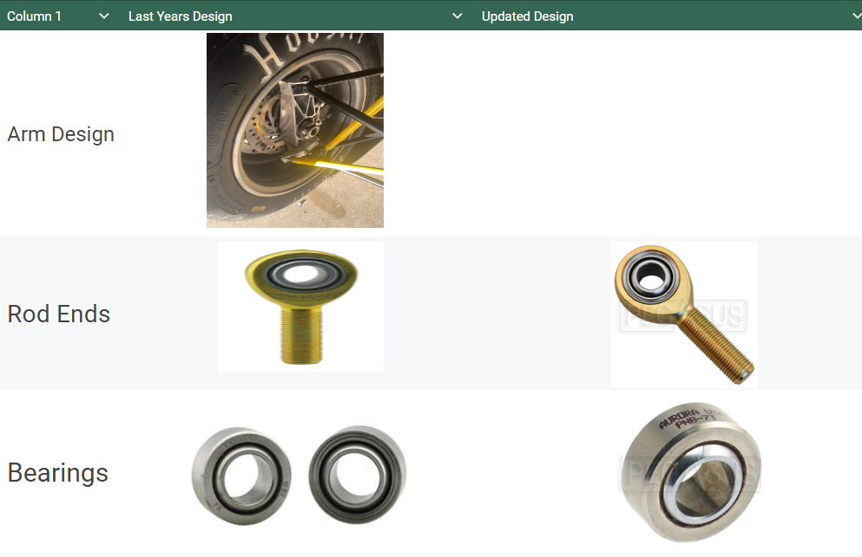
Concept Generations (A-Arm)
Table 6: Morph Chart
Biggest determining factor will be price of parts.
If suspension is given ideal funding, we can use the Updated Design but if not, we will have to comprise on quality of parts
Page 12-Garrett

Slide 13
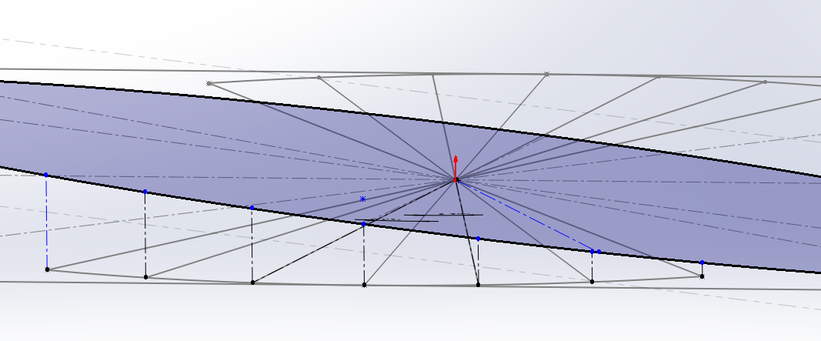



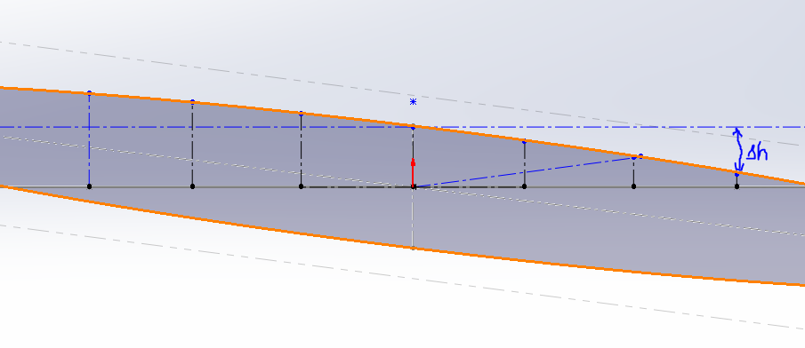
Engineering Calculations
From the simulation made in cad, we can evaluate the camber change based off different steering positions.
Variables:
= | Initial height – new height |
= change in height
= Tire width
PHOTO
= camber change
Page 13 - Parker
Figure 5: CAD Simulation

Slide 14
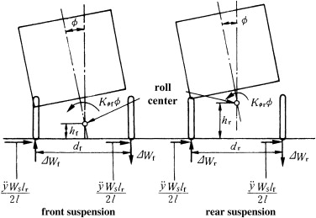

Engineering Calculations
The next step is to model the suspension forces in a few different section views of the whole system
There is a moment put on the COG that acts about the roll center, which increases the force applied from the road to the tire.
Simple Equations used for a more complex calculation:
PHOTO
Figure 6: FBD Example
Page 14 - Parker

Slide 15
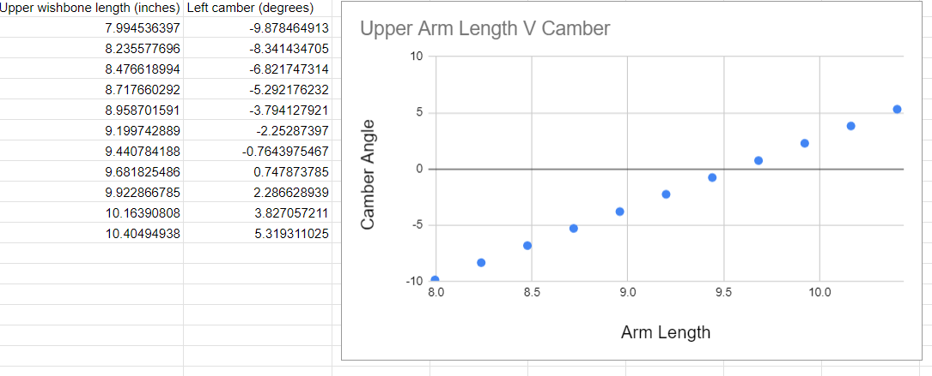
Engineering Calculations
PHOTO
Page 15-Garrett

Slide 16
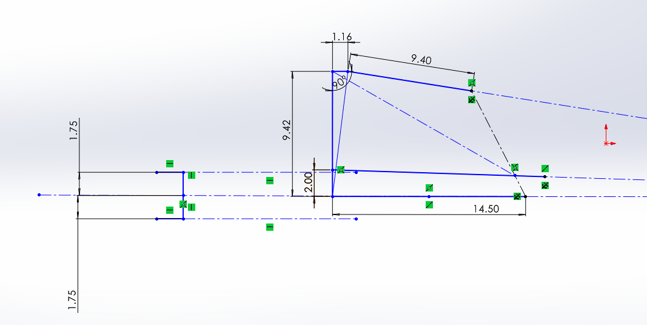
Engineering Calculations
Length from upper ball joint to tie rod
Conditions -
Static
Bump
Droop
Length from upper ball joint to tie rod always 8.15 in
Δ of Length in condition
Figure #7 - 2D Steering Geometry
Degrees Bump Steer = arctan( Δ of Length in condition / Length from upper ball joint to tie rod)
LL
For calculations I use base tie rod lengths
15.8 in
17.3 in
14.3 in
These are based on NARRCO steering rack length and the tie rods needed for using them
Page 16 - Matt

Slide 17
Engineering Calculations
Bump Δ
Static Length
Droop Δ
Note – Bump and droop are evaluated at +1.75 in and – 1.25 in in height respectively
-.05 in
-.04 in
-.07 in
14.3 in
15.8 in
17.3 in
.03 in
.03 in
.02 in
Bump Steer per rack
Droop Steer per rack
.006 deg toe in
.0049 deg toe in
.0086 deg toe in
PHOTO
.0037 deg toe out
.0037 deg toe out
.0025 deg toe out
This validates that the current steering rack (15.8 in tie rods) works the best due to minimal total steer variation
Page 17 - Matt

Slide 18
Engineering Calculations
Variables:
P_{cr} = Critical Load
E = Young's modulus of pushrod material
(aluminum 10*10⁶ psi)
I = Aera moment of inertia of pushrod cross-section
L = Length of pushrod
(23 in*^{this will change})
K = Column effective length factor
(1.0)
Buckling Calculation:
P_{cr}=(πEI)/(KL)²
PHOTO
I =(π(.25 in)⁴)/4= .00307 in⁴
P_{cr}= (π²*(10*106 psi ) * .00307 in⁴)/(1.0*23 in)²= 574.66 Ibf
From this it was determined a shorter pushrod
would increase the resistance to buckling.
Page 18 - Joe

Slide 19
Engineering Calculations
Variables:
Weight Bias Front: 51%
Weight Bias Rear: 49%
Uf: Coefficient of Friction(tire/ground): 1.4
Center of Gravity: 304 mm above ground **
Car mass approx: 600 lbs(272 kgs)
Dynamic Weight Balance: 77/23
Wb = wheelbase, 1625mm
Dr: Distance from rear axle to CG, 886
Df: 882mm
Tractive Forces:
F = Uf*m*a*g
Front: 1442N
Rear: 426.5 N
Normal Force:
F(front) = ((m*g)*Dr)/Wb = 2098 N
F(rear) = 750 N
Required Torques:
Front: 391.38 N/m
Rear: 140.08 N/m
PHOTO
Page 19 - Joe

Slide 20
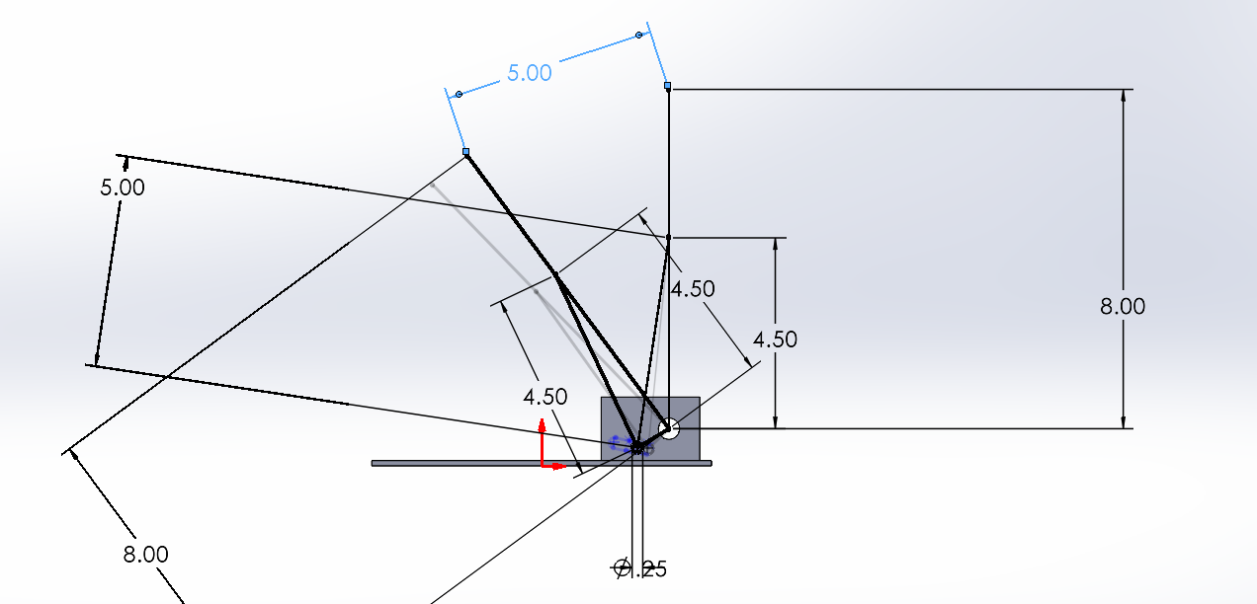
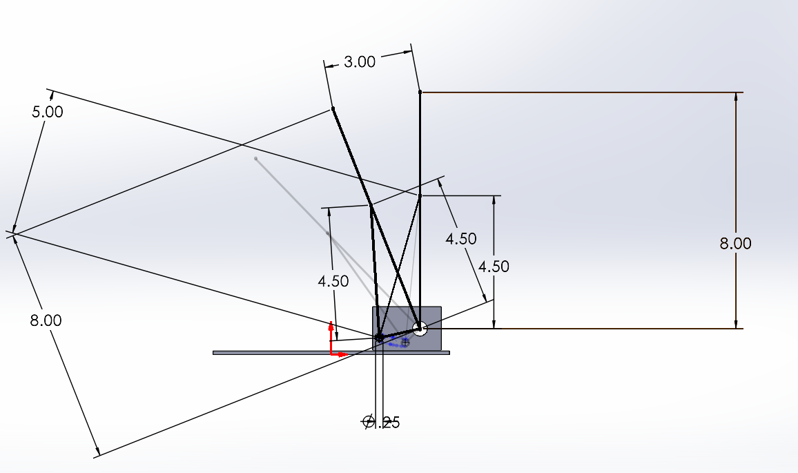
Concept Evaluation(Brakes)
PHOTO
Page 20 - Chris

Slide 21
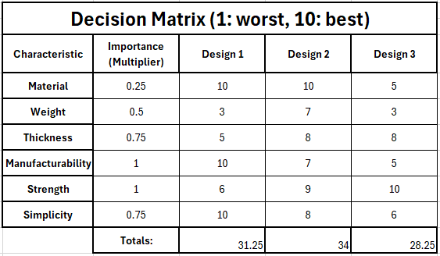
Concept Evaluations (Knuckles)
Table 7: Decision Matrix
PHOTO
Page 21 - Parker

Slide 22
Concept Evaluations (Knuckles)
This will be easy to make, however the main concerns are the strength and its compatibility with different wheel hub designs
This type of design is desirable based off the decision matrix for its strength, ease of manufacturability, and wheel hub compatibility
PHOTO
This design will be strong but heavy and will require welding. The dimensions will also be less exact.
Page 22 - Parker

Slide 23
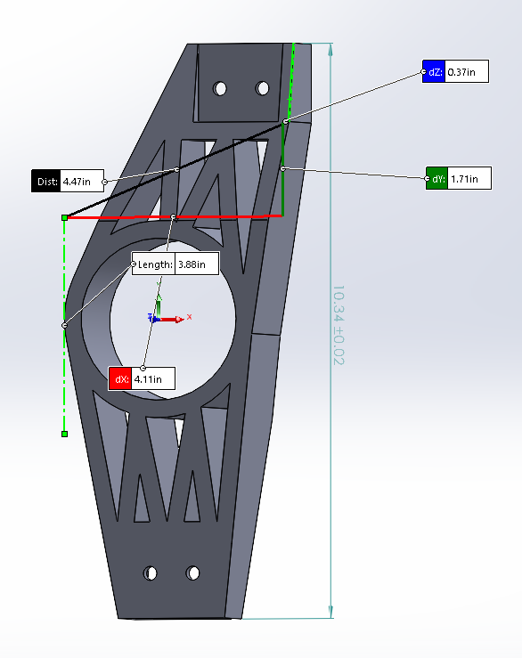
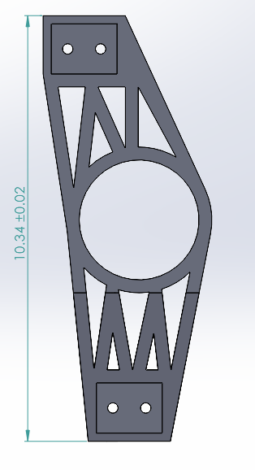
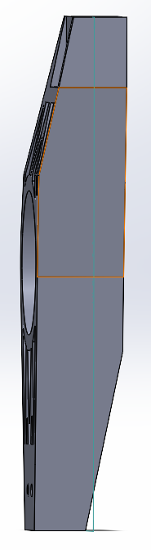
Rough CAD (Knuckles)
PHOTO
Page 23 - Parker
Figure 4: Rough CAD of knuckles

Slide 24
Concept Evaluations (Steering)
Best combination will be -
Mounted below legs for ease of construction
Aluminum for material weight
Hollow tie rods for weight saving
Double U joint for best linear steering pattern
Bearing mount on the steering column for minimized play
Carbon fiber steering wheel for weight savings and material stiffness
PHOTO
Page 23 - Matt

Slide 25
Concept Evaluations (Brakes)
Pads/Rotors/Rotor Material:
All depend on one another, getting off the shelf stuff for all of this for simplicity
High-temp pads and steel rotor for wear and cost
Pedal box:
Swivel MC for space savings and adjustability
4 wheel calipers for simplicity, reliability, and tuning abilities
Master Cylinder selection: Swivel base, lightweight and low profile, motorsports quality
Caliper selection: Lightweight, robust, go-to for many teams. Material conducts heat well and not worried about avaliability
PHOTO
Page 25 - Chris

Slide 26
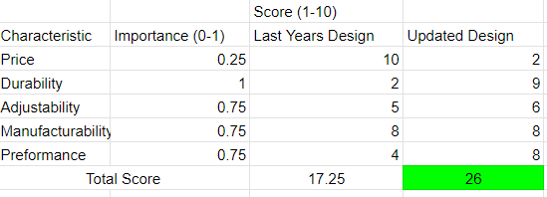
Concept Evaluations (A-Arms)
Table 8: Decision Matrix
PHOTO
Page 26 - Garrett

Slide 27
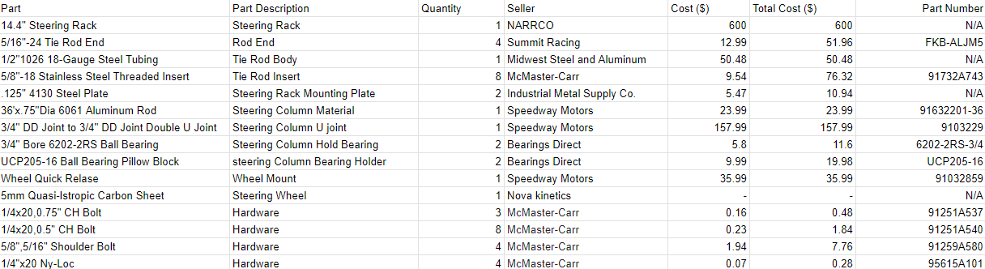
Steering Bill of Materials
PHOTO
Figure # Bill Of Materials Steering
Current Estimation: $1049.61
Page 27 - Matt

Slide 28
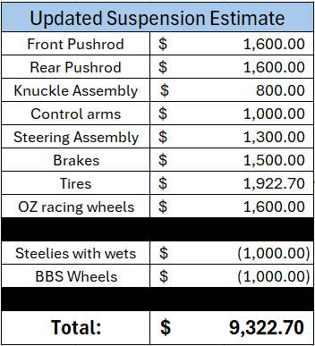
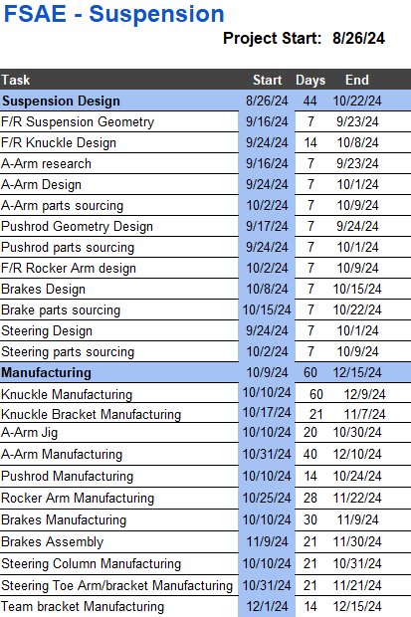

Schedule and Budget
PHOTO
Figure 6: Updated Budget 2025
Figure 7: Production timeline
Page 28 - Parker

Slide 29


Thank you!

