Slide 1




Formula SAE Suspension
Presentation 1
Parker Johnson: Suspension Design Lead
Chris Laney: Brakes Engineer
Garrett Pearson: A-Arm Engineer
Mathew Cusson: Steering Engineer
Joseph Ciao: Pushrod Assembly Engineer
Page 1

Slide 2



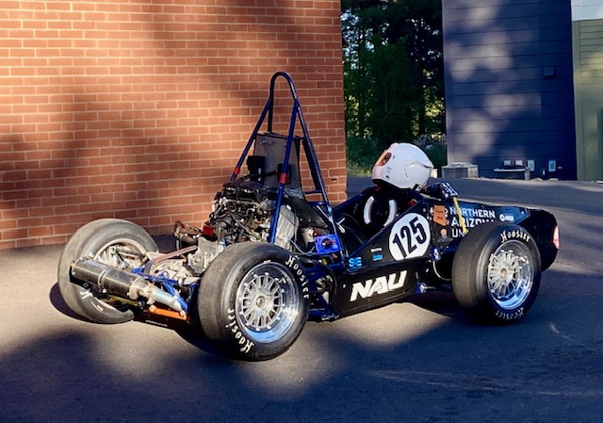







Project Description
What is Formula SAE?
Formula SAE: Yearly collegiate competition to design and build a Formula style race car to be tested in multiple static/dynamic events
The car must meet the requirements of a very extensive rulebook that ensures the safety of drivers and volunteers at competition.
The project will be sponsored by any company willing to help with funds in exchange for company exposure
PHOTO
Current Sponsors
Fig. 1: Picture of 1st year Formula Car
Page 2 - Parker

Slide 3
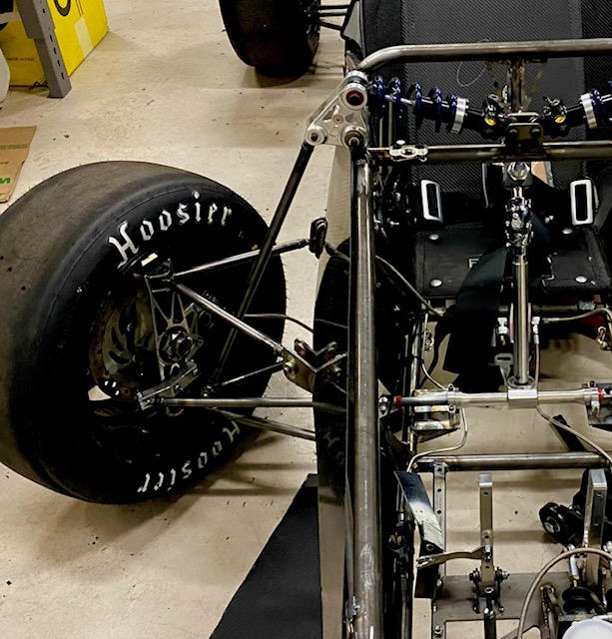
Sub Team Description
Suspension System Design
Our sub team focus is on the vehicles overall suspension system, steering and brakes.
All these components have some effect of the cars ability to maintain traction
PHOTO
The main goal of our sub team is to design a suspension system that maximizes tire contact with the road
We will be improving the adjustability of the suspension for tuning, as well as the ease of steering.
Fig. 2: Picture of 1st year Front Suspension System
Page 3 - Parker

Slide 4
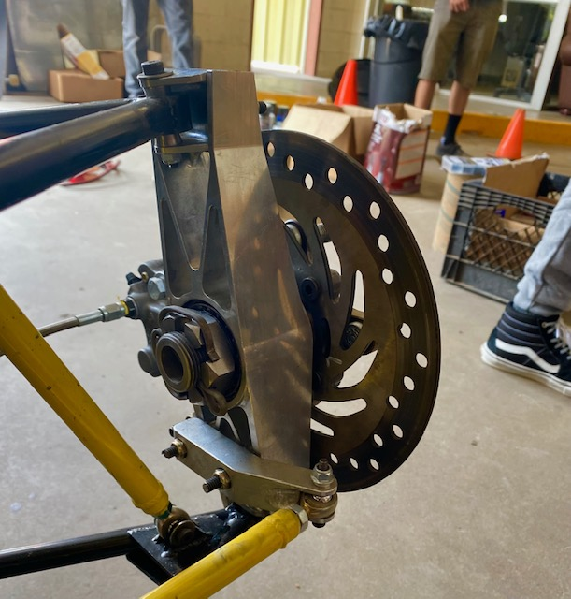
Steering Knuckle Background
Current designs for production cars include heavy steering knuckles that are typically forged or cast iron, for their high strength.
Formula SAE designs their knuckles to be lightweight, but still more than strong enough for its application.
Last year’s team made great knuckles; however they lacked in adjustability, and they overlooked some important settings.
This year we will focus more on design for manufacturability, and the knuckle’s adjustability to get the suspension tuned for our application.
PHOTO
Figure 3: 2024 car knuckle
Page 4 - Parker

Slide 5
Steering SOTA/Benchmark
Current design standard is rack and pinion for smaller vehicles
Steering gearbox is another option however generally reserved for large vehicles
Setup of steering has the additional caveat of front or rear steering – this is NOT front or rear wheel steering
Most used setup for racing is front steering
PHOTO
Page 5 - Matthew

Slide 6
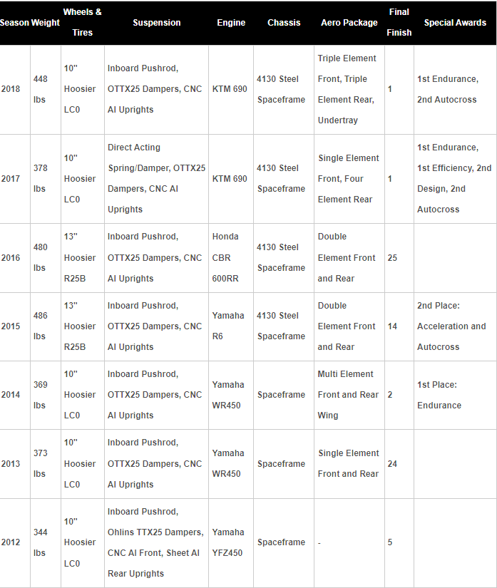
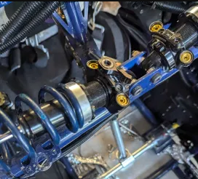
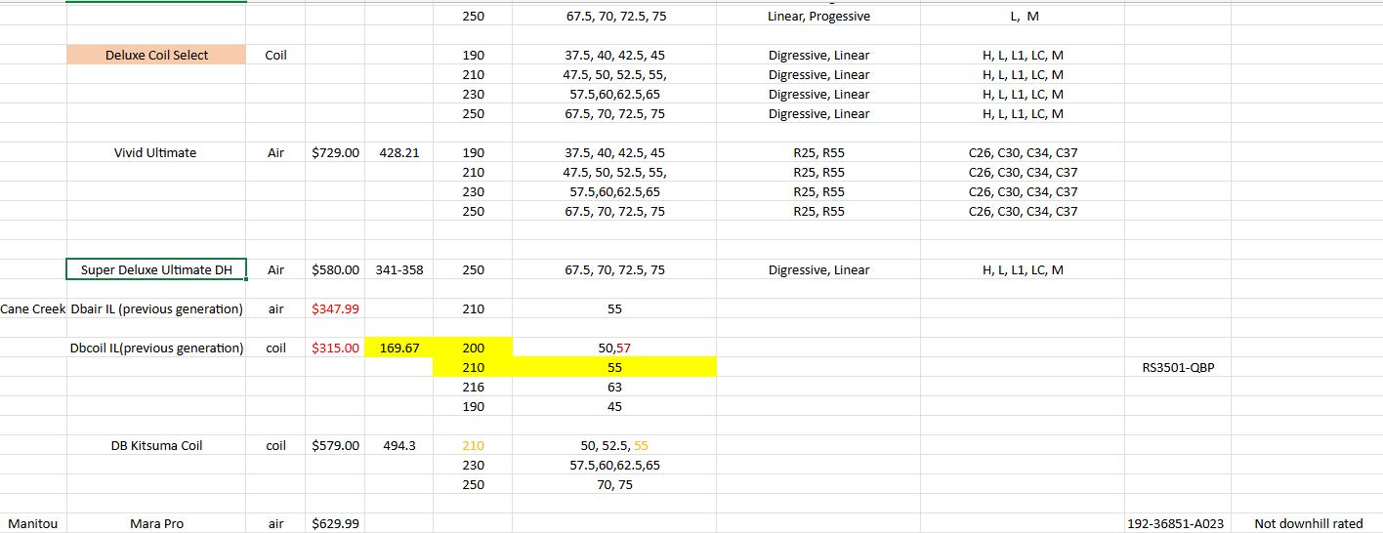
Pushrod Background and Benchmarking
PHOTO
Figure 5. Last year's team coilover selection
Figure 4. 2024 front suspension mounting
Last year's design used a unique coil over for the competition . The car was setup with max amount of preload to get desired ride height.
Changes for this year so far
More "standard" coil over
More spacing between mounting points
Figure 6 . Winning team damper choices through the years
Page 6 - Joe

Slide 7
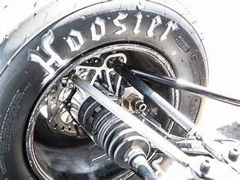
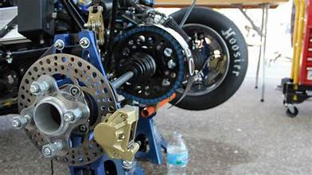
Brakes – Overview/Background
System consists of pedal box, master cylinder(s), brake lines, calipers, and pads.
"Most powerful" system on the car
Today, the limiting factor in a brakes system
is typically cooling related
Braking force can easily be manipulated on individual
wheels by changing rotor size, pad contact patch,
increasing master cylinder pressure(by adjusting
brake pedal)
PHOTO
Figure 7. 2024 car front brakes
Figure 8. 2024 car rear brakes
Page 7 - Chris

Slide 8
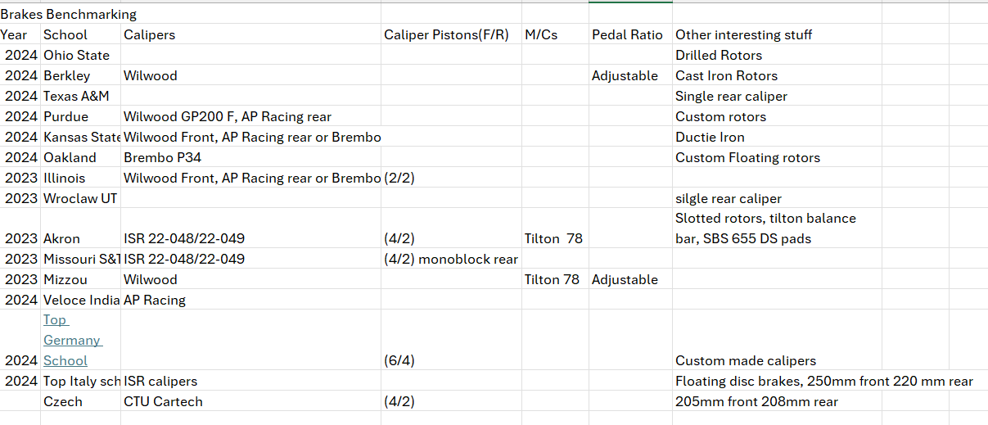
Brakes - Benchmarking
PHOTO
Averages : Wilwood, AP Racing, ISR, Brembo Calipers. (4/2) piston front and rear, Tilton 78 series master cylinder, adjustable pedal ratio, cast iron drilled rotors, 200-250mm diameter, 2 rear calipers
Page 8 - Chris

Slide 9
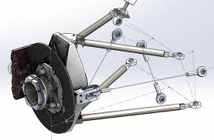
A-Arm Benchmarking and Background
Background
Last year's design used a double a-arm system for the front and rear because it helps keep good stability at high speeds and makes keeping negative camber easier.
Issues
PHOTO
Cheap rod ends
Low adjustability
Camber
Potential Solutions
Use higher quality parts
Increase range of adjustment on arms
Adjusting Caster angle
Figure 9. A-Arm Cad model
Page 9 - Garrett

Slide 10
House of Quality
PHOTO
Figure 10. QFD
Page 10 - Parker

Slide 11
Steering Requirements
Required components per FSAE regulations-
Mechanically connected to wheels
Positive steering stops for locking prevention
Steering play is no more than 7 degrees
Steering rack mechanically attached to chassis
All joints must be mechanical and plainly visible
Rear wheel steering is allowed. Mechanical play limit is 6 degrees
Steering wheel must be quick disconnect and operable by the driver
Steering wheel must have continuous and oval/near oval perimeter
Steering wheel must stay below front hoop
PHOTO
Page 11- Matthew

Slide 12
Steering Knuckle Sources
[1] D. L. Milliken and W. F. Milliken, Race Car Vehicle Dynamics: Problems, Answers, and Experiments. Warrendale, PA: SAE International, 2003.
[2] J. C. Dixon, Suspension Geometry and Computation. Chichester, U.K: Wiley, 2009.
[3] E. F. Gaffney and A. R. Salinas, Introduction to Formula SAE® Suspension and Frame Design. Warrendale, Pa: Society of Automotive Engineers, 1997.
[4] G. Valdo and C. Rouelle, “FSAE front axle optimization using OptimumKinematics optimization module,” OptimumG, https://optimumg.com/fsae-front-axle-optimization-using-optimumkinematics-optimization-module/ (accessed Sep. 16, 2024).
[5] R/FSAE on reddit: Scrub radius and mechanical trail help, https://www.reddit.com/r/FSAE/comments/1dbmr01/scrub_radius_and_mechanical_trail_help/ (accessed Sep. 16, 2024).
[6] “Vehicle suspension: Front view online suspension simulator,” Vehicle Suspension: Front View Online Suspension Simulator, https://vsusp.com
[7] S. Ranganathan, S. gopal, S. eswaran, and S. muthusamy, “Design and analysis of steering knuckle for FSAE vehicle,” SAE International Journal of Advances and Current Practices in Mobility, https://www.sae.org/publications/technical-papers/content/2020-28-0506/ (accessed Sep. 16, 2024).
PHOTO
Page 12 - Parker

Slide 13
Steering Source Review
1 - Suspension Geometry and Computation chapter 5 and 6 – explains suspension basics and lay out the concept of Ackerman and Bump Steer while giving good equations to calculate both values accurately
2 - Automotive steering system preferences evaluated using a driving simulator – is a study of steering wheel designs and what is the most useful for various speeds and road conditions
3 - A STUDY OF MODERN AUTOMOTIVE-VEHICLE STEERING-SYSTEMS - nearly a century old, teaches pitfalls of amateur designs and how to avoid basic faults to create worse bump steer or turning conditions
4 - Tech Explained: Ackerman Steering Geometry – continues to explains how to set Ackerman with respect to slip angle
5 – Slip Angle Explained – explains the concept of slip angle and how it applies to driving techniques along with how to measure it
[1] J. C. Dixon, Suspension Geometry and Computation. Chichester, U.K: Wiley, 2009.
[2] J. Rodriguez et al., “Automotive Steering System Preferences evaluated using a driving simulator - International Journal of Automotive Technology,” SpringerLink, https://link.springer.com/article/10.1007/s12239-016-0006-0?error=cookies_not_supported&code=651a5789-c052-4355-9167-d85115dbe9d2 (accessed Sep. 15, 2024).
[3] H. Chase, A study of modern automotive-vehicle steering-systems on JSTOR, https://www.jstor.org/stable/44723675 (accessed Sep. 16, 2024).
[4] J. Vogel, “Tech explained: Ackermann Steering Geometry,” Racecar Engineering, https://www.racecar-engineering.com/articles/tech-explained-ackermann-steering-geometry/ (accessed Sep. 16, 2024).
[5] Racelogic, “Slip angle explained,” https://www.racelogic.co.uk/_downloads/vbox/Application_Notes/Slip%20Angle%20Explained.pdf (accessed Sep. 16, 2024).
[6]https://saemobilus.sae.org/papers/study-influence-variation-camber-toe-handling-passenger-vehicle-cornering-2019-26-0073
[7] https://www.sae.org/publications/technical-papers/content/2016-28-0201/
PHOTO
Page 13 - Matthew

Slide 14
Pushrod References
[1] Jörnsen Reimpell, J. Betzler, and H. Stoll, The Automotive Chassis. Hodder Education, 2000.
Fundamentals of car design, relates to all aspects of the project
‌[2] W. F. Milliken, Race car vehicle dynamics and workbook. Soc Of Automotive Eng, 1998.
More specialized knowledge of dampers
‌
[3] Y. S. Saurabh et al., “Design of Suspension System for Formula Student Race Car,” Procedia Engineering, vol. 144, pp. 1138–1149, 2016, doi: https://doi.org/10.1016/j.proeng.2016.05.081.
-overview of a teams design process
[4] K. B. Evseev and A. B. Kartashov, “Search for optimal design parameters of suspension arms for Formula Student race car,” Izvestiya MGTU MAMI, vol. 9, no. 3–1, pp. 32–37, Feb. 2015, doi: https://doi.org/10.17816/2074-0530-67179.
-optimization of suspension
[5] A. A. Vadhe, “Design and Optimization of Formula SAE Suspension system,” International Journal of Current Engineering and Technology, vol. 8, no. 3, May 2018, doi: https://doi.org/10.14741/ijcet/v.8.3.17.
-a study on current sae formula car suspension systems
‌
[6] “Automotive Suspension - MATLAB & Simulink,” www.mathworks.com. https://www.mathworks.com/help/simulink/slref/automotive-suspension.html
-how to model suspension and simulate it in matlab
‌[7] “Suspension Design Series,” YouTube. http://www.youtube.com/playlist?list=PLfNrVTkV8cM_kaP29HJqIXWjDcHNv-cqs (accessed Sep. 16, 2024).
‌- video series on the design process of suspension
[8] Summitracing.com, 2024. https://www.summitracing.com/search/part-type/coilover-springs/product-line/hyperco-formula-sae-coilover-springs (accessed Sep. 19, 2024).
‌-coilover options
Page 14 - Joe

Slide 15
A-Arm – Literature Review
[1] J. C. Dixon, Suspension Geometry and Computation. Chichester, U.K: Wiley, 2009.
  Chapters 7 and 12
[2] L. Sun, Z. Deng, and Q. Zhang, “Send Orders for Reprints to reprints@benthamscience.ae Design and Strength Analysis of FSAE Suspension,” The Open Mechanical Engineering Journal, vol. 8, pp. 414–418, 2014, Accessed: Sep. 16, 2024. [Online]
[3] S. Iván, Design of the Suspension System for a FSAE Race Car. 2017.
[4] Evan Drew Flickinger, Design and Analysis of Formula SAE Car Suspension Members. 2014.
[5] “Formula Penn Racing FSAE - Hunter Shank,” cargocollective.com.
https://cargocollective.com/huntershank/Formula-Penn-Racing-FSAE
‌ [6] “Formula SAE Vehicle,” Capstone Senior Design. https://www.mines.edu/capstoneseniordesign/project/formula-sae-car/
[7] Ben Beames, “Race Car Suspension Fabrication,” YouTube, Jun. 07, 2023. https://www.youtube.com/watch?v=40O2cQ6WPUk (accessed Sep. 19, 2024).
‌ [8] AM Custom fab, “HOW TO Build A Welding Jig or Fixture For Beginners.,” YouTube, Jan. 23, 2021. https://www.youtube.com/watch?v=OUrGvS41zA8 (accessed Sep. 19, 2024).
PHOTO
Page 15 - Garrett

Slide 16
Brakes – Literature Review
Shivkumar Mirajgave, et al. “Design and Cost Effective Manufacturing of Swivelling Brake Master
Cylinder for a Formula Student Vehicle.” Materials Today: Proceedings, Elsevier, 2 Jan. 2023,
www.sciencedirect.com/science/article/pii/S2214785322074740.
Usama, Mohd & Singhal, Gagan. (2018). Design and Analysis of Braking System for FSAE.
10.13140/RG.2.2.26149.65760.
“Circuit Tire Specifications.” Hoosier Racing Tires,
www.hoosiertire.com/news/article/64377/Circuit_Series_Tire_Specs. Accessed 16 Sept. 2024.
Tom McCready and James Walker, Jr. of SCR motorsports. “Brake Bias and Performance.” Brakes,
www.brakes-shop.com/brakepedia/general/brake-bias-and-performance. Accessed 16 Sept. 2024.
Markel, Andrew. “Brake Math: Calculating the Force Needed to Stop a Car.” Brake & Front End, 5 Nov.
2020, www.brakeandfrontend.com/brake-math-calculating-the-force-needed-to-stop-a-car/.
Mora, Luis Alberto. Design of a FSAE Braking System, Massachusetts Institute of Technology, 1 Jan.
2018, dspace.mit.edu/handle/1721.1/119947.
Gupta3, Eshaan, et al. “Design and analysis of brake system for FSAE race car” Engineering Research Express, IOP Publishing, 25 Apr.
2022, iopscience.iop.org/article/10.1088/2631-8695/ac6ecd.
Schiller, Brad W. “2007 Formula SAE Pedal Box.” 2007 Formula SAE Pedal Box, Massachusetts Institute of Technology, 1 Jan. 2007,
dspace.mit.edu/handle/1721.1/40481?show=full.
PHOTO
Page 16 - Chris

Slide 17
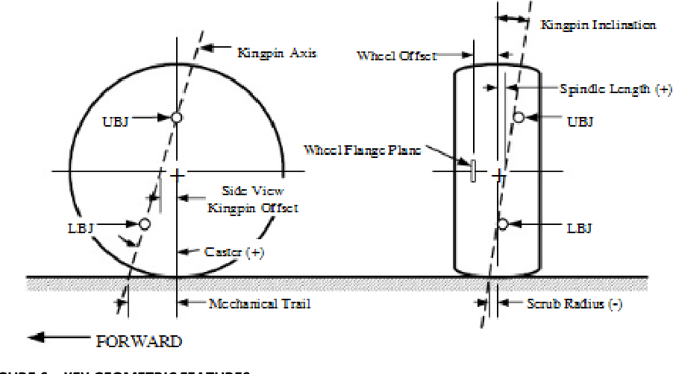
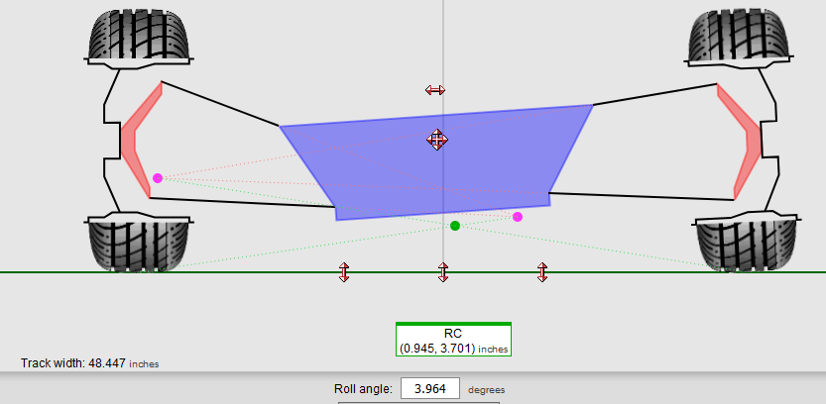
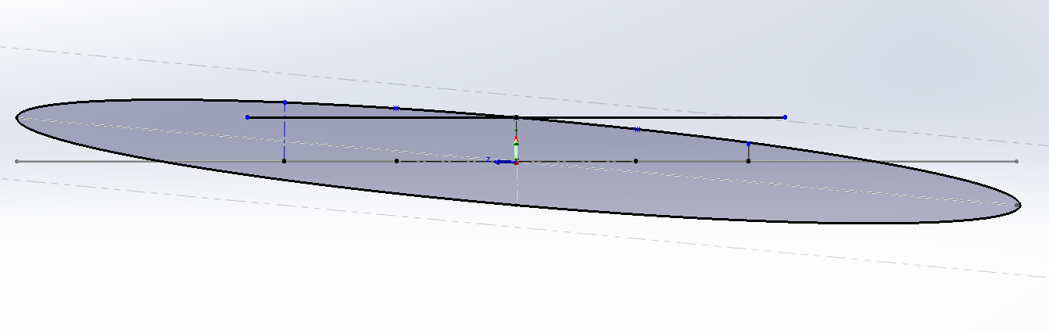
Knuckle/Geometry Modeling
Vsusp.com
(.03deg, -2.6deg)
PHOTO
Figure 11. Vsusp website
Figure 12. Diagram of steering axis inclination
More positive camber for the right wheel, and more negative for the left wheel.
From reducing mechanical trail, the ellipse will change its position relative to the horizontal, which will give us different camber gain from steering.
The goal is to compensate for these changes by changing camber gain from articulation
Figure 13. Cad model to show wheel changes
Measures height of edge of tire to the center, to find camber gain/loss from turning right or left.
Page 17 - Parker

Slide 18
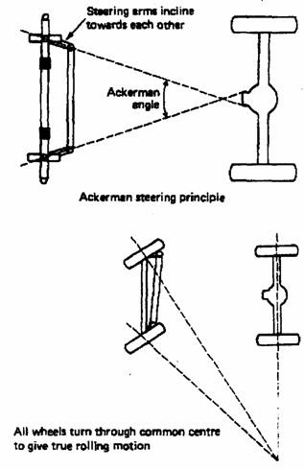
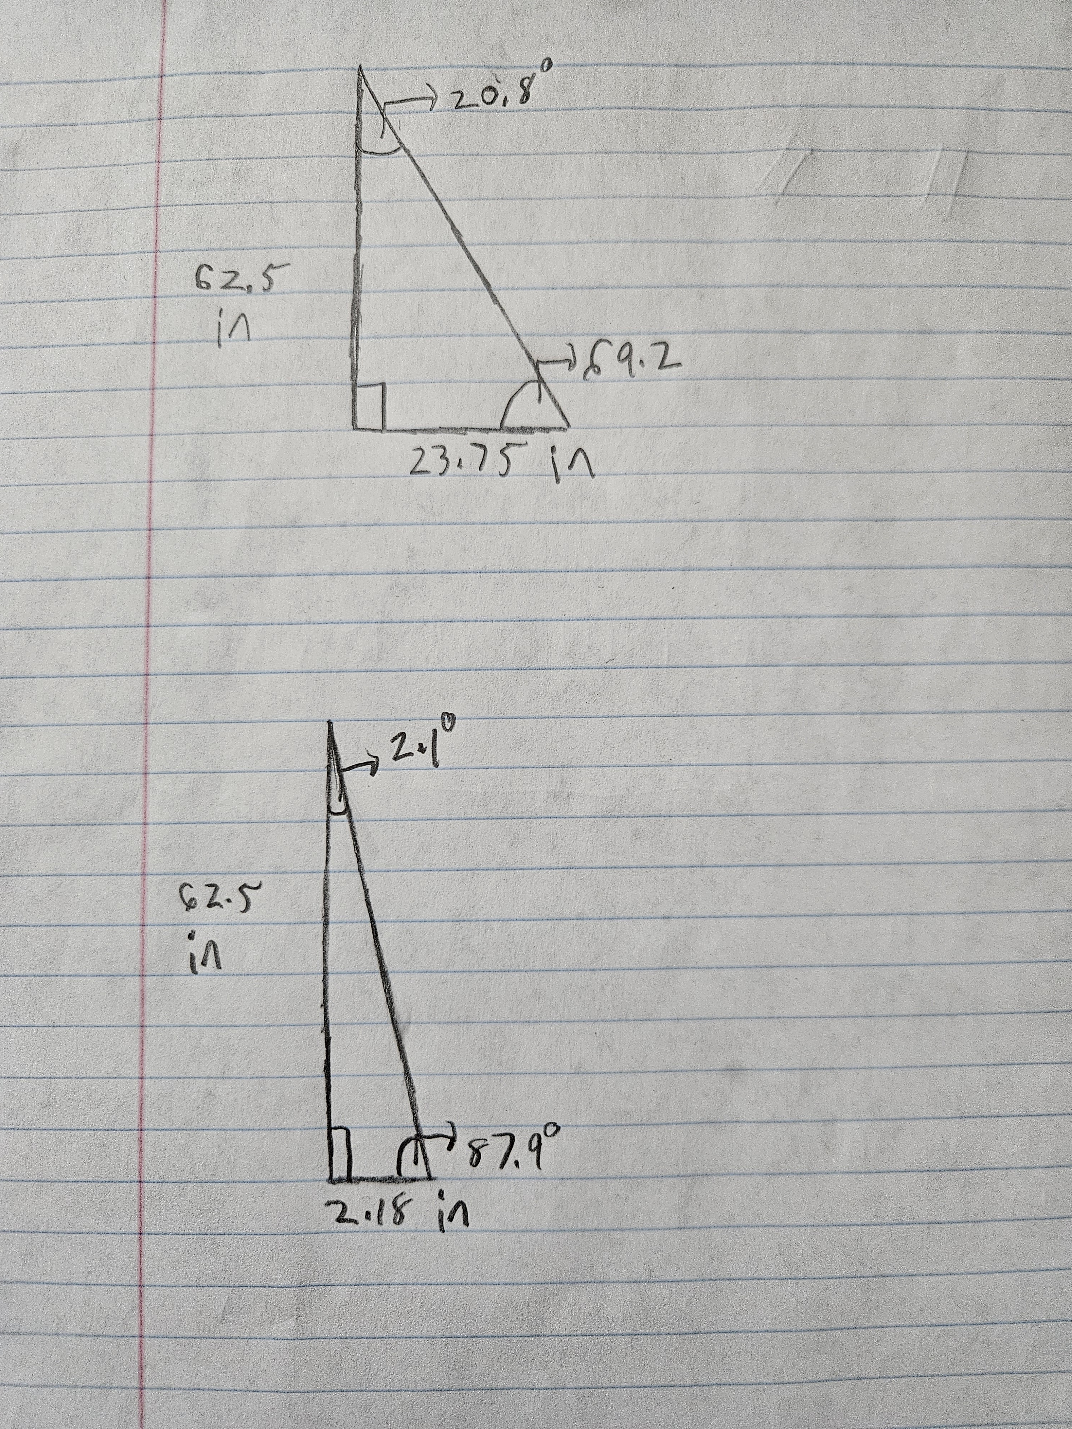
Steering Mathematical Modeling
To design the steering knuckle measurements
We need to know Ackerman
From our last car we see an Ackerman of 10%
We had an original angle of 2 degrees
This car will have a beginning angle of 10 Degrees (50%)
Will be fine-tuned as design progresses
PHOTO
Figure 14. Hand calculations for Ackerman angle
Figure 15. Ackerman Diagram
Page 18 - Matthew

Slide 19
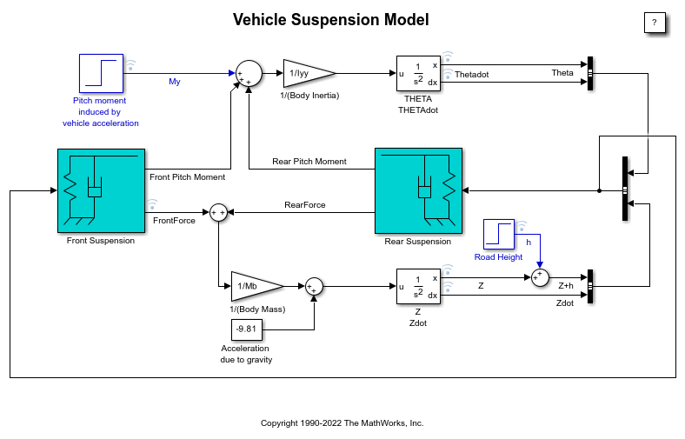
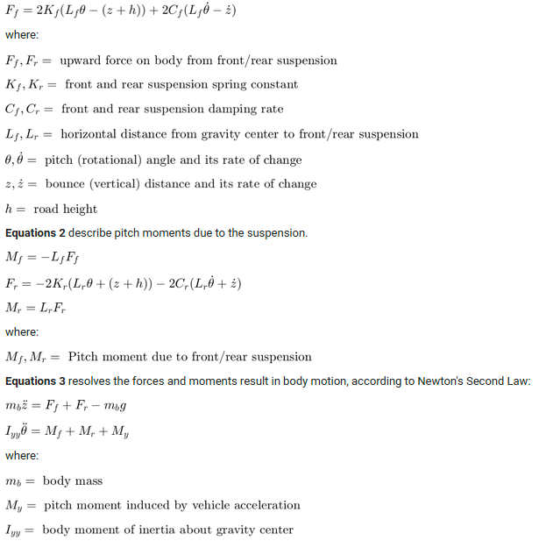
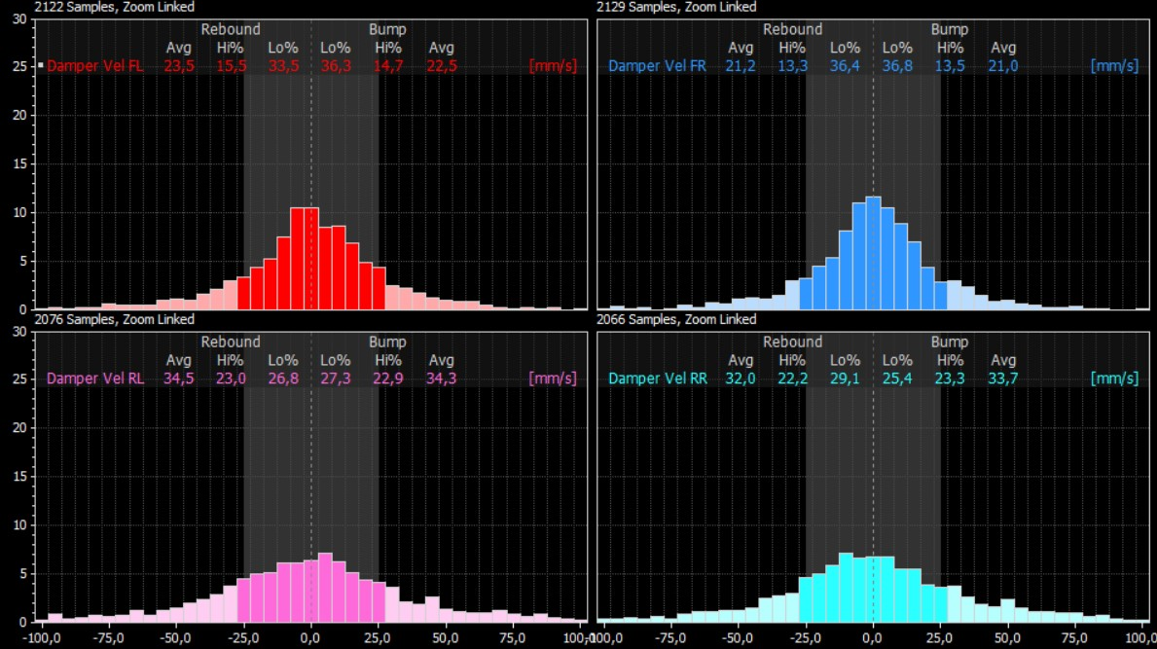
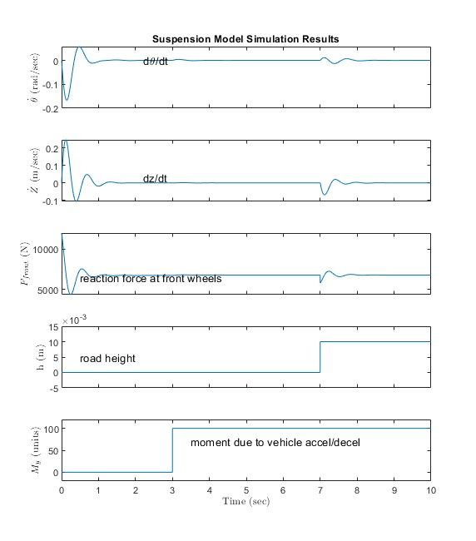
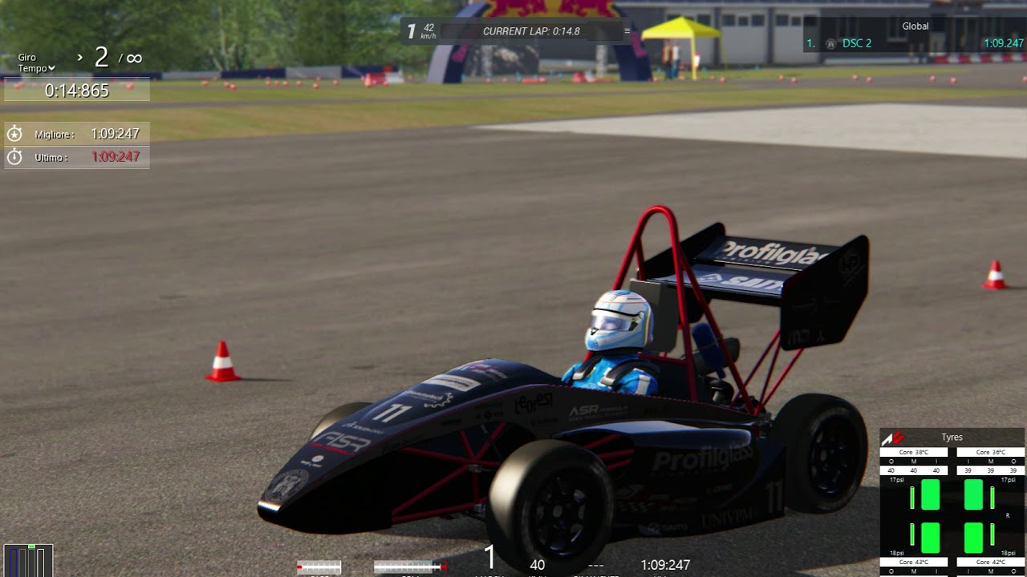
Pushrod Modeling
Tools
Figure 18. Simulink suspension model
PHOTO
Figure 16. MoTec damper data
Figure 19. Formulas used in model
Figure 17. FASE car mod
Figure 20. Model results
Page 19- Joe

Slide 20
Brakes – Mathematical Modeling
Areas of improvement identified on last year's car
-Better adjustability than last year in terms of brake bias, pedal ratio, and distance from pedal to seat(accommodations for different size drivers)
- Improved pedal feel/sensitivity
- Lighter weight relative to last year
- Low profile brake line/pedal box assembly for space saving
Programs: Matlab, Solidworks, and Assetto Corsa(racing sim)
PHOTO
Page 20 - Chris

Slide 21
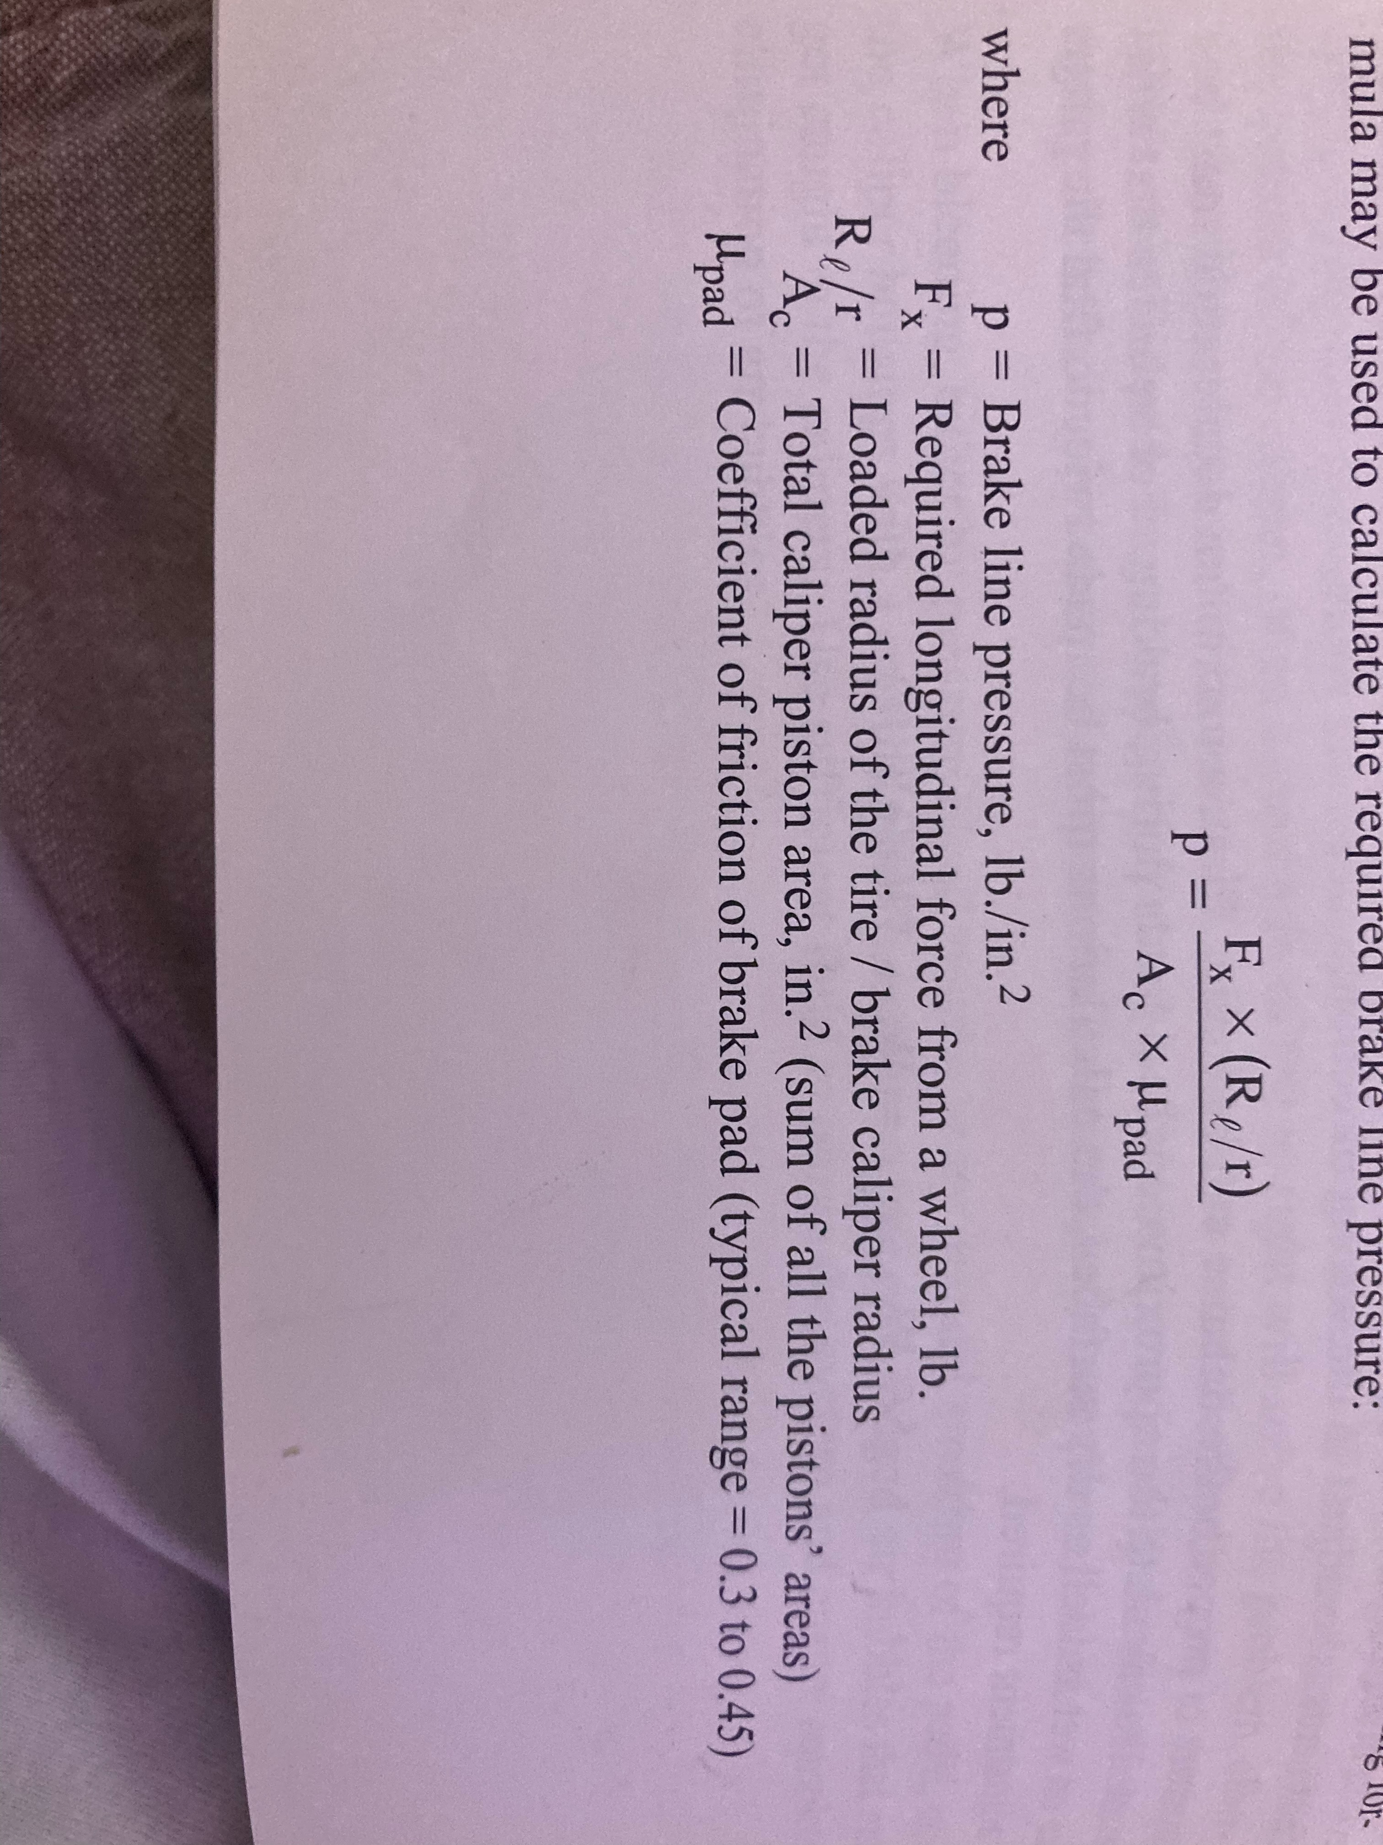
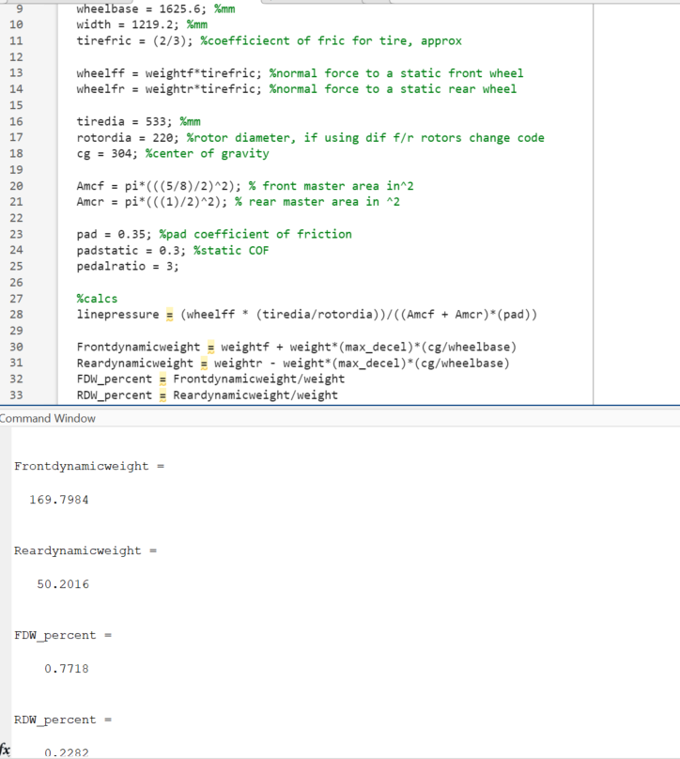
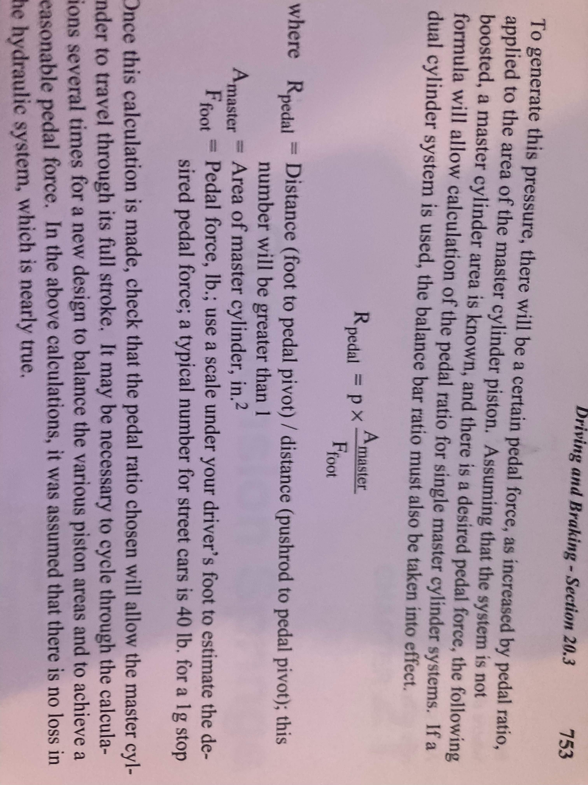
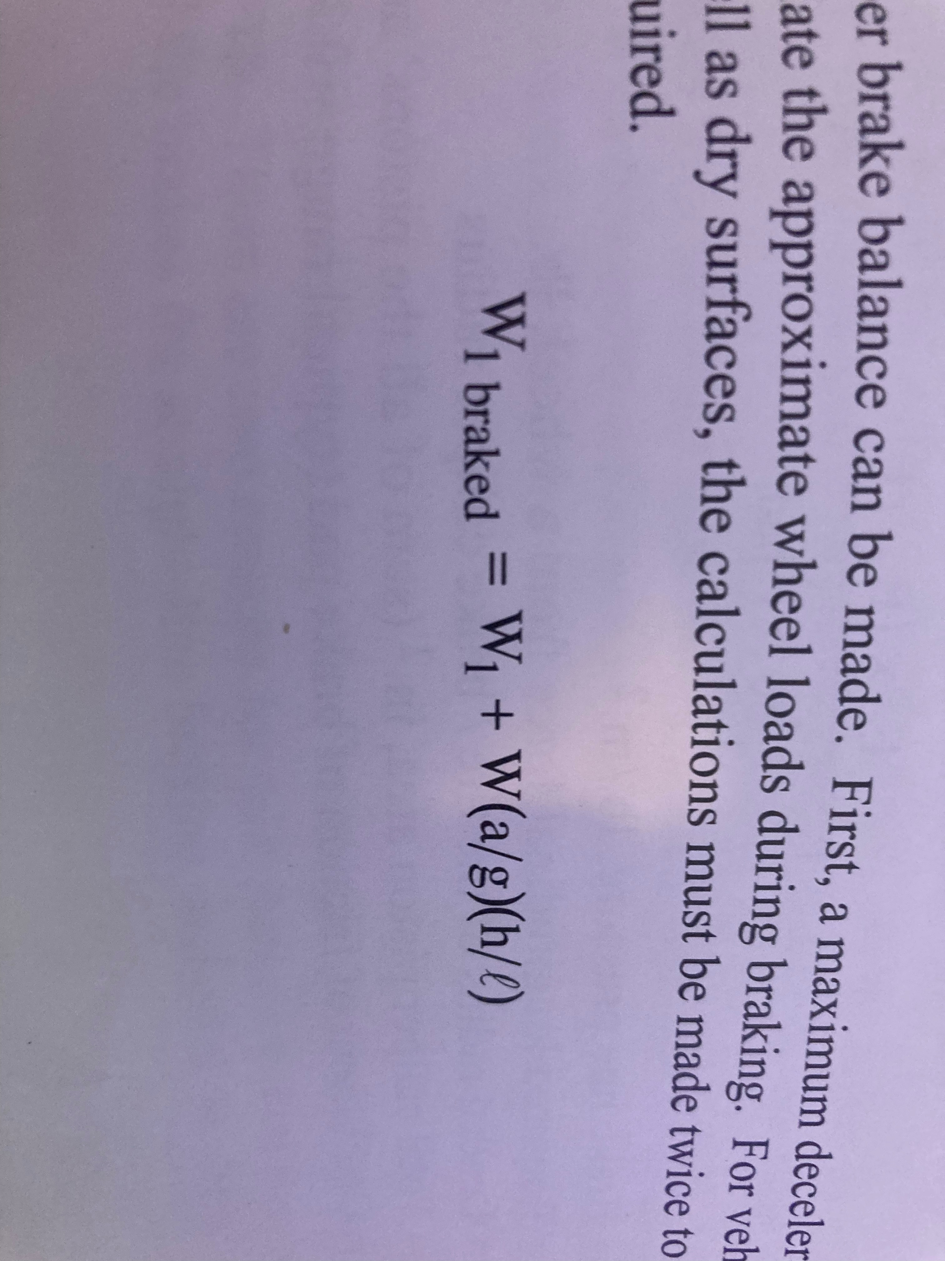
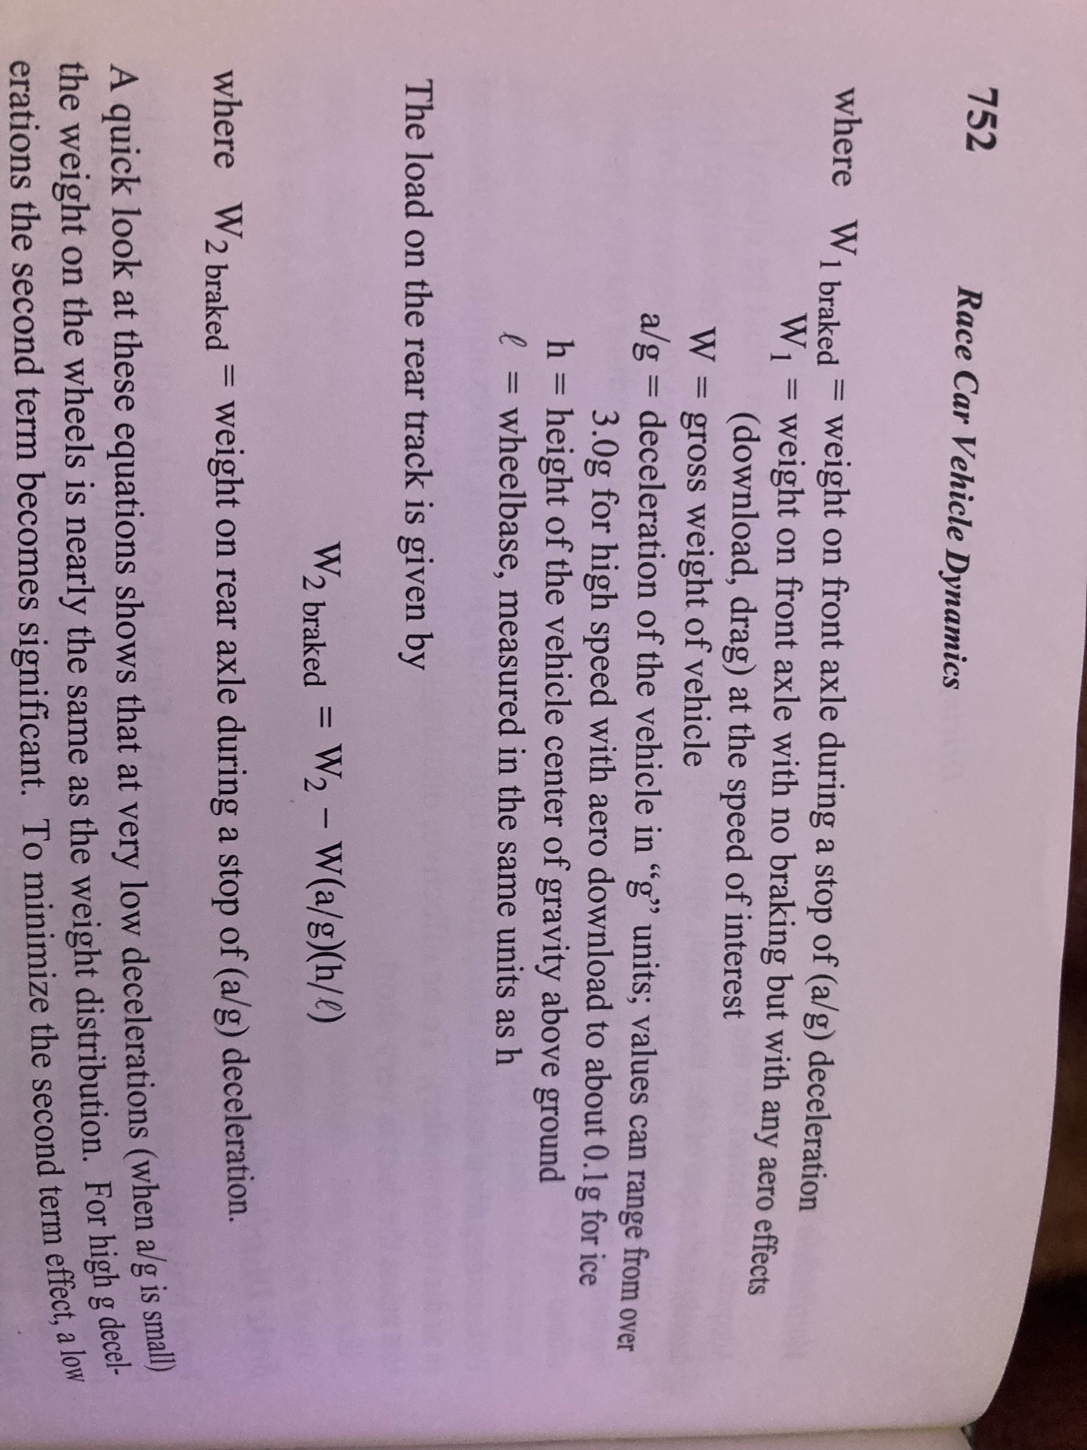
Brakes- Mathematical Modeling
PHOTO
Figure 21. Brake equations
Page 21 - Chris

Slide 22
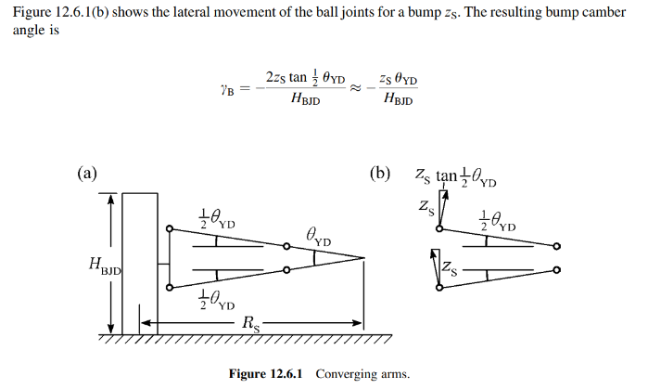
A-Arm - Mathematical Modeling
Bump Camber Angle
Yb= -(Zs/Rs) = -.2
The resulting calculation showed that we would encounter minimal negative camber change over a bump
PHOTO
Figure 22. A-Arm diagram
Page 22 - Garrett

Slide 23
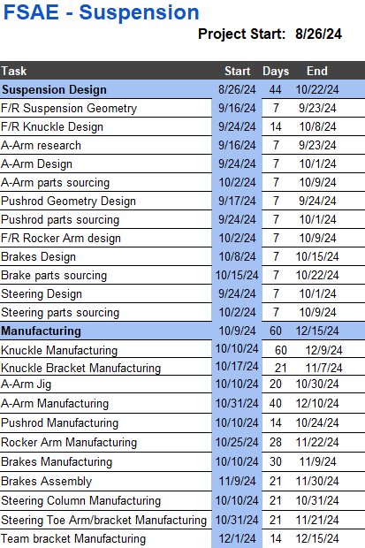
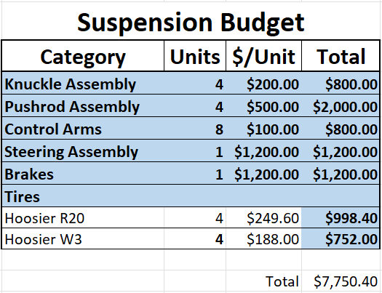
Schedule and Budget
PHOTO
Figure 23. Budget 2025
Figure 24. Production timeline
Page 23 - Parker

Slide 24


Thank you!

