Slide 1
Powertrain
FSAE
Damian Boniella, Matt Gingold, Tobin Lanford, Joey LeBlanc, Lucille Longhurst

Slide 2
Agenda
Project Description
1
2
Background & Benchmarking
3
Customer and Engineering Requirements
4
A Literature Review
5
Mathematical Modelling
Schedule & Budget
6

Slide 3
Project Description
What is the powertrain?
The powertrain is the system in the vehicle that is responsible for generating and delivering power to the wheel and enabling motion.
Goals As A Subteam:
Engine
Fuel/Air System
Exhaust System
Cooling System
Transmission
Shifting System
Differential
Control System
Purpose:
Acquire a low mileage engine
  Includes an aftermarket Engine Control Unit (ECU)
Limited Slip Differential
Pass tech efficiently at competition
Our primary purpose is to ensure efficient power transmission from the engine to the wheels, maximizing performance, reliability, and safety. It gives us practical experience, fosters team collaboration, solid integration skills, and problem solving innovation.

Slide 4
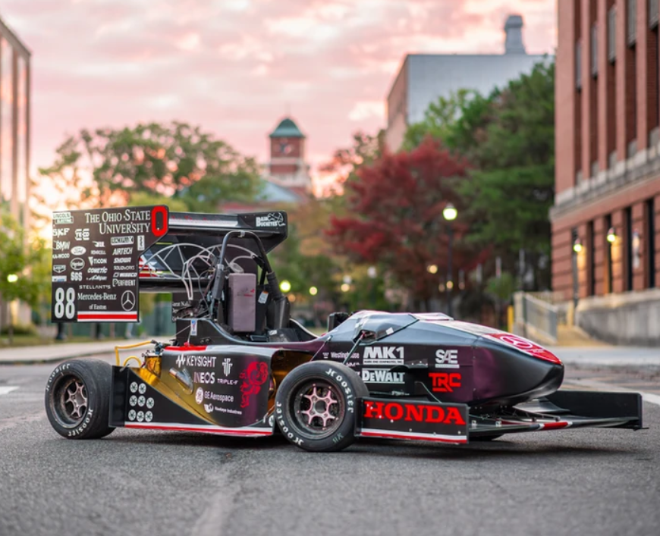
Background & Benchmarking
Ohio State University:
Overall all result: 1st
Acceleration: 4.271 sec
Skidpad: 5.346 sec
Autocross: 46.911 sec
Endurance: 1395.891 sec (23.26 min)
Efficiency: 0.535
“State of The Art”
FSAE 1st Place:
Ohio State University

Slide 5
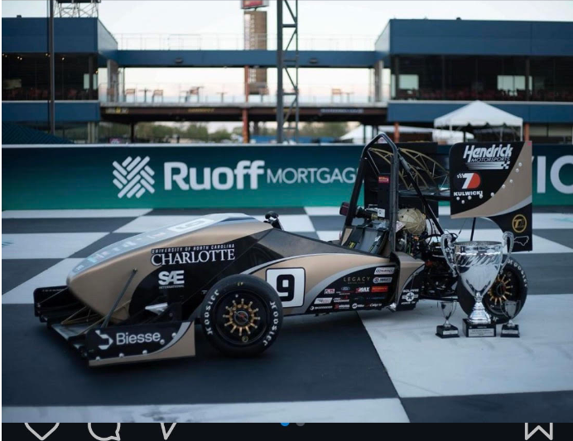
Background & Benchmarking
Results FSAE 2024
Overall all result: 2nd
Acceleration: 4.811 sec
Skidpad: 5.243 sec
Autocross: 50.329 sec
Endurance: 1408.963 sec (23.48 min)
Efficiency: 0.691
FSAE 2nd Place:
Univ. North Carolina -Charlotte

Slide 6
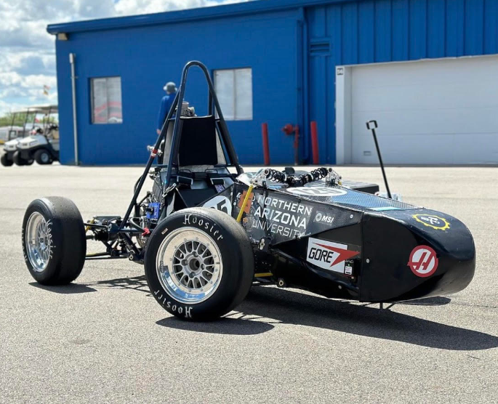
Background & Benchmarking
Results FSAE 2024
96th Overall
Acceleration: DNA
Skidpad: DNA
Autocross: DNA
Endurance: 2092.469 ~ 35 minutes
Efficiency: DNA
Components:
Honda CBR600F4i
Spool in the Rear
Shifting System
Intake
Muffler
NAU FSAE 2024

Slide 7
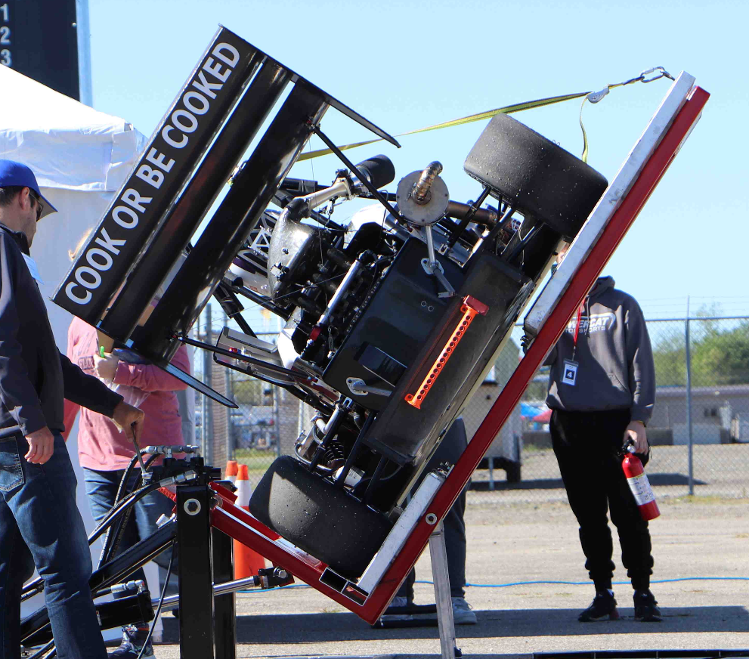
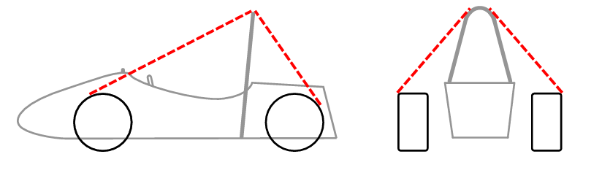
Requirements
Engineering
Customer
Maximum engine displacement of 710cc
20mm diameter intake restrictor
103 decibel limit at idle in c-scale
  110 decibel at all other speeds in c-scale
Must stay within the Tire Surface Envelope
Scatter Shields on any rotating items
Prevent all leaks with the car at a 45°
General User Experience
Modularity
Clean Wiring
Ease of Shifting
Safety

Slide 8
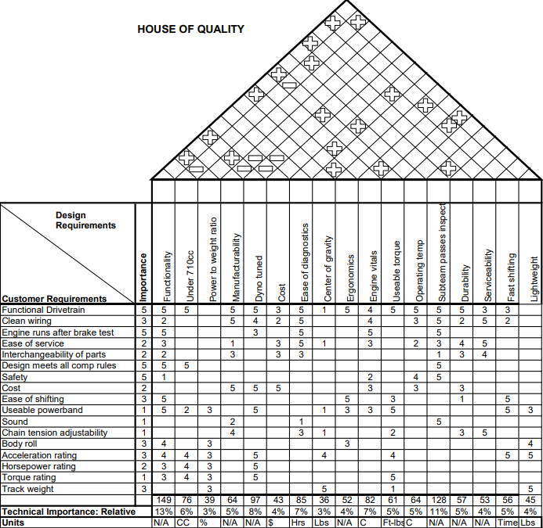
Quality Factor
Design

Slide 9
Literature Review - Joey
Textbooks
[1] G. Banish, Engine Management: Advanced Tuning. North Branch, MN: CarTech, 2007.
Discusses different sensor functions and tuning procedures for when NAU FSAE tunes the build
[2] J. B. Heywood, *Internal Combustion Engine Fundamentals*, 2nd ed. New York: McGraw-Hill, 2018.
Chapter 2: Engine Design Operation Parameters
Chapter 3: Thermochemistry of Fuel- Air Mixtures
Used for engine horsepower and torque calculations
Published Papers
[1] B. Devak and P. Deepan, “Sustainable use of single-cylinder engine over multi- ...,” International Research Journal of Engineering and Technology, https://www.irjet.net/archives/V4/i7/IRJET-V4I7301.pdf (accessed Sep. 16, 2024).
Used to decide on a inline four cylinder engine as opposed to a single cylinder engine
‌

Slide 10
Literature Review - Joey
Published Papers (cont)
[2] K. Lutenbacher, B. Mayeaux, and J. Waller, “FSAE Engine Selection: Four or One Cylinder.” Available: https://korilutenbacher.weebly.com/uploads/5/4/9/9/5499743/klutenbacher_bmayeaux_jwaller_me4633_fsae_report.pdf
Used to research how other teams decided on a single cylinder or inline four cylinder engine
[3] T. Ayres, K. Hayward, and F. Guzzomi, “Design of a custom FSAE engine,” ResearchGate, https://www.researchgate.net/profile/Kevin_Hayward/publication/320081033_Design_of_a_Custom_FSAE_Engine/links/5a4c1d0fa6fdcc3e99cf6b23/Design-of-a-Custom-FSAE-Engine.pdf (accessed Sep. 16, 2024).
Gives insight on things that need to be considered when designing or selecting an engine
Standard
[1] FSwiki, “List of Engines,” List of engines, https://fswiki.us/List_of_Engines (accessed Sep. 16, 2024).
Provides an extensive list of engines other teams have used in FSAE competitions and was used to cross reference engine choices
‌

Slide 11
Literature Review - Joey
Online Resources
[1] C. Catto, “Thread: Engine selection: New advances V. tried and true,” Engine selection: new advances V. tried and true , https://www.fsae.com/forums/showthread.php?3760-Engine-selection-new-advances-V.-tried-and-true%2Fpage5 (accessed Sep. 16, 2024).
Information from current students on selecting an engine
[2] “R/FSAE on reddit: Internal Combustion Engine for our first car,” FSAE Reddit, https://www.reddit.com/r/FSAE/comments/nc7ke3/internal_combustion_engine_for_our_first_car/ (accessed Sep. 16, 2024).
Considerations for a first year team when selecting an engine
[3] “R/FSAE on reddit: Engine choices,” FSAE Reddit, https://www.reddit.com/r/FSAE/comments/8ljj9r/engine_choices/ (accessed Sep. 16, 2024).
A alumni & student perspective on the different engine choices
‌

Slide 12
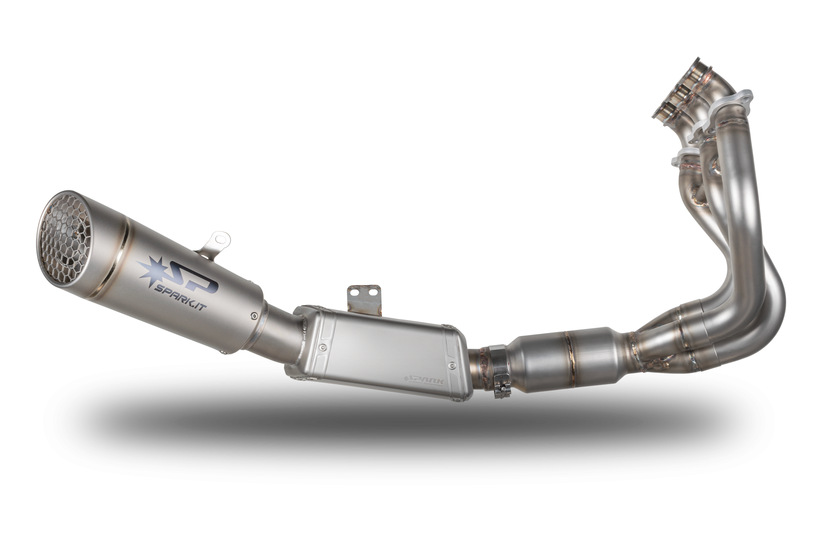
Literature Review - Matt
https://www.sparkexhaust.com/en
Textbooks:
[1] J.B. Heywood, Internal Combustion Engine Fundamentals, 2nd edition. New York: McGraw-Hill, 2018.
Chapter 5: Ideal Models of Engine Cycles
Chapter 6: Gas Exchange Processes
Looks at how to deal with hot gases in the exhaust system and how to optimize them
[2] Mike Mavrigian, Performance Exhaust Systems, How to Design, Fabricate, and Install. North Branch MN: CarTech Inc, 2014. https://www.google.com/books/edition/Performance_Exhaust_Systems/FkP7AwAAQBAJ?hl=en&gbpv=1&dq=motorcycle+exhaust+system+design&printsec=frontcover
Deciding how to fabricate an exhaust by taking into account things like equal length headers and how to make them
Standard:
[1] Erik Oberg, Franklin D. Jones, Holbrook L. Horton, and Henry H. Ryffel, Machinery’s Handbook, 29th Edition. New York: Industrial Press, 2012.
Comparing different materials to use for the exhaust piping

Slide 13
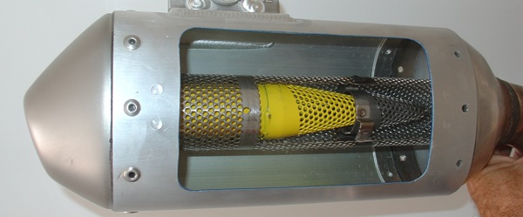
Literature Review - Matt
Published Papers:
[1] Hiroshi Kuribara, et al, Prediction of Fatigue Strength of Motorcycle Exhaust System Considering Vibrating and Thermal Stresses. SAE International Journal of Engines, 2016. https://www.jstor.org/stable/26284825?seq=1
Looks into exhaust failures due to vibrations and thermal stresses
[2] A M Siregar, et al, Engineering of motorcycle exhaust gases to reduce air pollution. IOP Conference Series: Materials
Science and Engineering, 2020. https://iopscience.iop.org/article/10.1088/1757-899X/821/1/012048/meta
Discusses interesting ways to reduce emissions from a motorcycle exhaust system
[3] Taguchi, T., Aoki, M., Katsukawa, Y., KOGA, M. et al., "Development of a Noise Prediction Technique for Designing a High-Performance Muffler of Motorcycle," SAE Technical Paper 2010-32-0023, 2010, https://doi.org/10.4271/2010-32-0023
Talks about custom mufflers, and how to optimize them for the engine at hand
https://motocrossactionmag.com/10-things-you-need-to-know-about-mufflers/

Slide 14
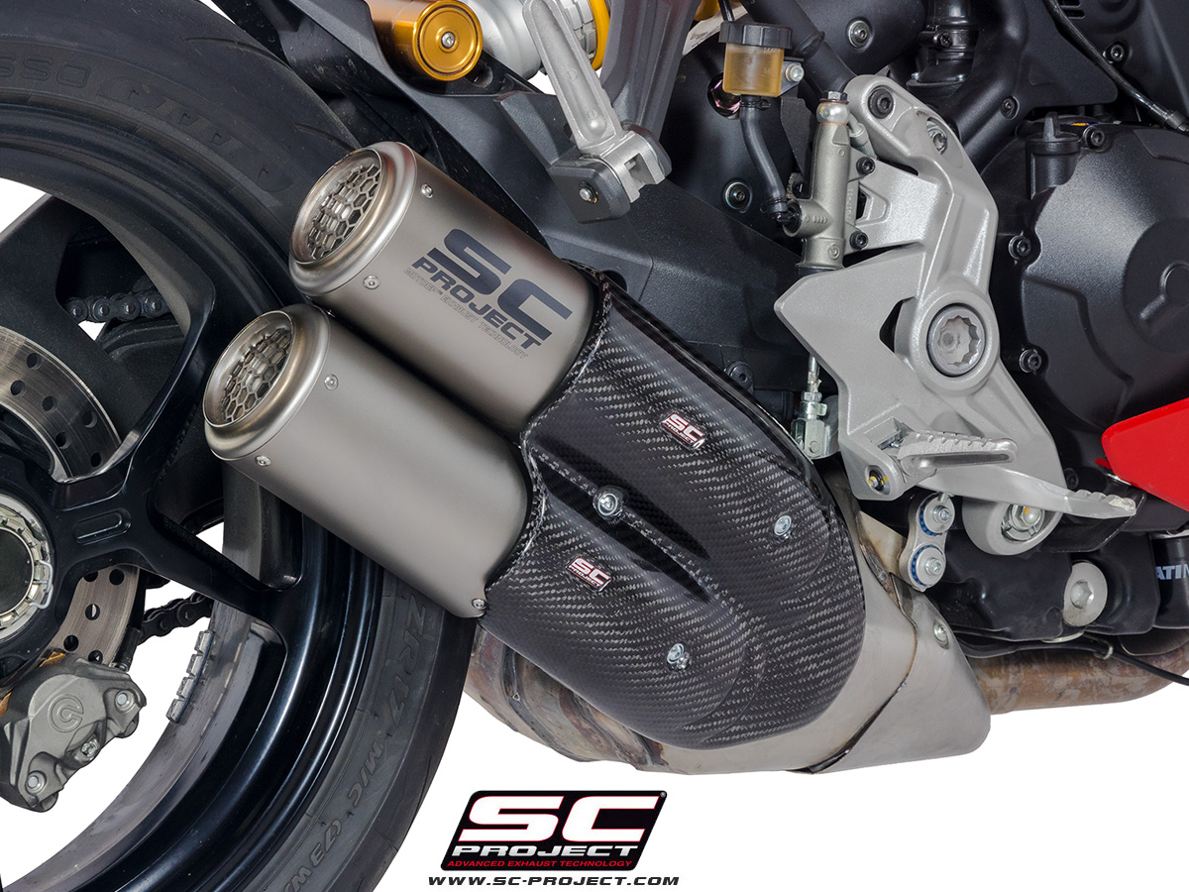
Literature Review - Matt
Online Resources:
[1] MXA, Ten Things You Need to Know About Mufflers. Motocross Action Mag, 2019. https://motocrossactionmag.com/10-things-you-need-to-know-about-mufflers/
Talks about all of the traits you should look for in a muffler, and points out some nifty things
[2] Martin Pechout, et al, Regulated and unregulated emissions and exhaust flow measurement of four in-use high performance motorcycles. Science Direct: Atmospheric Enviroment: X, 2022. https://www.sciencedirect.com/science/article/pii/S2590162122000247
Compares different bikes with differing displacements to see emissions and flow rates
[3] Zach Jobe, et al, DIY Exhaust! - Is it worth it? Donut Media: Money Pit, 2021. https://www.youtube.com/watch?v=io9k0gNj7c4
Video showing the process of making a custom exhaust (this example is on a car), and it even includes using a welder and showing how to use it.
https://www.sc-project.us/dual-titanium-cr-t-exhaust-by-sc-project-ducati-d21-d36t.html?mmyId=24140&mmy=Ducati-Supersport-2022

Slide 15
Literature Review - Damian
Textbooks:
[1] J. B. Heywood, Internal Combustion Engine Fundamentals. New York: McGraw-Hill Education, 2019.
Sec: 6.1, 7.5, 14.3: Intake Air Flow Phenomena and Modeling
[2] W. W. Pulkrabek, Engineering Fundamentals of the Internal Combustion Engine. Unid States of America: Prentice Hall, 2004.
Sec: 2.9 and chap: 5, 6, 7: Intake Designing Equations
Standard:
[1] Erik Oberg, Franklin D. Jones, Holbrook L. Horton, and Henry H. Ryffel, Machinery’s Handbook, 29th Edition. New York: Industrial Press, 2012.
Pg. 1004-1327: Standards on machining speeds, feed rates, and cutting fluids

Slide 16
Literature Review - Damian
Published Papers:
[1] T. Setoguchi, S. Matsuo, H. D. Kim, and M. Alam, “Nozzle Geometry Variations on the discharge coefficient,” ScienceDirect, https://www.sciencedirect.com/science/article/pii/S2212540X16000031 (accessed Aug. 25, 2024).
Research on how nozzle geometry affects discharge coefficients
[2] A. J. Szaniszlo, “EXPERIMENTAL AND ANALYTICAL SONIC NOZZLE DISCHARGE COEFFICIENTS FOR REYNOLDS NUMBERS UP TO 8x10^6,” NASA, https://ntrs.nasa.gov/api/citations/19750006921/downloads/19750006921.pdf (accessed Aug. 25, 2024).
Research on how nozzle geometry affects discharge coefficients
[3] “PERFORMANCE OF CONICAL JET NOZZLES IN TERMS OF FLOW AND VELOCITY COEFFICIENTS,” NASA, https://ntrs.nasa.gov/api/citations/19930091998/downloads/19930091998.pdf (accessed Aug. 25, 2024).
Research on how nozzle geometry affects velocity and pressure

Slide 17
Literature Review - Damian
Online Resources:
[1] J. Szabo, “Calculating Critical Air scoop speed with a forward facing Air Inlet,” EngineLabs, https://www.enginelabs.com/engine-tech/calculating-critical-air-scoop-speed-with-a-forward-facing-air-inlet/ (accessed Aug. 7, 2024).
Discusses the effectiveness of scoops for high performance cars
[2] “Proper hood scoop sizing,” Yellow Bullet Forums, https://www.yellowbullet.com/threads/proper-hood-scoop-sizing.2022842/ (accessed Aug. 7, 2024).
A forum discussing scoop sizing

Slide 18
Literature Review - Tobin
Textbooks
[1] E. Oberg and C. J. McCauley, Machinery’s Handbook: A Reference Book for the Mechanical Engineer, Designer, Manufacturing Engineer, Draftsman, Toolmaker, and Machinist. “Machining Operations” and “Fasteners” New York: Industrial Press, 2012.
Aid in designing mounts for ease of manufacturability
[2] R. G. Budynas and J. K. Nisbett, “Chapter 17: Flexible Mechanical Elements,” in Shigley’s Mechanical Engineering Design 11th Edition, McGraw Hill, 2020, pp. 882–934
Equations for calculating torque applied to differential
Standards
[3] E. Oberg and C. J. McCauley, Machinery’s Handbook: A Reference Book for the Mechanical Engineer, Designer, Manufacturing Engineer, Draftsman, Toolmaker, and Machinist. “Mechanics and Strength of Materials,” New York: Industrial Press, 2012.
Material properties for potential differential mount materials
[4] S. Cecchel, “Materials and technologies for Lightweighting of structural parts for Automotive Applications: A Review,” SAE International Journal of Materials and Manufacturing, vol. 14, no. 1, Sep. 2020. doi:10.4271/05-14-01-0007
Aid in material selection for differential mounts
Articles
[5] S. Das, P. Gogoi, M. Agrawal, and Rounak, “Design of Differential Mounts and Rear Inboard Braking for an FSAE Vehicle,” in Advances in Manufacturing Engineering, Singapore: Springer, 2022, pp. 437–455
Design process of differential mounts for an FSAE vehicle utilizing a Drexler LSD

Slide 19
Literature Review - Tobin
Articles - continued
[6] R. A. James, Design of an Aluminum Differential Housing and Driveline Components for High Performance Applications, https://dspace.mit.edu/bitstream/handle/1721.1/32762/57570210-MIT.pdf?sequence=2&isAllowed=y (accessed Sep. 14, 2024).
Design process of a aluminum replacement differential housing for a Torsen differential in an FSAE vehicle
[7] Scelfo Tony, Lightweight Torsen Style Limited Slip Differential and Rear Driveline Package for Formula SAE, https://dspace.mit.edu/bitstream/handle/1721.1/36702/77550024-MIT.pdf?sequence=2&isAllowed=y (accessed Sep. 14, 2024).
Design process of an aluminum housing for a Torsen differential in an FSAE vehicle
[8] K. Durand, Design of a Chain Driven Limited Slip Differential and Rear Driveline Package for Formula SAE Applications, https://dspace.mit.edu/bitstream/handle/1721.1/32862/62587598-MIT.pdf?sequence=2&isAllowed=y (accessed Sep. 2024).
Design process for a chain driven LSD mount that utilizes the swing arm mount of a Honda bike engine
Online Sources
[9] Produktkatalog - Drexler automotive GmbH, https://www.drexler-automotive.com/de/produkte/produktkatalog (accessed Sep. 14, 2024).
Product catalog from desired manufacturer for limited-slip differential

Slide 20
Literature Review: Lucille
Textbooks:
[1] R. G. Budynas and J. K. Nisbett, Shigley's Mechanical Engineering Design, 11th ed. New York: McGraw-Hill, 2020.
Chapter 12: Gears-General
Provided general gear equations and foundations
[2] U.S. Tsubaki, Inc., The Complete Guide to Chain, Wheeling, IL, USA: U.S. Tsubaki, Inc., 1997.
4.1.4 Power Transmission Chain
Provided equations needed for calculations.
[3] E. Oberg, C. J. McCauley, and H. H. Ryffel, *Machinery's Handbook*, 29th ed. New York: Industrial Press, 2012.
Gears, Splines, and Cams
This chapter covers various types of gears and gearing systems, which are integral to the functioning of a car’s transmission.
Articles:
[3] M. Irfan, "Modelling and optimization of gear shifting mechanism," Licentiate thesis, Dept. of Applied Mechanics, Chalmers Univ. of Technology, Gothenburg, Sweden, 2017.
Focuses on developing and optimizing a gear-shifting mechanism through modeling techniques to improve performance, reliability, and efficiency in automotive applications.
[4] C. Tyagi, S. Verma, A. Pandey, D. Prasad, and V. Nath, "Study and Design of Electro-Pneumatic Shifting System," in Proc. 3rd Int. Conf. Microelectronics, Computing and Communication Systems, 2019, pp. 481-488.
Present the design and analysis of an electro-pneumatic gear shifting system aimed at enhancing the precision, speed, and efficiency of shifting in automotive applications.

Slide 21
Literature Review: Lucille
Articles Continued:
[5] P. Arora, M. R. Agrawal, P. P. Singh, N. Gobinath, and M. Feroskhan, "Design and Analysis of a Formula SAE Vehicle Chain Sprocket under Static and Fatigue Loading Conditions," SAE Int. J. Mater. Manf., vol. 14, no. 3, pp. 275-282, 2021, doi: 10.4271/05-14-03-0018.
Evaluates the structural integrity and performance of a chain sprocket used in Formula SAE vehicles, focusing on its response to both static and fatigue loads to ensure reliability and durability.
Other References:
[6] R. J. Chalmela, Electro-pneumatic shifting and servo control of a clutch for a FSAE racecar, M.S. thesis, Dept. Mech. and Aerosp. Eng., Univ. Texas at Arlington, Arlington, TX, USA, 2017.
Report from University Texas in Arlington of how their FSAE completed an electro-pneumatic shifting and servo control of a clutch.
[7] L. Redstone, L. Weston, and J. Deglint, FSAE electronic shifter: Final project report, Univ. Victoria, Victoria, BC, Canada, Dec. 2012. [Online]. Available: http://electronicshifter.wordpress.com/.
A final year report of University of Victoria of how their team completed their electronic shifter
[8] A. J. Kennett, Design of a pneumatically assisted shifting system for Formula SAE® racing applications, M.S. thesis, Dept. Mech. Eng., Massachusetts Institute of Technology, MA, USA (2008)
Discusses the development and implementation of a pneumatic shifting system to enhance the performance and efficiency of gear changes in Formula SAE® race cars.

Slide 22
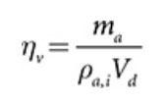
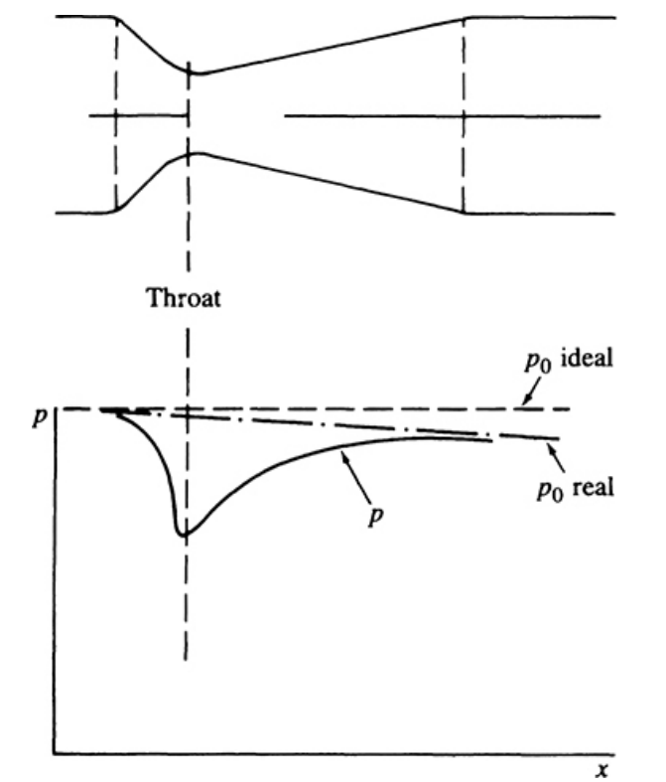
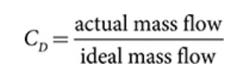
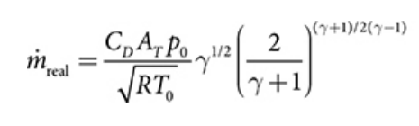
Mathematical Modeling: Damian
Volumetric Efficiency:
Discharge Coefficient:
Mass Flow Rate of Choked Air:

Slide 23
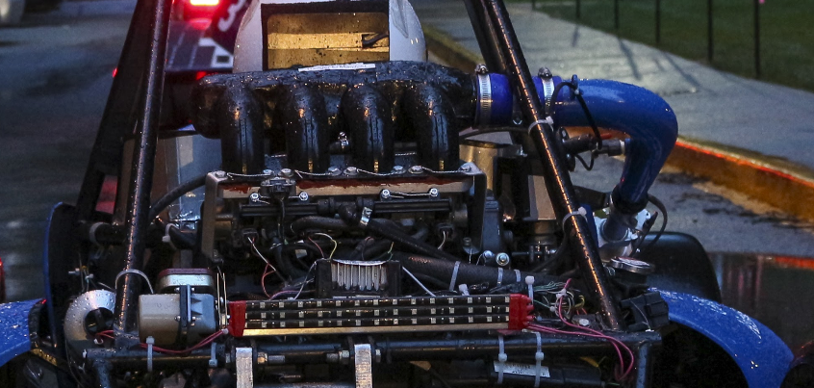
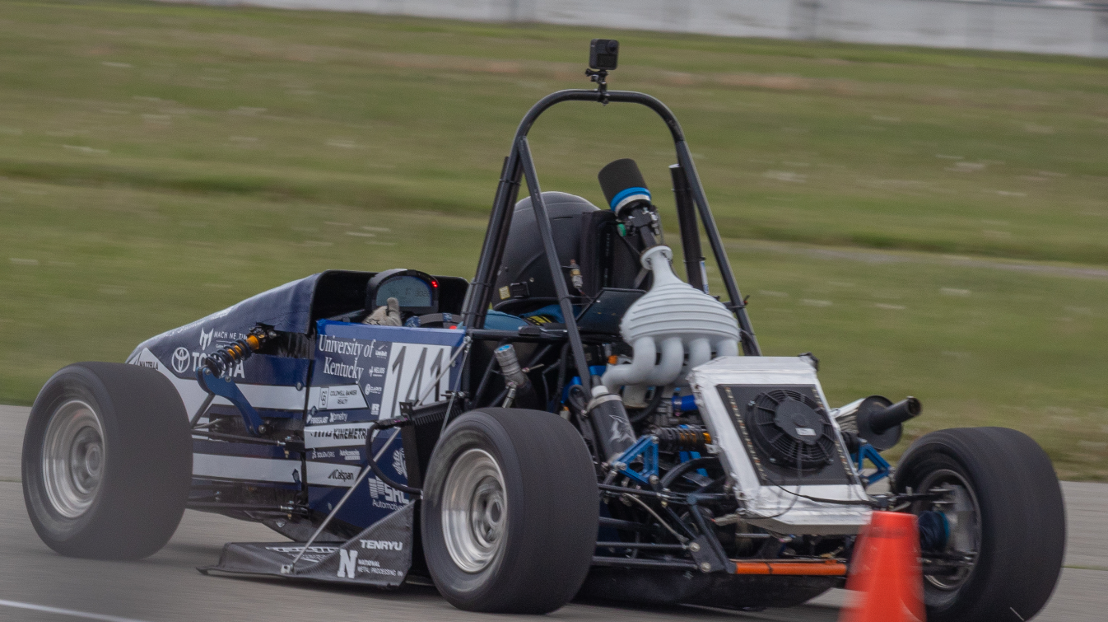
Mathematical Modeling: Damian
Engine CFM_{air}:
CFM_{MAX} = (Displacement x RPM x η_{V}) / (1728 x 2)
CFM_{MAX} = Maximum air the engine needs (ft^3/min)
Displacement = Engine displacement (in^3)
RPM = Engine redline rpm (rpm)
η_{V} = Volumetric Efficiency
1728 = Conversion factor for in^3 to ft^3 (in^3/ft^3)
2 = Engine revolutions per intake cycle
Using the CBR600rr: Displacement: 36.55 in^3, Redline: 13,500 RPM, η_{V}: 88%
CFM_{MAX} = 125.64 ft^3/min of air is needed (Reasonable engine size)

Slide 24

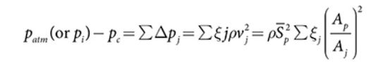
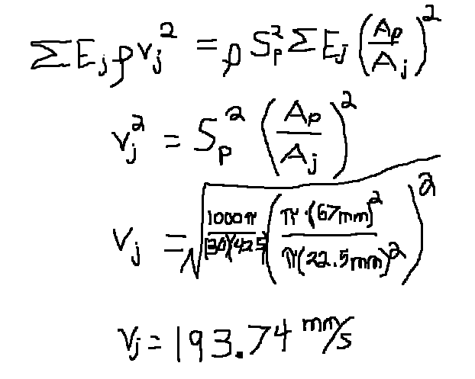

Mathematical Modeling: Matt
Bernoulli’s equation (assuming quasi steady flow)
ξj is the flow resistance coefficient
vj is the local velocity
This relates to piston speed (Sp):
Equation giving loss due to friction in the intake and exhaust
Aj is minimum flow area
Ap is piston area

Slide 25
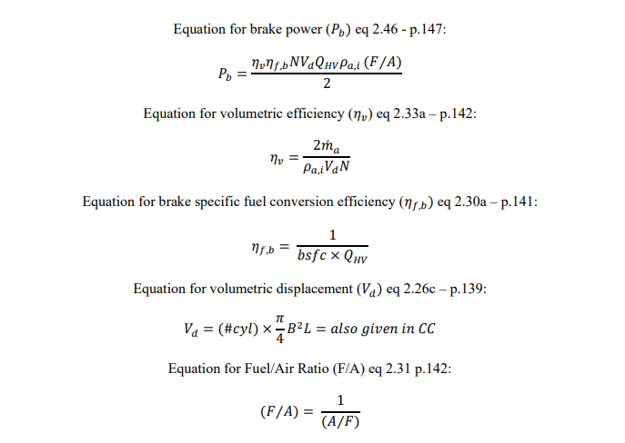
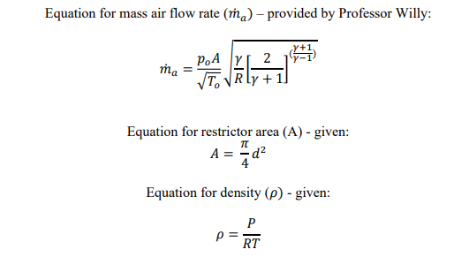
Mathematical Modeling: Joey

Slide 26
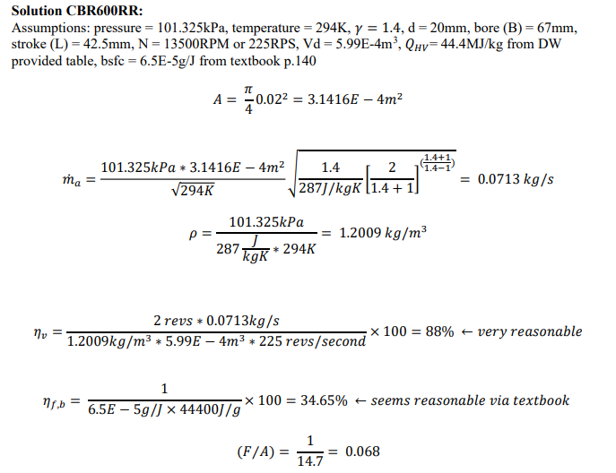
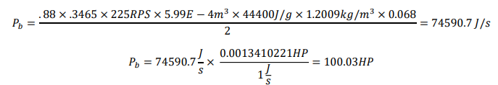
Mathematical Modeling: Joey

Slide 27
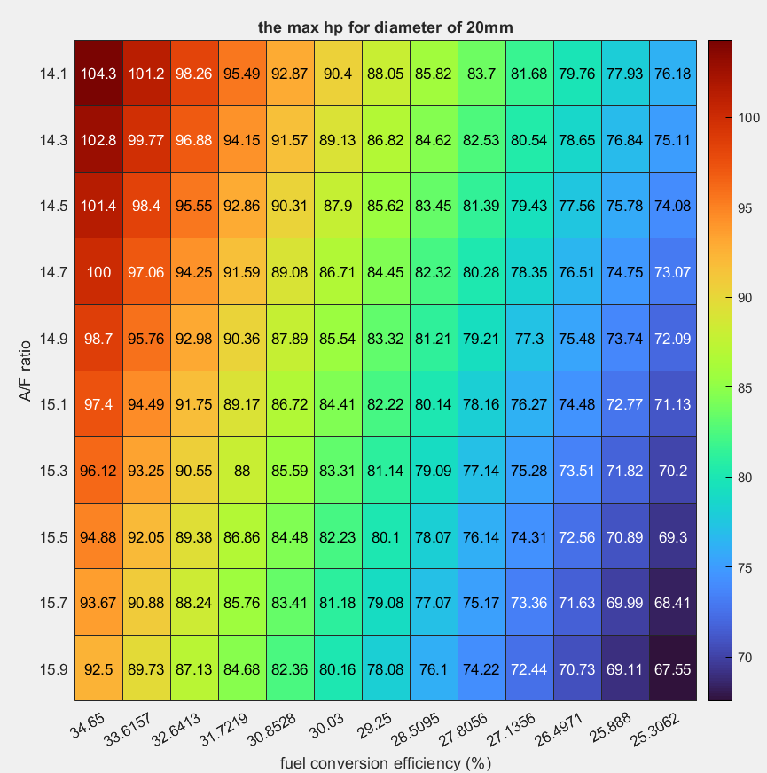
Mathematical Modeling: Joey

Slide 28
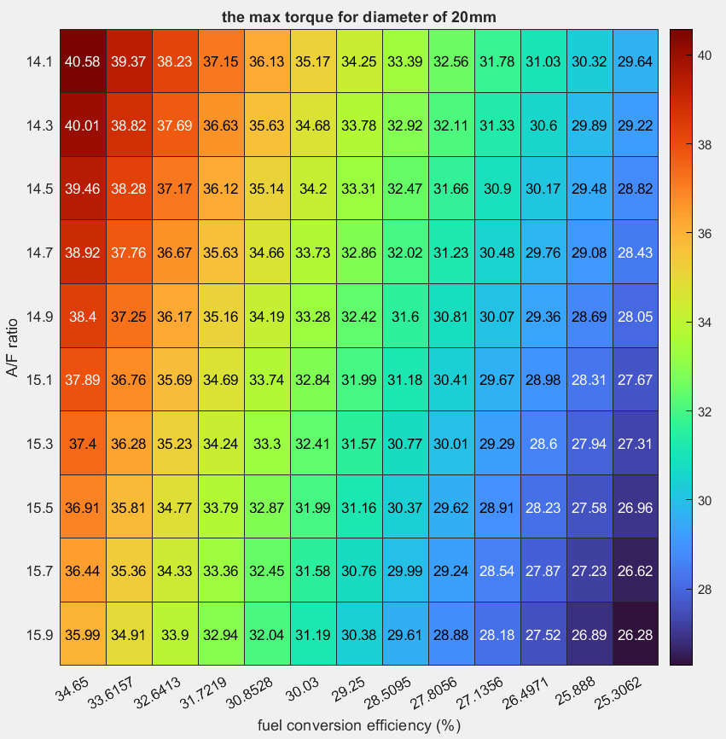
Mathematical Modeling: Joey

Slide 29
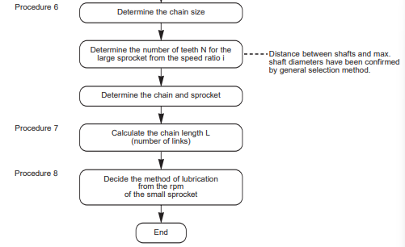
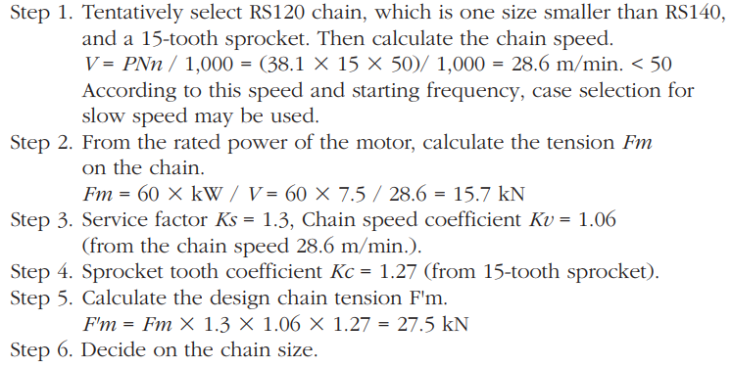
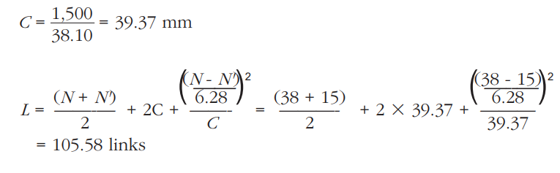
Mathematical Modeling: Lucille
Chain Length
Gear Ratio
Shig’s (Table 13-3)

Slide 30
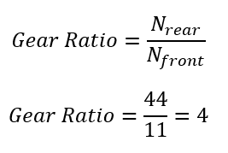
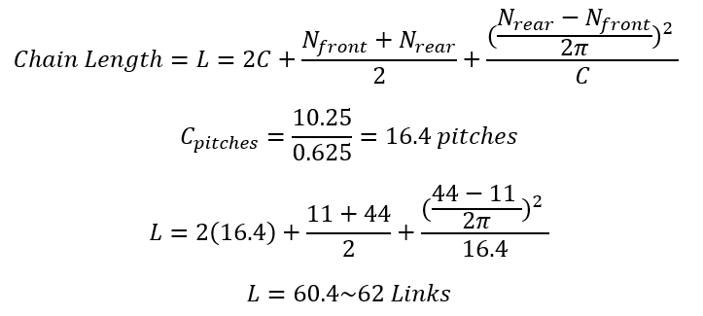
Mathematical Modeling: Lucille
Front Sprocket: 11 teeth, Rear Sprocket: 44 Teeth, 5 – 20 Chain, Center Distance: 10.25 in.
Gear Ratio
Shig’s (Table 13-3)
Chain Length
The Complete Guide to Chains (Chapter 4)

Slide 31
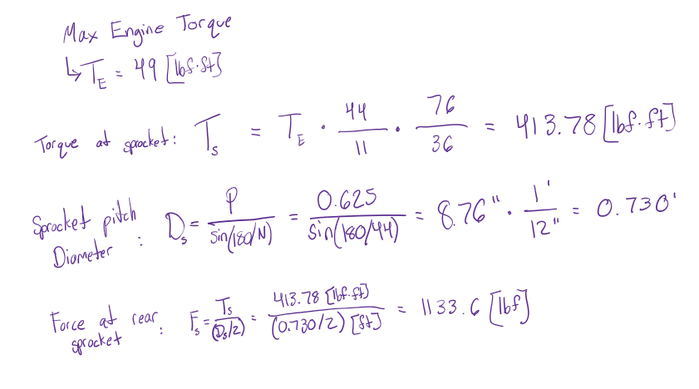
Mathematical Modeling - Tobin
Calculating maximum force on rear sprocket:

Slide 32
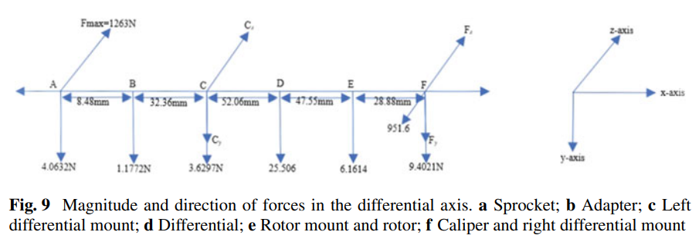
Mathematical Modeling - Tobin
Solving for reaction forces on left and right differential mounts
[5]
Basic model for calculating reaction forces on differential mounts based on force on the sprocket, component weights, and brake caliper frictional force.
Numbers shown do not reflect our vehicle measurements or forces present, but simply provided framework for calculations.

Slide 33
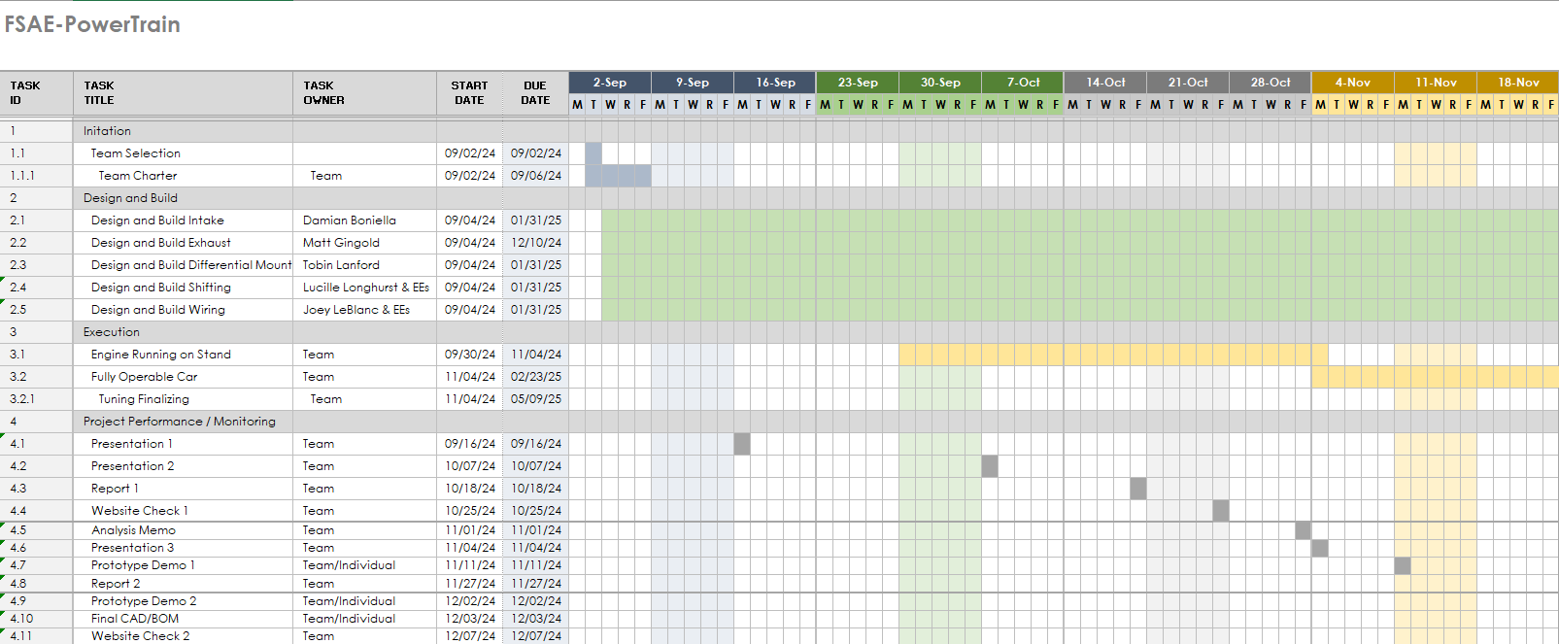
Scheduling: Gantt Chart

Slide 34
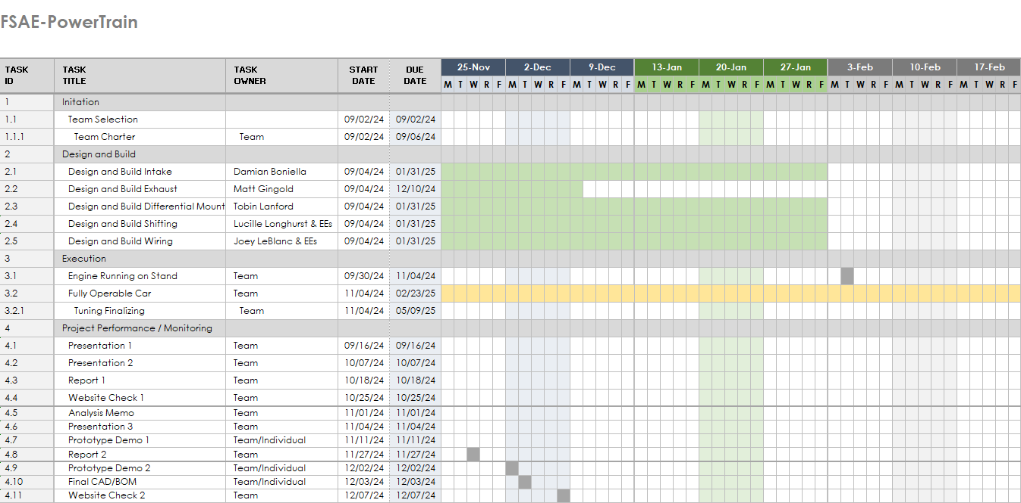
Scheduling: Gantt Chart Continued

Slide 35
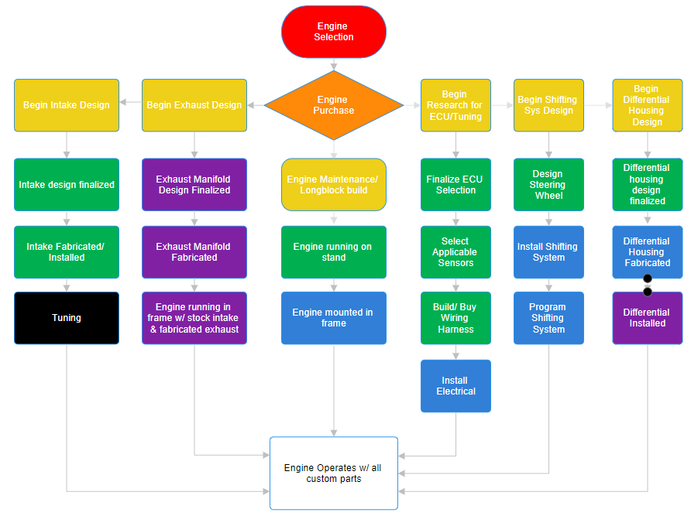
Scheduling

Slide 36
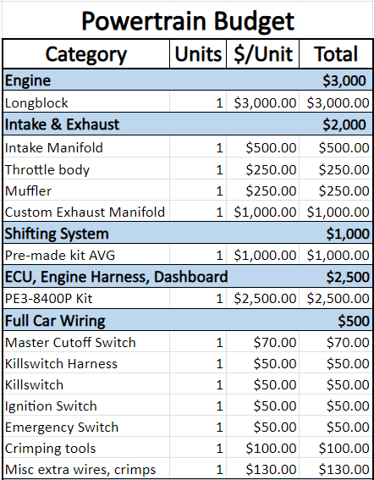
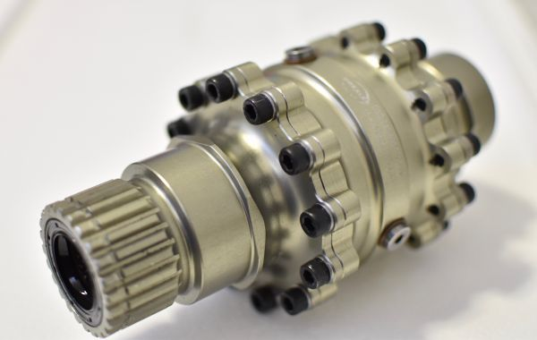
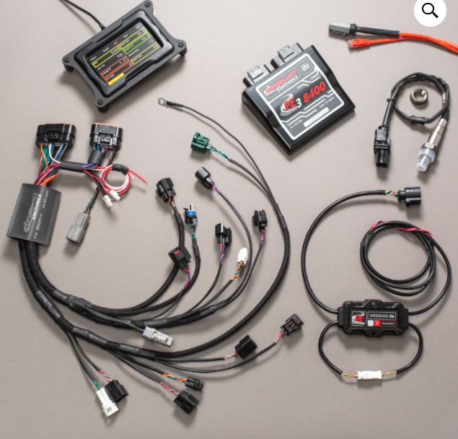
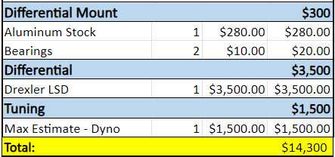
Powertrain Budget (ESTIMATED)

Slide 37
Overall Budget
Category | Total
Suspension | $8,000
Chassis | $6,000
Powertrain | $14,300
Misc Team Purchase | $1,000
Competition | $10,000
NAU Foundation Balance | $11,399.56
GoFundMe Balance | $7,444.75
Committed Donations | $3,500.00
Funds Raised: | $22,344.31
Fundraising Goal | $39,300
Notes:
Chassis - $6000, Suspension - $8000

Slide 38

Fundraising Plan
Novakinetics
Copper State
Machine Solutions
HAAS Grant
GOAZ
Napa Autoparts
Ruff’s Sporting Goods
Findlay Honda
O Reilly’s Autoparts
Flier’s Around Town
Tyr Tactical
Arizona Central Credit Union
Nestle Purina
Notes:
Chassis - $6000, Suspension - $8000

Slide 39
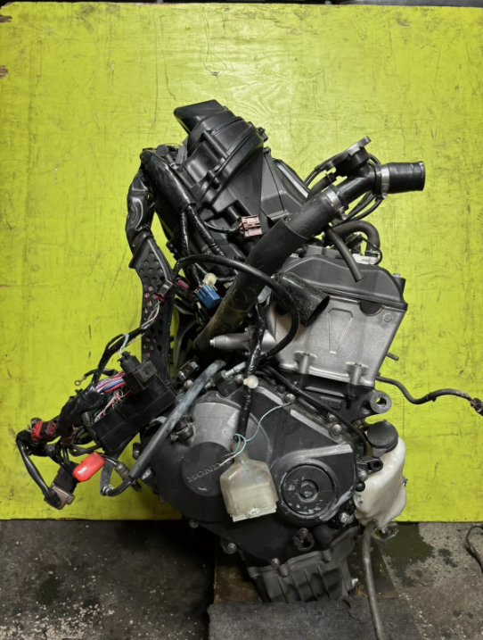
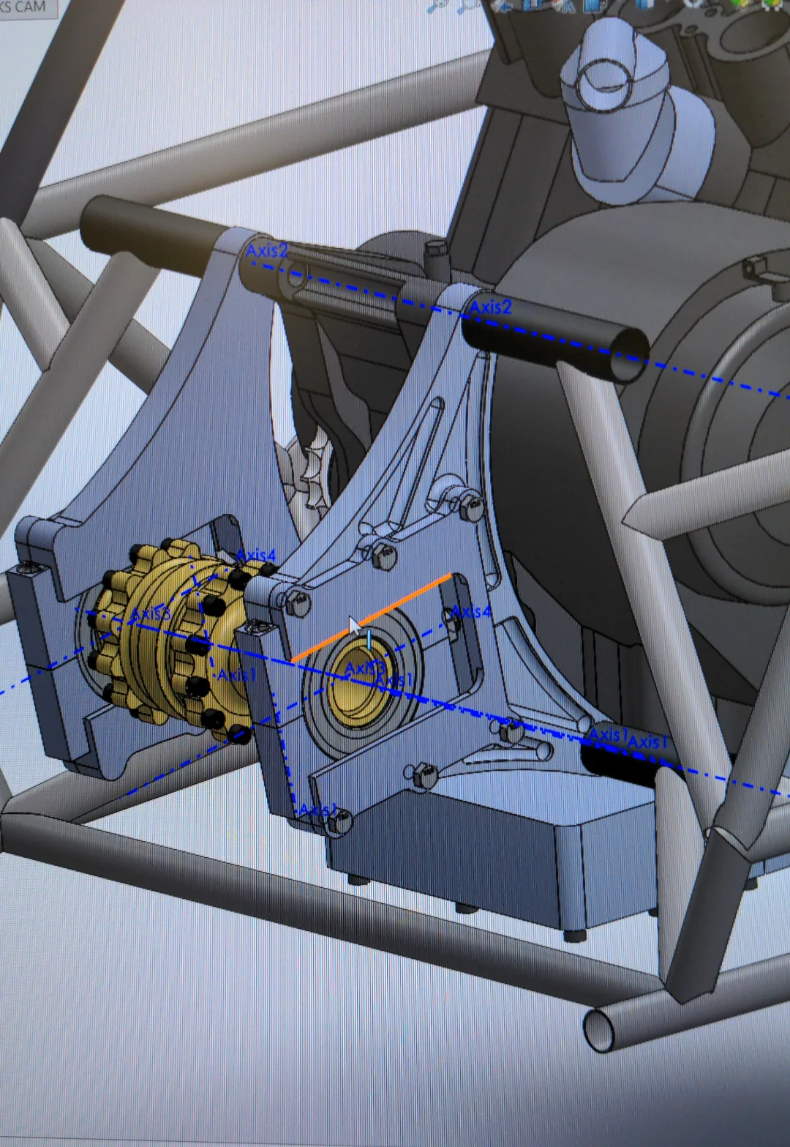
Conclusion
Future Plans:
Engine Purchase
CAD Designs and Calculations
Material and actual budget
Build designs and prep for final product
Continue Fundraising

Slide 40
Questions?
Thank you.

