Slide 1

SAE Formula
Chassis
Gustavo Ruiz
Brandon Guzman
Ryan Meger
Alexandra Brister
Carson Kent

Slide 2

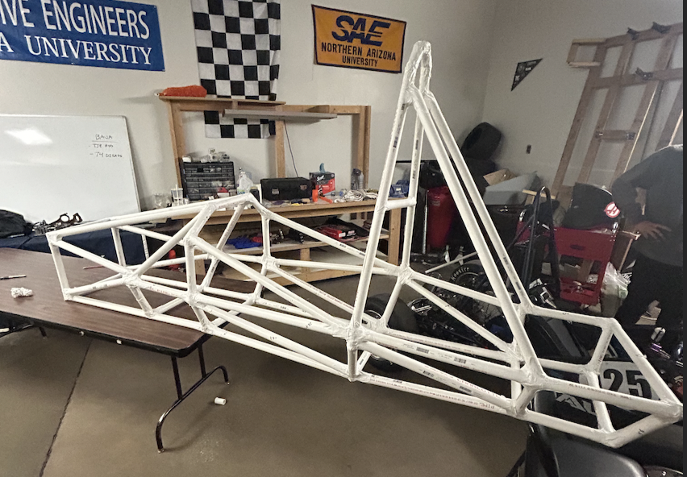
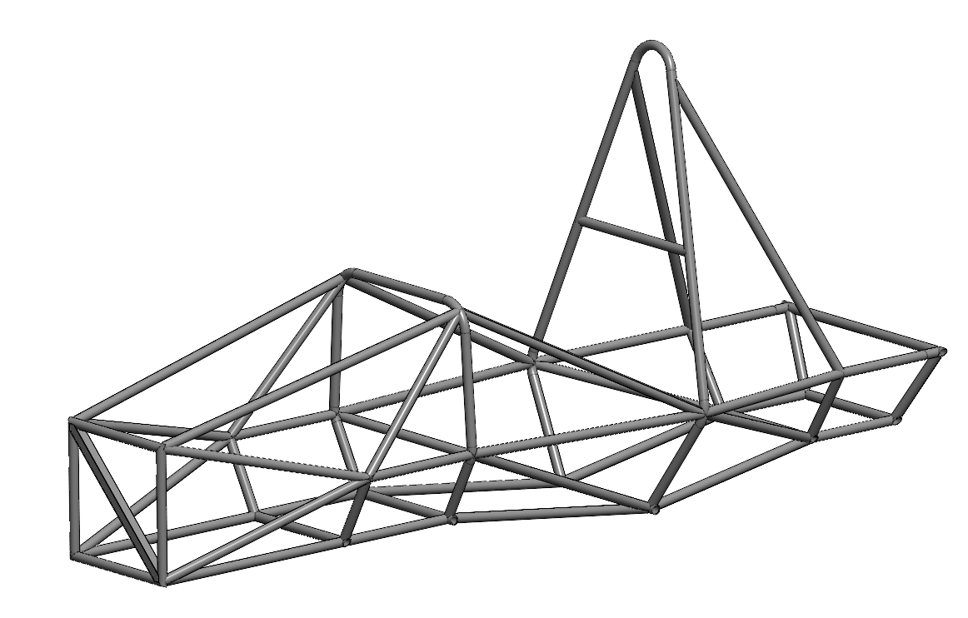
Project Description
GR
Chassis Prototyping:
Aimed to be totally compliant with FSAE rule book:
  Aim for more comfort and spacious cockpit
  Improve on any discrepancies from last year's chassis.
  Start beginning early stages of prototyping
With PVC protype complete based on general constraints and goals of other sub teams, more self-directed learning can occur in preparation for later this semester or the beginning of next semester.
These skills will aid in the final fabrication of the chassis design
Figure 1: PVC prototype
Figure 2: Current CAD

Slide 3
Project Description
GR
Larger Front Hoop for Improved Dash
Lower Vertical COM (9.93”), Lighter Frame (61.1 lbs.), Aerodynamics
More Cockpit Room, Egress improvements
Source & Prepare Tubing, Build Jig, Weld
Integration w/ Other Sub-Teams
Better Handling
Driver Ergonomics
Manufacturing Constraints
Structurally Safe Frame w/ Improved Handling

Slide 4
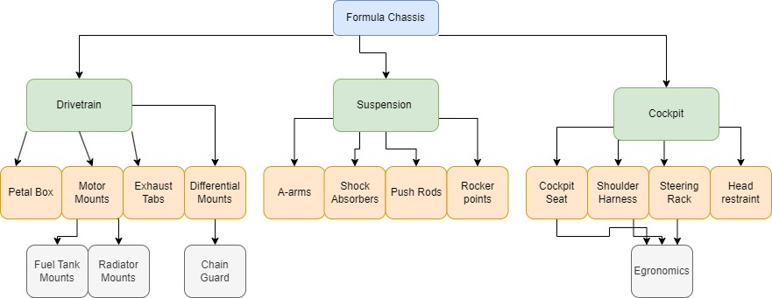
Decomposition Model
RM

Slide 5
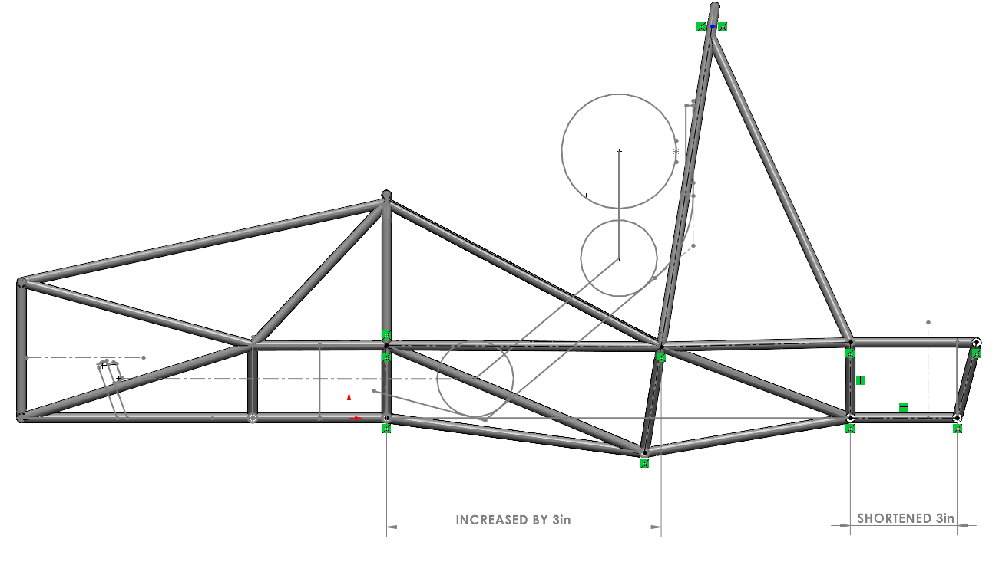
Concept Generation
CAD Prototype:
Aimed to be totally compliant with FSAE rule book
  Triangulation
  Spacing for driver
Main Changes from Last Years Chassis
  More cockpit room!
  Increased size of Front Hoop
  Made rear box 3 inches shorter
  Moved Pedal Box Farther Away
    Allows for more adjustability
Main concept generations:
  Aero design (several nose cones)
  Seat designs (seats, seat belt straps, steering wheel etc.)
RM

Slide 6
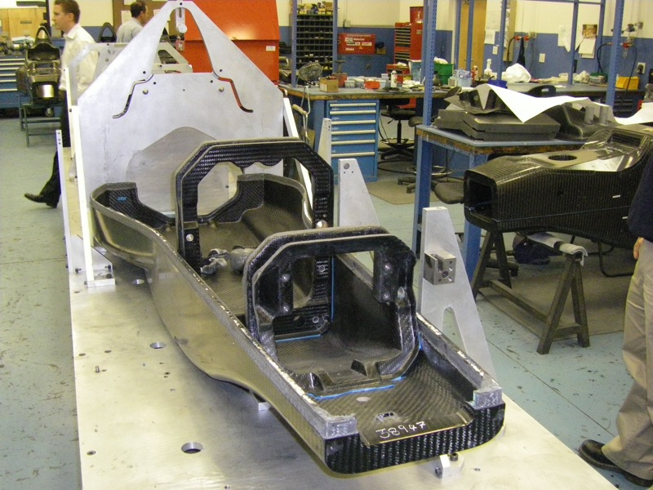
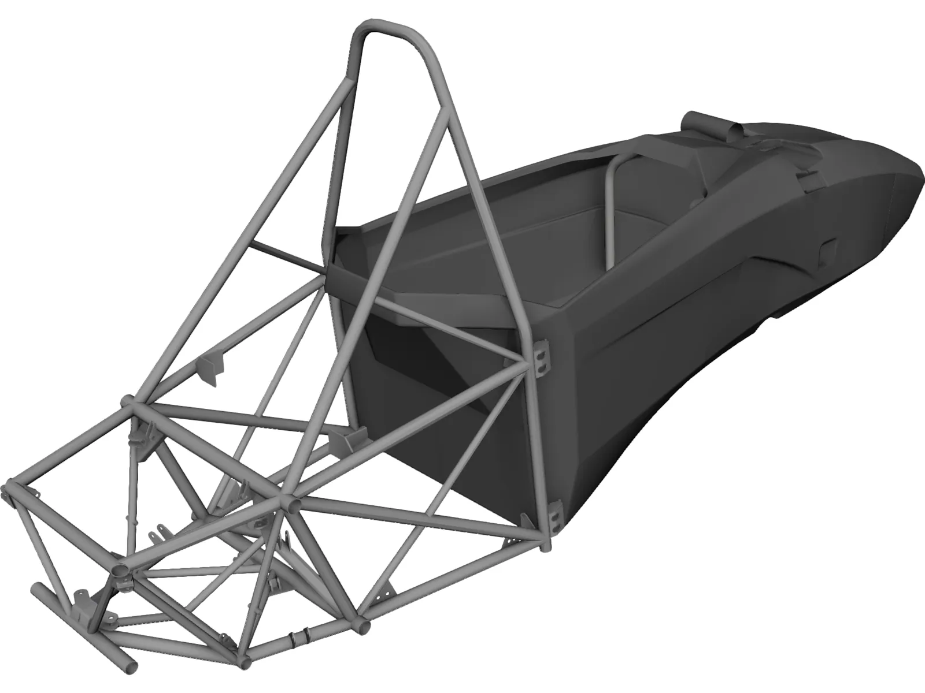
Concept Generation
Chassis Style (1) Worst – (5) Best | Monocoque(Carbon) | Space-frame | Hybrid(semi-monocoque)
Weight | 5 | 2 | 4
Cost | 2 | 5 | 3
Durability | 3 | 4 | 4
Manufacturability | 1 | 5 | 2
Strength | 5 | 3 | 4
Total | 16 | 19 | 17
RM

Slide 7
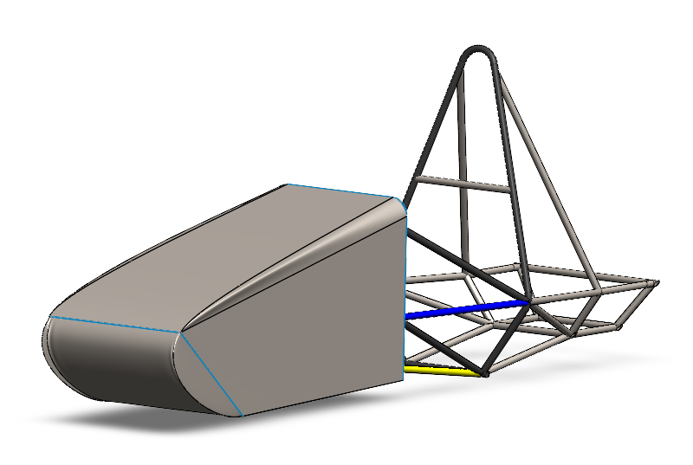
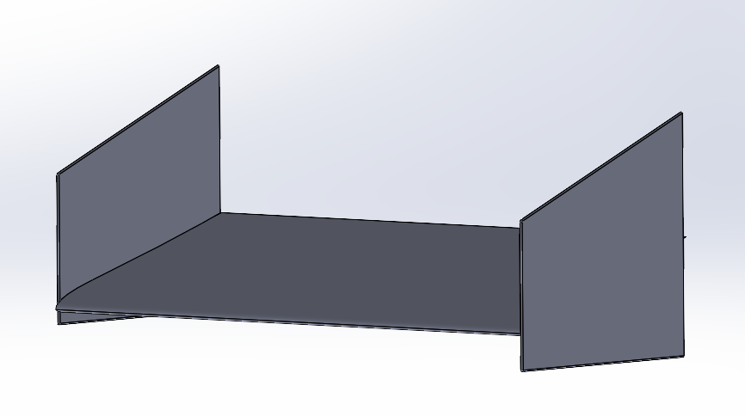
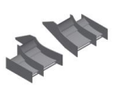
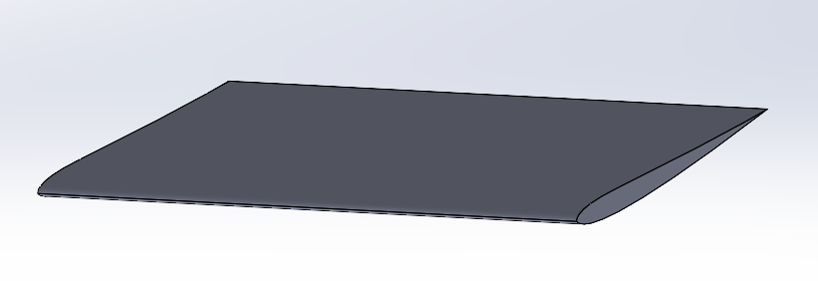
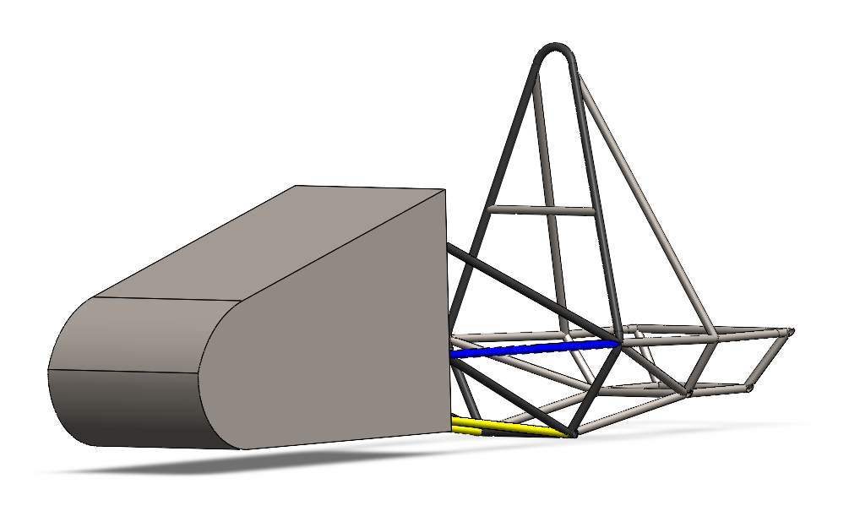
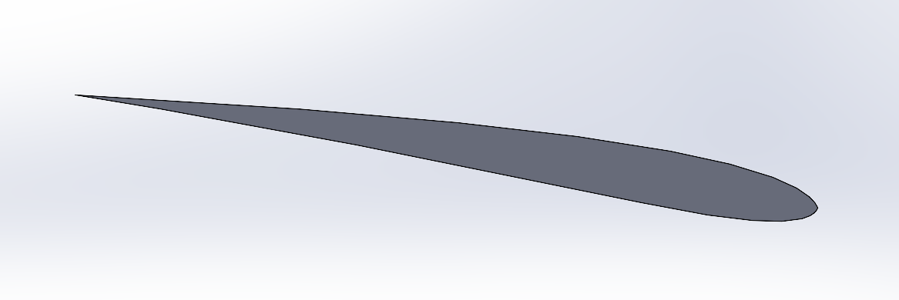
Concept Generation (Aero)
CK
Simple front wing design (not efficient)
Nose cone design #1
PHOTO
Split front wing design (more efficient, easier to mount)
PHOTO
Chosen airfoil geometry for wings
Nose cone design #2

Slide 8
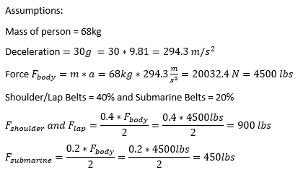
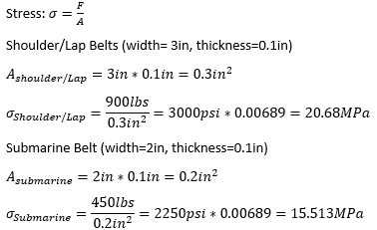
Engineering Calculations (Alexandra)
Stress for 6-Point Seat Belt

Slide 9
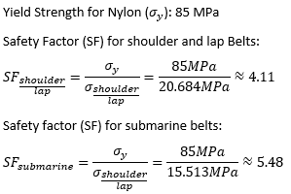
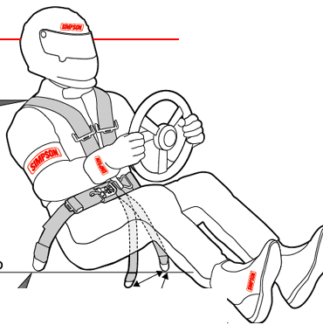
Engineering Calculations (Alexandra)
Safety Factor for 6-Point Seat Belt

Slide 10
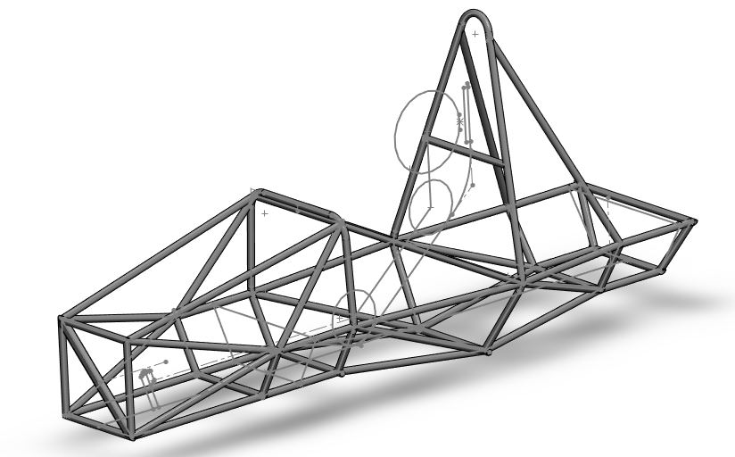
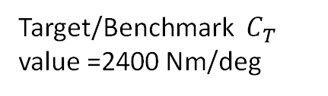


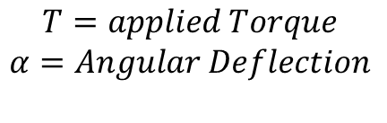

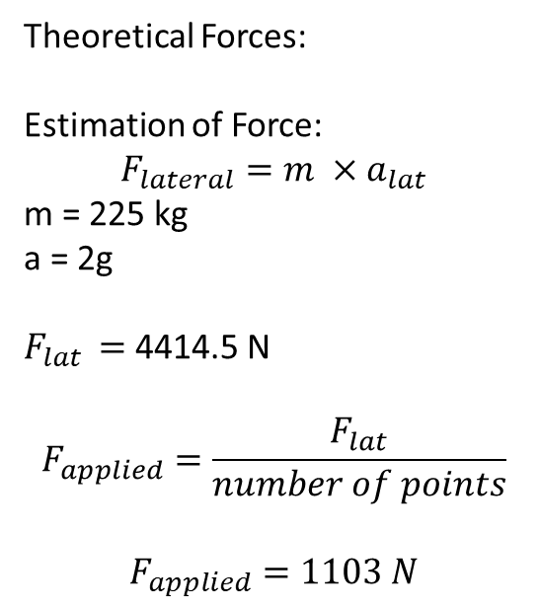
Engineering Calculations- Force Analysis
Torsional Analysis (Ryan Meger)
Frame Design was based off last years and was made in SolidWorks over the summer. No indication for making major design changes were mentioned. Analysis on current design was done.
Theoretical Forces:
Estimation of Force:
$$F_{lateral}=m ×a_{lat}$$
m = 225 kg
a = 2g
$F_{lat }=$4414.5 N
$$F_{applied}=\frac{F_{lat}}{number of points}$$
$$F_{applied}=1103 N$$
$$C_{T}=\frac{T}{α}$$
$$T=applied Torque$$
$$α=Angular Deflection$$
$α=arctan⁡(\frac{X}{Y}$)
X
$$α$$
Y
Target/Benchmark $C_{T}$ value =2400 Nm/deg
RM

Slide 11
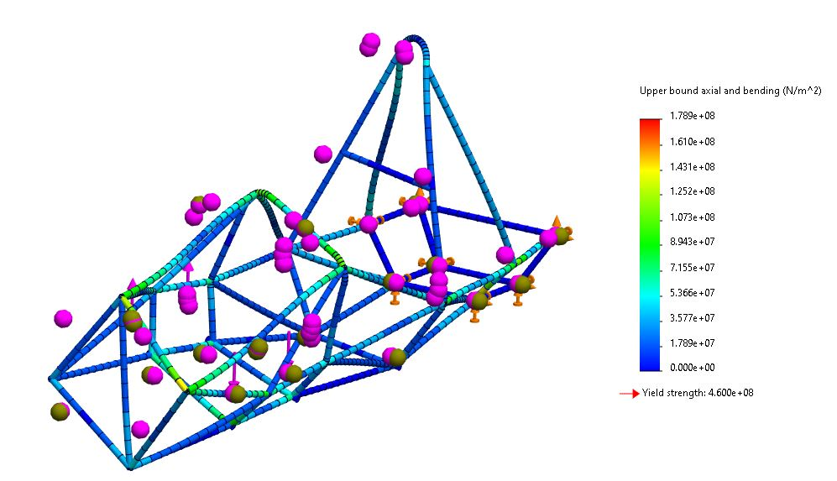
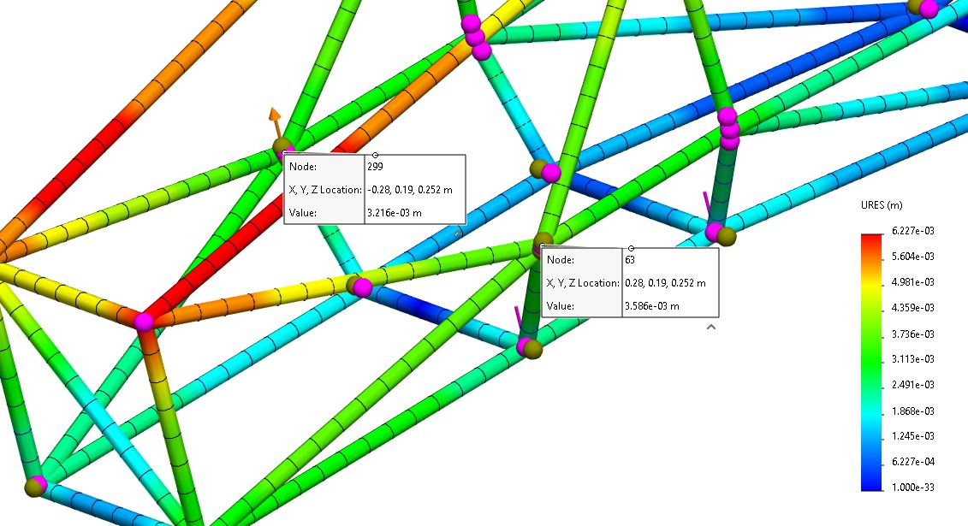
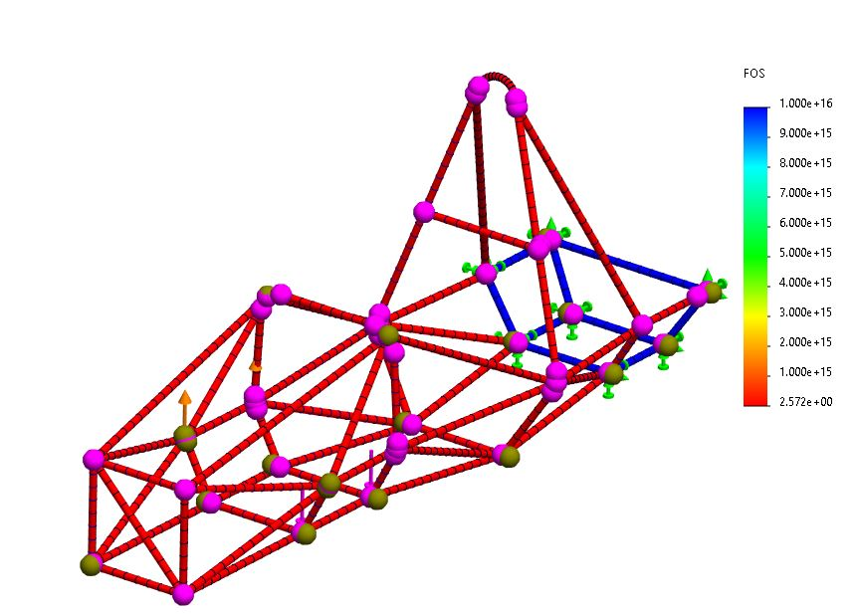
Engineering Calculations- Force Analysis
Torsional Analysis (Ryan Meger)
Displacement Plot
Stress Plot
FOS Plot
FOS = 2.6
Calculated Theoretical CT= 1932.7 Nm/deg
RM

Slide 12
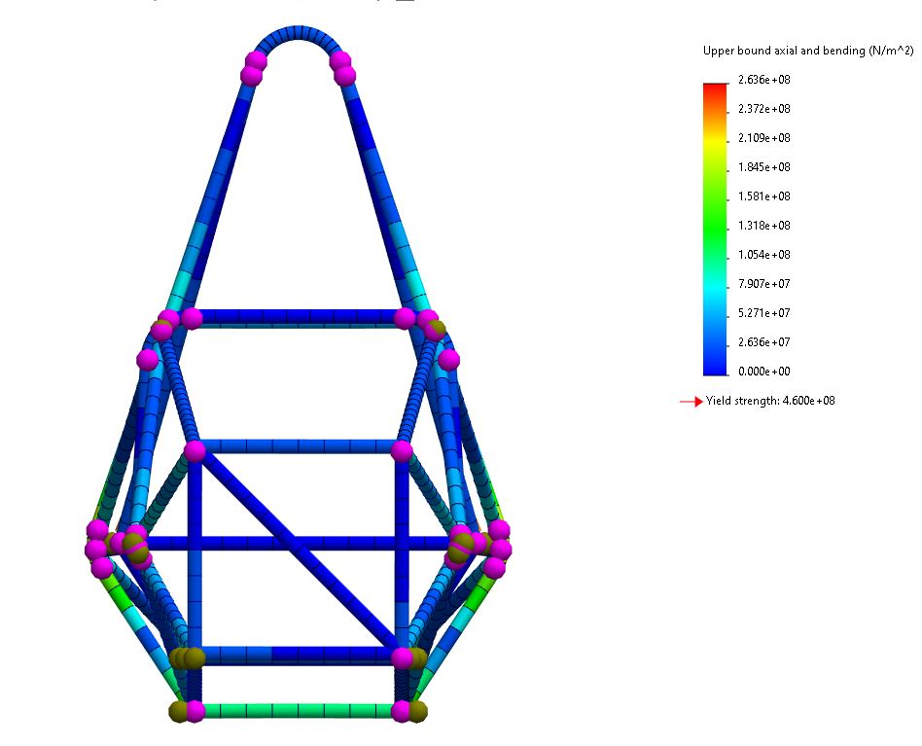
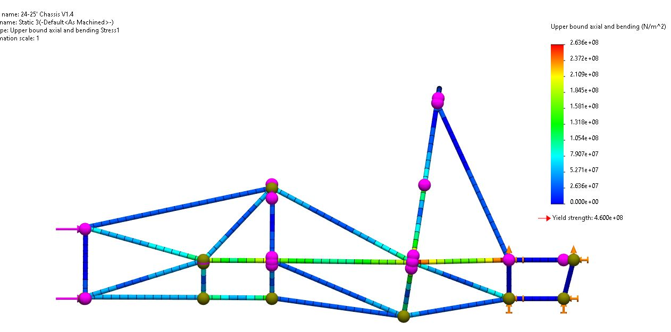
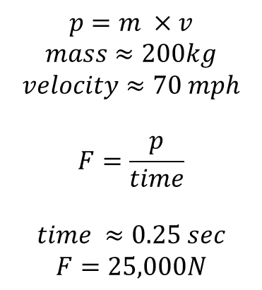
Engineering Calculations
$$p=m ×v$$
$$mass≈200kg$$
$$velocity≈70 mph$$
$$F=\frac{p}{time}$$
$$time ≈0.25 sec$$
$$F=25,000N$$
Front Impact
Front View:
Stress Plots
PHOTO
PHOTO
Side View:
RM

Slide 13
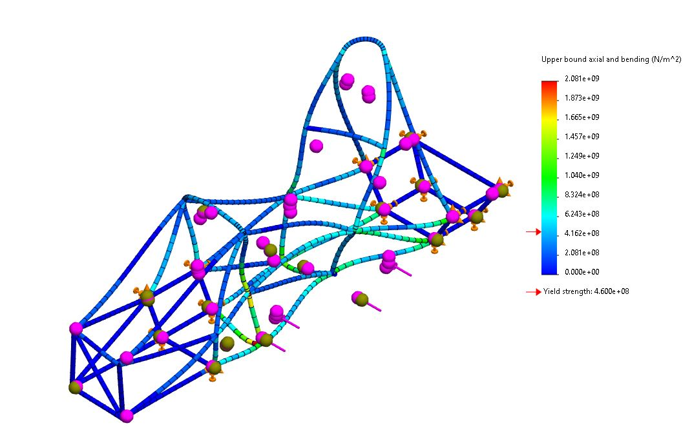
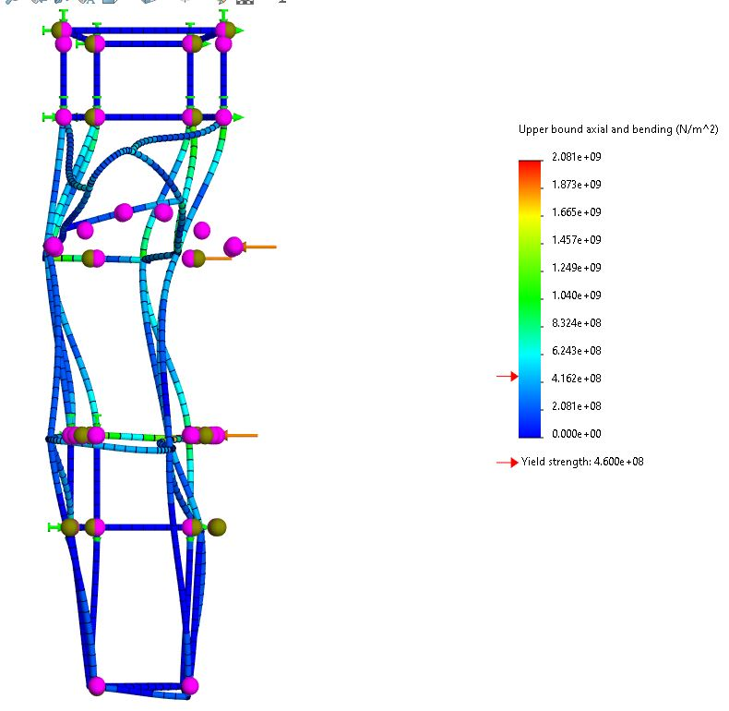
Engineering Calculations
Side Impact
Same amount of Force = 25,000 N
Isometric View:
Stress Plots
PHOTO
PHOTO
Top View:
RM

Slide 14
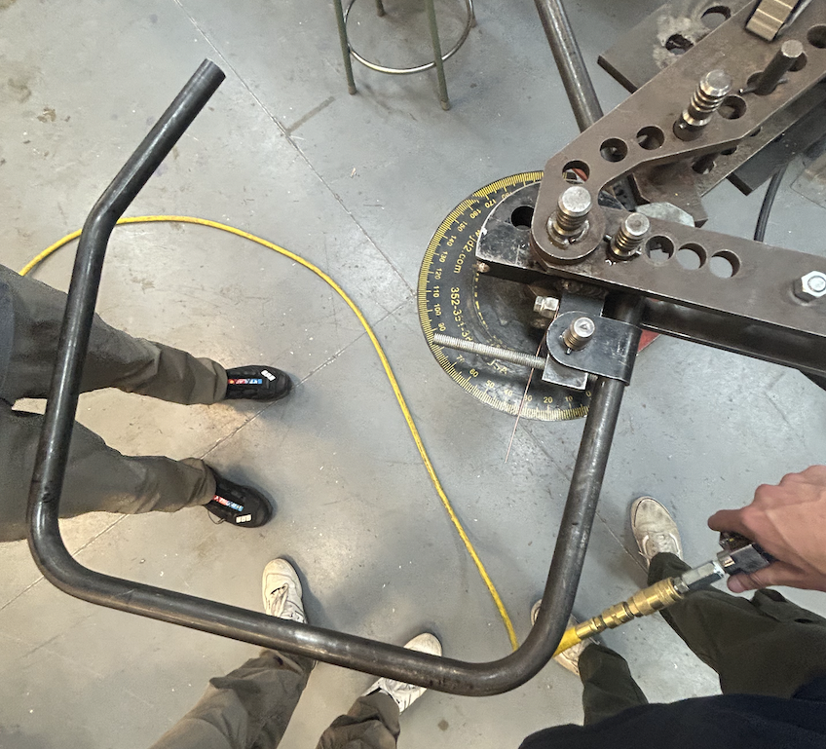
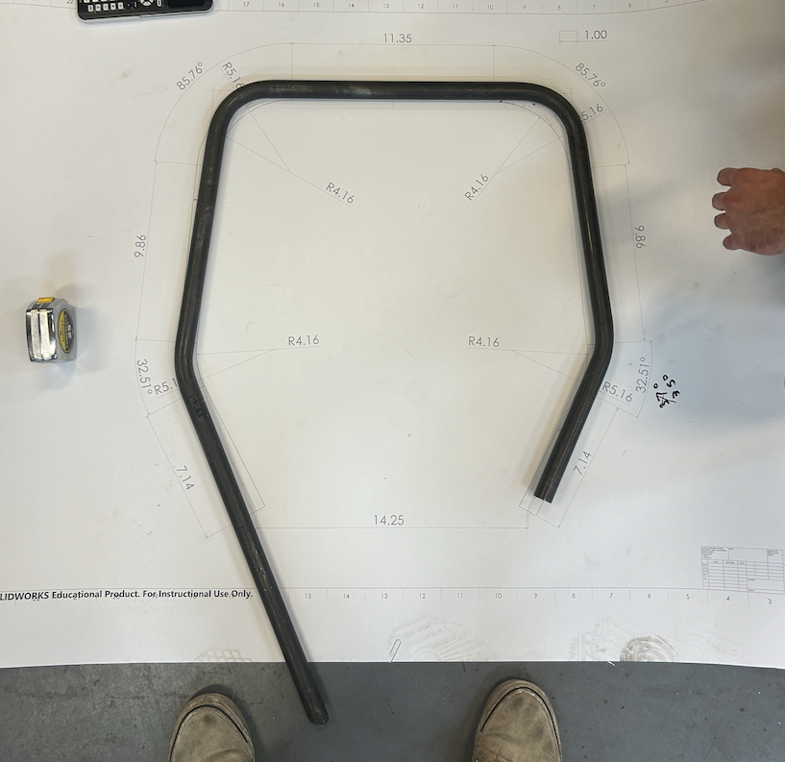
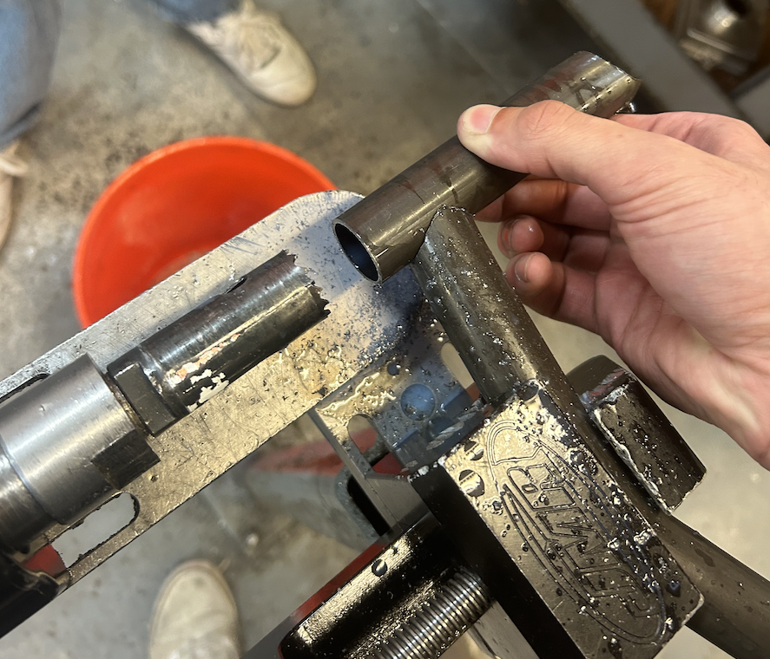
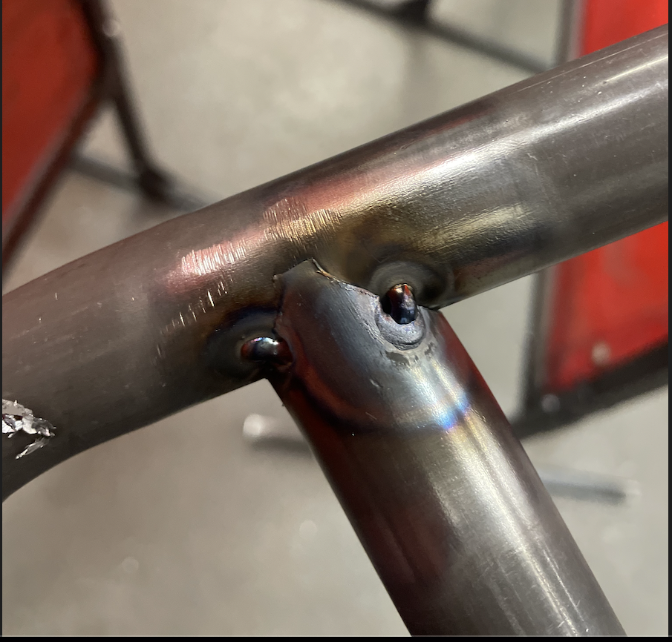
Early Prototype Practice:
BG
Early fabrication practice includes:
Steel tube bending
  This consisted of an early prototype of the front hoop for the 25' car using leftover Size B steel tube.
  Spring-back of steel was also practiced during the duration of this prototyping.
Hole sawing
  Early practice making cuts for final design, as well as for another team member to practice tacking.
Figures: Front hoop Prototype
Figures: Hole saw practice & tacking

Slide 15
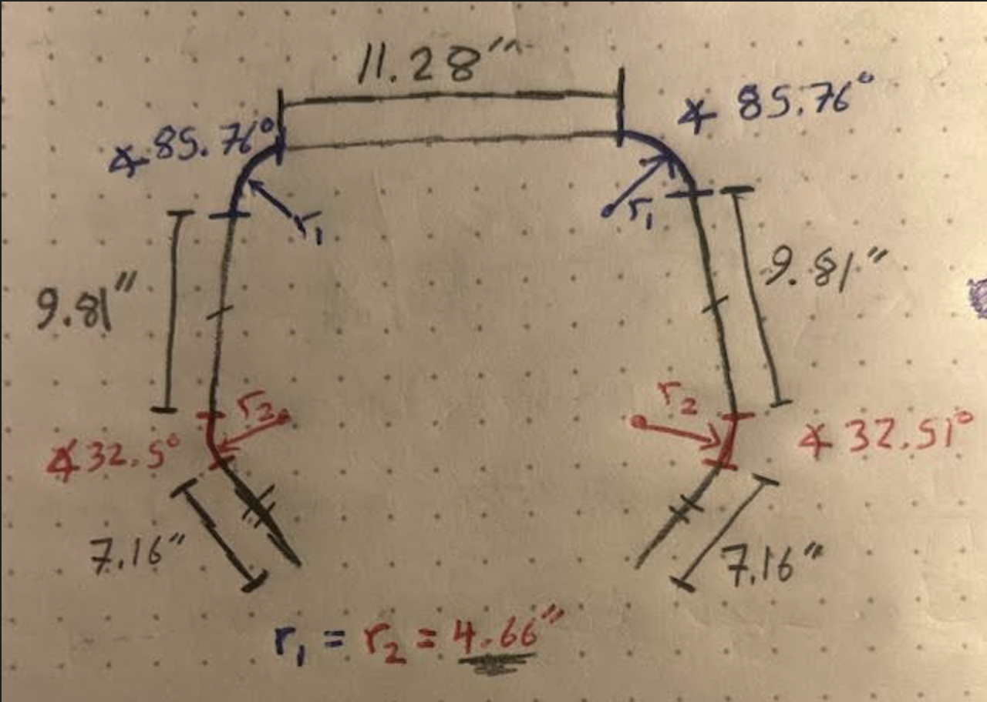

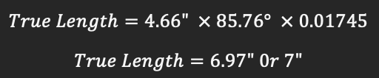
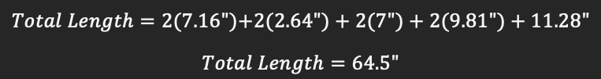

Engineering Calculations
Equations: (Brandon Guzman)
Steel bending calculations:
Simple calculations for finding length of steel tube for bending.
Consisted of use of Solid works for angles, and mathematical hand calculations to find length.
Bending Constant:
Constant = 0.01745
Equation:
For r1:
For r2:
PHOTO
Figure: Front hoop drawing & angles
[1]“The construction Process: Pipe and Tube bending,” https://www.herl.pitt.edu/indiachair/indiachairsh/cl_bend.html#:~:text=Rule%20for%2090%20d (accessed Oct. 2, 2024)

Slide 16
Evaluation of Prototype Practice
Key Takeaways & Errors:
Learning to use hydraulic bending chuck
Learning to bend steel tube and adjust for spring-back
Grasp the use of angle gauge for precise bends
Team needs to source a 4" bending chuck to fit CAD design. Current front hoop used 3" benching chuck, which caused some misalignment with the one-to-one scale drawing.
Figure: Front hoop Prototype

Slide 17
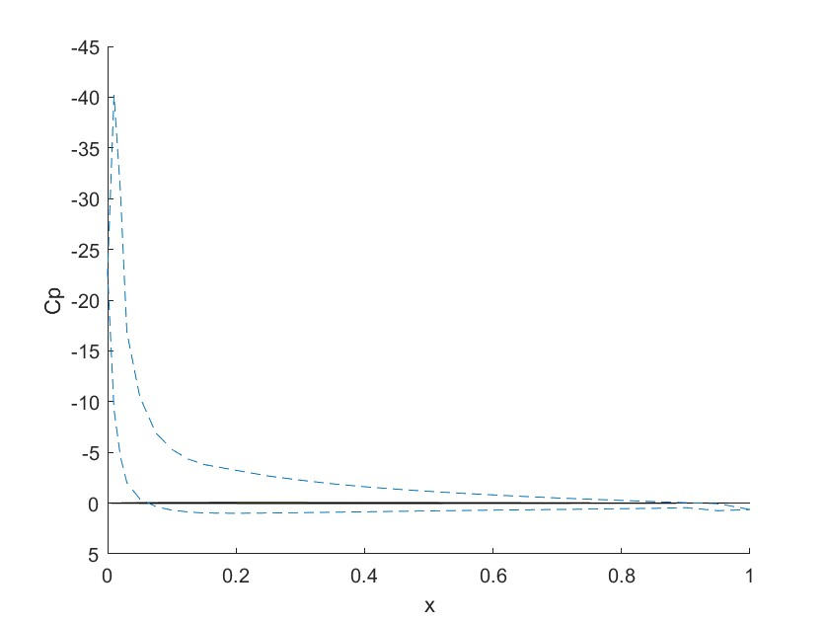

Engineering Calculations (Aero)
CK
Preliminary calculations were performed on the chosen airfoil geometry using the vortex panel method
Results are promising as pressure spikes on the leading edge of the airfoil and decreases down the chord
Negative lift results in downforce, so a coefficient of lift of –3 tells us at a –30 degree angle of attack we will produce significant downforce
PHOTO
PHOTO
Pressure plot for angle of attack of –30 degrees
Lift and drag results

Slide 18
Concept Evaluation
GR
Decision Matrix
Weight Table
Weight | 0.25
Strength | 0.2
Safety | 0.2
Manufacturability | 0.15
Integration | 0.1
Handling | 0.1
Scale 1-5 | 2024 Frame | 2025 Frame
Weight | 3 | 4
Strength | 4 | 4
Safety | 4 | 5
Manufacturability | 3 | 4
Integration | 3 | 5
Handling | 3 | 4
TOTAL | 3.4 | 4.3

Slide 19
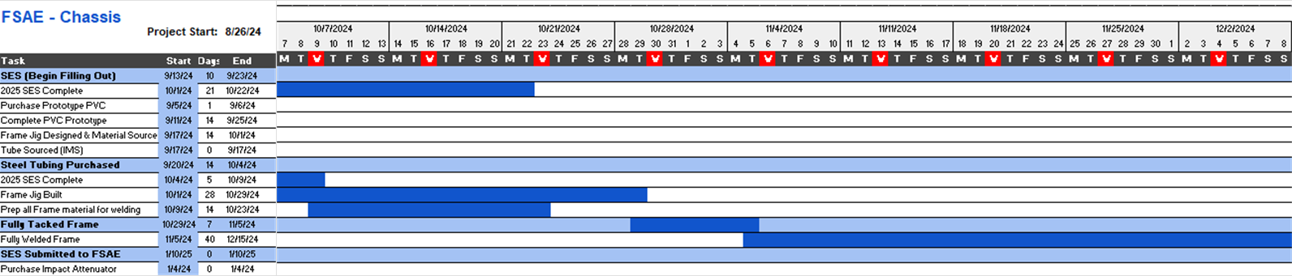
Schedule
GR
Gantt Chart

Slide 20
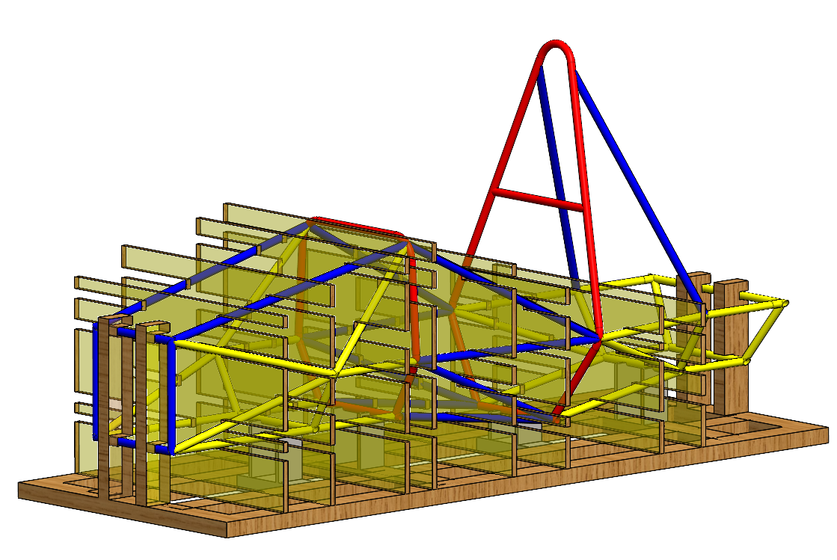
Schedule
GR
Complete PVC Frame
Complete JIG Design
Source JIG Materials
Prepare Tubing for JIG
Weld
Fill out SES as we go

Slide 21
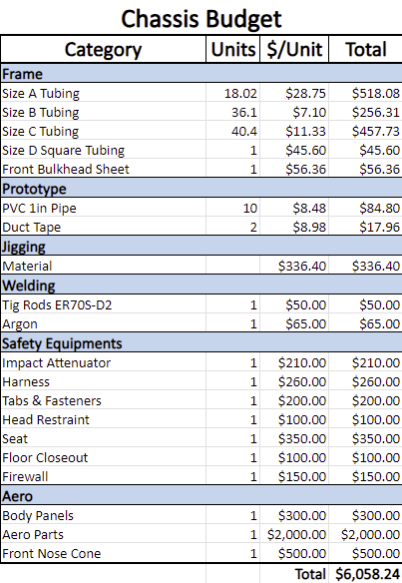
Budget
GR
Budget can range from $4k-7K depending on Aerodynamics

Slide 22
Bill of Materials for JIG
GR
JIG BOM
Part | Units | $/Unit | Total
MDF Board (3/4"x 4'x 8') | 3 | $48.98 | $146.94
Angle Iron (1/8" x 2" x 48") | 1 | $32.47 | $32.47
Washers (3/16" x 1.5") | 1 | $8.62 | $8.62
Bolts (M8-1.25x40mm class 8.8) | 40 | $2.75 | $110.00
Nuts (M8-1.25 2 per bag) | 20 | $1.25 | $25.00
Screws 140 pack (8 x 1.25") | 1 | $13.37 | $13.37
 |  |  | $336.40

Slide 23
Sources:
GR
Ryan Meger:
[1] N. Geneva and C. Dodd, “Meeg 402-010 chassis design report 2017 FSAE SENIOR ...,” MEEG 402-010 Chassis Design Report, https://udel.edu/~pgeneva/downloads/fsae/2017_FSAE_chassis.pdf (accessed Oct. 8, 2024).
[2] D. Milliken and W. Milliken, “Race Car Vehicle Dynamics,” SAE International, https://www.sae.org/publications/books/content/r-146/ (accessed Oct. 8, 2024).
[3] Formula Team, “1st Year Final Report.” NAU, Flagstaff, May. 1, 2024
[4] FSAE, “2024 Formula SAE Rule Book,” Formula SAE, https://www.fsaeonline.com/cdsweb/gen/documentresources.aspx (accessed Oct. 8, 2024).
[5] R. Patil, “FEA analysis of FSAE chassis,” FEA Analysis of FSAE Chassis , https://www.ijert.org/research/fea-analysis-of-fsae-chassis-IJERTV9IS070148.pdf (accessed Oct. 8, 2024).

Slide 24

Thank You!

