Slide 1

SAE Formula Chassis
Gustavo Ruiz
Brandon Guzman
Ryan Meger
Alexandra Brister
Carson Kent

Slide 2


Project Description (Gustavo)
Frame-Body-Aero:
Create a structurally safe and strong frame using CAD simulation software and resources.
Ensure all customer requirements are met for chassis to be rule eligible.
Improve on any shortcomings or discrepancies last year's chassis team faced.
Goals as sub-team:
Larger Cockpit
Removable fire wall
Nose cone
Reduce rear suspension box size
Make adjustable pedal box
Increase height of front hoop

Slide 3
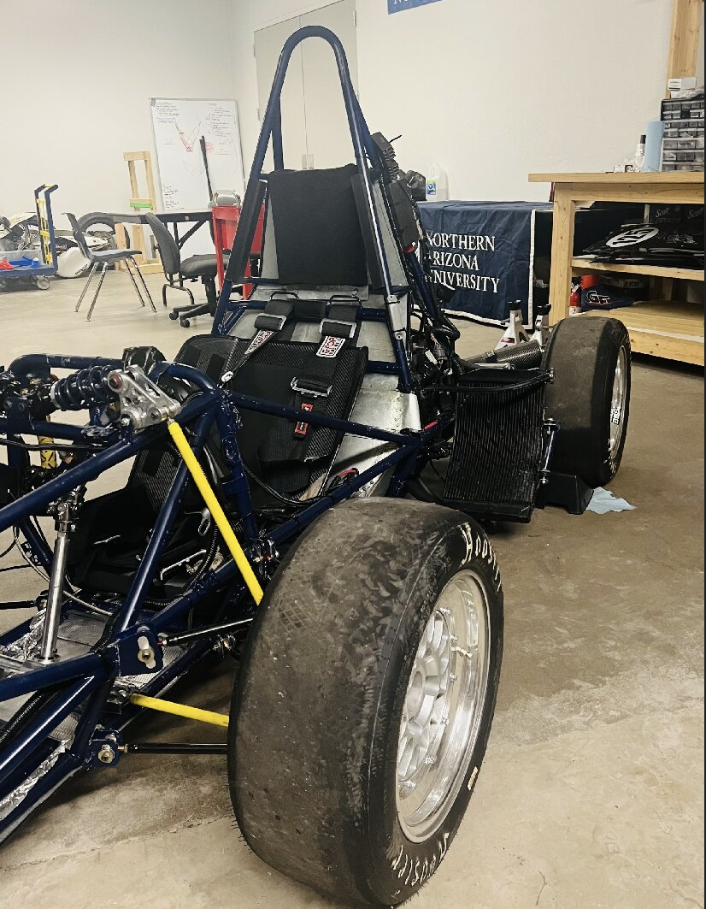
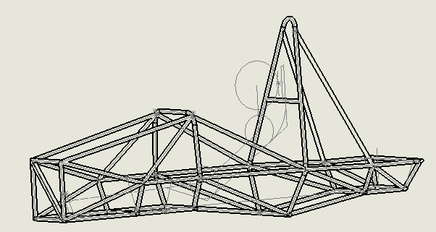
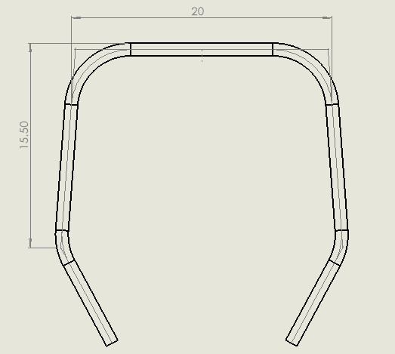
Background & Benchmarking (Brandon)
Existing SOTA for chassis design:
What did other university teams do well or deficiently with the chassis design?
What did last year's team do well or deficiently with the chassis design?
Figure 1: CAD for 2025 Car
Figure 2: Front hoop 2025 car
Front hoop:
3in taller(Y-axis)
Cockpit:
Length Increased by 3in(Z-axis)
Rear Suspension Box:
Decreased length by 3in (Z-axis)
Main Hoop:
Made 2in wider(X-axis)
Figure 3: Last year's car

Slide 4
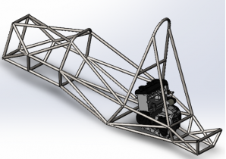
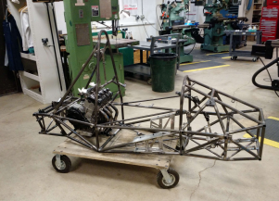
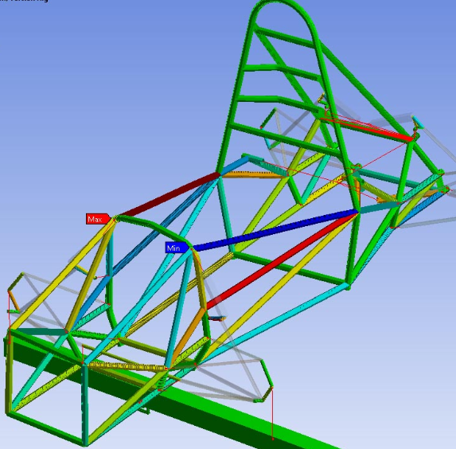
Background & Benchmarking (Brandon)
Existing SOTA for chassis design:
What did other university teams do well or deficiently with the chassis design?
What did last year's team do well or deficiently with the chassis design?
Other Universities Chassis:
Figure 4: San Diego State Chassis
Figure 5: University of Delaware
Figure 6: Purdue University
Similarities:
Large front hoop
Properly triangulated
Large Cockpit

Slide 5
Customer & Eng. Requirements (Ryan)
Structural Equivalency Spreadsheet
SES provides details & guidance when designing the Chassis
Document the Primary Structure & show compliance with Formula SAE Rules
All teams must submit an SES as given in section DR - Document Requirements
Tubing & Material
Primary Structure must be constructed from one or a combination of
  Steel Tubing & Material
  Alternative Tubing Materials
  Composite Materials
Minimum radius of bend must be 3 or more times the tube outside diameter

Slide 6
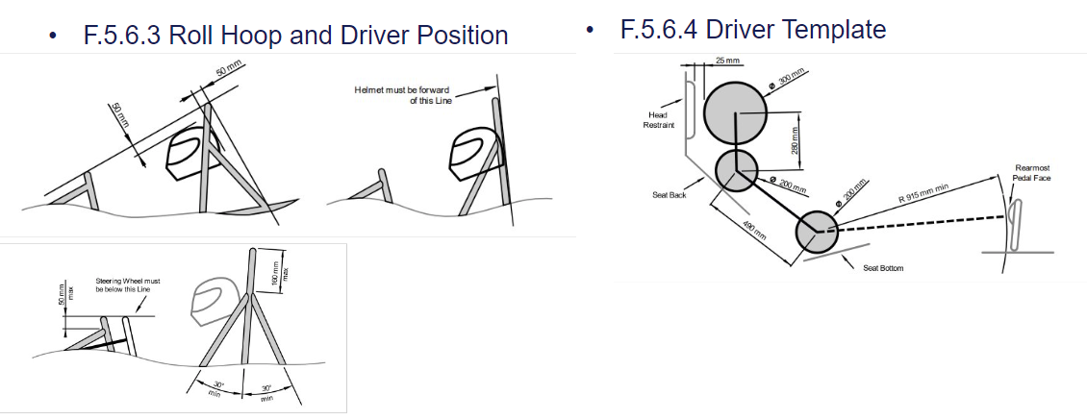
Chassis (Ryan)
Roll Hoops (Front & Main Hoop)

Slide 7
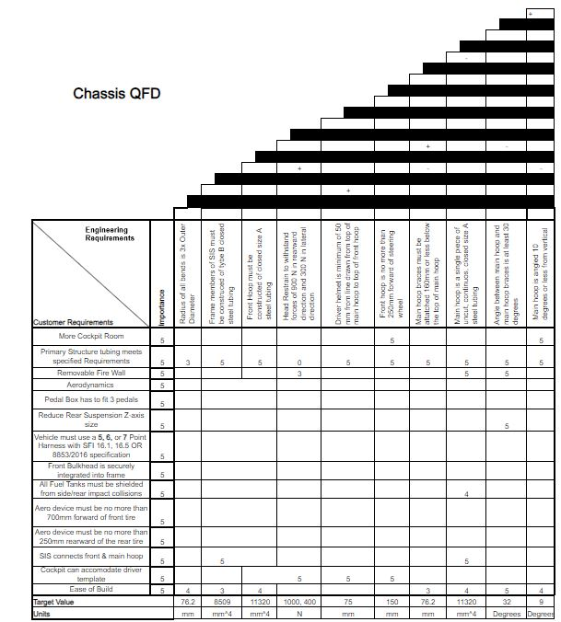
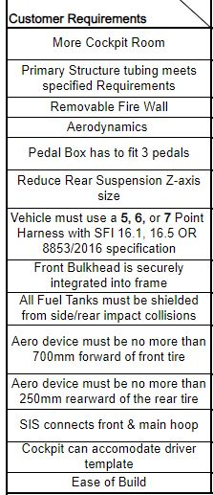
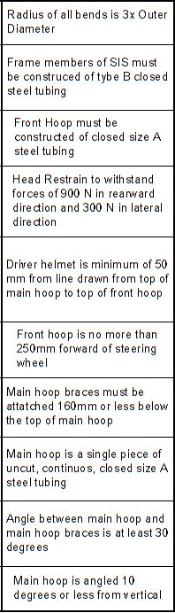
QFD (Ryan)
RM
Engineering Requirements

Slide 8
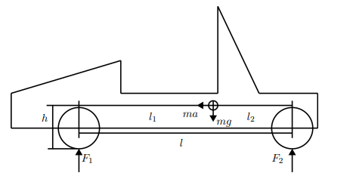



Mathematical Modelling (Brandon )
Acceleration weight Transfer Analysis: Goal is to ideally have even front to rear weight distribution(Breaking forces)[4][Brandon G.]
When the car is decelerating the normal forces on each wheel is found by summing the moments about the contact point of each wheel to the ground.
Here the Moment equations can be Rearranged to solve for F1 and F2 Respectively, where G is defined as Car acceleration divided by gravity [5].
PHOTO
Figure 7: Mathematical rough draft
Ideally F1 and F2 are equal when breaking, however During acceleration F2 is expected to be slightly larger than F1(depends on acceleration).
Terms:
g = 32.2 ft/s^2
m(25' car Just the chassis) = 62.58 lb's
This ratio of the two forces will be used instead of comparing the normal forces directly.
Add a descriptive caption here.

Slide 9
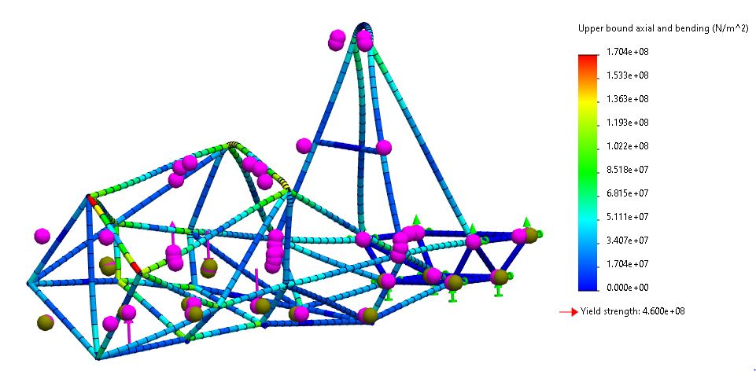
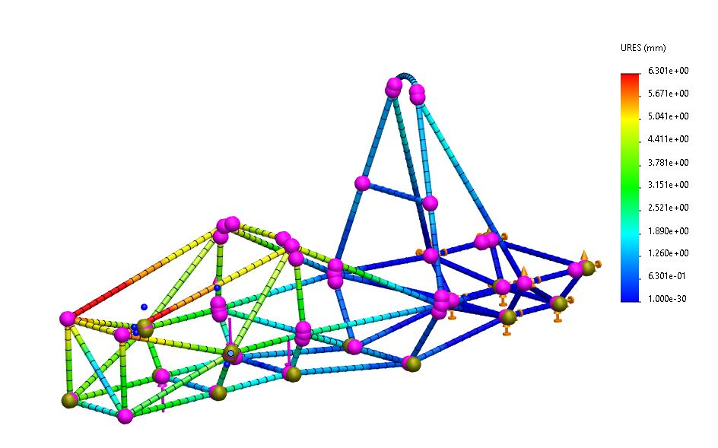
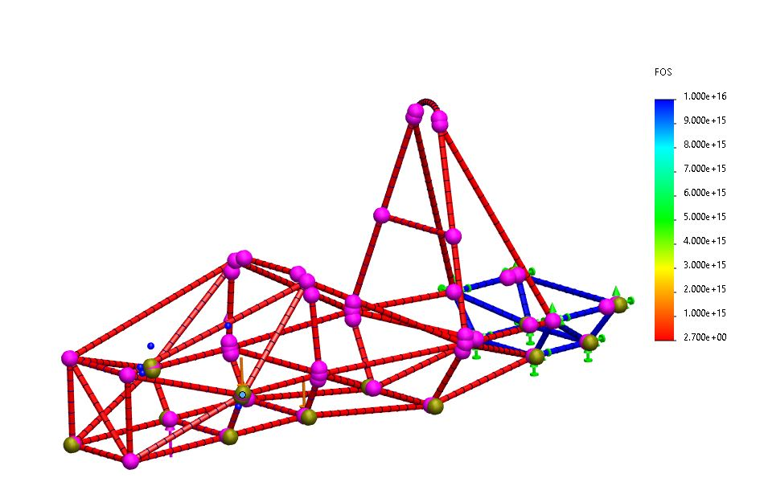
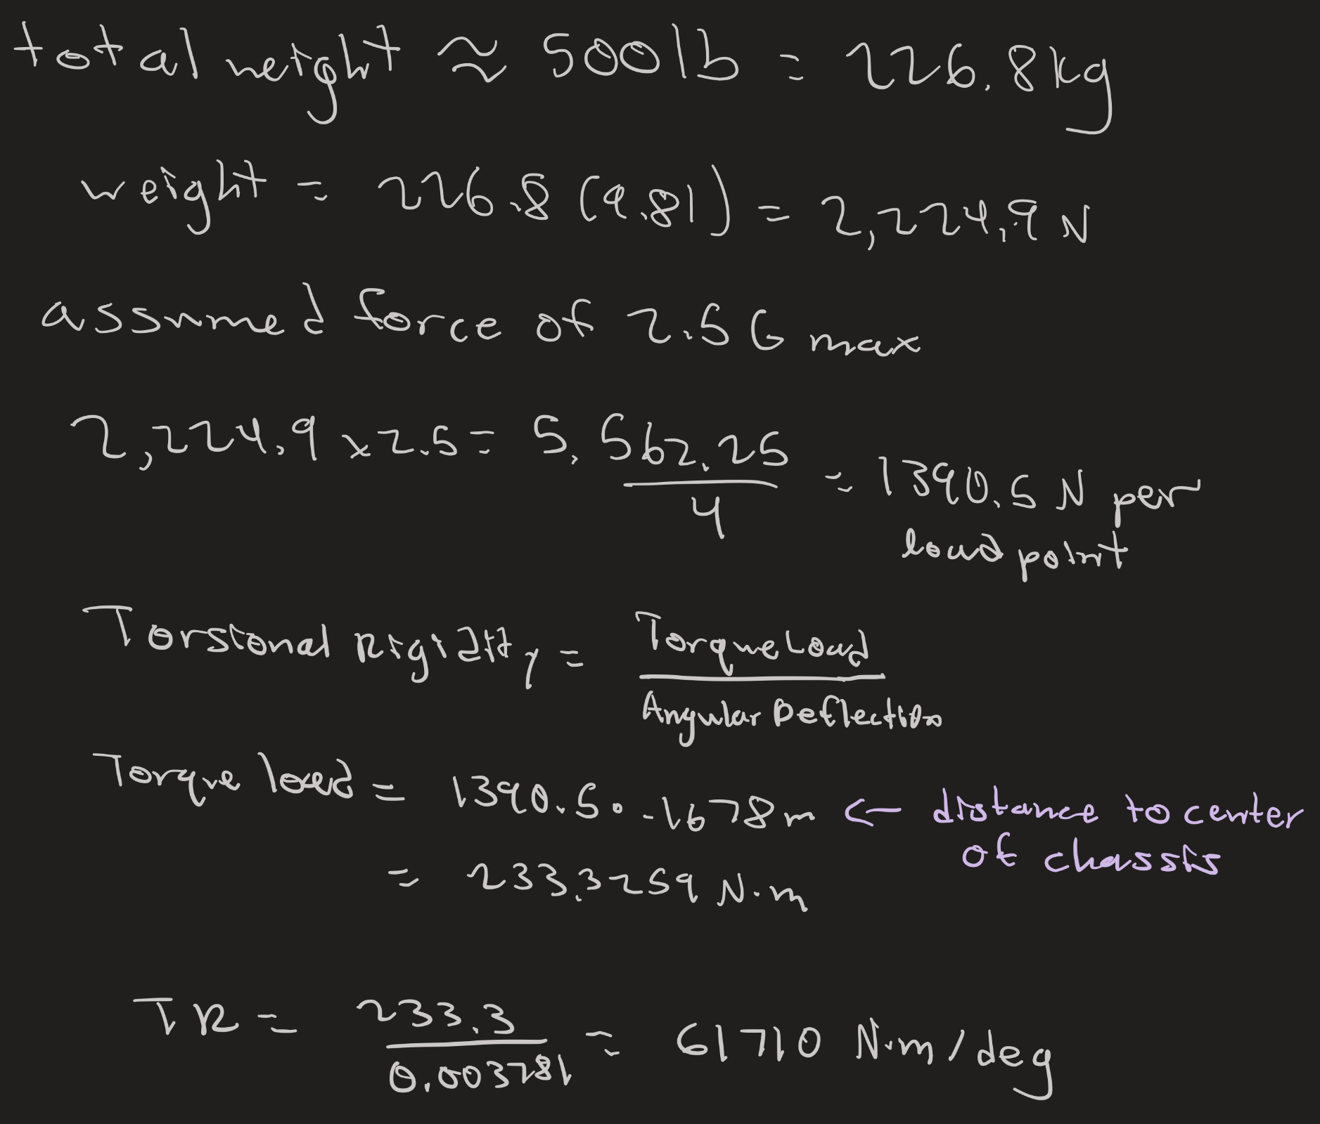
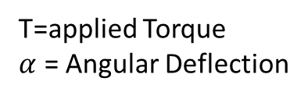

Mathematical Modelling:
RM
Stiffness of the Chassis
Testing Torsional Stiffness using SolidWorks Simulation feature.
Minimum Factor of Safety of 2.5
$$C_{T}= \frac{T}{α}$$
T=applied Torque
$α$ = Angular Deflection
PHOTO
Calculations for Amount of Force and Torsional Rigidity:
TR = 61,710 N*m/deg
Yield Strength = 4.6e8 N/m^2
Add a descriptive caption here.
Notes:
Torsional Analysis – how much the structure can resist twisting; important to withstand these forces through turning, drifting through cornering, and uneven road surfaces; helps with precise controls of the suspension
Bending Analysis – can the car support its own weight, including aero; can apply a vertical force on the car to simulate
Static Structural analysis- car must withstand impacts safely; simulate with contact on the side of the car, like it touching a wall; simulate with frontal impact
Modal Analysis – the study of vibrational forces along the frame; important because if cyclic loads are applied at a specific frequency the frame can go into a resonance condition and lead to a catastrophic failure

Slide 10
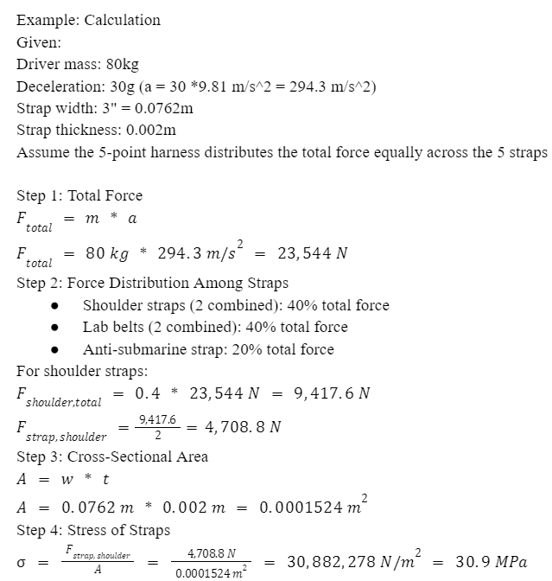
Mathematical Modelling: (Alexandra)
RM
Stress on 5-point seatbelt
ΣF = m * a
F = Total Force
m = Mass of driver
a = acceleration or deacceleration
Total Force: Newton's Second Law:
Force Distribution Across the Straps:
Shoulder straps (2 straps): Per strap
F_{shoulder} ≈ 0.4 * F /2
Lap belts (2 straps): Per strap
F_{Lap} ≈ 0.4 * F /2
Sub strap (1 strap):
F_{sub} ≈ 0.2 * F
From: Effects of seat belts and shock absorbers on the safety of racing car drivers
PHOTO
Cross-sectional Area:
A = w * t
w = Width of Strap t = Thickness of strap
Uniformly distributed stress equation:
σ = F_{strap} /A
σ = Stress in belt material (N/m^2)
F_{strap} = Force in each strap
A = Cross-sectional Area (m^2)

Slide 11
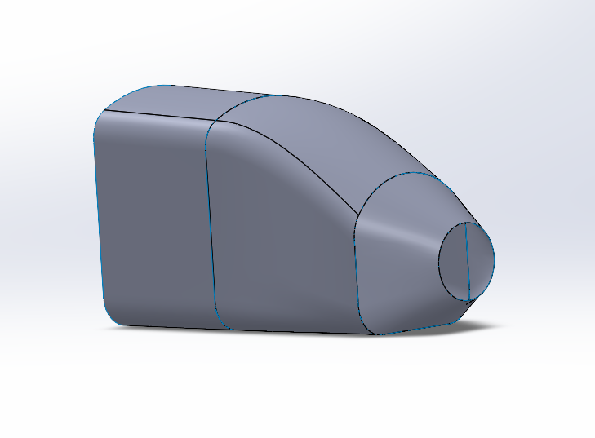
Aerodynamics (Carson)
Aero piece to focus on initially will be front wing as it produces the most impact on the vehicle
CAD model for front wing/nose cone has been started (shown below)
After a great deal of research, I have found that most teams run similar aero packages with front wing, rear wing, air ducting for cooling, and one-piece nose cone
This cone will be two pieces instead of multiple, allowing for easy removal during competition and better aerodynamic performance
Figure 10: Nose Cone example

Slide 12
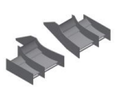
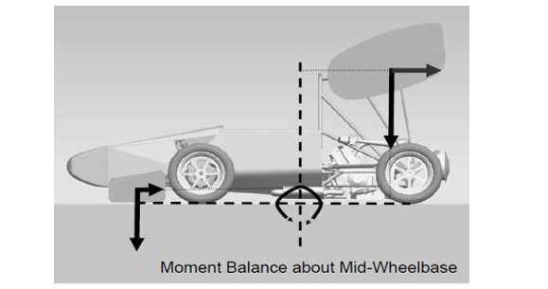
Aerodynamics (Carson)
Below is rough estimate of the front wing design that will be achieved in SolidWorks, this will be attached the front of the nose cone and provide downforce with the flow coming into the front clip of the vehicle
It is important to consider the balance of moment forces when adding downforce on the front and rear of vehicle
Through benchmarking other teams and previous expenditures, I believe the top dollar for cost of these aerodynamic pieces is ~$5000. This is based on exclusively using carbon fiber for aero components.
Figure 11: Example Front splitter

Slide 13
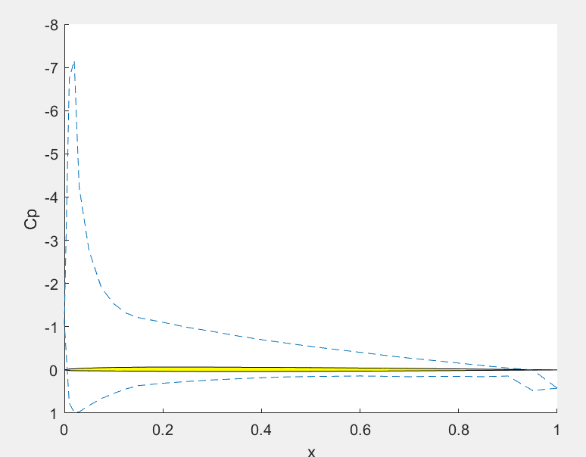
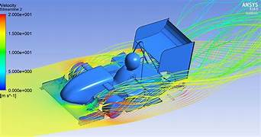


Aerodynamics – Modeling (Carson)
Analysis of the aerodynamic performance will mainly be done through ANSYS external aerodynamics program
A MATLAB code which executes vortex panel method will be used before ANSYS to get a solid approximation of lift and drag
Alpha = 4 deg
Alpha = -10 deg

Slide 14
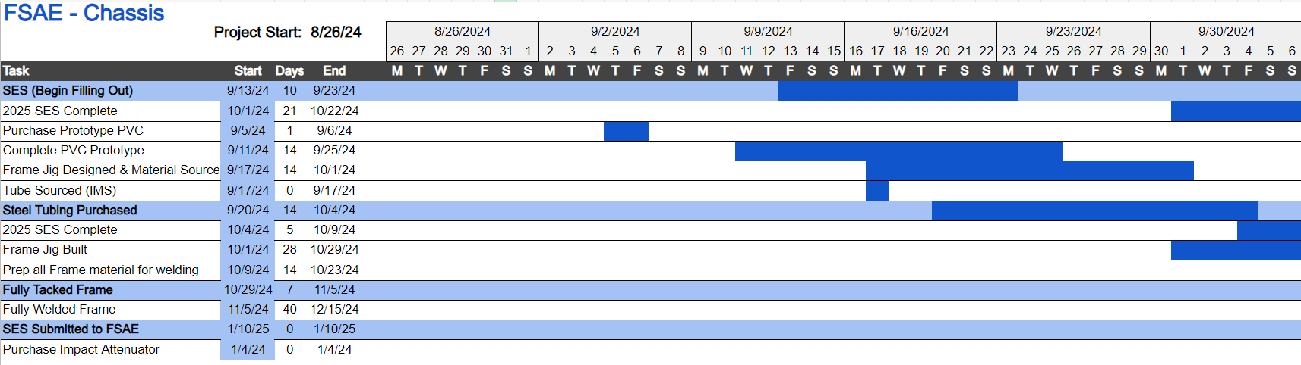
Gantt Chart – SAE Formula 24 (Gustavo)

Slide 15
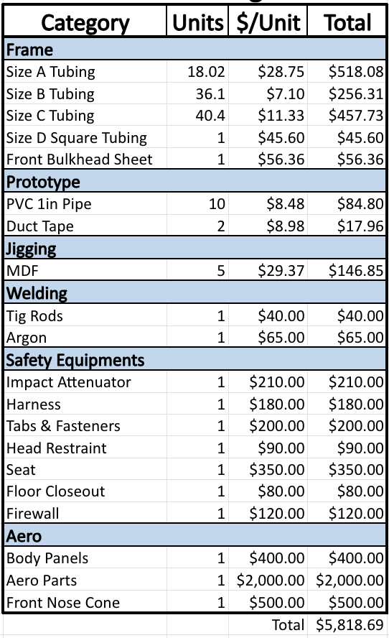
Budget (Gustavo & Carson)
Budget can range from $4k-7k depending on aerodynamics
Figure 8: budget breakdown

Slide 16
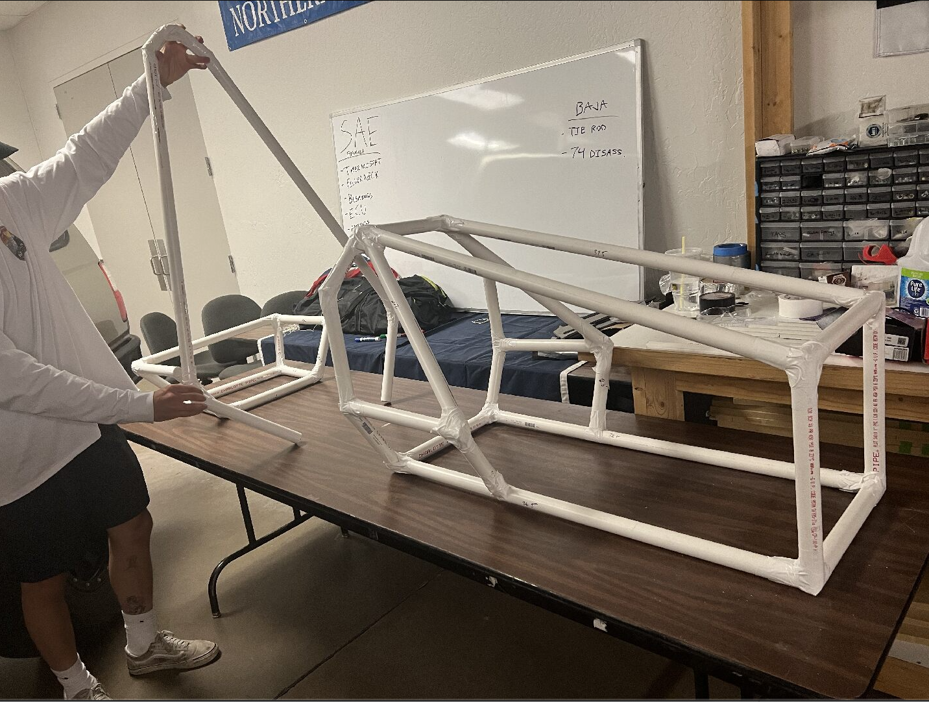
Prototype progress (Alexandra)
PVC Components completed:
Rear Suspension box
Main Hoop
Front Hoop
Front suspension box
Components not complete:
Engine Box
Cockpit
Structural Members

Slide 17
Literature Review (Brandon)
References and how they apply to our research:
Each reference directly applies to the sub-team's research or benchmarking purposes
[1] Benchmarking from San Diego states chassis, to see how they designed the front and main hoops for their car. (website)
[2] Chassis design report from Delaware Universities chassis sub team, this is great for benchmarking as well as seeing any deficiencies with research or design process.[ (Report)
[3] Article on Purdue university's Formula car, the design score for their 2020 car was the highest they’ve ever scored. This is great for benchmarking with the 2025 car and NAU's car last year. (website)
[4] Book specifically for this capstone regarding racecar dynamics and design, lots of useful equations for mathematical research .(book)
[5] Book on vehicle dynamics, also has many useful equations for mathematical research regarding forces on the car as well as weight and acceleration transfer. (book)

Slide 18
Literature Review (Ryan)
References and how they apply to our research:
Textbooks:
[9] Describes what Torsional Stiffness is in a car. How it can help handling. How to measure it. How to increase Torsional Stiffness.
[22] Dynamics Textbook from ME 252 to find equations.
Published Papers:
[10] Research and calculations on a FSAE chassis using ANSYS and applicable analysis techniques.
[23] Goes over forces on a FSAE chassis.
[24] Intro on suspension and frame design of a FSAE
Standard:
[11] Formula SAE Rule book to follow chassis standards and requirements.
Online Resources:
[12] Goes over how to do a static torsional analysis of a FSAE chassis.
[13] Covers mesh analysis in SolidWorks and how to fix error in a FSAE Chassis.
[14] How to setup a side impact for a FSAE Chassis.

Slide 19
Literature Review (Alexandra)
References and how they apply to our research:
[15] Shigley’s mechanical engineering design Chapter 3 (Textbook)
In a 5-point harness system, the force from a crash is distributed between the shoulder straps, lap belts, and the anti- submarine strap. Found the uniformly distributed stress equation.
[16]“SAE standards for Mobility Knowledge and Solutions,” SAE International (Website)
Standards for the SAE formula, aims to promote safety, productivity, efficiency, and certification in mobility. Found specific standards for the 5-point seatbelt.
[17]The, Dynamics: Force and Newton’s Laws of Motion. Chapter 4 (Textbook)
This chapter covers Newton's 2nd Law of motion, which is essential for analyzing the forces acting on the seatbelt.
[18] The Effect of the Use of Full Body Harnesses on Their Protective Properties,” International Journal of Occupational Safety and Ergonomics (Paper)
This paper provides guidelines for periodic checks and maintenance of harnesses for them to retain the protective properties, which helped established safety margins.
[19] Effects of seat belts and shock absorbers on the safety of racing car drivers (Paper)
Used this for the example problem for the mathematical modeling, this paper gave an example of a 5-point seatbelt stress.
[20] Design of a Formula SAE race car: Vehicle Dynamics and Performance,” SAE Technical Paper Series (Paper)
This paper explores the dynamics of a race car, the vehicle dynamics uses Newton's Laws of Motion, with a few different case studies.
[21] "Crash test numerical analysis of a Formula SAE vehicle"
This video showed the behavior of a FSAE vehicle under frontal impact, simulated on LS-Dyna

Slide 20
Literature Review (Gustavo)
References and how they apply to our research:
[25] "Design and Analysis of FSAE Chassis for Safe Conditions" (Paper)
Helpful design parameters and calculations to run our design through, as well as finding vertical center of gravity methods.
[26] "FEA Analysis of FSAE Chassis" (Paper)
Main goal highlighted were to decrease weight and increase torsional rigidity, helpful ANSYS simulation of stresses and torsion.
[27] "The Science of Vehicle Dynamics", Chapter 3 "Vehicle Model for Handling" (Book)
Great explanation on aerodynamics in a Formula car, and goes more in depth on front and rear vertical forces
[28] "Fundamentals of Aerodynamics", Chapter 19 "Turbulent Boundary Layers" (Book)
Helpful way to create turbulent modeling and find characteristics of a turbulent flow.
[29] "Renewable Energy Vehicle Project: Pedal Box Design for Formula SAE" (Paper)
Future Work ideas from pedal box are to decrease weight and use an angle-mounted cylinder to decrease pedal box length, like our goal.
[30] "Formula SAE Rules 2025", F- Chassis and Structural (Standard)
Main design constraints and regulations that are frame needs to abide by. Helpful templates to ensure ergonomics of vehicle and as well as its functionality.

Slide 21
Literature Review (Carson)
References and how they apply to our research:
"Aerodynamics Analysis of a Formula SAE car" (Paper)
Helped in giving an overview of all components studied when designing aerodynamics
"Aerodynamics of Road Vehicles, 5th edition" (Book)
Gives tons of information about production passenger cars and other various road vehicles
"Aerodynamic Study of Formula SAE car" (Paper)
Gives great insight into design of previous SAE cars and good practices
"NACA 4-digit airfoil generator" (standard)
Helped me pick out which airfoil geometry will be best for this application.
"Introduction to Aircraft Airfoil Aerodynamics" (paper)
Gave me a broader understanding of airfoils outside of car aerodynamics.
"How an Airfoil Works – MIT" (website)
Showed some great methods for characterizing an airfoil for different applications.
"Theory of Airfoil Lift Aerodynamics" (book chapter)
Helped give an overall grasp of how airfoils are generally used

Slide 22
Sources:
[1] M. Planchard, “San Diego state university formula SAE team showcased at Solidworks World,” SOLIDWORKS Education Blog, https://blogs.solidworks.com/teacher/2014/01/san-diego-state-university-formula-sae-team-showcased-at-solidworks-world.html (accessed Sep. 15, 2024).
[2] C. Dodd, N. Geneva, P. Geneva, and C. Morris, Dr. Steven Timmins , rep., 2017
[3] “Purdue Formula SAE scores 2nd place; Best Design Score in their history,” Mechanical Engineering - Purdue University, https://engineering.purdue.edu/ME/News/2021/purdue-formula-sae-scores-2nd-place-best-presentation-score-in-their-history- (accessed Sep. 15, 2024).
[4] William F Milliken and Douglas L Milliken. Race car vehicle dynamics. Vol. 400. Society of Automotive Engineers Warrendale, 1995
[5] Martin Meywerk. Vehicle Dynamics. John Wiley & Sons, 2015
[6] Sahil Gupta and Kishal Saxena, "Aerodynamics Analysis of a Formula SAE car", Department of Aerospace Engineering and Department of Engineering Design at Indian Institute of Technology Madras
[7] Craig, C. and Passmore, M., "Methodology for the Design of an Aerodynamic Package for a Formula SAE Vehicle," SAE Int. J. Passeng. Cars - Mech. Syst. 7(2):575-585, 2014, https://doi.org/10.4271/2014-01-0596.
[8] Reza Samarghandi, Vortex Panel Method - File Exchange - MATLAB Central (mathworks.com)
[9] R. Patil and V. Chikkali, “FEA analysis of FSAE chassis,” International Journal of Engineering Research and, vol. V9, no. 07, Jul. 2020. doi:10.17577/ijertv9is070148 [Ryan]
[10] W. F. Milliken, P. G. Wright, and D. L. Milliken, “Moment method - a comprehensive tool for race car development,” SAE Technical Paper Series, pp. 673–677, Dec. 1994. doi:10.4271/942538
[11] F. S. Organization , 2024 Formula SAE Rules V1, Aug. 2023. Accessed: Sep. 16, 2024. [Online]. Available: https://www.fsaeonline.com/cdsweb/app/NewsItem.aspx?NewsItemID=4af3d94c-748b-40e9-b5ed-dddea428a08b
[12] Random Simple Knowledge, “FSAE Chassis Torsional Analysis and Side Impact Analysis in SolidWorks ,” YouTube, https://www.youtube.com/watch?v=KUtUp6bA39w (accessed Sep. 17, 2024).
[13] Simple Random Knowledge, “3 Easy Method to Locate Gap in between FSAE Chassis Pipes | How to Edit Green Dots in SolidWorks,” YouTube, https://www.youtube.com/watch?v=CtqHrskxpe8 (accessed Sep. 17, 2024).
[14] DP Design, “Frontal Impact Simulation of FSAE Chassis using Solidworks ,” YouTube, https://www.youtube.com/watch?v=rDjoRXzVH-0 (accessed Sep. 17, 2024).
[15] R. G. Budynas, J. K. Nisbett, and J. E. Shigley, Shigley’s mechanical engineering design. New York, NY: McGraw-Hill Education, 2020. Chapter 3
[16] “SAE standards for Mobility Knowledge and Solutions,” SAE International, https://www.sae.org/standards?utm_source=google&utm_medium=ppc&utm_campaign=LVL_SAE_SCH_GSE_NTN_GPM_B2C_Standards&utm_content=Standards&utm_term=B2C&utm_device=c&utm_keymatch=p&utm_adposition=&gad_source=1&gclid=CjwKCAjw0aS3BhA3EiwAKaD2ZSgsuuN9rfyeBQE_uWePei2JlxfRiqc2r97IeRPudAJ_66PtXDuT6xoC7T4QAvD_BwE (accessed Sep. 17, 2024).
[17] The, Dynamics: Force and Newton’s Laws of Motion. 2019.
[18] K. Baszczyński and M. Jachowicz, “The Effect of the Use of Full Body Harnesses on Their Protective Properties,” International Journal of Occupational Safety and Ergonomics, vol. 15, no. 4, pp. 435–446, Jan. 2009, doi: https://doi.org/10.1080/10803548.2009.11076823.
[19] C. Itu, A. Toderita, L.-V. Melnic, and S. Vlase, “Effects of seat belts and shock absorbers on the safety of racing car drivers,” Mathematics, vol. 10, no. 19, p. 3593, Oct. 2022. doi:10.3390/math10193593
[20] C. D. Carter, C. B. Sherman, and R. D. Matthews, “Design of a Formula SAE race car: Vehicle Dynamics and Performance,” SAE Technical Paper Series, Feb. 1982. doi:10.4271/821092 Aerodynamics
[21] Bruno Muss. "Crash test numerical analysis of a Formula SAE vehicle," YouTube, 1/17/2018. https://www.youtube.com/watch?v=c8k9Idy5kwk.
[22] R. C. Hibbeler, Engineering Mechanics: Dynamics. Hoboken, N.J: Pearson, 2022.
[23] S. Khaire, “Design and analysis of FSAE race car chassis,” International Journal for Research in Applied Science and Engineering Technology, vol. 9, no. 4, pp. 1234–1237, Apr. 2021. doi:10.22214/ijraset.2021.33880
[24] E. F. Gaffney and A. R. Salinas, “Introduction to formula SAE® suspension and frame design,” SAE Technical Paper Series, Apr. 1997. doi:10.4271/971584

Slide 23
Sources:
[25] Subramanyam, B., Rao, B. N., Sai, Y. Y., Mouli, K. C., & Pavansai, S. (2019). International Journal of Innovative Technology and Exploring Engineering. Design and Analysis of FSAE Chassis for Safe Conditions, 8(5). https://doi.org/10.35940/ijitee
[26] Patil, R., & Chikkali, V. (2020). FEA Analysis of FSAE Chassis. International Journal of Engineering Research & Technology, 9(7). https://doi.org/2278-0181
[27] Guiggiani, M. (2018). The Science of Vehicle Dynamics: Handling, braking, and ride of road and Race Cars. Springer.
[28] Anderson, J. D. (2017). Fundamentals of aerodynamics. McGraw Hill Education.
[29] Scheitlin, M. (2011). The University of Western Australia. Renewable Energy Vehicle Project: Pedal Box Design for Formula SAE.
[30] Formula SAE Rules 2025 (2025th ed.). (n.d.). . Society of Automotive Engineers.

Slide 24

Thank You!

