Slide 1

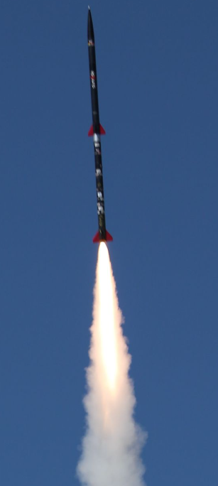
NG Super Sonic Rocket
Presenters: Austin Paothatat, Avery Charley, Koi Quiver,
Lindsey Dineyazhe
Figure 1: Two stage rocket
University of Sheffield [1]

Slide 2

Project Description
Our team is working towards building a two-stage supersonic rocket that will make use of advanced composite materials. Our foremost goal is to not only meet but surpass our customers’ expectations while keeping the budget under $7,300. Some important details to note are that we plan to conduct test flights in Fall 2024 and have a small-scale prototype ready by late April.
Stakeholders
  Northrop Grumman
Avery 2/26/24 NG Super Sonic Rocket

Slide 3
Project Purpose
Provide launch vehicle for future capstone payload
Research and design a two-stage rocket capable of recording data
Provide a test bed for a future space shot rocket
Funding:
Northrop Grumman Space Systems, $7,300
Avery 2/26/24 NG Super Sonic Rocket

Slide 4
Black Box Model
(2) Level 2 Motors
Sustained Mach 2 Velocity
Rocket
Flight
Midflight Separation
Max Altitude: 40,000+ ft.
Carbon Fiber Material
10 lb. Payload
Avery 2/26/24 NG Super Sonic Rocket

Slide 5
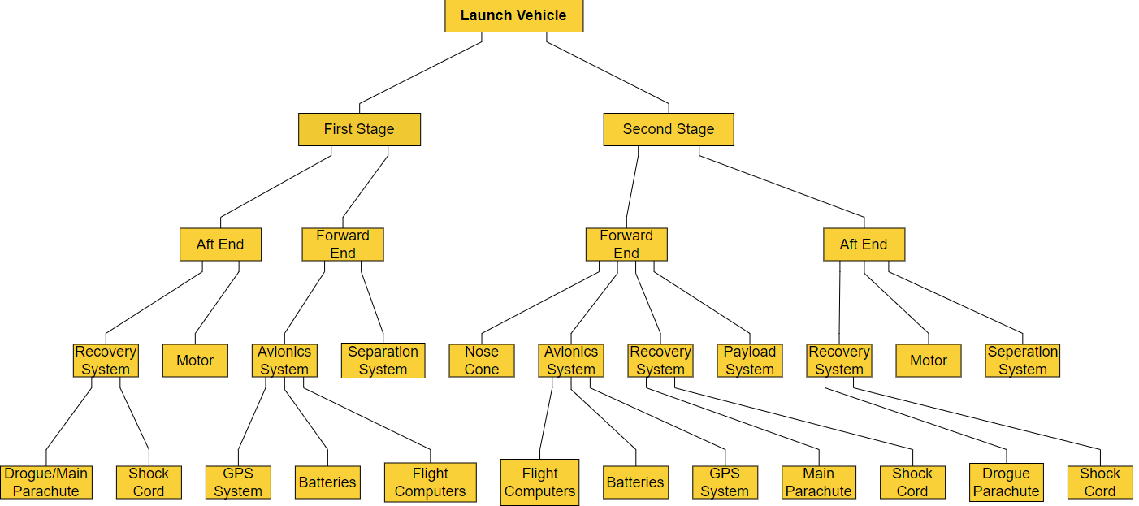
Functional Decomposition
Austin 2/26/24 NG Super Sonic Rocket

Slide 6
Concept Generations
Subsystems
  Avionics
  Separation System
  Body Design
  Fin Design
  Nose Cone
  Internal Rocket Layout
Requirements:
  5 concepts for each subsystem
Lindsey 2/26/24 NG Super Sonic Rocket

Slide 7
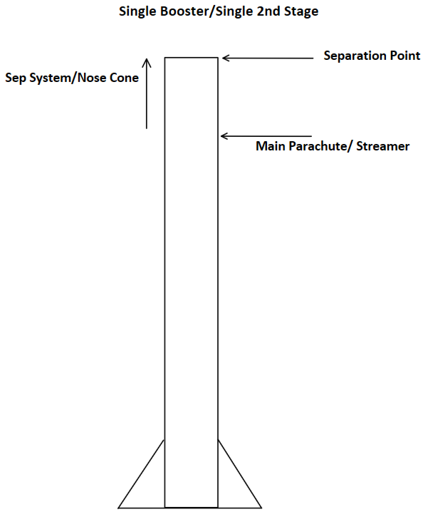
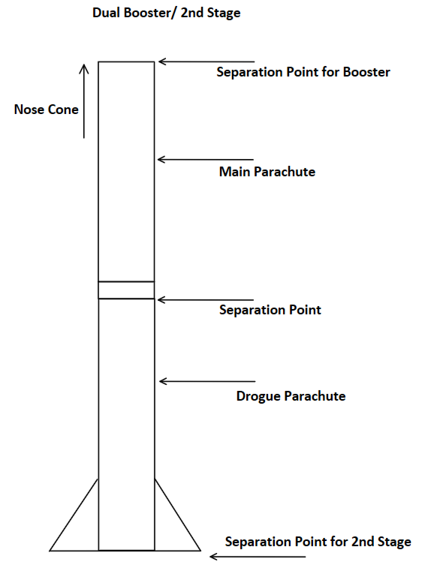
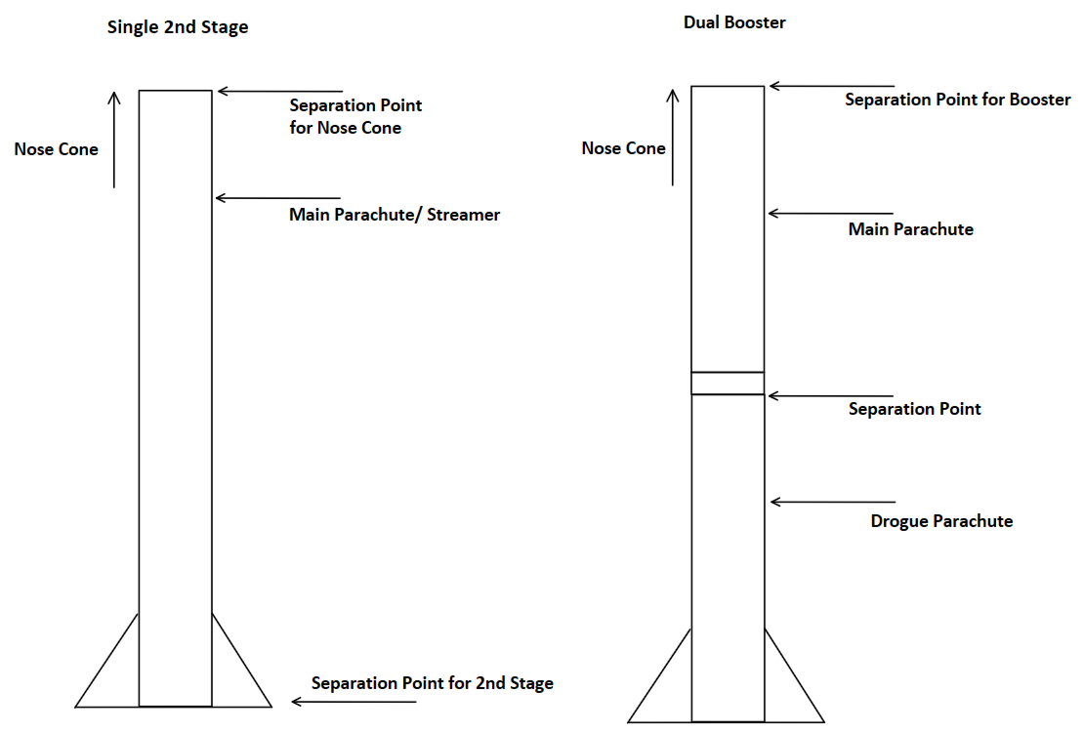
Subsystem - Avionics
A1
A2
A3
Austin 2/26/24 NG Super Sonic Rocket

Slide 8
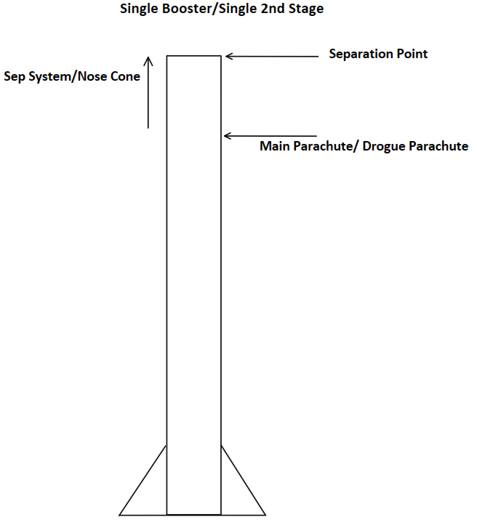
Subsystem - Avionics
A4
A5
Austin 2/26/24 NG Super Sonic Rocket

Slide 9
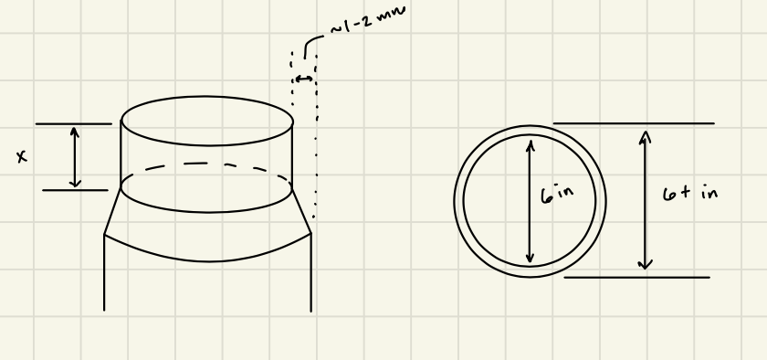
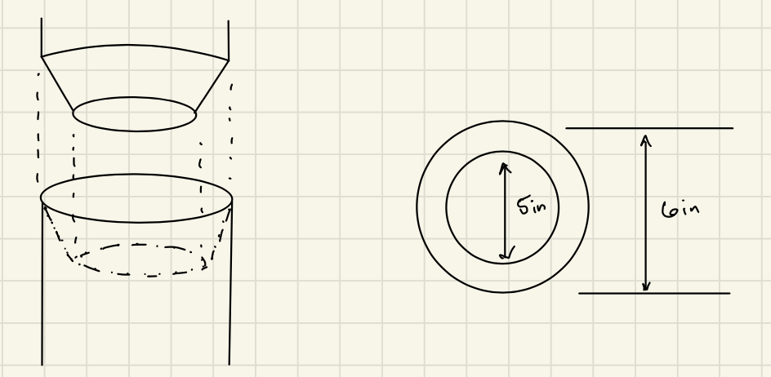
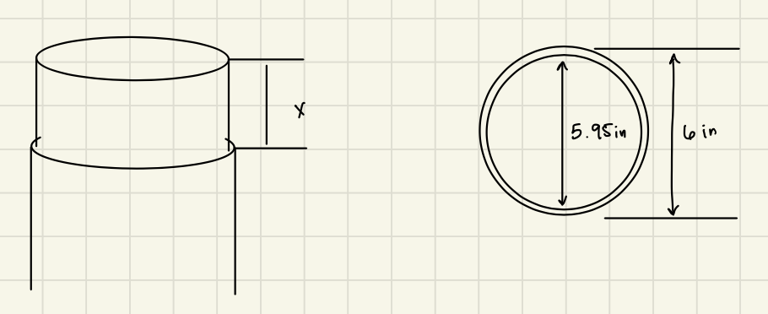
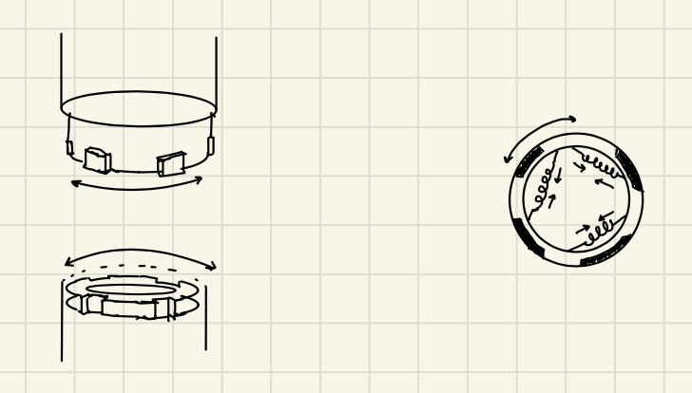
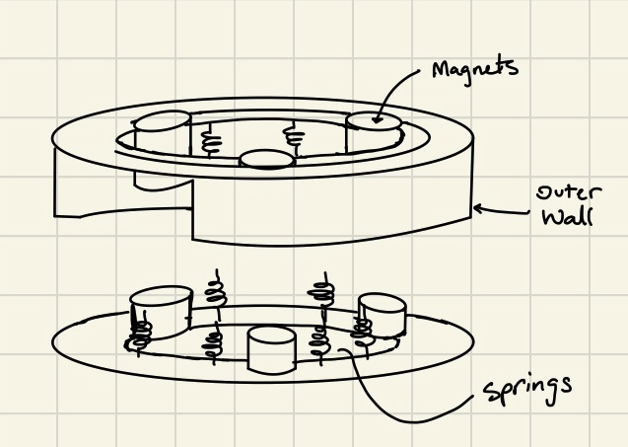
Subsystem – Separation System
B1
B2
B3
B4
B5
Avery 2/26/24 NG Super Sonic Rocket

Slide 10
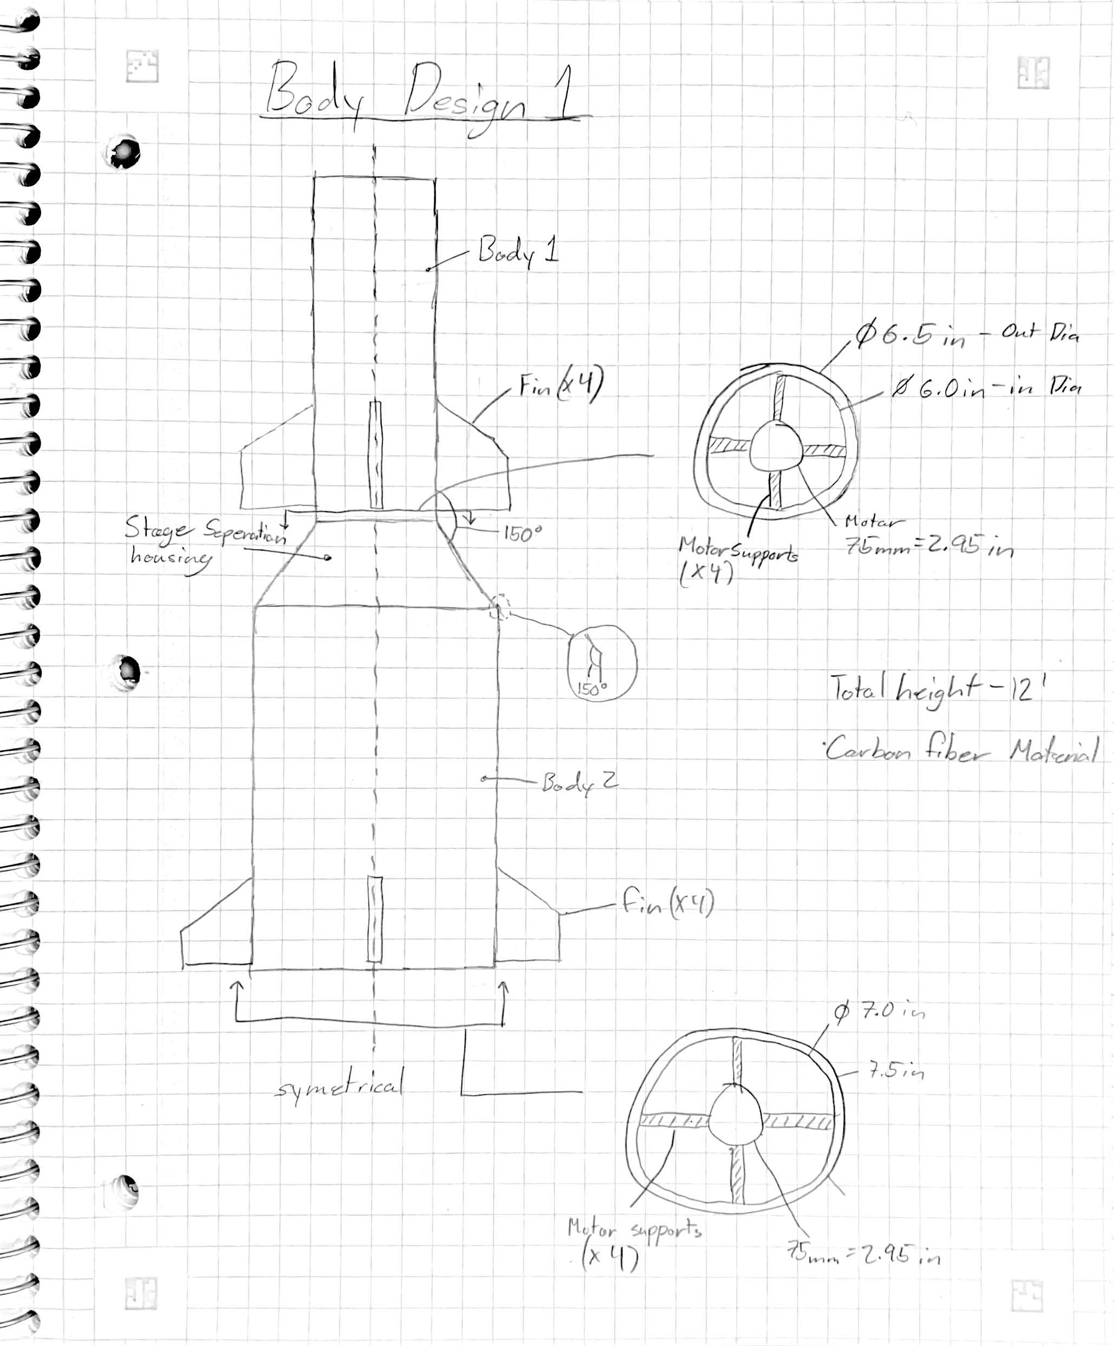
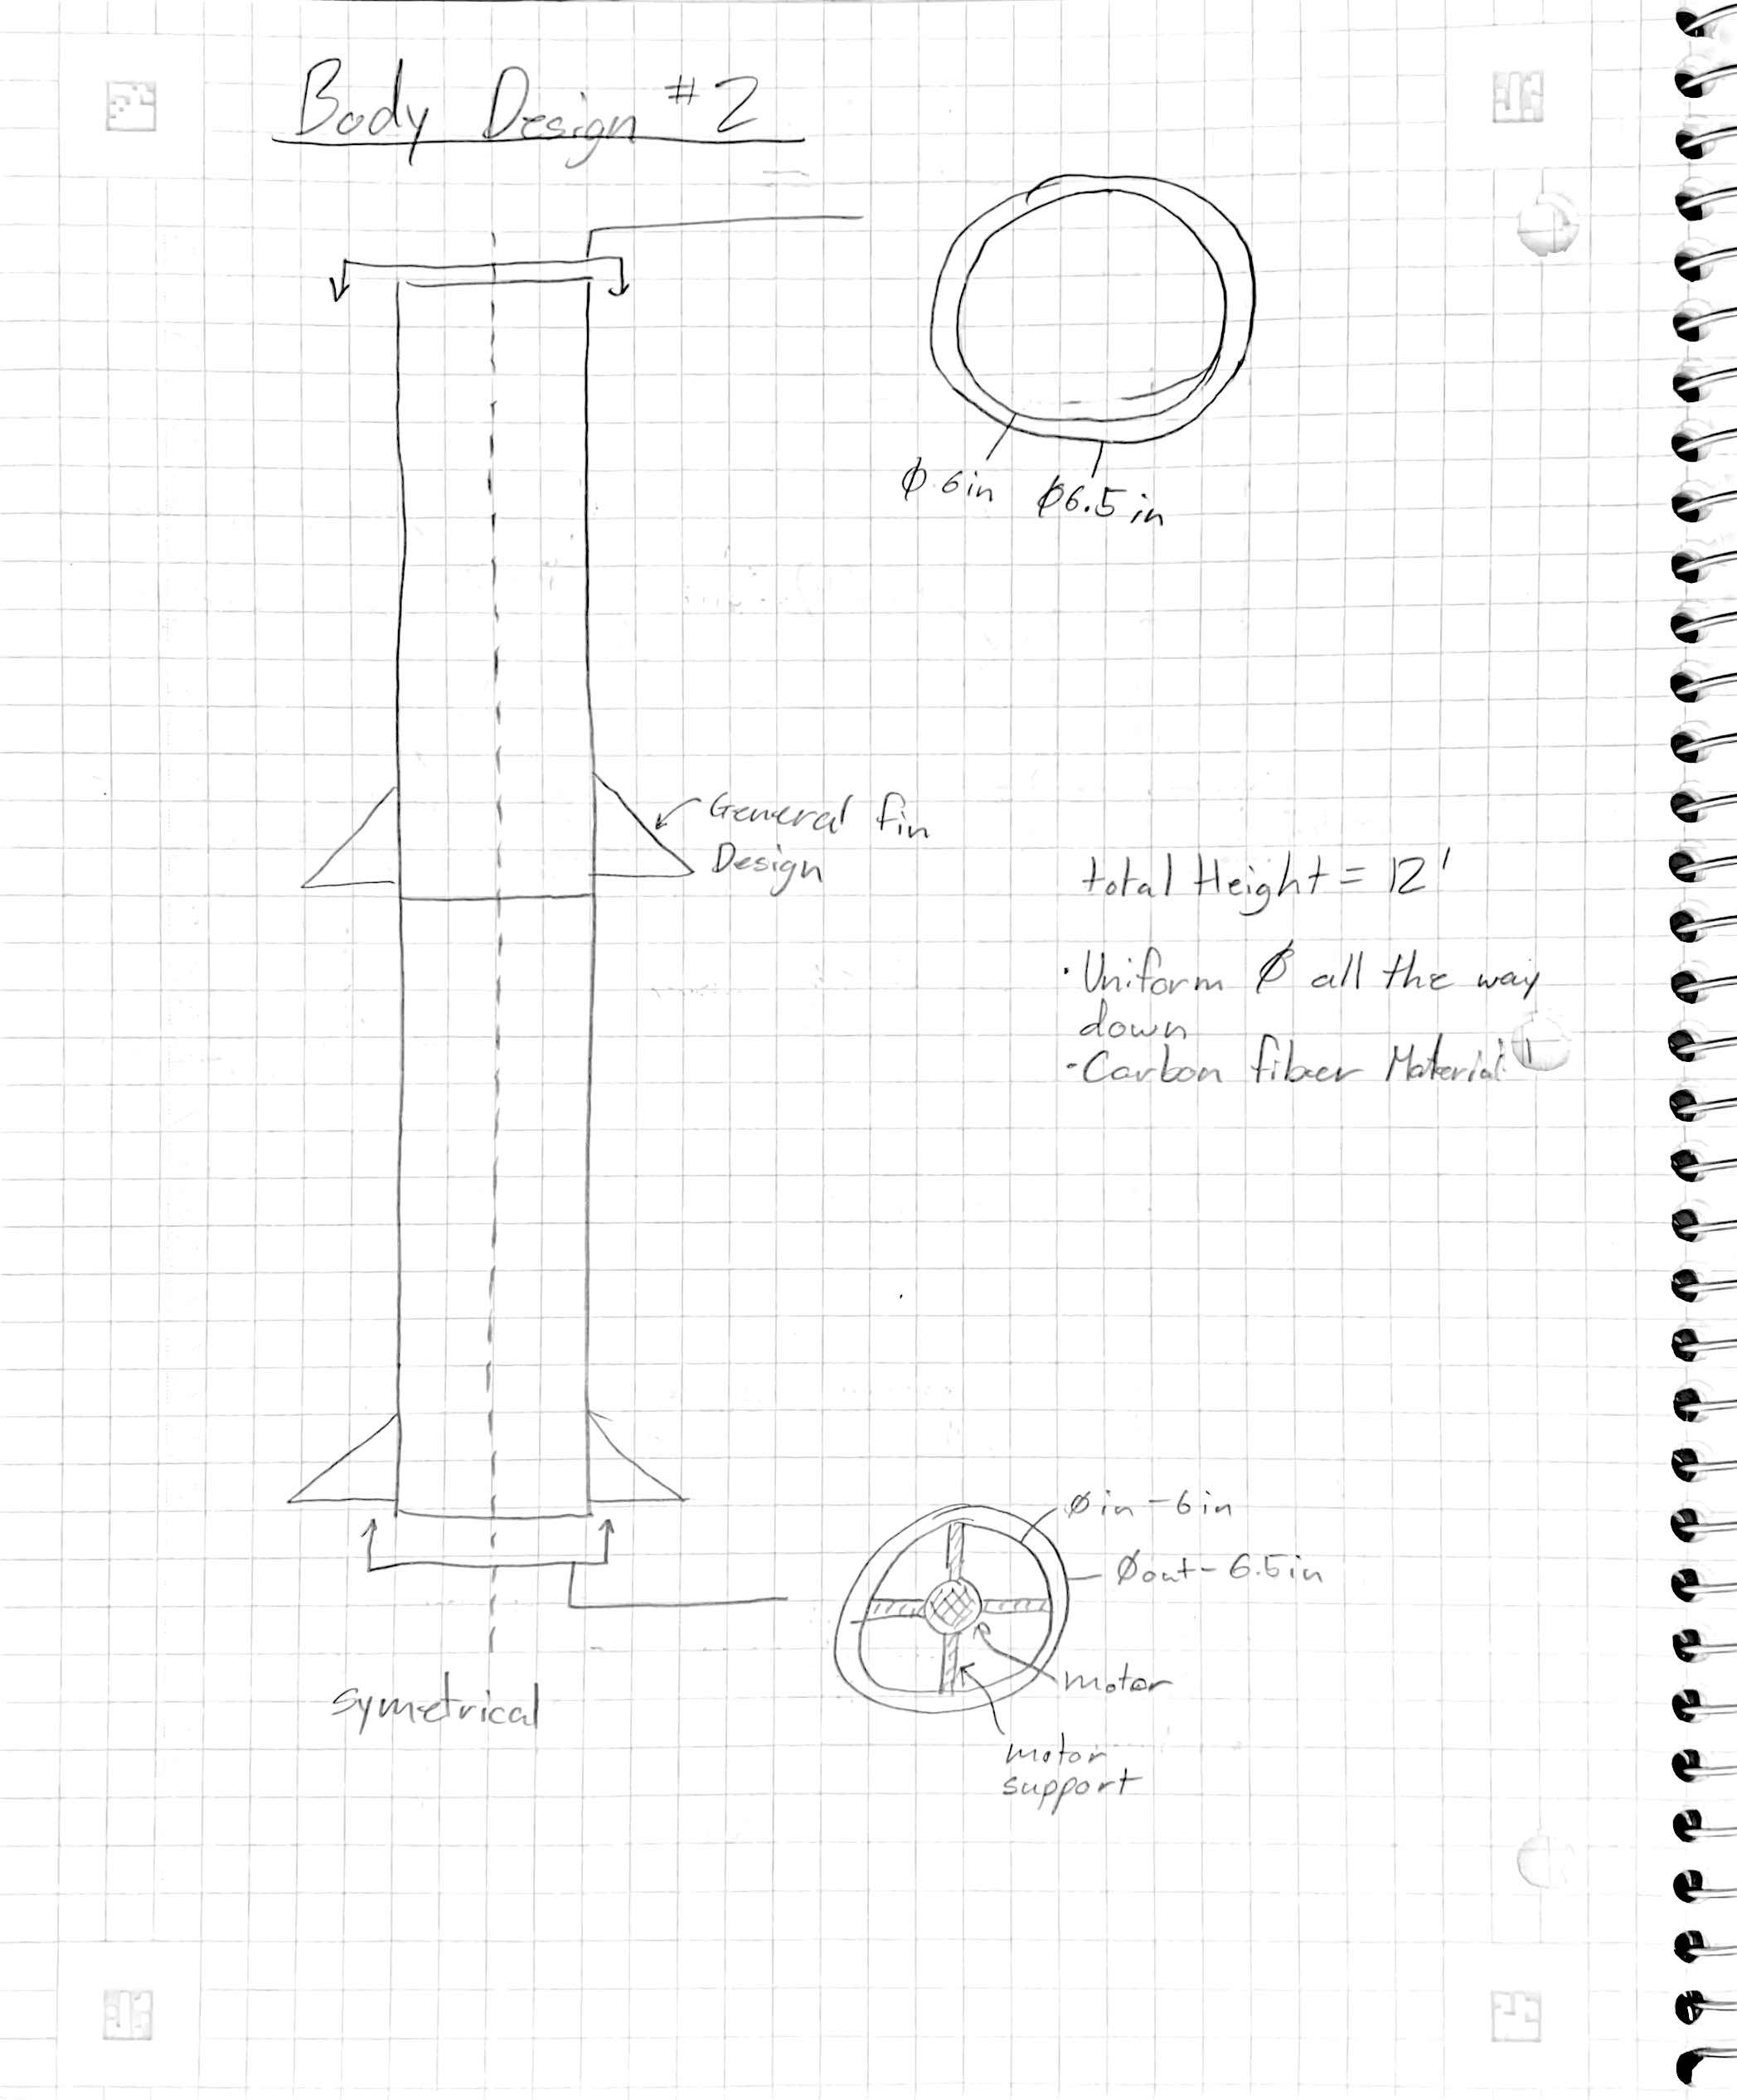
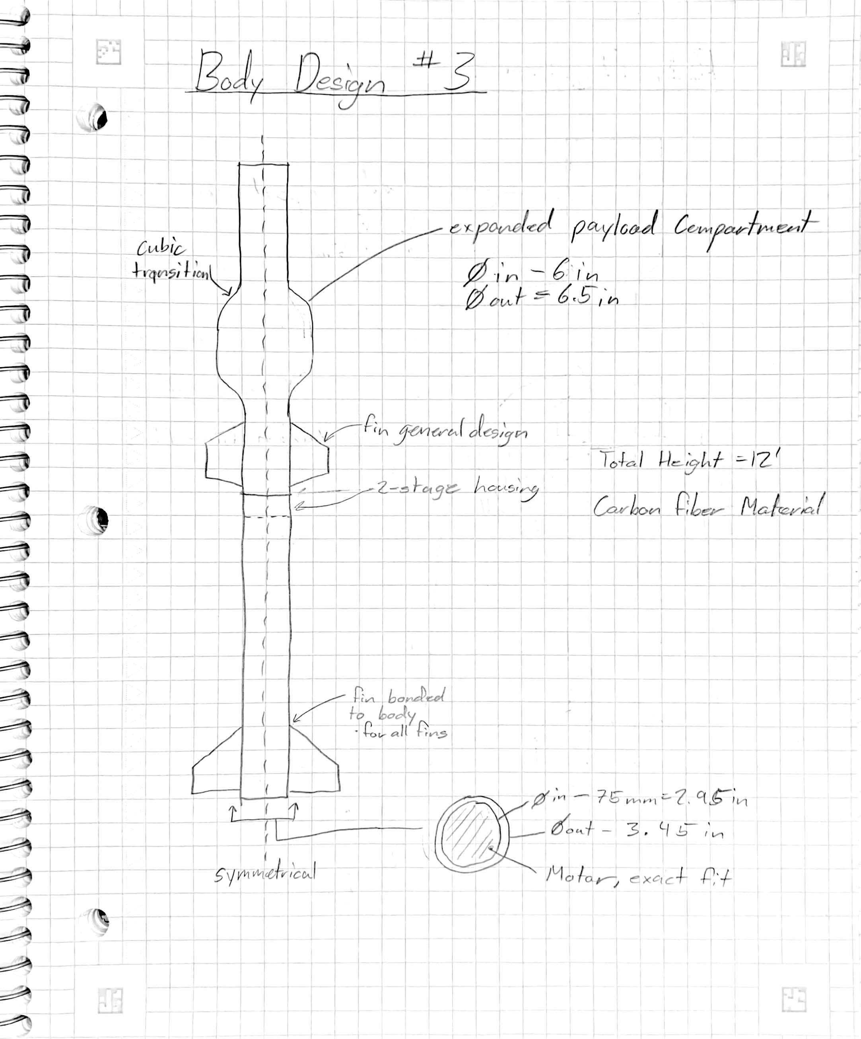
Subsystem – Body Design
C1
C2
C3
Koi 2/26/24 NG Super Sonic Rocket

Slide 11
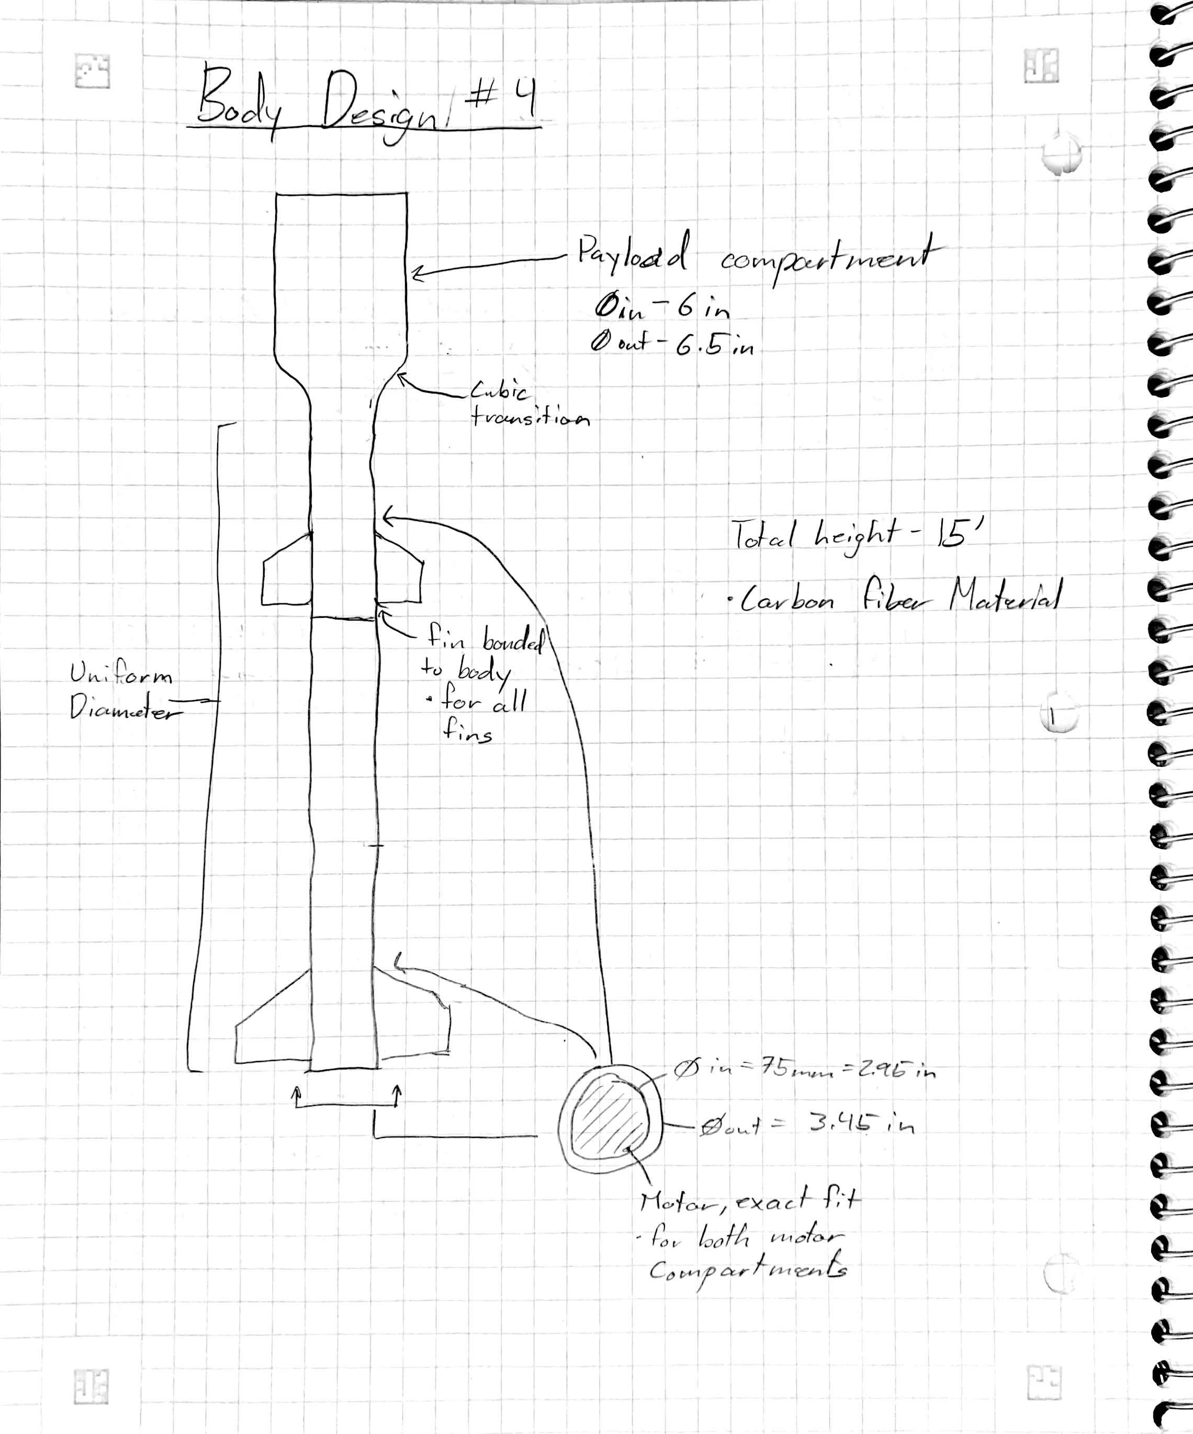
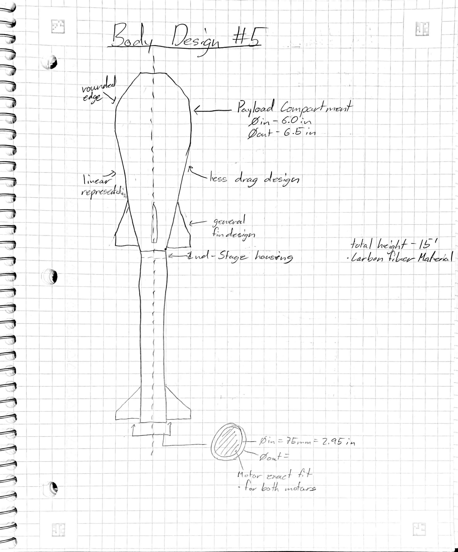
Subsystem – Body Design
C4
C5
Koi 2/26/24 NG Super Sonic Rocket

Slide 12
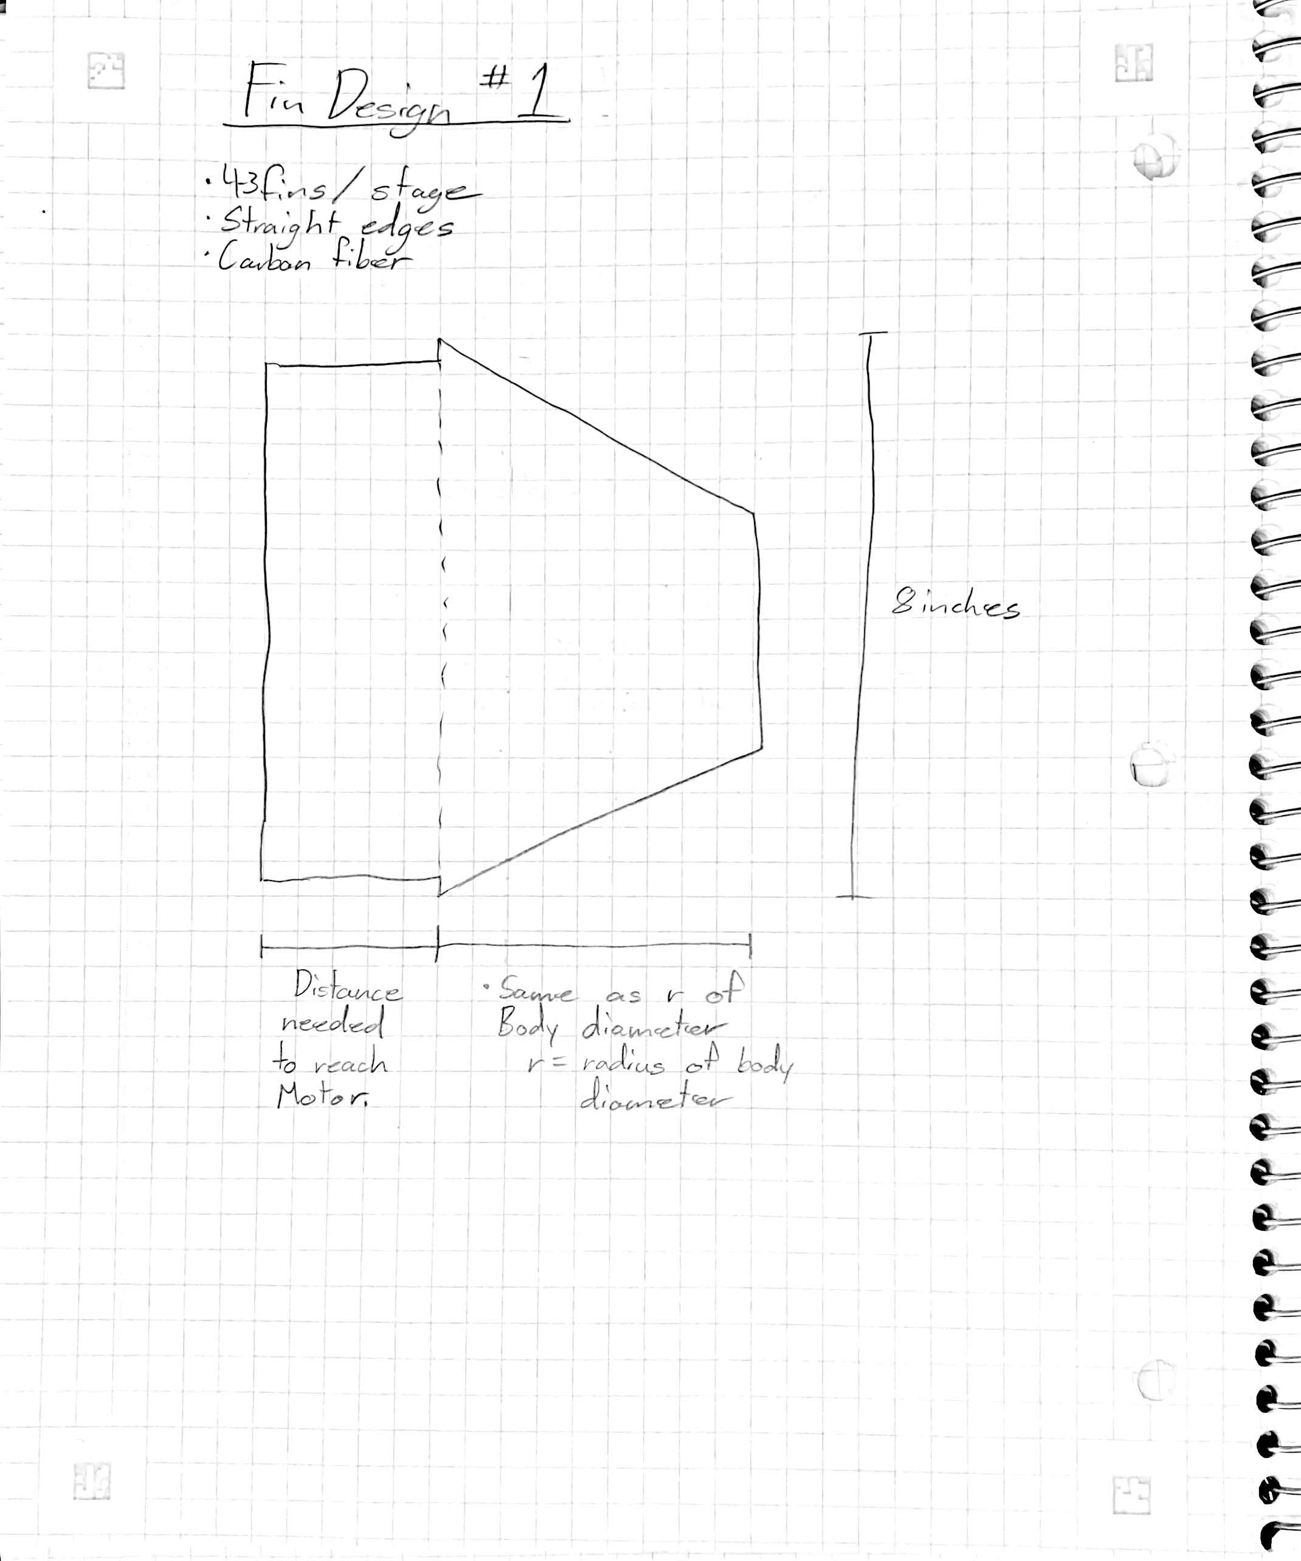
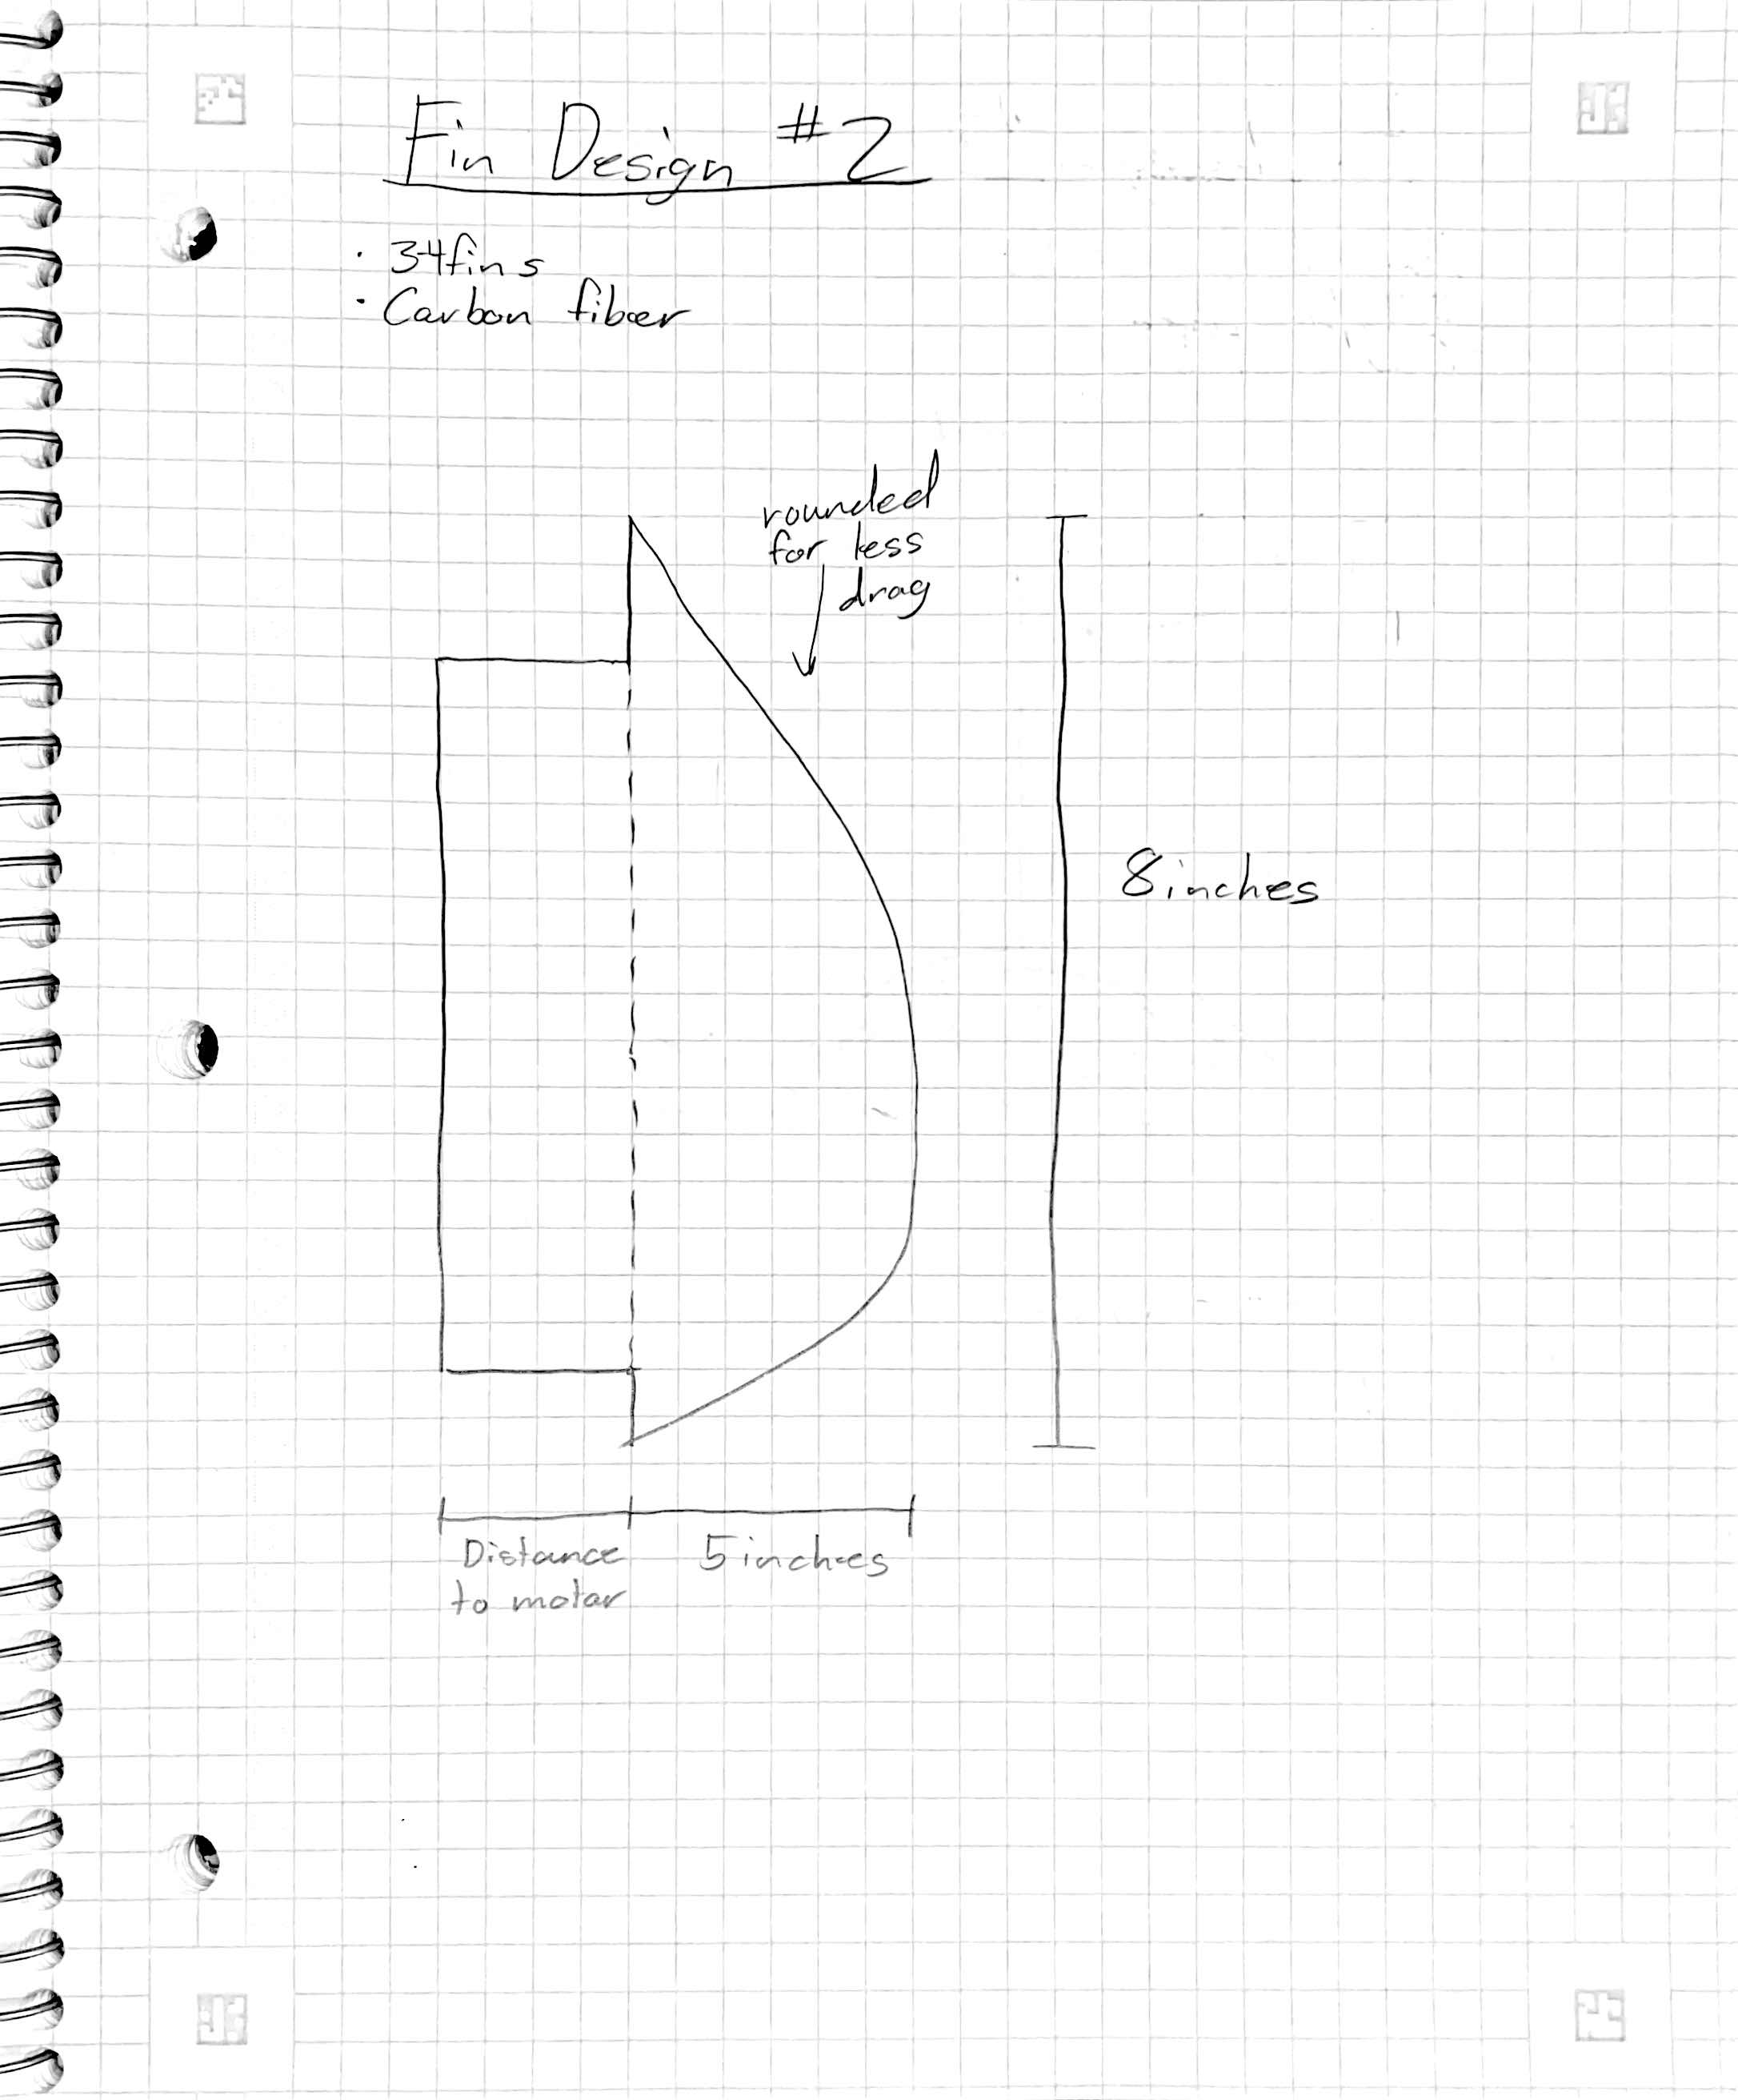
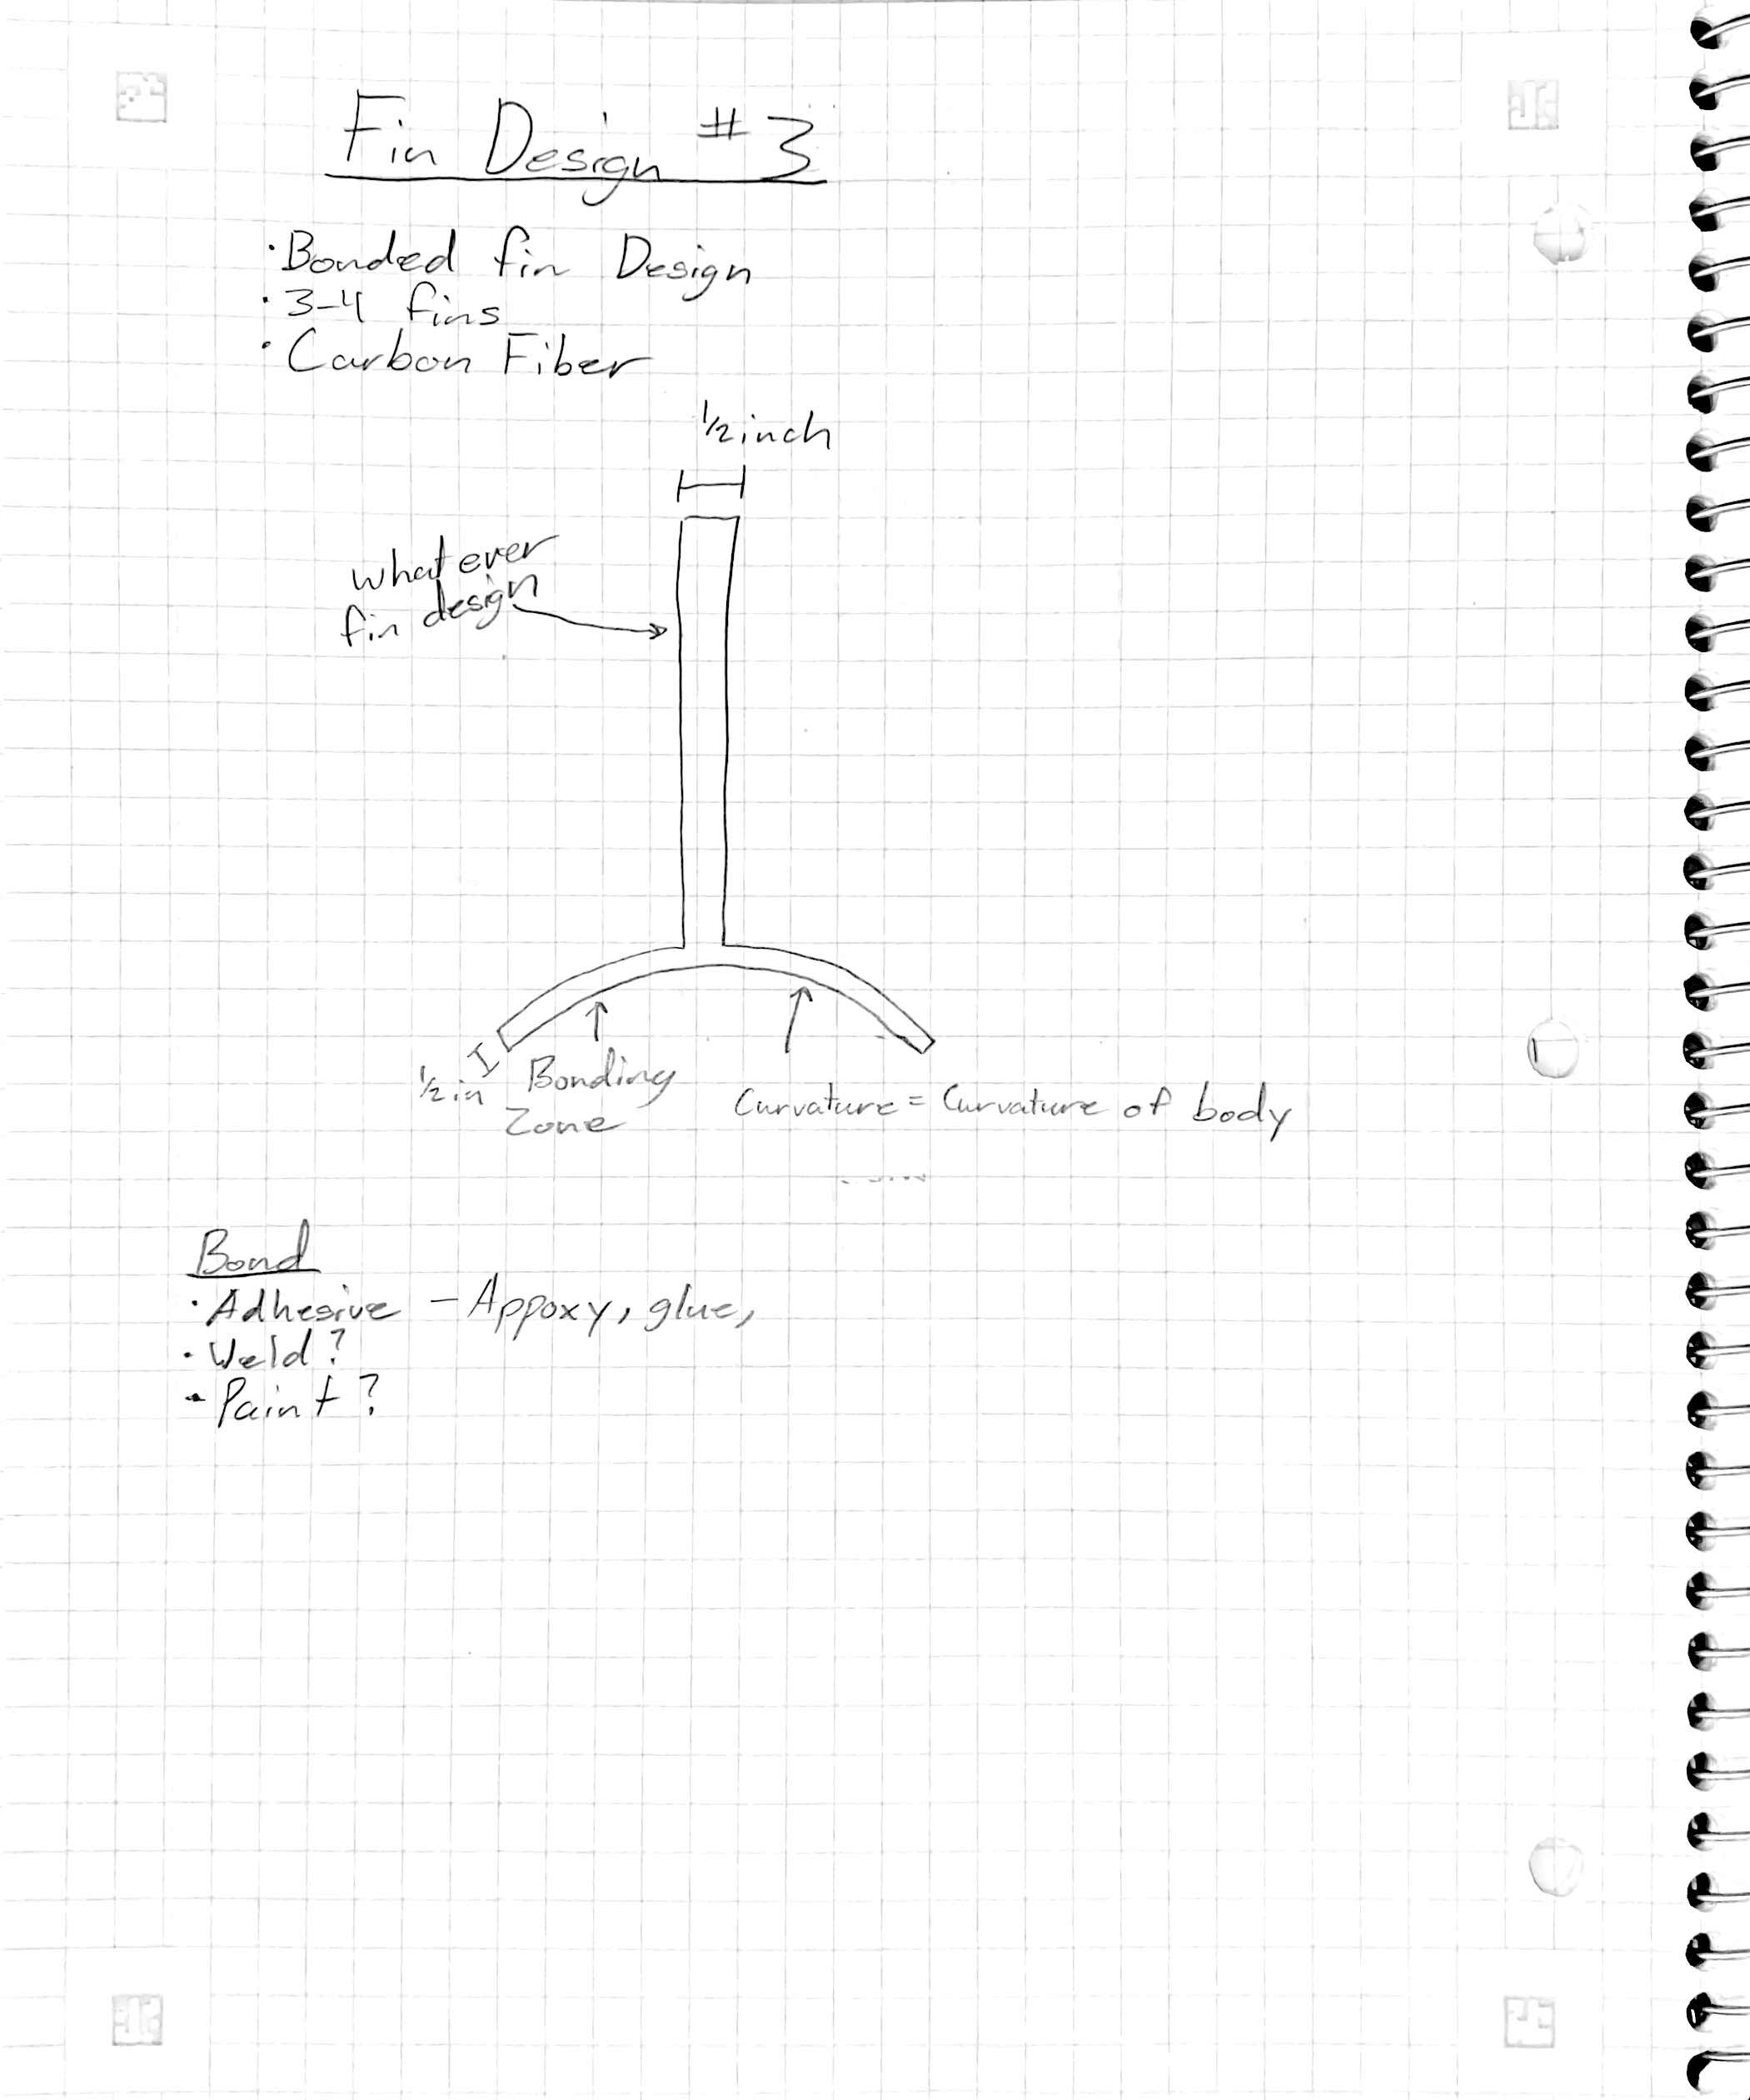
Subsystem – Fin Design
D1
D2
D3
Koi 2/26/24 NG Super Sonic Rocket

Slide 13
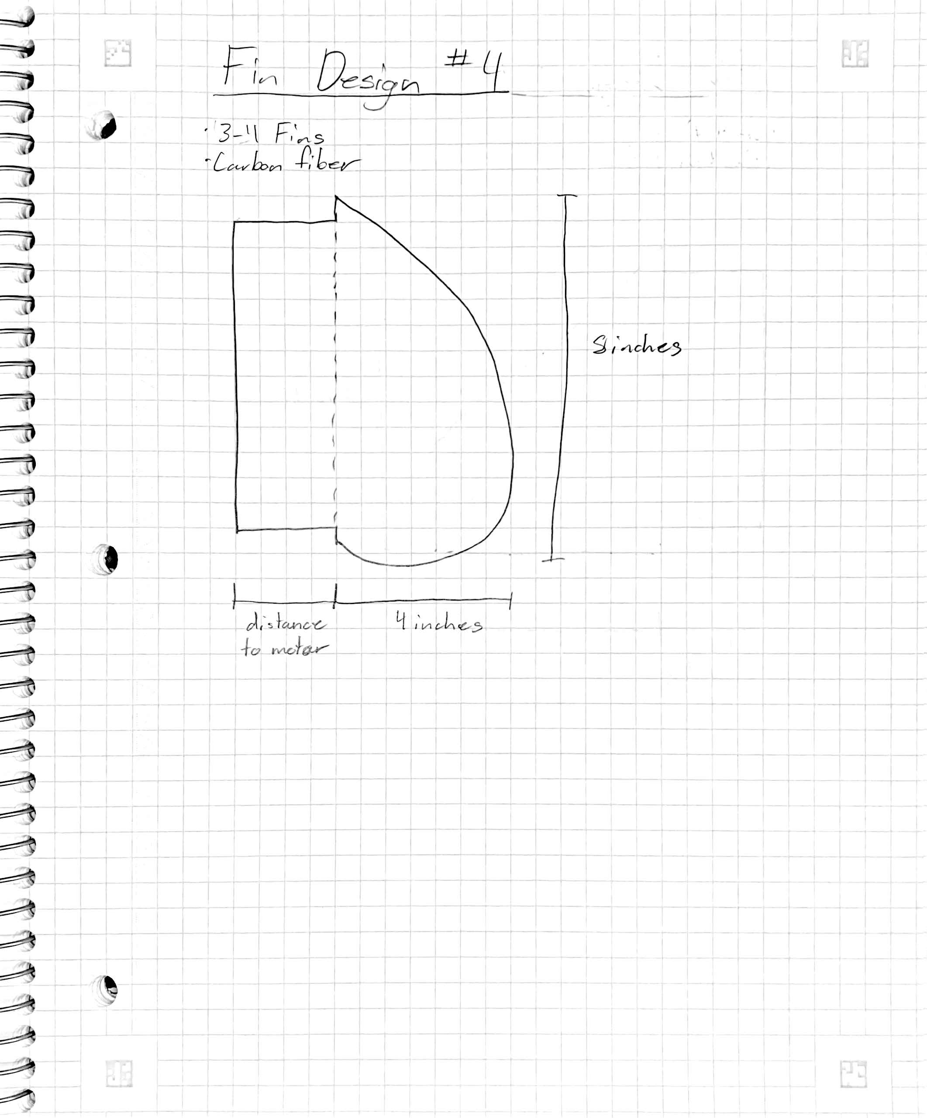
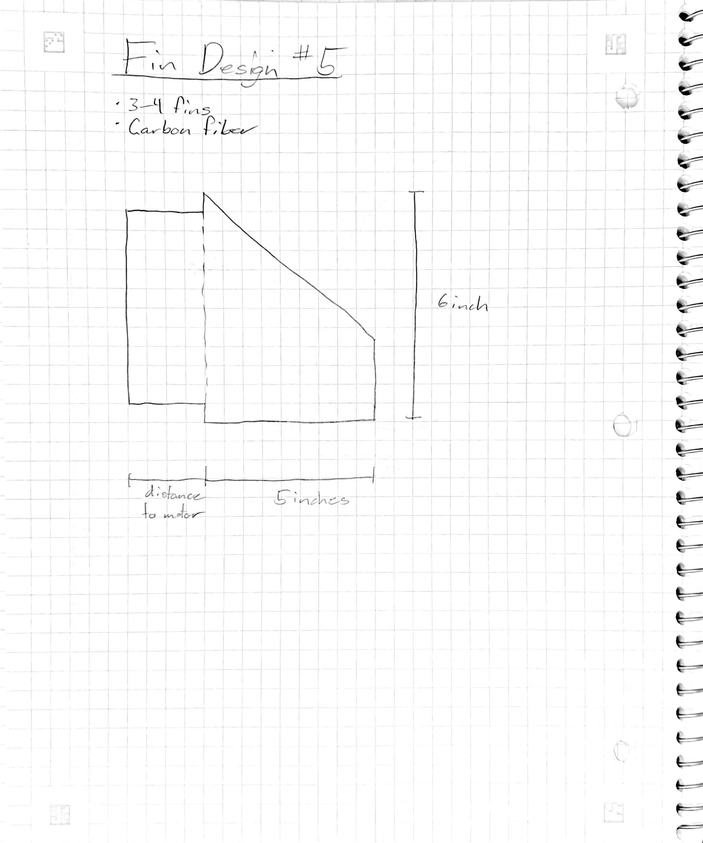
Subsystem – Fin Design
D4
D5
Koi 2/26/24 NG Super Sonic Rocket

Slide 14
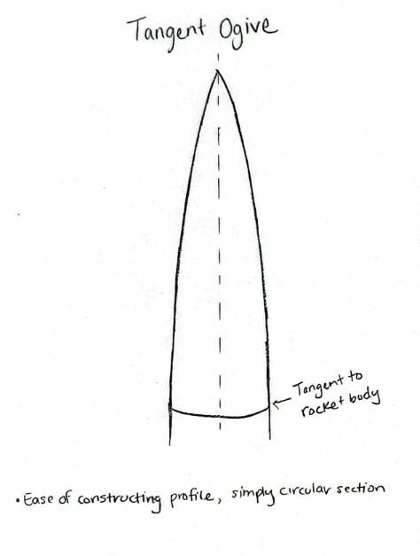
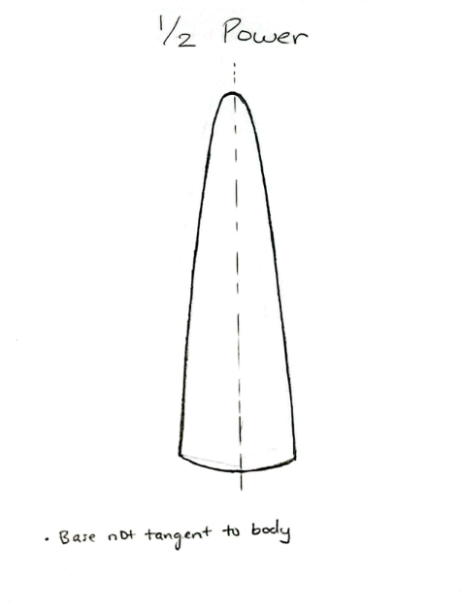
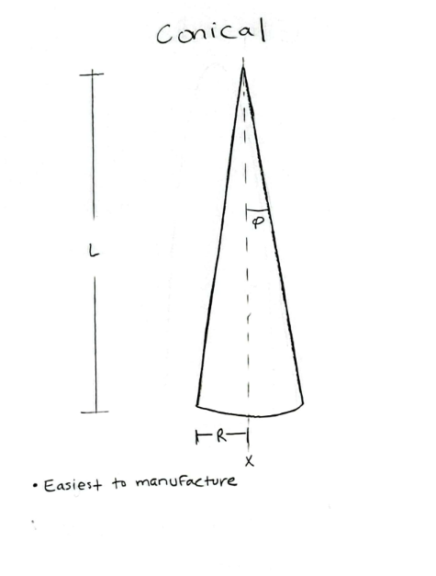
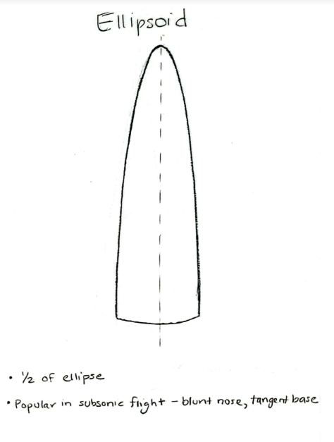
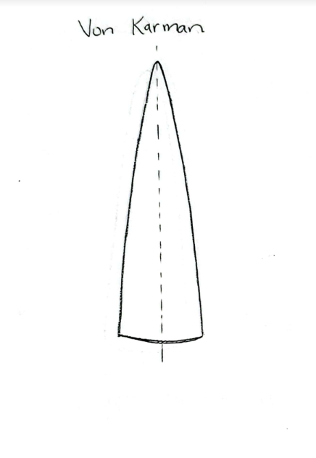
Subsystem - Nose Cone
E1
E2
E3
E4
E5
Lindsey 2/26/24 NG Super Sonic Rocket

Slide 15
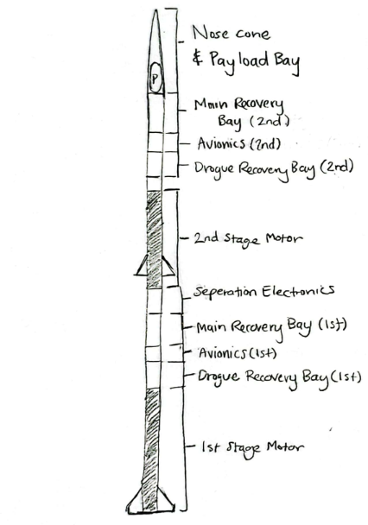
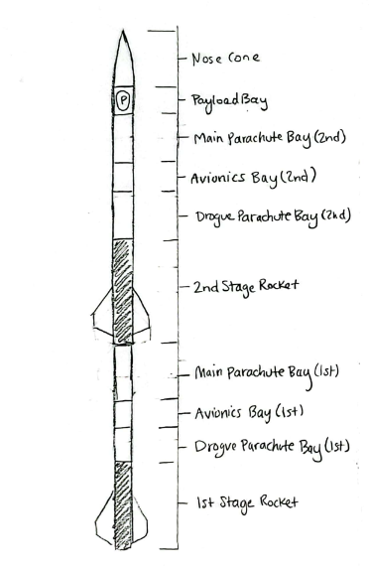
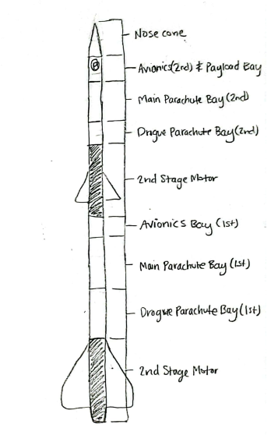
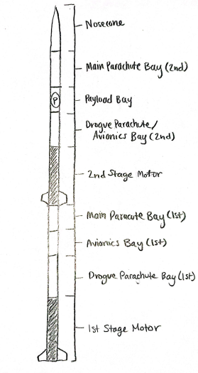
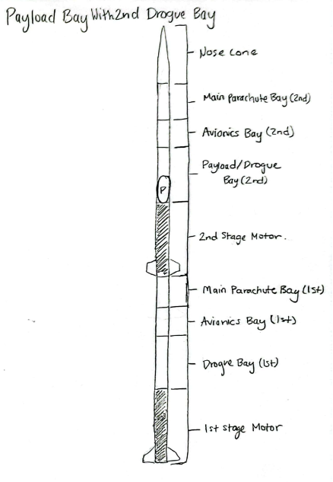
Subsystem – Internal Rocket Layout
F1
F2
F3
F4
F5
Lindsey 2/26/24 NG Super Sonic Rocket

Slide 16
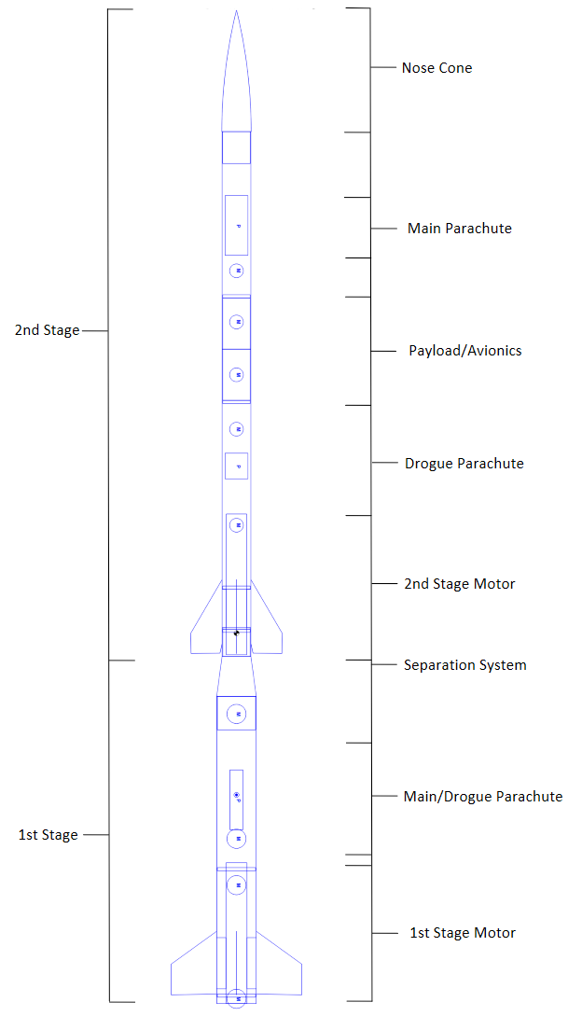
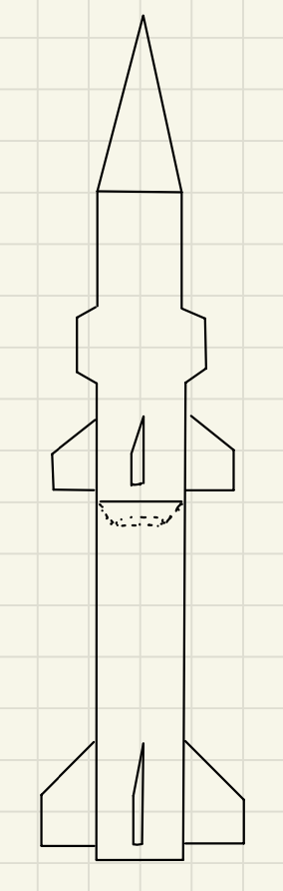
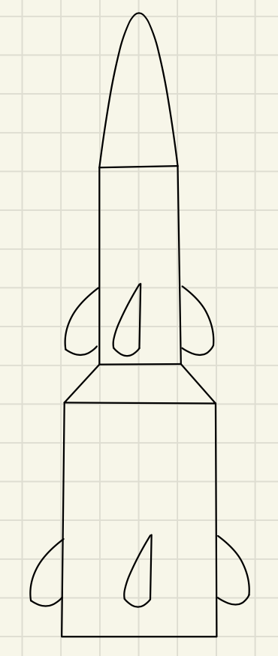
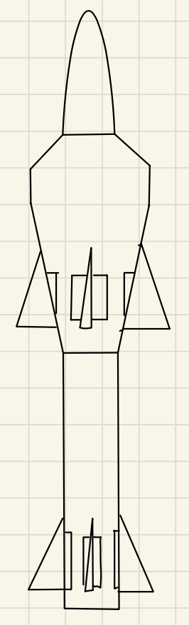
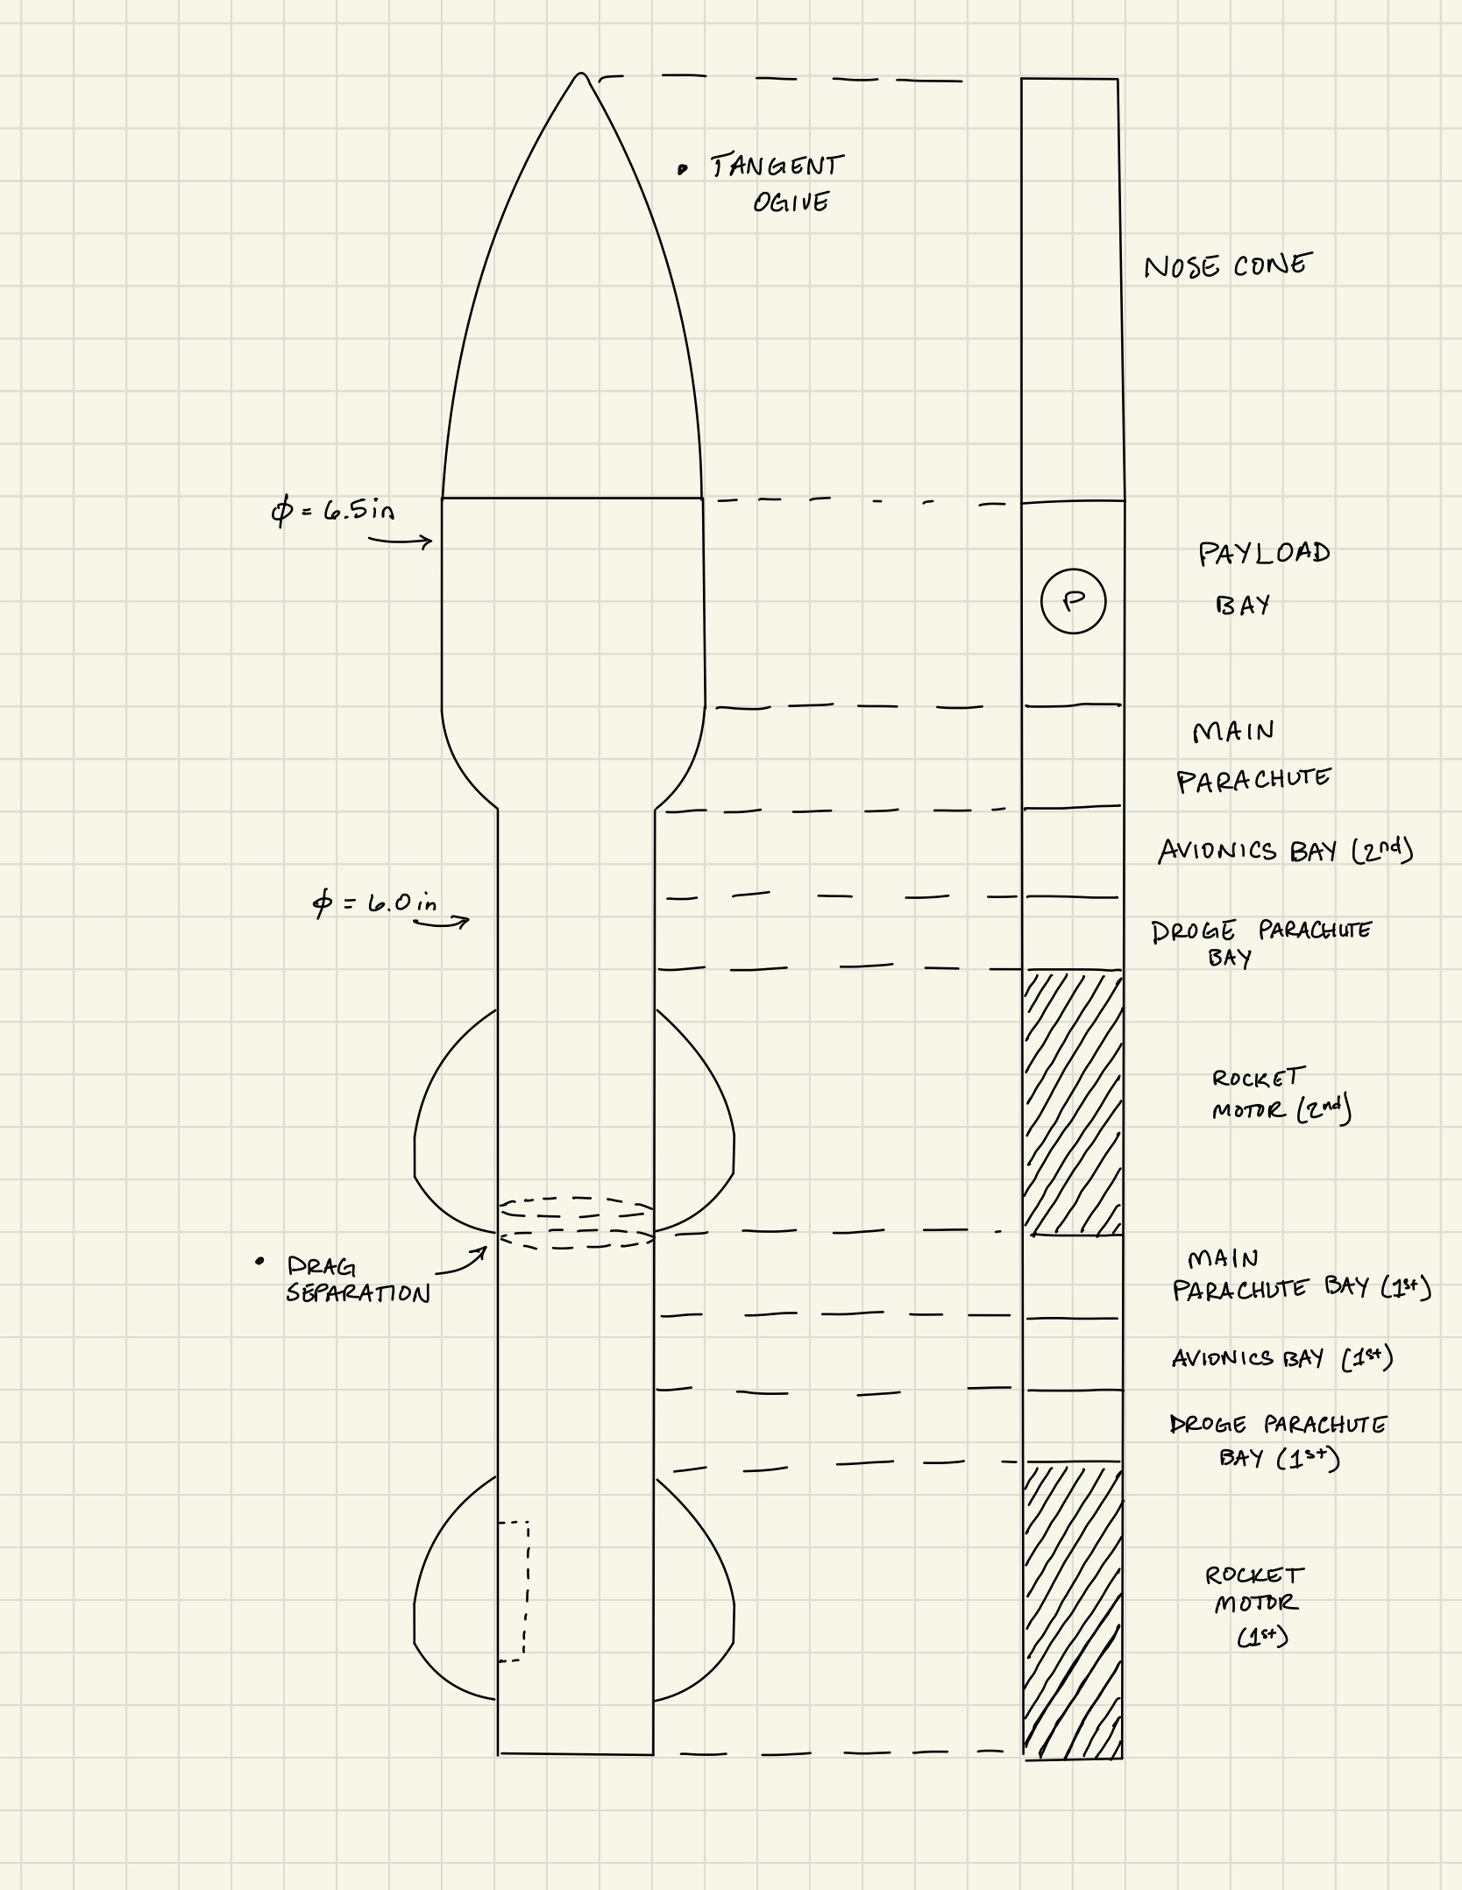
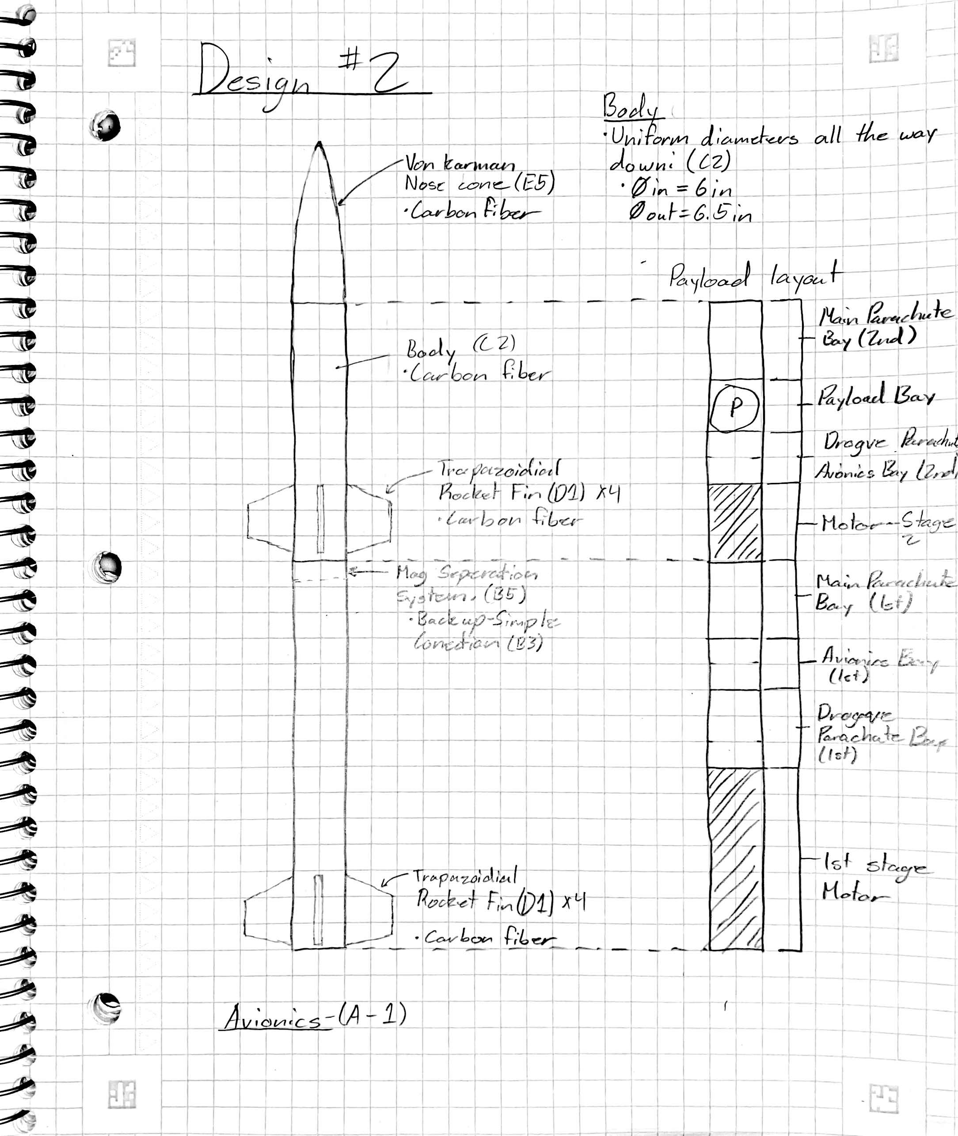
Designs Generated
Design 1
Design 2
Design 3
Design 4
Design 5
Datum
Avery 2/26/24 NG Super Sonic Rocket

Slide 17
Pugh Chart
Concept Criteria | Design 1 | Design 2 | Design 3 | Design 4 | Design 5 | Design 6
Max Velocity | - (wide body, more drag) | + (aerodynamic) | - (high drag force) | S | S | datum
Separation Event | S | + | S | + | + | datum
Payload Capacity | -(unstable) | +(stable) | S | S | - | datum
Altitude | - | +(max velocity | - | S | S | datum
Lightweight | -(wide body) | +(less material) | - | S | - | datum
Cost of Production | -(more material) | +(less material) | - | S | - | datum
Reusable | S | S | S | S | S | datum
Payload Volume | - | - | + | S | - | datum
∑+ | 0 | 6 | 1 | 1 | 1 | N/A
∑- | 6 | 1 | 4 | 0 | 4 | N/A
∑s | 2 | 2 | 3 | 7 | 3 | N/A
Avery 2/26/24 NG Super Sonic Rocket

Slide 18
Pugh Chart Results
Design 5
Design 2
Design 4
Avery 2/26/24 NG Super Sonic Rocket

Slide 19
Decision Matrix
Criterion | Weight | Design 2 |  | Design 4 |  | Design 5
 |  | Un-weighted score | Weighted score | Un-weighted score | Weighted score | Un-weighted score | Weighted score
Max Velocity | 30% | 100 | 30 | 90 | 27 | 95 | 28.5
Separation Event | 0%
Altitude | 25% | 100 | 25 | 90 | 22.5 | 95 | 23.75
Payload Weight
Lightweight | 15% | 85 | 12.75 | 70 | 10.5 | 80 | 12
Cost of Production | 15% | 95 | 14.25 | 75 | 11.25 | 90 | 13.5
Reusable | 10% | 95 | 9.5 | 95 | 9.5 | 95 | 9.5
Payload Volume | 5%
Total | 100% | Sum: | 91.5 | Sum: | 80.75 | Sum: | 87.25
Koi 2/26/24 NG Super Sonic Rocket

Slide 20
Final Design
Pros
Balanced weight distribution
Simple aerodynamic body
Simplified Avionics and Recovery systems
Easily manufacturable
Best performance
Koi 2/26/24 NG Super Sonic Rocket

Slide 21
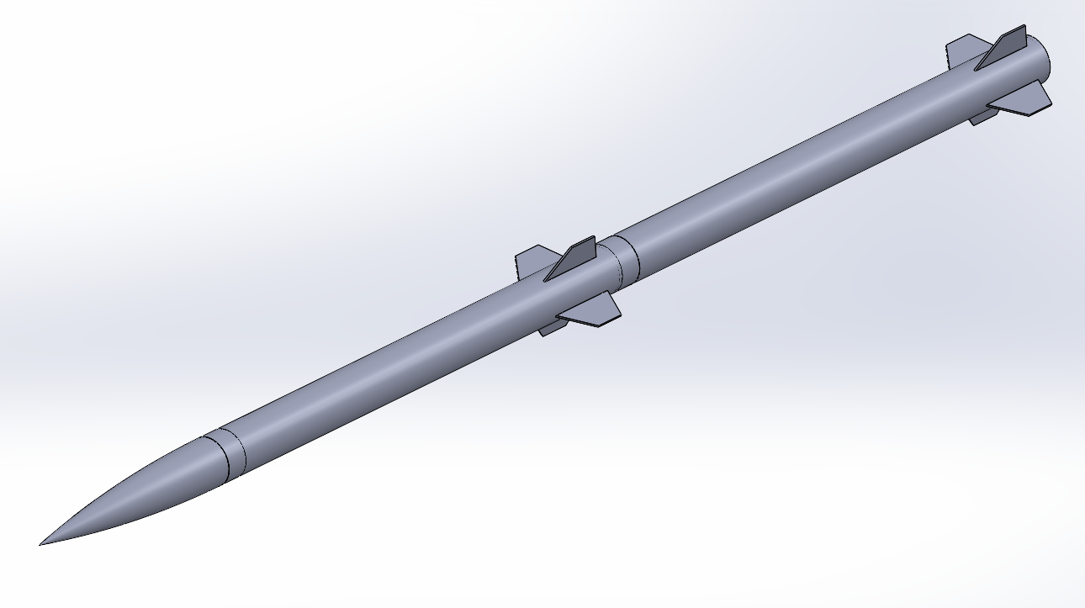
Final Design - CAD
Built in Solidworks
Koi 2/26/24 NG Super Sonic Rocket

Slide 22
Engineering Calculations: Magnetic System
Final Design includes Magnetic Separation System
Total Weight of lower half
  Carbon Fiber density (1550 kg/m^3)
  Carbon Fiber Body (r = 3in, 29.53in)
    1.111 kg
  Carbon Fiber Fins x 4 (8in x 6in)
    0.084 kg
  Level 2 Motor (~75mm)
    1-2 kg
  Avionics and Parachute
    1-2 kg
Final Total Weight: ~5kg/11.02lbs
Permanent Electromagnets [4]
  12mm Dia. And 12V connection
  Hold 3.3 lbs.
  Min: 4
Avery 2/26/24 NG Super Sonic Rocket

Slide 23
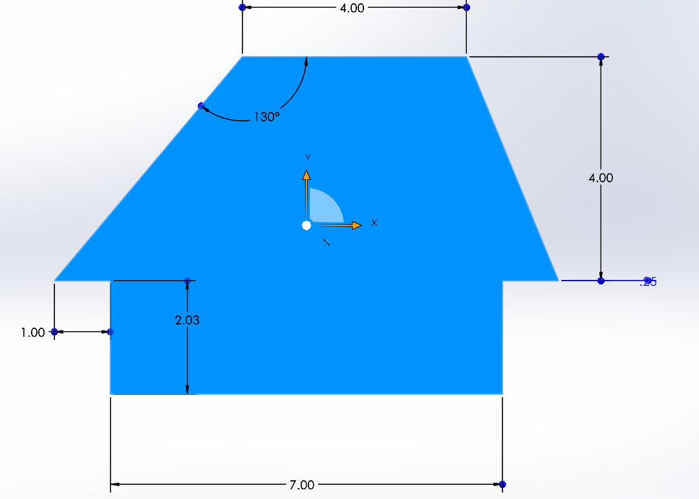

Engineering Calculation: Rocket Fin Drag
Used the Drag Force formula:
Variables:
C_d = 0.005
V = Mach 2 = 1535 (mph) = 686 (m/s)
A = 26 (in^2) = 0.01677 (m^2)
P = 8.80349*10^-2 (kg/m^3) = 0.0880349 (kg/m^2)
Answer:
D = 1.737 N = 0.390 (lbf) (Individual fin)
D_tot = 1.737N * 8 = 13.9 (N) = 3.125 (lbf) (total of all fins)
Assumptions: Coefficient is of a flat plate at turbulent flow, the density of air is at an elevation of 20,000ft, the area used is the planform area. Some error due to compressiblility at Mach 2.
Koi 2/26/24 NG Super Sonic Rocket

Slide 24
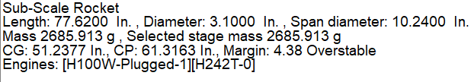
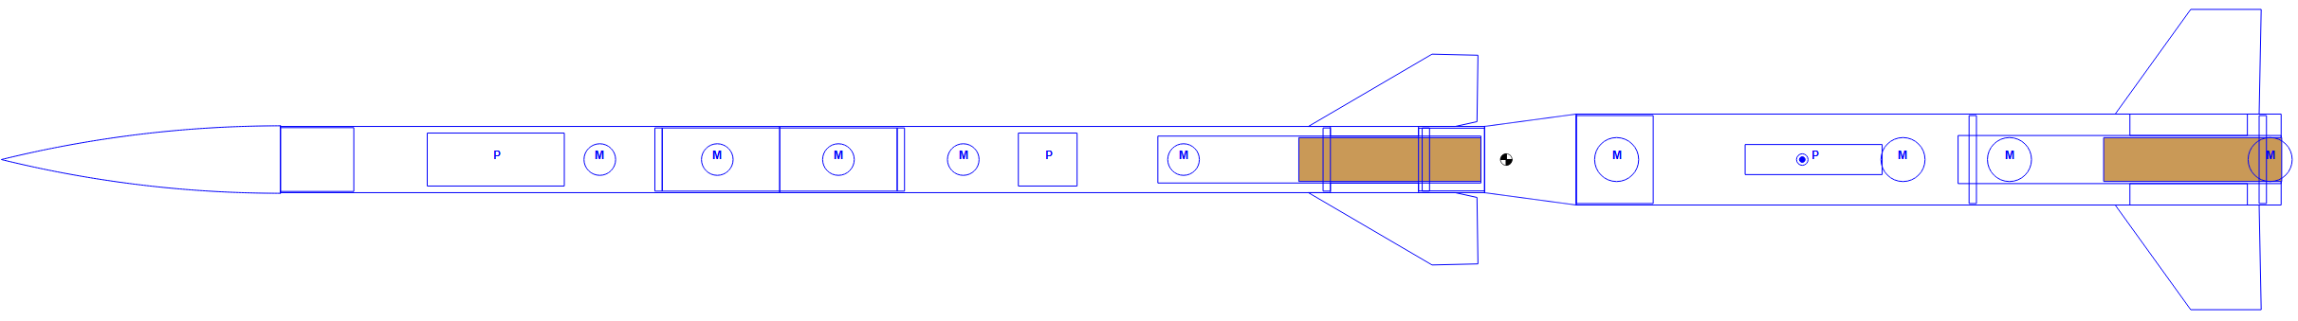
Engineering Calculations: Rocksim
Austin 2/26/24 NG Super Sonic Rocket

Slide 25
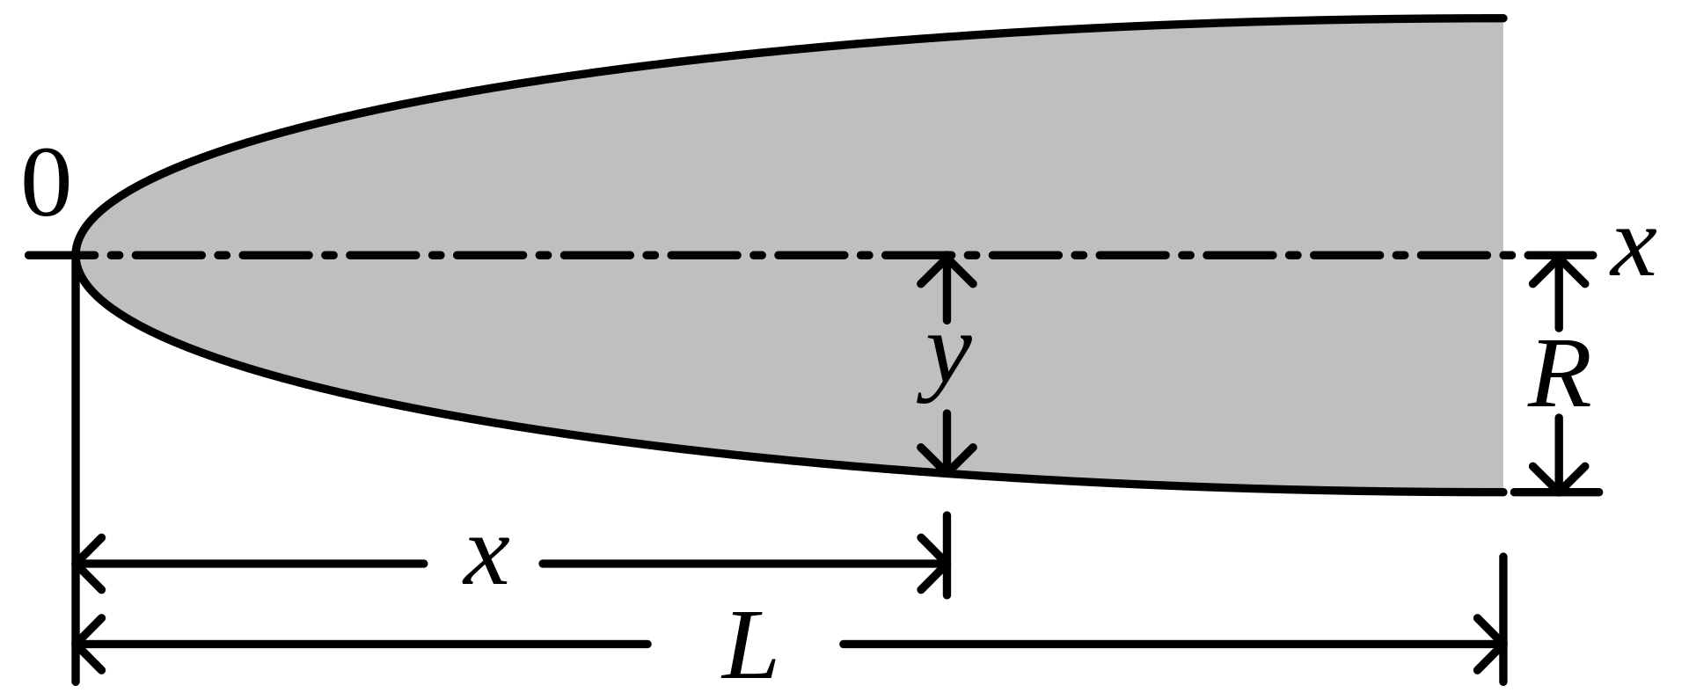


Engineering Calculation: Fineness Ratio
Fineness ratio: The ratio of the length of a body to its maximum width or diameter
Helps reduce wave drag coefficient; but can increase skin friction drag
Generally, a high fineness ratio is wanted for supersonic speeds (~5:1)
Lindsey 2/26/24 NG Super Sonic Rocket
Notes:
"At supersonic speeds, the fineness ratio has a significant effect on nose cone wave drag, particularly at low ratios; but there is very little additional gain for ratios increasing beyond 5:1. As the fineness ratio increases, the wetted area, and thus the skin friction component of drag, will also increase. Therefore, the minimum drag fineness ratio is ultimately going to be a trade-off between the decreasing wave drag and increasing friction drag."

Slide 26
Budget Plans
Funding:
1) Northrop Grumman - $7,300
2) Fundraising 10% - $730
  Material donations from Nova Kinetics
  GoFundMe
  Friends/Family Donations
  Potential fundraising collaboration w/Rocket Club
Budget | Description | Amount
Funding Available | Northrop Grumman | $7,300
Pending Expenses | Prototype rocket kit, prototype motors(x2) | ~$300
Anticipated Expenses | Avionics, RockSim Licenses, Rocket Certifications | $1000
Balance |  | $7,300
PHOTO
Lindsey 2/26/24 NG Super Sonic Rocket

Slide 27
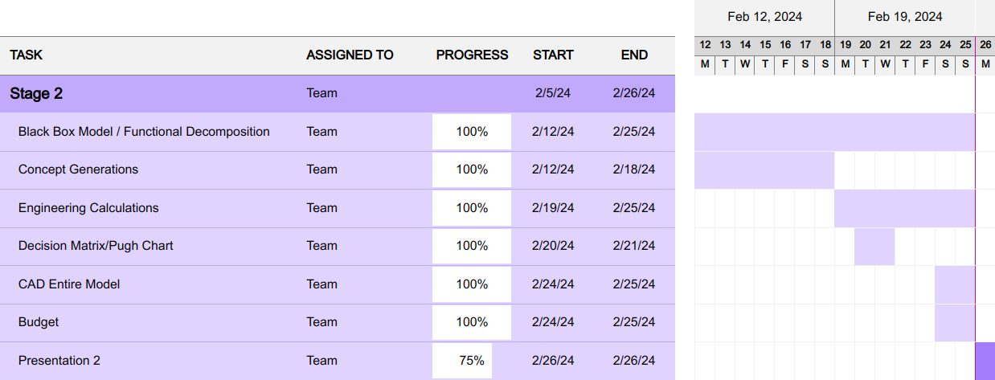
Schedule (2/5 - 2/26)
Lindsey 2/26/24 NG Super Sonic Rocket

Slide 28
Next Steps
Report 1
Website
Prototype 1
  Ordering kit
  Building
  Launching
Continuing fundraising
Lindsey 2/26/24 NG Super Sonic Rocket

Slide 29
Conclusion
Thank you!
Questions?
PHOTO
2/26/24 NG Super Sonic Rocket

Slide 30
References
  [1] A. Mishra, K. Gandhi, K. Sharma, N. Sumanth, and Y. Krishna. Teja, “CONCEPTUAL DESIGN AND ANALYSIS OF TWO STAGE SOUNDING ROCKET,” International Journal of Universal Science and Engineering, vol. 07, pp. 53–73, Aug. 2021.
  [2] P. Davies et al., “Preliminary Design and Test of High Altitude Two-Stage Rockets in New Zealand,” Aerospace Science and Technology, vol. 128, pp. 107741–107741, Sep. 2022, doi: https://doi.org/10.1016/j.ast.2022.107741.
  [3] P. Żurawka, N. Sahbon, D. Pytlak, M. Sochacki, A. Puchalski and S. Murpani, "Multi-Objective Optimization of a Fin Shape for a Passive Supersonic Rocket Stage," 2023 IEEE Aerospace Conference, Big Sky, MT, USA, 2023, pp. 1-12, doi: 10.1109/AERO55745.2023.10115859.
  [4] “EML12MM-12 - round permanent electromagnet 12 mm DIA. 12 volts DC - holding 3.3 lbs.,” APW Company, https://apwcompany.com/eml12mm-12/ (accessed Feb. 25, 2024).
PHOTO

