Slide 1

NG Super Sonic Rocket PDR
Presenters: Austin Paothatat, Avery Charley, Koi Quiver,
Lindsey Dineyazhe

Slide 2

Project Description
Our team is designing, building, and testing a two-stage supersonic rocket out of composite materials. The goal is to meet a set of advanced requirements that include an altitude of 40,000ft, maintain a speed of Mach 2, and carry a 10 lb. payload. The budget for this project is $7,000 plus any fundraising completed during the project.
Stakeholders
  Northrop Grumman
Avery 5/2/24 NG Super Sonic Rocket

Slide 3
Engineering Requirements
Altitude of at least 40,000 ft AGL (Above Ground Level)
Required to carry a maximum 10 Lb payload
Require to reach and maintain over Mach 2 or roughly 1500 mph and maximize time spent at that speed or greater
Acceleration of the vehicle needs to meet a minimum of 12g's
Composite structural components will be simulated and tested to ASME standards
Current payload will carry instrumentation to measure vibrations during flight test and the ability to predict them
Recovery of entire launch vehicle for reuse
Koi 5/2/24 NG Super Sonic Rocket

Slide 4
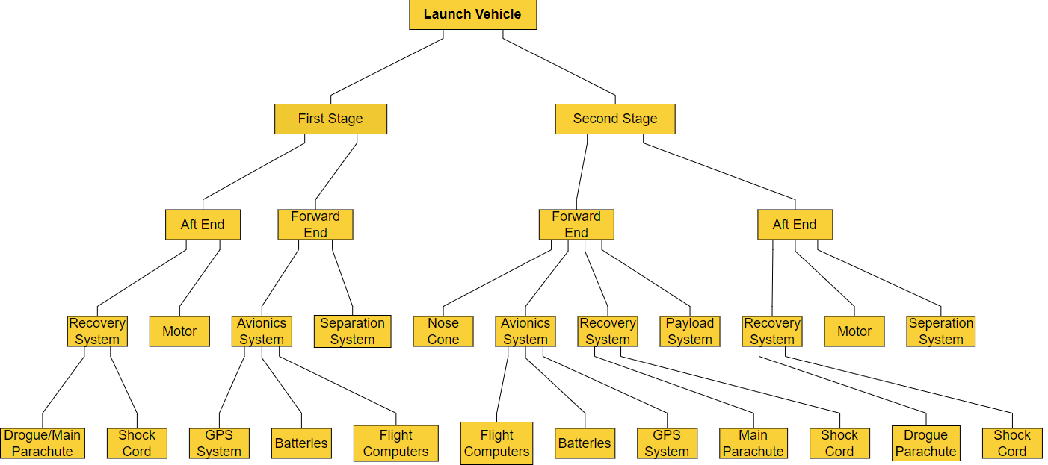
Functional Decomposition
Austin 5/2/24 NG Super Sonic Rocket

Slide 5
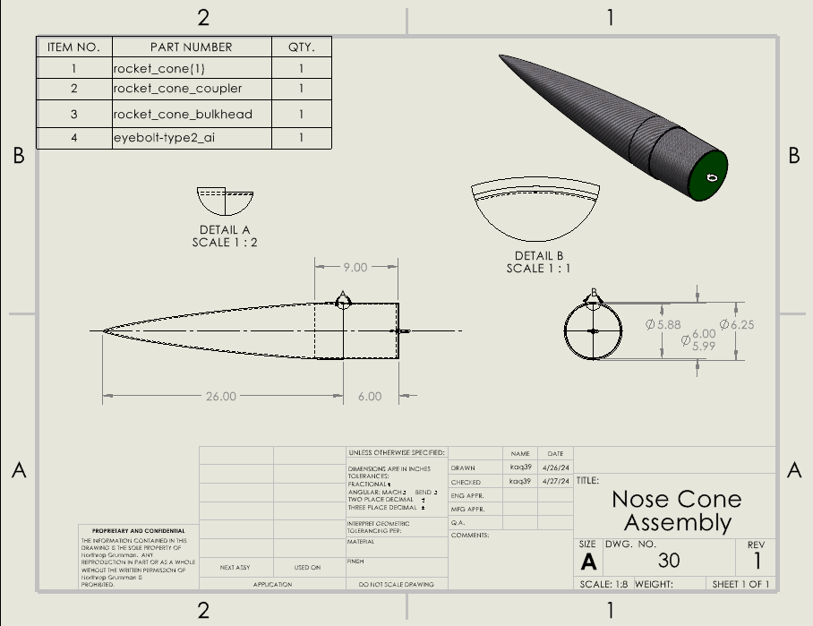
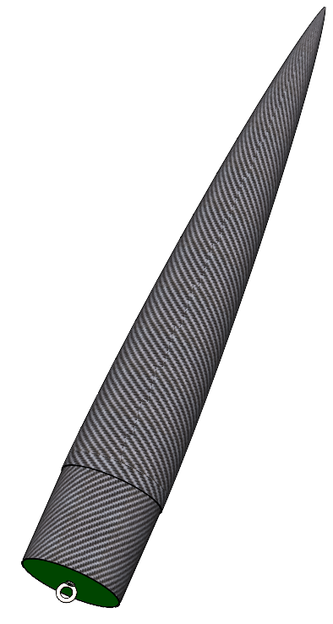
CAD: Nose Cone
Lindsey 5/2/24 NG Super Sonic Rocket
Notes:
Nose cone helps to reduce aerodynamic drag, control, and stability which helps with speed, acceleration, altitude, and fuel usage.

Slide 6
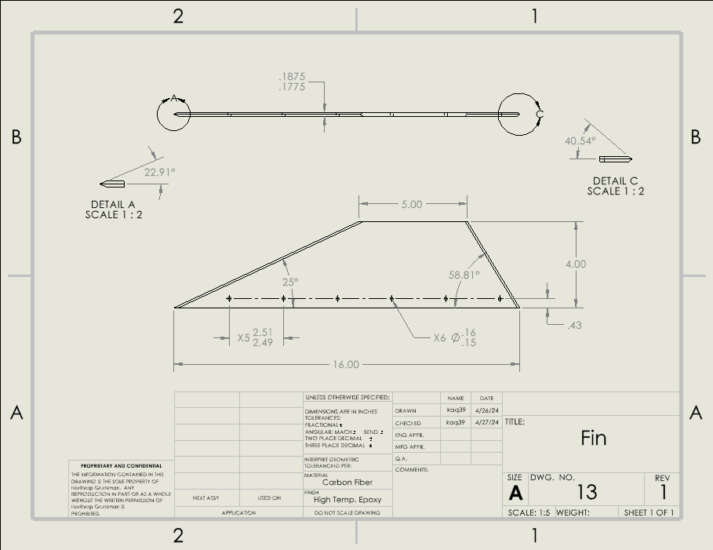
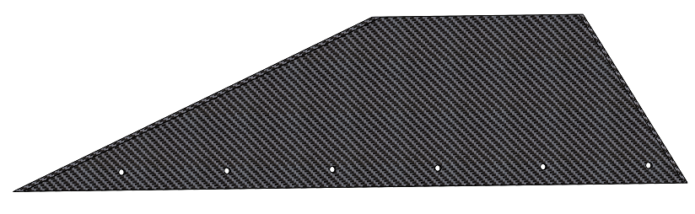
CAD: Fins
Lindsey 5/2/24 NG Super Sonic Rocket
Notes:
Controls direction and stability, also helps with speed, acceleration, and altitude.

Slide 7
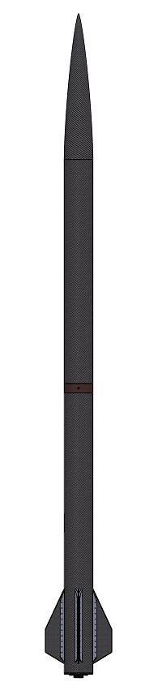
CAD: 2nd Stage Assembly
Koi 5/2/24 NG Super Sonic Rocket

Slide 8
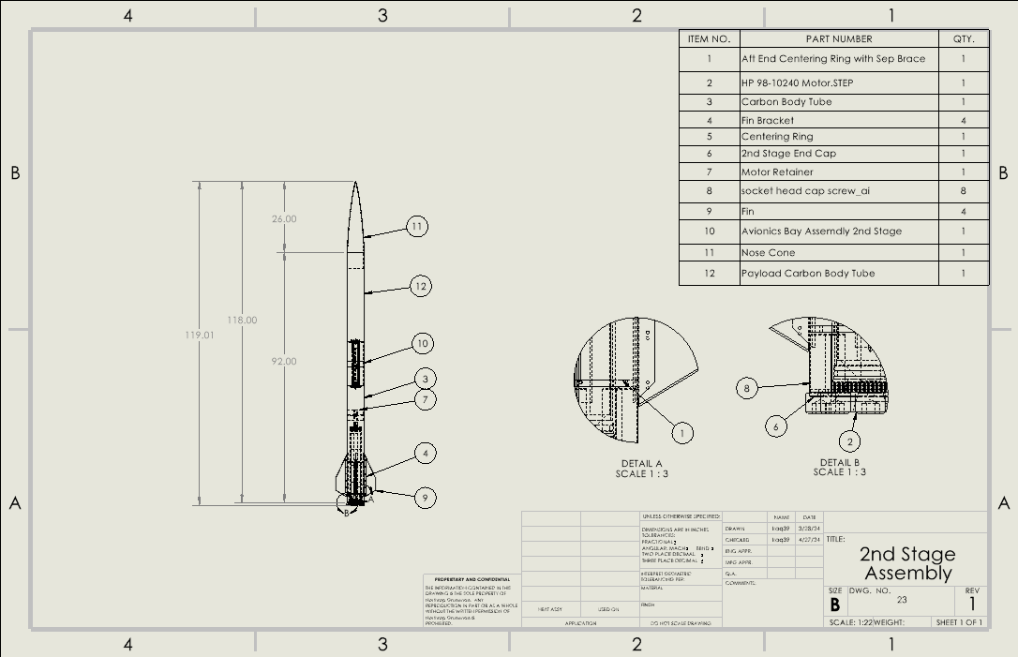
CAD: 2nd Stage Assembly
Koi 5/2/24 NG Super Sonic Rocket

Slide 9
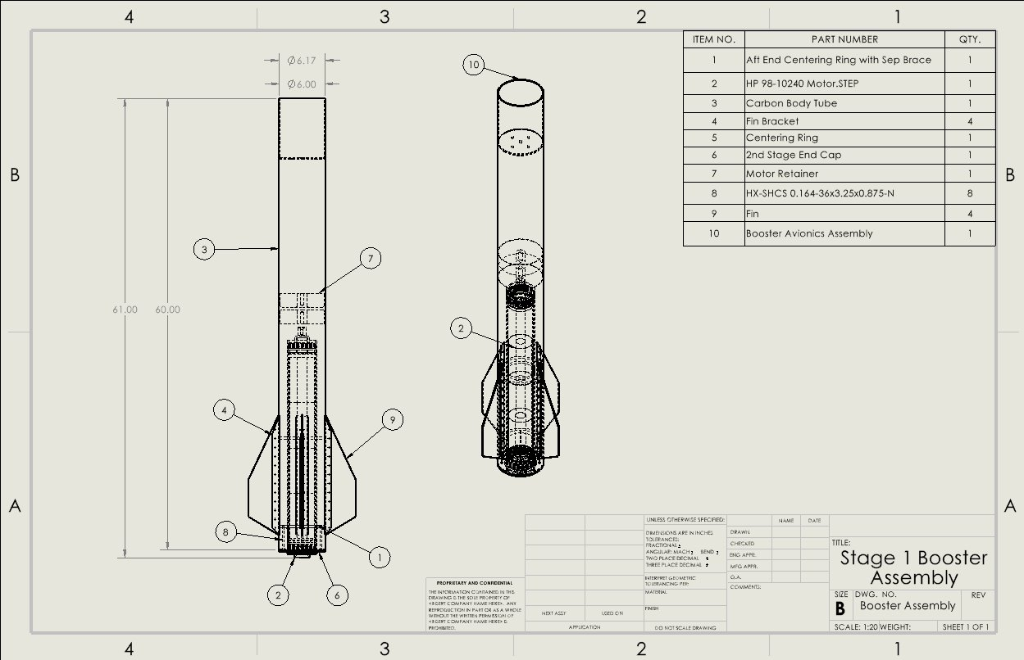
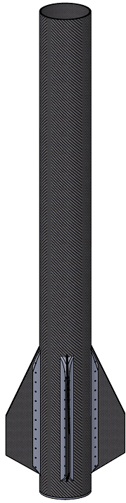
CAD: Booster Assembly
Koi 5/2/24 NG Super Sonic Rocket

Slide 10
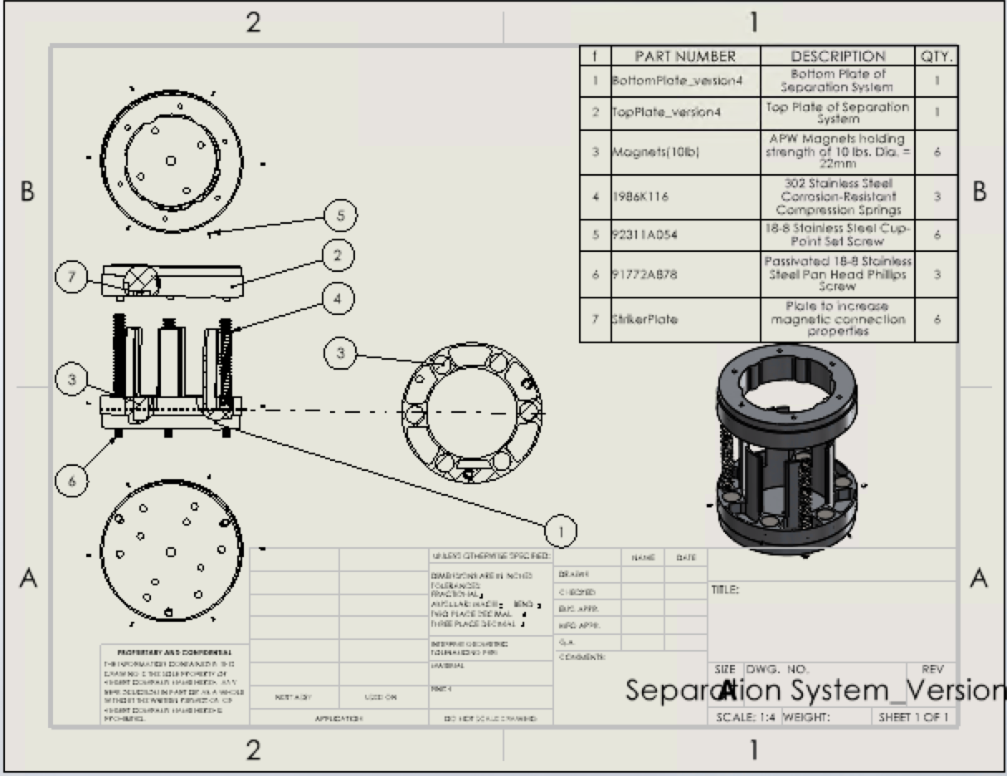
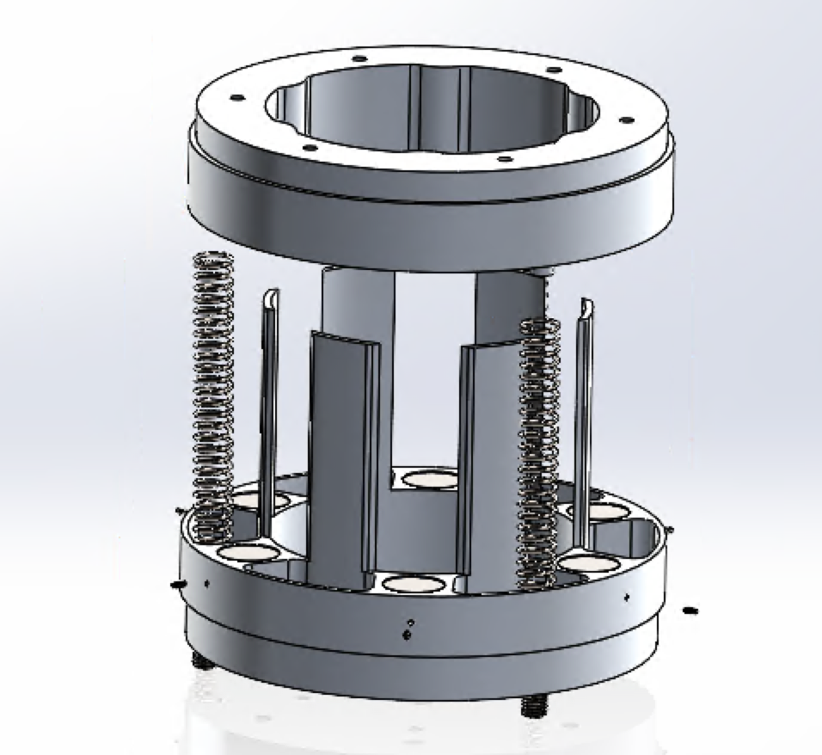
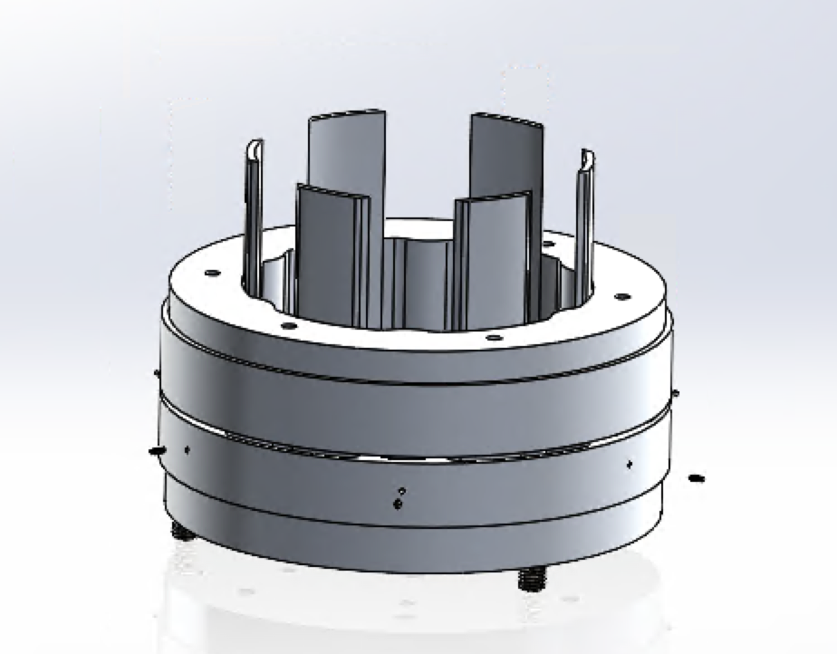
CAD: Sep System
CLOSED
OPEN
Avery 5/2/24 NG Super Sonic Rocket

Slide 11
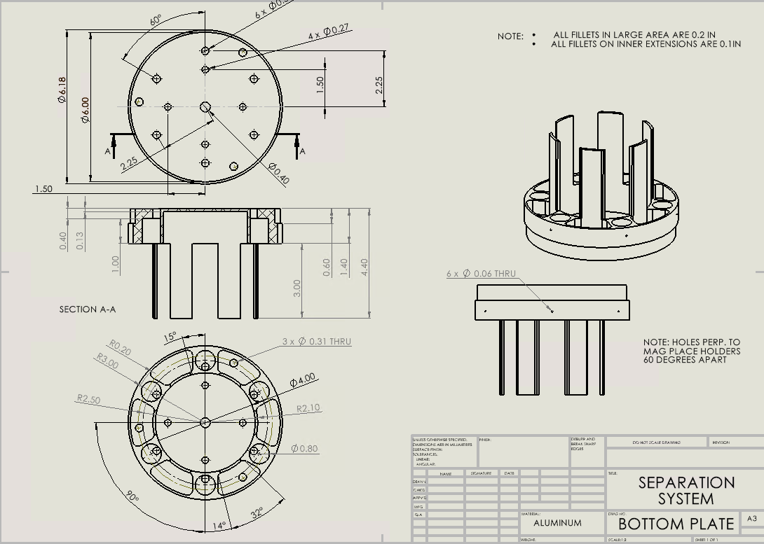
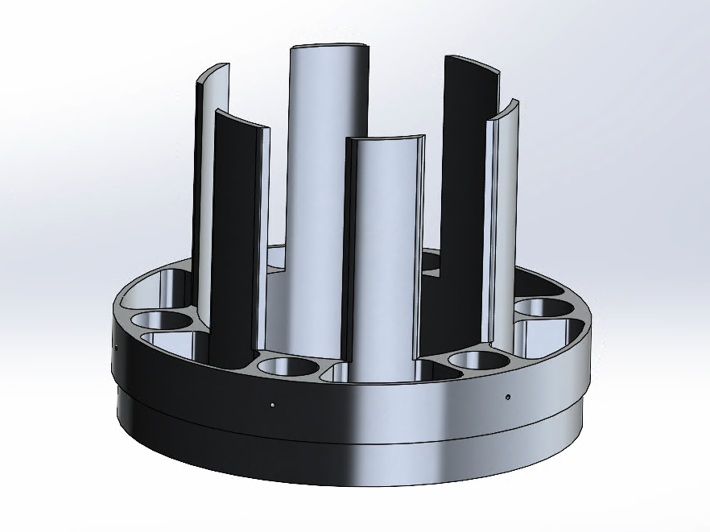
CAD: Sep System Parts 1/2
Avery 5/2/24 NG Super Sonic Rocket

Slide 12
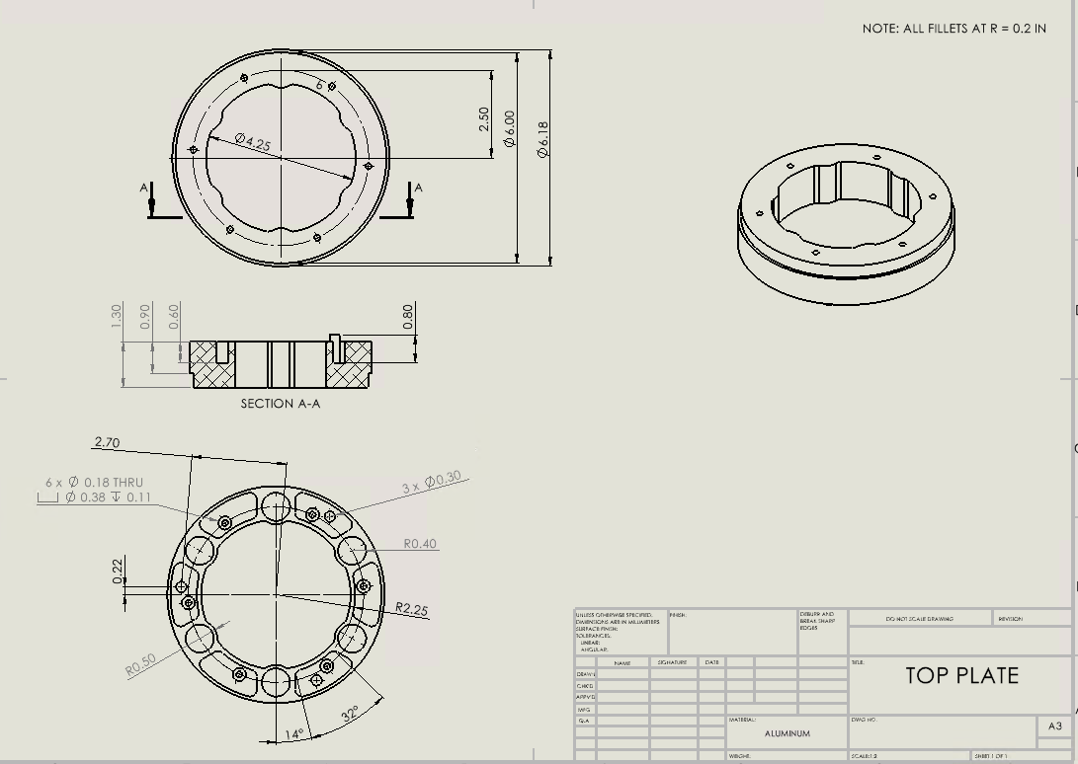
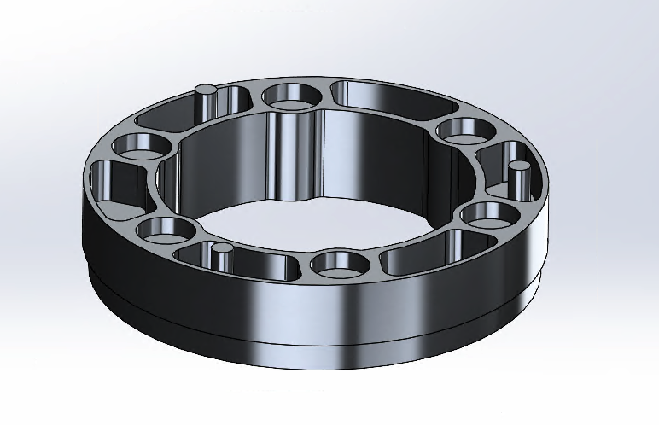
CAD: Sep System Parts 2/2
Avery 5/2/24 NG Super Sonic Rocket

Slide 13
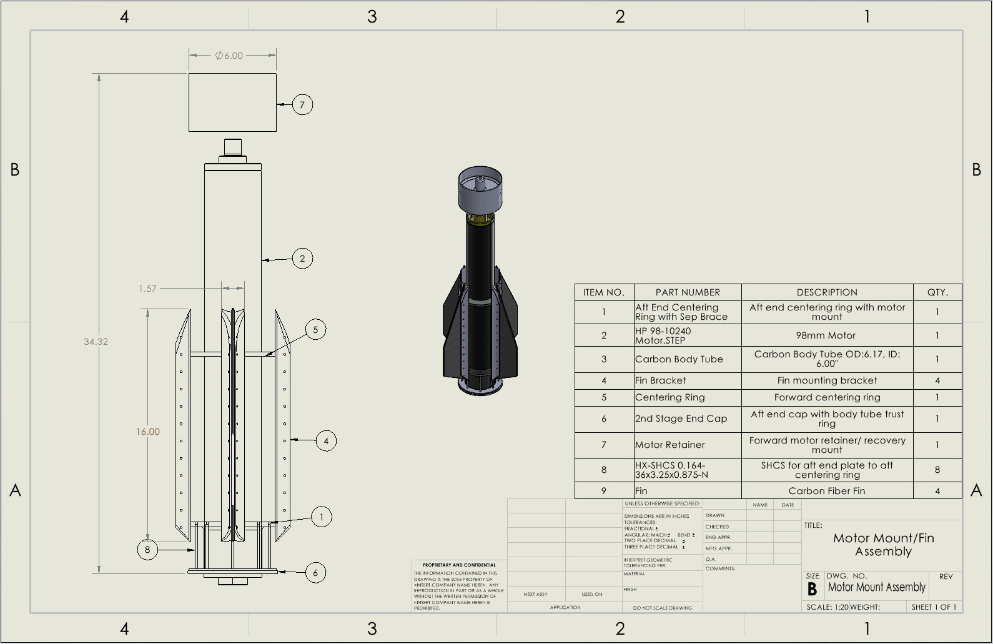
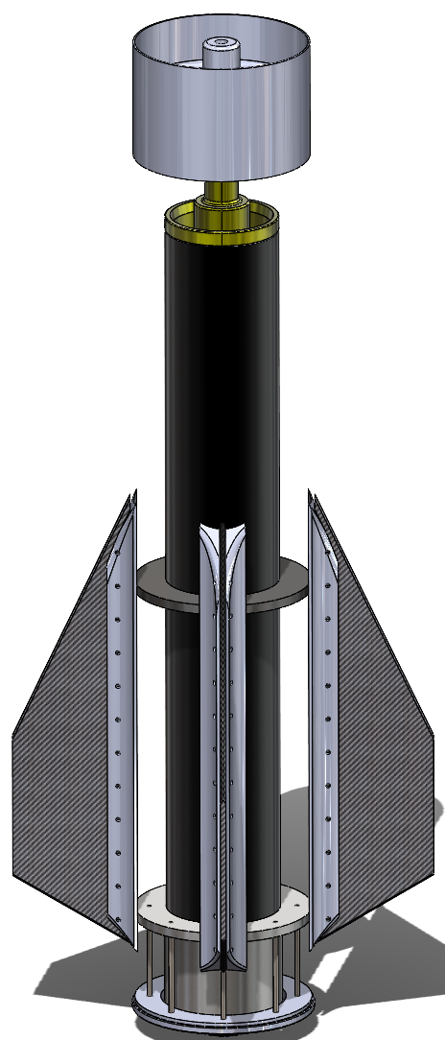
CAD: Motor Mount
Austin 5/2/24 NG Super Sonic Rocket

Slide 14
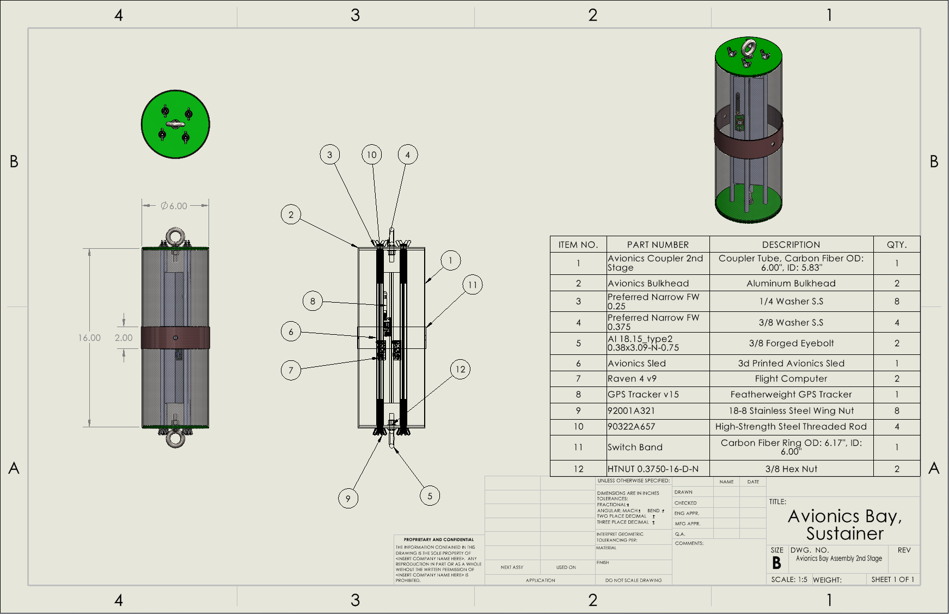
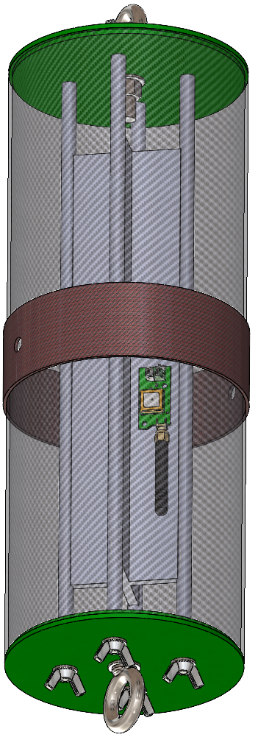
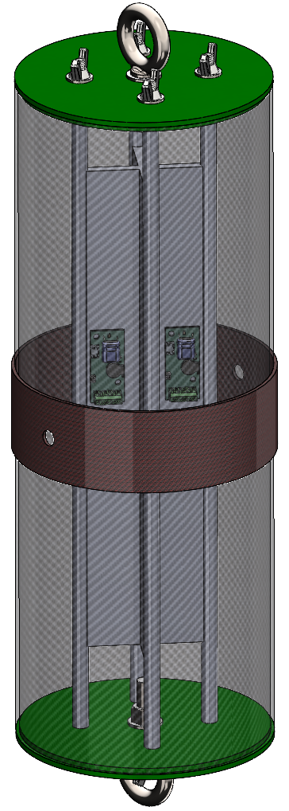
CAD: Avionics
Austin 5/2/24 NG Super Sonic Rocket

Slide 15
CAD: Full Launch Vehicle
Austin 5/2/24 NG Super Sonic Rocket

Slide 16
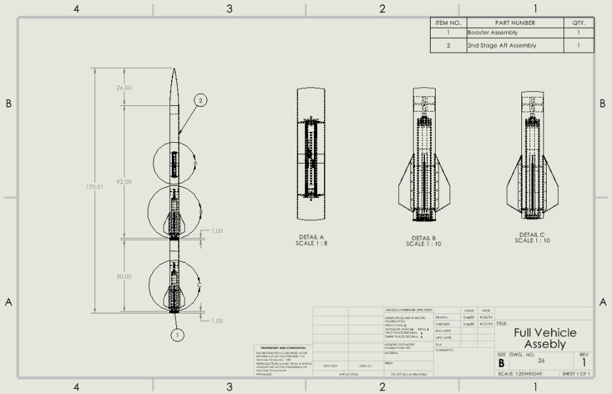
CAD: Full Launch Vehicle
Austin 5/2/24 NG Super Sonic Rocket

Slide 17



Engineering Calculations: Sep. System
Upper Stage
Conditions of Separation
  Altitude = 9500 ft
  Velocity = 430mph (630.67ft/s)
Holding Strength:
  10.12lbf * 6 = 60.72lbf ≥ W₁ = 13.01lbf
Assisted Separation Strength:
  F = -kx = -4.9lbf/in(-2.54in)→ 12.446lbf
  Number of Springs (3) → 37.34lbf
Lower Stage
W = 13.01lbf
$$F_{d}=\frac{1}{2}ρV^{2}AC_{d}$$
W = 48.53lbf
$$W=mg$$
F_{f} = 857.76lbf
F_{D} = 60.18lbf
F_{f} = 1586.81lbf
$$ΔF=800lbf$$
Sep. System
Avery 5/2/24 NG Super Sonic Rocket

Slide 18

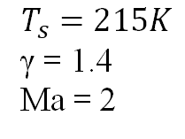
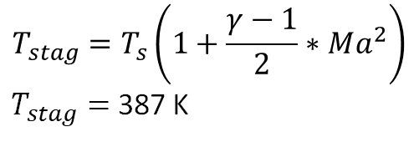
Engineering Calculations: Nosecone
Fineness Ratio
Stagnation Temperature
$$T_{stag}=T_{s}\left(1+\frac{γ−1}{2}∗Ma^{2}\right)$$
$T_{stag}=$387 K
$$T_{s}=215K$$
γ = 1.4
Ma = 2
Typical cure temperatures for carbon fiber pre-pregs ~ 250 °F or 350 °F, therefore a resin system that is cured at 350 °F would be preferred
Lindsey 5/2/24 NG Super Sonic Rocket

Slide 19
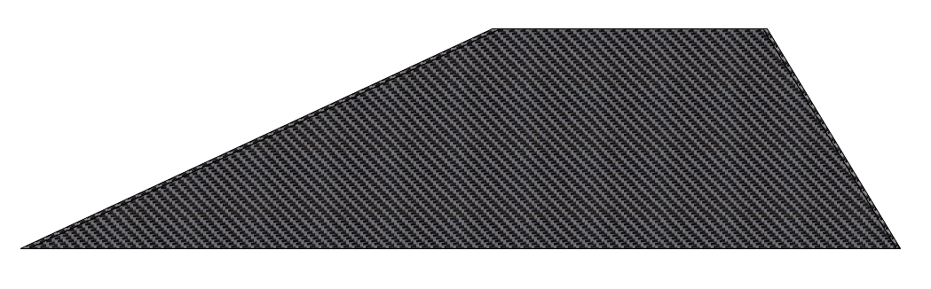

Engineering Calculations: Fin Drag
Used the Drag Force formula:​
​
​
​
Variables:​
C_d = 0.005​
V = Mach 2 = 1535 (mph) = 686 (m/s)​
A = 26 (in^2) = 0.103226 (m^2)​
P = 8.80349*10^-2 (kg/m^3) = 0.0880349 (kg/m^3)​
​
Answer:​
D = 10.7 N = 2.403 (lbf) (Individual fin)​
D_tot = 10.7 N * 8 = 85.53 (N) = 19.23 (lbf) (total of all fins)​
​
Assumptions: Coefficient is of a flat plate at turbulent flow, the density of air is at an elevation of 20,000ft, the area used is the planform area. Some error due to compressiblility at Mach 2.​
Koi 5/2/24 NG Super Sonic Rocket

Slide 20

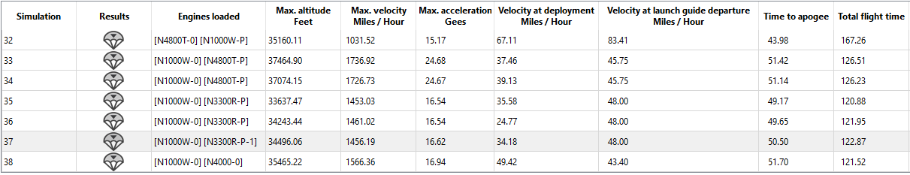
Engineering Calculations: Rocksim
Austin 5/2/24 NG Super Sonic Rocket

Slide 21
Failure Mode Element Analysis
Item # | Item | Failure | Root Cause | Likelihood 1 = least 5 = most | Severity 1 = least 5 = most | Precaution | Performance 1 = least 5 = most | Schedule 1 = least 5 = most | Cost 1 = least 5 = most
1.1 | Separation System (Staging) | Fails to Separate, buckling, thermal, | Electrical Failure, Mechanical failure | 3 | 5 | Ground Testing before launch to certify system | 1 | 3 | 3
1.2 | Separation System (Structural) | Failure in flight of sep. system, impact, thermal | System detaches mid-flight/ aero forces exceed limits | 2 | 4 | Ensure system is secured before flight. | 1 | 3 | 3
1.4 | Body (Structural) | Body bending, cracks, deformities | Forces during flight/temperature | 2 | 5 | Visual/NDT inspections | 2 | 2 | 3
1.5 | Fins (Structural) | Bending, cracks, deformities | Material deformation, adhesive epoxy failure | 2 | 5 | Visual/ NDT inspections | 2 | 2 | 3
1.6 | Avionics | Flight computers do not set off energetics | Battery failure, electrical short, match failure | 2 | 5 | Ground testing with energetics | 4 | 2 | 3
Avery 5/2/24 NG Super Sonic Rocket

Slide 22
Testing Procedures
Structural Component Testing: Composite material strength testing, Separation system, Fin assembly.
  These components will be simulated and tested to ASME D638 and other applicable standards.
  Meets our structural testing requirement
Functionality Test of Systems: Avionics deployment, Separation system deployment, Payload ground testing
  All systems will be tested individually for this series of tests.
  Proves function of systems apart of the staging system and payload
Systems Test: Full dress rehearsal of the launch vehicle (Not including energetics)
  Proves launch vehicle is ready for flight and functions as expected
Subscale Testing: Built and tested subscale launch vehicle
  Further proves components and will be used for scale up data collection and improvements. This will be launched to collected data.
Full scale launch: Final launch vehicle will be constructed and ran through the testing procedures and complete a full flight.
Austin 5/2/24 NG Super Sonic Rocket

Slide 23
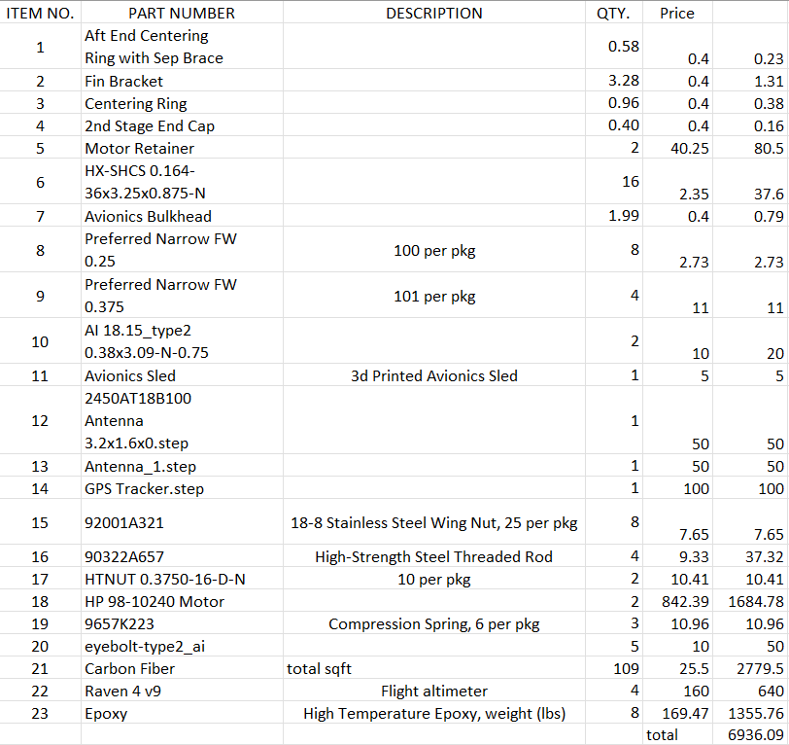
Bill of Materials
BOM of the current vehicle design.
Most expensive parts:
  Motors
  Epoxy
  Carbon Fiber
  Raven Altimeters.
Account for about 93.1% of the total cost of the rocket
Projected the team will use 90% of the budget for the build of the rocket.
Koi 5/2/24 NG Super Sonic Rocket

Slide 24
Next Steps
Wrap up Prototype 2
Analysis on designed components
Prototype revision and testing
Planning for next semester
Working over summer to develop the design.
Lindsey 5/2/24 NG Super Sonic Rocket

Slide 25
Conclusion
Thank you!
Questions?
PHOTO
NG Super Sonic Rocket

