Slide 1

Presentation 2: Concept Generation and Evaluation
Presented By: Brandon Knutson, Daniel Cooke, Isaiah Padilla, Mason Goodman, Mica Nellis, Russel Stringham

Slide 2
Project Description
Clients: Andrew Acosta & Arjun Banerji
Description:
Design a robotic drilling arm for Northrop Grumman Space Systems for vehicles that aid in sending satellites to orbit
Drill through composite materials to be able to bolt secondary structures such as brackets and tubing
Most important drilling through cylindrical structures that are used to connect entire vehicle together
Four degrees of freedom with double linear actuators attached
Importance:
Allow for quicker and easier construction of these vehicles
Given different bolts are needed for different areas of the vehicles it will allow for quick adjustments when fastening different parts together
Help overall production for Northrop Grumman to increase
Deadlines be met with accuracy as needed
Mica Nellis, 10/10/23, F23toSp24_NorthrupGrumman
1

Slide 3
Black Box Model
Kinetic, Mechanical, Heat
Electric, Human
Provide Intended Displacement
Drill Through Material
Energy Flow:
Digital
Displacement, Force
Signal Flow:
Select Program
R, z, and θ Movement
Command Input:
Daniel Cooke, 10/10/23, F23toSp24_NorthrupGrumman
3

Slide 4
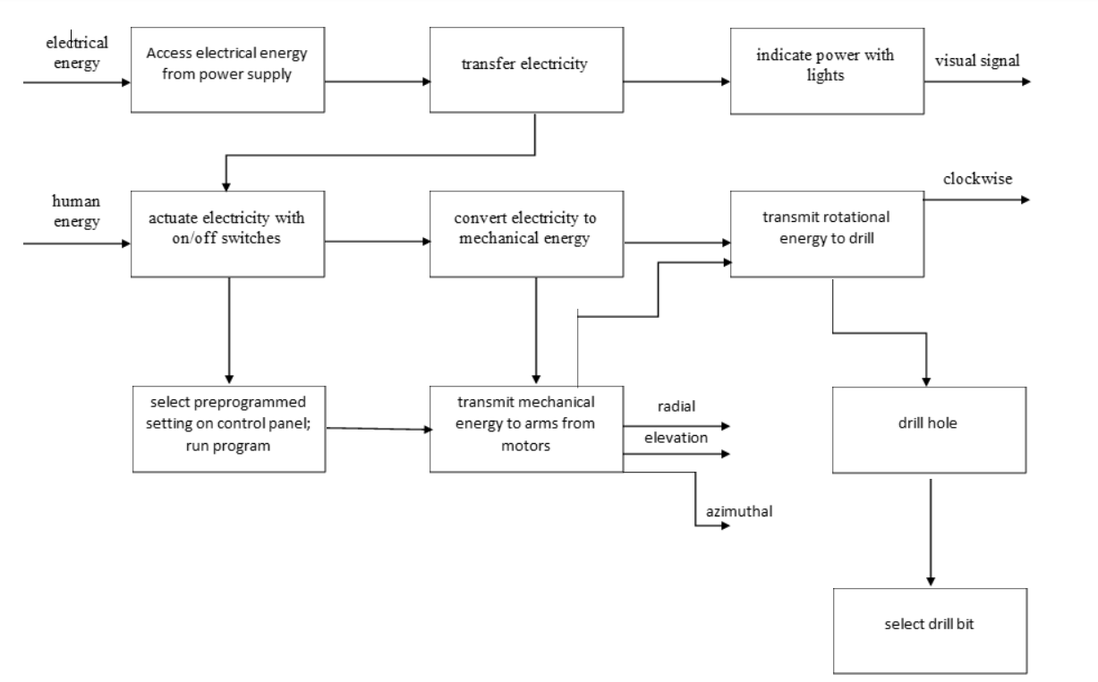
Functional Model
Functional Model
Structured representation of actions performed within system
Shows function outputs as instigated by energy inputs
Outputs
Rotary movement
Linear Actuation
Force Applied
Subsystems
Arm
Drill
Automated System
Daniel Cooke, 10/10/23, F23toSp24_NorthrupGrumman
2

Slide 5
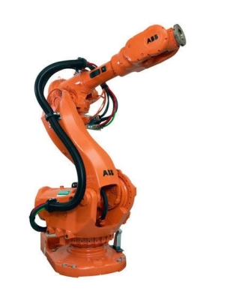
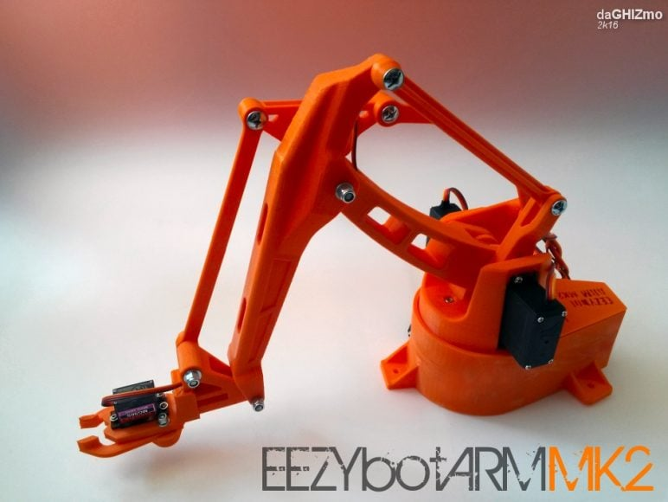
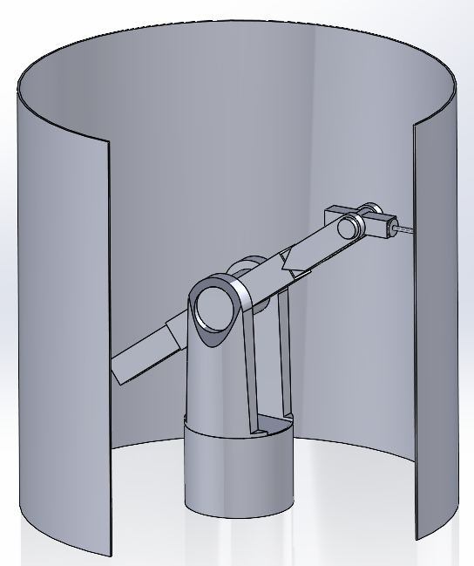
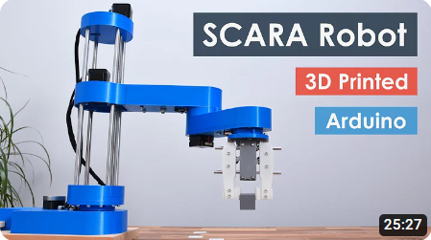
Concept Generation: Top-Level
All Concepts were Case Study Implementations
Brandon Knutson, 10/10/23, F23toSp24_NorthrupGrumman
[1-3]
4

Slide 6
Concept Generation: Top-Level
Design Name | Simplicity | Power Options | Deflection Reduction | Performance
6DOF | 4th | 4th | 2nd | 4th
Scara | 2nd | 2nd | 4th | 3rd
3DOF | 1st | 3rd | 3rd | 2nd
Current Design | 3rd | 1st | 1st | 1st
Brandon Knutson, 10/10/23, F23toSp24_NorthrupGrumman
5

Slide 7
Concept Generation: Top-Level
6DOF Robot: Power Delivery
Servo Motors and Cycloidal Drives
Scara Robot: Simplicity, Deflection, Bearings
Reducing Moment Arms and Fiction at DOF's
3DOF Robot: Adaptable Geometry and Drilling capacity
Automatic adjustment to parts specifications
Current Design: Wiring, Linear actuators and Slew Drives
Brandon Knutson, 10/10/23, F23toSp24_NorthrupGrumman
6

Slide 8
Concept Generation: Top-Level
6DOF Robot: Power Delivery
Servo Motors and Cycloidal Drives
Scara Robot: Simplicity, Deflection, Bearings
Reducing Moment Arms and Fiction at DOF's
3DOF Robot: Adaptable Geometry and Drilling capacity
Automatic adjustment to parts specifications
Current Design: Wiring, Linear actuators and Slew Drives
Brandon Knutson, 10/10/23, F23toSp24_NorthrupGrumman
7

Slide 9
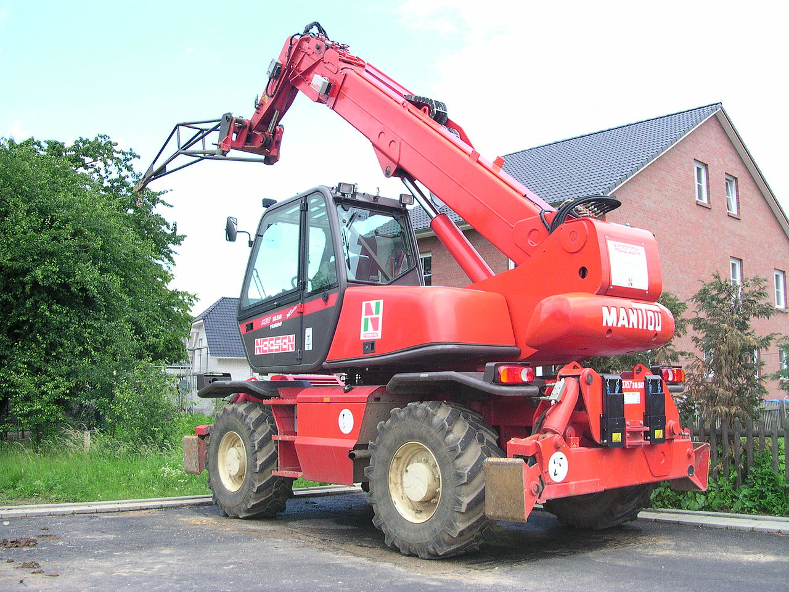
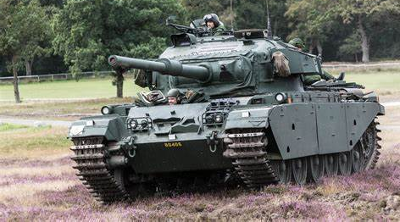
Concept Generation: Slew Drive
Commonly Used in Tank Turrets and Telescopic Handlers
Desired for their Carrying Capacity, High Tolerance and Torque
 | Purchased | Manufactured | Sectional Design (M)
Advantages | Highest Tolerance Potential Donation | Less assembly vs Sectional Design Higher Tolerance | Faster Manufacturing, Easier Setup, Cheapest Option
Disadvantages | Highest Cost, Lack of customization with large price increase | Longer Manufacturing, More waste, and More Expensive | Worse tolerance that both Manufactured and Purchased, More Assembly
[4-6]
Brandon Knutson, 10/10/23, F23toSp24_NorthrupGrumman
8

Slide 10
Concept Generation: Deflection
Goal: Determine shape and material of main arm to prevent deflection.
Material | Steel | Aluminum | Polyacetal Plastic
Properties | σyield = 415 Mpa E = 200 GPa | σyield = 276 Mpa E = 68.9 GPa | σyield = 110 Mpa E = 11.7 GPa
Advantages | High Rigidity, High Strength | Light, Heat and corrosion resistive | Low Friction, Cheap, Light
Disadvantages | Heavy, Corrosive, Expensive | Galling, Expensive | Less Dimensional Stability
Beam Shape | Cylinder | Structural Tubing | I-Beam
Daniel Cooke, 10/10/23, F23toSp24_NorthrupGrumman
9

Slide 11
Concept Generation: End Effector
Goal: Determine the optimal material of the drill bit to appropriately drill through substances
Material [9] | Cobalt | High Speed Steel | Titanium Aluminum Nitride (TiAlN) Coating
Properties | S(y) = 225 MPa[10] E = 211 GPa K (thermal conductivity) = 69.21 W/m-K | S(y) = 180 – 500 MPa [11] E = 200 GPa [12] K = 41 W/m-K [13] | E = 600 GPa [14] G (shear) = 240 GPa K = 19.0 W/m-K
Advantages | Preferred material for drilling aluminum, best thermal conductivity, mid yield strength and acceptable E-value | Can have higher yield strength than cobalt but comes at the cost of a worse thermal conductivity value | Coating for drill bits, not a full material, have a long lifespan, and are good for drilling both hard and soft metal
Disadvantages | Costly and can be brittle if not cared for properly | Not suitable for drilling through tougher materials | Once coating wears out, the bit cannot be used until the coating is reapplied
Isaiah Padilla, 10/10/23, F23toSp24_NorthrupGrumman
10
Notes:
Provide a description of how concepts were generated.
Researched basic forms of drilling spindles, noted what they had/didn't have in common. Compiled a list as a result of this initial work
Provide an overview of the designs being considered - these include top-level and sub-assembly-level concepts. Show all designs considered and have a top-level discussion focusing the audience’s attention on the most relevant concepts at the time of the presentation.
List advantages/disadvantages of each of the most relevant concepts in a table with an image of the concept at the top of the enumerated list. Generate these lists for top-level and sub-assembly-specific decisions that you must make.
Circle vs square spindle, square is more stable by a bit, discuss round vs square spindles a bit!
Runout (tendency of bit to leave the axis of drilling) is based on quality of spindle, not shape, and the bearings it is mounted upon

Slide 12
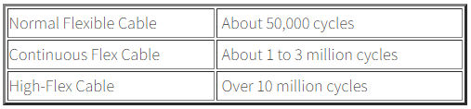
Concept Generation: Wiring
Industrial Robotic Arms – Common Issues – Cable Failure
Cable/Wiring Service Life Failure Leads to Extensive Machine Downtime
"Continuous Flex" cables are designed to transmit control and data signals to machines and robotic devices that continually move
"Torsional Flex" cables are designed to resist scrubbing and abrasions as well as continuous torsional stress
Cable/Wiring distributers often include a “flex-life” that rates a cable for a specified number of “cycles” (cycles are typically a 90-degree bend in any direction)
Mason Goodman, 10/10/23, F23toSp24_NorthrupGrumman
11

Slide 13
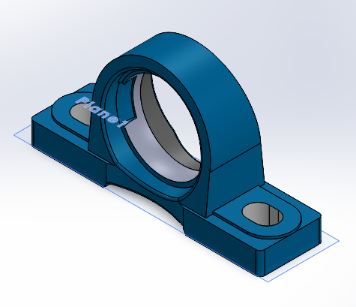
Concept Generation: Bearings
Bearings allow for less friction which will be important when considering the running time our drilling arm will undergo each day
Two different types of bearings will likely be implemented, one for the base and one for each different degree of freedom
Lazy Susan bearings(turntable bearings) and pillow block bearings
Recommended to use pillow block bearings because of durability and reliability
Used design tables so adjustments can be made to the CAD model
Bearing Type | Advantages | Disadvantages
Pillow Block Bearing | Extremely durable and has high max speeds | Takes up more space because of mounting block
Thin Section Bearing | Often used within robotic arms and take up very little space when designing | Cannot withstand as much weight and speed
[18]
Mica Nellis, 10/10/23, F23toSp24_NorthrupGrumman
12

Slide 14
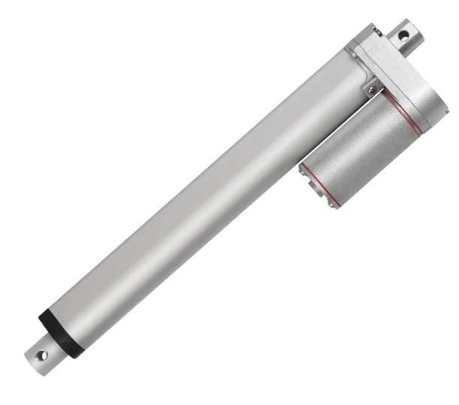
Concept Generation: Linear Actuator
Progressive Automations
Purchase
Complex Design
Reliability
Build
Custom
Time to Build
Quality
Price
25.4 cm Reach
Force – 220.411 N
Voltage – 12 VDC
Russel Stringham, 10/10/23, F23toSp24_NorthrupGrumman
13

Slide 15
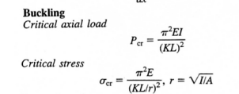

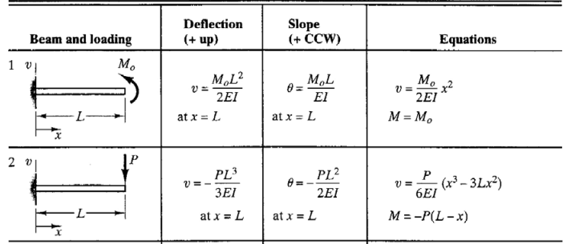
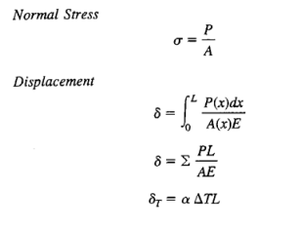

Engineering Calculations: Main Arm
Max Length: 29’’
Max Reaction Force: 500 N
Angle of Maximum Reach: 59 Degrees
End Effector Weight: 10kg
Average Pipe Diameter: 4’’
Tolerance: .001’’
Daniel Cooke, 10/10/23, F23toSp24_NorthrupGrumman
14

Slide 16
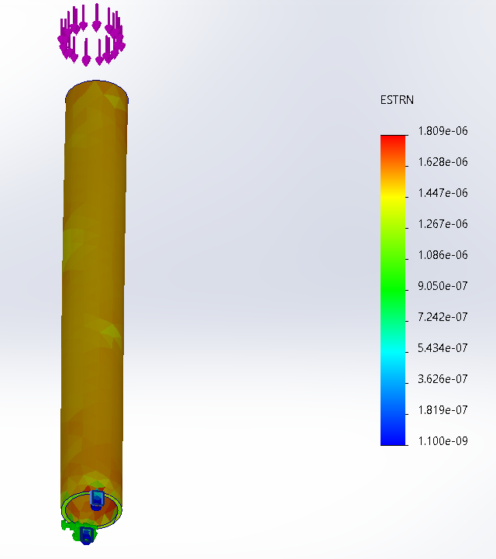
Engineering Calculations: Main Arm
Conclusion: All materials and beam shapes will deform minimally. All possible selections will not deform greater than maximum tolerance of .001 inches.
Maximum Deformation | Steel | Aluminum | Polyacetal
Cylinder | 1.78 μm | 5.47 μm | .0145 mm
Square Tube | 14.16 μm | 43.08 μm | .00114 m
I-Beam | 5.44 μm | 16.52 μm | .00044 m
Lowest Factor of Safety: 1.75
No materials reached ultimate stress under exaggerated load!
Daniel Cooke, 10/10/23, F23toSp24_NorthrupGrumman
15

Slide 17
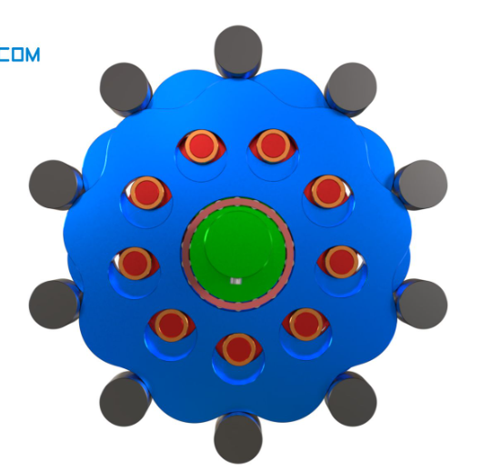

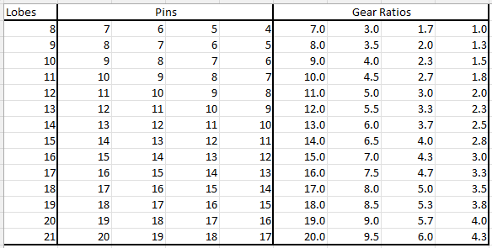
Engineering Calculations
Slewing Drives
Using a Treads Per Inch Basis
Worm Gear has 2 TPI
1 Worm Great Revolution = 1/2 Inch of Travel
1/2 Inch or travel/Circumference of Radial Gear=
Output Revolution
Gear Ratio:
1:(1/2)*(1/PI*18)
Gear Ratio: 1:0.0088
400W 1.5 Nm Motor
Will Produce 170Nm torque and 26 RPM
[7]
Cycloidal Drives
N = Pins
n = Lobes
Brandon Knutson, 10/10/23, F23toSp24_NorthrupGrumman
16

Slide 18
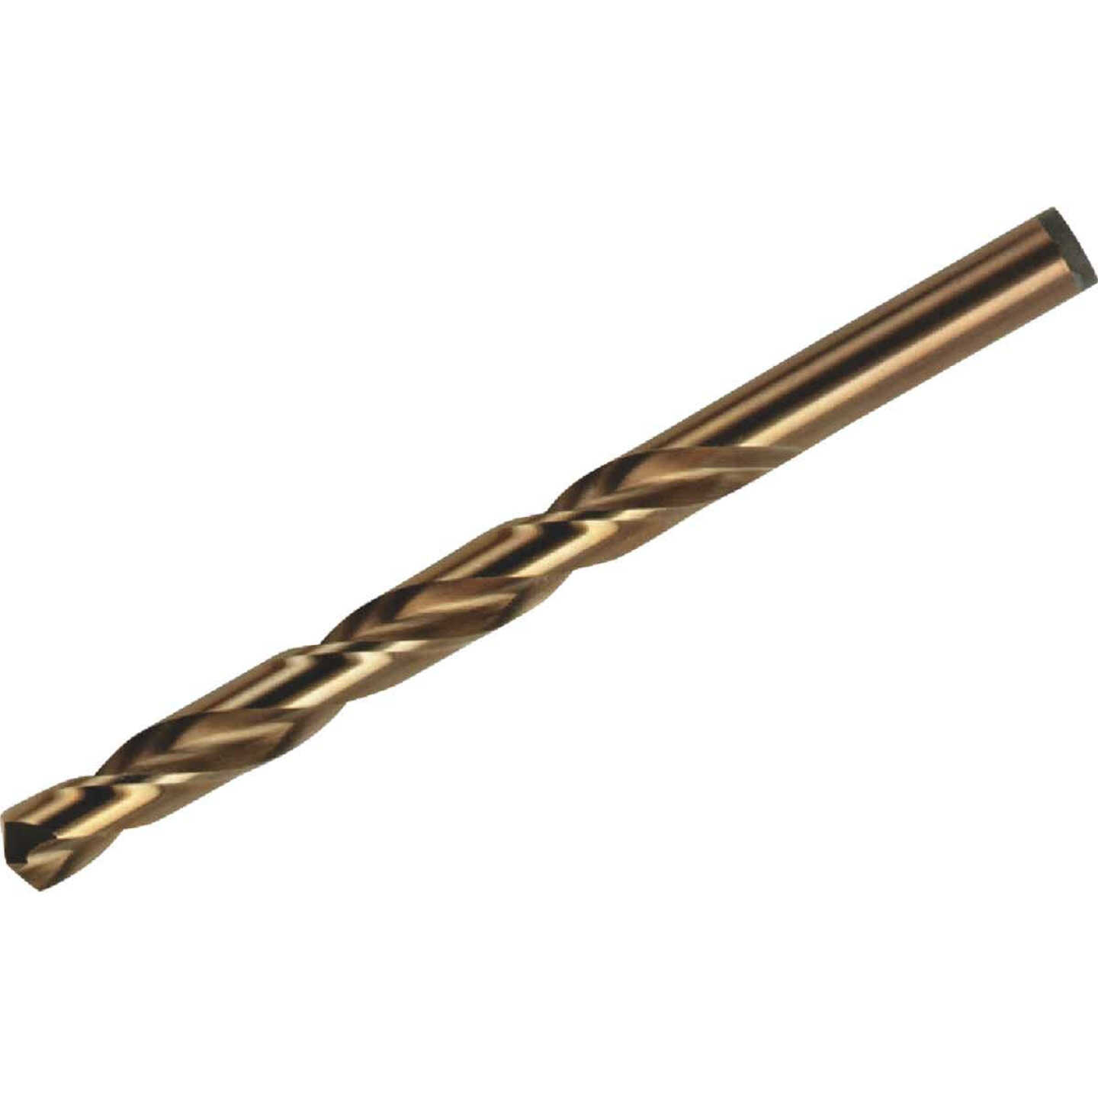
Engineering Calculations
Required Force & Torque for Drilling Through Aluminum
Torque (T)
Applied Force (F)
D = 0.01905 m
T = r * F * sin(theta)
-> F = T/(r * sin(theta)
F = 135.582 N m / ((0.0127 m/2) * sin (90 deg))
T(min) = 21351.49 N m
F = 135.582 N m / ((0.01905 in/2) * sin (90 deg))
T(max) = 14234.33 N m
D = (0.0127 - 0.01905) m
T = 100 ft lbs
T= 135.582 N m
Theta = 90 deg
Cobalt Drill Bit [8]
Isaiah Padilla, 10/10/23, F23toSp24_NorthrupGrumman
17
Notes:
Add to the list of equations, engineering analysis tools (other than CAD), and example problems that you started in the first presentation. Summarize their applicability to your project design space.
Provide calculations (equations and results only) and other quantifiable proof (such as well-known part specifications) per concept that targets all major engineering requirements and any quantifiable customer requirements.

Slide 19
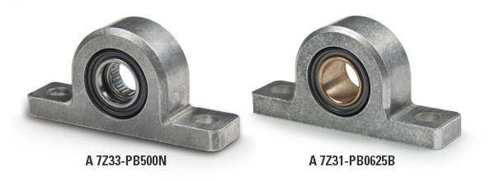
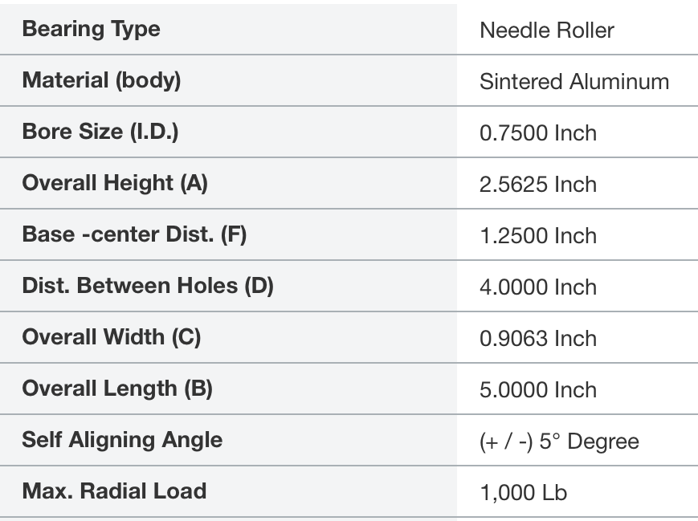
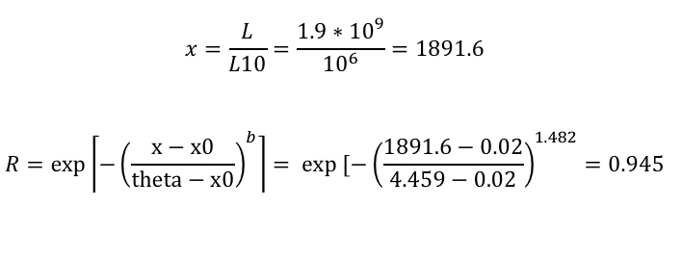
Engineering Calculations
Max Speed: 1000 rpm
Max Load: 40 lbs
Max Base-Center Distance: 2 inches
Max Drill Hole Distance: 5 inches
SI Units
N/a
N/a
0.0191 m
0.0651 m
0.0318 m
0.1016 m
0.0230 m
0.127 m
N/a
4448.2 N
[15-16, 20]
Mica Nellis, 10/10/23, F23toSp24_NorthrupGrumman
19

Slide 20
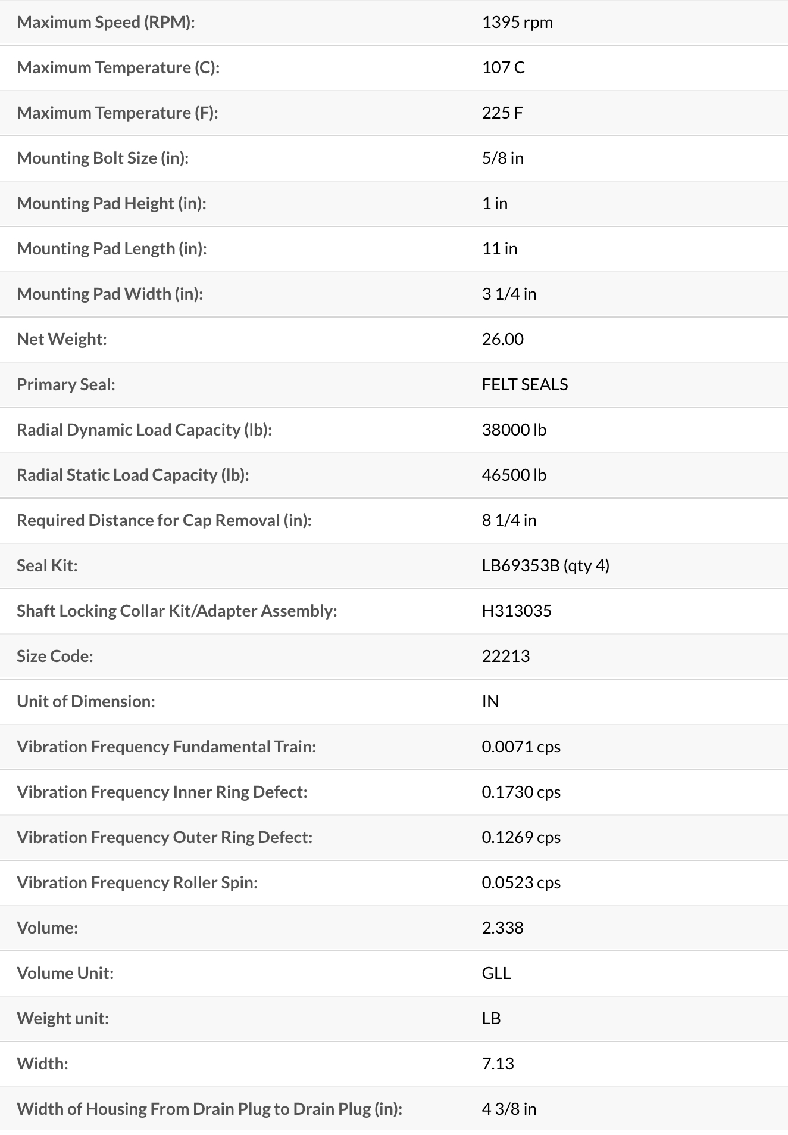
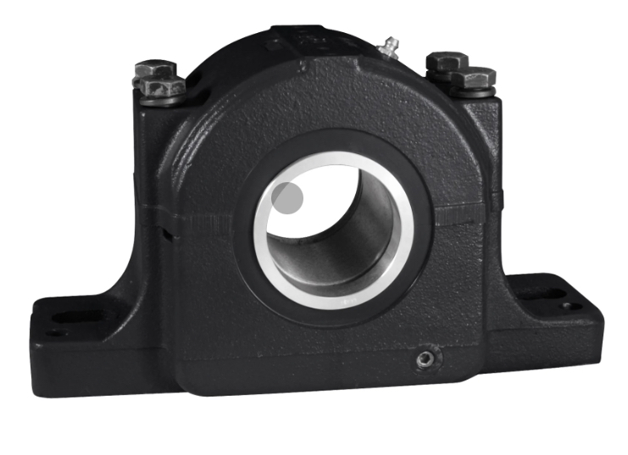
Engineering Calculations
Max Speed: 1000 rpm
Max Load: 40 lbs
Max Base-Center Distance: 2 inches
Max Drill Hole Distance: 5 inches
[15-16]
20
Mica Nellis, 10/10/23, F23toSp24_NorthrupGrumman

Slide 21
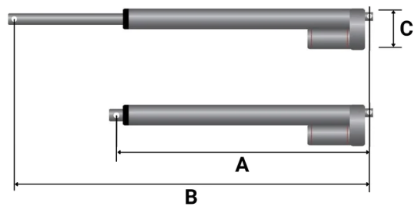
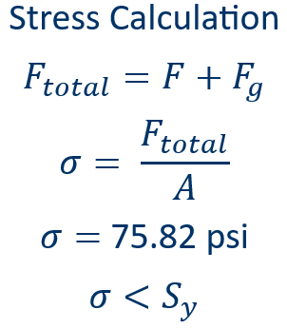
Engineering Calculations
Force = 50 lbs. (Actuator)
Weight = 11 lbs. (Applied to actuator)
Length = 10 in. (Reach of Actuator)
2.96 in
14.13 in
24.13 in
Torque Calculations
T = F × L
T = 41.67 lbs. - ft
T < Required
Russel Stringham, 10/10/23, F23toSp24_NorthrupGrumman
21
Notes:
The torque from the actuation is greater than the required torque need to drill through the material based on new calculation we need a high torque value
Based on the calculation the stress applied to the rod is less than the yield strength for Aluminum Alloy

Slide 22
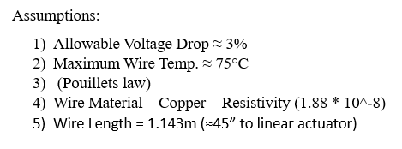
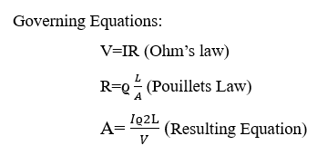
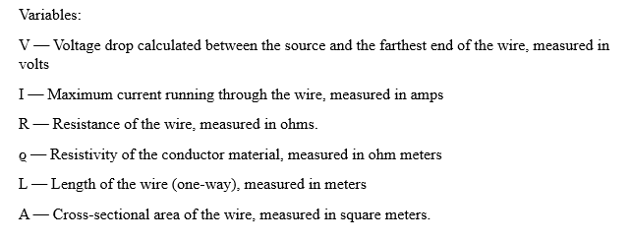
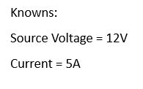
Engineering Calculations
Required Wire Guage to Supply Progressive Automations Liner Actuator
Mason Goodman, F23toSp24_NorthrupGrumman

Slide 23
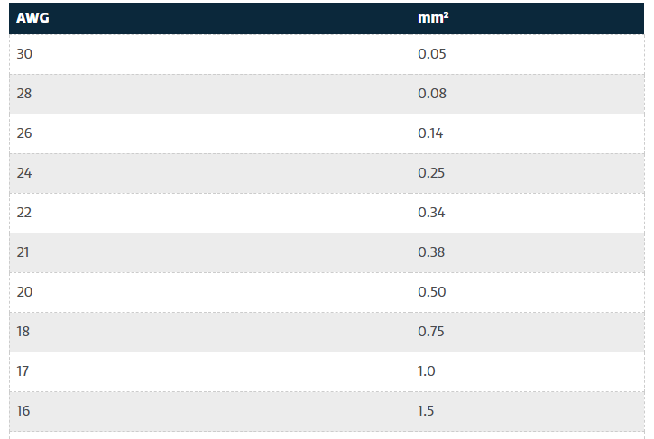


Engineering Calculations
Required Wire Guage to Supply Progressive Automations Liner Actuator
Mason Goodman, F23toSp24_NorthrupGrumman

Slide 24
Concept Evaluation
Criteria (BASE) | Weight | Slewing Drive | Cycloidal Drive
Shear Load | 5% | 0 | 1
Compression Load | 40% | 1 | 0
Cost | 30% | 1 | 0
Size | 20% | 1 | 0
Gear Ratio | 5% | 0 | 1
Total | 100% | 3 | 2
Weighted Total |  | 9 | 1
Criteria (JOINTS)​ | Weight​ | Slewing Drive​ | Cycloidal Drive​
Shear Load​ | 40% | 0​ | 1​
Compression Load​ | 5% | 1​ | 0​
Cost​ | 30%​ | 0 | 1
Size​ | 10% | 0 | 1
Gear Ratio​ | 15% | 0​ | 1​
Total​ | 100%​ | 1 | 4
Weighted Total​ | ​ | 0.5 | 9.5
Brandon Knutson, 10/10/23, F23toSp24_NorthrupGrumman
22

Slide 25
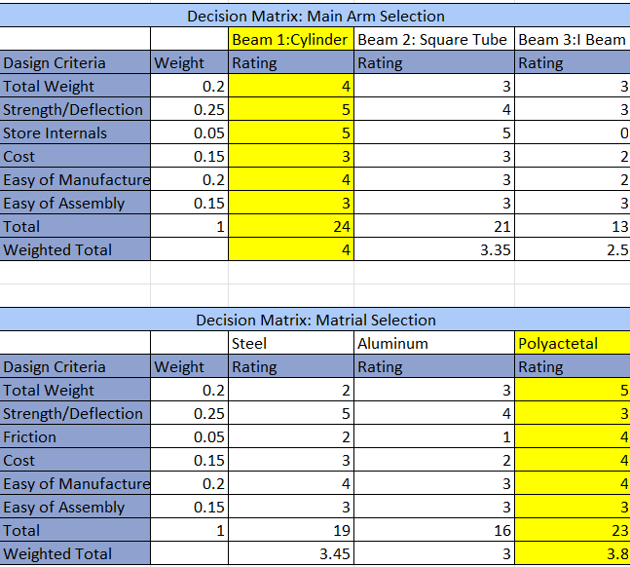
Concept Evaluation: Main Arm
Cylindrical Beam: Easiest Shape to manufacture, most structurally rigid shape to work with, can use less material and achieve similar
Polyacetal Plastic: Will not deform under given load, no galling, low maintenance cost, corrosion resistant
Final Main Arm Design: Polyacetal Cylinder
Daniel Cooke, 10/10/23, F23toSp24_NorthrupGrumman
23

Slide 26
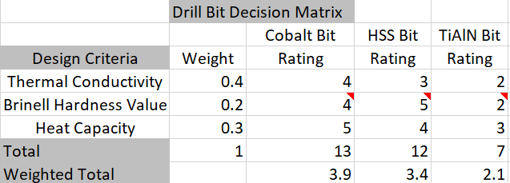
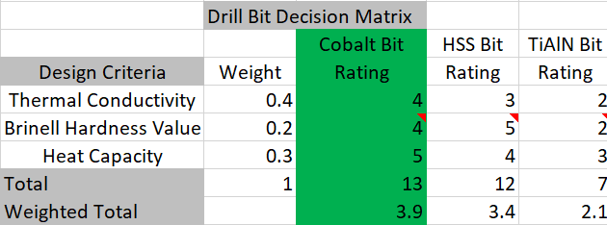
Concept Evaluation
Comparison of various drill bit materials
Cobalt bits are the best according to the matrix
This is supported by customer feedback declaring cobalt to be the best for drilling aluminum
Isaiah Padilla, 10/10/23, F23toSp24_NorthrupGrumman
24
Notes:
Summarize your quantifiable proof within Pugh charts, decision matrices, specification tables, and/or Factor of Safety (FoS) tables. There will be some engineering/customer requirements that you can’t quantify yet. That’s OK. Discuss your plan to calculate/quantify those to validate your design BEFORE it’s built
Discuss how concepts compare to each other and against your benchmarked designs within each customer and engineering requirement.
Summarize the design(s) selected that best meets your design space as defined by the Customer Needs and the Engineering Requirements[object File]

Slide 27
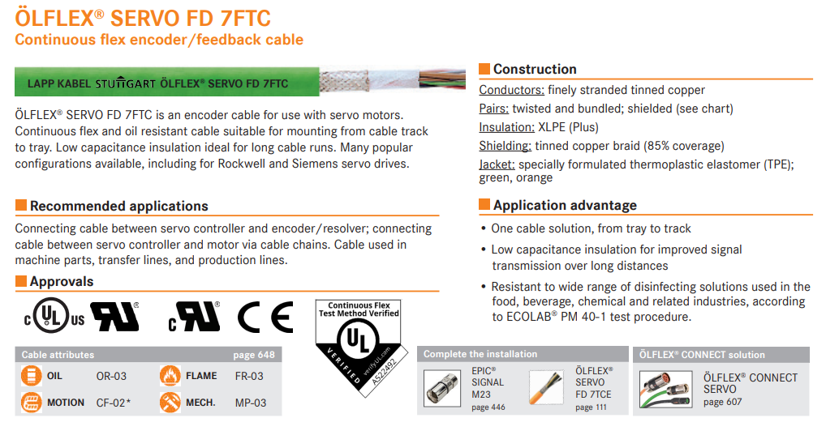
Concept Evaluation
Mason Goodman, 10/10/23, F23toSp24_NorthrupGrumman
25

Slide 28
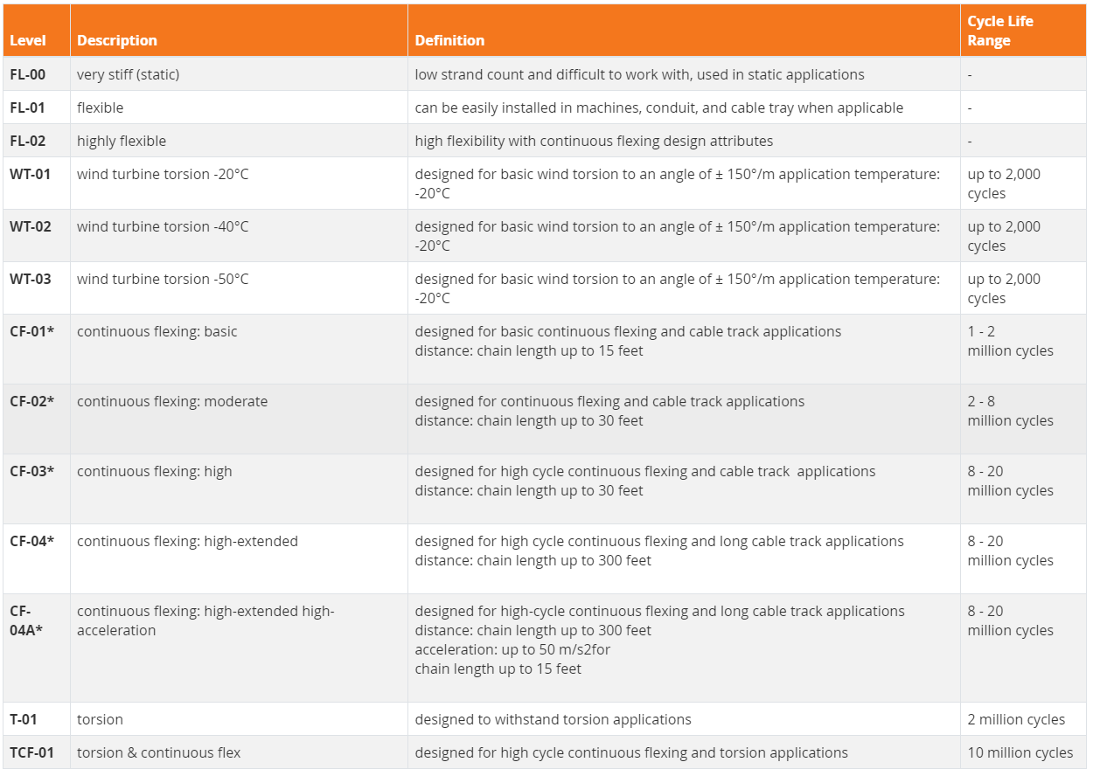
Concept Evaluation
Mason Goodman, 10/10/23, F23toSp24_NorthrupGrumman
26

Slide 29
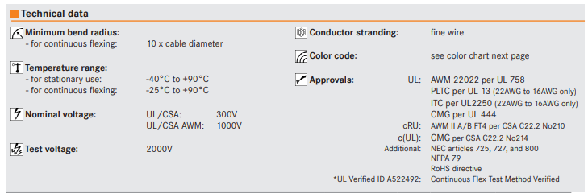
Concept Evaluation
Mason Goodman, 10/10/23, F23toSp24_NorthrupGrumman
27

Slide 30
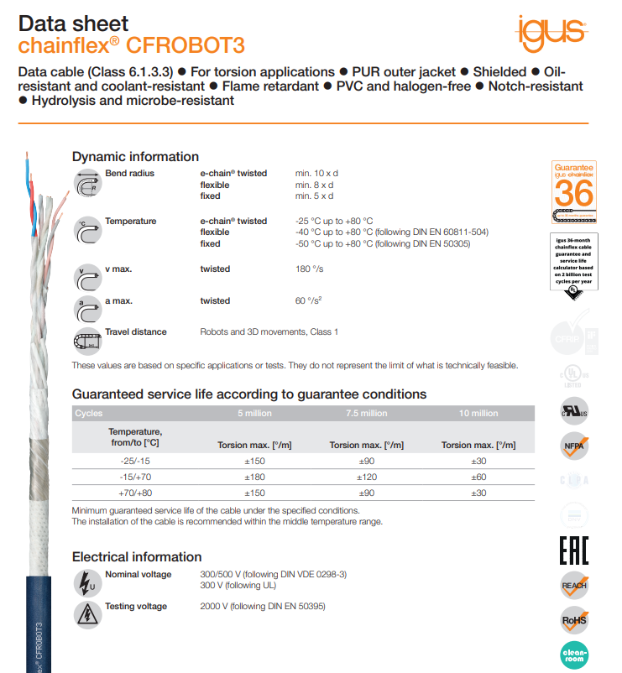
Concept Evaluation
Mason Goodman, 10/10/23, F23toSp24_NorthrupGrumman
28

Slide 31
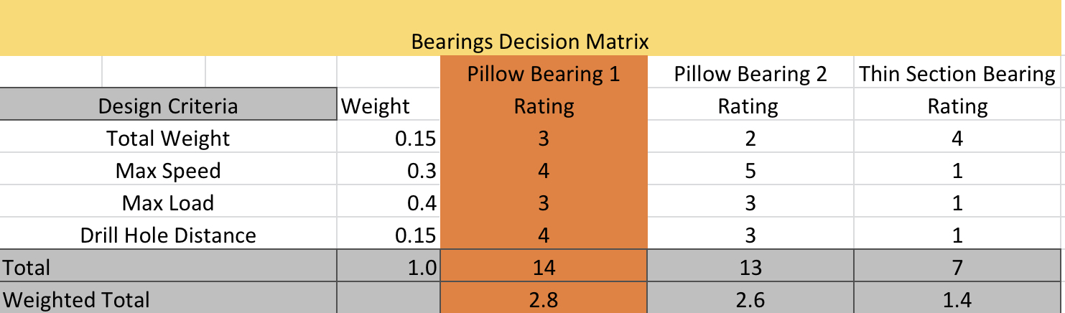
Concept Evaluation
Two different bearings shown previously versus thin section bearing commonly used in robotic arms
Thin section bearings were rated worst and pillow bearings 1 and 2 were very similar
Based on engineering requirements pillow bearing 1 was best
Client stated using thin section bearings is not recommended and this matrix proved that
[15-18]
Mica Nellis, 10/10/23, F23toSp24_NorthrupGrumman
29

Slide 32
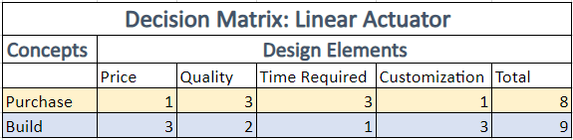
Concept Evaluation
Russel Stringham, 9/19/23, F23toSp24_NorthrupGrumman
30

Slide 33
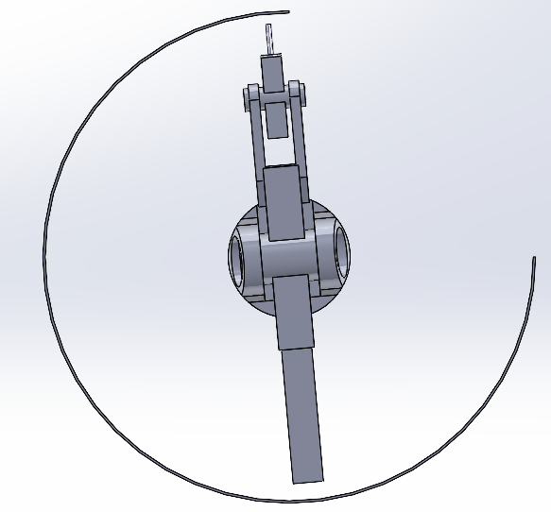
Concept Evaluation: CAD
Max Length: 3.75 ft
Reach Max Height: 4ft
Height Base to Top of Tower: 2ft
Russel Stringham, 10/10/23, F23toSp24_NorthrupGrumman
31

Slide 34
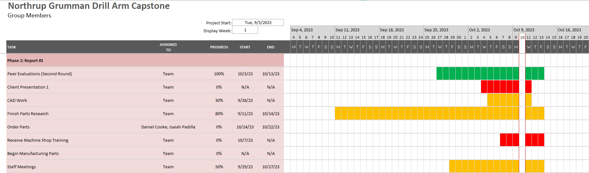
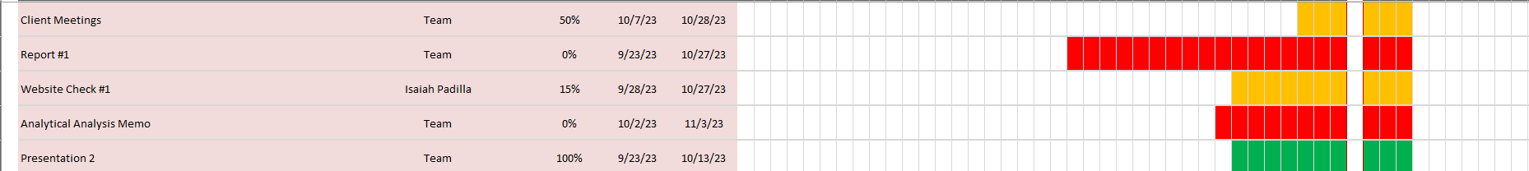
Schedule
Isaiah Padilla, 10/10/23, F23toSp24_NorthrupGrumman
33

Slide 35

Concept Evaluation: CAD
Russel Stringham, 10/10/23, F23toSp24_NorthrupGrumman
32

Slide 36
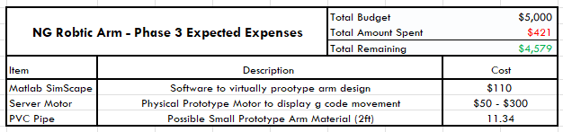
Budget
Project Manager & Budget Liaison Identified Flagstaff Manufactures of Interest in the Flagstaff Area
Electric Torque Machines
K & M Machine Tool
AZ Custom Plastics
Team Proposed Self – Donation for Prototype Purposes
Prototype Resources:
Home Depot
HomCo Lumber & Hardware
Mason Goodman, 10/10/23, F23toSp24_NorthrupGrumman
34

Slide 37
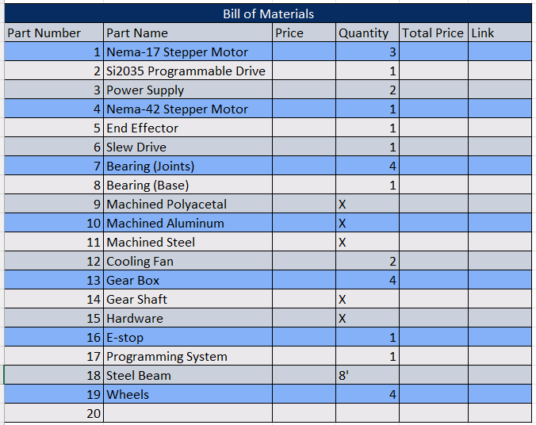
Bill of Materials
Daniel Cooke, 10/10/23, F23toSp24_NorthrupGrumman
35

Slide 38
Questions?

Slide 39
Bibliography
[1] “Robotstudio target external axis,” kasaplet. https://kasaplet.weebly.com/robotstudio-target-external-axis.html (accessed Oct. 08, 2023).
[2] “SCARA Robot | How To Build Your Own Arduino Based Robot,” www.youtube.com. https://www.youtube.com/watch?v=1QHJksTrk8s (accessed Oct. 20, 2022).
[3] “3D Printed Robots: The Most Advanced Projects of 2021,” All3DP, Sep. 11, 2021. https://all3dp.com/2/3d-printed-robot-print-robots/
[4] By Norbert Schnitzler - Own work, CC BY-SA 3.0,
‌[5] “Slewing drive,” Wikipedia, Mar. 31, 2023. https://en.wikipedia.org/wiki/Slewing_drive#cite_ref-Machinery (accessed Oct. 08, 2023).
[6] “Épinglé sur Armor,” Pinterest. https://www.pinterest.co.uk/pin/528258231263816409/ (accessed Oct. 08, 2023).
[7] tec-science, “How does a cycloidal drive work?,” tec-science, Jan. 14, 2019. https://www.tec-science.com/mechanical-power-transmission/planetary-gear/how-does-a-cycloidal-gear-drive-work/
[8] ItemImage-388386-Q5vwpk-Ddnp60-6vqsm9.
[9] “A-Z guide for drilling aluminium: Ruko shop UK,” RUKO UK, https://ruko.shop/blogs/ruko-shop-blog/drilling-aluminium- guide#:~:text=A%20regular%20HSS%20drill%20bit,and%20will%20therefore%2
0prevent%20overheating. (accessed Oct. 10, 2023).
[10] “The Online Materials Information Resource,” MatWeb, https://www.matweb.com/search/datasheet.aspx?bassnum=AMECo00&ckck=1 (ac cessed Oct. 10, 2023).
[11] [1] T. Kvackaj, J. Bidulská, and R. Bidulský, “Overview of HSS steel grades development and study of reheating condition effects on austenite grain size changes,” Materials (Basel, Switzerland),
https://www.ncbi.nlm.nih.gov/pmc/articles/PMC8071465/#:~:text=The%20yield%20strength%20of%20the,followed%20by%20HSS%20and%20UHSS. (accessed Oct. 10, 2023).
[12] “Steels - properties of steels,” Nuclear Power, https://www.nuclear-power.com/nuclear-engineering/metals-what-are-metals/steels-properties-of-steels/ (accessed Oct. 10, 2023).
[13] “High-speed steels - HSS - characteristics and uses,” Nuclear Power, https://www.nuclear-power.com/nuclear-engineering/metals-what-are-metals/steels-properties-of-steels/high-speed-steel-
hss/#:~:text=The%20thermal%20conductivity%20of%20high,K). (accessed Oct. 10, 2023).
[14] “The Online Materials Information Resource,” MatWeb, https://www.matweb.com/search/DataSheet.aspx?MatGUID=ffbf753c500949db95e502e043f9a404%E2%80%8B (accessed Oct. 10, 2023).
[15] [“Datasheet Directory,” Globalspec.com, 2020. https://www.globalspec.com/specsearch/partspecs?partId=
[16] “Datasheet Directory,” Globalspec.com, 2020. https://www.globalspec.com/specsearch/partspecs?partId=
[17] “Thin Section Bearings for Industrial Robots RBC Thin Section Ball Bearings: Because That’s How We Roll. Industrial Robot Applications: • Human Assist • Medical • Paint spray • Pick and place • Semiconductor -Vacuum -Atmospheric • Welding.” Accessed: Oct. 09, 2023. [Online]. Available: https://www.rbcbearings.com/literature/pdfs/ThinSect_Robots_3_28_16.pdf
10/10/23, F23toSp24_NorthrupGrumman

Slide 40
Bibliography
[18] “Pillow Block Bearing in SolidWorks,” www.youtube.com. https://www.youtube.com/watch?v=GG6Dj36HT_8
[19] “Miniature Electric Linear Actuator,” Progressive Automations, Sep. 29, 2021. https://www.progressiveautomations.com/products/mini-linear-actuator?variant=18277279105091 (accessed Oct. 05, 2023).
[20] R. G. Budynas and J. K. Nisbett, Shigley’s Mechanical Engineering Design, 11th edition, SI units, 11th ed, S.l., NY: MCGRAW- HILL EDUCATION (AS, 2020)
10/10/23, F23toSp24_NorthrupGrumman

