Slide 1

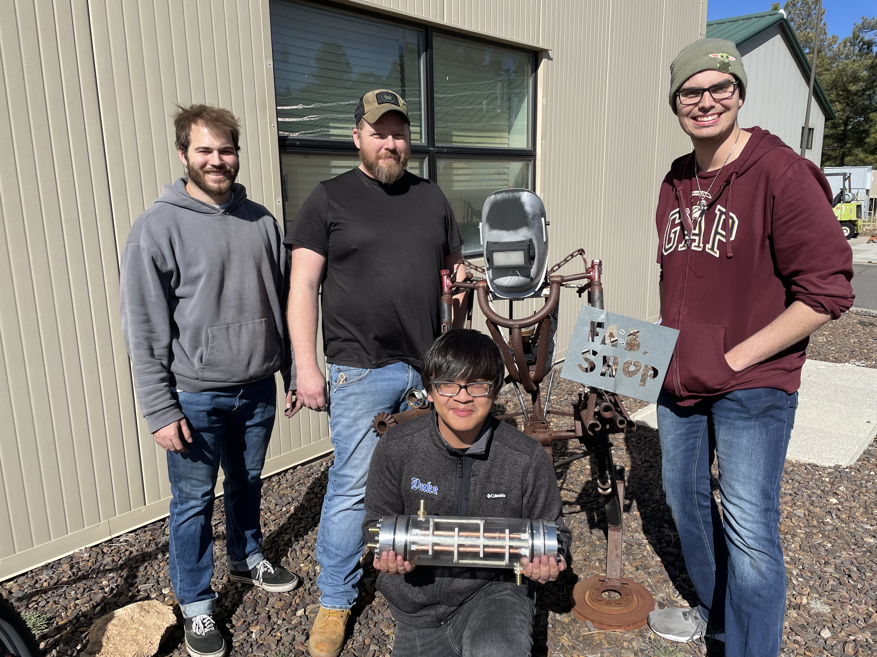
Heat Exchanger
Final Testing Results ME486C
4-17-24
Uriah Whitaker: Team Lead
Dennis Decker: Manufacturing Engineer
Christopher Mason: Test Engineer
Lorenz Vios: CAD Engineer

Slide 2
Design Requirements Summary CRs
CR1: The liquid coolant going into the radiator must be cold enough from the heat exchanger that when it conducts heat transfer to the air it will drop its temperature to a felt degree.
CR2: This system models the Apache Helicopter vapor compression system which will use HFO-1234yf which is a combustible refrigerant so a firewall will need to be put in place to isolate the cockpit from the refrigerant.
CR3: The liquid-to-liquid heat exchanger must meet this maximum sizing requirement. No weight constraint is specified.
CR4: Since the client requires the design of a demonstrator, they have requested clear housing to make the internal design of the heat exchanger visible.
CR5: The client would like to see the demonstration of the heat exchanger in person, so the system must be easy to transport and can be set up and operational within 1 hour.
CR6: The heat exchanger must continue to expel cold coolant to the radiator for a duration of 30 minutes.
Chris Mason,2

Slide 3
Design Requirements Summary ERs
ER1: The system must channel cold air to an observer’s hand.
ER2: The entire system must be easily transportable.
ER3: The system must operate for at least 30 minutes without melting all the ice within the system.
ER4: Mitigate the amount of head loss in the form of pressure drop.
ER5: Stay within the $6,000 budget.
ER6: Heat Exchanger must have a high effectiveness (>60%).
Chris Mason,3

Slide 4
Top Level Testing Summary
Experiment/Test | Relevant DRs | Testing Equipment Needed | Other resources
Exp 1 – Inlet/Outlet Temperature Test | CR1 – Temperature drop ER1 – Channel cold air ER3 – Run for 30 minutes ER6 – 60% effectiveness | Heat Exchanger / Full setup Thermocouples PICO Data Logger Computer | Thermo Fluids Lab
Exp 2 – Pressure Drop | ER4 - Low pressure drop | Heat exchanger / Full setup Pressure Gauges | Thermo Fluids Lab
Exp 3 – Sealing Tests | CR6 – 30 minute duration ER3 – Run for 30 minutes | Heat Exchanger/ Partial setup (Pump/ HX / gaskets/ o-rings) Means to make a video | Thermo Fluids Lab/ Machine shop
Uriah Whitaker,4

Slide 5
Detailed Testing Plans
Pressure Drop - Implement gauges to find pressure drop across system.
Inlet and Outlet Temperature Test - Use thermocouples at inlets and outlets to find temperatures which will be used to calculate effectiveness.
Sealing Test - Run the system for 30 minutes to check if heat exchanger is sealed properly
Dennis Decker,5

Slide 6
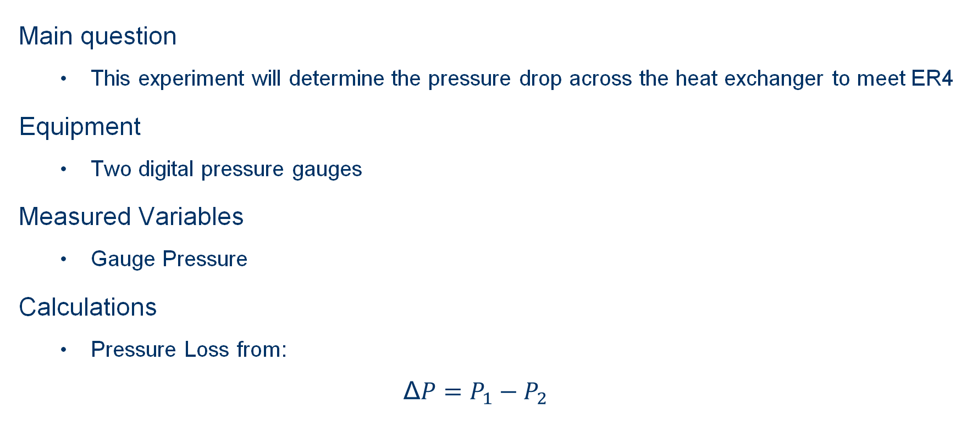
Pressure Drop Testing
Main question
  This experiment will determine the pressure drop across the heat exchanger to meet ER4
Equipment
  Two digital pressure gauges
Measured Variables
  Gauge Pressure
Calculations
  Pressure Loss from:
$$\text{Δ}P=P_{1}−P_{2}$$
Lorenz Vios,6

Slide 7
Pressure Drop Testing (cont.)
Procedure
  Turn on digital pressure gauges and pumps.
  Wait until both pressure gauges have stabilized their readings.
  Calculate the difference between inlet and outlet pressures for each fluid.
Results
Expected Pressure Drop: ~1.8 PSI
Actual pressure Drop: 2.2 PSI
Lorenz Vios,7

Slide 8
Inlet/Outlet Temperature Testing
Main question
The team will be testing for final output temperatures to meet DR’s 1,3,6
Equipment
Utilize 8 thermocouples to verify temperature distributions
2 pressure gauges to verify head loss is acceptable on coolant side
2 flow sensors in each flow to verify flow and pumps are acceptable for DR 6
Isolated variables
Ice water inlet temperature
Calculated results
Final effectiveness will be calculated from delta T
Procedure
Connect thermocouples to TC-08.
Start PicoLog and enable all channels, setting sample interval to 100ms.
Power on pumps and fans to start the system.
Wait for temperatures to reach steady state operation.
Calculate the effectiveness of the heat exchanger.
Calculate the temperature of the outlet air.
Dennis Decker,8

Slide 9
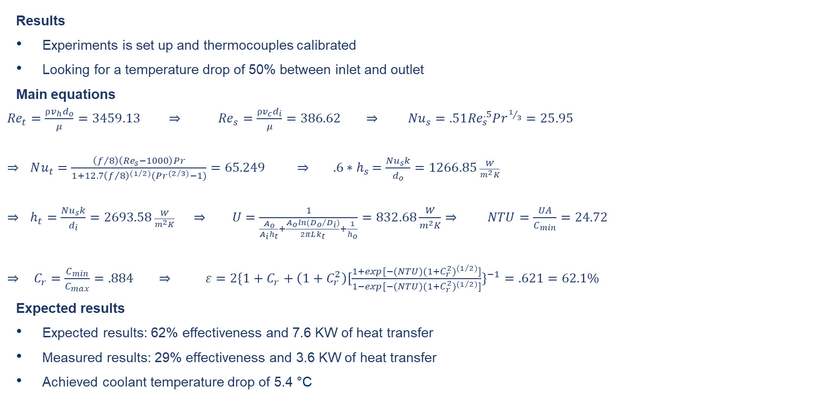
Inlet/Outlet Temperature Testing (cont.)
Results
Experiments is set up and thermocouples calibrated
Looking for a temperature drop of 50% between inlet and outlet
Main equations
${Re}_{t}=\frac{⍴v_{h}d_{o}}{μ}=3459.13 ⇒$ ${Re}_{s}=\frac{⍴v_{c}d_{i}}{μ}=386.62 ⇒$ ${Nu}_{s}=.51{Re}_{s}^{.5}Pr^{1/3}=25.95$
$⇒$ $Nu_{t}=\frac{\left(f/8\right)\left(Re_{s}−1000\right)Pr}{1+12.7{\left(f/8\right)}^{{(1}/{2)}}(Pr^{{(2}/{3)}}−1)}=65.249 ⇒ {.6∗h}_{s}=\frac{{Nu}_{s}k}{d_{o}}=1266.85 \frac{W}{m^{2}K}$
$⇒$ $h_{t}=\frac{{Nu}_{s}k}{d_{i}}=2693.58 \frac{W}{m^{2}K} ⇒$ $U=\frac{1}{\frac{A_{o}}{A_{i}h_{t}}+\frac{A_{o}ln⁡({D_{o}}/{D_{i})}}{2πLk_{t}}+\frac{1}{h_{o}}}=832.68\frac{W}{m^{2}K}⇒$ $NTU=\frac{UA}{C_{min}}=24.72$
$⇒$ $C_{r}=\frac{C_{min}}{C_{max}}=.884 ⇒ ε=2\{1+C_{r}+\left(1+C_{r}^{2}\right)[\frac{1+exp[−(NTU)(1+C_{r}^{2})^{{(1}/{2)}}]}{1−exp[−(NTU)(1+C_{r}^{2})^{{(1}/{2)}}]}\}^{−1}=.621=62.1\%$
Expected results
Expected results: 62% effectiveness and 7.6 KW of heat transfer
Measured results: 29% effectiveness and 3.6 KW of heat transfer
Achieved coolant temperature drop of 5.4 °C
Dennis Decker,9

Slide 10
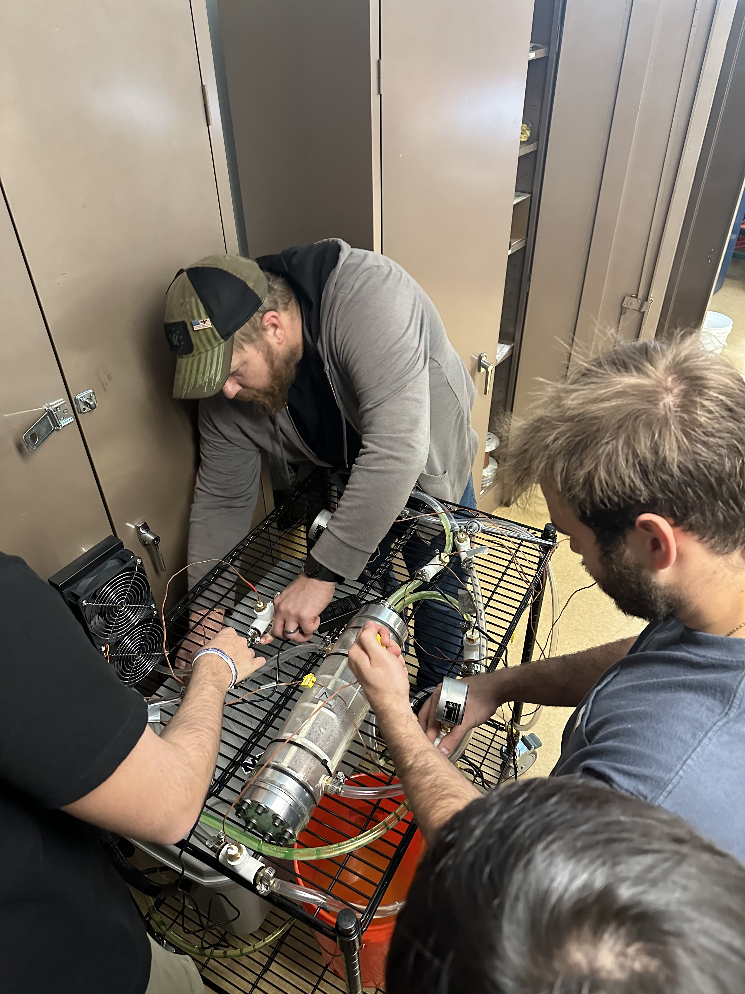
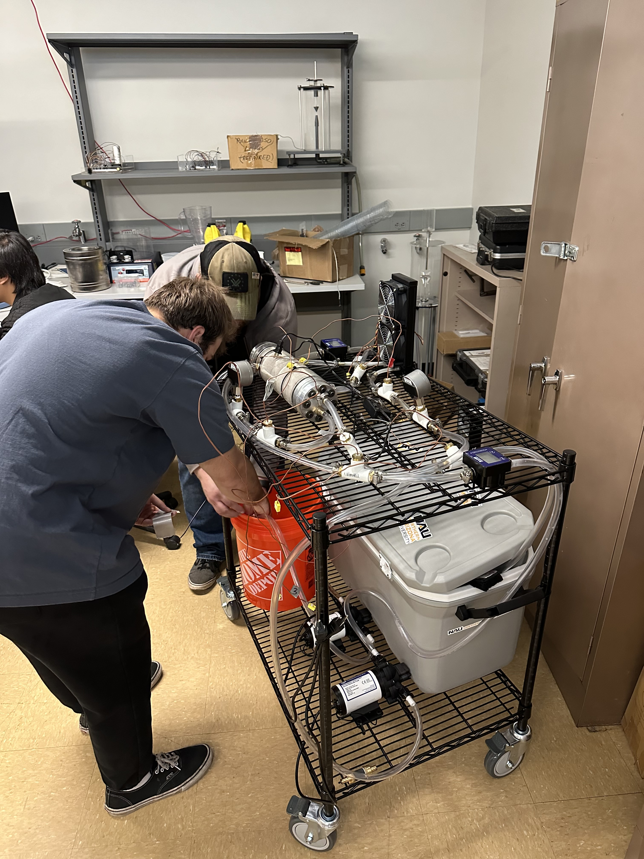
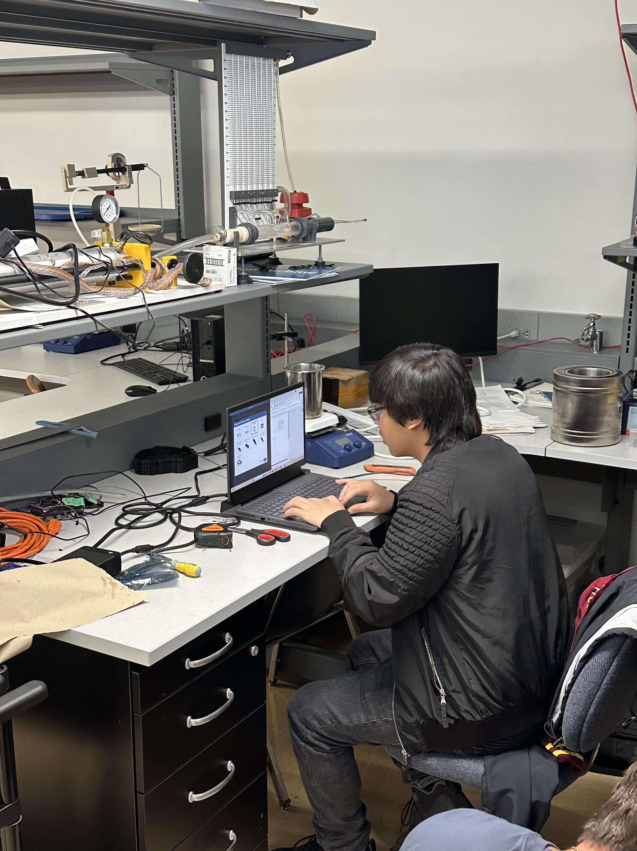
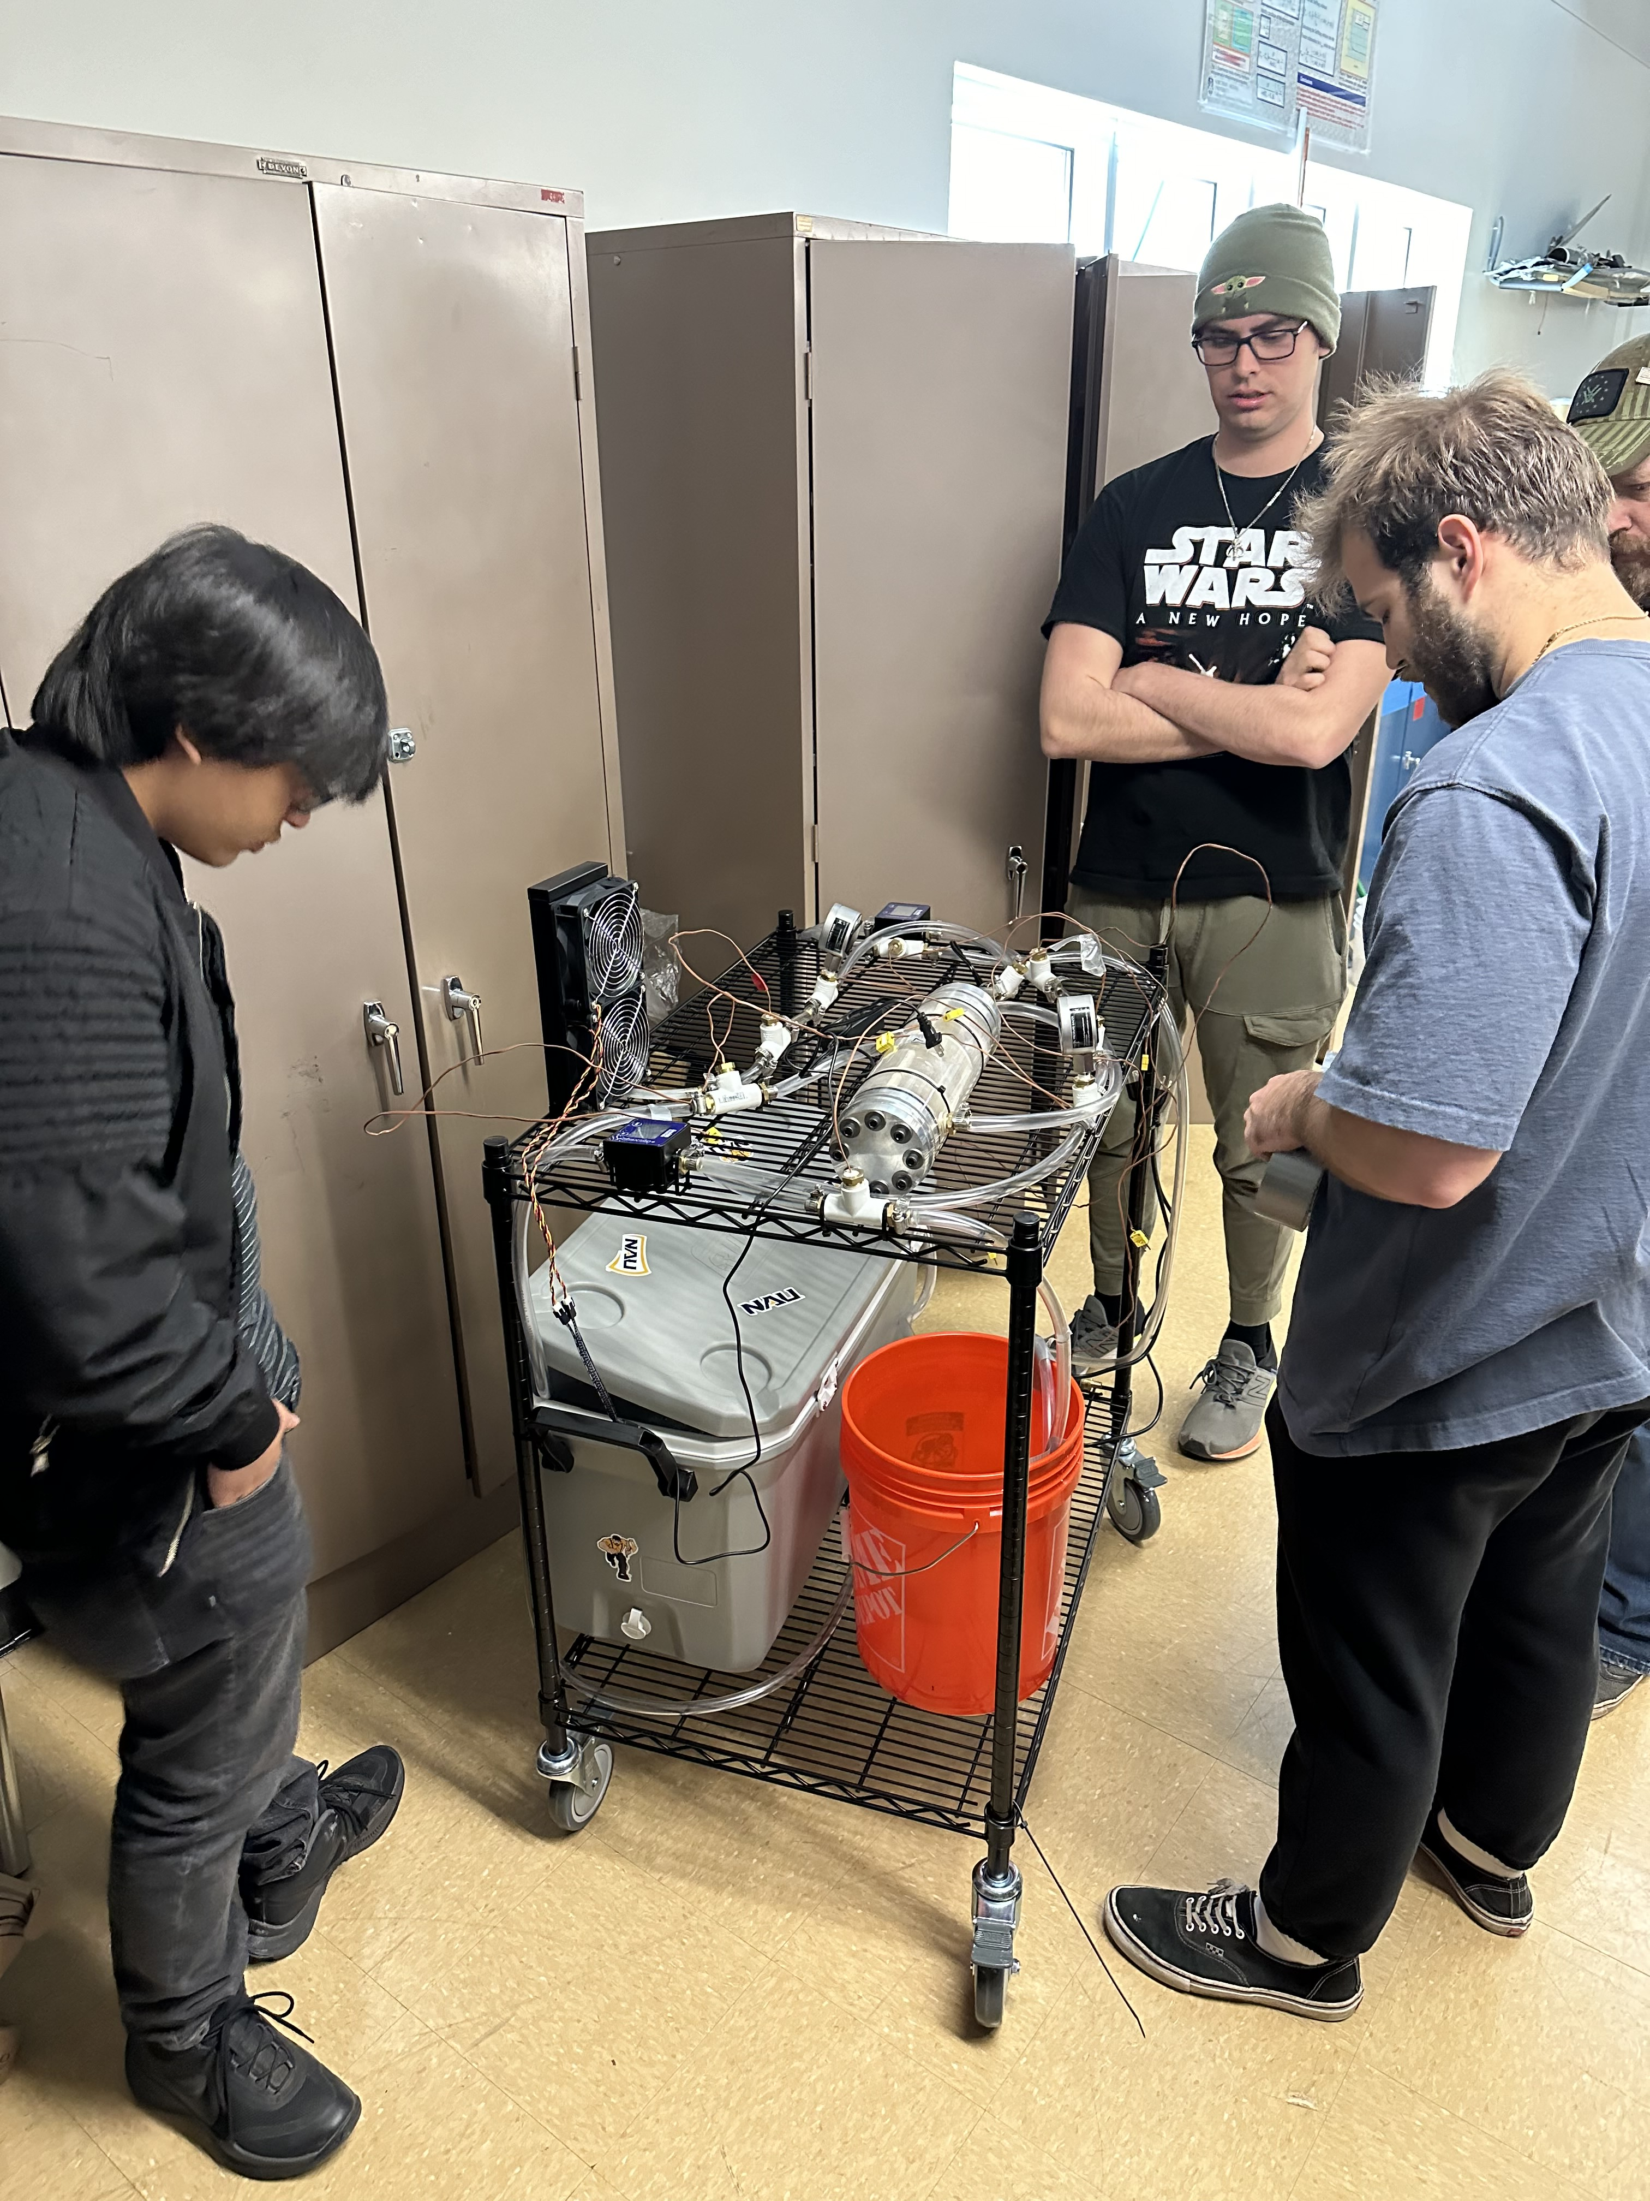
Inlet/Outlet Testing
Chris Mason,10

Slide 11
Seal Testing
Main questions
This experiment will test the seals to meet CR6 and ER3
Gaskets, O-rings, Epoxy are critical points
Procedure
Turn on pumps to start fluid flows.
Set timer for 30 minutes.
Check for external leaks in fittings and connections in between plastic tubing sections.
Check for external leaks in both heat exchanger end caps (gaskets and O-rings)
Check for internal leaks in the heat exchanger.
Repeat leak checks until timer ends.
Results
System remains leak free for desired run time
Lorenz Vios,11

Slide 12
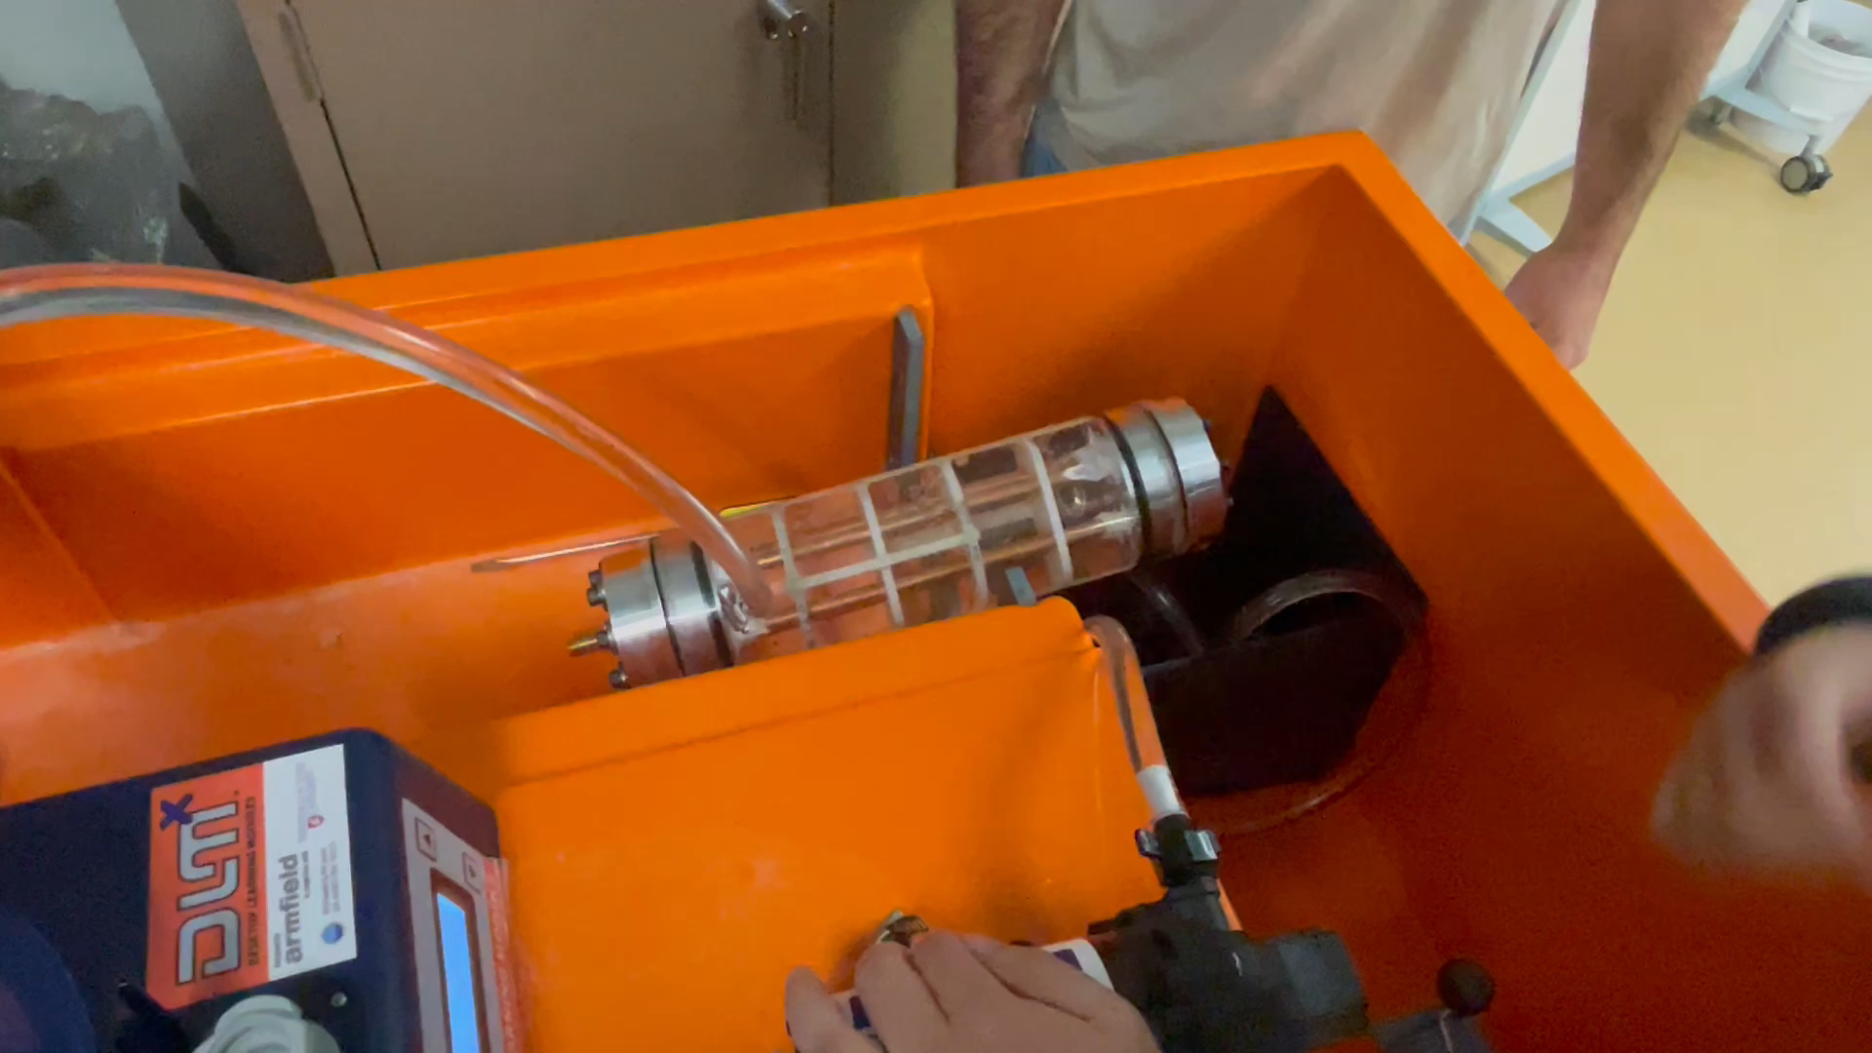
Seal/Pressure Test 1
Video Link
Chris Mason,12

Slide 13

30 Minute Run Seal Test
Video Link
Apache Footage: @WarLeaks – Military Blog Link
Chris Mason,13

Slide 14
Specification Sheets
Customer Requirement | CR met? (✓ or X) | Client Acceptable? (✓ or X)
CR1 – Air Temperature | ✓ | ✓
CR2 – Firewall Installed | ✓ | ✓
CR3 – HXR Volume Limit | ✓ | ✓
CR4 – Clear HXR | ✓ | ✓
CR5 – Portable System | ✓ | ✓
CR6 – 30min Operation | ✓ | ✓
Engineering Requirement | Target | Measured/ Calculated Value | ER met? (✓ or X) | Client Acceptable? (✓ or X)
ER1 – Low Air Temp | >5 °C drop | 5.4 °C | ✓ | ✓
ER2 – Small System Volume | < 1 m³ | .14 m³ | ✓ | ✓
ER3 – High Operation Time | > 30 min | 30 min | ✓ | ✓
ER4 – Low Pressure Drop | < 40 psi | 2.1 | ✓ | ✓
ER5 – Minimized Cost | < $1000 | $772.33 | ✓ | ✓
ER6 – High HXR Effectiveness | > 60% | 29% | X | TBD
Uriah Whitaker,14

Slide 15
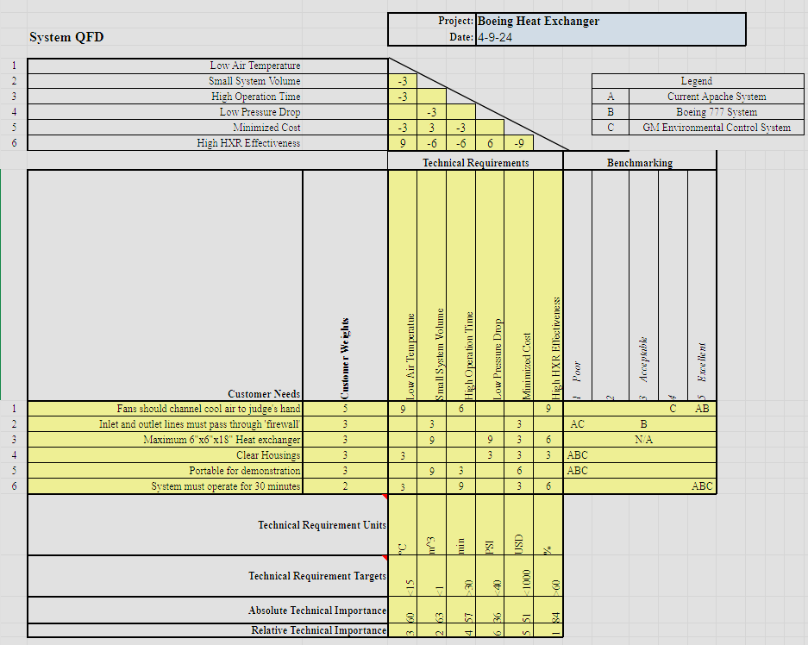
QFD
Uriah Whitaker,15

Slide 16
Thank You

