Slide 1

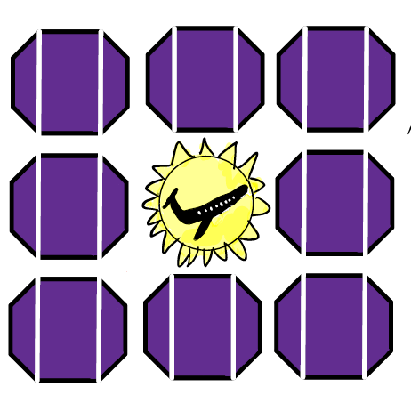
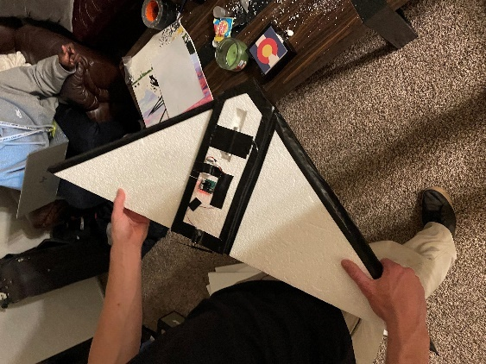
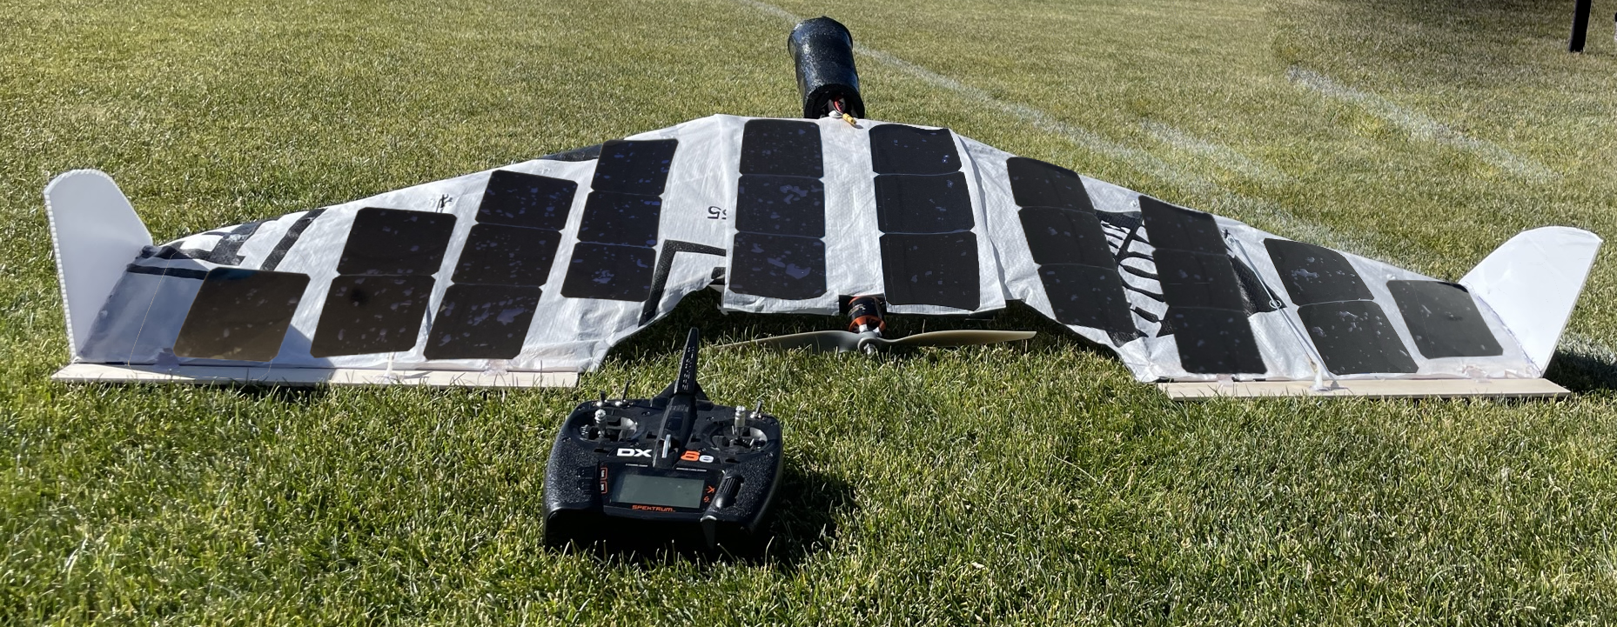
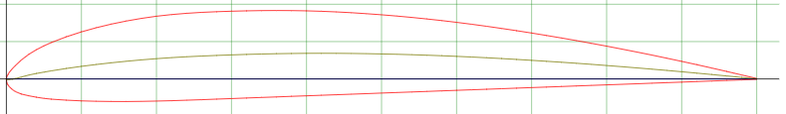
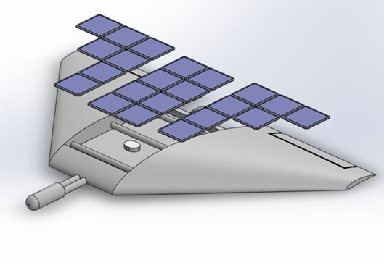
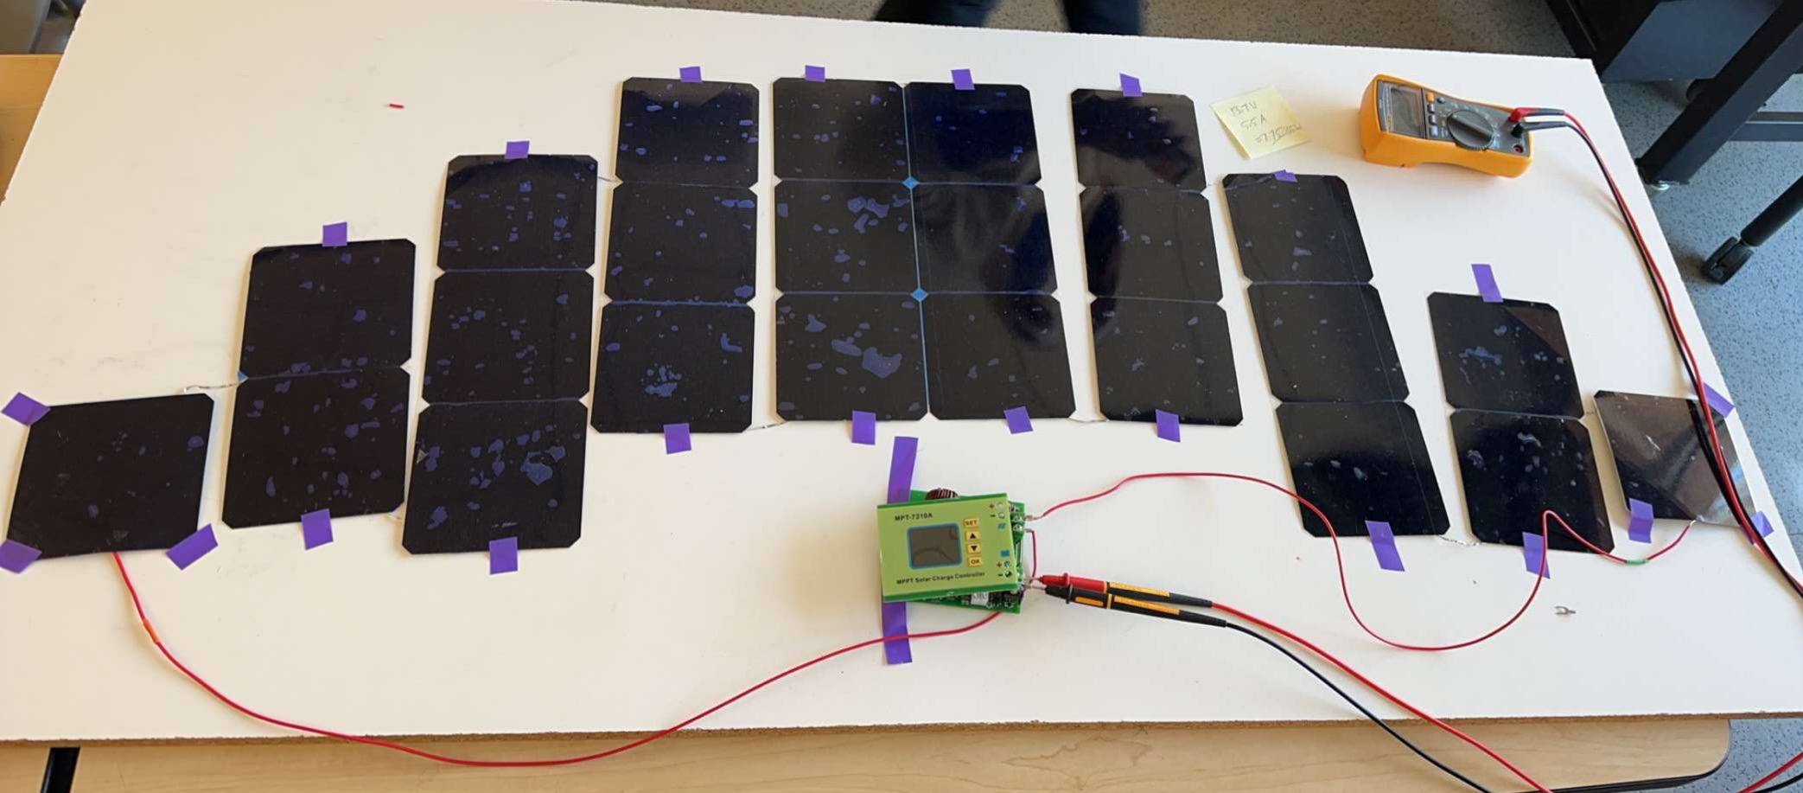
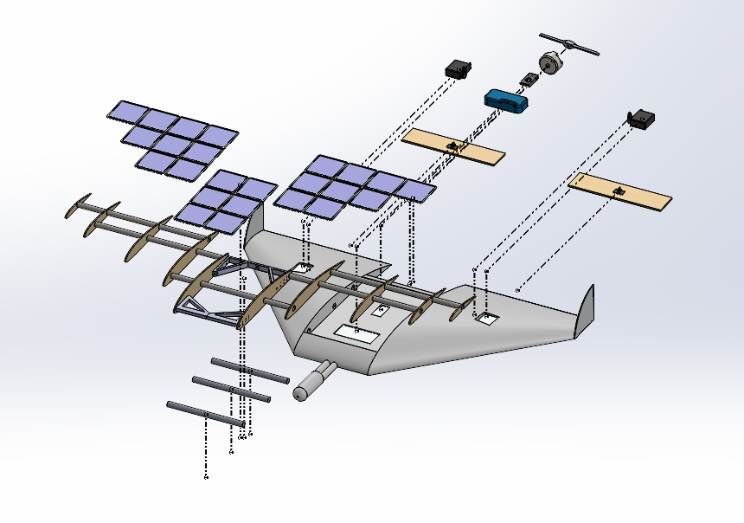
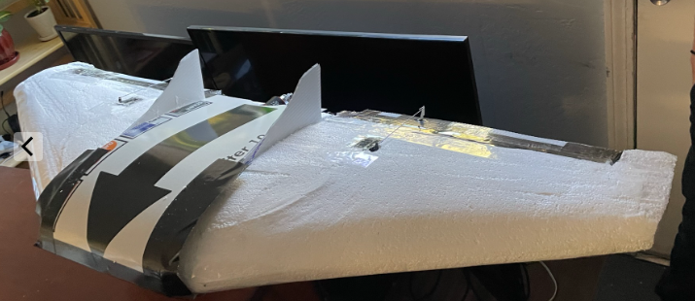
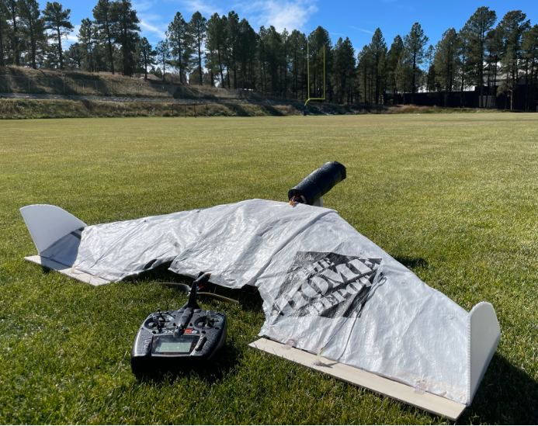
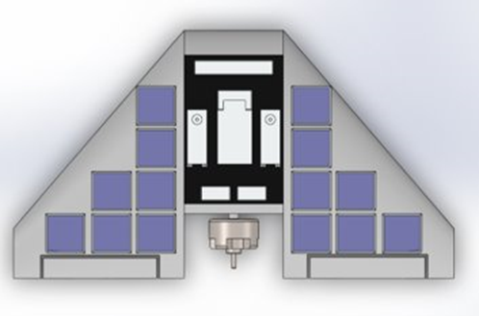
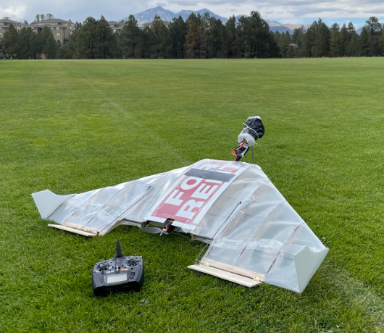
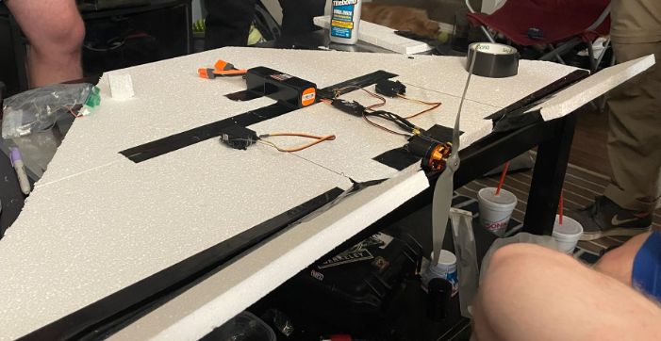
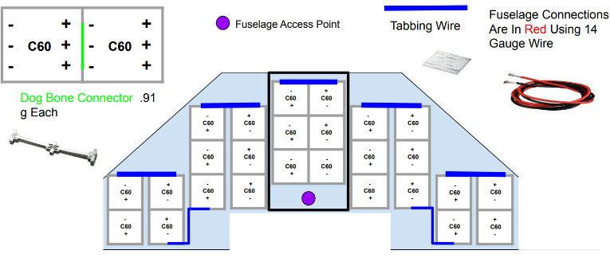
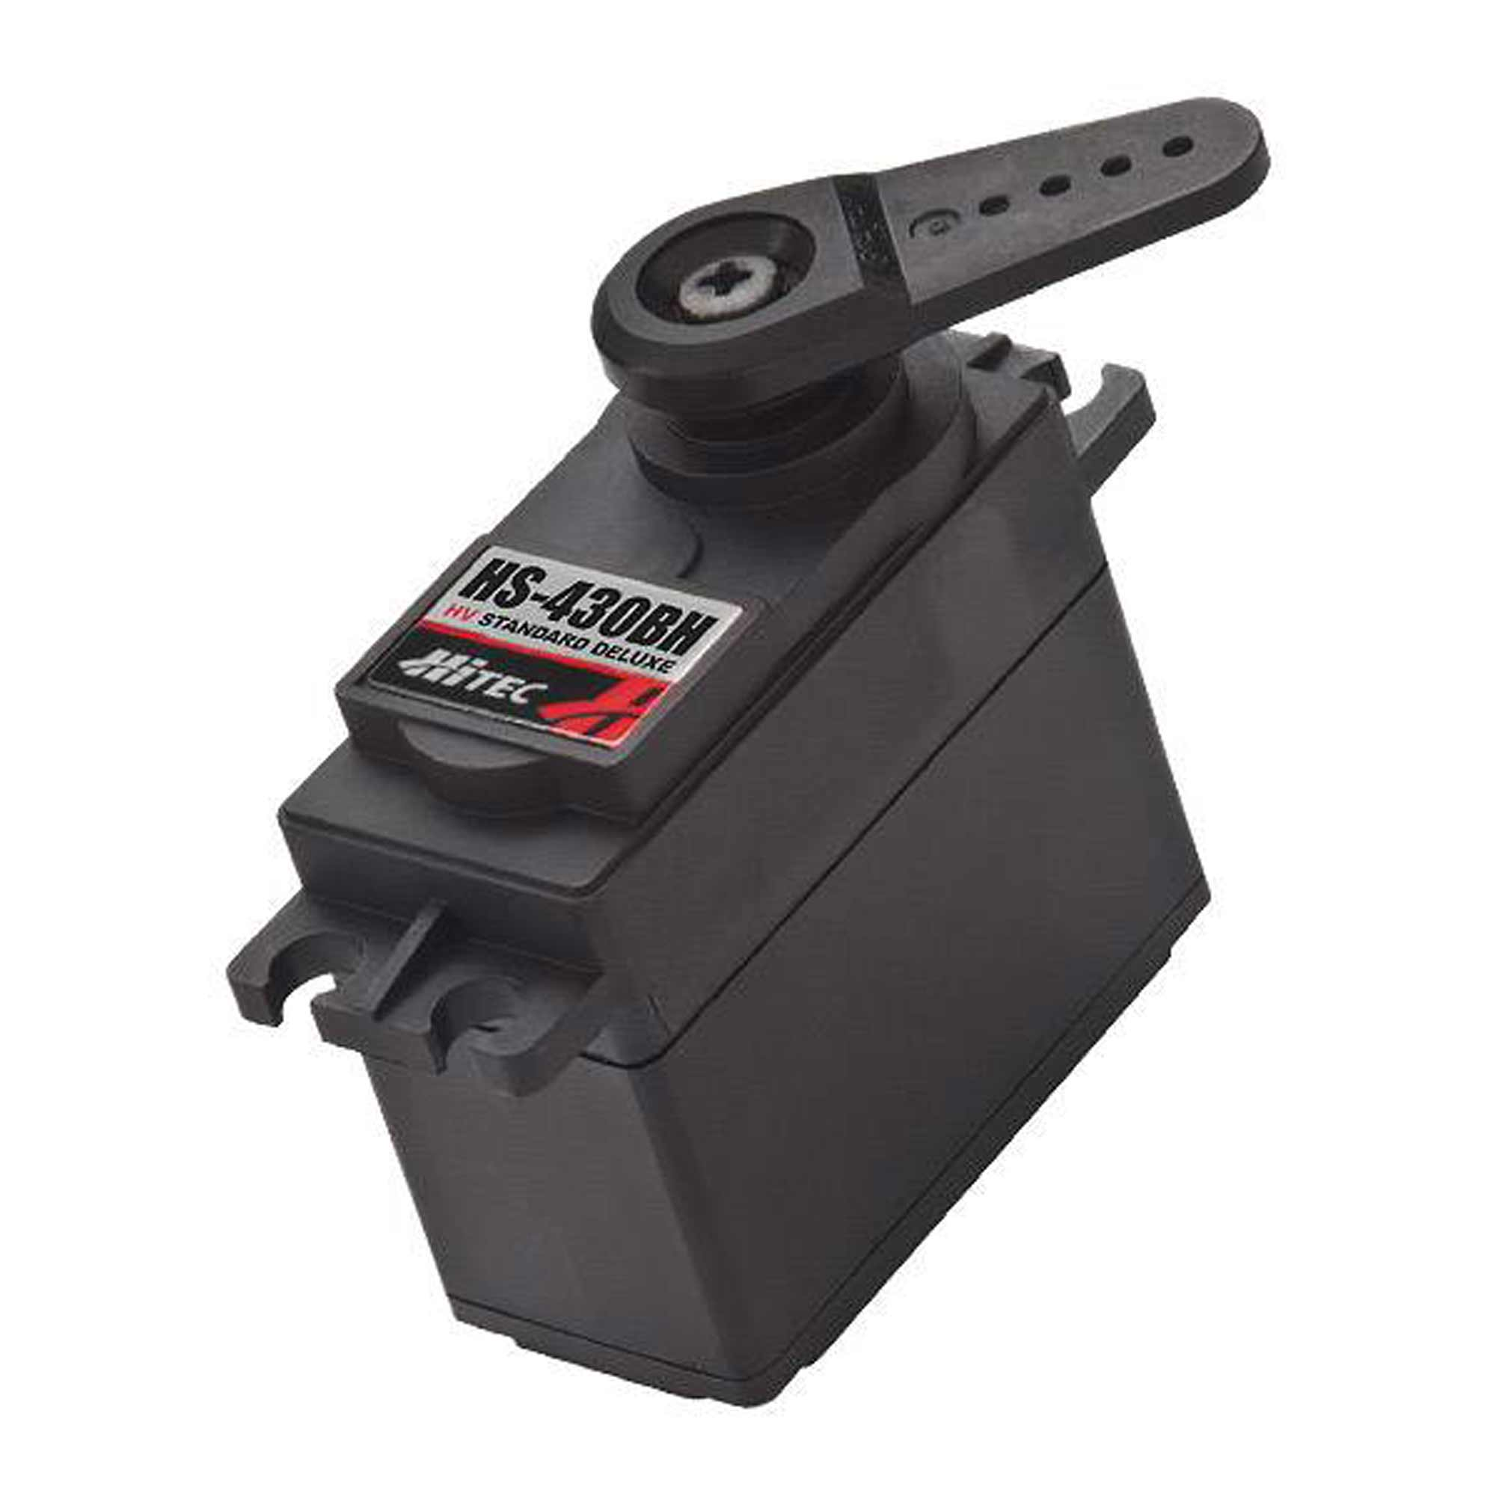
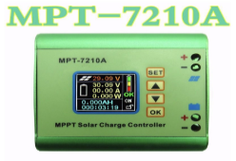
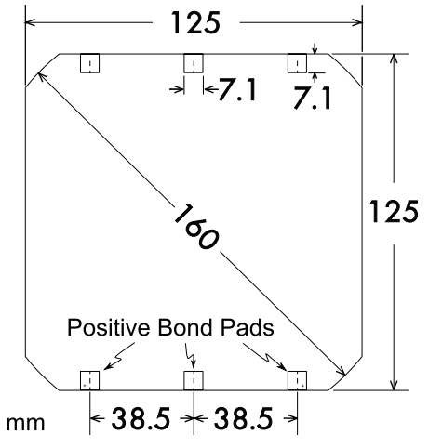
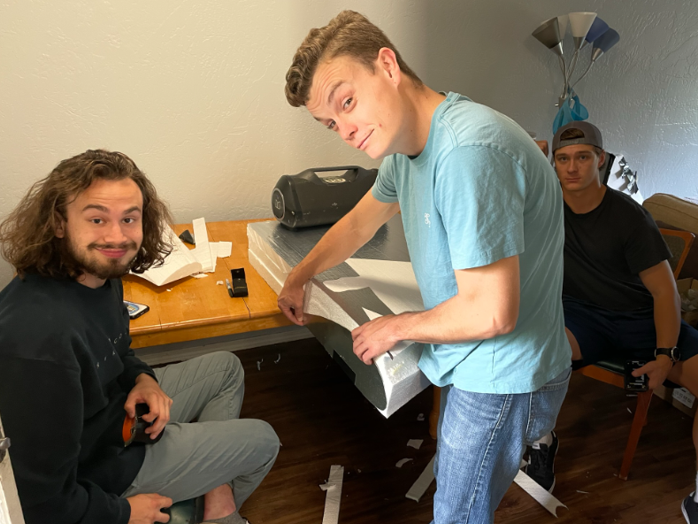
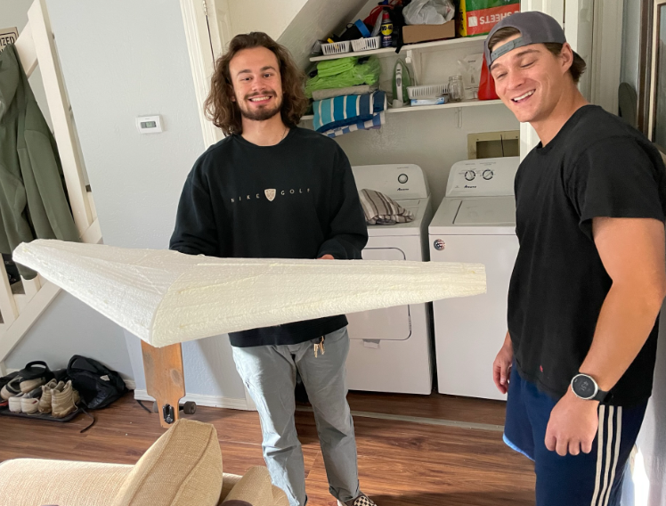
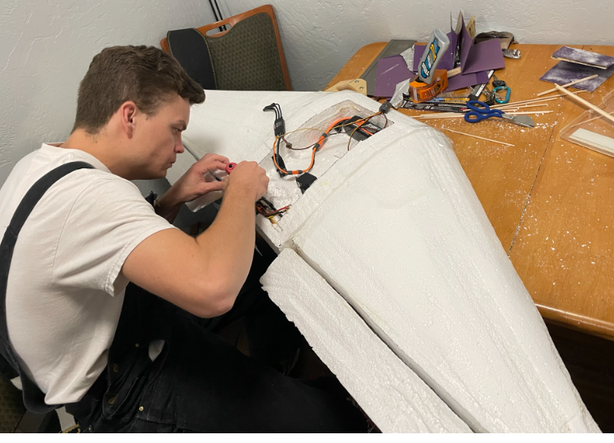
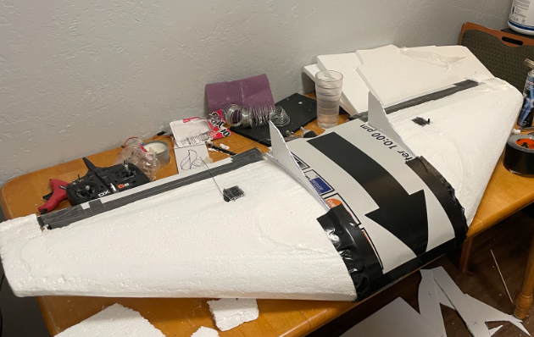
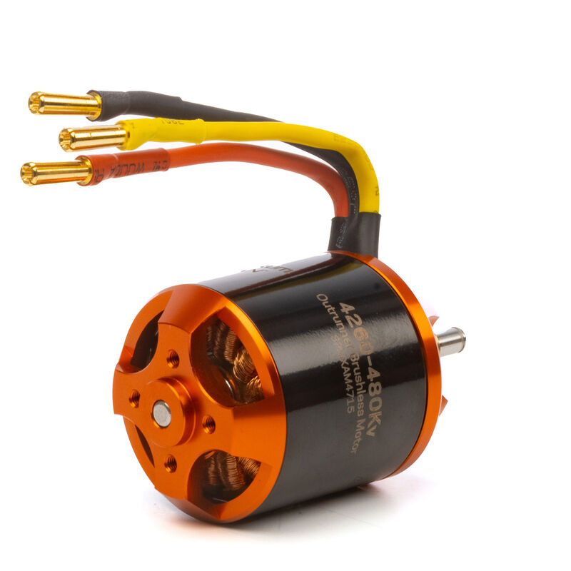
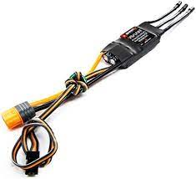
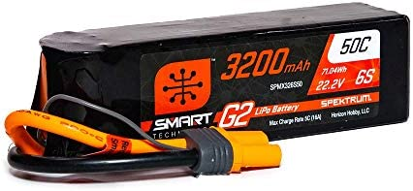
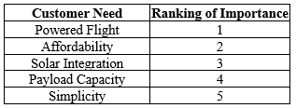
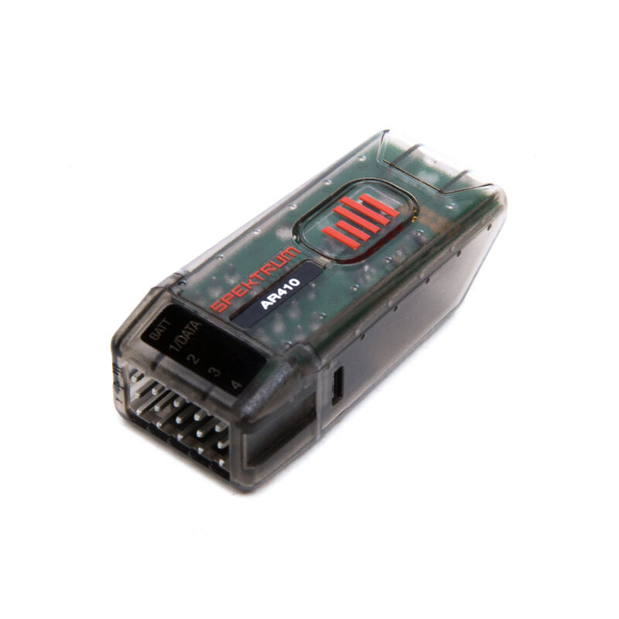
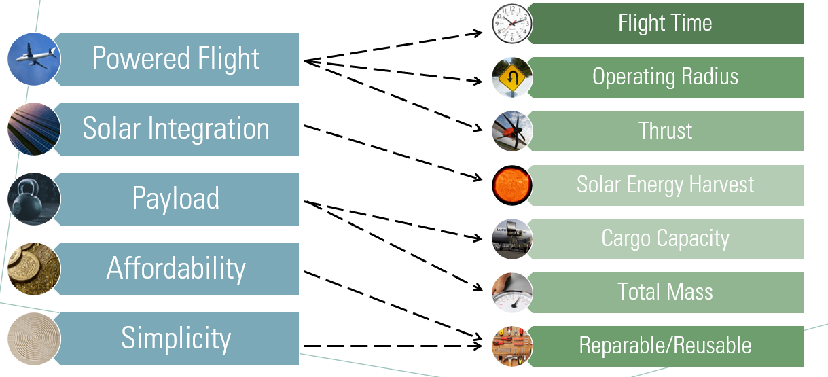
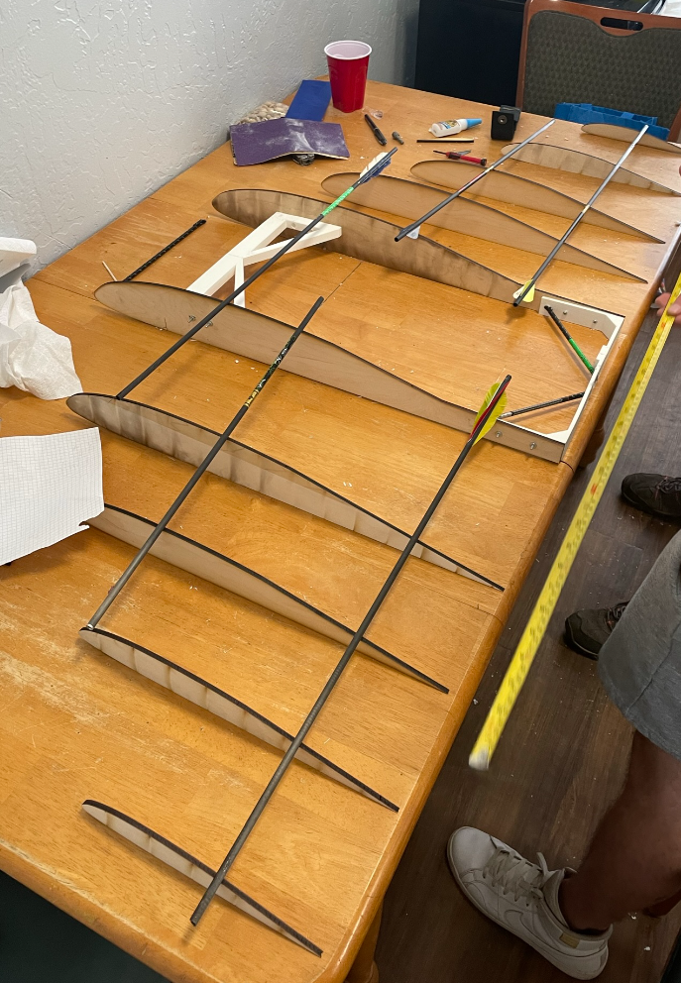
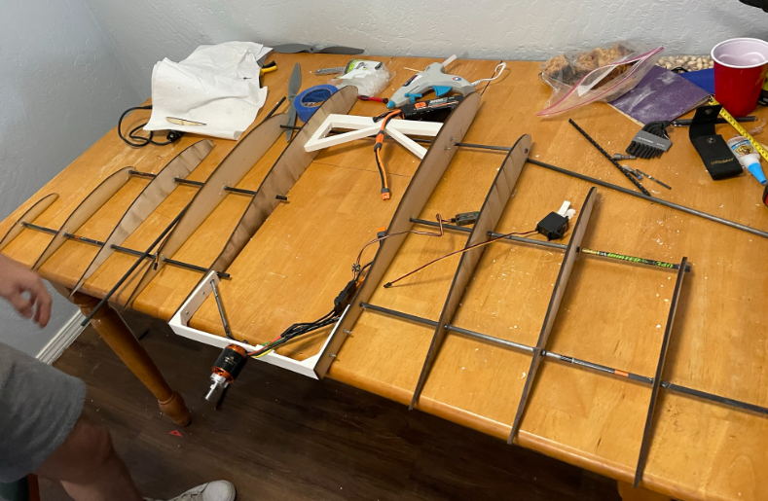
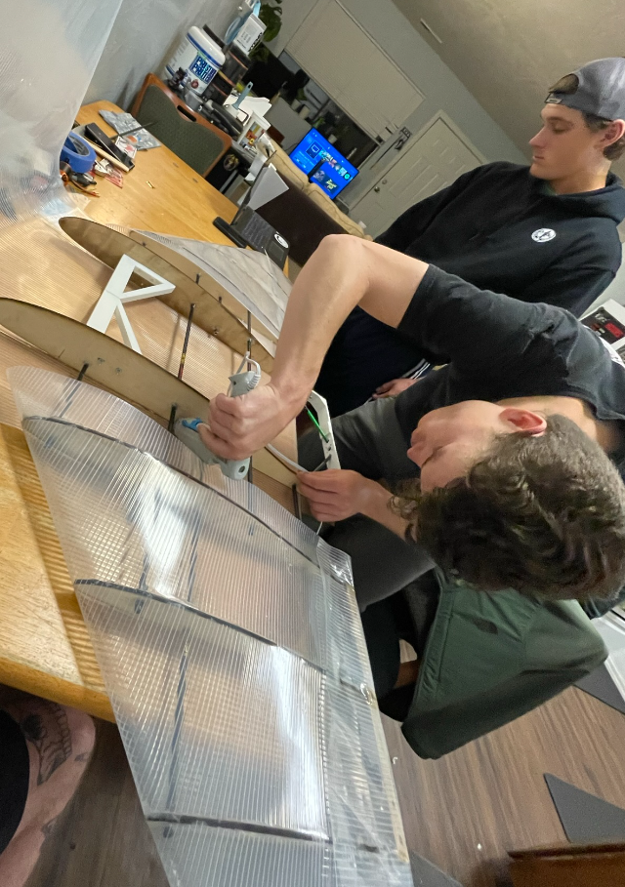
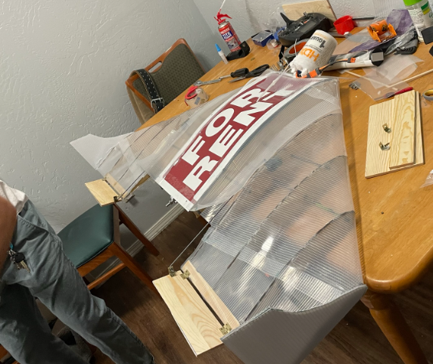
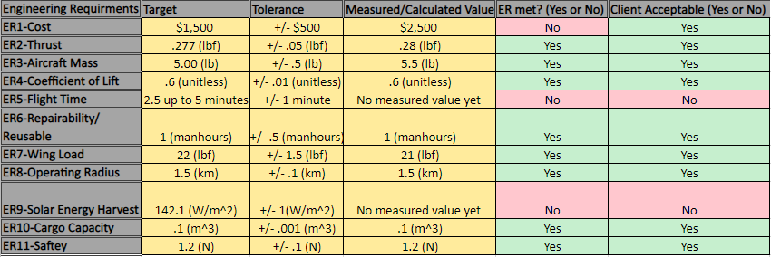
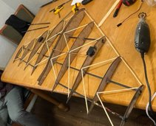
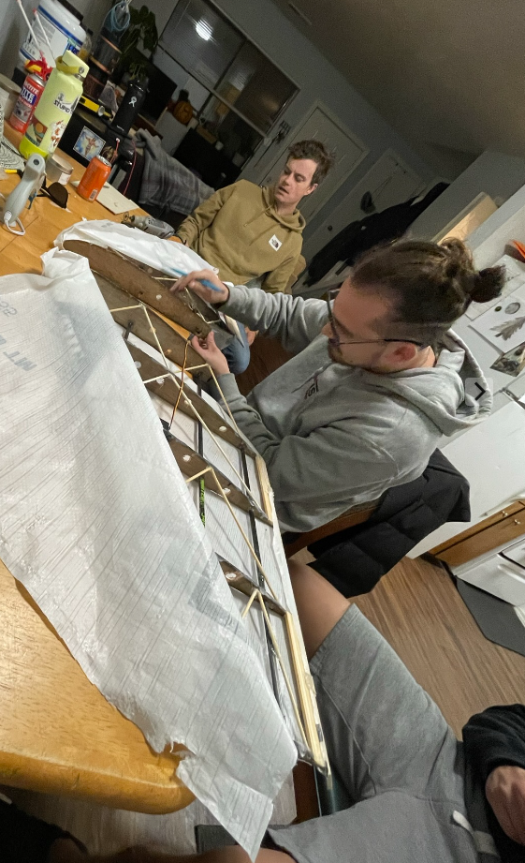
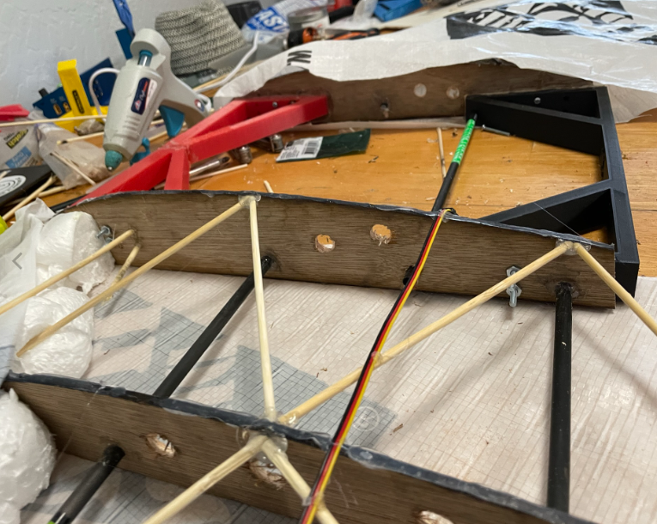
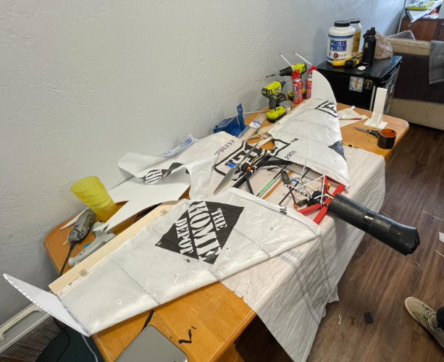
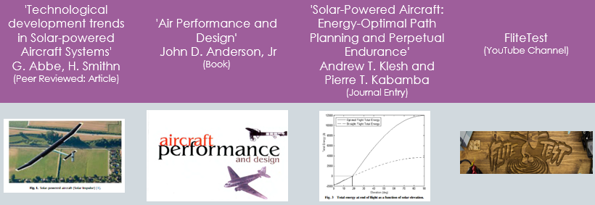
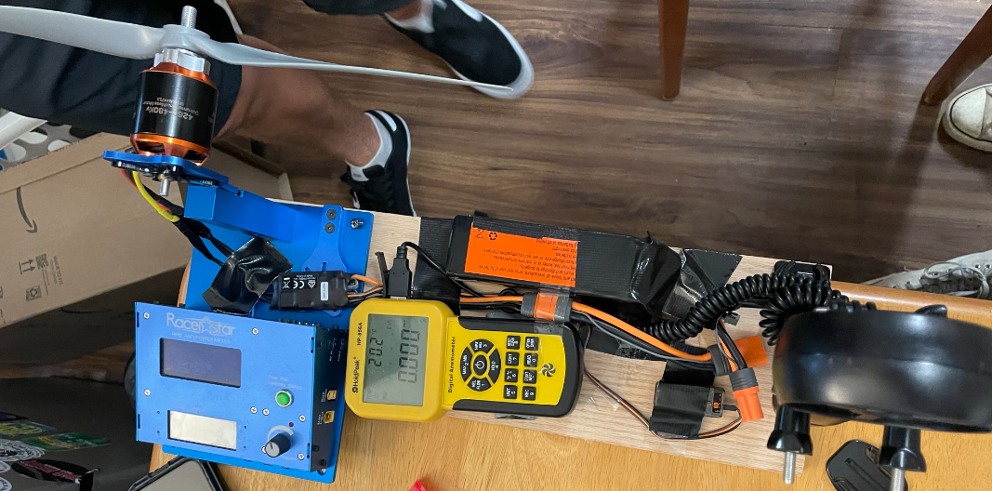
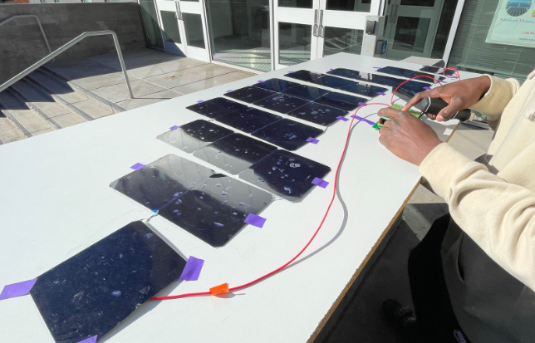
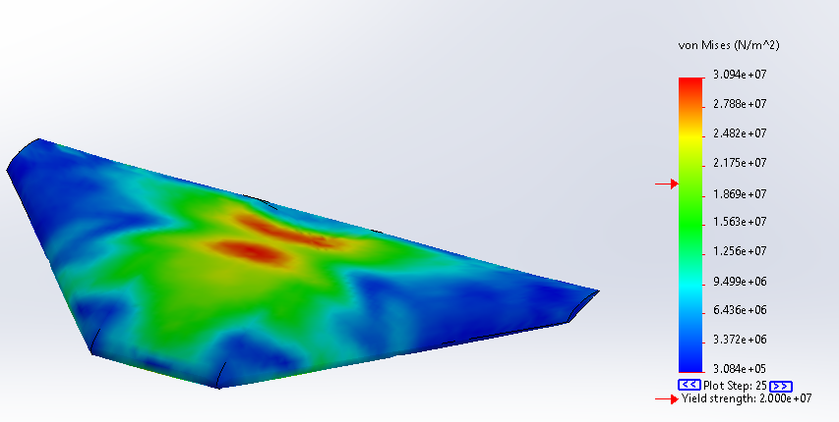
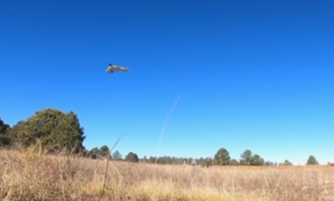
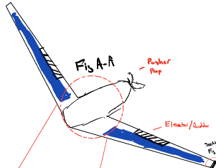
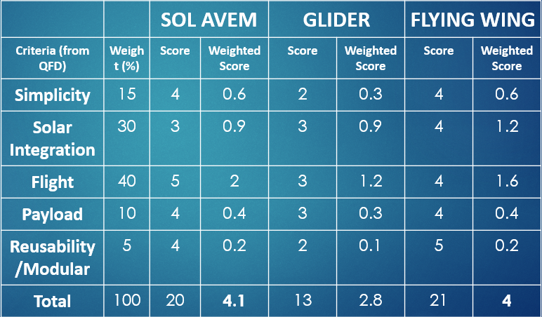
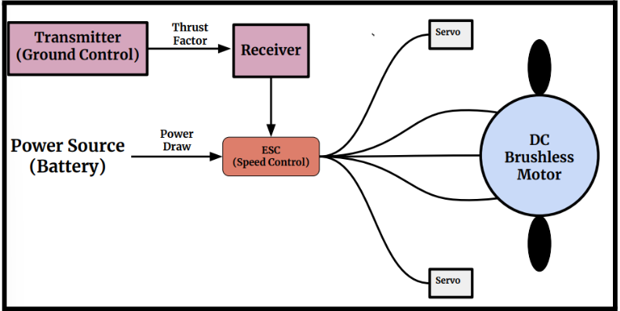
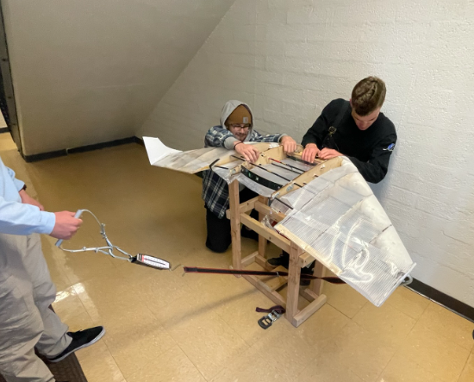
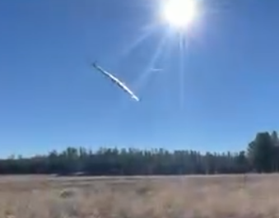
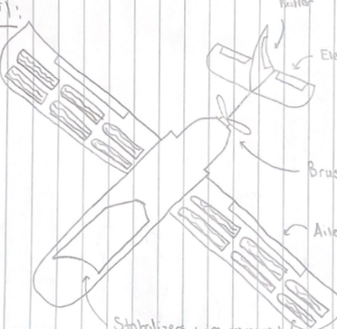
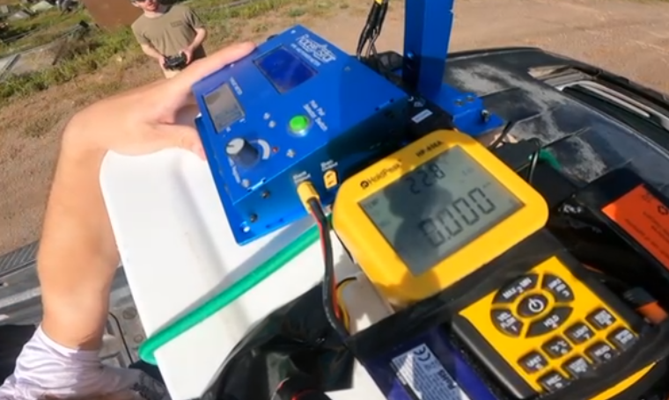
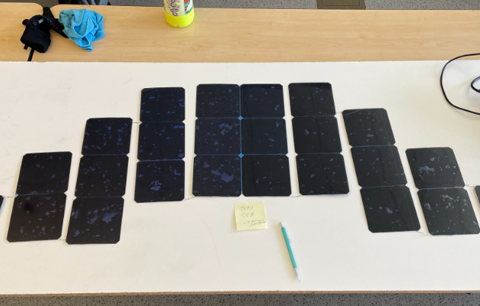
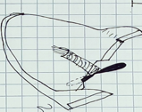
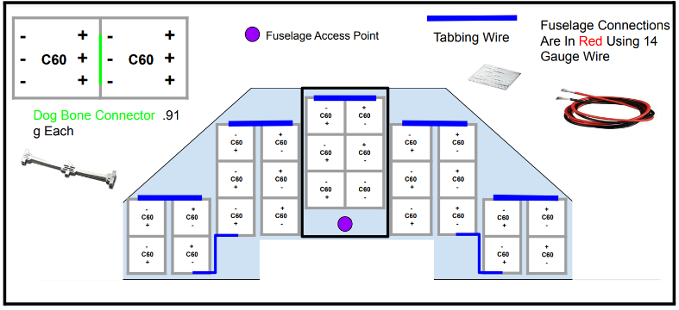


















Solar Powered Unmanned Aerial Vehicle (UAV)
Mitchell Anderson, Joel Freedman, Gage King & Radley Rel
College of Engineering, Informatics and Applied Sciences, Northern Arizona University, Flagstaff, AZ 86011
ABSTRACT
DESIGN ITERATIONS
AIRCRAFT SUBSYSTEMS
FINAL SPECIFICATIONS
Renewable energy is currently surpassing gas and oil in efficiency and ROI [3]. Therefore, renewable technologies such as wind power and photovoltaic cells (solar power) are being applied to every industry. Team Sol Avem is a multidisciplinary capstone team comprised of four Mechanical Engineers and two Electrical Engineers studying out of Northern Arizona University. The goal of this capstone project was to design and manufacture an aircraft that would utilize the sun’s energy to prolong its original flight duration. We approached this problem by completing extensive research in the field of aerospace and renewable technology to aid in the design of our delta shaped, solar powered flying wing. We constructed multiple iterations, learning from each failure and applying it to the next. We conclude that a single wing aircraft with an area of 6.8 ft² , weight of 6.1 lb. and 24 C60 solar cells integrated, can achieve one and a half times the flight only using batteries. We believe these findings could be introduced into the aerospace industry for future research. The principles can be used to survey large bodies of land with limited input or possibly be integrated with current aerospace projects. The possibilities are endless.
Iteration 1: Low Fidelity Prototype
GLIDE TEST PROTOTYPE ADJUST CENTER OF GRAVITY
CONNECT ELECTRICAL COMPONENTS
CRASH AND BURN
MAKE ADJUSTMENTS TO DESIGN
BUILD PROTOTYPE BASED OFF 2D DESIGN
A remote-controlled aircraft is primarily comprised of the following subsystems: Airfoil, Wing Design, Control and Electronic Systems. When these systems are correctly sized and assembled flight is inevitable. The moto for each subsystem is K.I.S.S (Keep It Simple Stupid).
Aircraft:
Weight: 5.7 lbs. (2600g)
Thrust to Weight Ratio: 0.81
Wingspan: 5 ft
Chord Length (Max): 19.5”
Chord Length (Min): 8”
Surface Area: 6.8 ${ft}^{2}$
Max Speed: 50 mph
Max Duration without solar: 6 minutes
Proof of concept
Not to scale
Incorrect components
Airfoil: Clark Y
Wing: Delta
Iteration 2: Foam Build (7.5lb.)
Deep Camber for low speeds
Large Coefficient of Lift: 1.2
Repairable
Rigid Airfoil
Weak Chassis
Iteration 4: Carbon Fiber Frame (5.07 lb.)
Flight Control: Ailerons
Fewer Subsystems
Large Surface Area: 6.8 ${ft}^{2}$
Iteration 3: Transparent Wrap (9.7lb.)
Light Weight
Repairable
Durable
Large Surface Area
Electronic Systems
Precise manufacturing
Rigid Wrap
Heavy Frame
Photovoltaic System:
24 solar panels (series)
Total Array Voltage (VOC): 13.7 V
Total Array Amperage (ISC): 5 AMPS
Max Power Output: 50 Watts
MPPT Charge Controller Voltage Output: 23 Volts
MPPT Charge Controller Amperage: 3.3 AMPS
Flight Duration with solar panels: 9 minutes 27 seconds
PROJECT CONSTRAINTS
FABRICATION
Fewer Control Systems (K.I.S.S)
Less Channels
Team Goal:
Motor: Avian4260-480Kv Outrunner Brushless
Servo (x2): HS-430BH Standard Analog HV Deluxe Servo
The goal of this project is to design and manufacture a Solar Powered Unmanned Aerial Vehicle (UAV) that can fly 1.5X its battery powered duration
Foam Build
ESC: Avian 45 Amp Brushless Smart ESC, 3S-6S
Battery: 22.2V 3200mAh 6S 50C Smart G2 LiPo Battery: IC5
Customer Requirements
Requirement Relationships
Receiver: AR410 Receiver
PROJECT CONCLUSIONS
Transparent Wrap
TESTING
After spending half a year working to research/design aircrafts and photovoltaic arrays. Then the other half of the year working to build the final product. The team is confident that our design is successful at completing the customer requirements of flying one and half times with solar integration. All requirements established by the testing procedure have been satisfied and additional testing has led the team to conclude that the designed solar aircraft has the ability of indefinite flight if scaled correctly. Possible future work on the aircraft includes further optimizing the solar efficiency to increase maximum power output and reducing the overall weight of the aircraft. Our team believes this is only the beginning for renewable energy integration with established sectors, such as aerospace. We are excited for the future and the technology it holds.
Engineering Requirements
The four tests that we focused on were dynamic/thrust, solar panel efficiency, flight duration, and wing load testing. The group focused on testing these components as they are the most important for a successful flight
Experiment/Test | Relevant ERs
Ex1 – Dynamic and Static Thrust | ER3, ER4,
Ex2 - Solar Efficiency | ER2,ER9,ER5, CR1, CR2
Ex3 - Wing Loading | ER2, ER3, ER7
Ex4 - Operating Range/Duration | ER5, ER8
DESIGN PROCESS
Carbon Fiber Frame
Experiment 4: Flight Range and Duration
Goal: Consistent flight and efficient time duration
Experiment 1: Dynamic and Static Thrust
Goal: Discover the weight threshold to stay under
Experiment 2: Solar Integration
Goal: Discover how much power can be harvested from the sun
Experiment 3: Wing Load Test
Goal: Build aircraft to handle maximum inflight loads
BENCHMARKING
Total Manufacturing Time for all iterations and solar: 450 manhours
REFERENCES
SOLAR POWER
1] “Flite test: RC Planes, Quadcopters, Videos, articles & more,” Flite Test | RC Planes, Quadcopters, Videos, Articles & More, 2022. [Online]. Available: https://www.flitetest.com/. [Accessed: 04-Mar-2022].
[2] Recreational Flyers & Modeler Community-based organizations, 05-Jan-2022. [Online]. Available: https://www.faa.gov/uas/recreational_fliers/. [Accessed: 08-Apr-2022].
[3] Klesh, A. T., & Kabamba, P. T. (2009). Solar-powered aircraft: Energy-optimal path planning and perpetual endurance. Journal of Guidance, Control, and Dynamics, 32(4), 1320–1329.
[4] An investigation of goertler vortices on slotted, natural-laminar-flow airfoils. (2021). https://doi.org/10.2514/6.2021-2588.vid
[5] Solis fur. [Online]. Available: https://www.ceias.nau.edu/capstone/projects/ME/2018/18F22_SolarPlane/. [Accessed: 04-Mar-2022].
[6] “ECFR :: 14 CFR Part 107 -- small unmanned aircraft systems.” [Online]. Available: https://www.ecfr.gov/current/title-14/chapter-I/subchapter-F/part-107. [Accessed: 09-Apr-2022].
CONCEPT GENERATION
Solar harvesting provided to the 22.2V 6S 3200 mAh battery to trickle charge it during flight
There are 24 C60 monocrystalline solar cells integrated onto the top of the wings and fuselage of the plane
VOC = 13.7V : ISC = 5 AMPS
MPPT Charge controller used to boost up the nominal voltage of the panels from 13V to 24V in order to recharge the battery
Special soldering techniques were used to limit resistance
These cells add up in voltage in order to produce 75 Watts of power
CHECK OUT OUR WEBSITE!
_{Results}
ACKNOWLEDGEMENTS
Weight Estimation
Rough Area to Calculate Lift and Weight
CAD to get higher fidelity area
Send exact area and weight back
Use exact area and rerun calculations to determine lift and weight
Use exact weight to determine component purchase
Main Program Loop:
Lift Force: $L=C_{L}{∗q}_{∞}∗A_{p}$
$$W_{TO}=\sum{W_{ME}+W_{EE}}$$
DESIGN ANALYSIS
Lift-To-Drag Ratio:
$$L/D$$
Main Program Loop:
Drag Force: $D=C_{D}∗q_{∞}∗A_{x}$
Wing Loading
$\frac{W}{A_{p}}=$ $q_{stall}$ ${∗C}_{L,max}$
Velocity
Thrust-To-Weight
$$V_{TO}=1.2\sqrt{\frac{2\left(W_{TO}/A_{p}\right)}{ρC_{L_{max}}}}$$
$$T=\frac{π}{4}D^{2}ρV∆V$$
Weight < 2800g (6.17 lb.) for Thrust to Weight > 0.7
MPPT at 12 Volts @ Ideal Conditions
Each winged trussed structure can withstand 32 LBS of load

