Slide 1


Solar UAV:
Presentation 2
Team #6: Mitch Anderson, Joel Freedman, gage king, and Radley rel

Slide 2







Our Team
Mitchell Anderson: Project Manager and Airfoil/Aircraft Design
Joel Freedman: Logistics Manager/Test Engineer and Wing Selection/Flight Control Design
Gage King: CAD Engineer/Manufacturing and Engine/On-Board Component Selection Design
Radley Rel: Financial Manager and On-Board System/Solar Design
Gabriel Martin : Electrical Engineering Lead
Sultan Alhazawbar: Electrical Engineering Team
Kelly Gallagher: Team Sponsor
Team

Slide 3
Table of Content
Project Description
Black Box Model
Decomposition Chart
Concept Generation
Concept Evaluation
Budget and Materials
Questions
Schedule & Design Phase
Joel

Slide 4

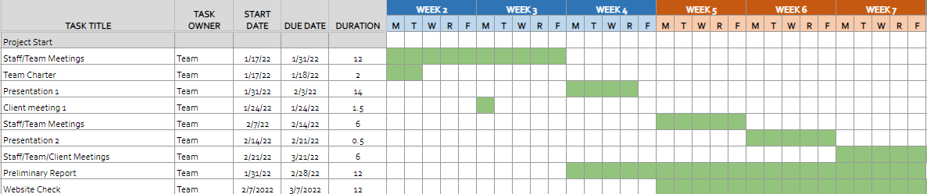



Schedule
& Phase
Figure 1: Gantt Chart
First Semester Requirements:
Aircraft Research & Benchmarking
Aircraft Design &Testing
Final Prototype Design
Second Semester:
Final Iteration of Aircraft Design
Solar Output Integration
Solar Flight by Week 30
Radley

Slide 5

Project Description
Team Goal: The goal of this project is to design and manufacture a Solar Powered Unmanned Aerial Vehicle (UAV).
Team Purpose: Our team's focus is creating an aircraft that can fly off solar power and battery system with a designated payload.
Importance: Offers a huge opportunity to not only design an aircraft and fly it successfully, but to power it with renewable solar energy.
Client: David Willy
Joel

Slide 6

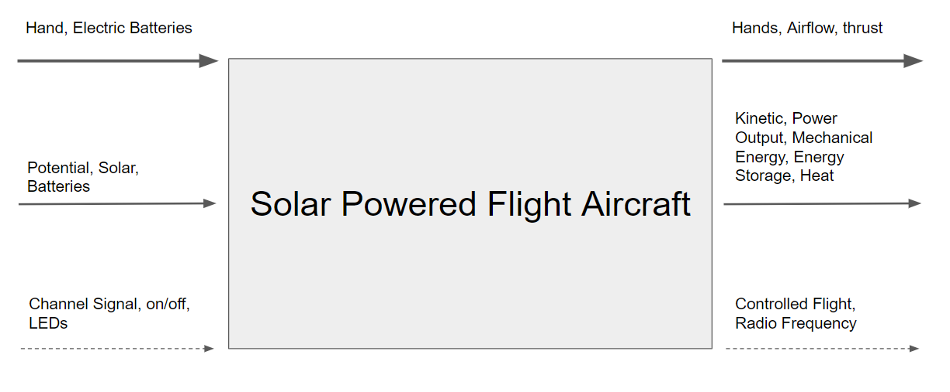



Figure 2: Black Box Model​​
Gage

Slide 7
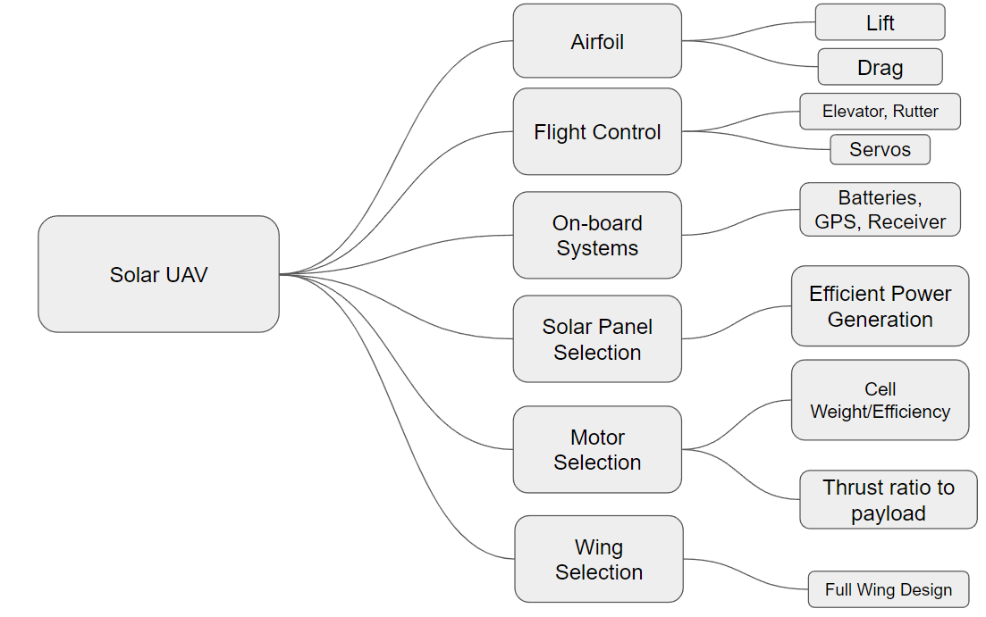
Figure 3: Decomposition Figure​
Gage

Slide 8
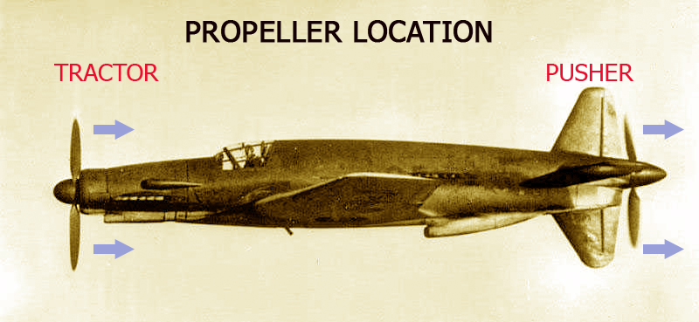
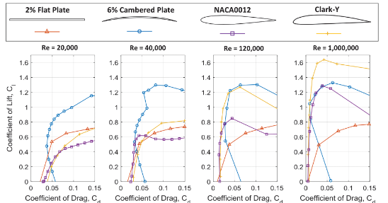
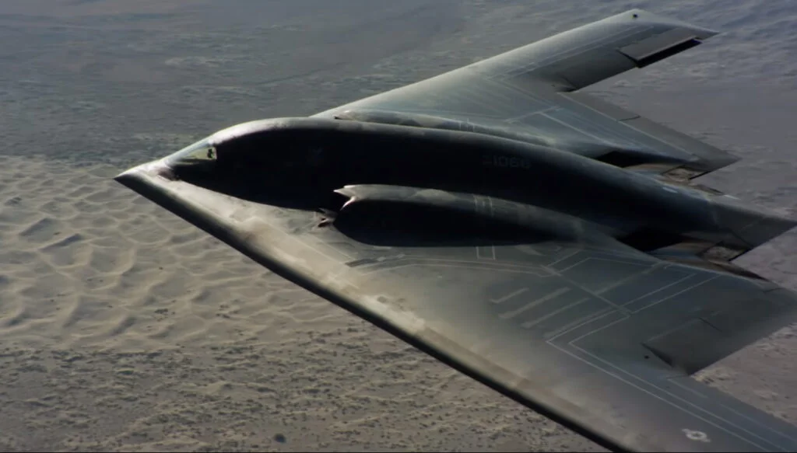
Concept Generation
Figure 5: Motor Selection​​
Figure 4: Airfoil Selection​​
Figure 6: Wing Selection​​
Mitch and Joel

Slide 9
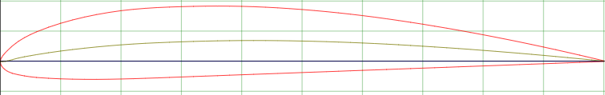
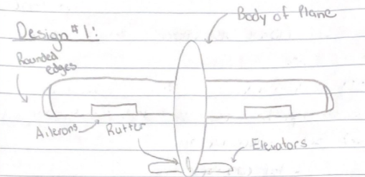
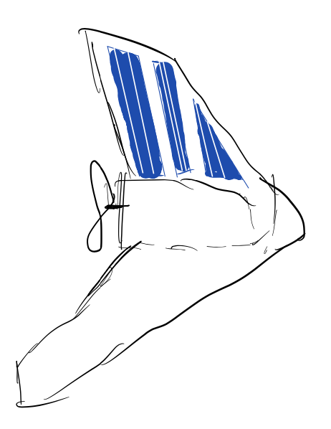
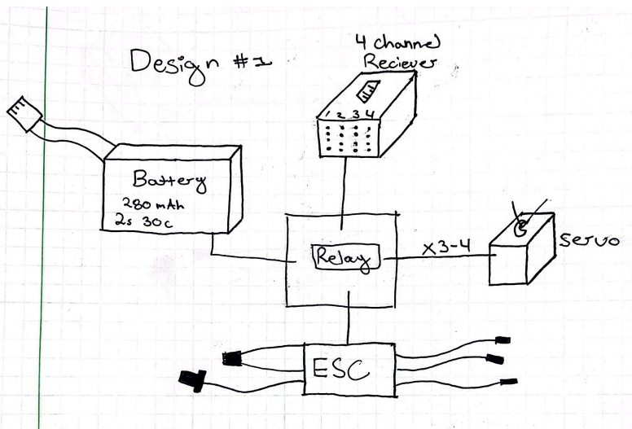
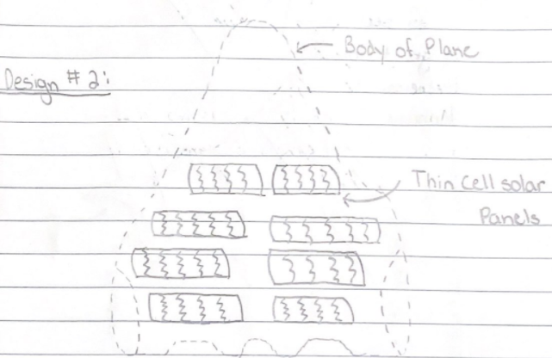
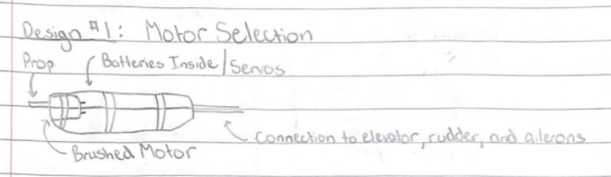
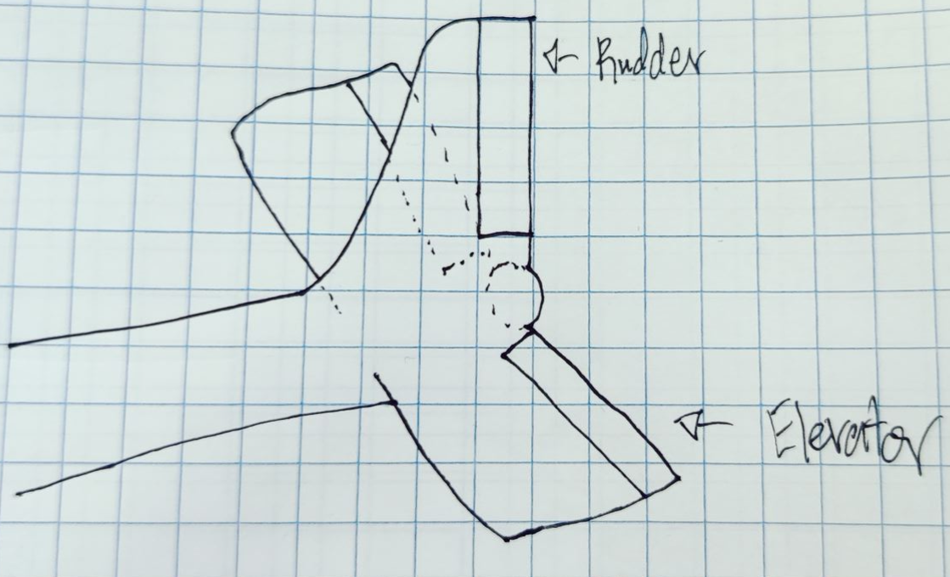
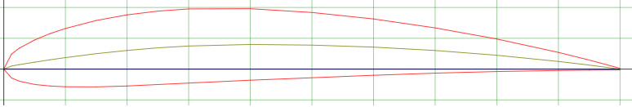
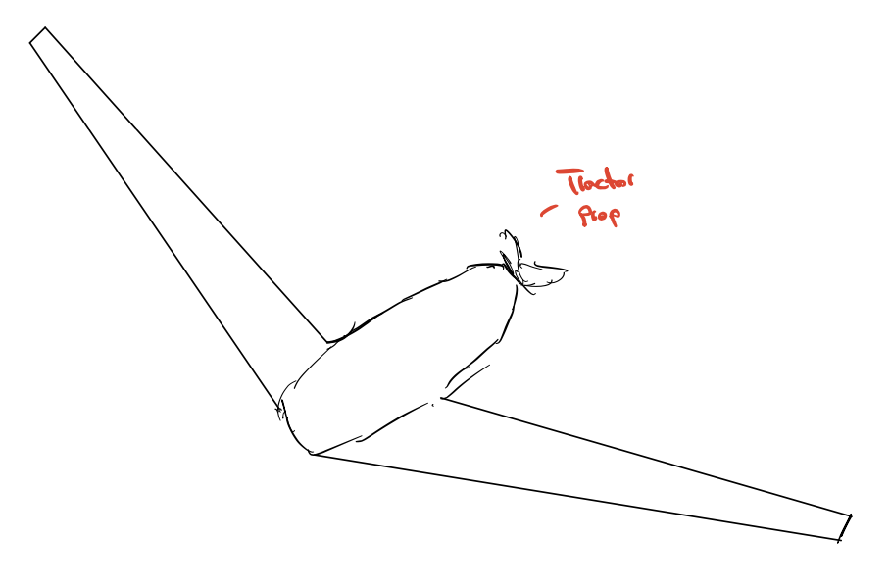
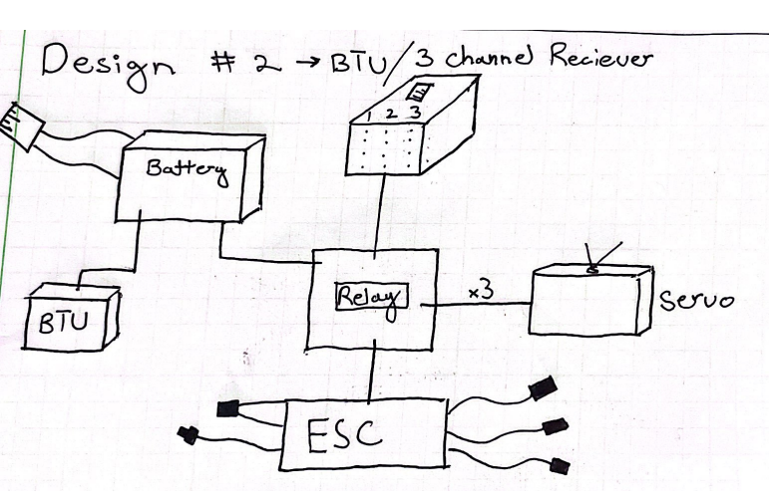
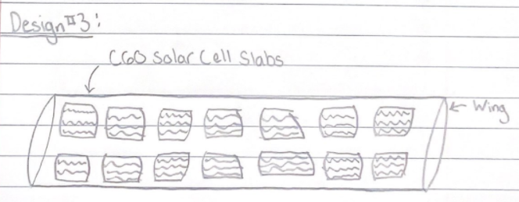
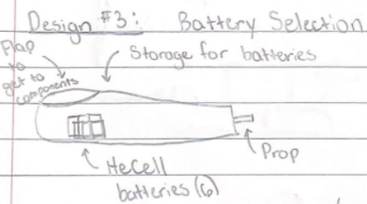
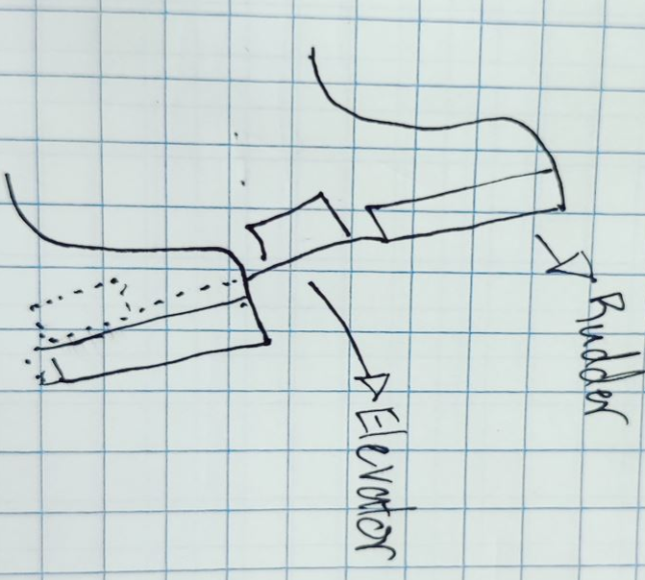
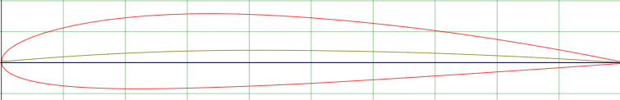
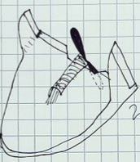
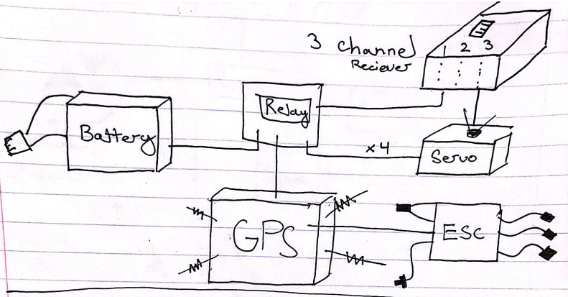
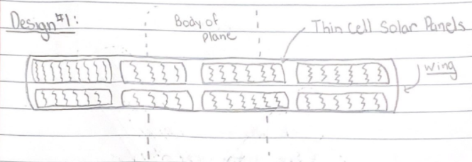
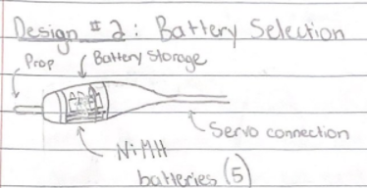
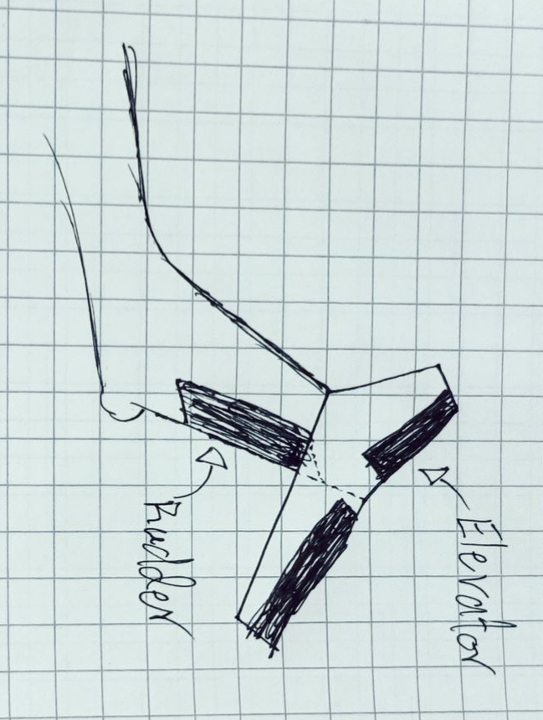
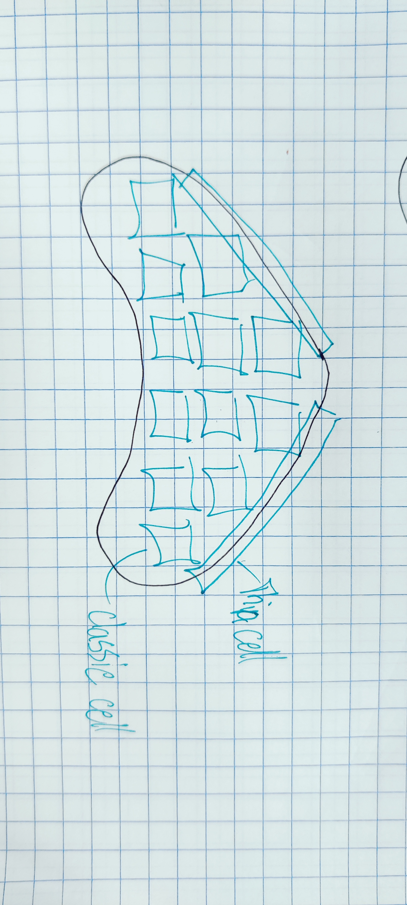
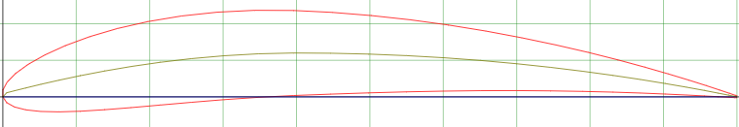
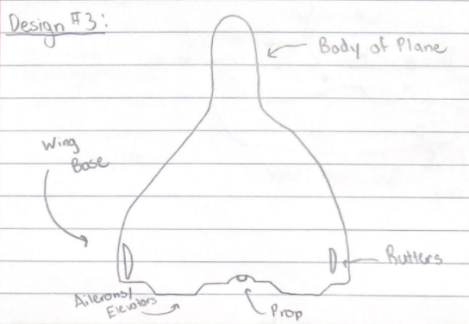
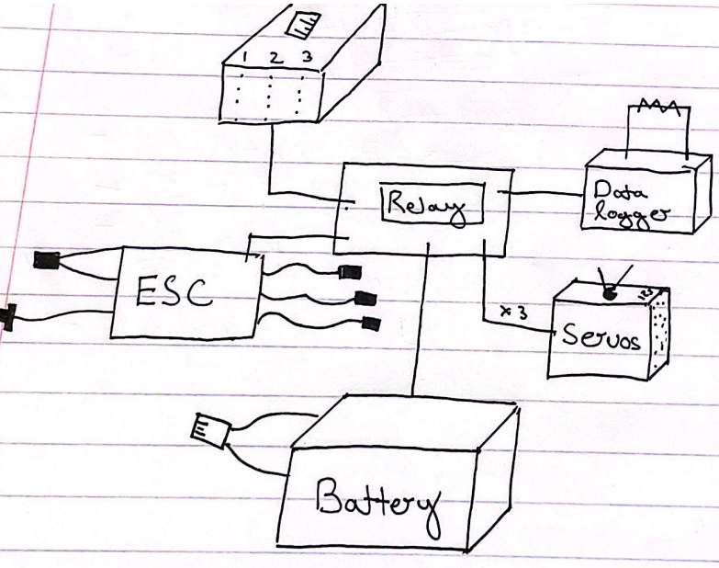
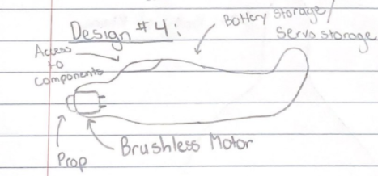
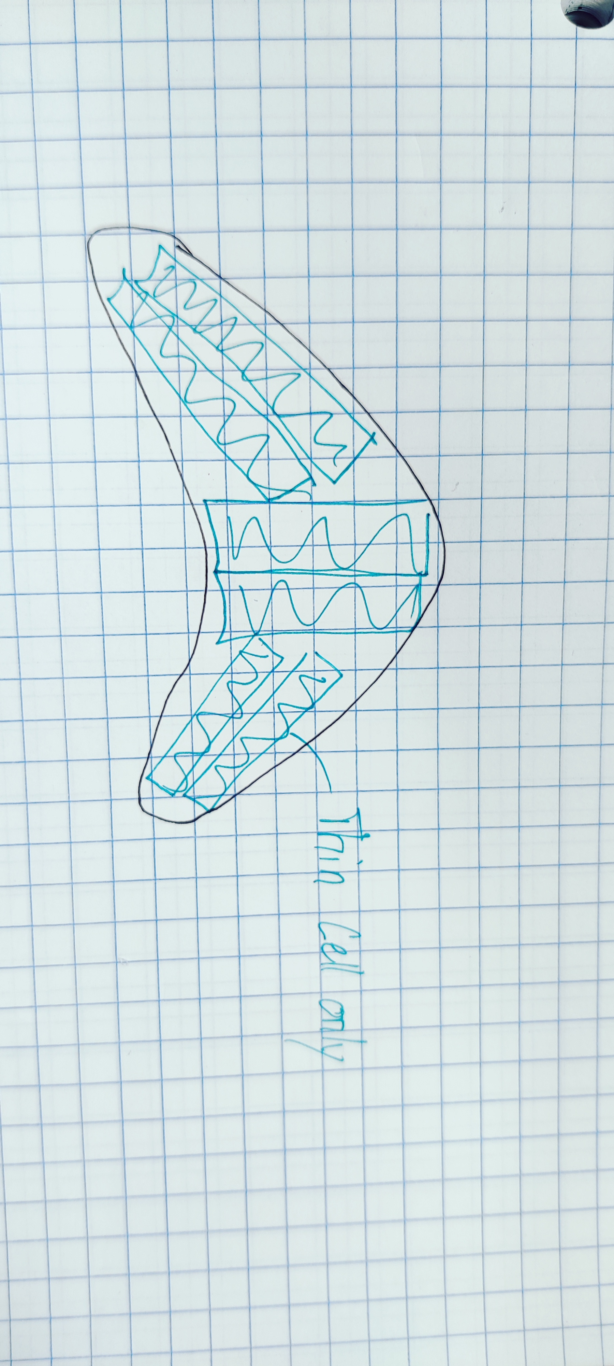
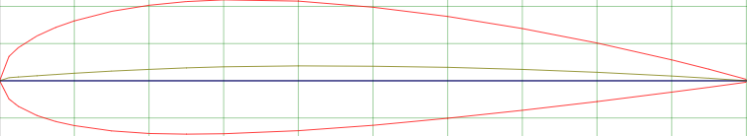
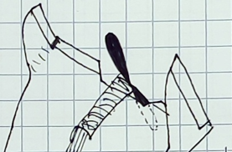
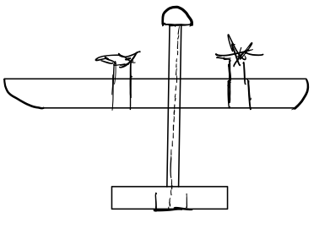
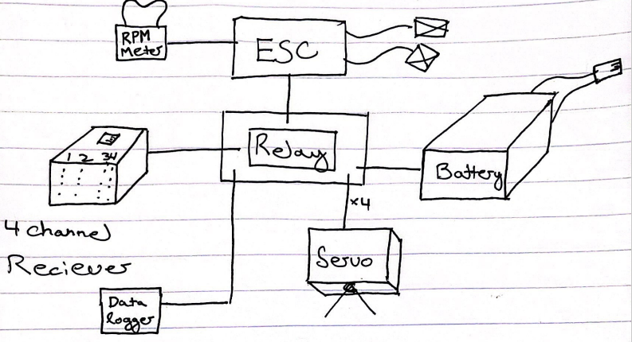
Morphological Matrix
Airfoil | Flight Control | Wing Selection | On-board Systems | Solar Selection | Motor Selection
NACA CLARK Y | Ailerons/Rutter/Elevator | Flying Wing Glider | 4 Channel Simple | Thin Cell | Brushed Motor in Fuselage
NACA 4412 | Tri-Tip Tail with Rudder and Elevator | High Aspect Ratio Glider | BTU/3 Channel | C60 Cells | Modular Battery
NACA 2414 | Dual Tail Rudder/Elevator | Flying Wing | 3 Channel/GPS | Thin Cell Parallel | Brushless Motor
NACA 6412 | Rudder/Elevator | Jet Design | Data Logger | Thin/Classic Cell | Tractor Design
NACA 2418 | No Tail Elevator/Rudder | Traditional Design | 4 Channel/ RPM Sensor | Amorphous Thin Cell | Pusher Design
Team

Slide 10
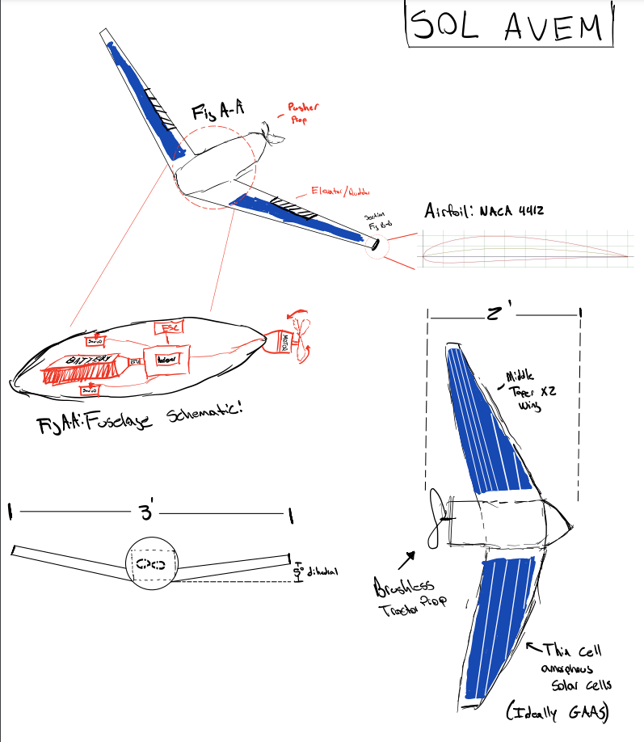
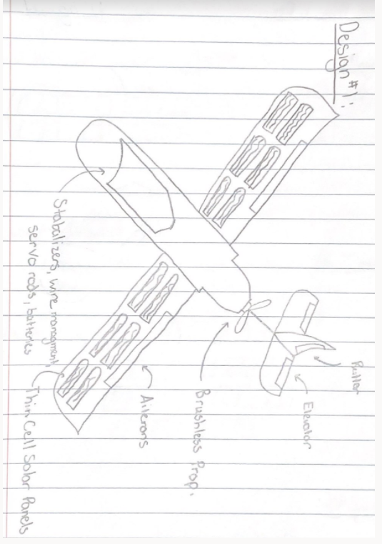
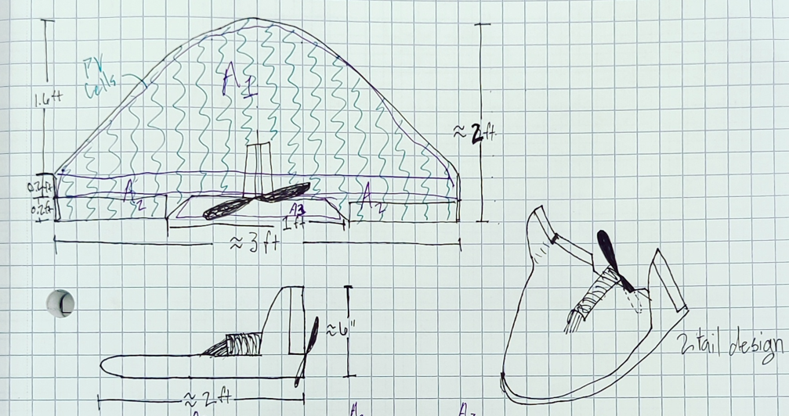
Design Alternatives
SOL AVEM
GLIDER
FLYING WING
Joel

Slide 11
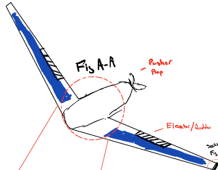
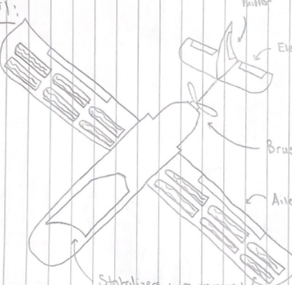

Concept Selection: Decision Matrix
 |  | SOL AVEM |  | GLIDER |  | FLYING WING
Criteria (from QFD) | Weight (%) | Score | Weighted Score | Score | Weighted Score | Score | Weighted Score
Simplicity | 15 | 4 | 0.6 | 2 | 0.3 | 4 | 0.6
Solar Integration | 30 | 3 | 0.9 | 3 | 0.9 | 4 | 1.2
Flight | 40 | 5 | 2 | 3 | 1.2 | 4 | 1.6
Payload | 10 | 4 | 0.4 | 3 | 0.3 | 4 | 0.4
Reusability/Modular | 5 | 4 | 0.2 | 2 | 0.1 | 5 | 0.2
Total | 100 | 20 | 4.1 | 13 | 2.8 | 21 | 4
Mitch

Slide 12
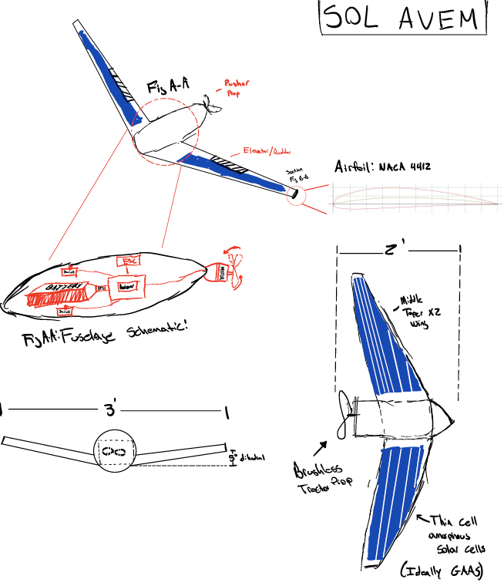
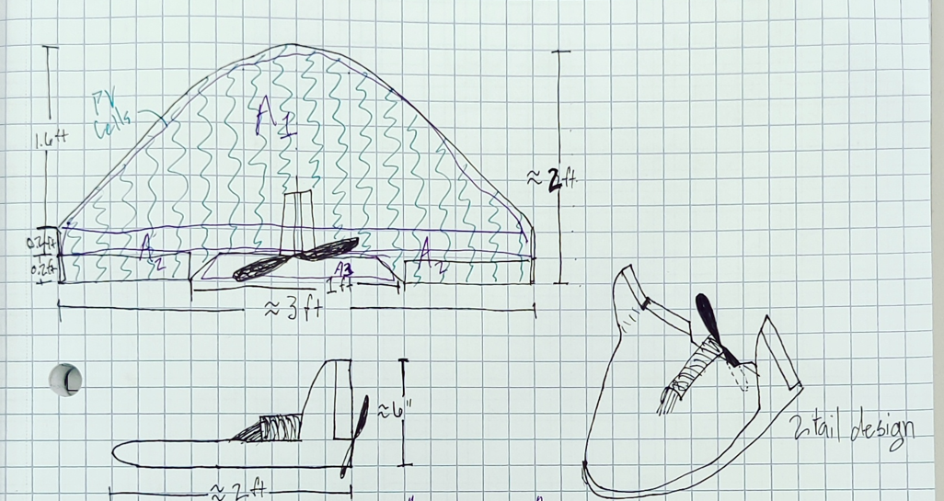
Final Design
Figure 4: Airfoil Selection​​
Figure 8: Flying Wing Final Design
Figure 7: SOL AVEM Final Design​​
Mitch

Slide 13
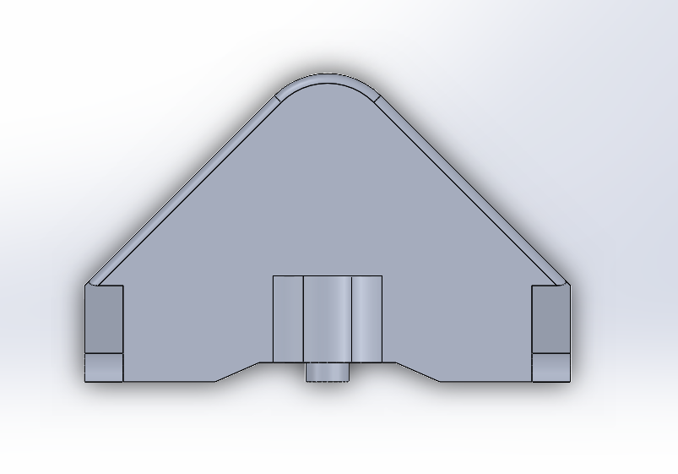
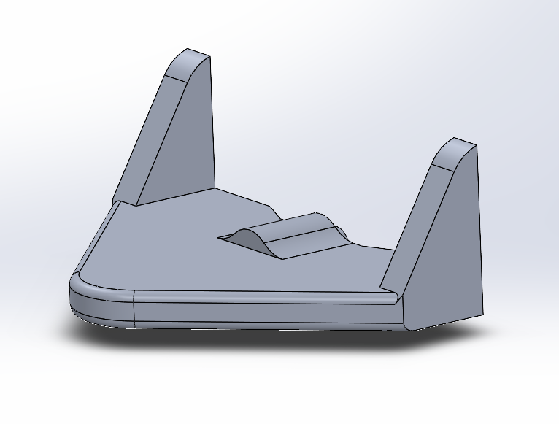
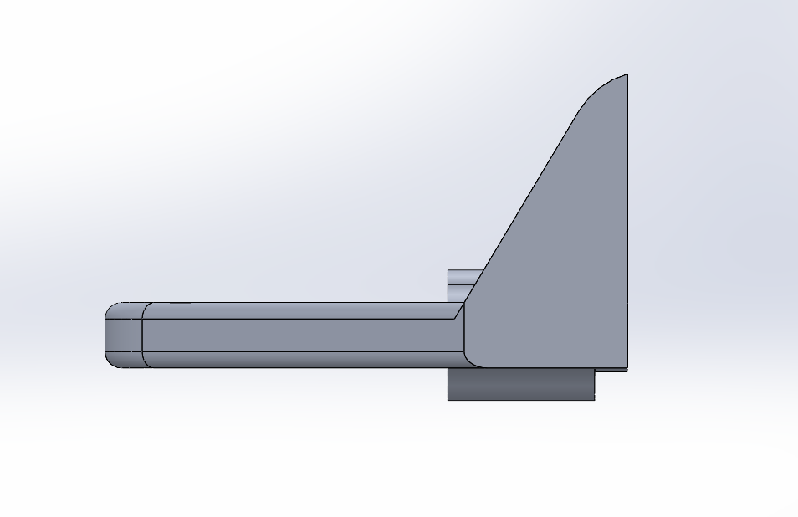
Aircraft Body CAD Drawing
Figure 9: Flying Wing CAD Design
Gage

Slide 14
Budget and Materials
 | Bill of Materials
Part # | Description | Quantity |  | Mass (g) |  | Part Price ($) | Source
1 | Motor | 1 |  | 189.1 |  | 25.99 | Amazon
2 | Prop | 1 |  | 22.96 |  | 9.49 | Amazon
3 | Servo | 2 |  | 13.4 |  | 21.98 | Amazon
4 | Radio Reciever | 1 |  | 27.22 |  | 49.99 | Amazon
5 | Battery | 1 |  | 57 |  | 9.99 | Amazon
6 | Solar Cells | 4 |  | 20 |  | 14.72 | Amazon
7 | Speed Controller | 1 |  | 14.8 |  | 8.99 | Amazon
8 | Airfoil | 2 |  | 22.1 |  | 35.98 | Amazon
9 | Chasis (Fuselage) | 1 |  | 20 |  | 5 | 3D printer
10 | Chassis (Wings) | 1 |  | 20 |  | 5 | 3D printer
11 | Wiring harness | 1 |  | 30 |  | 40 | various
12 | Hardware | 1 |  | 15 |  | 20 | various
 |  | FINAL MASS= | 547.08 | g | Total Price= | 247.13
 |  |  | 1.205 | lbs
Radley

Slide 15

Questions?

Slide 16
Resources
https://www.boldmethod.com/learn-to-fly/aircraft-systems/how-does-aspect-ratio-affect-a-wing/
https://www.solarreviews.com/blog/pros-and-cons-of-monocrystalline-vs-polycrystalline-solar-panels
https://www.internationaljournalssrg.org/IJME/2015/Volume2-Issue6/IJME-V2I6P104.pdf
https://arc.aiaa.org/doi/pdf/10.2514/1.C034415
http://physicscamp.weebly.com/uploads/1/4/4/2/14428600/glider_design.pdf
https://www.sciencedirect.com/topics/earth-and-planetary-sciences/gallium-arsenides#:~:text=Gallium%20arsenide%2Dbased%20multijunction%20solar,as%20satellites%20and%20space%20investigation.
https://www.newcastle.edu.au/newsroom/featured/public-debut-for-printed-solar
https://www.youtube.com/watch?v=xhNWSxHbFjw
https://www.youtube.com/watch?v=kI7qaYa9j3Q
https://www.rc-airplane-world.com/propeller-size.html

