Slide 1

Boeing Autonomous Drone Capstone Northern Arizona University (NAU) 2022-2023

Slide 2
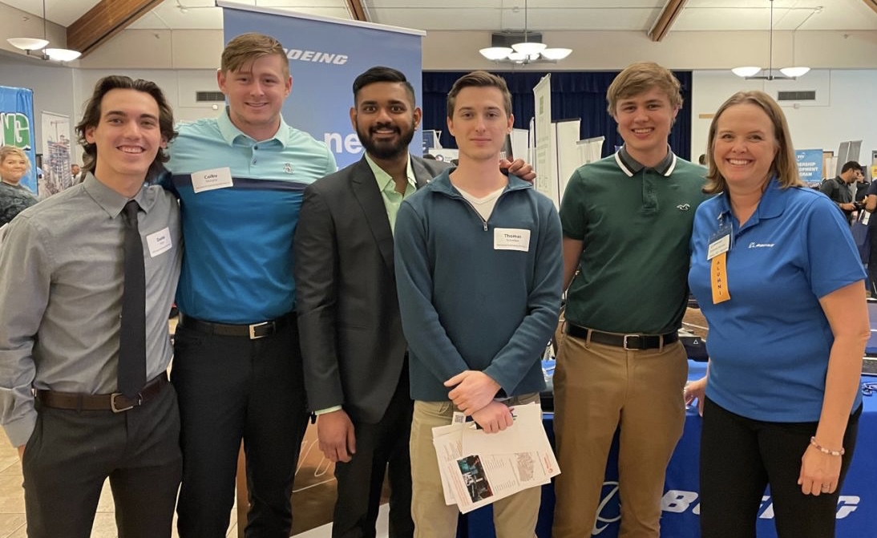
Introductions
Students
Dante Faria – Project Manager
Colby Murphy – Finance and Logistic Manager
Tommy Schreiber – CAD Engineer
Damien Brothers – Manufacturing Engineer
Jay Khunt – Test Engineer
Faculty/Course Advisors
David Willy
Armin Eilaghi

Slide 3
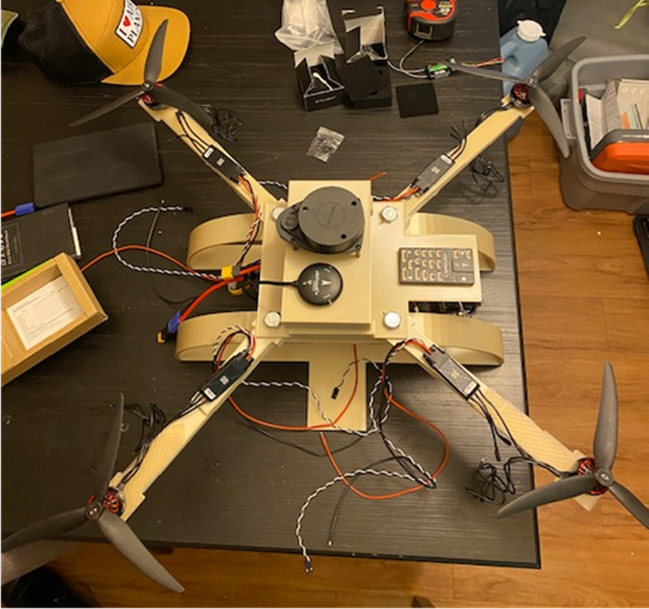
Project Summary
Purpose: Design, analyze, and manufacture a 3D printed drone frame that minimizes weight and maximizes flight time using set commercially available components.​
Sponsor: Boeing
Required Deliverables:​
Material Optimization​
Lightweight Prototype
Central CoM
Software Stress Simulation

Slide 4
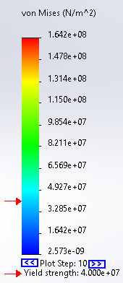
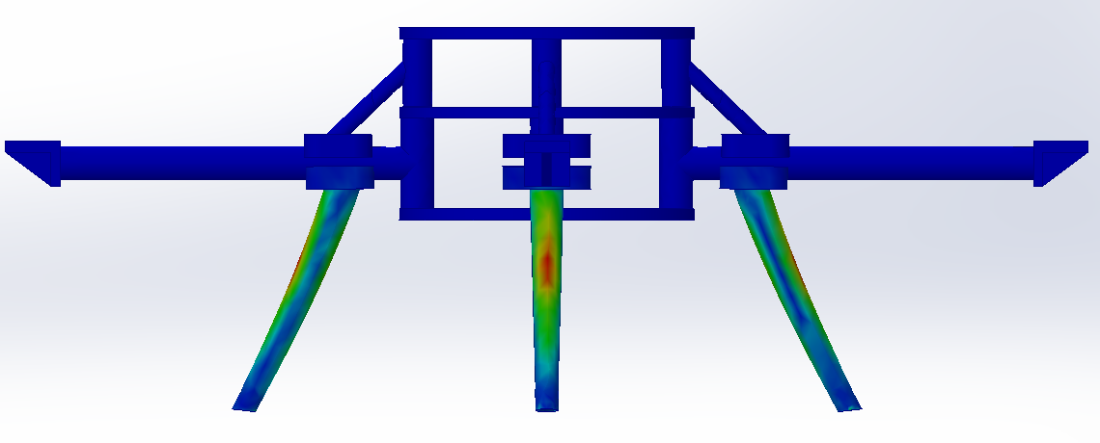
Requirements
Lighter than 3 pounds
Power to weight ratio improved from 1.81
Durable
Increased flight time
ANSYS/SOLIDWORKS stress simulations
Requirements being met through evaluation of prototype

Slide 5
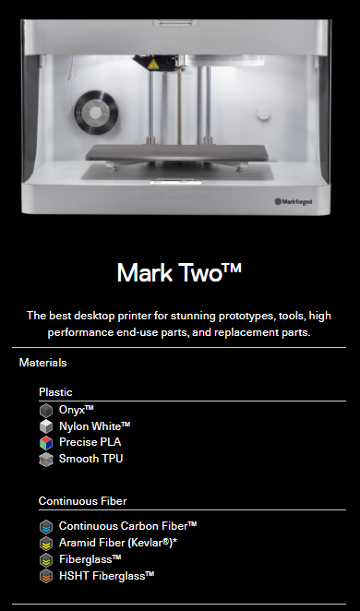
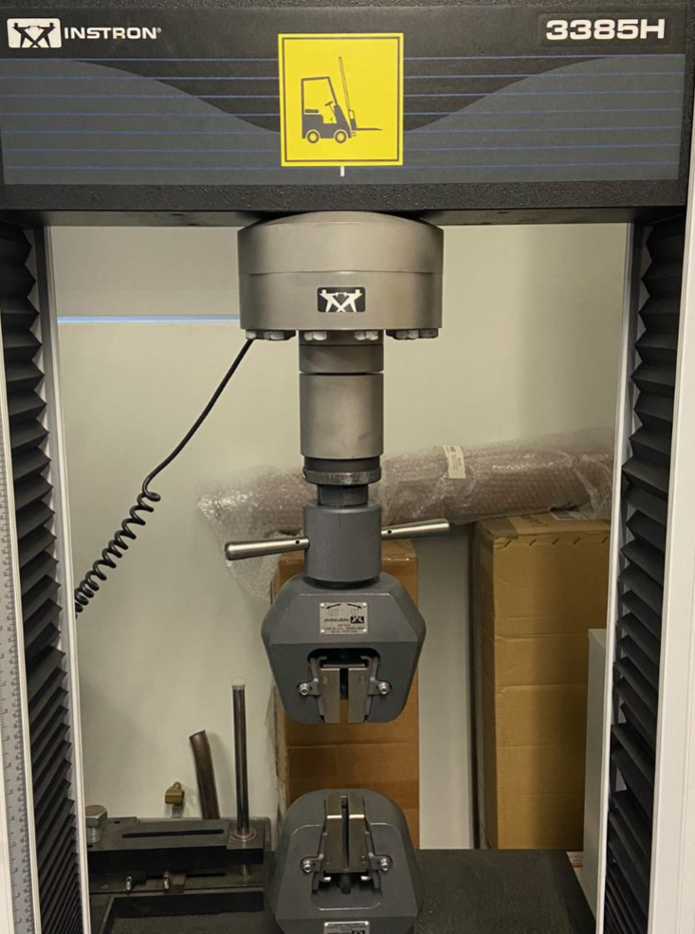
Dog Bone Testing
Markforged Mark Two (12 x 5 x 6in)
Created 20 ASTM D638 Type 1 Dog Bones
Printed Horizontally
50% Infill
Internal Reinforcement
Instron 3385H
Smaller Clamps Installed

Slide 6
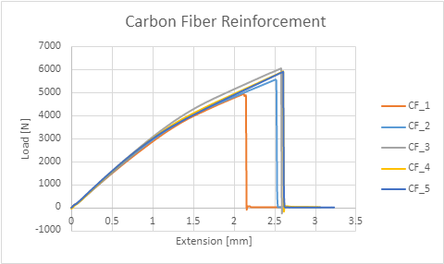
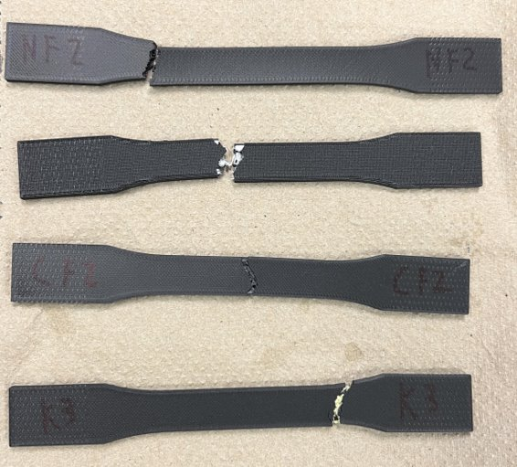
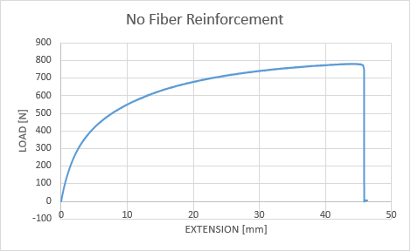
Dog Bone Testing Results
Strength Rankings
Carbon Fiber
HSHT Fiberglass
Kevlar
No Reinforcement
Extension Length Rankings
No Reinforcement
HSHT Fiberglass
Kevlar
Carbon Fiber
No Reinforcement
HSHT Fiberglass
Carbon Fiber
Kevlar

Slide 7
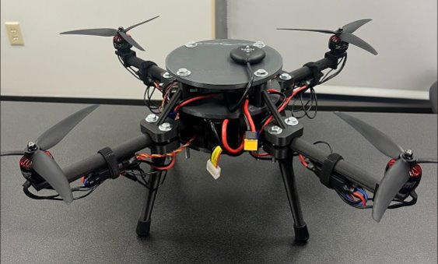
Final Prototype
Current prototype is not final
Next will look similar with different materials
Frame is 2.2 pounds
Current prototype is 6.03 pounds

Slide 8
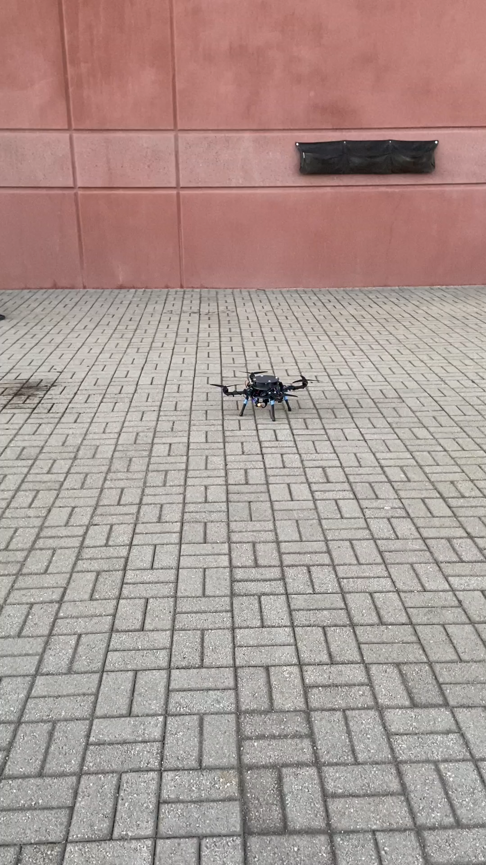
Demonstration 4- Success
Tested drone in controlled environment (inside) for ~10 successful times before taking outside.
Successful flights in outdoor environment for ~5 times with minimum steering before crash.
Needed Positioning of components for more stability and achieve the required Center of Mass
Mode: Stability
Damien, 11

Slide 9
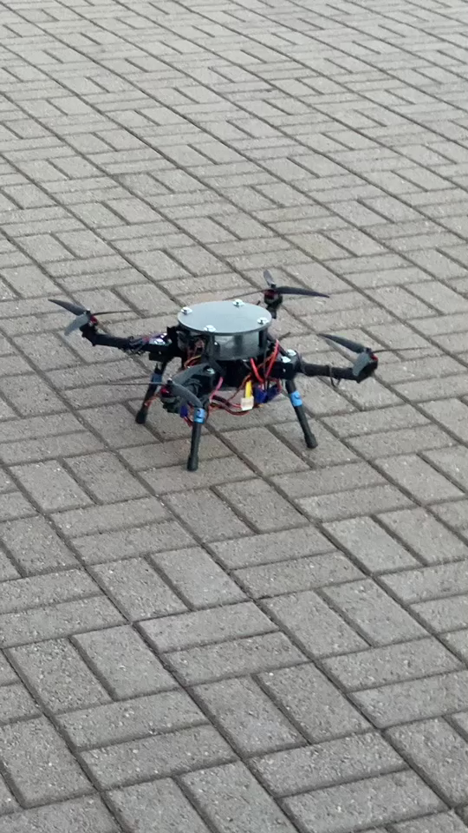
Demonstration 5- Failure
Catastrophic Failure about 20 feet above the Concrete
Broke 2 propellers, 1 arm, 2 legs, and 2 Trusses
Most likely the propeller came loose off the motor and caused it to death wobble
Other Issues include:
Safety mode returning motors to idle
Lack of control when trying to steer
Dante, 12

Slide 10
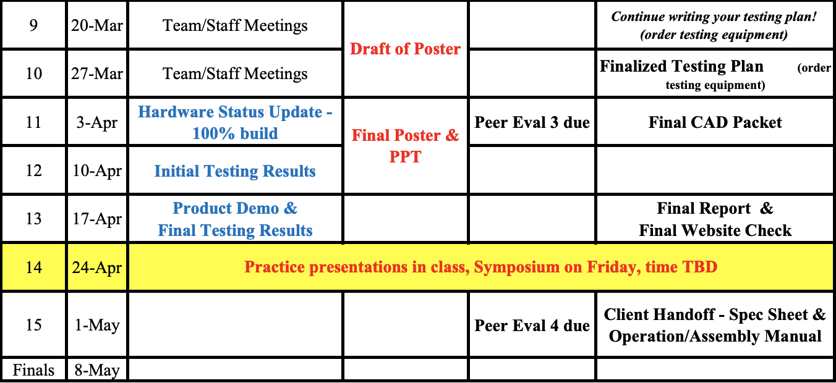
Schedule Update
~75% Complete Build
Next Steps
Print Final Parts
Wire Management
Next Deliverables
U-grads Poster Draft (March 31st)
Final Testing Plan (March 31st)
Upcoming
Final CAD Packet (April 7th)
Final Report (April 21st)
Final U-grads Poster/Presentation (April 21st)
U-Grads Seminar (April 28th)

Slide 11
Q&A

