Slide 1

HELIUM-FILLED BUBBLE SOAP GENERATOR​
P16: Aaron Walcott, Simei Portillo, Musaab Nasralla​

Slide 2
What is Our Project?
The microscale soap bubble team has been tasked with making a nozzle that will output millions of microscale bubbles per second as a tracer particle for flow analysis
The current type of nozzle is a two-layer nozzle with a third layer adapter
Inlet for air, helium, and soap solution

Slide 3
Design Requirements
Bubble output rate 100,000,000 bubbles/second
Bubble concentration of 20,000 bubbles/cm³
Device residence of 30 minutes
Device material of aluminum and brass
Bubble size of 15-150 microns

Slide 4
Current Roadblock and Resolution
Not enough money to finish the third layer adapter
Wire edm (electrical discharge machining) veto from client
Buying the collet to attempt at the machine shop is out of Budget
Now approved as of 2/15/2023
Meeting with Client this week to determine what the next steps are
3D print new version of 3rd layer adapter for testing
Waiting for machine shop (need to talk to Perry

Slide 5
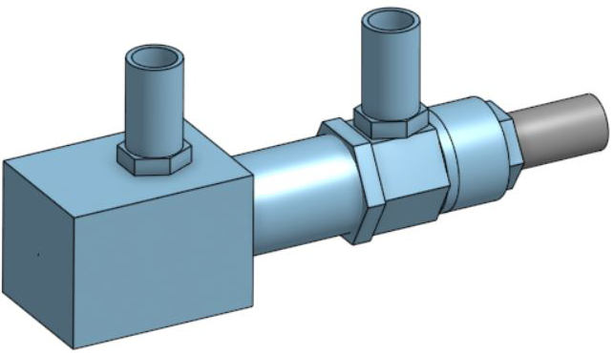

Design Efforts
Three-layer coaxial nozzle
Uses a brass nozzle
Third layer adapter made of aluminum
Micro hole diameter: 0.5mm
Figure 1: Closeup Image of Micro Hole
Figure 2: CAD of Full Nozzle

Slide 6
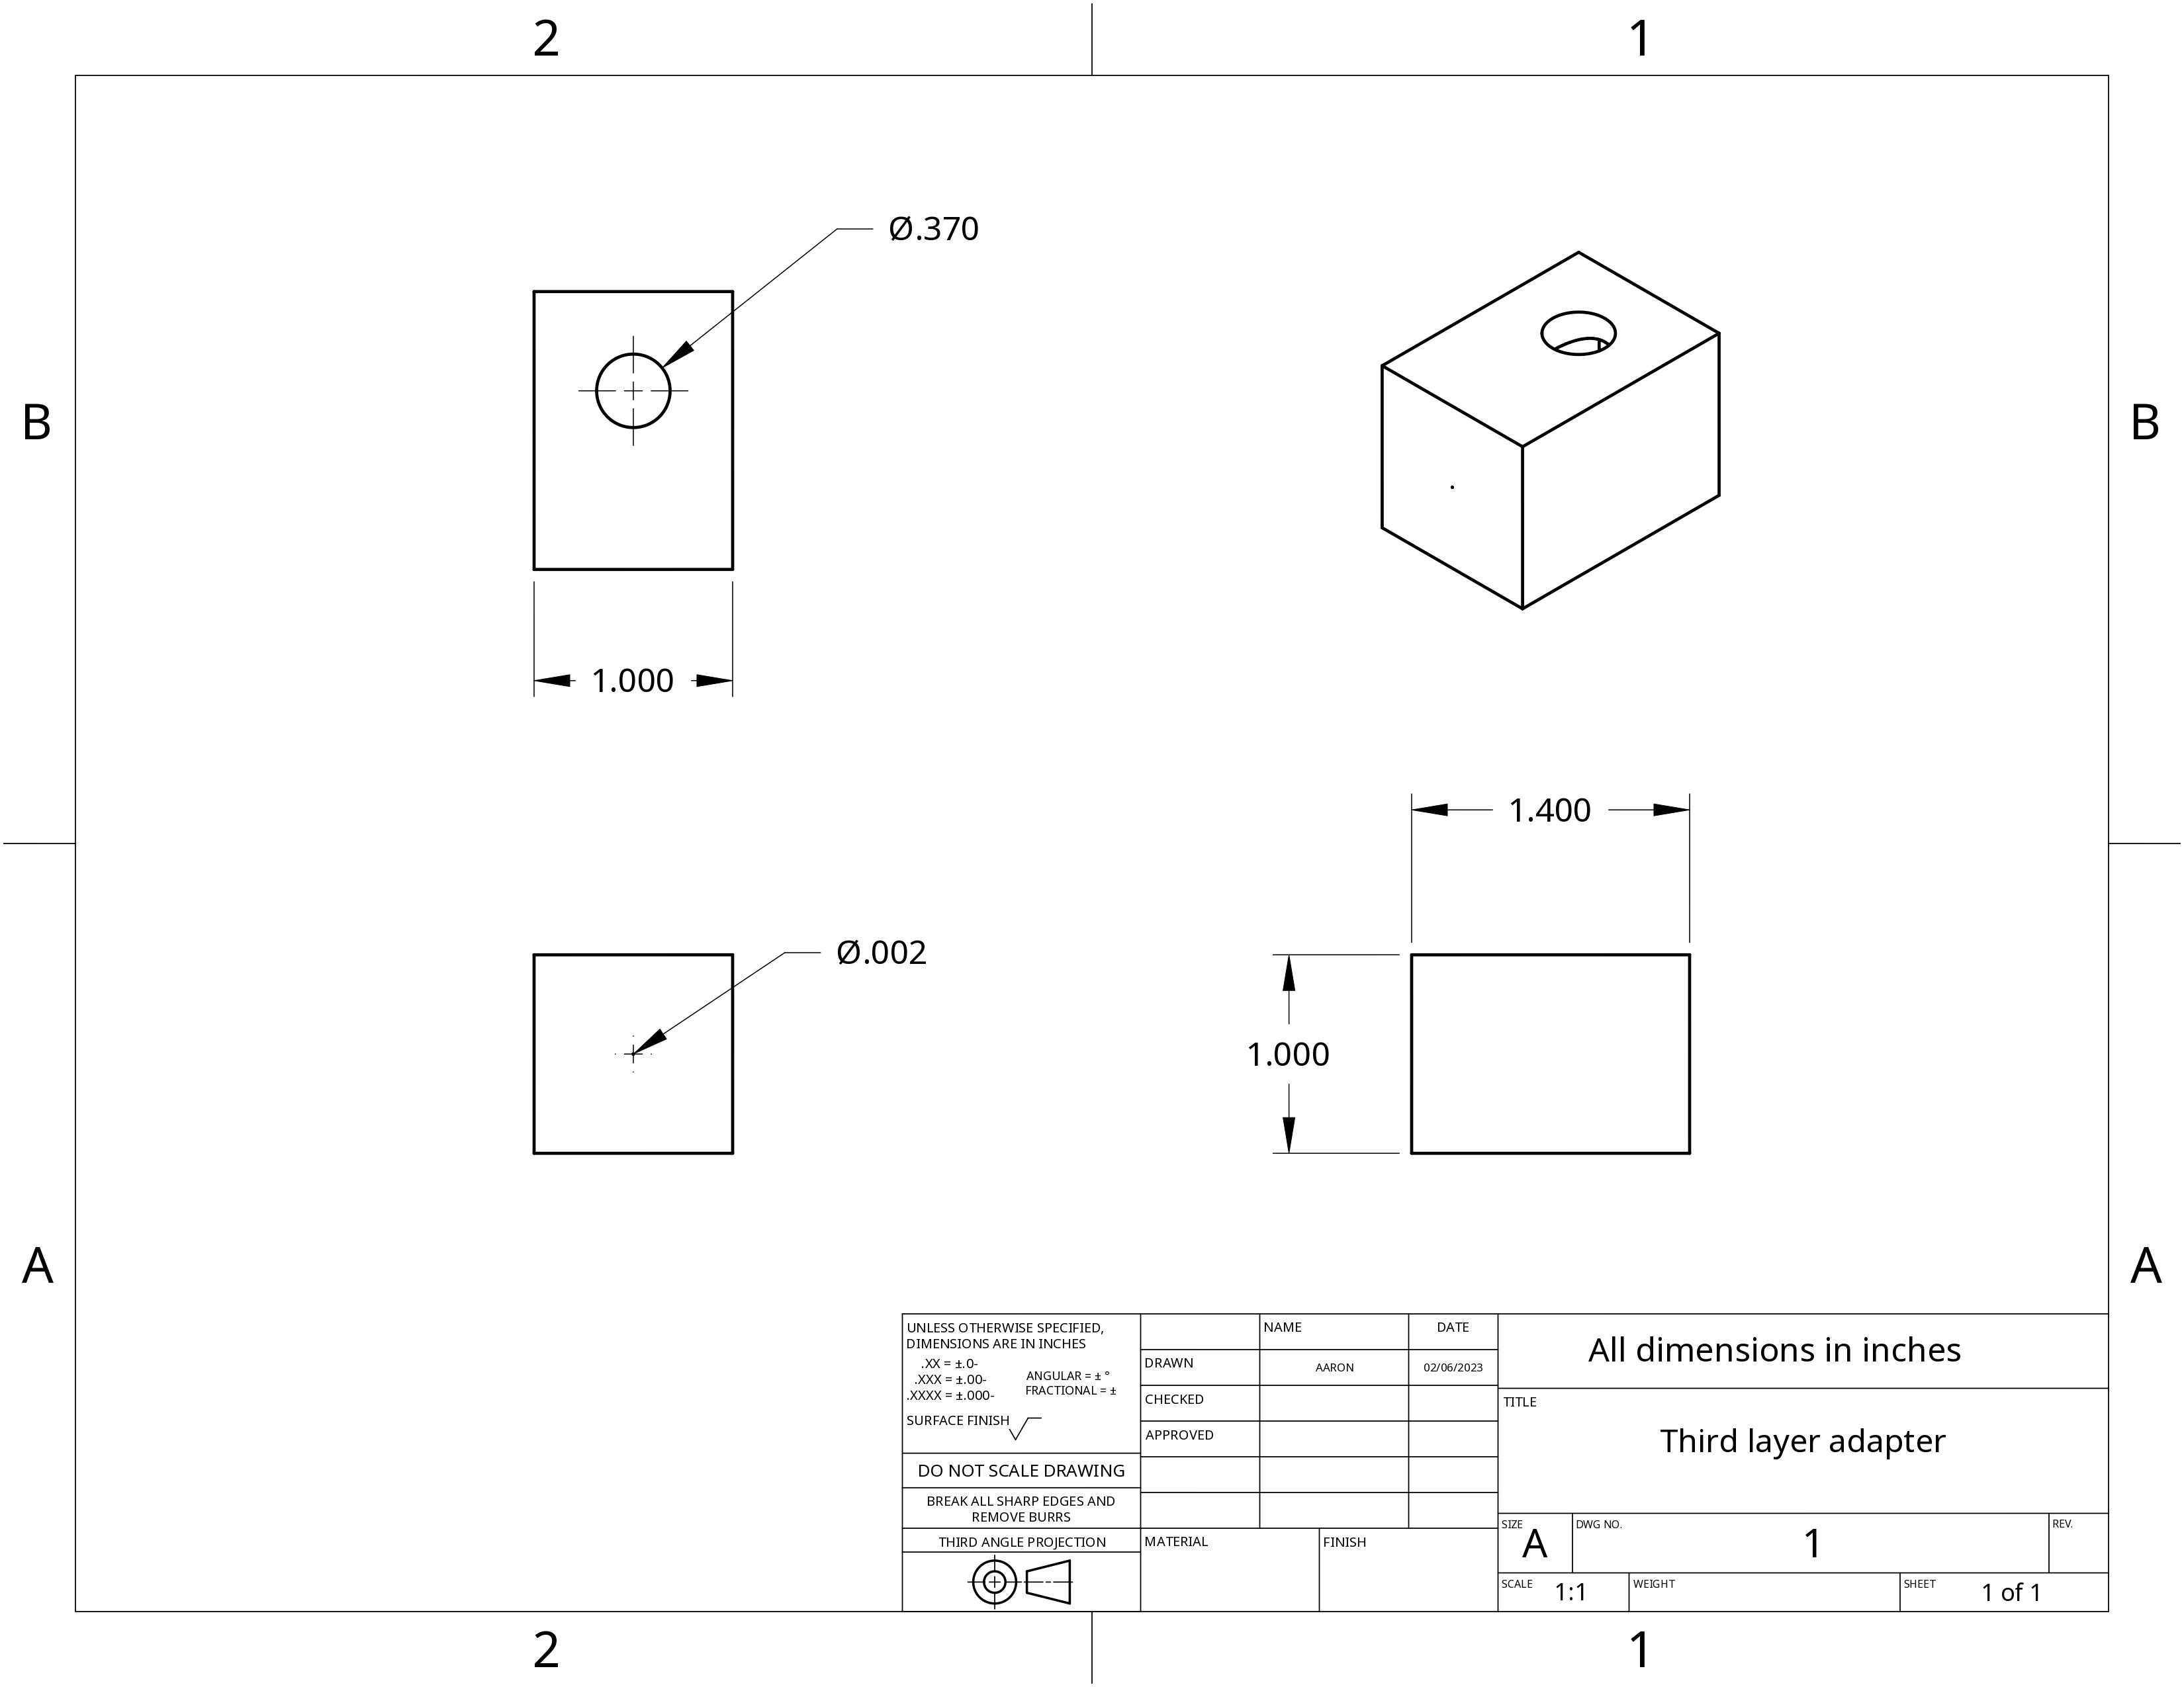
Nozzle Drawing
Figure 3: 3rd layer adapter drawing

Slide 7
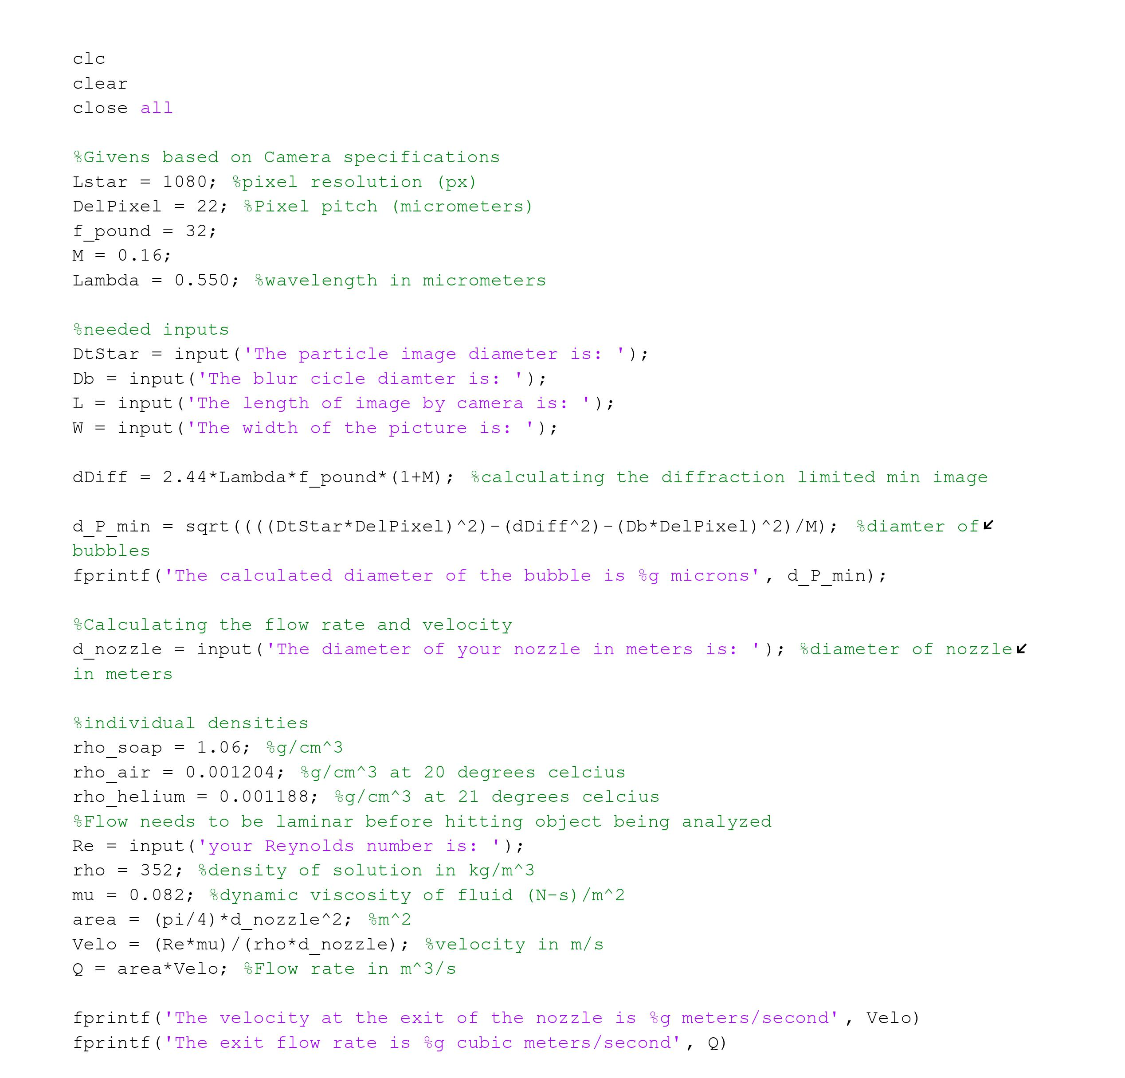
MATLAB Code
MATLAB Code has been started
Helps determine bubble diameter based on pictures
Living code, update as testing is done
Figure 4: Current MATLAB Code

Slide 8
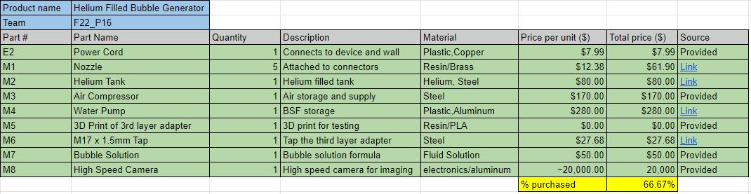
Purchasing Plan
Figure 5: Purchasing Plan

Slide 9
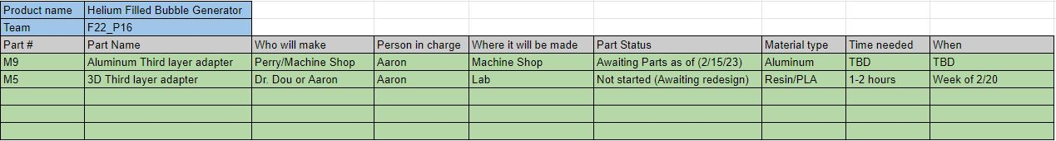
Manufacturing Plan
Figure 6: Manufacturing Plan

Slide 10
Example of the device
Microscale Bubble Generator Example

Slide 11
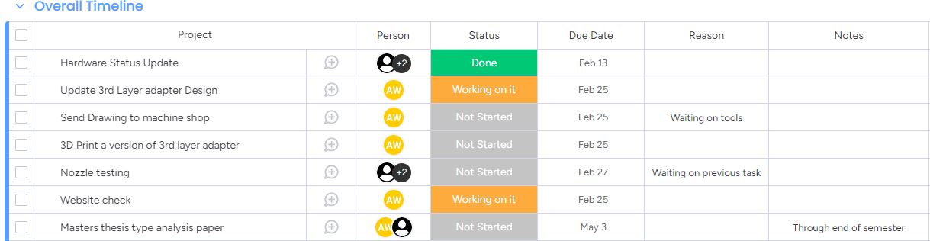
Gantt Chart
Figure 7: Updated GANTT Chart

Slide 12
Questions?

Slide 13
References
[TSI Incorporated]. (2020, March 17). Microscale Bubble Generator for Wind Tunnel Applications [Video]. Youtube. https://www.youtube.com/watch?v=lO9MycW_p7E&t=72s

