Slide 1

HELIUM-FILLED BUBBLE SOAP GENERATOR​
P16: Aaron Walcott, Simei Portillo, Musaab Nasralla​

Slide 2
Where are we at now?
First few prints of the third layer adapter
  Resin printed
  Pla printed
Designing the testing stand
  Update: Not currently needed- 3/12/2023
Client meeting on Wednesday to discuss the Pla printed version before resin printing
  Hit 67% by Friday after confirming current printed design
    Adjusted manufacturing plan – now 50%
  Post spring break team will be able to test with the full nozzle
Update: Adapter drawing sent to machine shop
  Will be at 50% build by the end of Spring break

Slide 3
Cont.
New testing parameters
  ~125 psi max
    Easier to work with than previously estimated pressure
  0-5 liters per minute
Testing setup
  Tube attached to air compressor and clipped to ensure no leakage
  Split T tube to allow for flow routing through flow meters
  More than likely held vertical for testing
  Camera capturing microscopic bubbles in 10 second intervals to allow for analysis

Slide 4
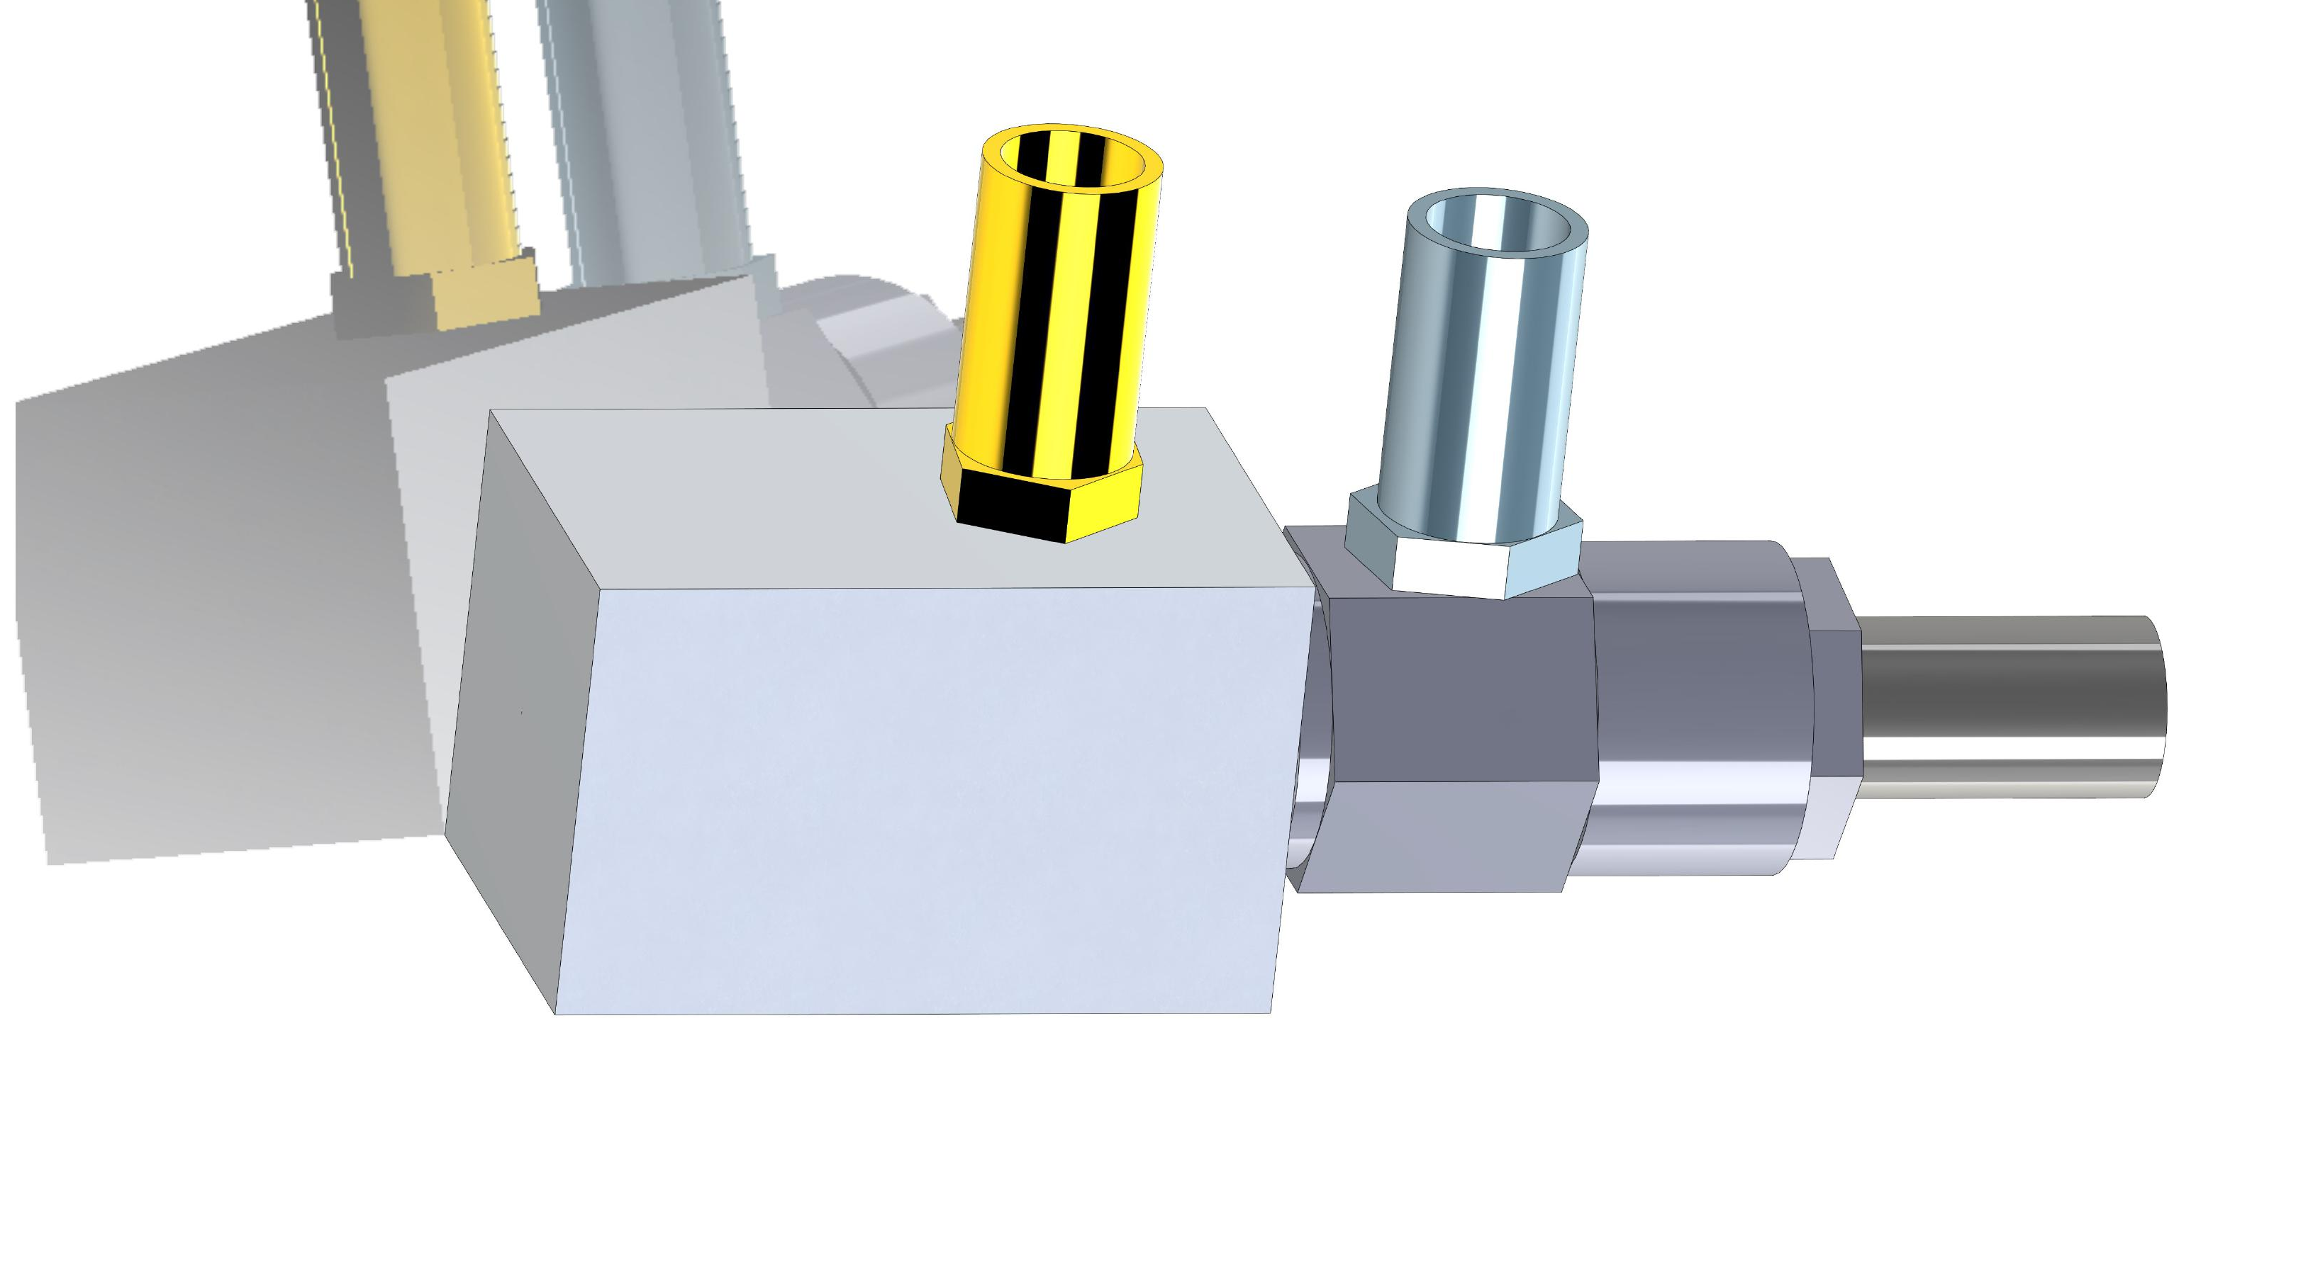
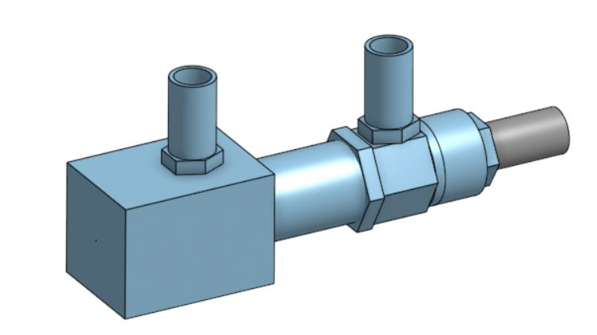
Nozzle Status
New third layer adapter is longer than the previous version for the 33% build
Threads all the way to the end of the nozzle
2-3mm of space between brass nozzle end and adapter outlet
Made from aluminum
Still 0.5mm diameter outlet
Figure 1: New Full Design
Figure 2: Old Full Design

Slide 5
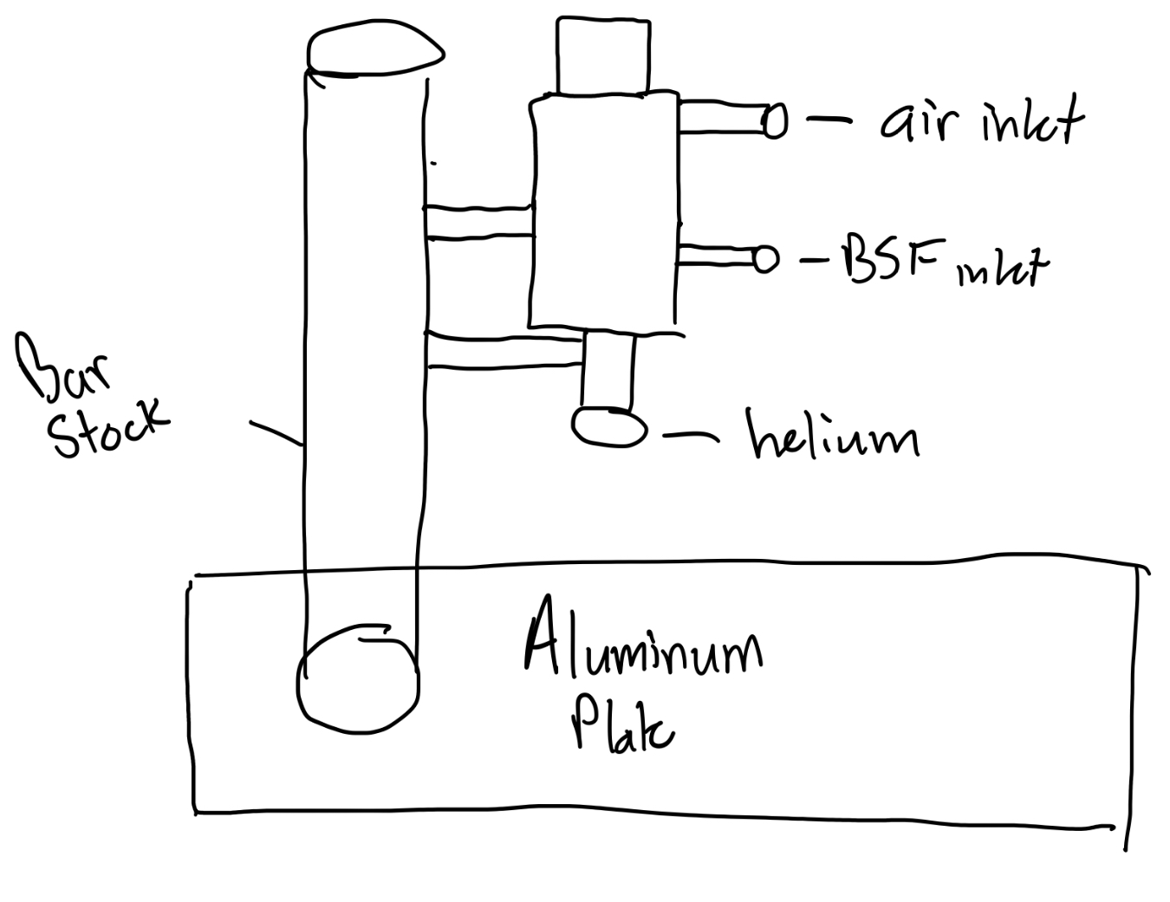
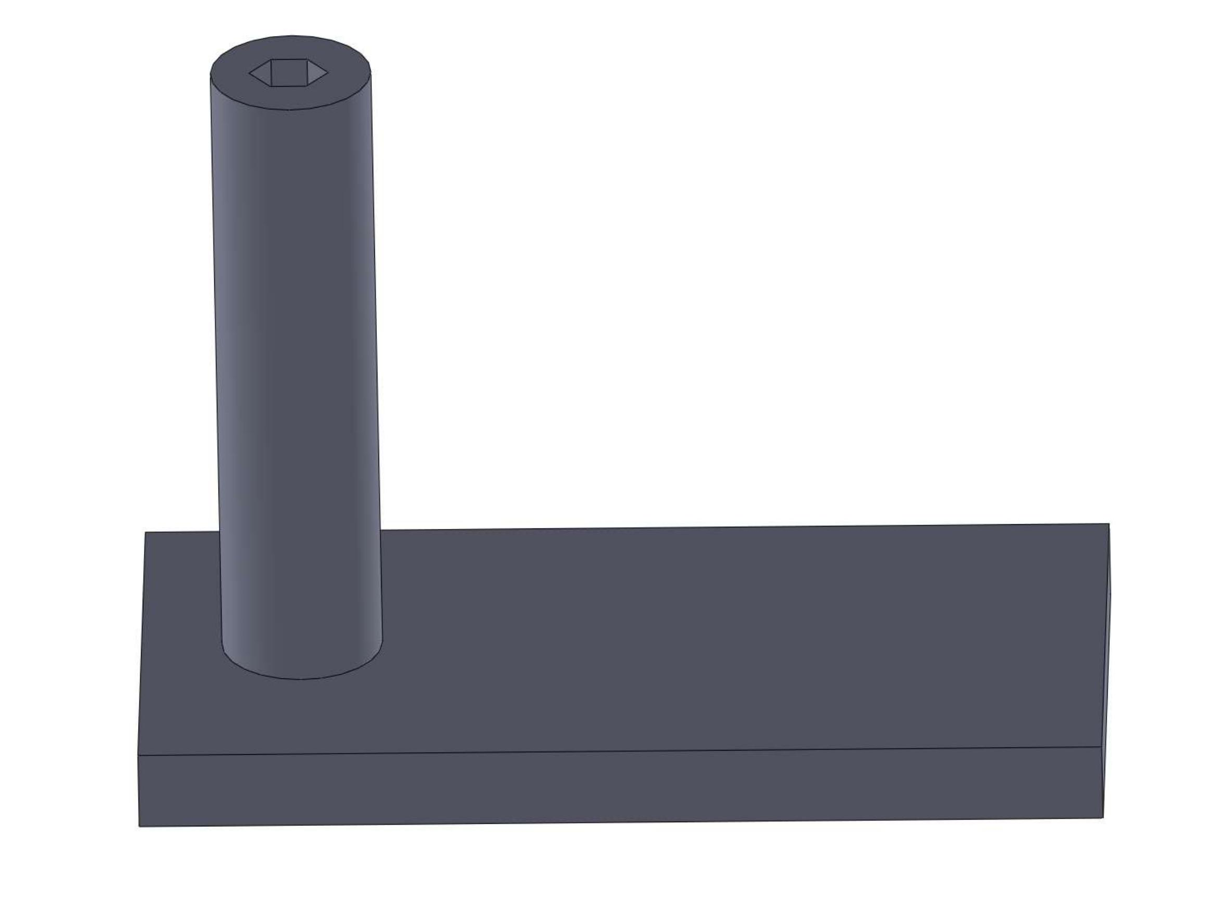
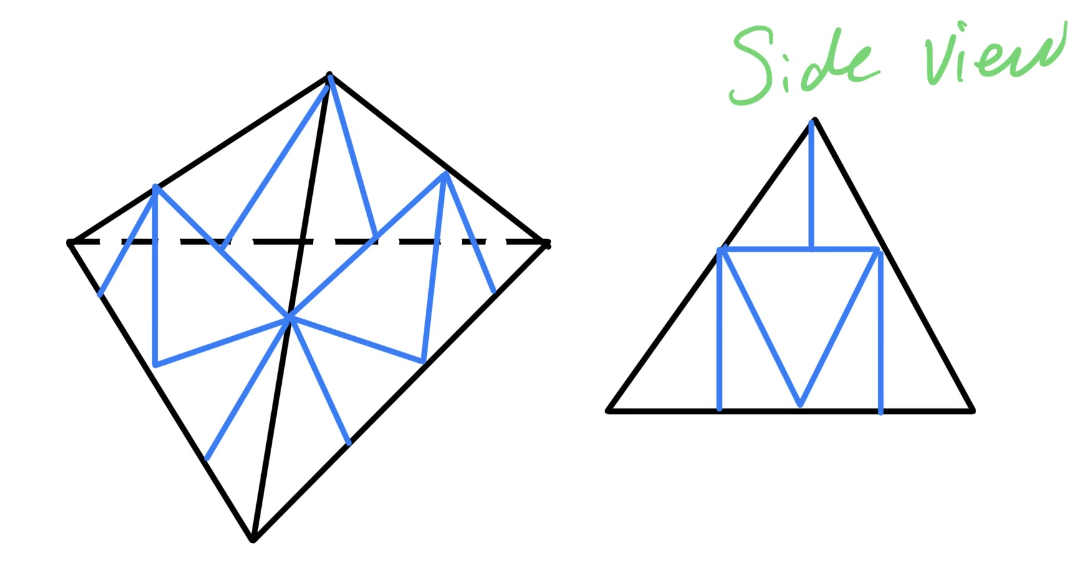
Nozzle testing
Started designing nozzle stands for testing
Client meeting on Wednesday to discuss testing procedures
Figure 3: Nozzle Testing Stand Idea
Figure 4: Test Stand Idea 2
Figure 5: Test Stand Idea 3

Slide 6
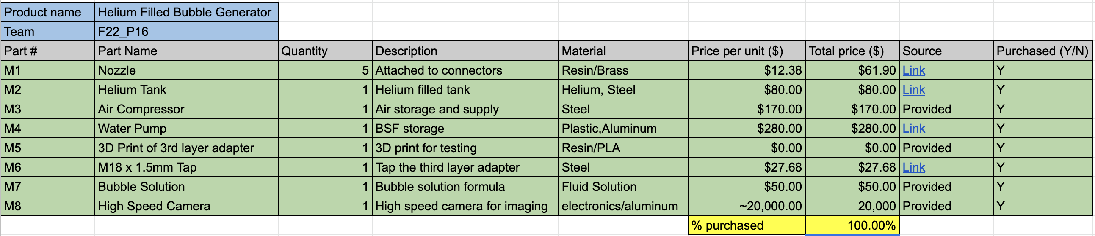
Purchasing Plan
Figure 6: Purchasing Plan

Slide 7
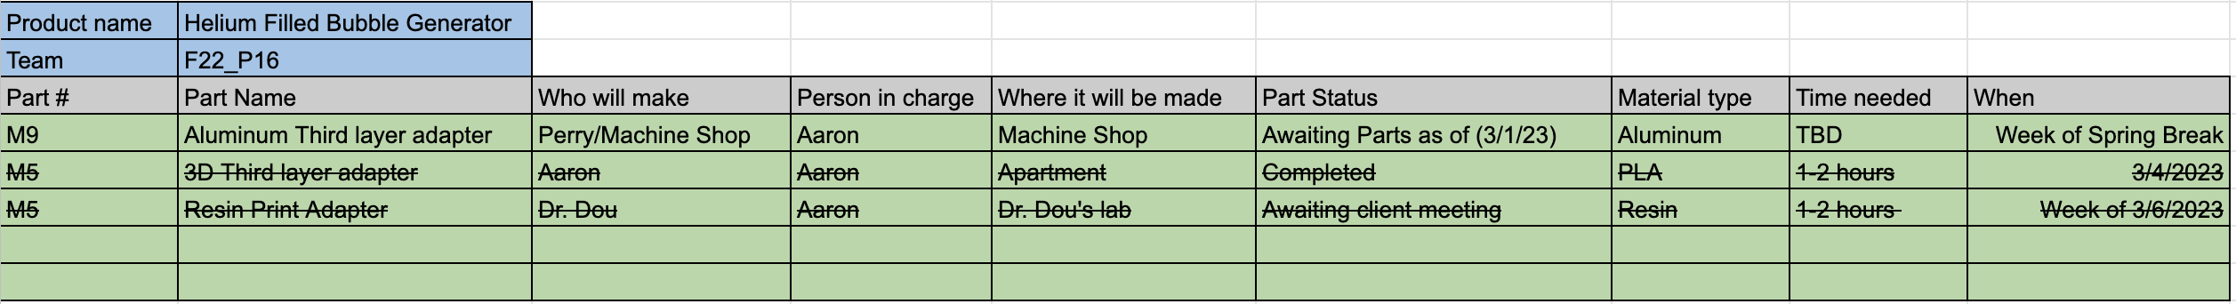
Manufacturing Plan
Figure 7: Manufacturing Plan

Slide 8
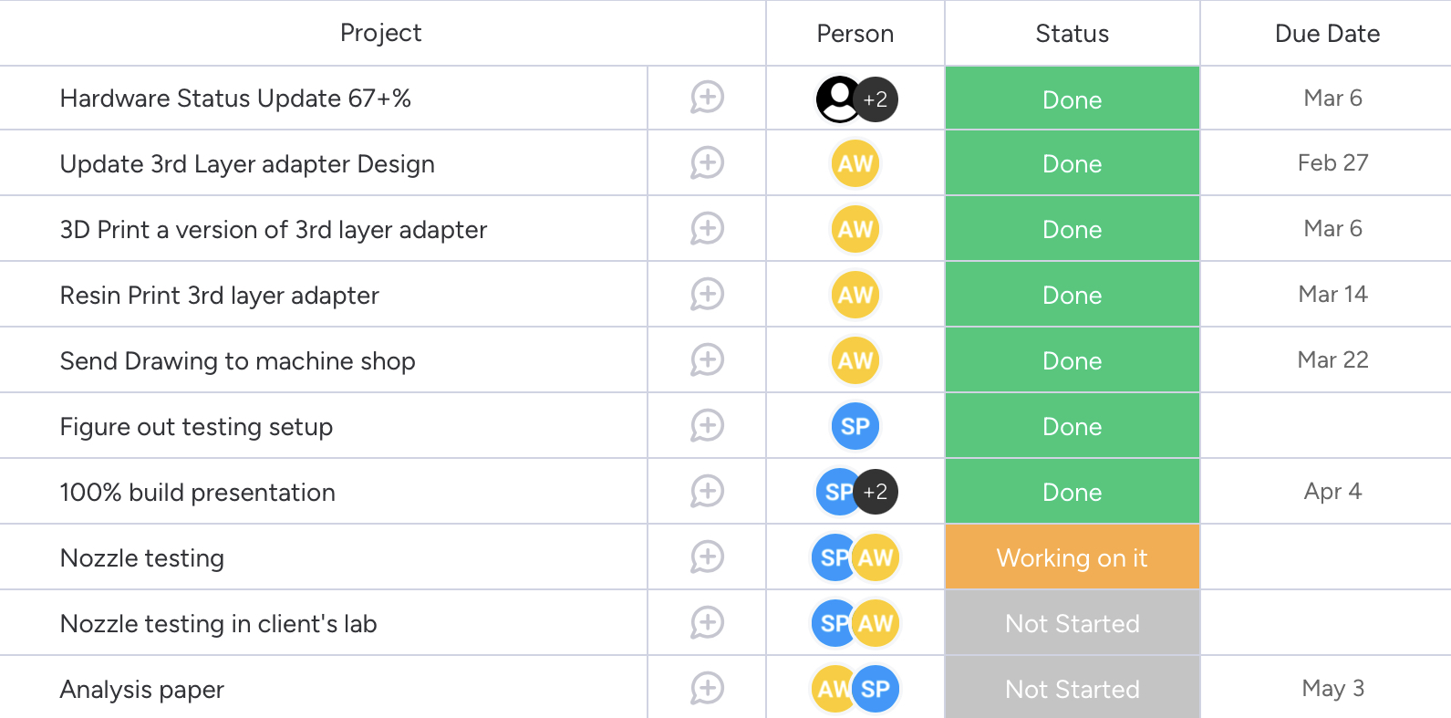
Gantt Chart
Figure 8: Gantt Chart

