Slide 1

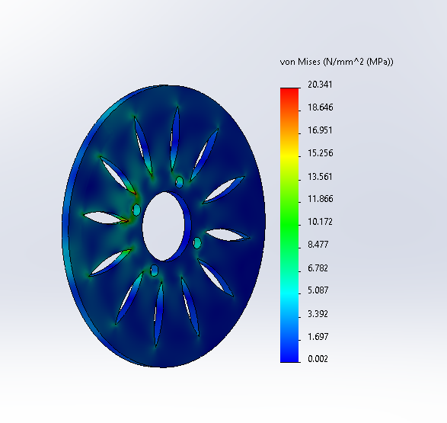
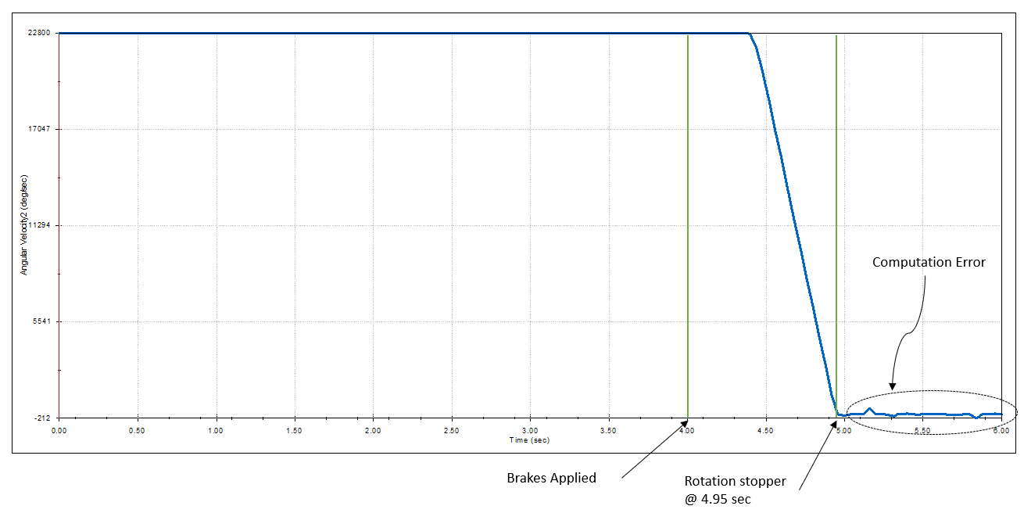
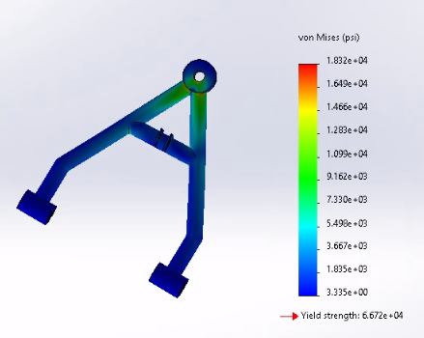
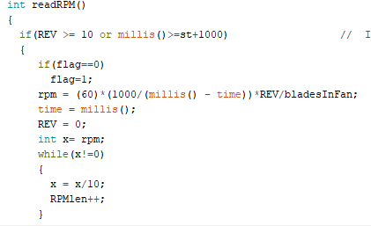
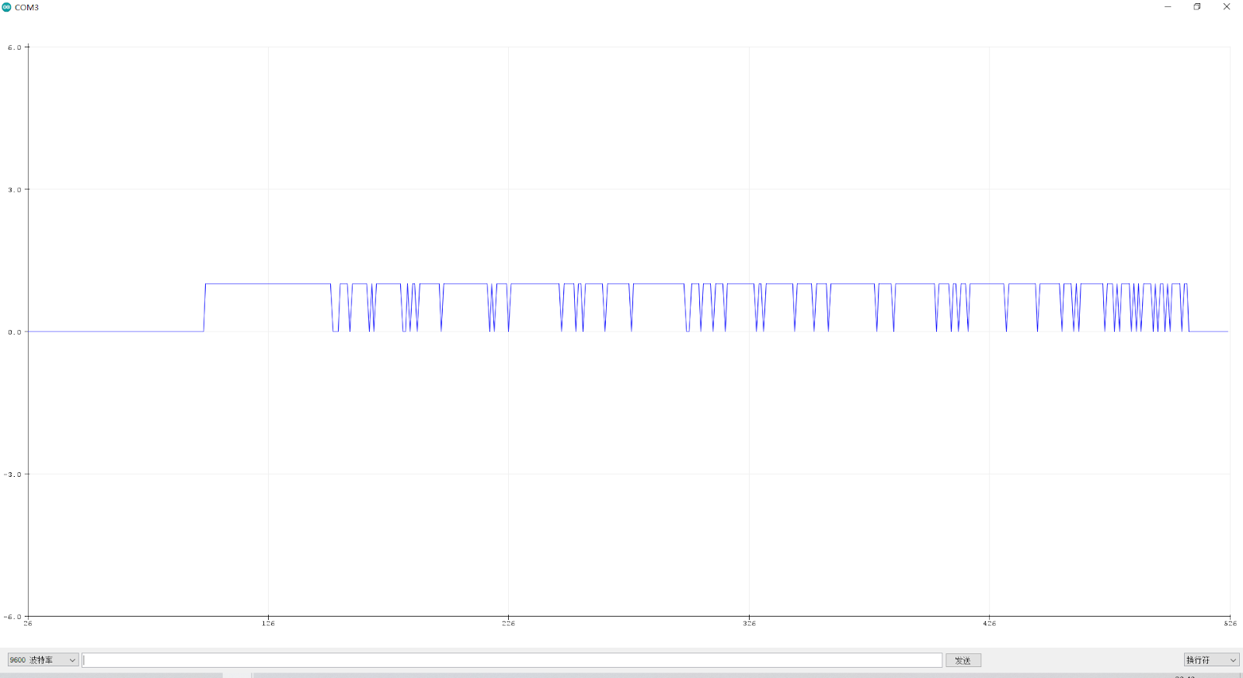
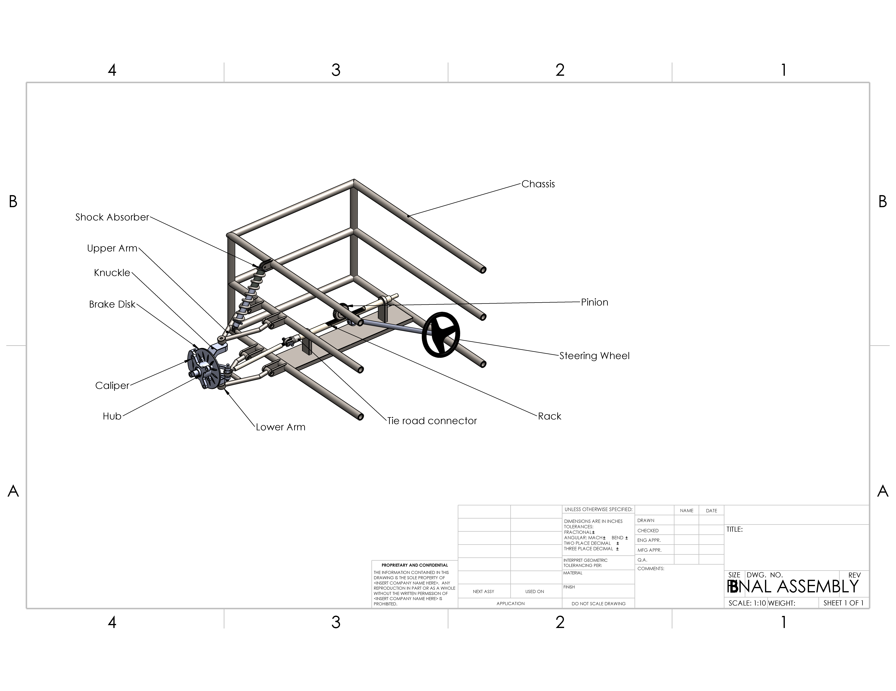
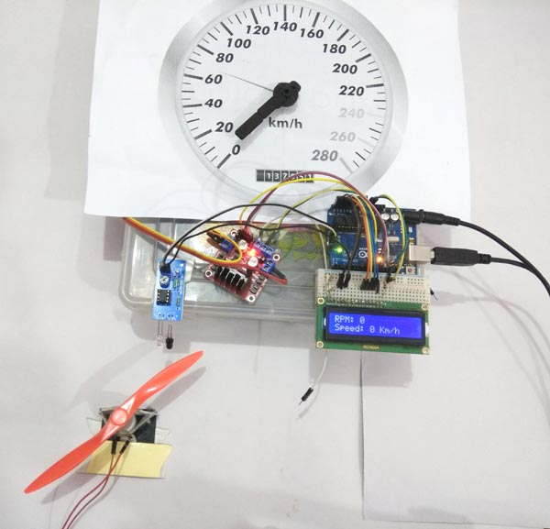
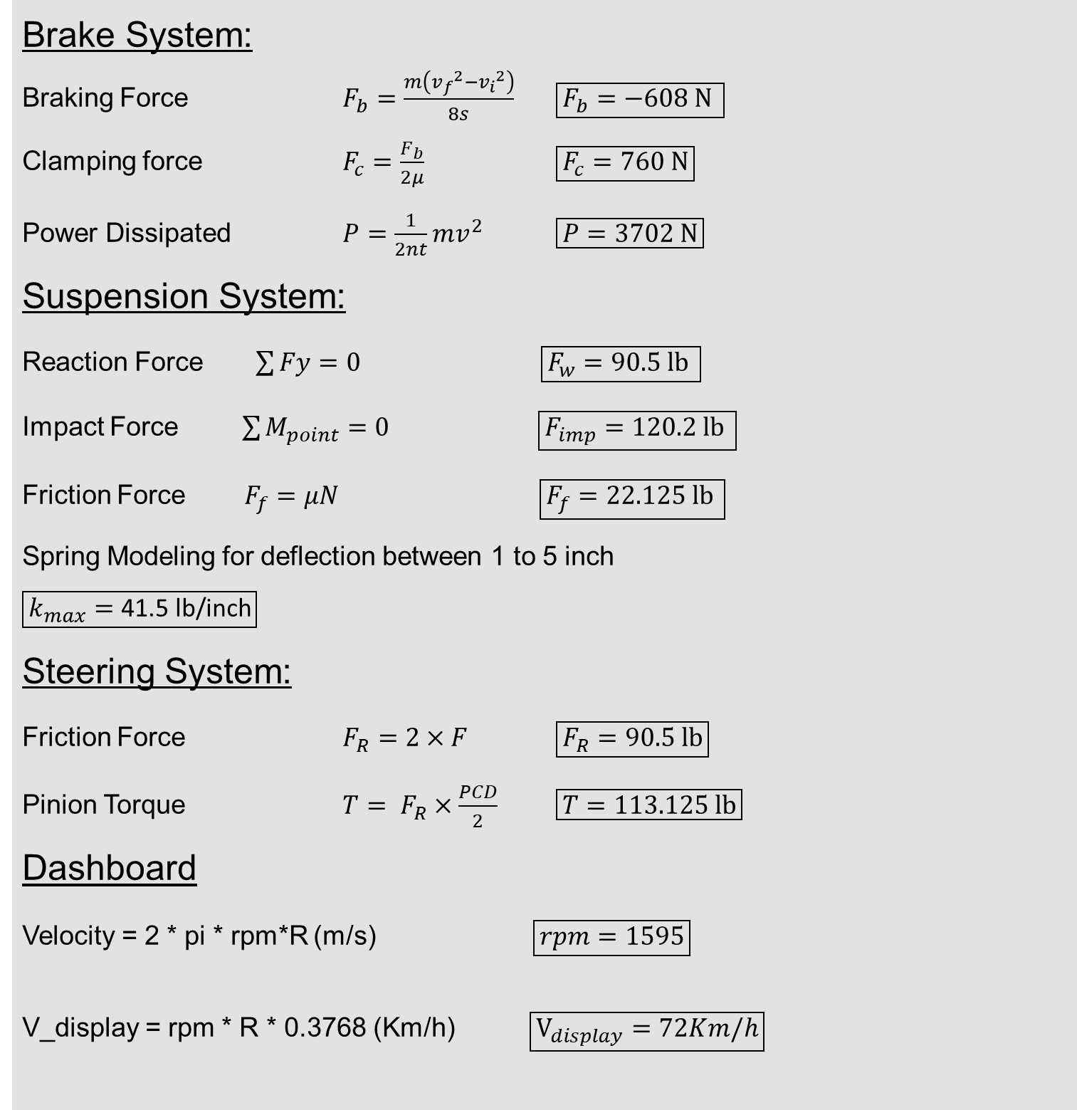
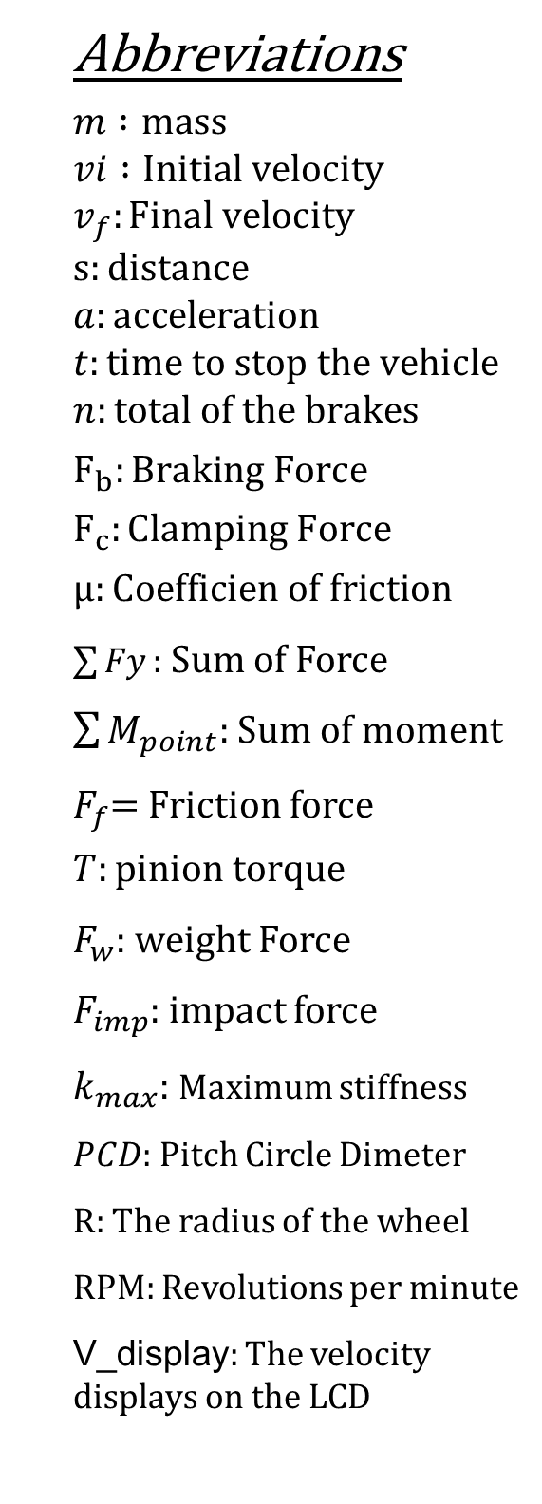
Baja Vehicle Analytical Project
Omer Alamoudi, Musaed Fraidoun, Salem Al Marri, Rashid Algelmod, Chujian Wang
Department of Mechanical Engineering, Northern Arizona University, Flagstaff, AZ 86011
Abstract
Testing Result
Project Design
The Project objective is to analyze the front suspension, brakes, steering, and dashboard systems for the Baja SAE competition. The design is completed using the engineering requirements as critical metrics, and calculations are performed for critical parts in each system. FEA is utilized to validate all the mechanical systems as well as the motion analysis to study some parts of project . The final CAD is generated as the project is analytical as it was assigned last spring. The final product of the dashboard is an Arduino system connected with a speed sensor, motor, and LCD based on the designed schematic.
Brake System
Brake System:
The brake system consists of a disk, caliper and pads all connected directly or indirectly to the knuckle. Both thermal and structural analysis are performed to ensure a safe design for brakes as they are the critical part of any vehicle. The material for brake disk is Cast Iron.
Front Suspension:
The front suspension consists of Equal A arms, mono-tube shock absorber with coil spring. The damper is attached to upper arm. The materials used is 4130 steel for both arms. The coil spring is also used for this project to reduce the force of amount of shocking.
Steering System:
The rack and pinion is used for the steering and designed such that the wheel can turn 30º in either direction. The steering is moving as linear motion. The number of teeth of pinion is 32 and the material used is steel for rack and pinion.
Dashboard System:
The dashboard is consisted of Arduino board, LCD, step motor, motor driver and speed sensor. it can be easily applied on the Baja and display the rpm and speed of the vehicle on LCD and on the Imitation dashboard. The project changed from the original programmable motor and its own Hall element to a separate sensor to facilitate the design of better applications. The design gives up the control of the motor being measured, and adds a stepper motor to reflect the size of the speed through the angle of rotation of the stepper motor.
Project Description
Figure1: Von-Mises of Disk Brake
Figure 2: Motion Analysis of Brake system
Baja SAE vehicles are designed to withstand multiple terrains. The systems assigned to the team are brake, front suspension, steering, and dashboard system. The team's goal is to increase the steering and front suspension efficiency, improve the braking time, and the dashboard is for the driver to detect the vehicle's speed displayed on the LCD.
Front Suspension
Calculation
Conclusion
Brake System:
Braking Force $F_{b}=\frac{m\left({v_{f}}^{2}−{v_{i}}^{2}\right)}{8s}$ $\boxed{F_{b}=\text{−608 }\text{N} }$
Clamping force $F_{c}=\frac{F_{b}}{2μ}$ $\boxed{F_{c}=760 N}$
Power Dissipated $P=\frac{1}{2nt}mv^{2}$ $\boxed{P=3702 N}$
Suspension System:
Reaction Force $\sum{Fy}=0$ $\boxed{F_{w}=\text{90.5 }\text{lb} }$
Impact Force $\sum{M_{point}=0}$ $\boxed{F_{imp}=\text{120.2 }\text{lb} }$
Friction Force $F_{f}=μN$ $\boxed{F_{f}=\text{22.125} \text{lb} }$
Spring Modeling for deflection between 1 to 5 inch
$$\boxed{k_{max}=\text{41.5 }\text{lb}\text{/}\text{inch}}$$
Steering System:
Friction Force $F_{R}=2×F$ $\boxed{F_{R}=90.5 lb}$
Pinion Torque $T= F_{R}×\frac{PCD}{2}$ $\boxed{T=113.125 lb}$
Dashboard
Velocity = 2 * pi * rpm*R (m/s) $\boxed{rpm=1595}$
V_display = rpm * R * 0.3768 (Km/h) $\boxed{V_{display}=72Km/h}$
Abbreviations
$$m :mass \\ vi :Initial velocity \\ v_{f}:Final velocity \\ s:distance \\ a:acceleration \\ t:time to stop the vehicle \\ n:total of the brakes$$
$$F_{b}:Braking Force$$
$$F_{c}:Clamping Force$$
$$μ:Coefficien of friction$$
$\sum{Fy}:$ Sum of Force
$\sum{M_{point}:}$ Sum of moment
$F_{f}$= Friction force
$$T:pinion torque$$
$F_{w}$: weight Force
$F_{imp}$: impact force
$k_{max}$: Maximum stiffness
$PCD$: Pitch Circle Dimeter
R: The radius of the wheel
RPM: Revolutions per minute
V_display: The velocity displays on the LCD
The final design is completed in SolidWorks as the project is analytical. Team utilized the Solidework to analyze the Von- Missis and The Factor of Safety (FOS) of brake system, front suspension and steering system. Moreover, the team used the motion study for the project testing. All the engineering requirement and customer requirement are fulfilled. Also, The Factor of Safety (FOS) for all the systems greater than 1.Microsoft Excel is used to perform the calculations for the spring in shock absorber. The dashboard is completed in hardware, which is based on Arduino.
Figure3: Von-Mises of Upper Arm
Figure 4 : Spring rate coil spring of suspension system
Dashboard
Reference
[1]"2022 Baja SAE Rules Now Available Online", Bajasae.net, 2021. [Online]. Available: https://www.bajasae.net/cdsweb/app/NewsItem.aspx?NewsItemID=88d2d966-232b-446e-b70d-669cbf645768. [Accessed: 12- Nov- 2021]
Acknowledgement
We want to express our sincere appreciation for our client since he supported our team last spring until this semester. This project could not be contributing successfully to completion without the supports of the client who David Willy. The client explained the requirement in detail to ensure we in the right way of solution the requirements that led us to feed our knowledge about the project and find our specific attributes to improving our project.
Figure 5 : Code for reading rpm from level signal
Figure 6 : Speed sensor level signal
Final Design
Methods
Throughout the improvement and enhancement of the design project of the fourth sub-system: Braking, Front suspension, and Steering, and Dashboard, the team significantly used various methods to perform the project successfully. The team utilized three majorities of Software to test the project as analytical that are SoildWork, Excel, and Arduino. Initially, the team analyzed and calculated all the forces and moments that affect the parts of suspension and steering to apply the FEA and motion analysis to analyze the stress and safety factors. Also, the team utilized Excel for analyzing the Rate of Spring and the spring force between 1 inch to 5 inch. For dashboard data testing, the team obtains the sensor's level signal by reading the serial port information on the Arduino.
Figure 7: Final Design CAD of systems
Figure 8: Final Design of Dashboard

