Slide 1
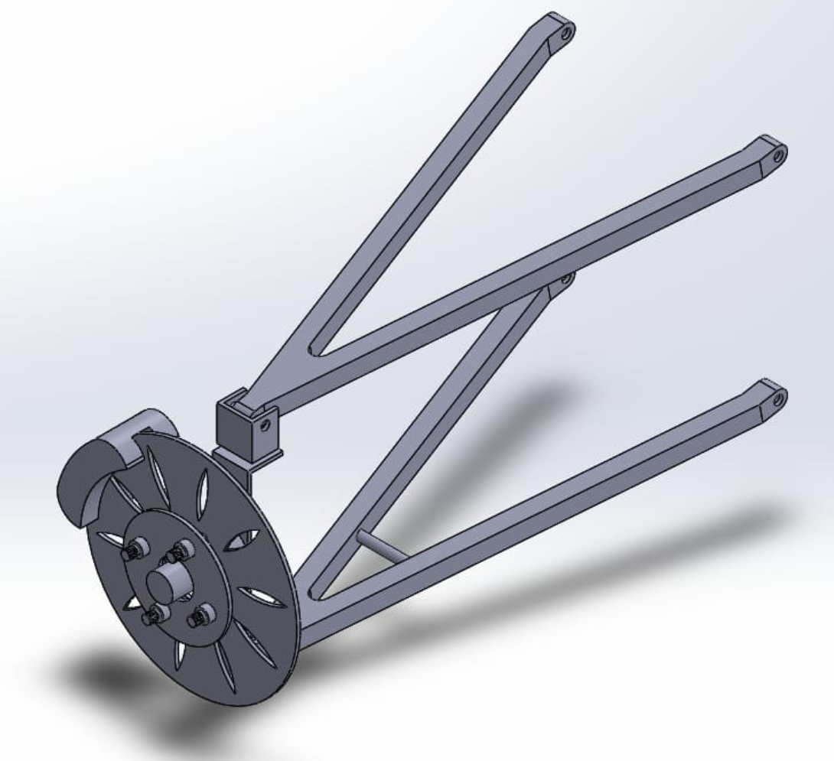
SAE BAJA BRAKE SUSPENSION and DASHBOARD SYSTEM
Musaed Fraidoun Omer Alamoudi Salem Almarri Rashid Algelmood Chujian Wang
Team Members:

Slide 2
Project Description
SAE BAJA is a competition for university Students
Build small off-road car
Off-road car contains different subsystems
SAE BAJA 2021 will use the advance cars from previous years
This project will take part in the competition
The project will follow the competition rules
Develop three systems for off-road car
Front Suspension
Brake System
Dashboard
Rashid/ SAE Baja/21-2-2021

Slide 3
Project Description
Project need to redesign the system
Creative Design
Efficient System
Front Suspension need to handle all types of terrains
Rough terrains
Up and Down’s
Brake System need to stop the car
With Short Duration of time
Stop vehicle instantly
The dashboard needs to show the condition of the vehicle
Speed
Rotation speed
fuel level
Rashid/ SAE Baja/21-2-2021

Slide 4
Design Description
Front suspension Design consist of
Wishbones
Shock absorber
Moveable Hinges
Brake Design consist of
Drum Disc
Brake Pad
Trailing Shoe
Dashboard Design consist of
Single chip microcomputer
LCD
Motor
Switch
Salem/SAE Baja/21-2-2021

Slide 5
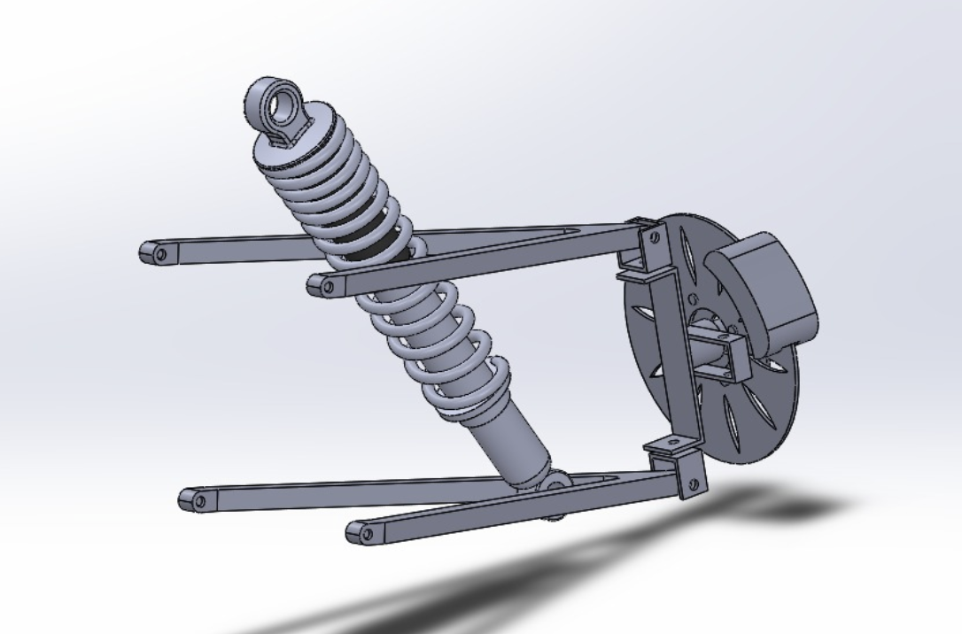
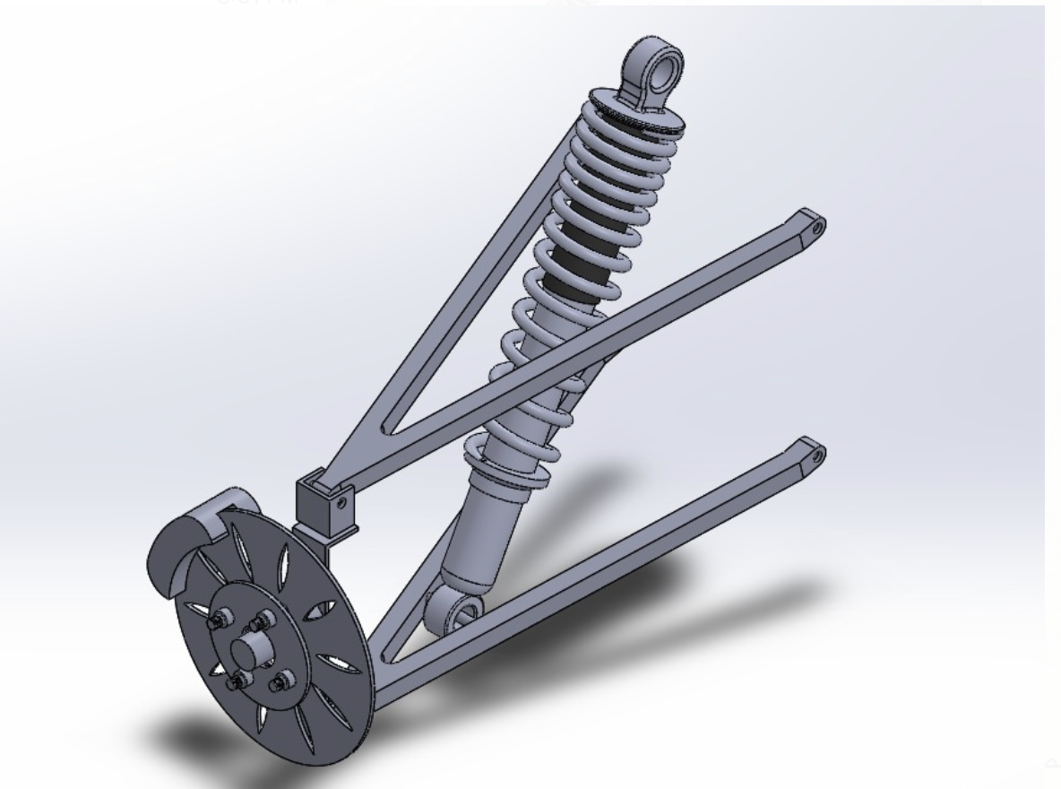
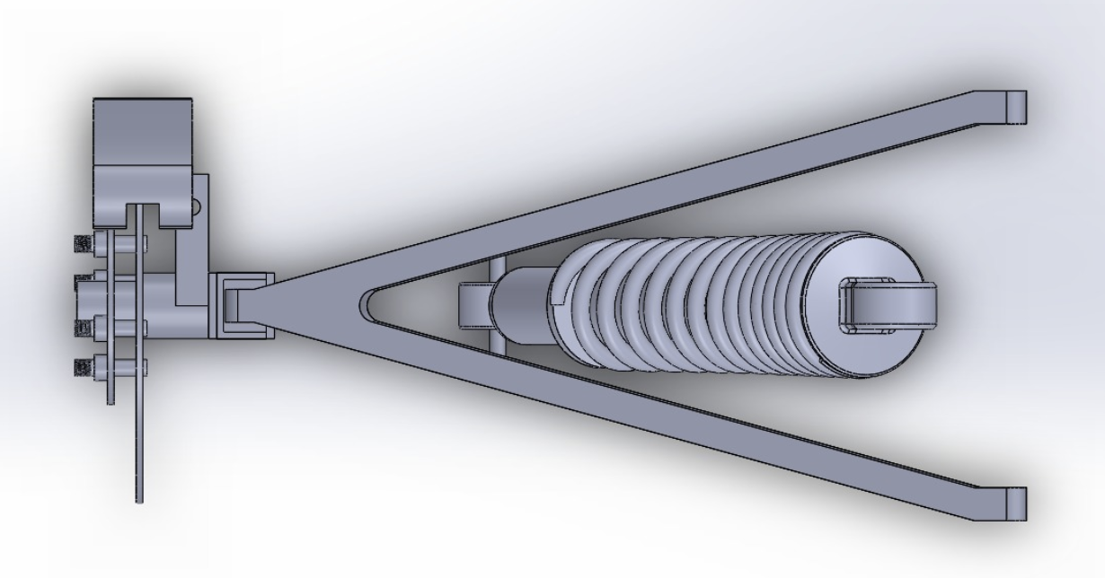
Design Description
CAD Images
Figure 1: Side View
Figure 2: Isometric View
Figure3: Top View
Salem/SAE Baja/21-2-2021

Slide 6
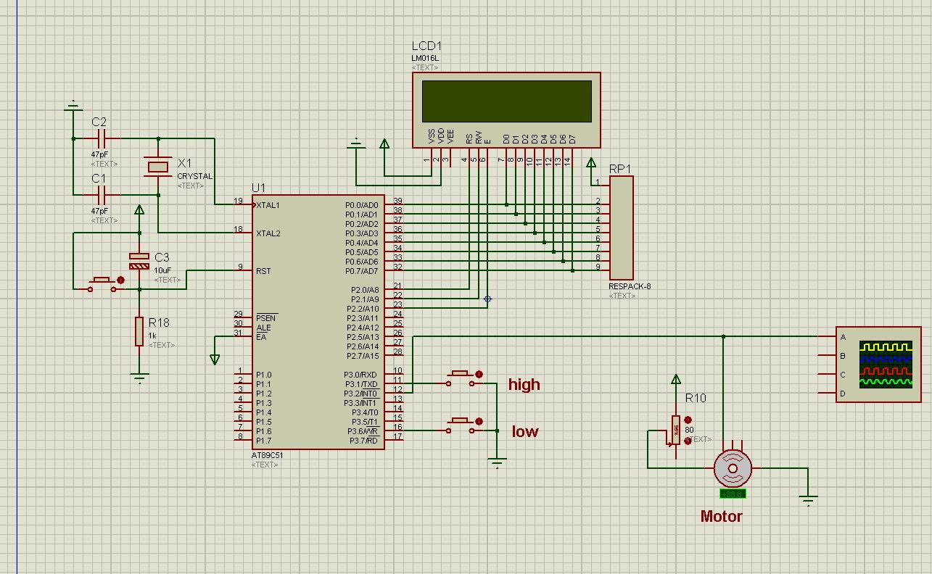
Design Description
Figure 4:Schematic of dashboard
circuit design
Wang/ SAE Baja/21-2-2021
Notes:
The schematic circuit diagram shows how the single-chip microcomputer and each component are connected. The most important components in the picture are the LCD, the motor and the switch that controls the oil level.

Slide 7
Design Functioning
Wishbones will provide the suspension support
It will connect with the car chassis
Force will apply over the wishbone by the car
Wishbones will move around the axis in up and down direction
Brake system contains disc
Disc rotate with the wheel
When the brake will apply, disc pad will provide friction to the wheel
Wheel will stop smoothly and instantly
When the motor speed changes, the pulse frequency should change.
When the oil level changes, the signal level will change
Salem/SAE Baja/21-2-2021
Notes:
The speed of the motor can be calculated by changing the frequency of the pulse. The oil level can be controlled by a switch.

Slide 8
Implementation Plan
Material for the wishbone and brake disc will decide
Wishbone frame will manufacture
Brake disc will manufacture
Joints will develop
All the components will assemble
Wishbones will connect with the disc brake through the joints
Brake disc will fix with the joints
Leather pads will fix over the disc brake
Simulate vehicle speed changes by changing the motor speed
Turn on/off the switch to display the level of the liquid level
Salem/SAE Baja/21-2-2021
Notes:
Calculate the motor speed by changing the motor speed and monitoring the pulse frequency and display it on the LCD screen. When the oil level is below a certain level, the LCD screen will indicate that the liquid level is low

Slide 9
Design Requirements – CR’s
Table 1: Customer Requirements
Customer Requirements | Details
Efficient Brake System | The system need to efficiently stop the vehicle in short duration of time
Efficient Front Suspension System | The suspension need to work smoothly and efficiently to provide complete comfort
Dashboard | The dashboard can clearly, precisely display the vehicle speed, rpm and fuel level
Safe to Use | Brake system should be safe to use
Durable/Long Lasting | Suspension and brake should work for long duration
Reliable | Systems should be reliable and must not fail during the operation
Flexible Suspension | Suspension should be flexible enough to bear the rough terrains and off-road hectic.
Light in Weight | Suspension, brakes, and dashboard everything should be light weight
Long power backup | Battery size should be sufficient for power
Wang/ SAE Baja/21-2-2021

Slide 10
Design Requirements – ER’s
Table 2: Engineering Requirements
Engineering Requirements | Targets | Rationale
Heat | < 80 Degrees | The brake system in SAE Baja should be designed and equipped as a disk brake because it is less receptive to heat during the stopping vehicle time.
Spring | < 2 N/m | The Spring means that it contributes to reduce the effect of shock force when the vehicle shocks a stone or rigid body
Track width | <64 in | referees to the distance between the two wheels in the front suspension. when the track width is smaller
Dashboard | Accurate to the one digit | Rotation speed and speed can be accurate to the unit position, and the fuel tank can display high and low
Braking Distance | < 10 meters | Stop the vehicle after applying the brake, the distance it will cover during the applied brake
Braking Time | < 5 sec | Time it takes to apply the brake and then the vehicle required the time to get stop
Operating Voltage | 10.8V-16V;0.05A-0.4A | By replacing the microcontroller AT89C51, the operating voltage was reduced to 5V
Decrease the Weight | <250 Ibs | Depends on the Baja rules, is able to carry the driver weight that should not exceed 250 Ibs
Battery | 5V | The battery can be within the range of working voltage, increase or decrease according to voltage needs
Wang/ SAE Baja/21-2-2021

Slide 11
Design Requirements – ER’s
Design has met the engineering requirements
Heat
The use of leather pad will produce less amount of heat and it will not exceed the 80 degrees temperature
Spring
Spring has added in the suspension with the spring constant value of less than 2 N/m to make it flexible and comfort suspension
Track Width
The track width has set less than 64 inches to make sure it meet the criteria
Omer/ SAE Baja/21-2-2021

Slide 12
Design Requirements – ER’s
Dashboard
Rotation speed and speed can be accurate to the unit position, and the fuel tank can display high and low
The working voltage is reduced to 5V
Braking Distance
Using of leather pads will make it sure to the car can stop in less than 10 meters
Braking Time
With the help of leather pads, the car can stop in 5 seconds hence this engineering requirement has met as well
Omer/ SAE Baja/21-2-2021

Slide 13
Design Requirements – ER’s
Decrease Weight
The design has made simplified therefore it will be lesser than 100 lb. therefore it can state that this engineering requirement has met by the design
Omer/ SAE Baja/21-2-2021

Slide 14
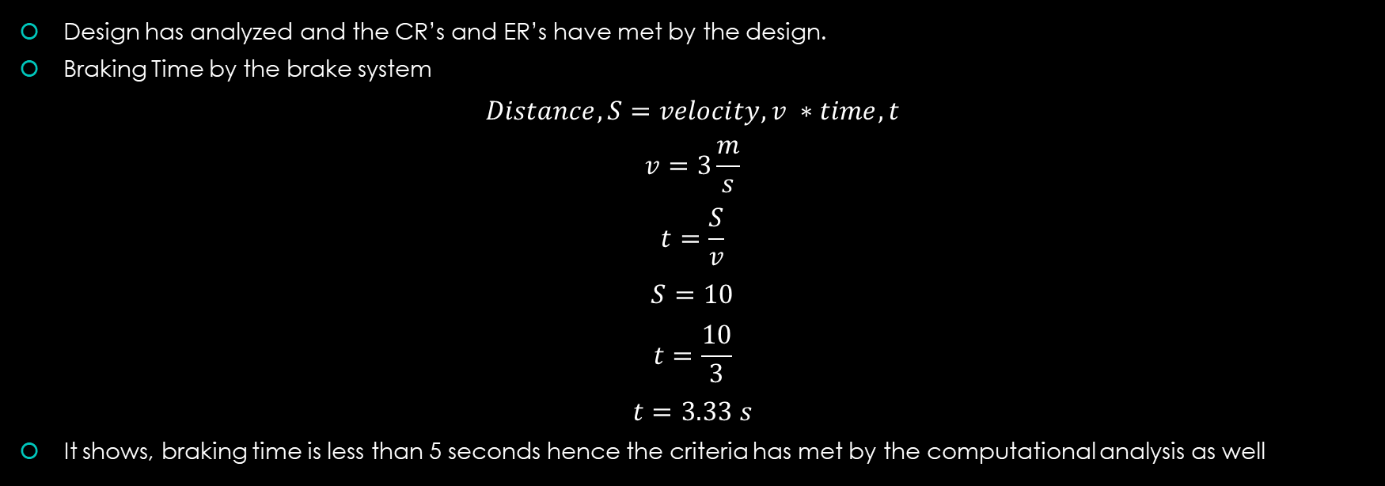
Design Requirements - Analysis
Omer/ SAE Baja/21-2-2021

Slide 15
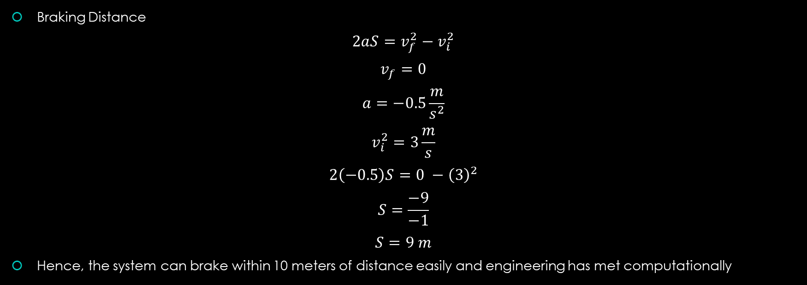
Design Requirements - Analysis
Omer/ SAE Baja/21-2-2021

Slide 16
Design Validation - FMEA
FMEA Analysis has conducted
FMEA table has presented in the Appendix
Failure of Suspension
It can mitigate with high quality of material to use in the suspension
Failure of Brakes
It can mitigate with high quality of material to use in the brakes
Use of good quality leather in the pads
Regular maintenance and check up
Failure of Dashboard
It can mitigate with more accurate oil level detection methods.
Musaed/ SAE Baja/21-2-2021

Slide 17
Design Validation – Trade-off Analysis
Failure of Suspension
Trade-off for failure of suspension is replacement of suspension parts over the time by paying extra cost.
Regular maintenance and check up will avoid this risk and no need to do any trade-off in that condition
Failure of Brakes
Trade-off for brake failure is using additional leather pads to avoid the damage
Replace leather before the life span finishes
Regular check up will avoid this risk
Failure of Dashboard
Trade-off for failure of dashboard is regular calibration
Musaed/ SAE Baja/21-2-2021
Notes:
Errors in vehicle data may affect the driving level of the driver, and errors in fuel level may lead to decisive consequences. The failure of the dashboard can be avoided by calibration, and regular calibration and testing can make the dashboard continue to work stably

Slide 18
Design Validation – Testing Procedures
Engineering requirements testing can perform to verify if they have achieved or not
Heat
This can be done using a heat analysis through Finite Element inside the brake and test the brake system to record the temperature of brakes rising
Spring
Spring suspension can test by using the hook’s law and then applying the computational equations in MATLAB to determine the spring constant value
Track Width
Width track can measure by the feet scale in software like SolidWorks
Musaed/ SAE Baja/21-2-2021

Slide 19
Testing Procedures
Dashboard
All the tests on the dashboard can be tested by proteus simulation
Braking Distance
The distance of breaking can analyze using the MATLAB simulation by implementing the computational equations, and then measure the distance using the meter scale after how long the car has stopped
Braking Time
The time can calculate using the time equations using the MATLAB simulation to see after how long it stops.
Musaed/ SAE Baja/21-2-2021

Slide 20
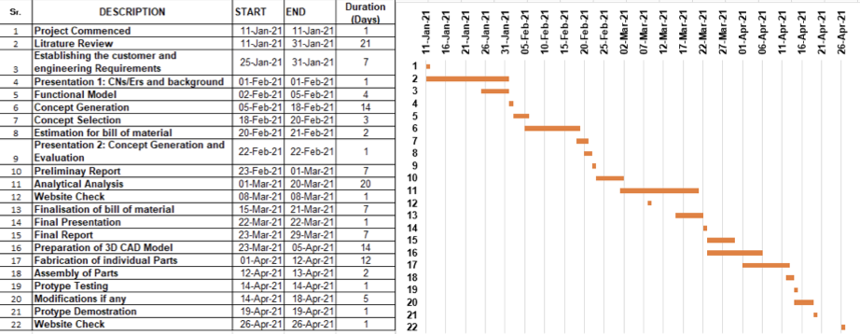
Schedule- Gantt Chart- Current Semester
Table 3: Gantt Chart - Current Semester
Rashid/ SAE Baja/21-2-2021

Slide 21
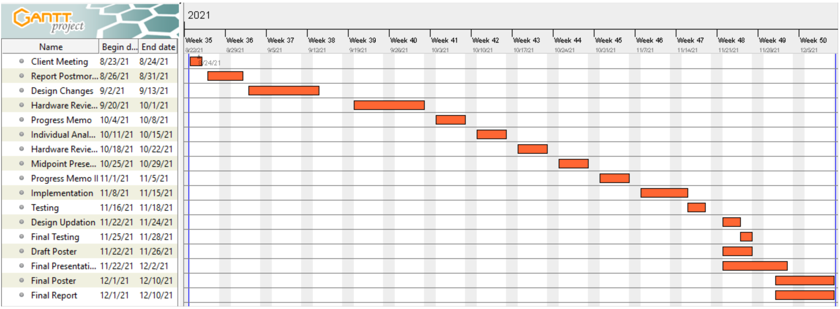
Schedule – Gantt Chart- Next Semester
Table 4: Gantt Chart - Next Semester
Rashid/ SAE Baja/21-2-2021

Slide 22
Budget
Front Suspension Cost: 5000 $
Brakes: 1000$
Dashboard: 400$
Rashid/ SAE Baja/21-2-2021

Slide 23
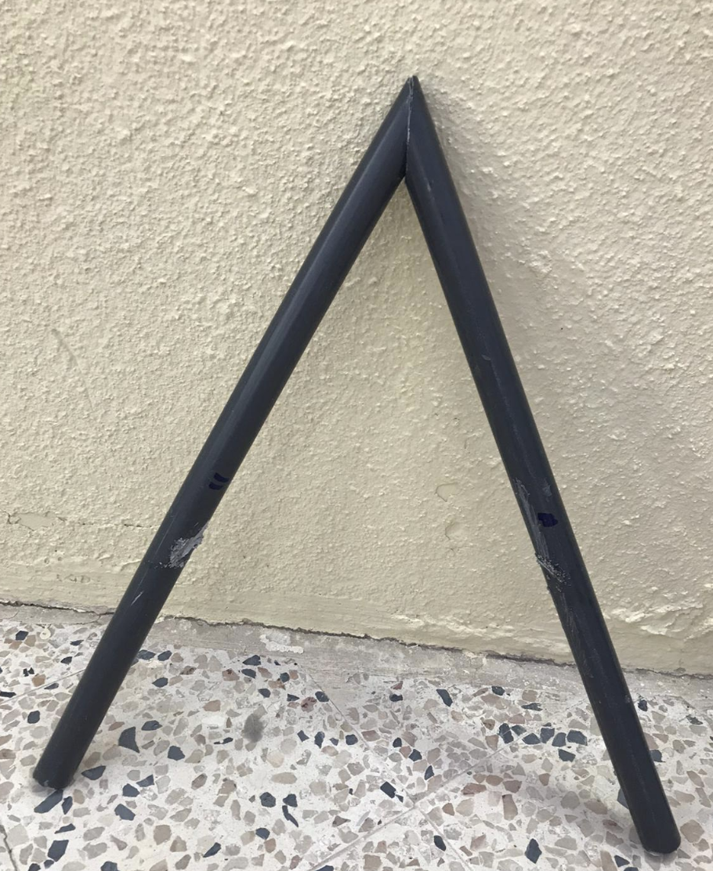
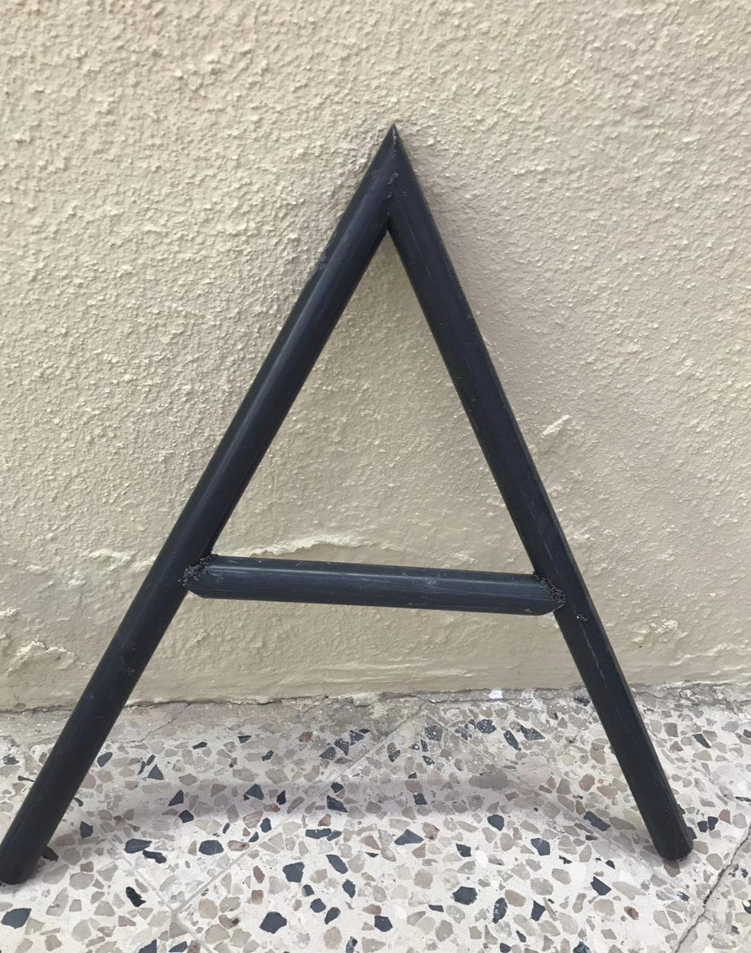
Prototype - Front Suspenssion
Figure 5: Upper A-Arm
Figure 6: lower A-Arm
Salem/SAE Baja/21-2-2021

Slide 24
Prototype - Dashboard
Salem/SAE Baja/21-2-2021
Figure 8: Schematic of dashboard circuit design

Slide 25
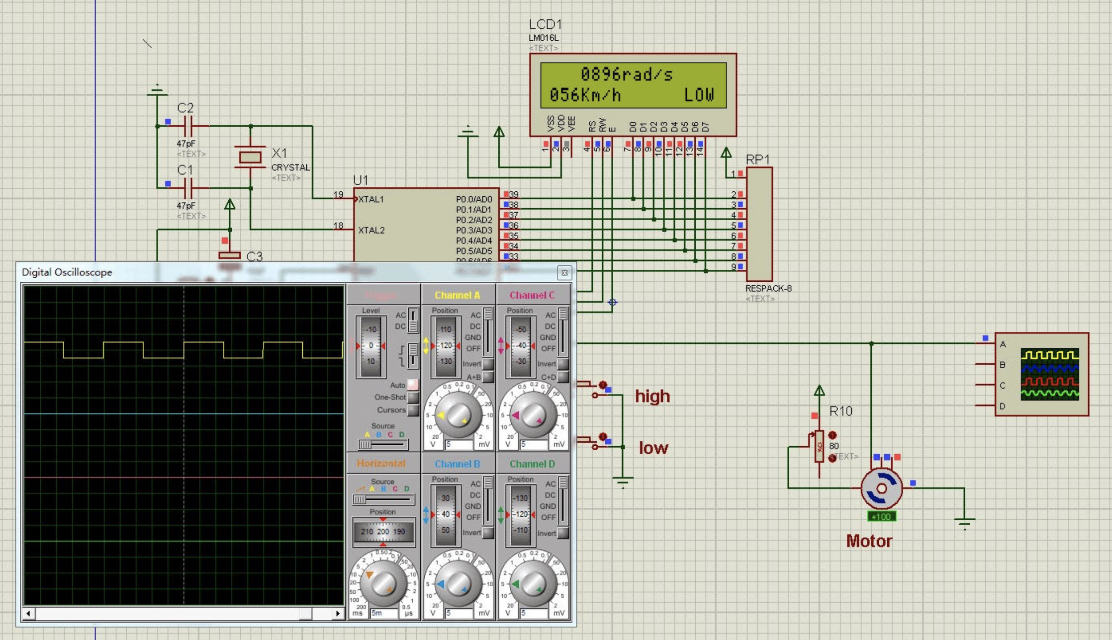
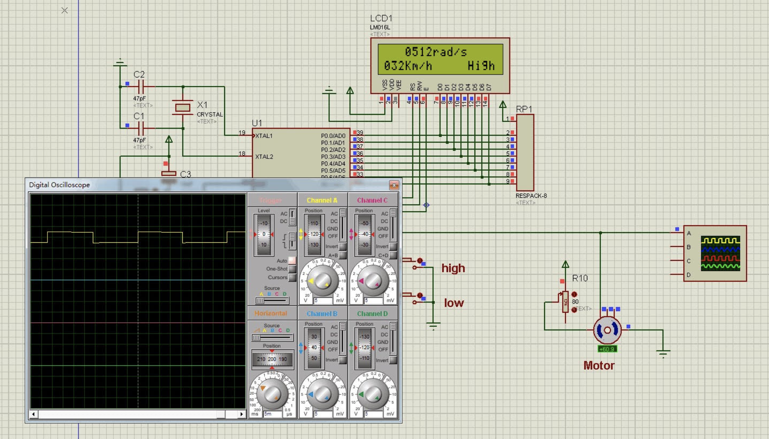
Prototype - Dashboard
Salem/SAE Baja/21-2-2021
Figure 9: Simulation of dashboard circuit design

Slide 26
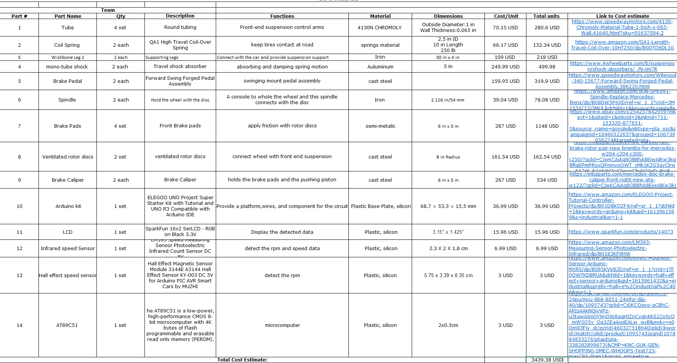
Bill of Materials (BOM)
Wang/ SAE Baja/21-2-2021

Slide 27
Conclusion
Project design has selected for suspension, brake system and dashboard.
Schedule for the future tasks has made
Budget has decided and divided
Future Work
Components and materials need to select
Implementation and Assembly will start
Testing will perform
Wang/ SAE Baja/21-2-2021

Slide 28
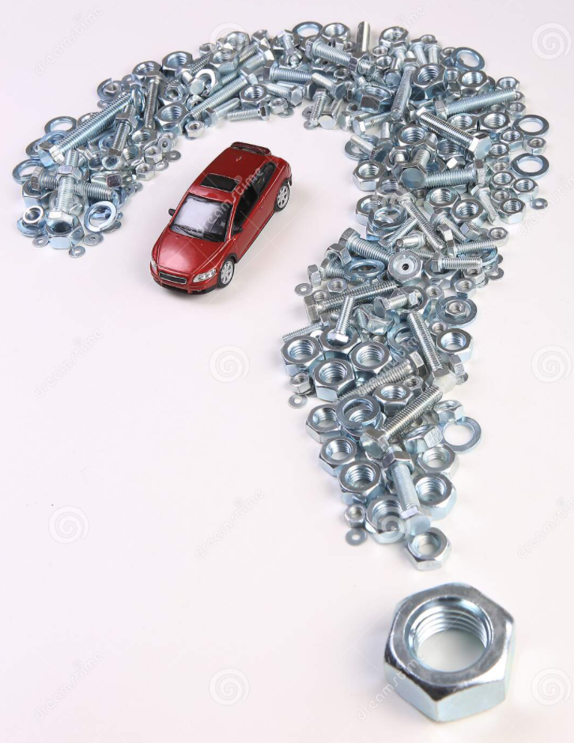
ANY QUESTIONS

Slide 29
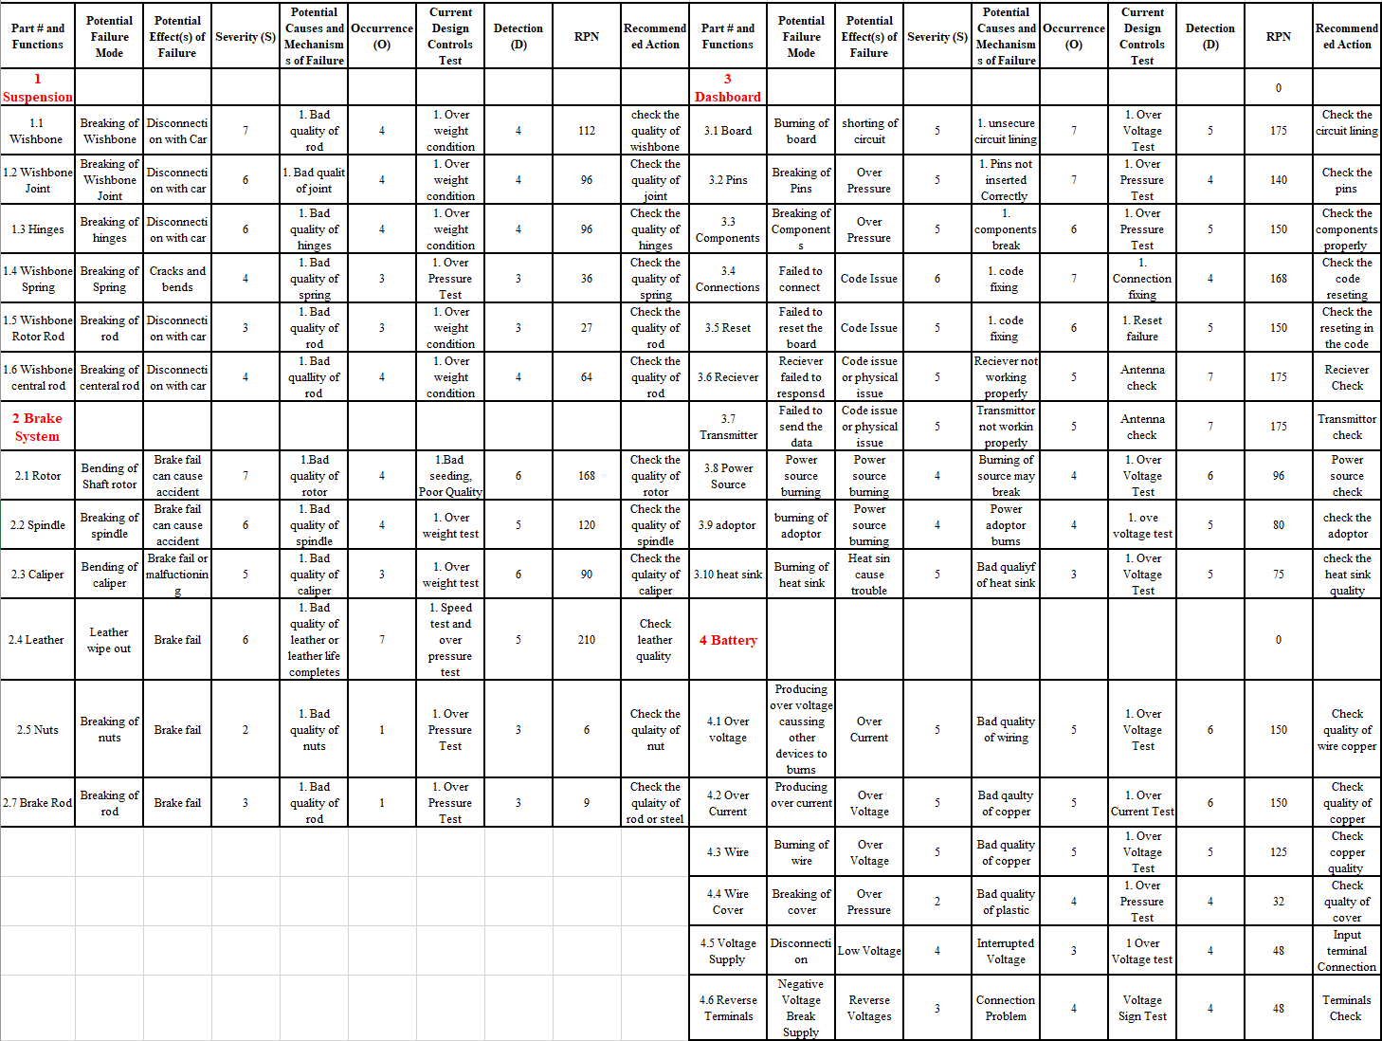
APPENDIX - FMEA

