Slide 1


Northrop Grumman Umbilical 100% Build
Griffin Brandt, Leah Blakney, Jonathan Armijo, Jack Shields
March 31st, 2022

Slide 2
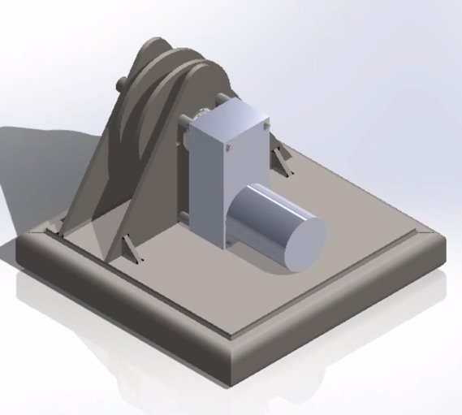
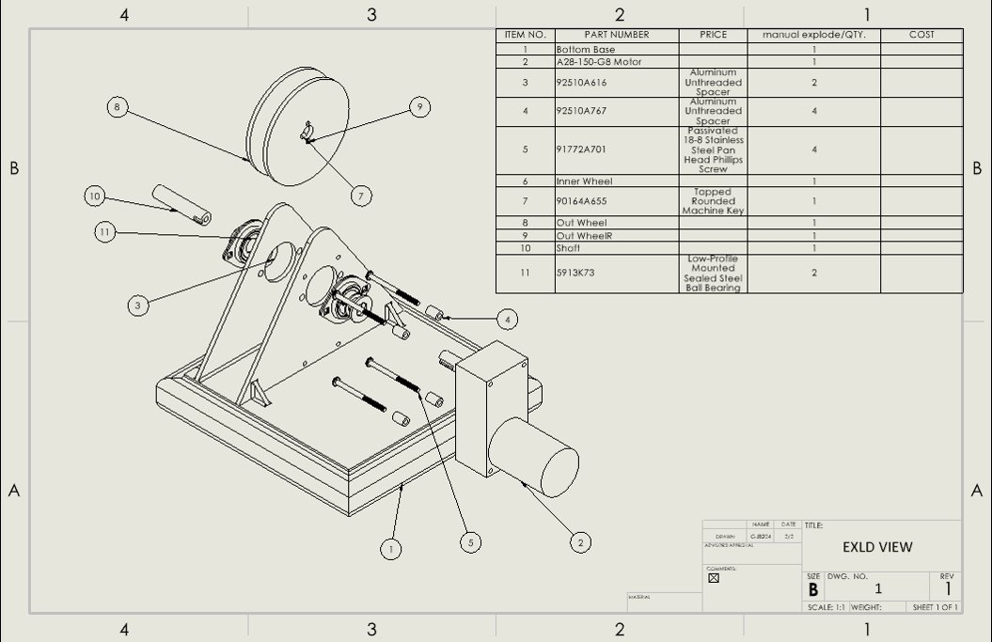
Design Efforts - CAD
Figure 1: CAD Assembly
Figure 2: CAD Exploded View
Heat Shield Removed
NG – 3/31/2022
Griffin Brandt

Slide 3
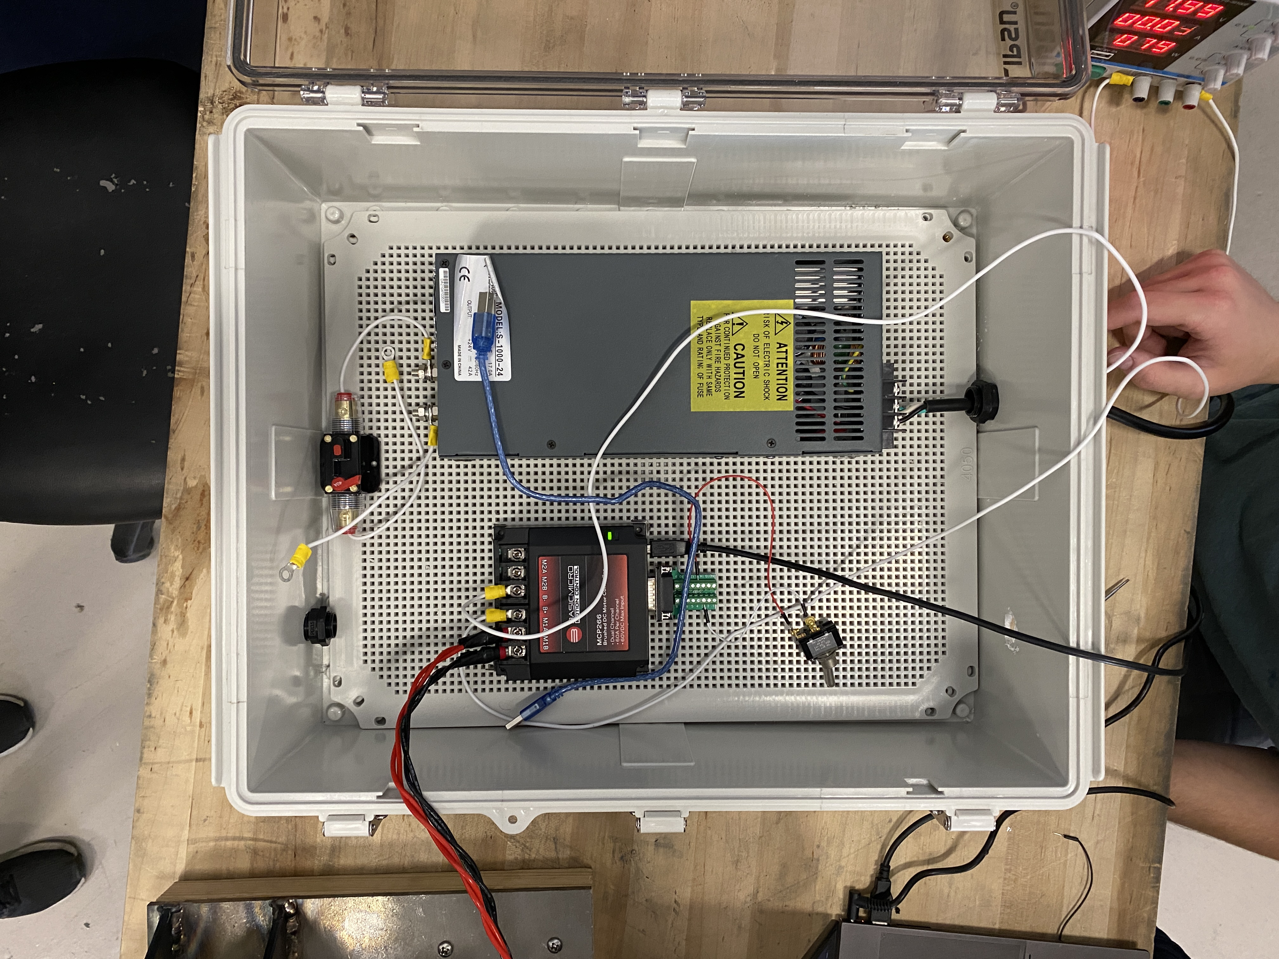
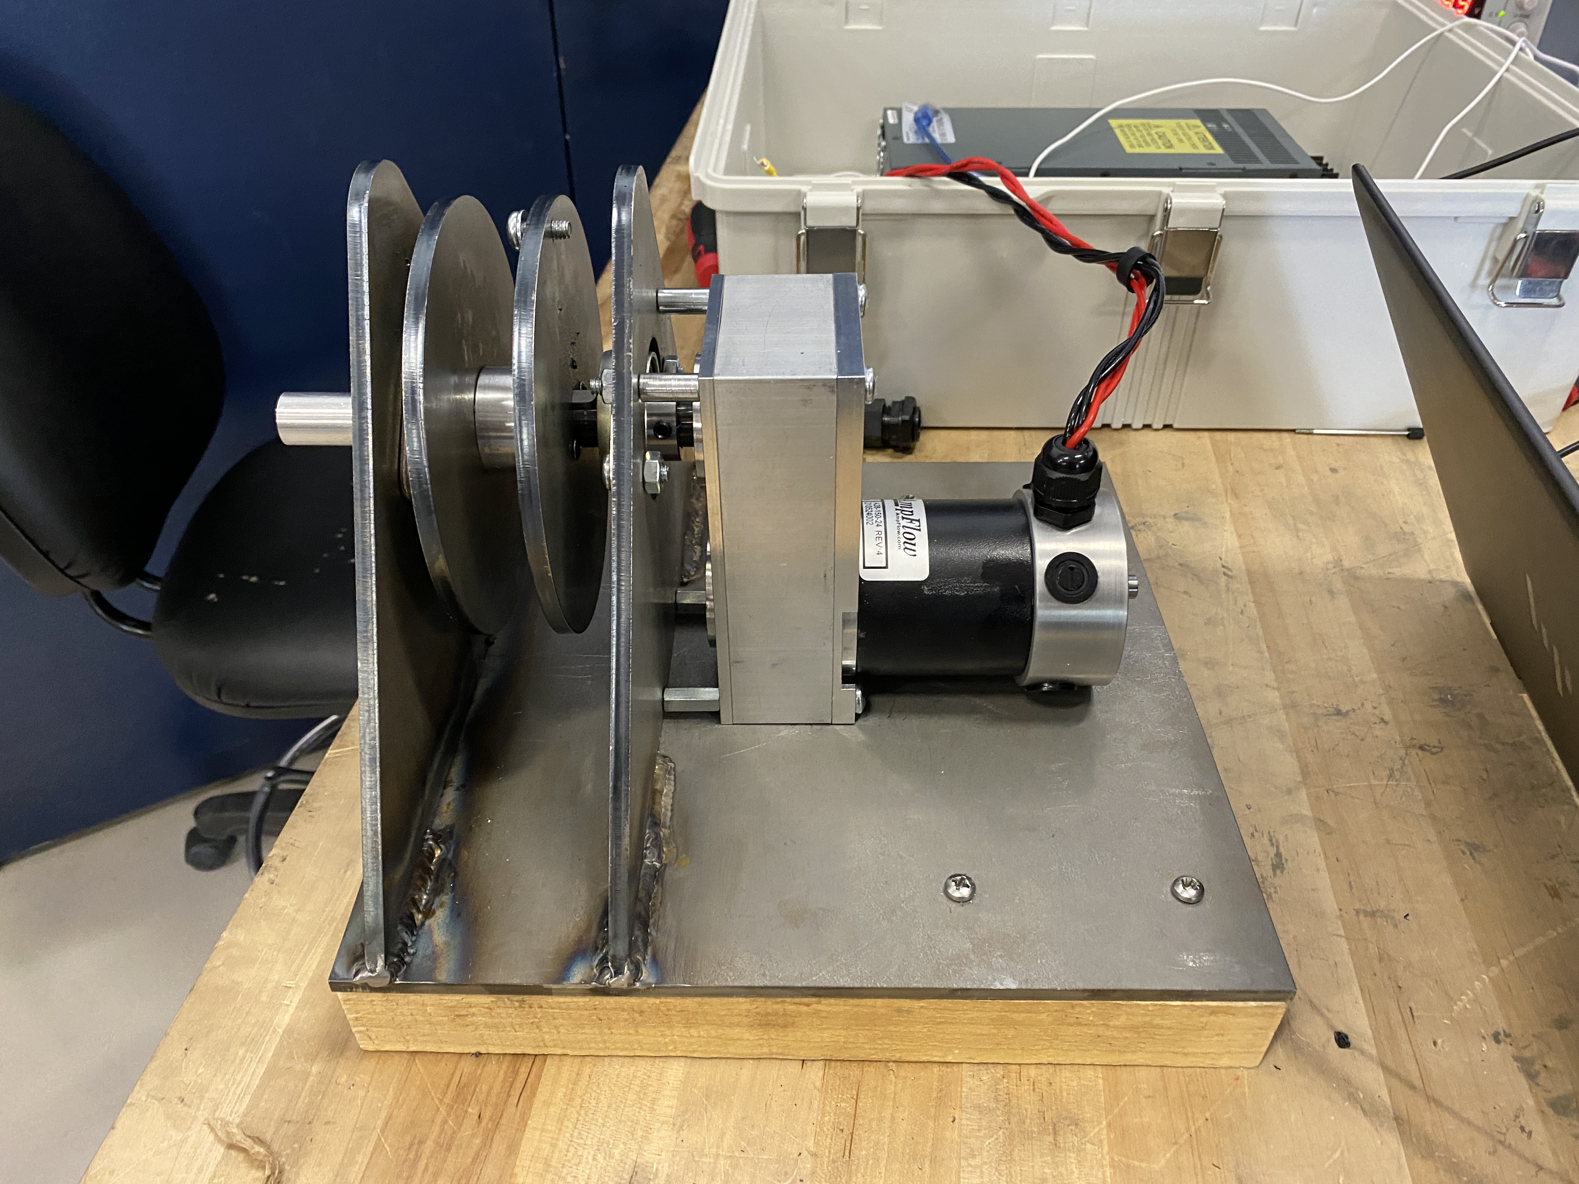
Design Efforts - Assembly
Figure 3: Electrical Circuit
Figure 4: Hardware Assembly
Full assembly made
Show demonstration later
NG – 3/31/2022
Jonathan Armijo

Slide 4
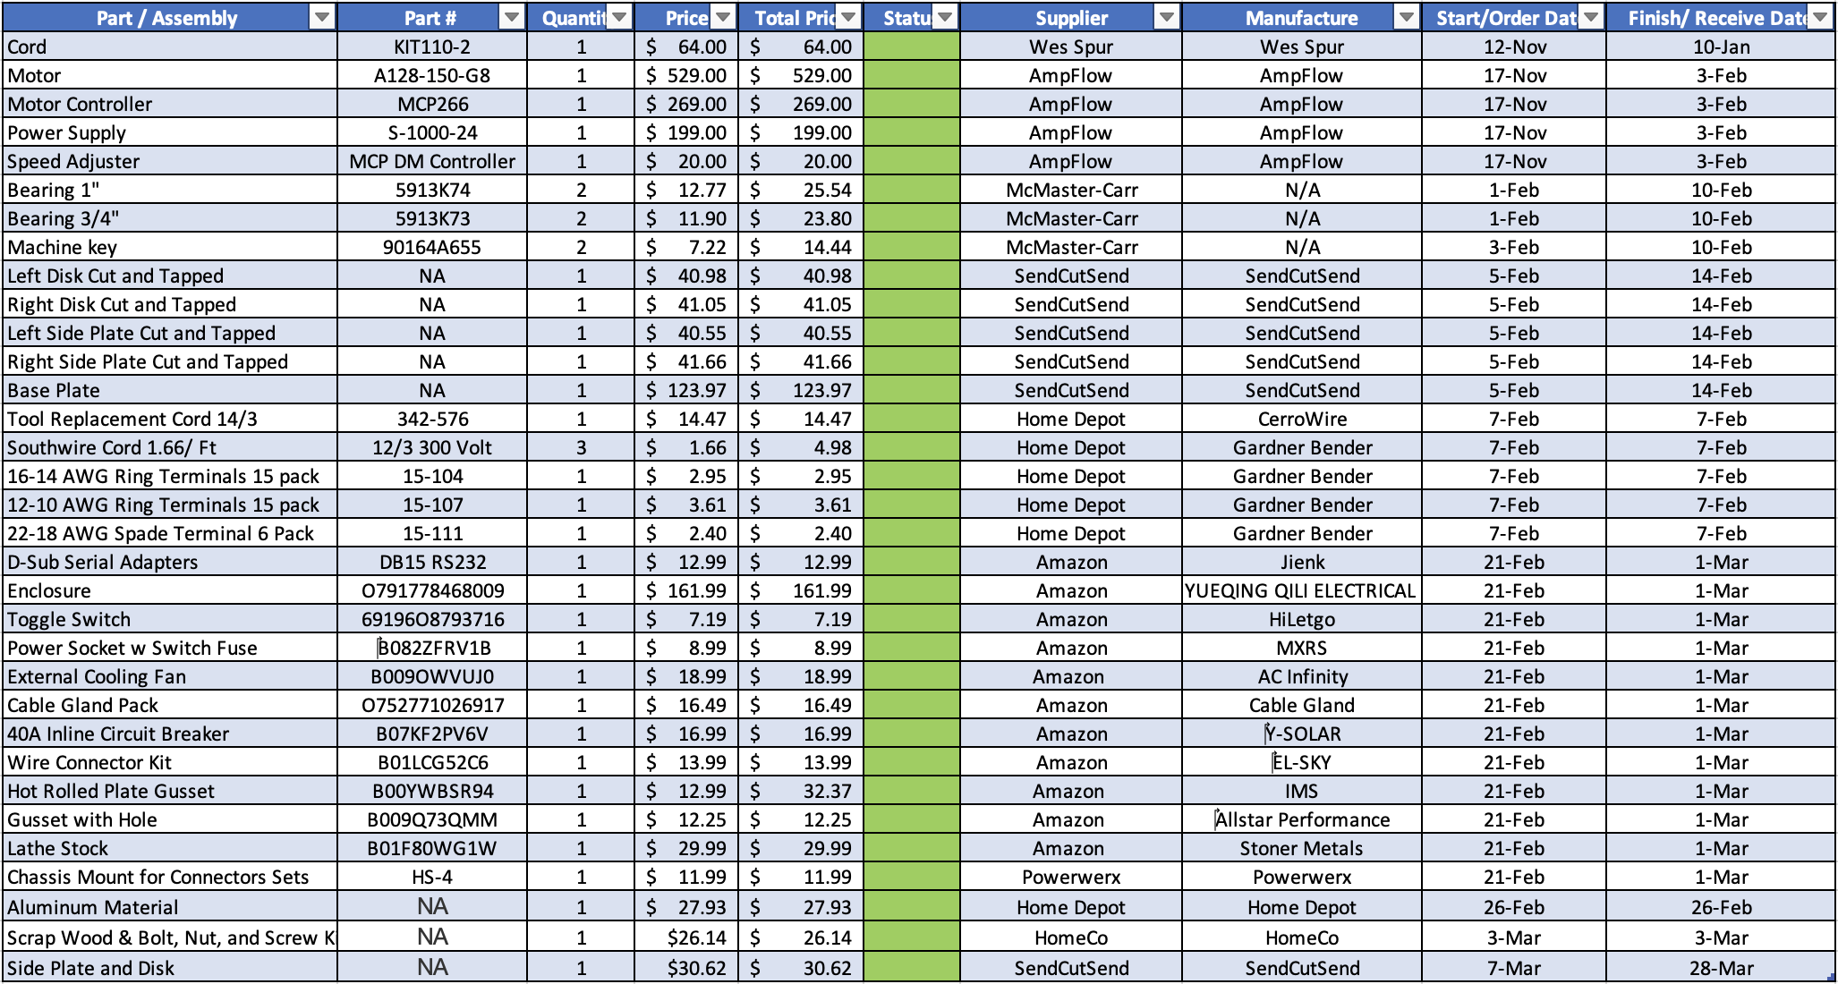
Purchasing Plan
Table 1: Purchasing Plan
Total
Purchasing
Plan
$1890.31
NG – 3/31/2022
Jack Shields

Slide 5
Manufacturing Plan
Table 2: Manufacturing Plan
Part / Assembly | Part # | Quantity | Price | Total Price | Status | Supplier | Manufacture | Start/Order Date | Finish/ Receive Date
Left Disk Cut and Tapped | NA | 1 | $40.98 | $40.98 |  | SendCutSend | SendCutSend | 5-Feb | 14-Feb
Right Disk Cut and Tapped | NA | 1 | $41.05 | $41.05 |  | SendCutSend | SendCutSend | 5-Feb | 14-Feb
Left Side Plate Cut and Tapped | NA | 1 | $40.55 | $40.55 |  | SendCutSend | SendCutSend | 5-Feb | 14-Feb
Right Side Plate Cut and Tapped | NA | 1 | $41.66 | $41.66 |  | SendCutSend | SendCutSend | 5-Feb | 14-Feb
Base Plate | NA | 1 | $123.97 | $123.97 |  | SendCutSend | SendCutSend | 5-Feb | 14-Feb
Welding, R/L Plate to Base | N/A | 1 | N/A | N/A |  | N/A | Machine Shop | 25-Feb | 25-Feb
Inside Wheel | N/A | 1 | N/A | N/A |  | Home Depot | Jonathan/ Machine Shop | 25-Feb | 4-Mar
Shaft | N/A | 1 | N/A | N/A |  | Home Depot | Jonathan/ Machine Shop | 25-Feb | 4-Mar
Electrical Layout | N/A | 1 | N/A | N/A |  | N/A | Jonathan | 4-Mar | 11-Mar
Machine Assembly | N/A | 1 | N/A | N/A |  | N/A | Griffin/ Machine Shop | 7-Mar | 30-Mar
Electrical Assembly | N/A | 1 | N/A | N/A |  | N/A | Jonathan/ Machine Shop | 7-Mar | 29-Mar
Full Assembly | N/A | 1 | N/A | N/A |  | N/A | Team | 14-Mar | 30-Mar
NG – 3/31/2022
Griffin Brandt

Slide 6
Demonstration
NG – 3/31/2022
Jonathan Armijo

Slide 7
Testing Plan
Motor Startup – Complete
Cable Type – Postponed due to weather
Side Force - <10lbs
Retraction Speed – 6lb umbilical 6ft in 1sec
Temperature – -30F to 160F
NG – 3/31/2022
Leah Blakney

Slide 8
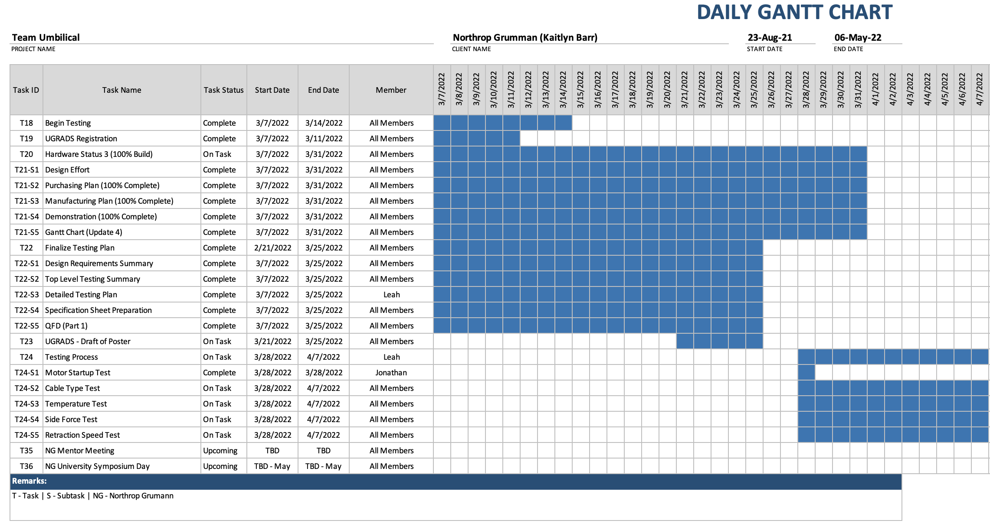
Gantt Chart
NG – 3/31/2022
Figure 5: Gantt Chart
Jack Shields

Slide 9

Questions
NG – 3/31/2022

Slide 10
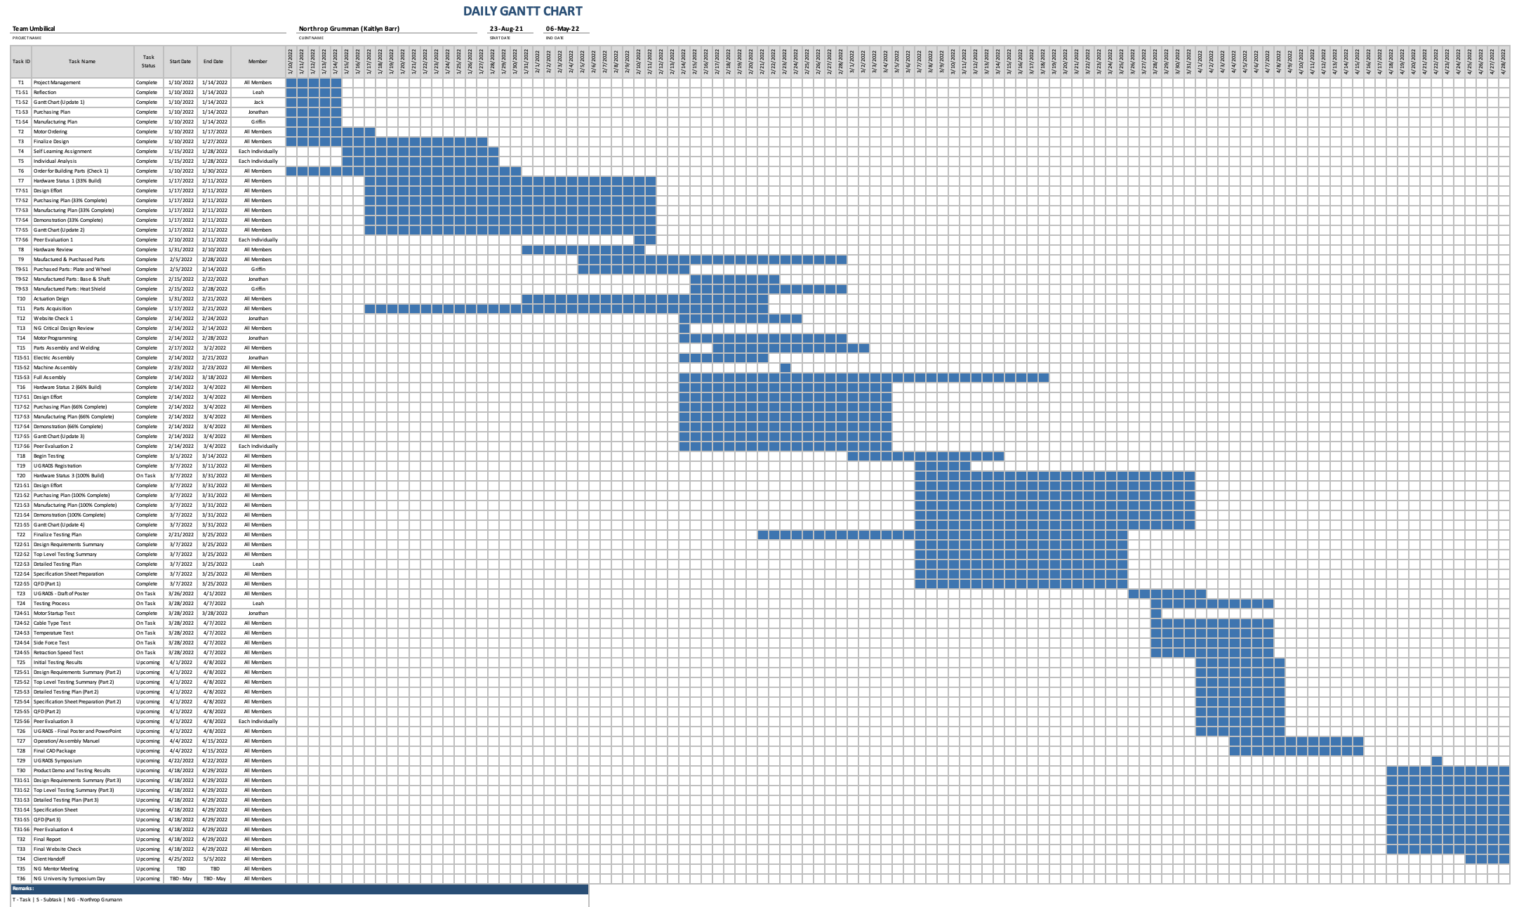
Full Gantt Chart

Slide 11
Reference
K. Your, "blasting off!," Know Your Meme, [Online]. Available: https://news.knowyourmeme.com/photos/1958576-tonight-on-bottom-gear. [Accessed 3 November 2021].

