Slide 1


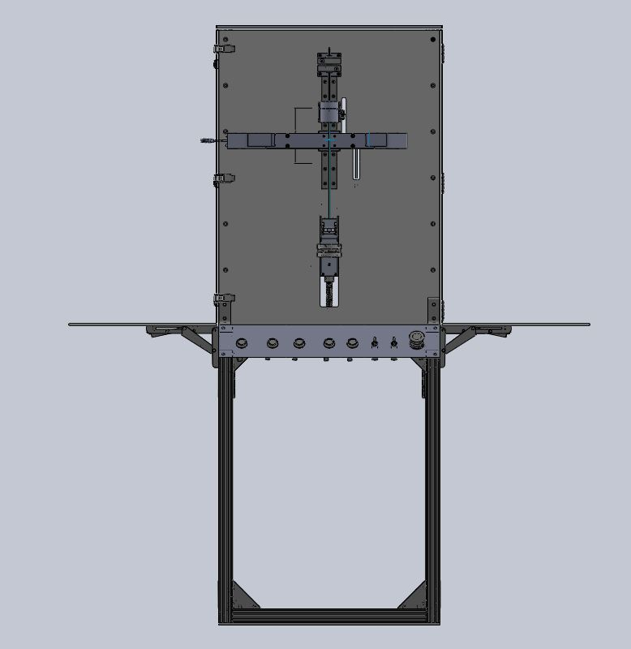
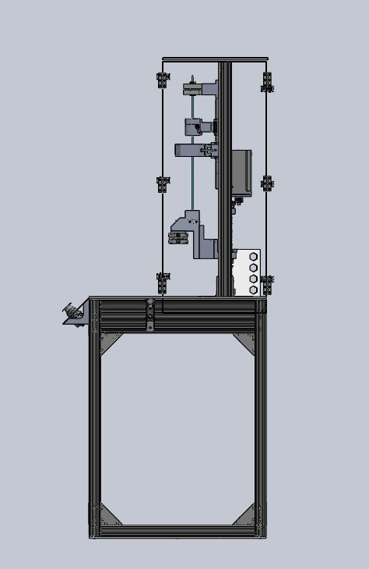
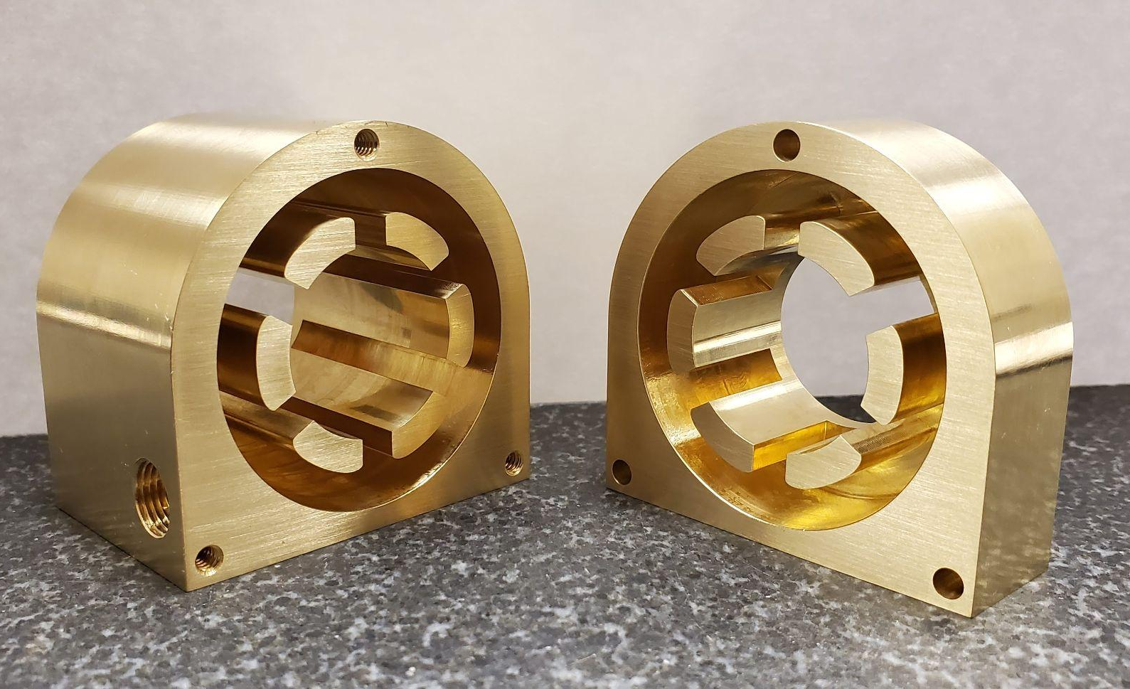
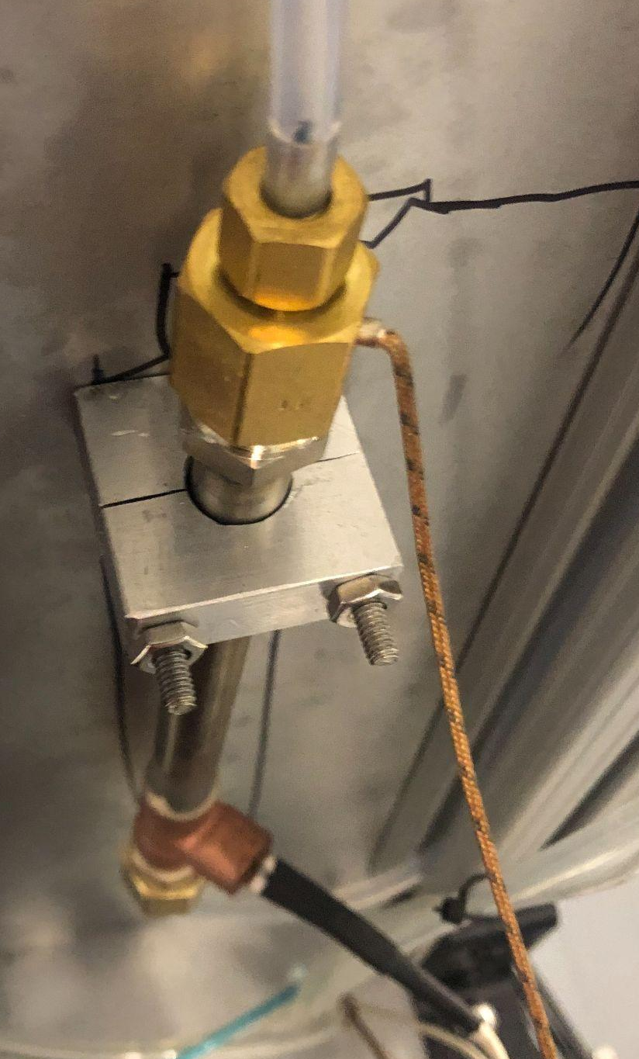
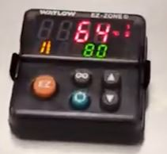
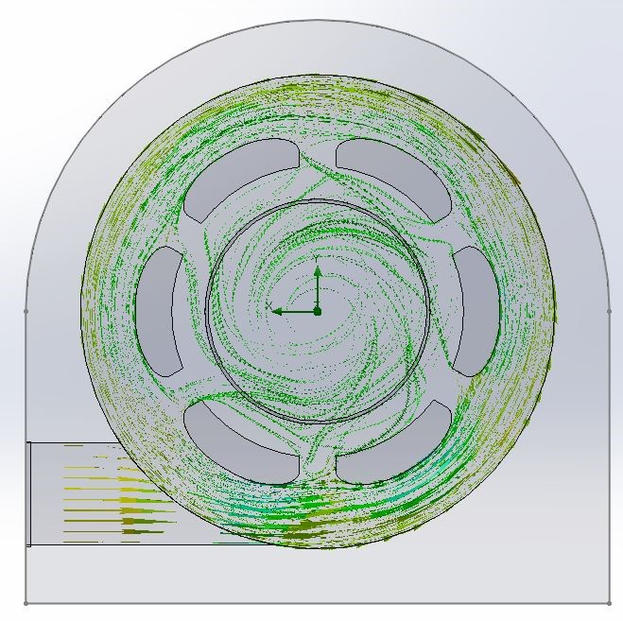
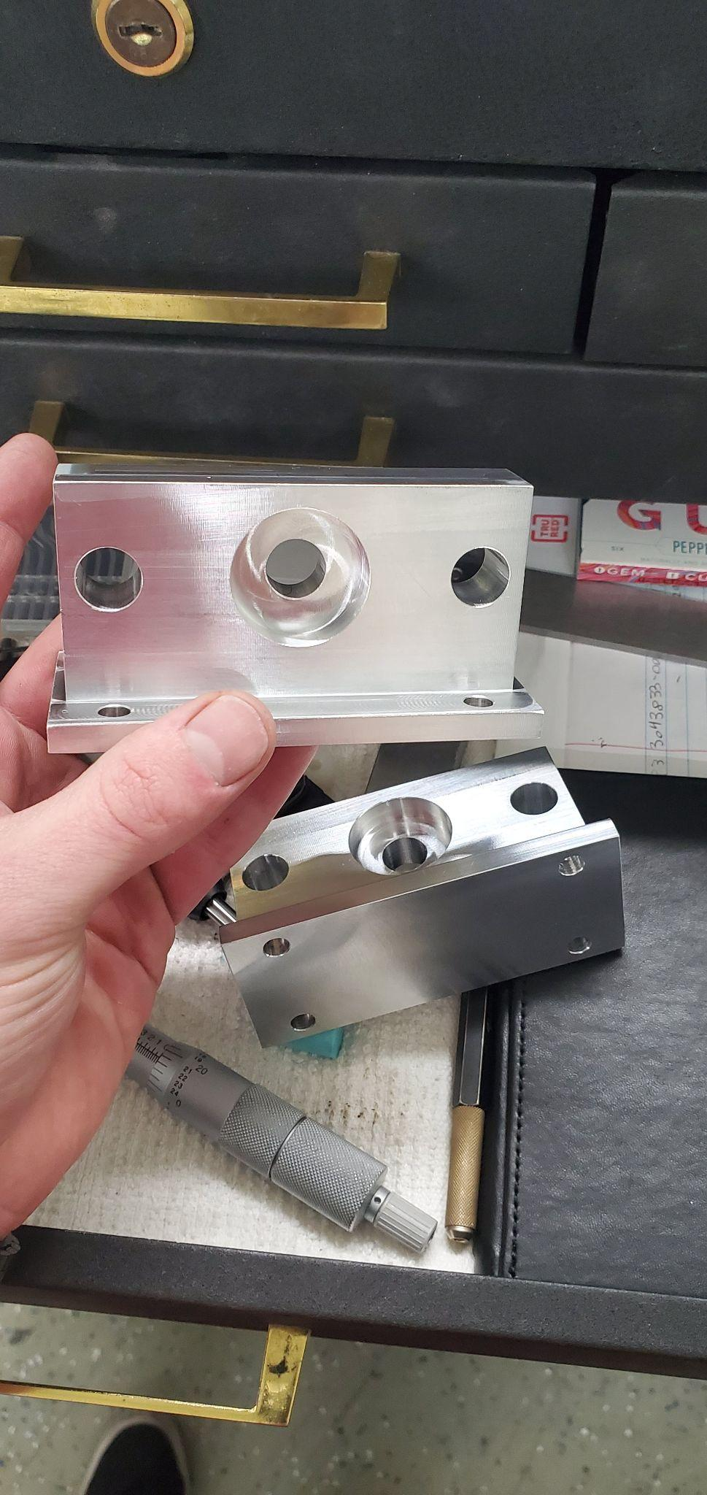
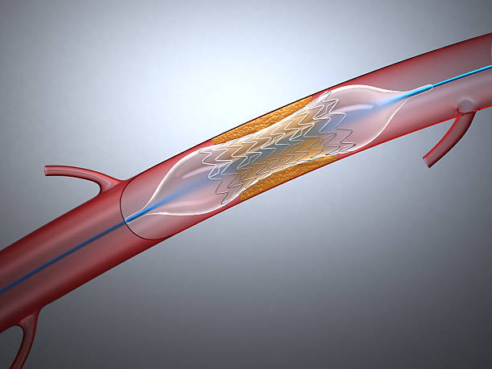
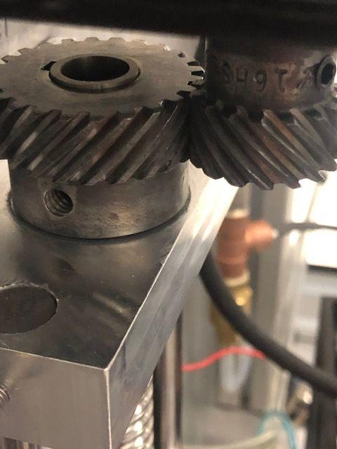
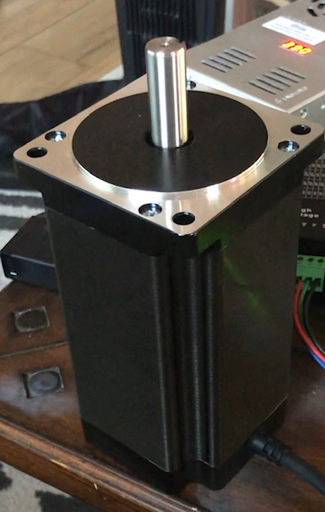
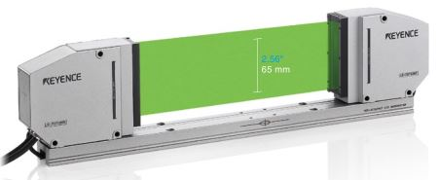
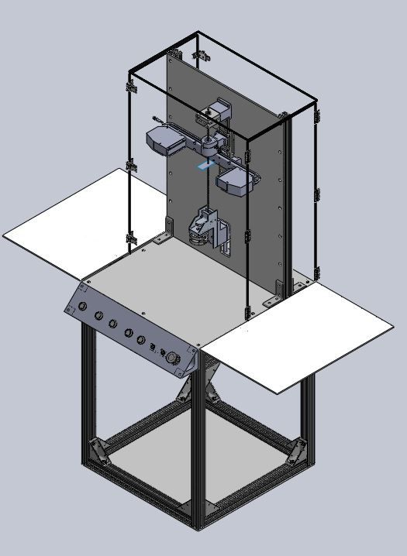
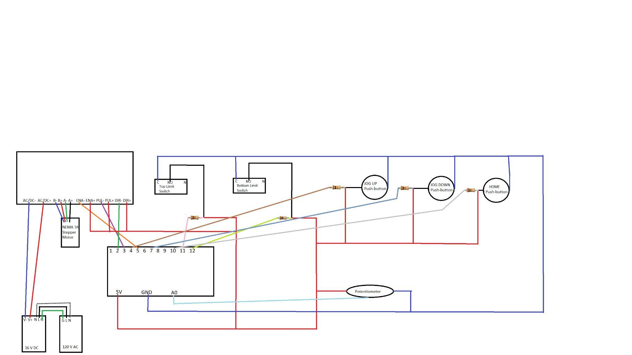
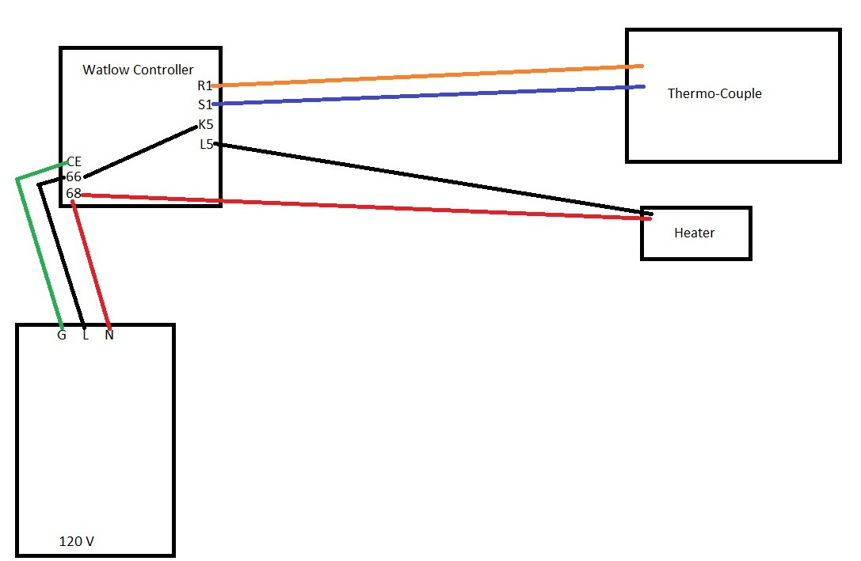
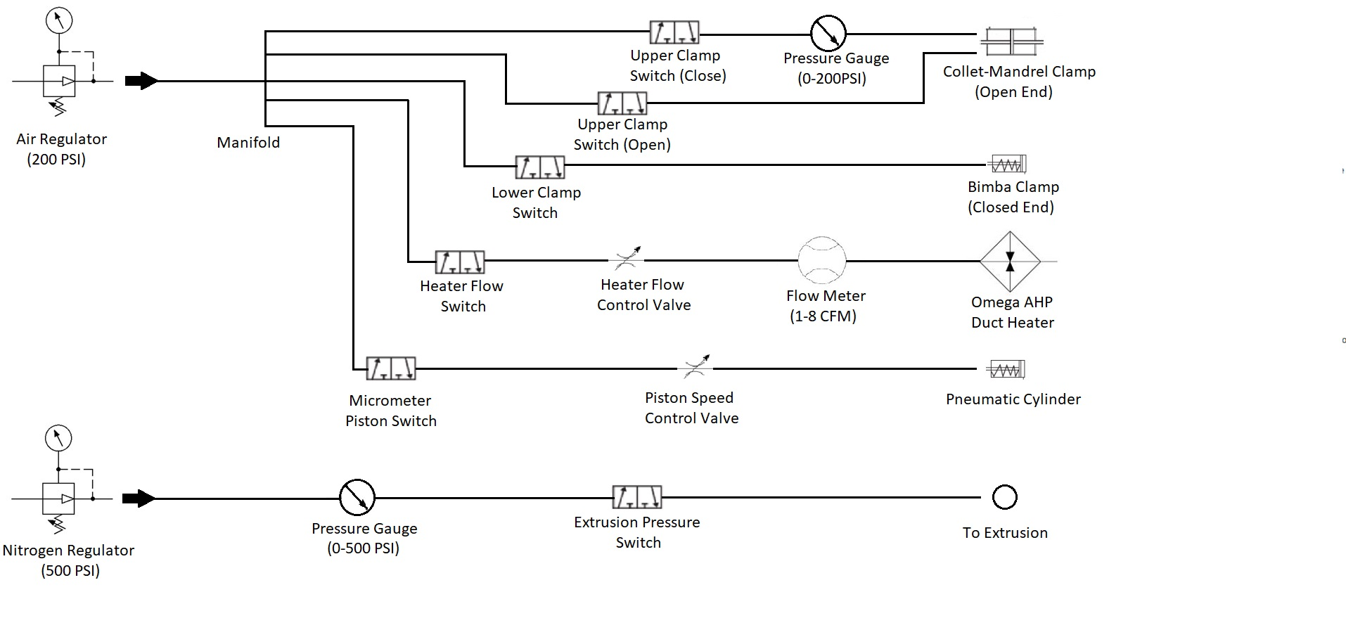
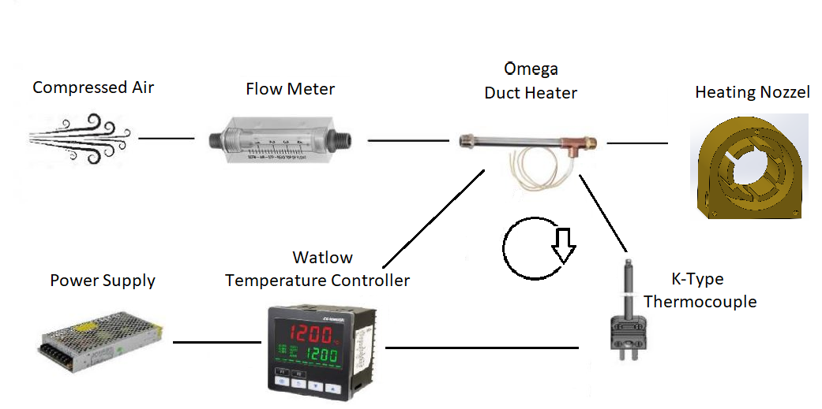
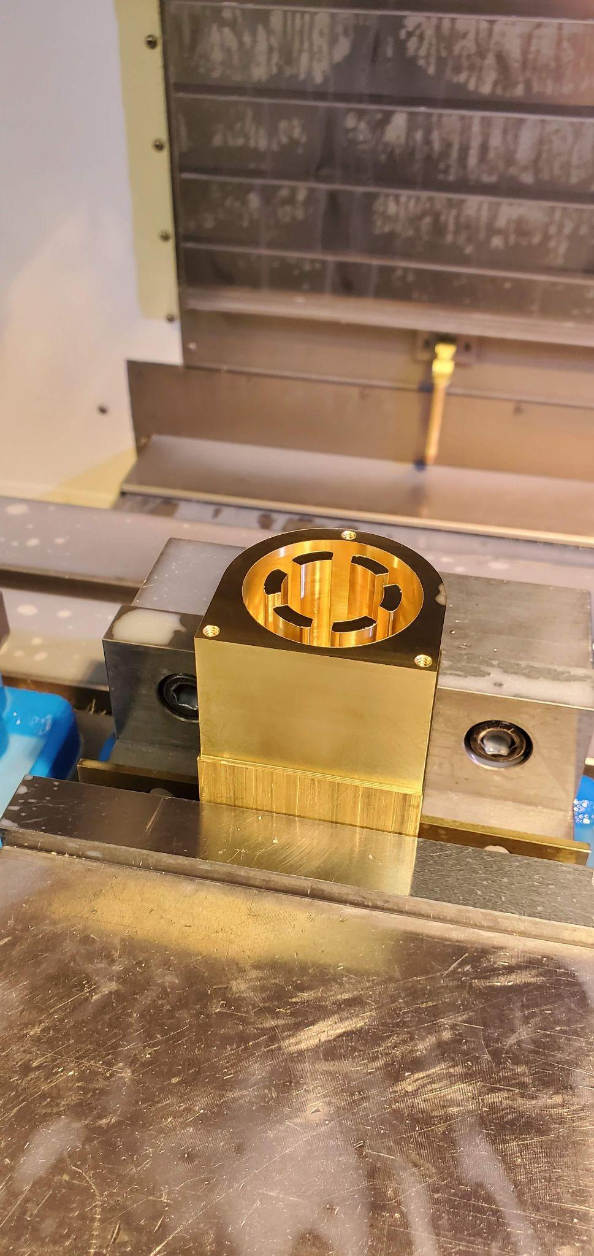
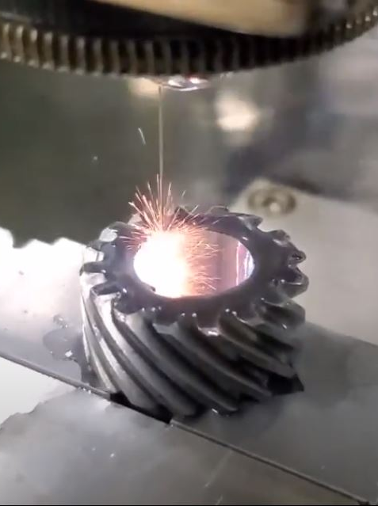
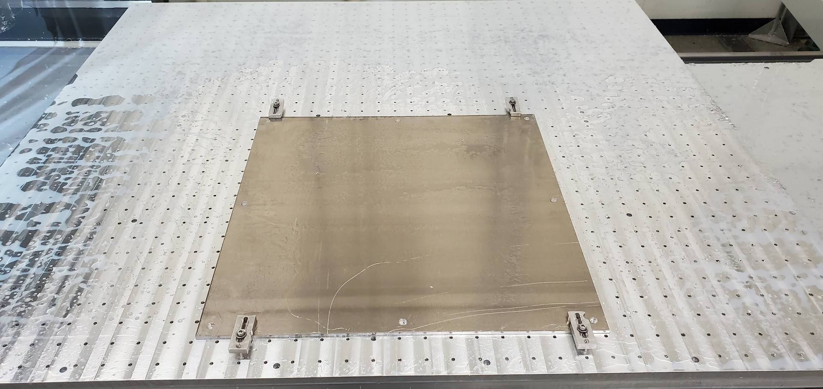
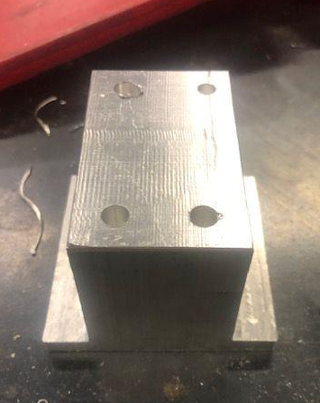
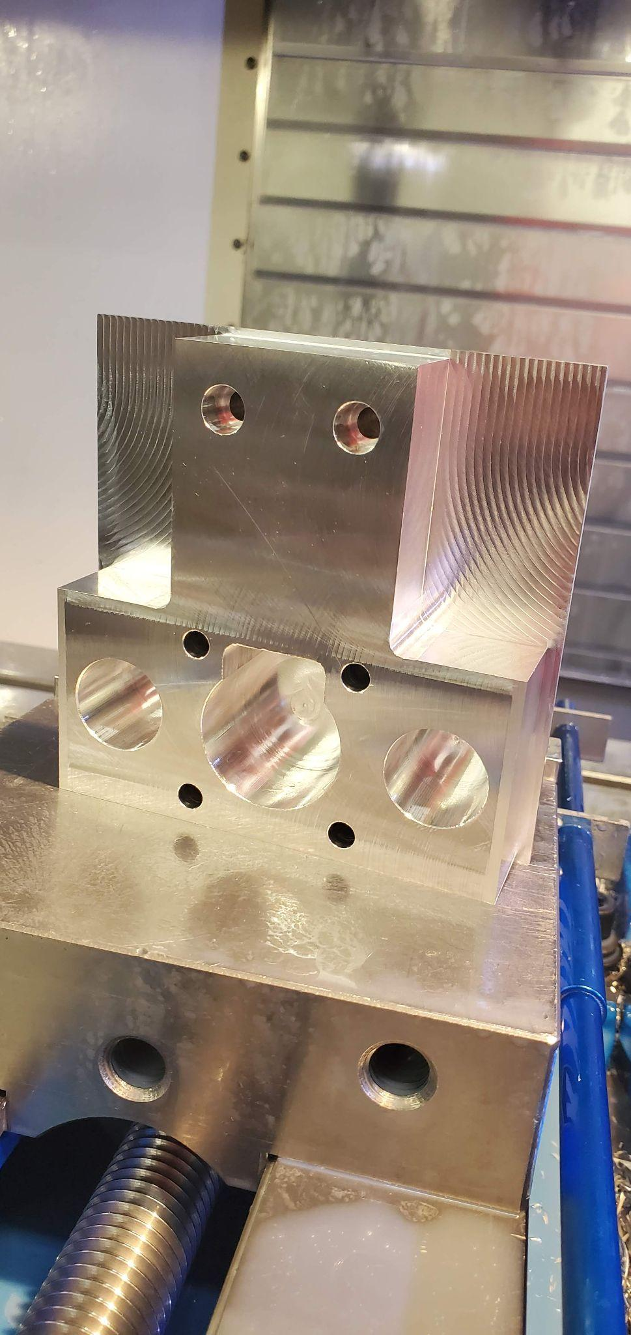
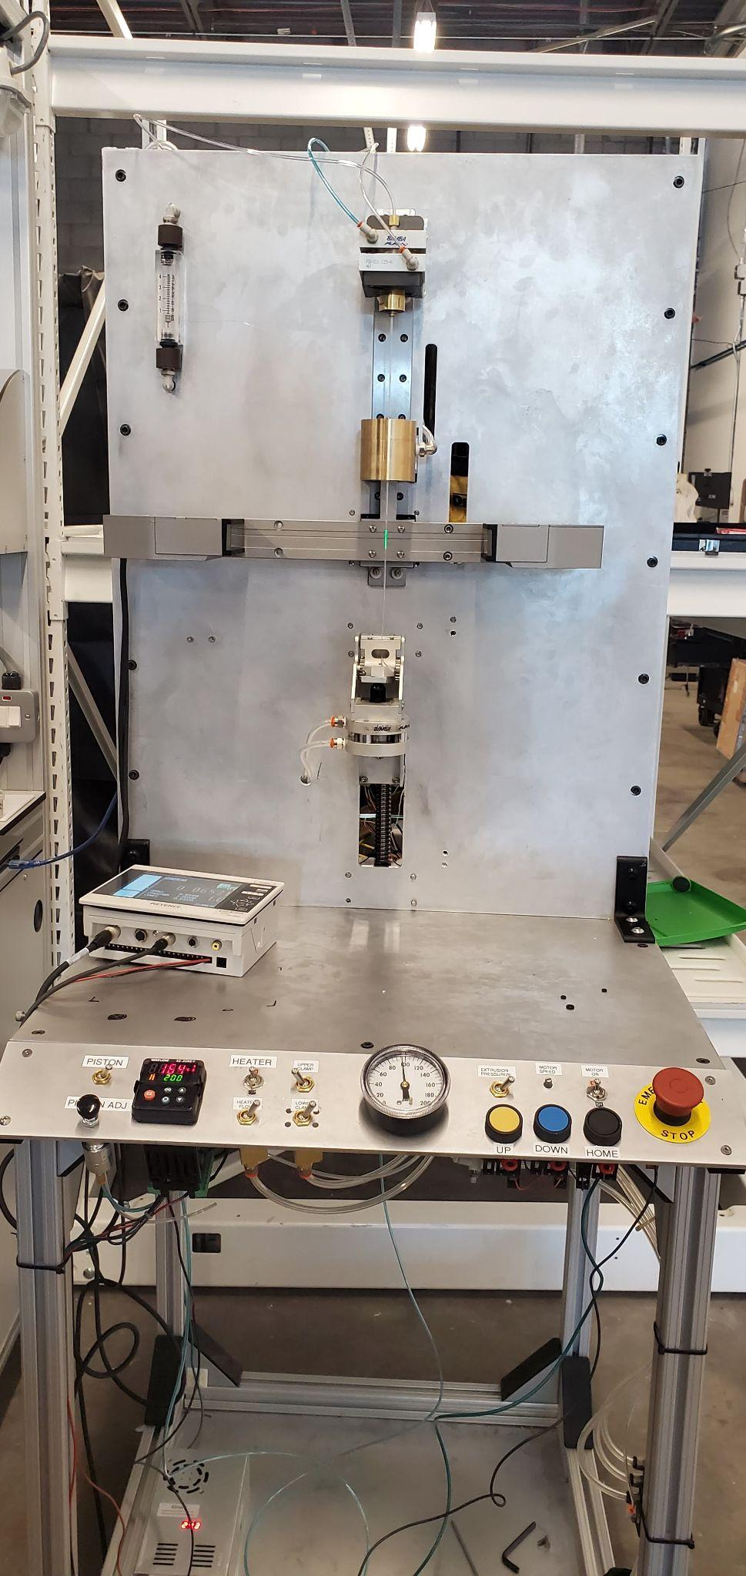
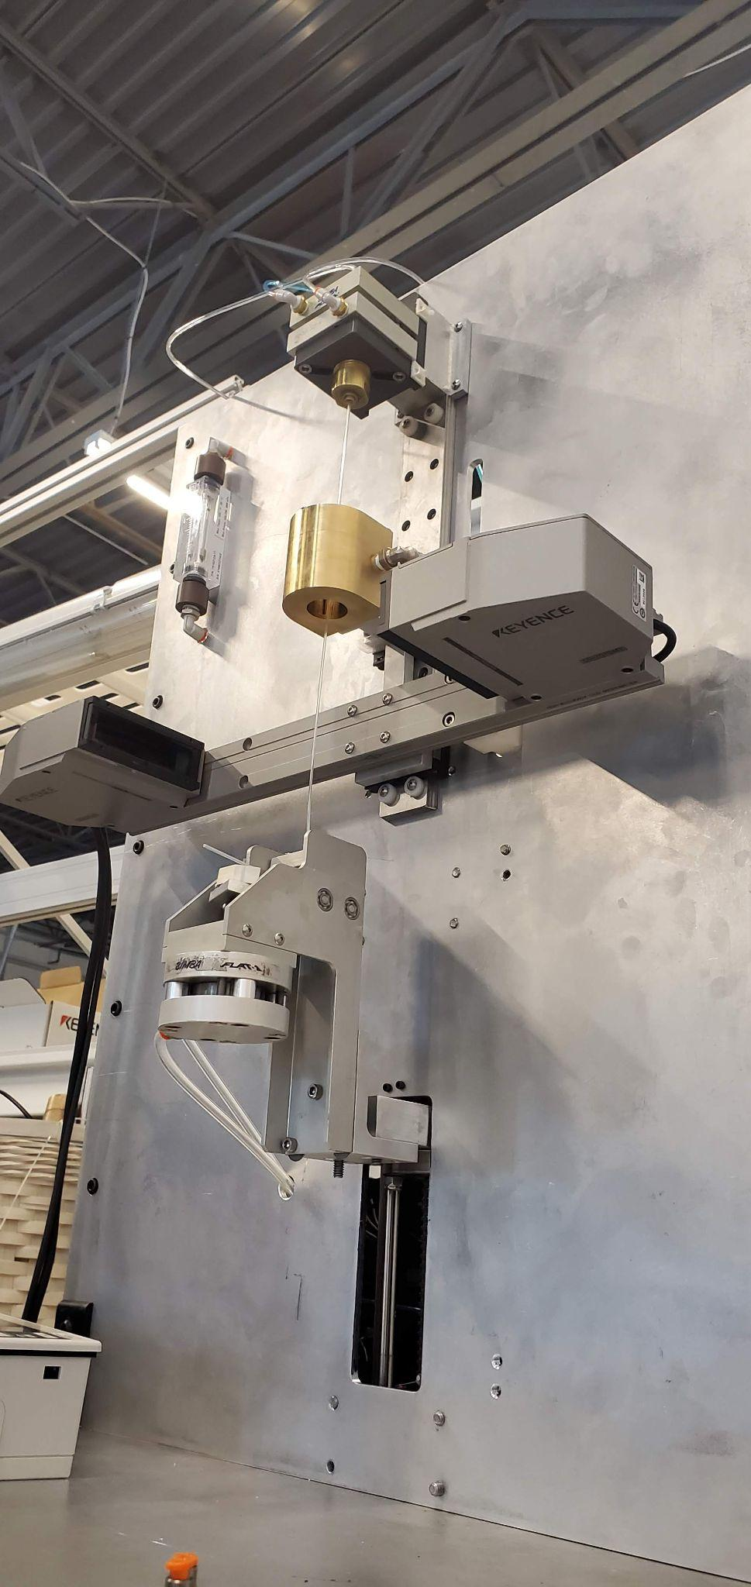
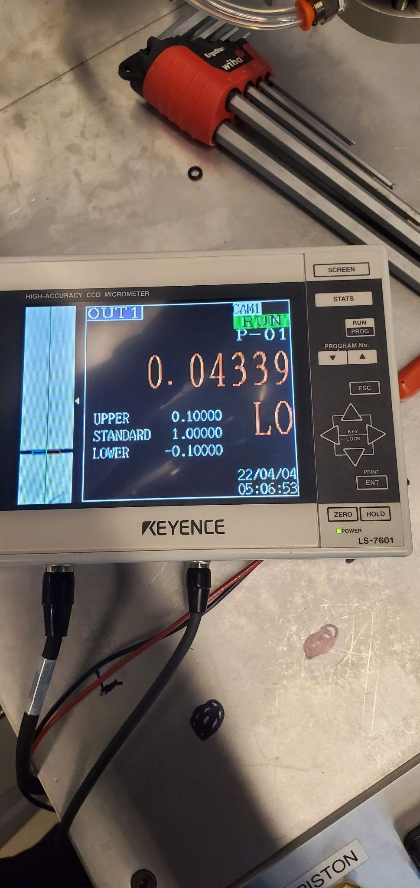
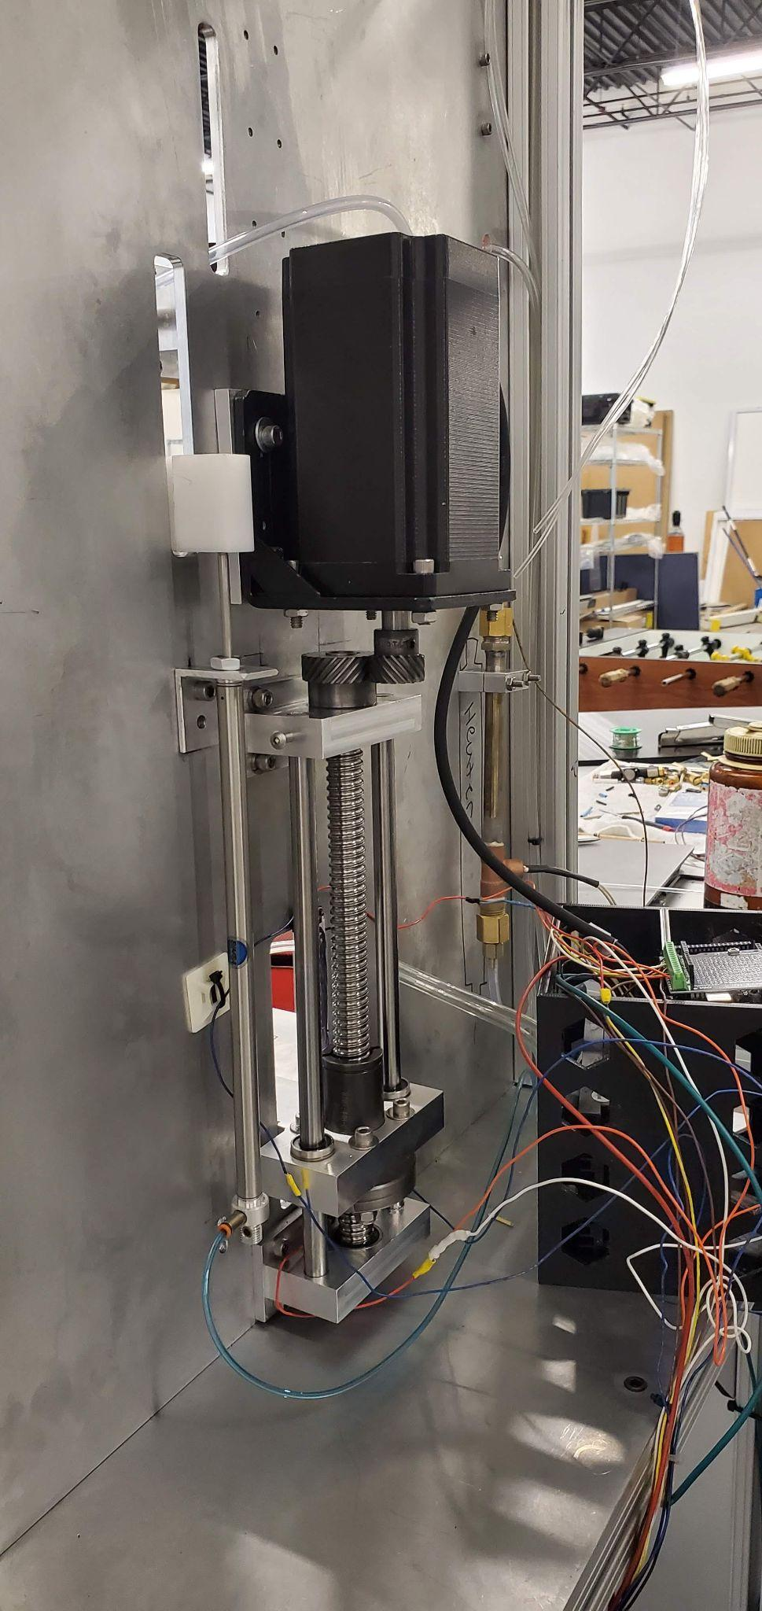

Radial Expansion Tester
Michael Bransky, Noah Keyes, Vergil Sorg
Background
Temperature Control
Axial Loading
CAD
Medical balloons are used in a minimally invasive procedure called an “Angioplasty”. They are inserted into an artery in order to restore blood flow by either widening the passage or by expanding a stent mesh into the desired location.
Temperature control was accomplished using an Omega “AHP-5051” duct heater supplying heated air which flows around a custom CNC machined heater nozzle. The heater was controlled using a Watlow “Ez-Zone” temperature controller connected to a thermocouple placed at the outlet of the heater to vary the heater’s input power to reach a set point.
A Nema-34 Stepper motor combined with a ball screw driving a carriage has been designed in order to supply 150 lbf of axial force. The mounts for the system were CNC milled, and a 1:1.5 gear ratio has been adopted in order to favorably space the motor and increase torque. The motor is driven by a DM860H driver and an Elegoo Mega 2560 microcontroller.
Figure 2: Custom Air Nozzle
Figure 3: Air Heater
Figure 4: Temperature Controller
Figure 5 : Heater Nozzle CFD Analysis
Diameter Measurement
Figure 16: Gears meshing
Figure 17: CNC’d Mounts
Figure 18: Nema 34-Stepper Motor
Diameter measurement is accomplished with a Keyence “LS-7000” laser micrometer. This device is mounted on a linear guide rail which is driven by a pneumatic cylinder. This is done so the system can measure the most likely point of max expansion by moving to where the extrusion was heated.
System Diagrams
Figure 1 : Medical Balloon Example
Figure 6 : Keyence Laser Micrometer
Abstract
Manufacturing
The team has been tasked with designing and building a thermoplastic extrusion testing machine for Poba Medical, a local medical device manufacturer. These extrusions can be made from a range of different materials and are used to form medical balloons through a blow molding process which involves pressurizing them with nitrogen, heating them to given temperature, and stretching them to form the required shape. By varying these parameters, Poba Medical will be able to determine how a given material will behave under specific conditions which impacts the accuracy and predictability of the blow molding process as well as provide data to help improve the design of the medical balloon.
All manufacturing work for the radial expansion tester was done by members on the team. These included EDM work, CNC work, manual mill work, and bandsaw/drill press work. A notable manufactured part was the custom heater nozzle, which required 4 hours to mill.
Figure 19: Arduino Wiring Schematic
Figure 20: WATLOW Controller Schematic
Figure 7: Heater Nozzle Machining
Figure 8: Wire EDM machining ID of gear
Figure 9: Tabletop machined on CNC Mill
Figure 10: Mount machined on Manual Mill
Figure 11: First op of ball screw nut mount
Figure 21: Full Pneumatic Schematic
Figure 22: Full Heating System Diagram
Full Design
Testing
The full design consists of all 4 subsystems, as well as a baseplate and small table for the subsystems to be mounted on. All subsystems can be controlled using a combination of buttons and knobs, as seen in figure 12. Measurements are output onto gauges and a system provided by Keyance. All subsystems are currently functional and can work in tandem.
Full system testing was conducted in order to ensure that the system was working as intended. This was done by testing balloons at a variety of different temperatures, air flow rates, and “soak times.” Material A was nylon, Material B was pebax, and Material C a harder polymer of pebax.
Conclusion
Requirements
The team has created a fully functional Radial Expansion Tester which meets all of the engineering requirements and does so with repeatable and accurate results. This machine can provide well over 150 lbf of axial force, consistently heat the extrusion to 150 °F, and measure both the maximum diameter of an extrusion as well as the change in diameter. The clients have stated that they are very happy with the quality of the project and that the team met or exceeded all of their requirements.
In order to effectively test these thermoplastic extrusions, the machine will need to simultaneously accomplish the following tasks:
1 Pressurize extrusions up to 300 psi
2 Apply an axial load of up to 150 lbf
3 Measure maximum diameter of extrusion up to a maximum of 2.5”
4 Control temperature of extrusion up to 250°F
5 Expand Extrusions with diameters ranging from .02-.625”
6 Output measurements in easy to read format
Temperature (C) | Pressure (psi) | Flow (CFM) | Material | Change in Diameter
200 | 100 | .25 | A | -.0242
230 | 100 | .15 | A | -.0256
230 | 100 | .1 | A | -.0256
150 | 100 | .2 | B | Popped
200 | 100 | .2 | B | Popped
200 | 100 | .2 | B | Popped
150 | 100 | .2 | C | -.015
200 | 100 | .2 | C | Popped
Acknowledgements
Devon Martindale,
Bryce Igo,
Dr David Michael Willy,
Dr Perry Wood
Figure 12: Full Assembly Front View
Figure 13: Subsystems in Tandem
Figure 14: Digital Micrometer Reading
Figure 15: Full Axial Loading System

