Slide 1

Vertical Farming
Team Members:
Aaron Curley – Documents
Yanchu Du – Client Contact​
Richard Hamilton – Website Developer
Hunter Kea – Project Manager​
Alfred Serventi – Budget Liaison​

Slide 2

Project Description (Yanchu)
Background
Target Customer: individuals who is interested in planting
Requirements: size, sustainable, affordable
Client: our teammate Hunter
Sponsor: no sponsor currently

Slide 3
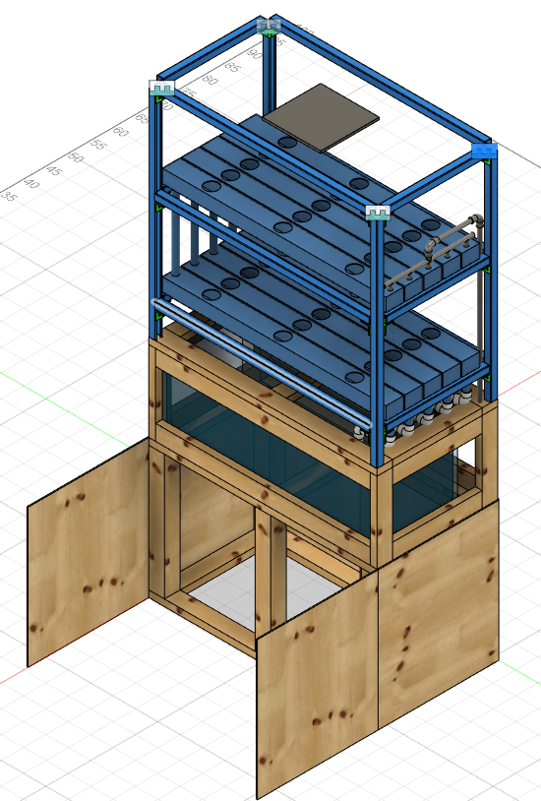
Design Description (Richard)
The current system uses a wooden base with an upper frame made of Unistrut to support the weight of the fish tank.
Underneath the tank is storage for fish food and plant nutrients as well as space for electronics and cables.
The submersed pump pushes water to the upper troughs through tubing
The water then runs into the troughs below and back into the fish tank.
Figure 1: Full CAD Model

Slide 4
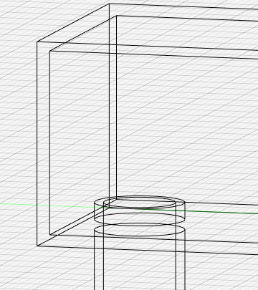
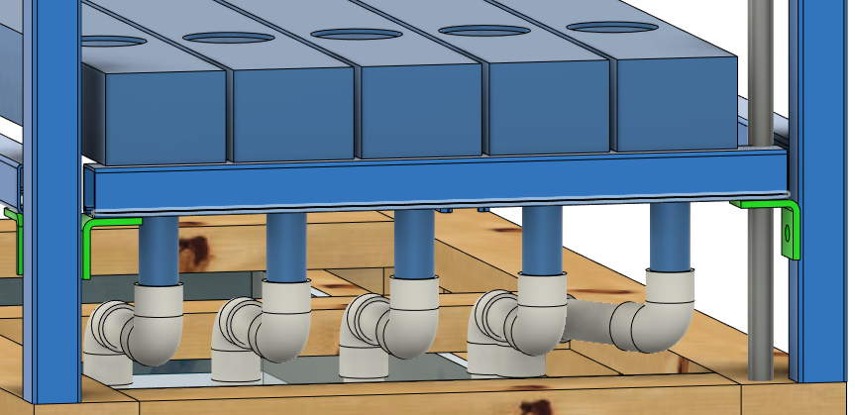
Design Description Cont. (Richard)
When installed, the PVC tubing sticks into the troughs 0.25 inches.
Due to this, the water level in the troughs must be maintained at 0.25 inches before drainage can occur.
This guarantees appropriate water level in the system and provides a method for limiting water drain.
The water drains from the lower pipes into the tank to be reused by the fish and pump.
The flowing water helps aerate the water to keep fish oxygenated.
Figure 2: Troughs with built in drain limiter
Figure 3: Drains from lower troughs into tank.

Slide 5
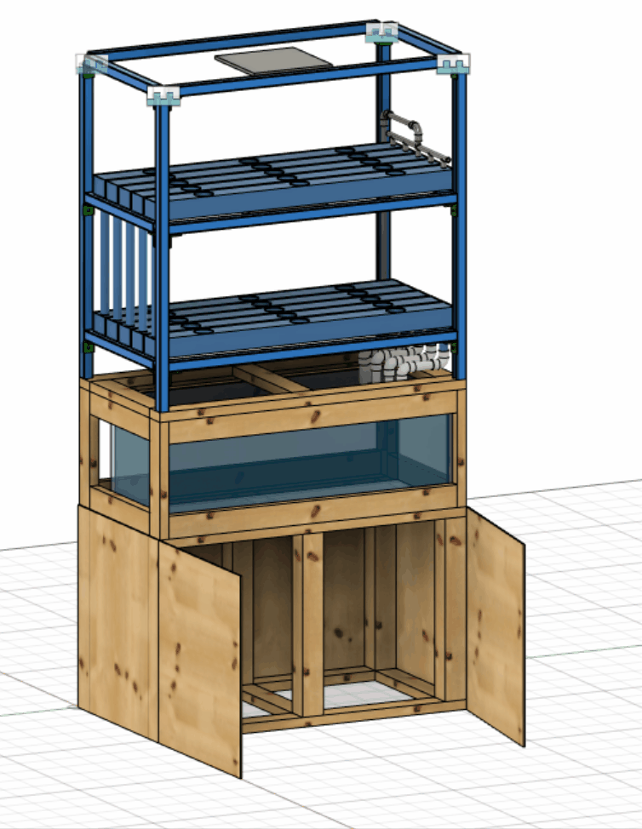
Current State of System (Aaron)
Customer Requirements | Target Engineering Requirements
Sufficient lighting | 200 PPFD
Maintain proper nutrient solution basicity | 6.8 - 7.2 PH
Maintain water temperature | 68°F-74°F
Support fish tank weight | Support 1300 lbs
Adequate flow rate | 28 GPH
Minimal electrical operating cost | $60 per month
Small footprint | 8 ft²
Quiet | 55 Decibels
Monitor flow rate | Alert @ flow rate < 5 GPH
Figure 4: Current CAD model

Slide 6
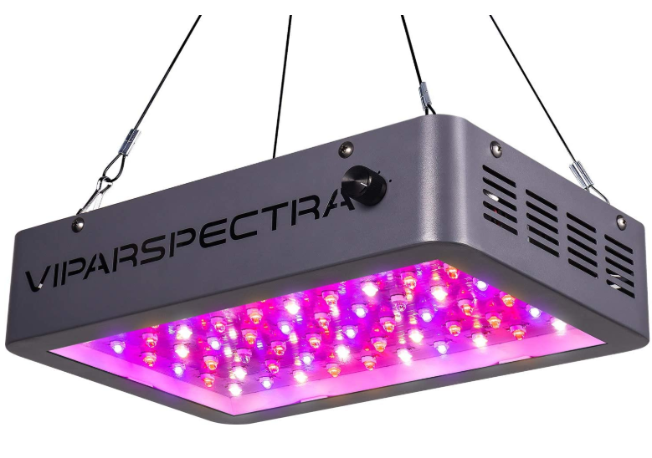
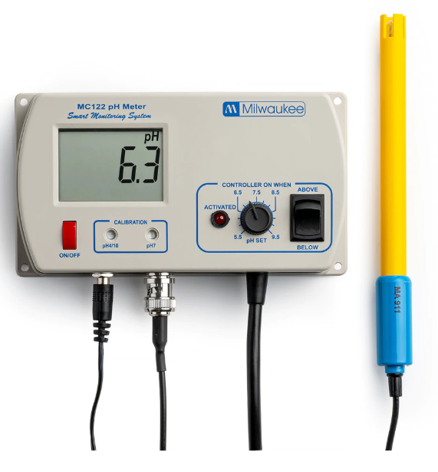
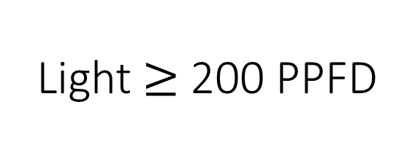
Current State of System (Aaron)
Light $≥$ 200 PPFD
Fig 5: VA600 Par light
Power of hydrogen = 6.8 - 7.2
Fig 6: Milwaukee MC122 PRO pH Controller

Slide 7
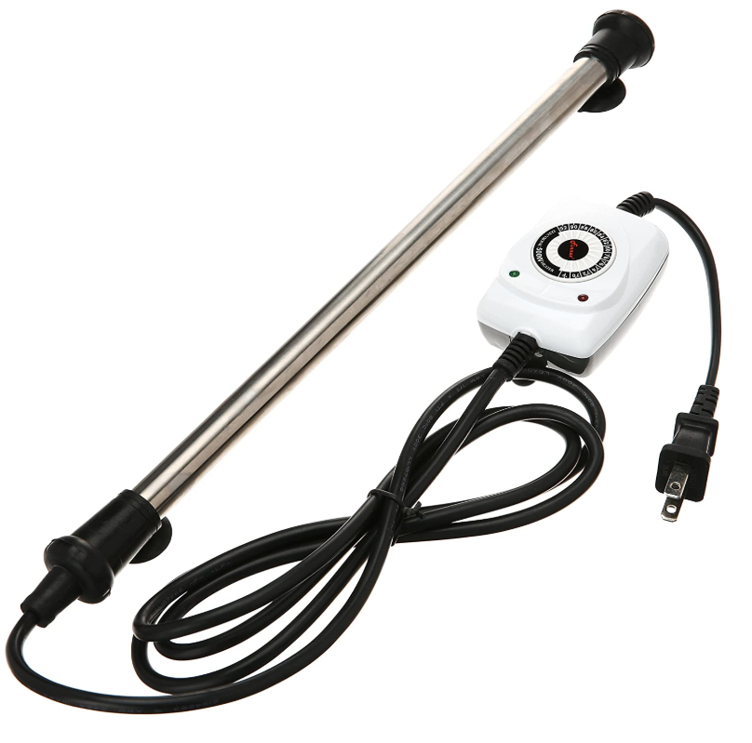
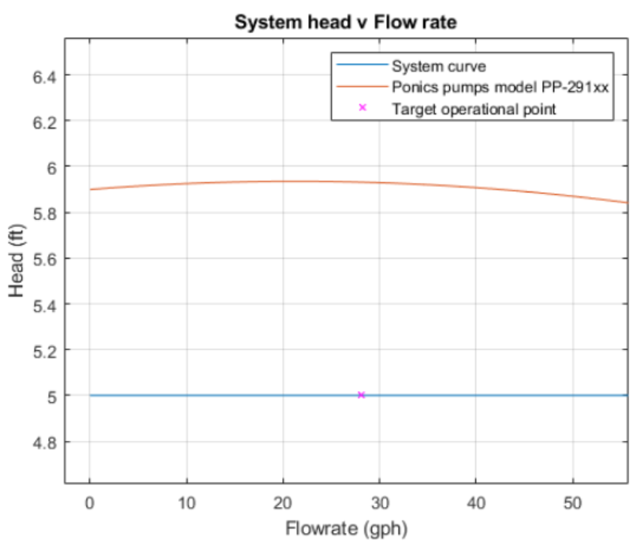
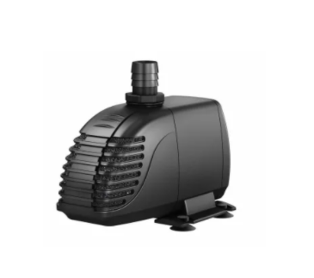
Current State of System (Aaron)
Maintain water temperature between 68°F-74°F
Fig 7: aquarium heater
Volumetric flow rate per planter = 28 gph
Fig 8: Ponics Pumps model-291
Fig 9: PP-291xx performance curve

Slide 8
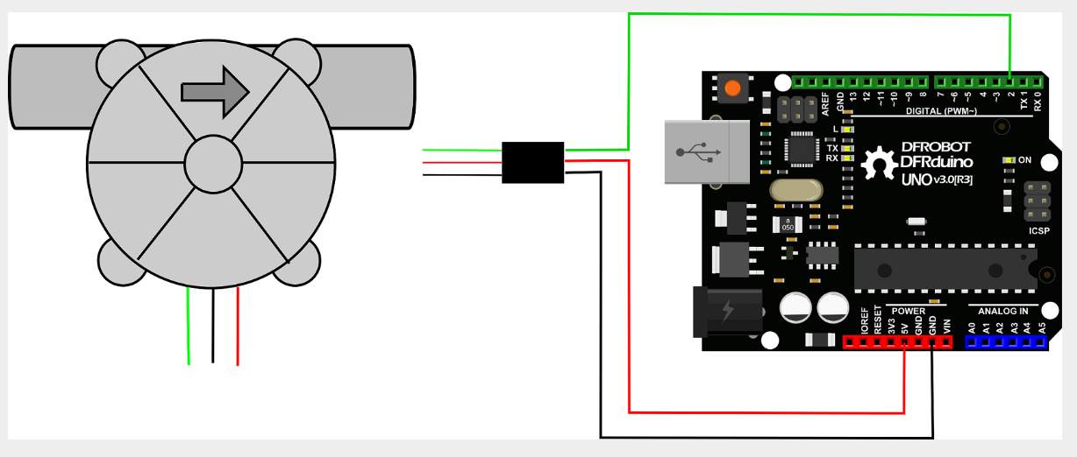
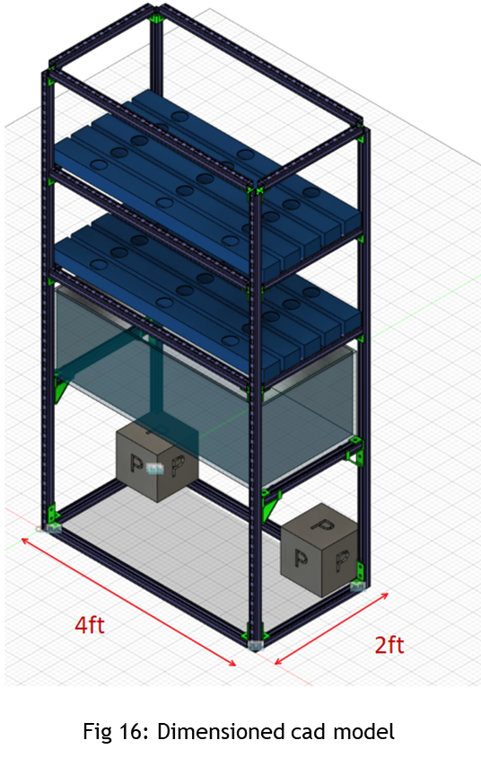
Current State of System (Aaron)
Volumetric flow rate per grow trough = 28gph
Alert @ flow rate < 28 GPH
Fig 10: Hall effect flow meter
Area = 8 ft²
Average ceiling height in the U.S. is 8-9ft
Fig 11: Hall effect flow meter

Slide 9
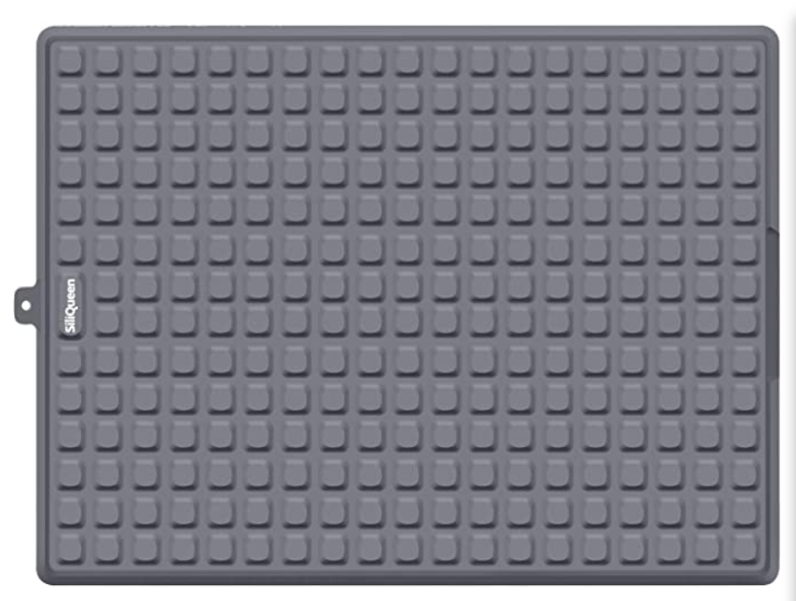
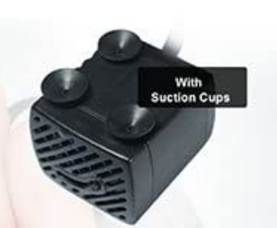

Current State of System (Aaron)
Operation noise $≤$55 Decibels
Typical refrigerator operating noise is 50 decibels
Fig 12: Silicone drying mat
Fig 13: Rubber pump feet

Slide 10
Current State of System (Aaron)
Table 1: Bill of materials
Material | Amount |  | Pricing |  | Total Cost | Supplier
Unistrut p1000 | 51.5 | ft | 35.75 | USD/10ft | $196.625 | Gainger
Unistrut p2223 | 16 | pieces | 9.62 | piece | $153.92
Led Panel | 2 | Pieces | 160 | USD | $320 | Amazon
Downpour spouts | 42 | ft | 27 | USD/10ft | $135 | HomeDepot
0.5 in PVC tubing | 20 | ft | 2.15 | USD/10ft | $4.30 | HomeDepot
0.5 in PVC Elbow | 15 | pieces | 0.4 | USD | $6 | HomeDepot
Wood | 62.5 | ft. | 6 | USD/8ft | $46.80 | HomeDepot
PlyWood | 2 | Sheets | 22 | USD/Sheet | $44 | HomeDepot
4x4 Wood | 14 | ft | 14.5 | USD/8ft | $29 | HomeDepot
Electronics, Pump, Arduino, Sensors |  |  |  |  | $150 | Various
Building Materials, PVC pipe glue, screws |  |  |  |  | $150 | Various
Automatic Fish feeder | 1 |  | 16 | USD | $16 | Amazon
Total Cost - $1251.64
Purchases
Water flow sensor - $8.99
PVC tubing – 10.24

Slide 11
Current State of System (Aaron)
Table 2: Action items
Team member | Week 8/9 | Week 8/16 | Week 8/23 | Week 8/30
Aaron | Learn simulink | Create Simulink model | Test Flow meter | Write code for flow meter.
Alfred | Structural analysis | Design wooden components | Learn woodworking | Prototype joints
Hunter | Calculate number of fish needed | Auto fish feeders | Feed rate | Fish acquisition
Richard | CAD – Joint known parts such as Unistrut | CAD – Modeled lights and fish tank Learn soldering | CAD - Modeled wood base, Practice through hole soldering | CAD – Modeling pipes and flow in system
Yanchu | Nutrient | Auto fish feeders | Feed rate | GD&T

Slide 12
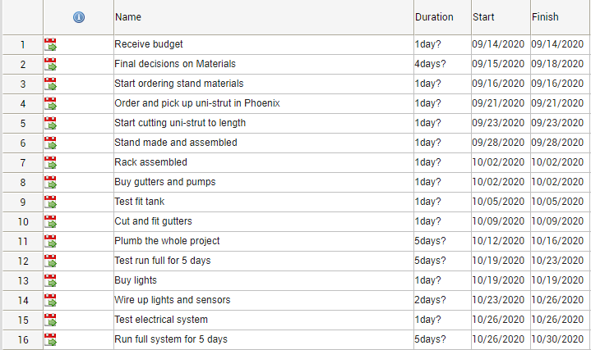
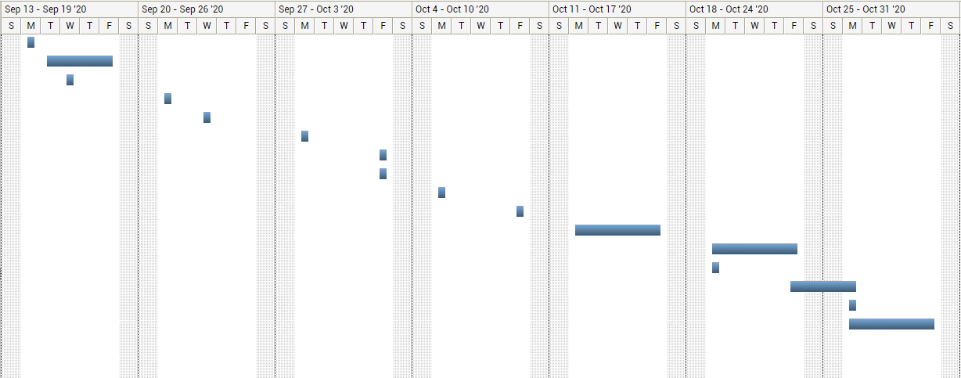
Implementation Plan (Hunter)
When we finally receive a budget the team will go through the bill of materials and trim the excess and upgrade where needed.
The team will work on the rest of the project together at a decided location to finalize the project deliverables
The team will decide on who is performing what task when the materials arrive

Slide 13
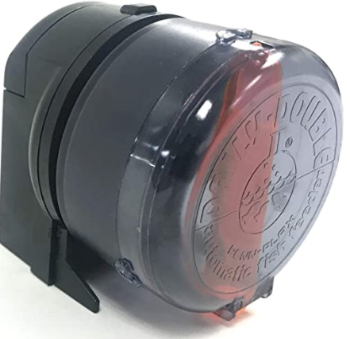
Testing Plan (Alfred)
Voltage Analysis across 24 hours
  Voltage meter & wall plug in for power draw
Measure flow rate of system for pumps
  Bucket-timer method
Light output with a PAR meter
Operational check of fish food dispenser
All equipment needed can be purchased through Amazon
If budget does not cover full design:
  test individual subsystems for proof of concept
Figure 14: Fish Feeder [1]

Slide 14
Conclusion (Alfred)
Project/Design Decription
Current State of System
Implementation Plan
Testing Plan

Slide 15
Q
Questions? (Alfred)

Slide 16
References
[1] Amazon.com. 2020. Penn-Plax Daily Double II Battery-Operated Automatic Fish Feeder. [online] Available at: <https://www.amazon.com/Penn-Plax-Double-Battery-Operated-Automatic-Feeder/dp/B0002565NO/ref=as_li_ss_il?dchild=1&keywords=penn-plax+daily+double+ii+battery-operated+automatic&qid=1594110826&sr=8-1&linkCode=li2&tag=fishkeepingw-20&linkId=7575a7597e17e5f114c1b81d03582b35&language=en_US> [Accessed 1 September 2020].

