Slide 1
Concept Generation
Ashley Blood, Jennifer Lawson, Cameron Lissarrague, Nick Green

Slide 2
Project Description
What are stents used for?
Expanding narrow or clogged arteries
Restoring blood to obstructed artery
What is crimping?
Decrease size of stent to fit onto balloon and catheter
Goal Statement
Design and develop a stent crimping device that utilizes an iris design with a radial force output.
Nick Green

Slide 3
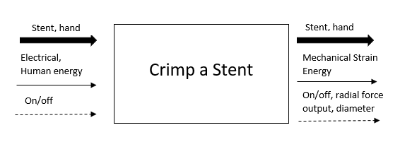
Functional Black Box Model
Figure 1: Black Box
Nick Green

Slide 4
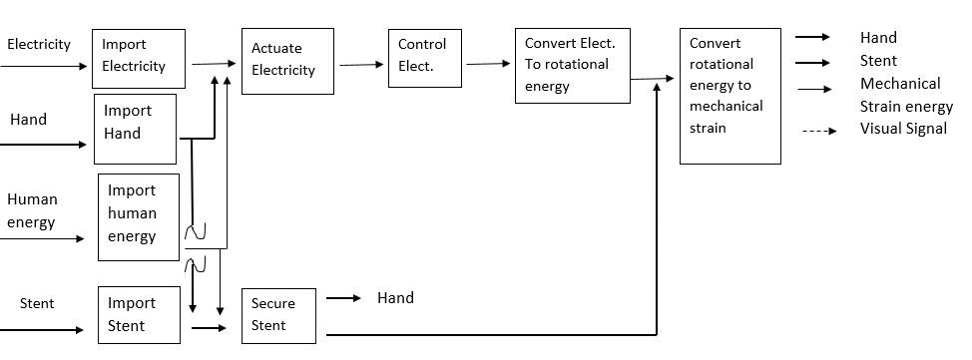
Functional Model
Figure 2: Functional Model
Nick Green

Slide 5
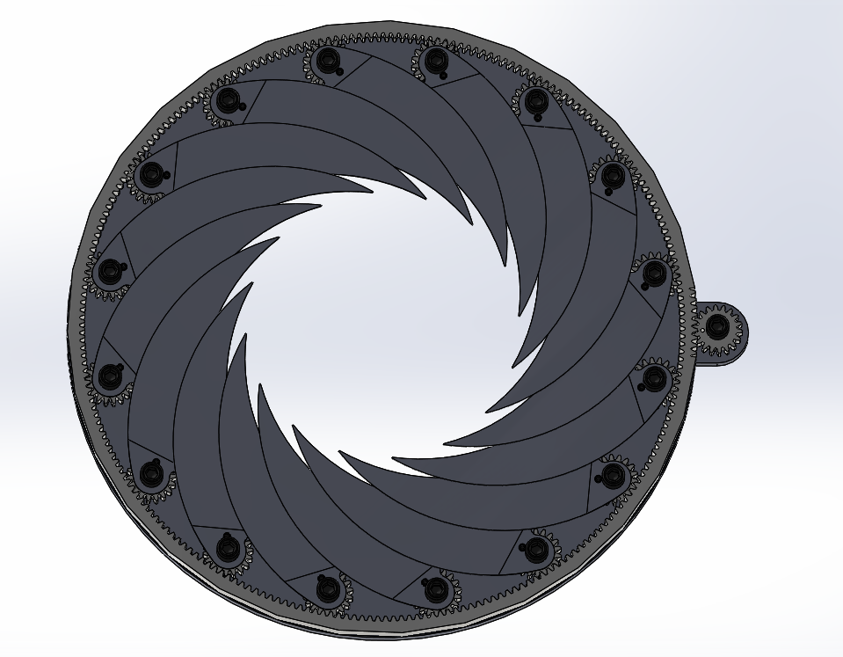
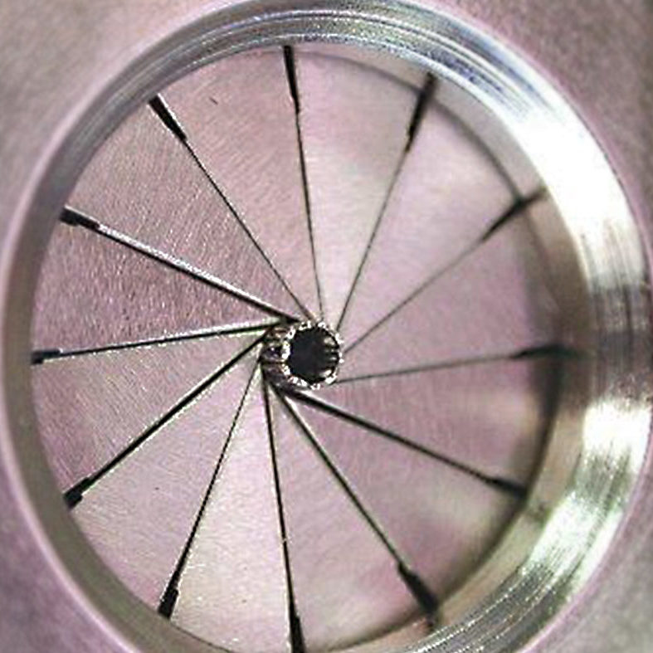
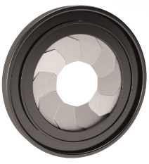
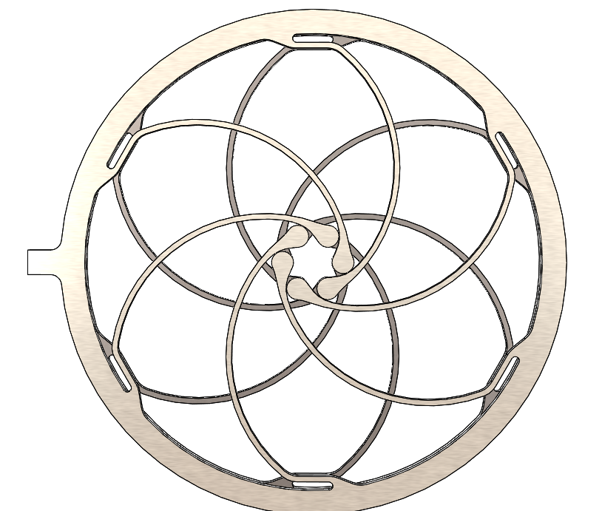
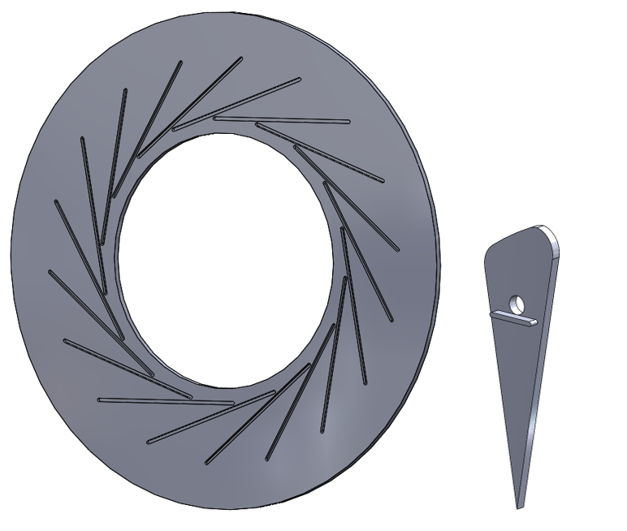
Concept Generation-Iris Designs
Leaflet types
Triangular
Curved
Geometric
Apparatuses
Gear
Slotted
Figure 5 [3]
Figure 3 [1]
Figure 4 [2]
Jenny Lawson
Figure 6
Figure 7 [4]

Slide 6
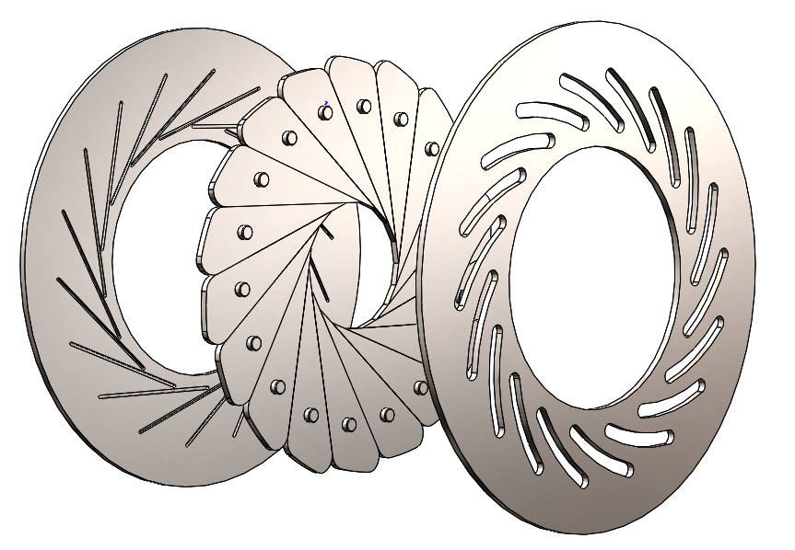
Concept Generation
Pros
more accurate shape (octadecagon)
large range of diameters (0.3mm to 45 mm)
Cons
Expensive machining (requires tight tolerances)
Figure 8: Slotted Design
Ashley Blood

Slide 7
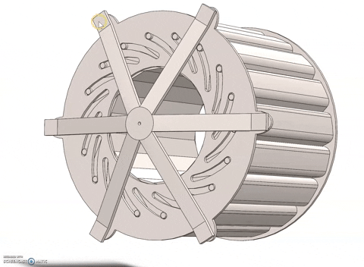
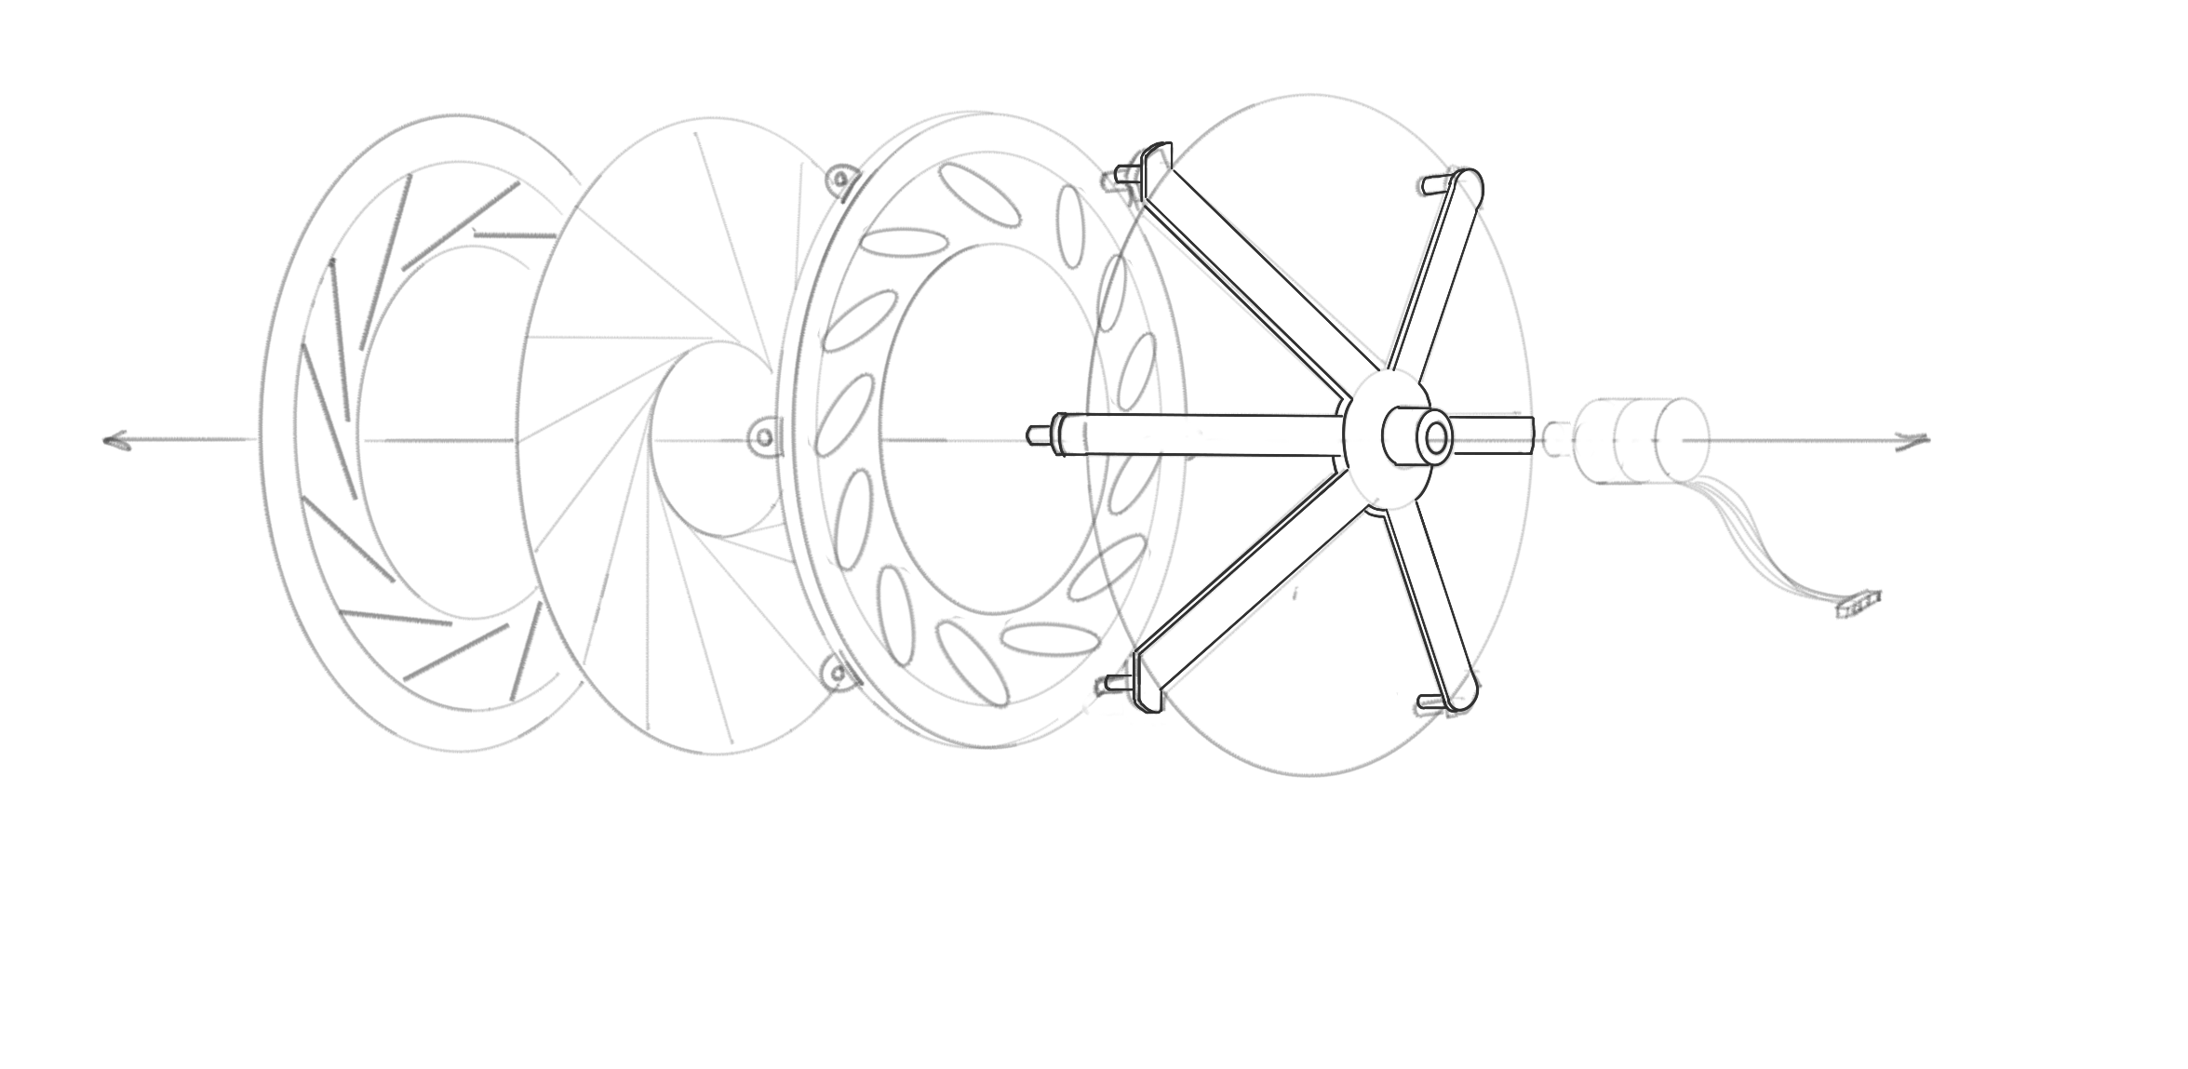
Concept Generation
Figure 9. Slotted design with actuator/motor mount
Jenny Lawson

Slide 8
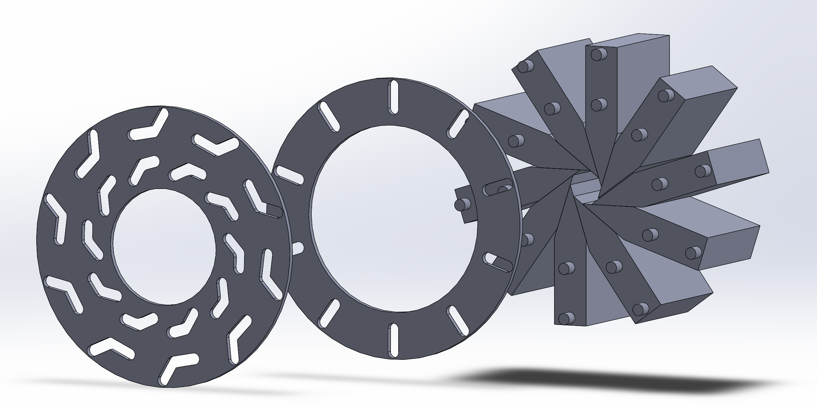
Concept Generations
Pros
Utilizing 2 slots per leaflet allows for angles to be adjusted for different diameters
Cons
Complex geometry is expensive to manufacture.
The iris forms a decagon and not a perfect circle.
Figure 10: Double Slotted design
Cameron Lissarrague

Slide 9
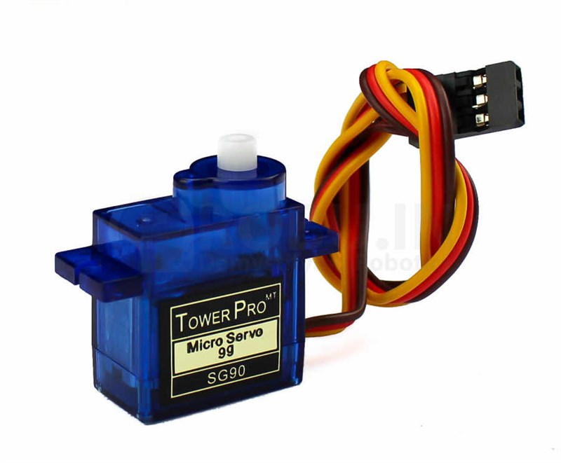
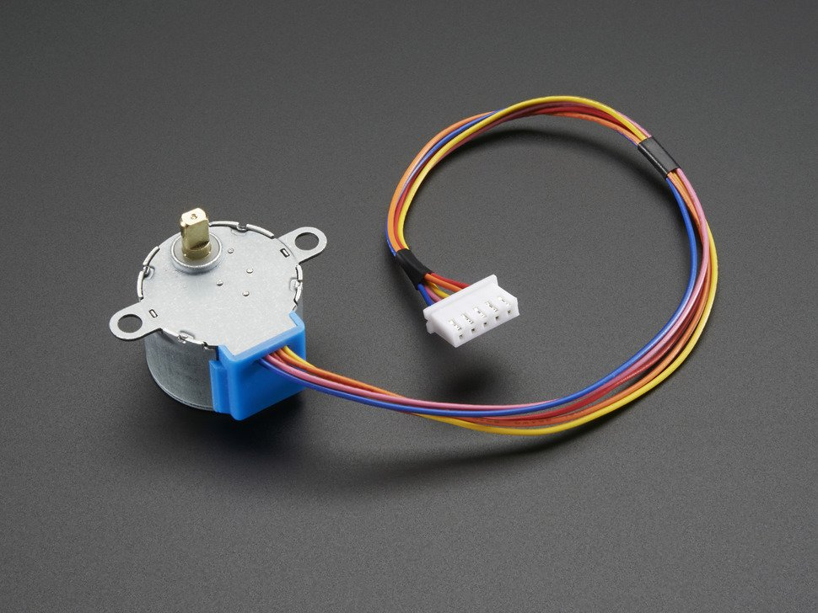
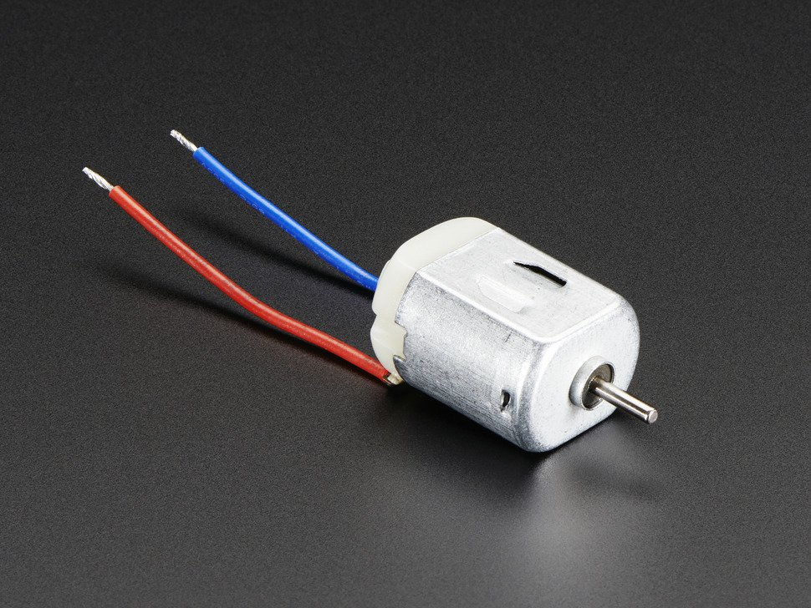
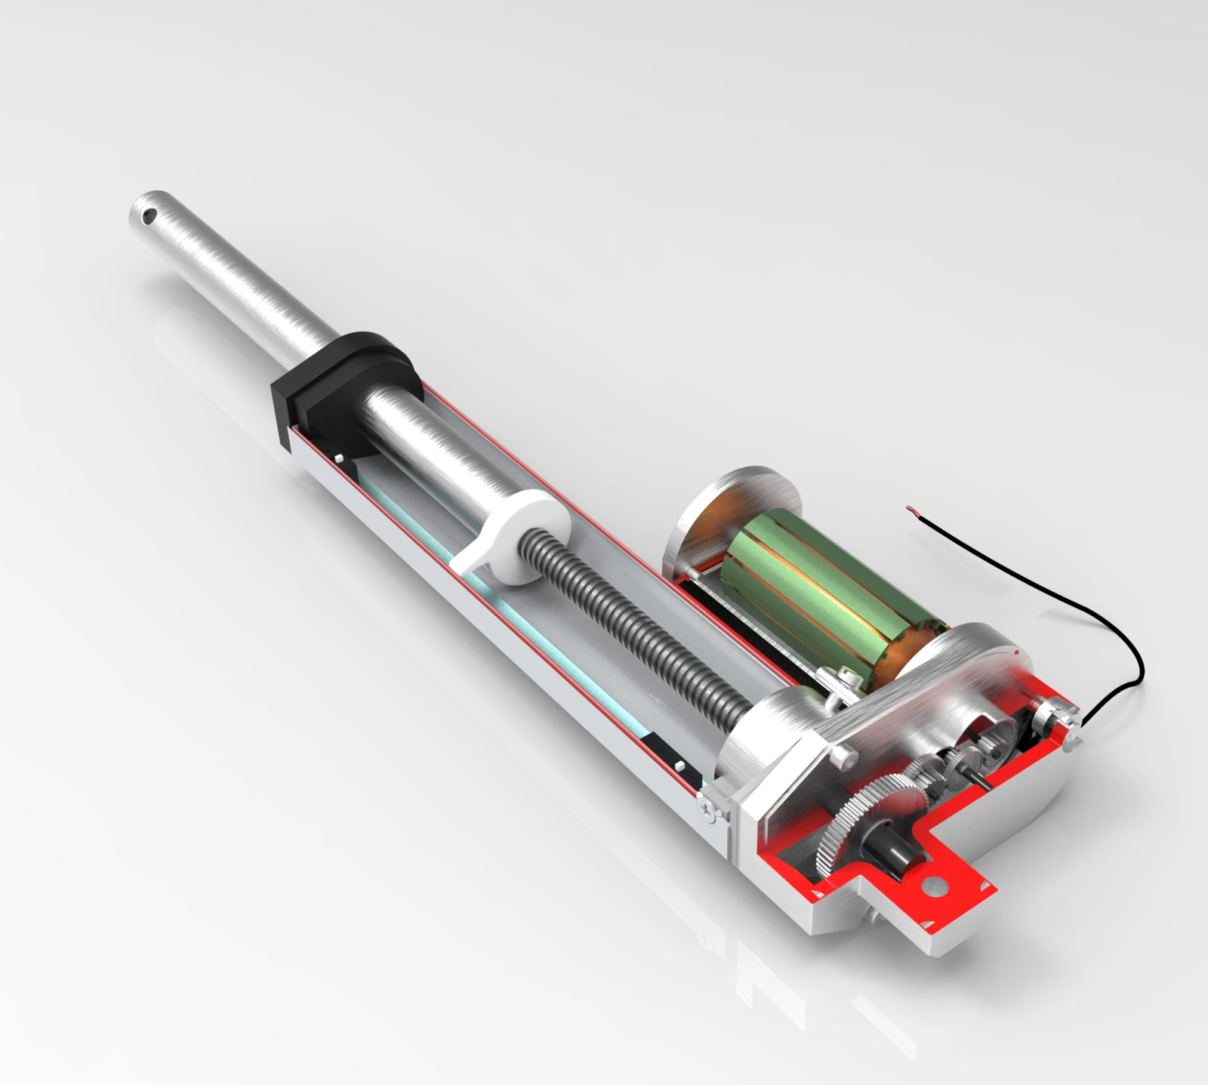
Concept Generation- Motors
Figure 13: Servo Motor [7]
Figure 11: Stepper Motor [5]
Figure 12: DC Motor [6]
Table 1: Analysis of Motors
 | Stepper Motor | DC Motor | Servo Motor | Linear Actuator
Cost | $10.15 [5] | $1.95 [6] | $2.00 [7] | $37.44 [9]
Torque (g*cm) | 150 [10] | 20 [10] | 2500 [10] | ** 298.15N of Thrust [10]
Figure 14: Linear Actuator [8]
Cameron Lissarrague

Slide 10
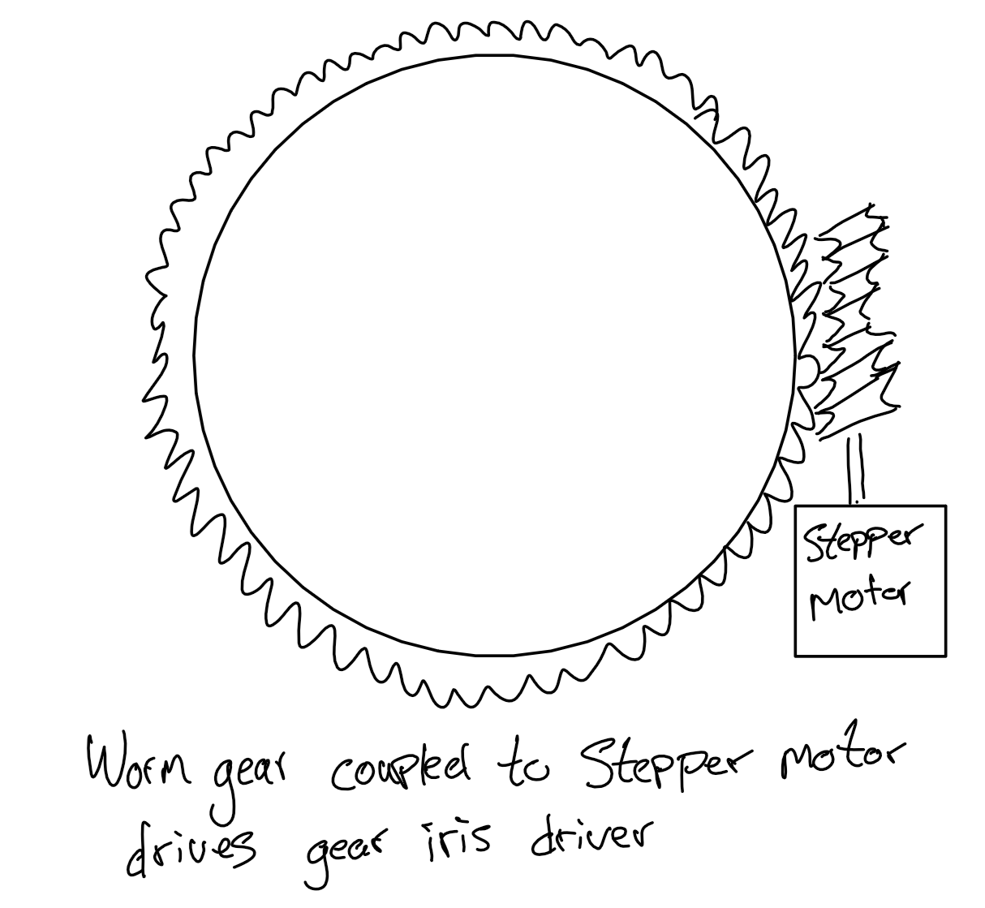
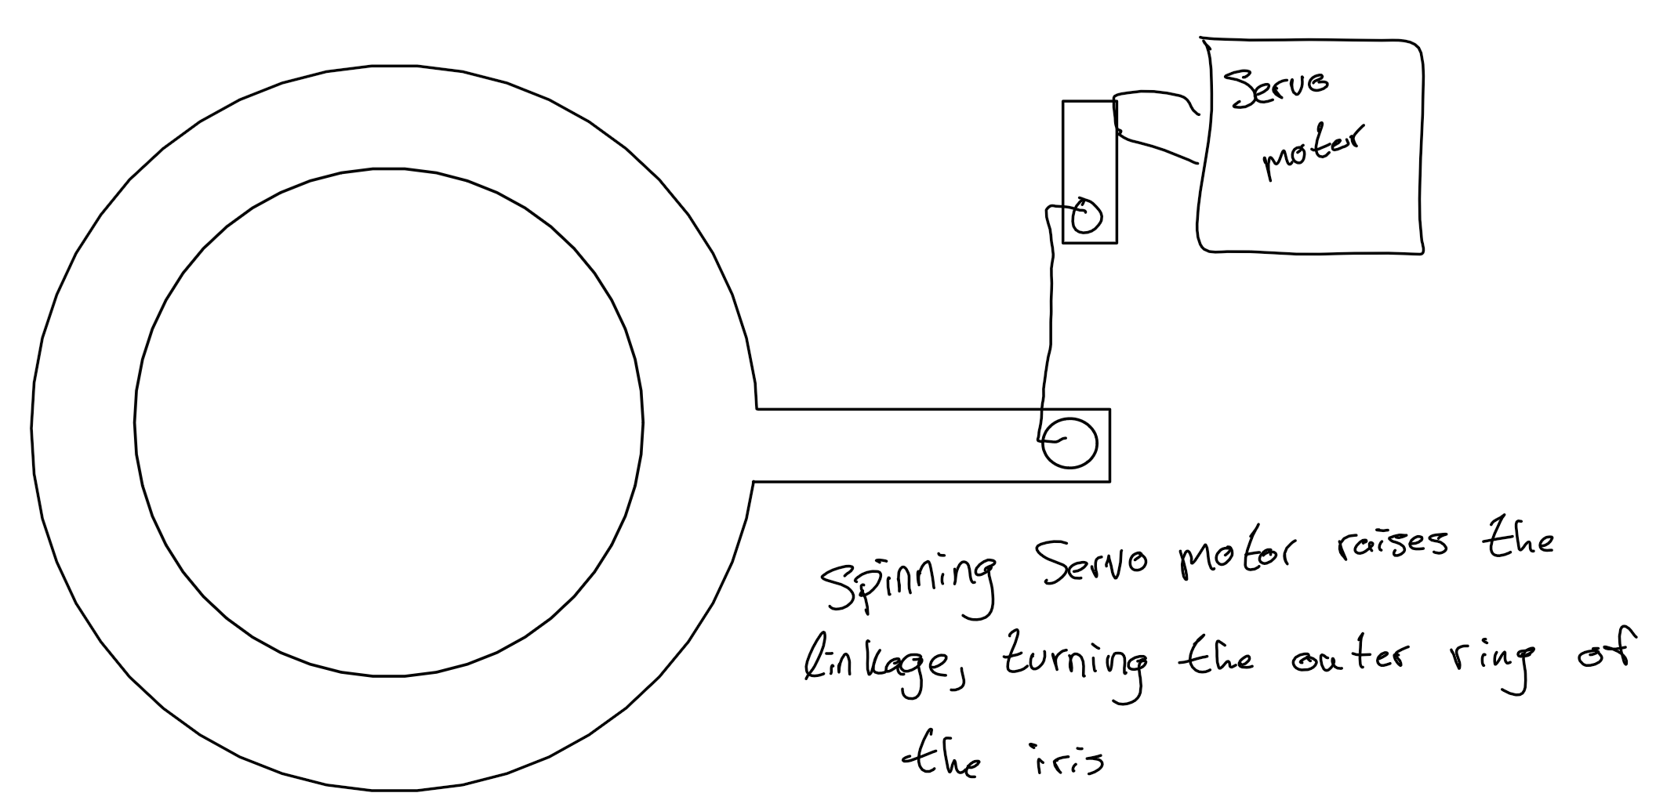
Concept Generation- Motors
Figure 16: Servo Motor Setup
Figure 15: Stepper Motor
Cameron Lissarrague

Slide 11
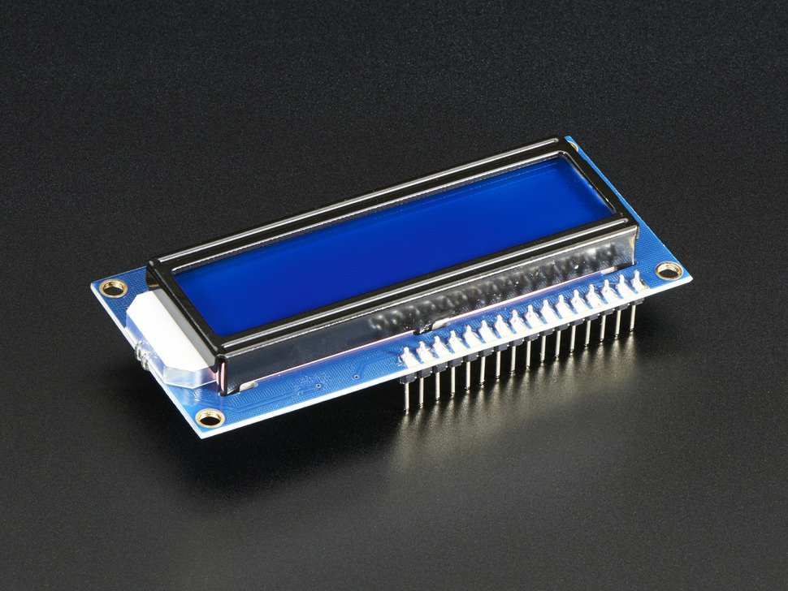
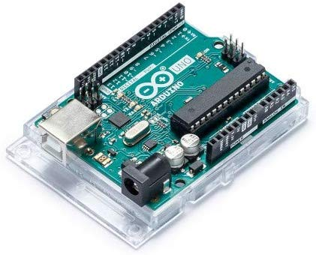
Concept Generation- Display & Output/Input
Arduino: $18.00 [11]
Display: $9.95 [12]
Figure 18: Adafruit display (16x2 characters) [12]
Figure 17: Arduino Uno [11]
Jenny Lawson

Slide 12
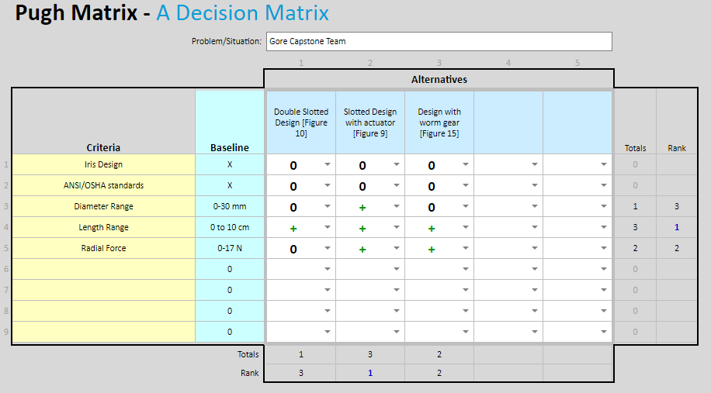
Concept Evaluation
Figure 19: Pugh chart
Jenny Lawson

Slide 13
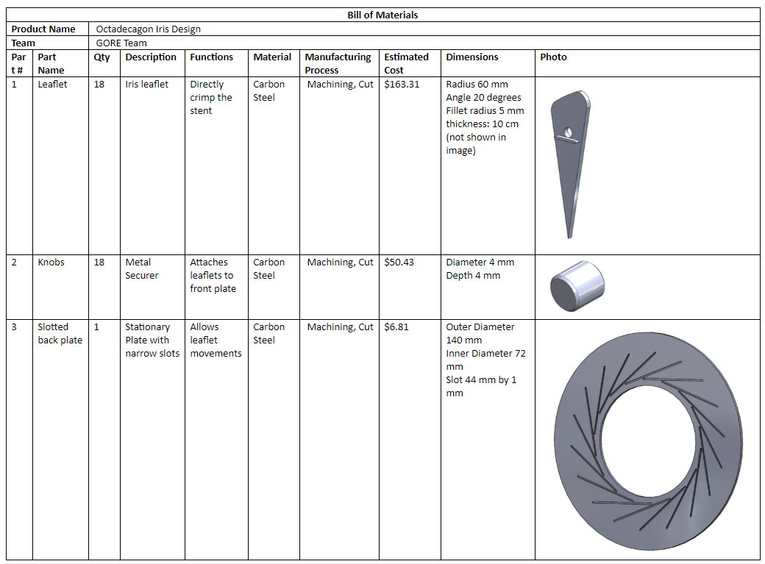
Bill of Materials
Estimated machining cost for final product
$237.35
Estimated total cost for final design
$267.30
Ashley Blood

Slide 14
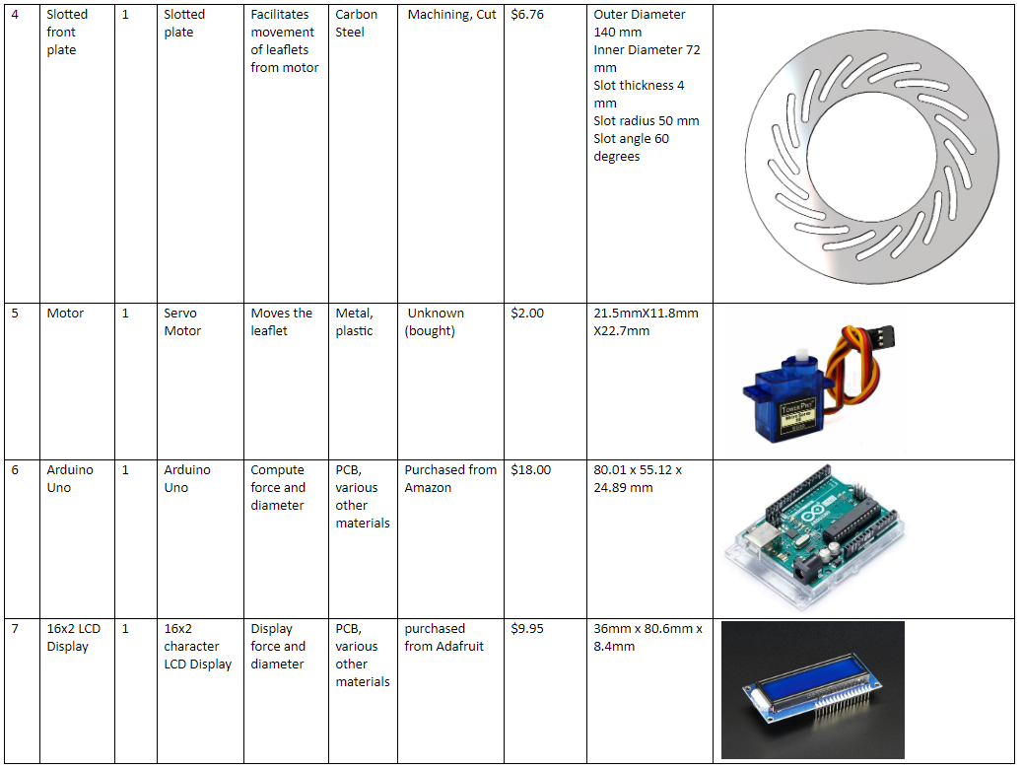
Bill of Materials
Ashley Blood

Slide 15
Budget Planning
Table 2: Budget Analysis
Note: Machine costs NOT given by machine shop
Final Product Costs
Machine Cost | $237.35
Motor | $2.00
Arduino | $18.00
Display | $9.95
Prototyping Costs
PLA costs | $35.33
Styrofoam costs | $5.83
Total | $308.46
Ashley Blood

Slide 16
Questions?

Slide 17
References
[1] “MSI Stent crimping equipment - precision tools for even stent compression,” MSI, 2016. [Online]. Available: https://msi.equipment/manufacturing-equipment/stent-crimping/. [Accessed: 24-Feb-2020].
[2] Asbemaister and 10 products, “Camera Aperture Model,” Camera iris aperture 3D model - TurboSquid 1325444, 09-Sep-2018. [Online]. Available: https://www.turbosquid.com/3d-models/camera-iris-aperture-3d-model-1325444. [Accessed: 04-Feb-2020]
[3] “Free CAD Designs, Files & 3D Models: The GrabCAD Community Library,” Free CAD Designs, Files & 3D Models | The GrabCAD Community Library. [Online]. Available: https://grabcad.com/library/mechanical-iris-window-shade-1. [Accessed: 24-Feb-2020].
[4] A. Thiraviam, “Free CAD Designs, Files & 3D Models: The GrabCAD Community Library,” Free CAD Designs, Files & 3D Models | The GrabCAD Community Library. [Online]. Available: https://grabcad.com/library/compliant-iris-1. [Accessed: 24-Feb-2020].
[5] “stepper motor,” Google Shopping. [Online]. Available: https://www.google.com/shopping/product/3633421175327270473?rlz=1C1CHBF_enUS745US745&biw=1920&bih=969&q=stepper+motor&prds=epd:8772076644907374686,paur:ClkAsKraX4r2TBh9_tax5sssv5gDQY0o9Qm08j3Lw03yHrZh3NIZEolEf6r5i-4YflWvvFfbcfUfTkTti1FfqSbEYmHPg2M1SzLLP1J9KSNvdONE7fi9ZYhfvhIZAFPVH72T3sRRGwW5_0FUqO7E20cby_iu8A,prmr:1&sa=X&ved=0ahUKEwiwnKLV9-rnAhVKnp4KHRgSDXgQ8wIImgM. [Accessed: 24-Feb-2020].

Slide 18
References
[6] “Adafruit Industries 711,” Octopart. [Online]. Available: https://octopart.com/711-adafruit industries-28550756. [Accessed: 24-Feb-2020].
[7] “Buy SG90 9G Micro Servo Motor,” Sumozade Robotics | Robot Parts | Robot Kits | Dc Motors | Lipo Batteries. [Online]. Available: https://www.sumozade.com/sg90-9g-micro-servo-motor-513. [Accessed: 25-Feb-2020].
[8] “200 mm Stroke 67 lb Thrust Light Duty Linear Actuator,” ServoCity.com. [Online]. Available: https://www.servocity.com/200-mm-stroke-67-lb-thrust-light-duty-linear-actuator. [Accessed: 25-Feb-2020].
[9] “500N Electric Linear Actuator 100/200/300/400/500MM (4-20’) Stroke Linear Motor Controller DC 12V,” Walmart.com. [Online]. Available: https://www.walmart.com/ip/500N-Electric-Linear-Actuator-100-200-300-400-500MM-4-20-Stroke-Linear-Motor-Controller-DC-12V/476429288?wmlspartner=wlpa&selectedSellerId=18528&adid=22222222227292784080&wl0=&wl1=g&wl2=c&wl3=354512683893&wl4=pla-762194253002&wl5=1013406&wl6=&wl7=&wl8=&wl9=pla&wl10=125216233&wl11=online&wl12=476429288&veh=sem&gclid=EAIaIQobChMIhLGl0fXr5wIVDtVkCh1unw6hEAkYCiABEgK6f_D_BwE. [Accessed: 24-Feb-2020]
[10] Adafruit Industries, “Adafruit Motor/Stepper/Servo Shield for Arduino v2 Kit - v2.3,” adafruit industries blog RSS. [Online]. Available: https://www.adafruit.com/category/229. [Accessed: 24-Feb-2020].

Slide 19
References
[11] Amazon.com. (2020). [online] Available at: https://www.amazon.com/Arduino-A000066-ARDUINO-UNO-R3/dp/B008GRTSV6/ref=asc_df_B008GRTSV6/?tag=hyprod-20&linkCode=df0&hvadid=309751315916&hvpos=&hvnetw=g&hvrand=13342739411460231366&hvpone=&hvptwo=&hvqmt=&hvdev=c&hvdvcmdl=&hvlocint=&hvlocphy=1013406&hvtargid=pla-457497319401&psc=1&tag=&ref=&adgrpid=67183599252&hvpone=&hvptwo=&hvadid=309751315916&hvpos=&hvnetw=g&hvrand=13342739411460231366&hvqmt=&hvdev=c&hvdvcmdl=&hvlocint=&hvlocphy=1013406&hvtargid=pla-457497319401 [Accessed 24 Feb. 2020].
[12] Digikey.com. (2020). 181 Adafruit Industries LLC | Optoelectronics | DigiKey. [online] Available at: https://www.digikey.com/product-detail/en/adafruit-industries-llc/181/1528-1502-ND/5774228?utm_adgroup=Display%20Modules%20-%20LCD%2C%20OLED%20Character%20and%20Numeric&utm_source=google&utm_medium=cpc&utm_campaign=Shopping_Optoelectronics_NEW&utm_term=&utm_content=Display%20Modules%20-%20LCD%2C%20OLED%20Character%20and%20Numeric&gclid=EAIaIQobChMIwsHamfrw5wIVkcpkCh2tzgghEAkYEyABEgI4u_D_BwE [Accessed 24 Feb. 2020].

