Slide 1
NAU Gore Capstone Team
Ashley Blood, Nick Green, Jenny Lawson, Cameron Lissarrague
Jenny

Slide 2
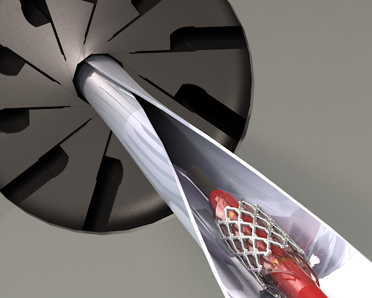
Background
What are Stents used for?
Expanding narrow or clogged arteries
Restoring blood to obstructed artery
What is a Stent Crimper used for?
Reduces Diameter of Stent for implantation
Figure 1: Stent Crimping Device [1]
Jenny

Slide 3
Design Requirements
Table 1: Design Requirements
Customer Need | Engineering Requirement
Iris Design | Device must perform like an iris
Diameter | 4mm-12mm [2]
Length | 10mm-59mm [2]
Radial Force | At least 105 N [3]
Outputs Data | Use of GUI to input and output data
Meets Safety Standards | Must meet ANSI and OSHA standards
Jenny

Slide 4
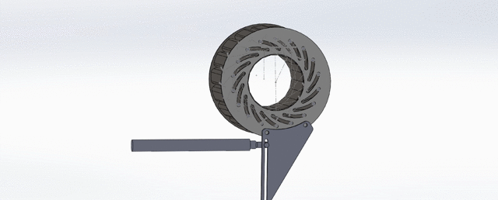
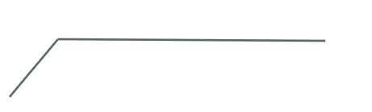
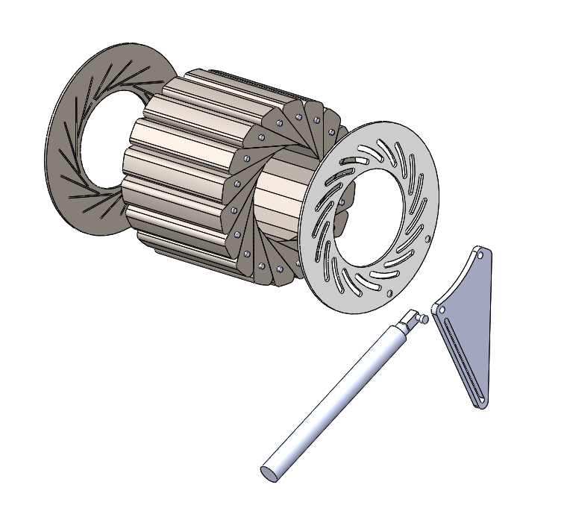
Design Description
Front Plate
Leaflets
Back Plate
Actuator rotates the front plate by pushing horizontally on the linkage plate
The front plate spins the leaflets
Leaflets close crushing a stent
Linear Actuator
Linkage plate
Figure 2: CAD Model
Cameron

Slide 5
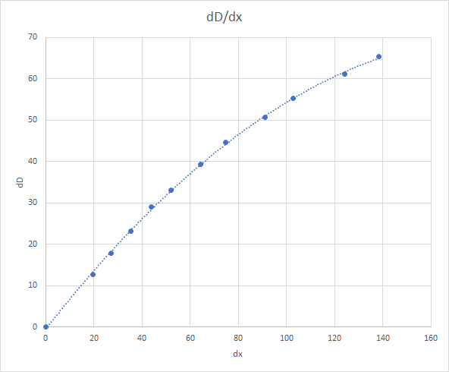
Design Validations
Radial force RF = [2/(dD/dx)] * F [4]
RF = Radial Force, dD =for Change in Diameter, dx = Actuator displacement, F = force
Fmin = 36.7 N given RF=105 N
Figure 3: Static Sensitivity
Cameron

Slide 6
FMEA (Failure Mode and Effects Analysis)
Risk Analysis
Potential failure if radial force is too high
  Mitigated by determining the maximum force (see previous slide) and selecting appropriate material
Fatigue Failures
  Determine materials and run fatigue analysis
Abrasive Wear
  Determine friction between components
  Mitigate through material selection and potential lubrication
Testing Procedures
Arduino and stepper motor: calibrate motor counts to precision diameter rods
Nick

Slide 7
Budget
Overall Budget: $3,000
Budget for Next Semester: $2,915.56
  Current Spending: $84.44
    Arduino Kit: $42.99
    Stepper Motor Controller: $14.99
    PLA filament: $19.99
  Expected Spending: $98.95
    Linear Actuator: $72.00
    POM filament: $26.95
Ashley

Slide 8
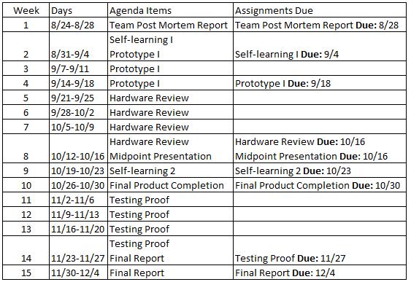
Schedule
Table 2: Proposed Schedule for ME 486C
Ashley

Slide 9
Conclusion
Due to COVID-19, much has changed, but the team has adapted and is continuing to strive for success in the end
Prototyping will continue once the semester starts in the fall
Nick

Slide 10
References
[1] “CX - Stent Crimping Machines,” CX - Stent Crimper. [Online]. Available: http://www.blockwise.com/stent-crimpers/cx/. [Accessed: 20-Apr-2020].
[2] J. Madjarov, “Stents,” CTSNet. [Online]. Available: https://www.ctsnet.org/article/stents. [Accessed: 24-Apr-2020].
[3] S. H. Duda, J. Wiskirchen, G. Tepe, M. Bitzer, T. W. Kaulich, D. Stoeckel, and C. D. Claussen, “Physical Properties of Endovascular Stents: An Experimental Comparison,” Journal of Vascular and Interventional Radiology, 15-Apr-2007. [Online]. Available: https://www.sciencedirect.com/science/article/pii/S1051044307616200. [Accessed: 24-Apr-2020].
[4] “Measuring Radial Force,” Blockwise Knowledge Base K050 [Online]. Available: http://www.blockwise.com/assests/knowledge/K050-Measureing%20Radial%20Force.pdf. [Accessed: 20-Apr-2020].
Nick

