Slide 1
Team 10A: Automatic Lego Sorting Machine
Team Members: Abdullah, Fahad , Sultan, Abdulaziz and Husain
Roles: Alternating roles

Slide 2
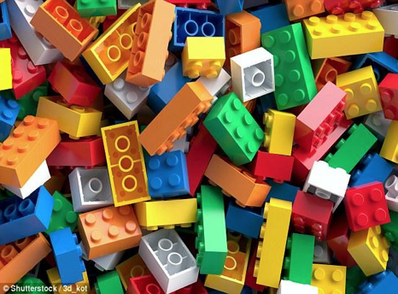
Project Description
Description of the project:
  Build a machine that sort Lego by size and functionality.
Sponsor/client:
  NAU, Dr. David Welly
Importance of the project:
  Skills and knowledge.
  Time and effort.
Figure 1: Lego [1]
Fahad Alotaibi
Notes:
Hi,everyone we are team 10A and your project is Automatic Lego Sorting Machine, My name is Fahad ….. Team Role is alternating Role.
The description of out project is to design,build and test a machine Legos by size and functionality.
The sponsor of the project is NAU and the client is Dr David Welly.

Slide 3
Project Description
Black Box:
Random Legos/Non-Legos, Hand
Sorted Legos/Non-Legos, Hand
Electrical Energy, Human Energy
Sorting Legos
Heat, Sound/Noise
On/Off, Empty Reservoir
On/Off, Full Reservoirs
Materials
Energy
Signals
Figure 2: Black Box
Sultan Alharbi

Slide 4
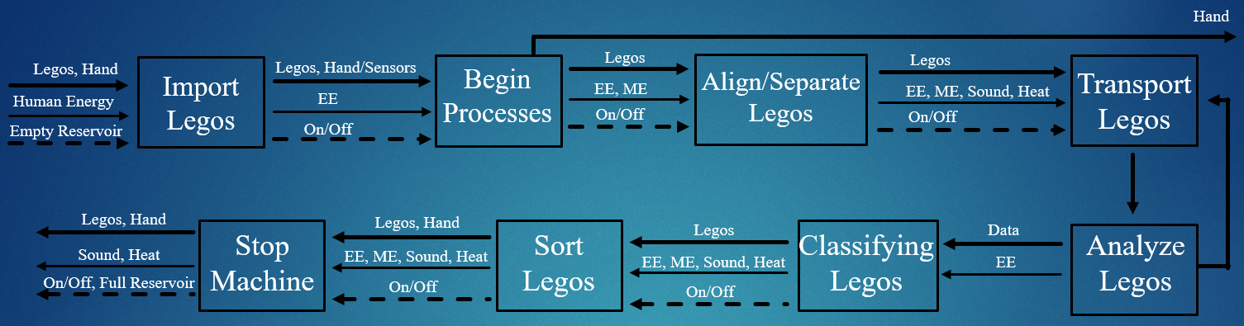
Project Description
Functional Decomposition:
Figure 3: Functional Decomposition
Sultan Alharbi

Slide 5
Concept Generations
Main subsystem concepts:
  Align/Separate Legos
  Transport Legos
  Classify Legos
  Sorting Legos
Fahad Alotaibi
Notes:
Based on our research on the functional modeling, we came up with 4 subsystem concepts
Separate Legos, when we through the legos inside the machine it will be mixed up and it needed to separate to be ready to transport.
Second, Transport Legos, after being separated the legos will be online and and one by one.
Third one, Classify legos, After transporting the lego one by one, it will be classified by its size and functuity
Final main subsystem concept is sorting legos to drop them in the right boxes.

Slide 6
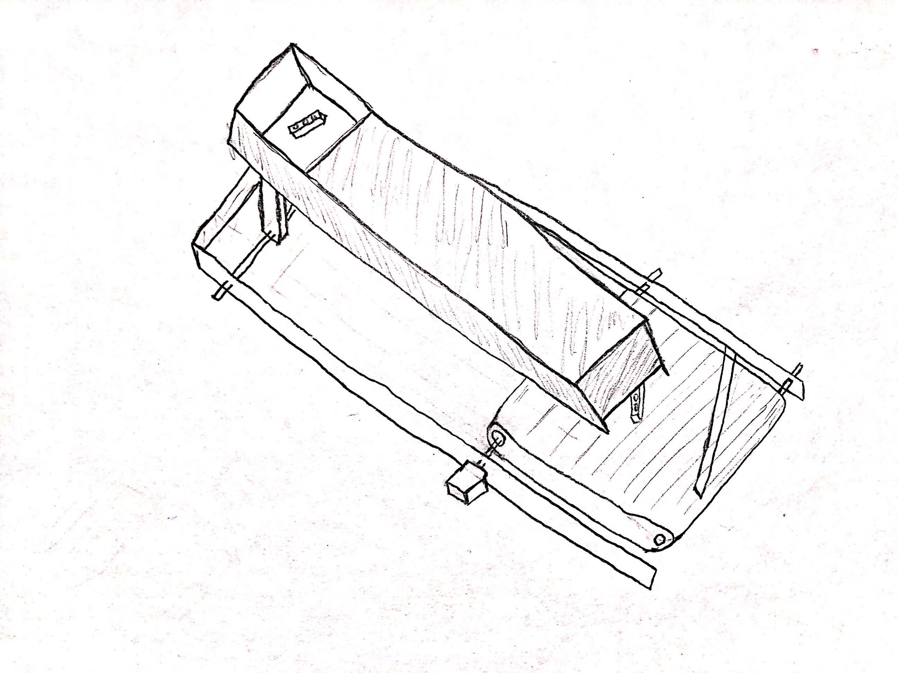
Align/Separate Legos
1- Slide Box
  Advantages
    Fast process
    No Electrical or kinetic energy
  Disadvantages
    Chance of breaking
Figure 4: Slide Box
Abdulaziz Almaimony
Notes:
In his idea, we have a slide box that makes the Legos go to the next step by just throw it into the slide without any electrical or kinetic energy to move the Legos. The idea has shown below as well.
Fast process: It’s going to be a fast process in this step because its a slide
No Electrical or kinetic energy: We don't need any electrical or kinetic energy to move the legos to the next step
Chance of breaking: when it's going to slide to the next step it will slide fast and it might break or scratching the lego when it's reach to the end

Slide 7
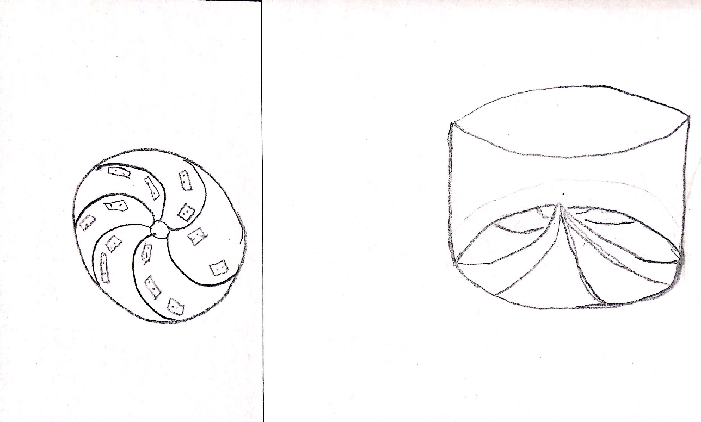
Align/Separate Legos
2- Roulette
  Advantages
    Large number of legos
  Disadvantages
    Slow process
    Chance of breaking
    Costly
Figure 5: Roulette
Abdulaziz Almaimony
Notes:
There is a Roulette in which the Legos goes, spin through the walls of the Roulette and then move to the next stage one by one, when the wall push it to move forward. The idea has shown below as well.
Large number of legos: it can hold more legos to move it to the next step
Slow process: when it will stick to the wall to get it to the next step it will move slowly because it might fall down if it goes fast.
Chance of breaking : the lego might break because it move to the next step there is a chance to fall down to the beginning step
Cost to much: this idea will cost too much because it needs motors by itself to roulette the legos to move it to the top and get it to the next step.

Slide 8
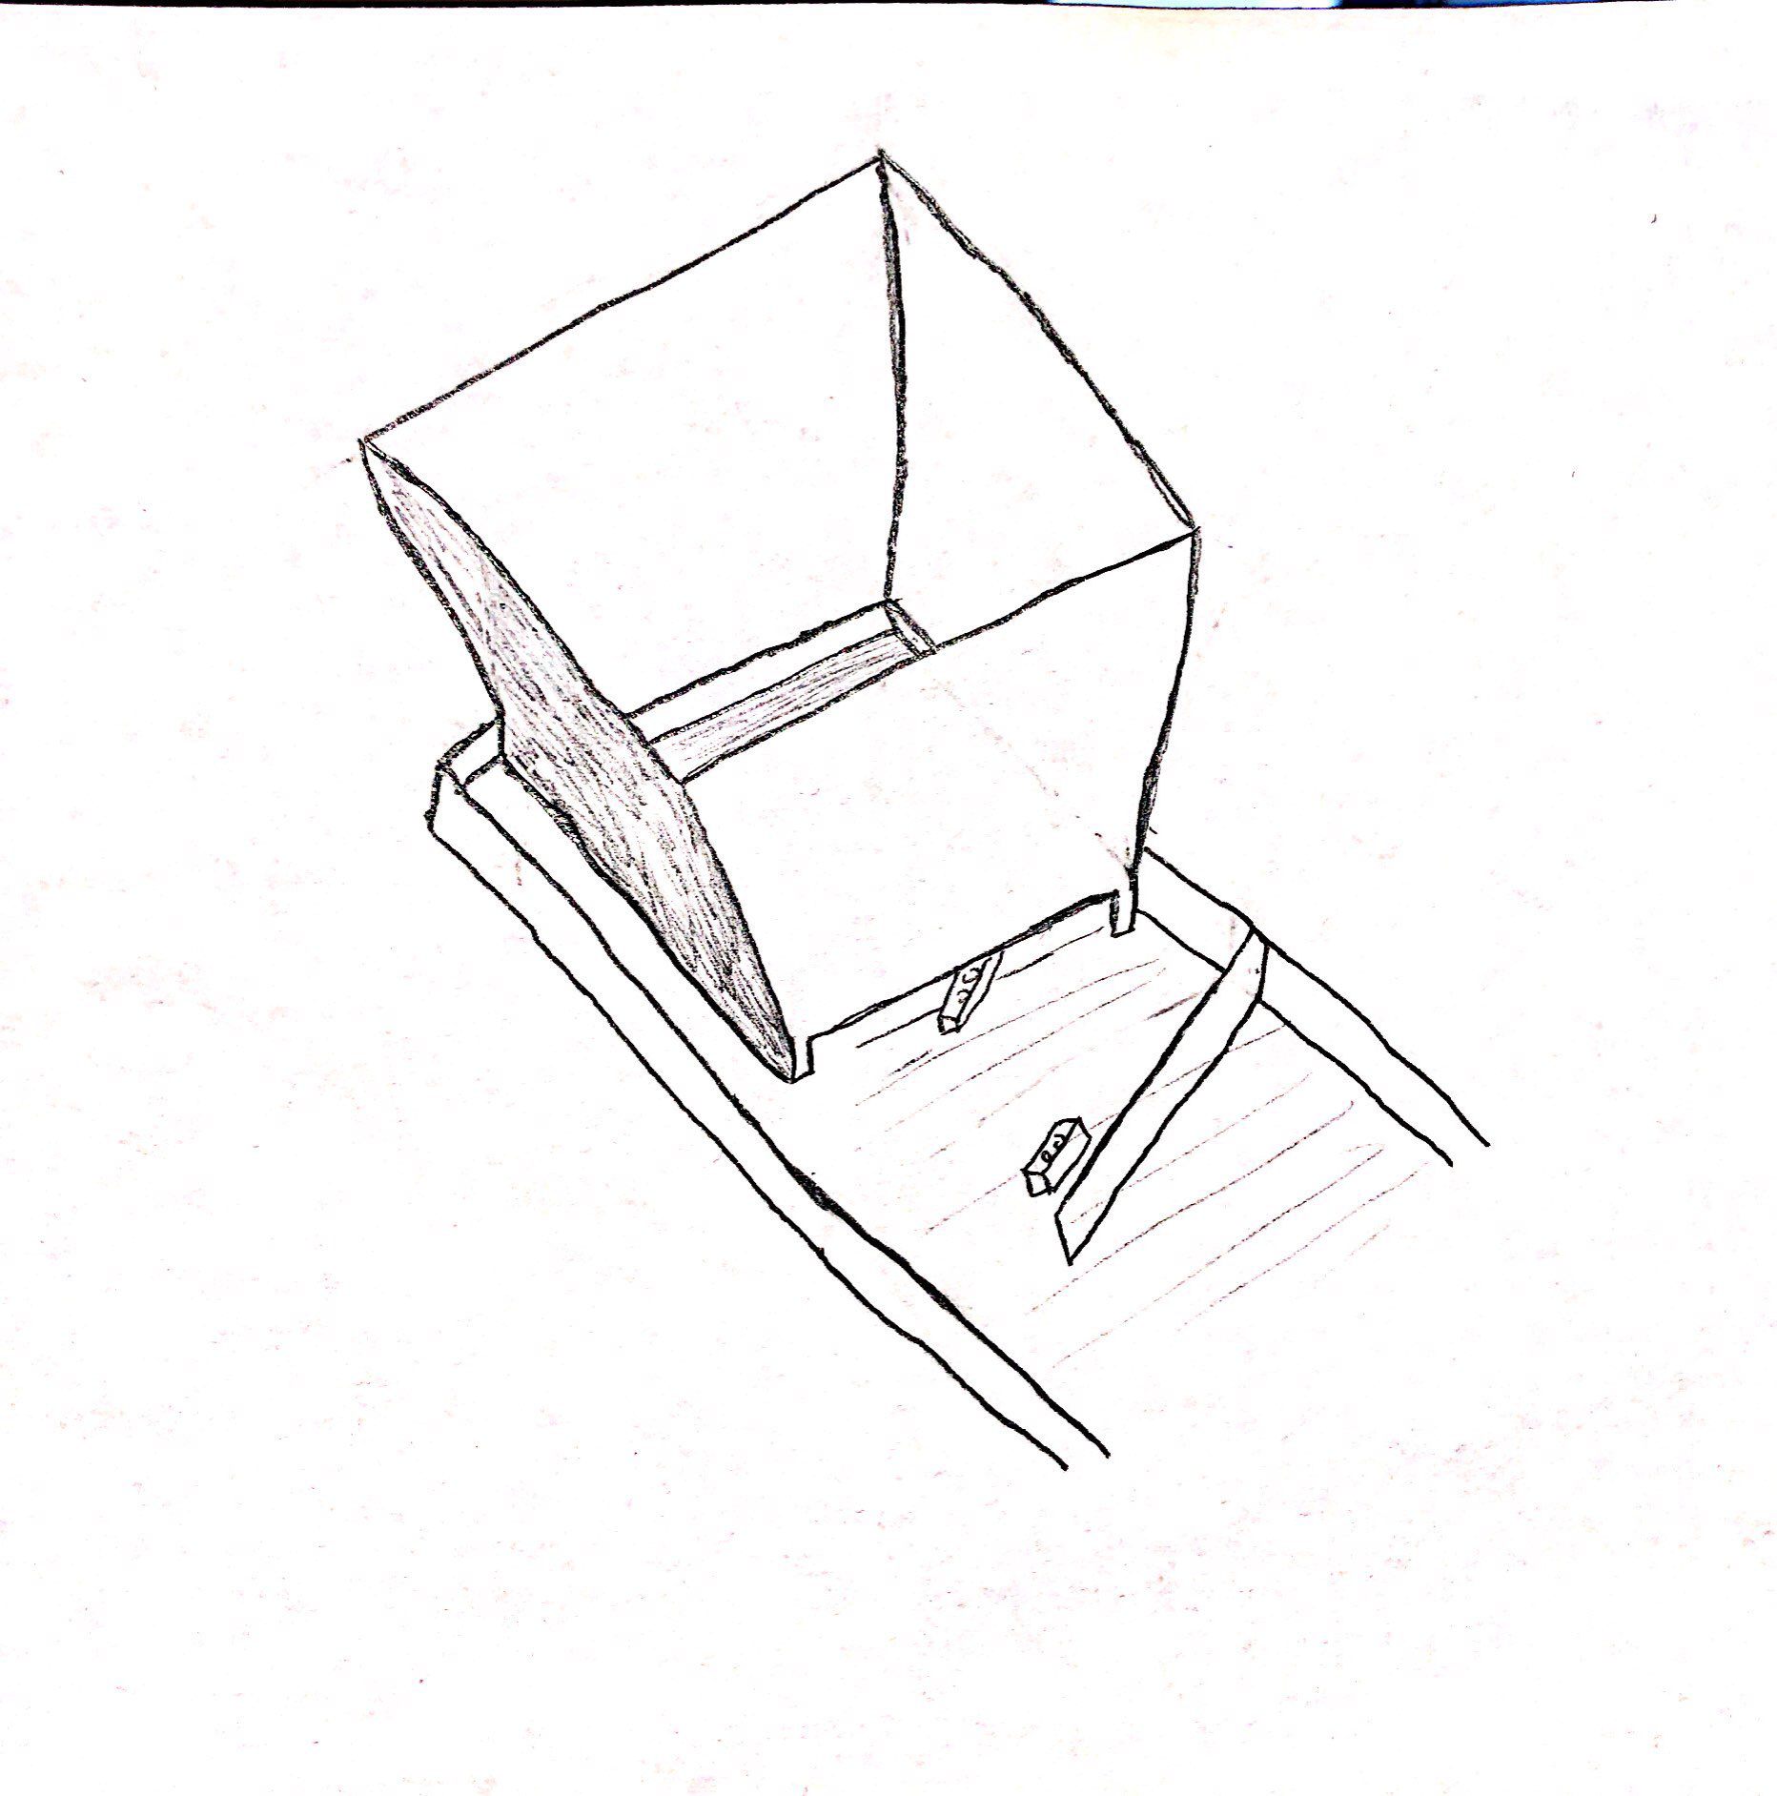
Align/Separate Legos
3- Box with a Gap
  Advantages
    Fast process
    Easy movement
    More Safe
  Disadvantages
    N/A
Figure 6: Box with a Gab
Abdulaziz Almaimony
Notes:
In this idea we are going to throw the legos into the box and as you see there is a small gap in the bottom of the front wall that gonna organize the lego to transport it to one by one the next step.

Slide 9
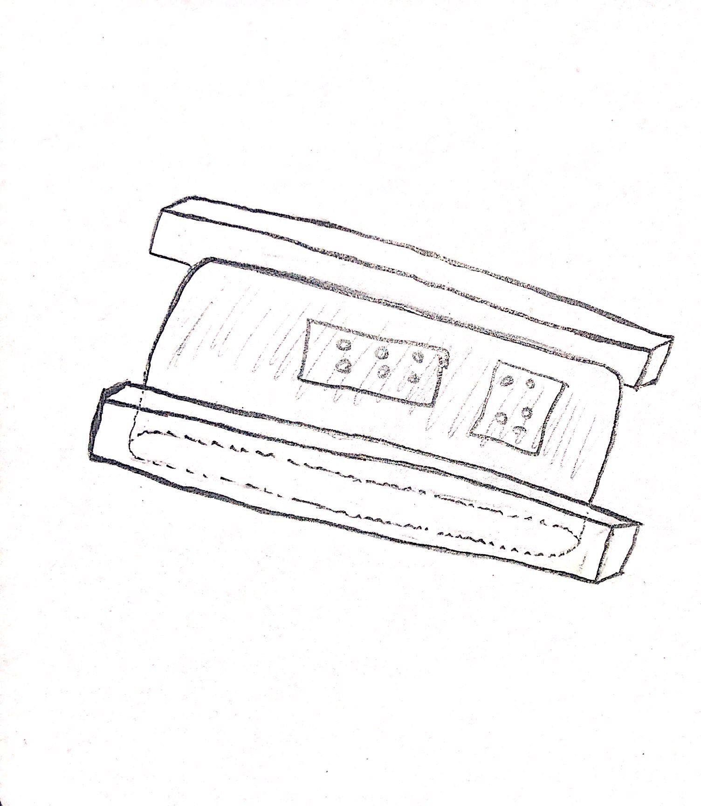
Transport Legos
1- Straight Belt
  Advantages
    More safe
  Disadvantages
    Slow process
    Less Legos to put in it
Figure 7: Straight Belt
Abdulaziz Almaimony
Notes:
The design idea states that it is good to use the straight belt which make a long que of Lego and move straightly without any interaction.

Slide 10
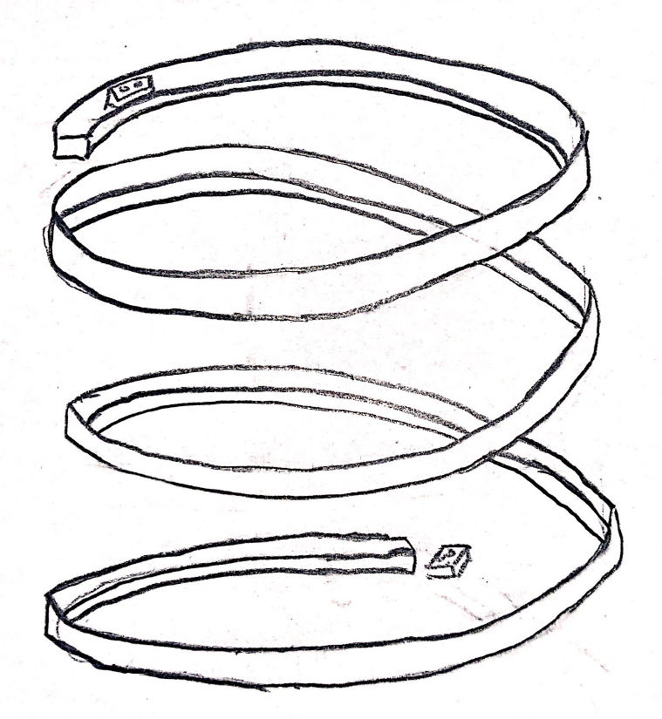
Transport Legos
2- Round Belt
  Advantages
    Large number of legos
  Disadvantages
    Slow process
    Chance of breaking
Figure 8: Round Belt
Abdulaziz Almaimony
Notes:
In this design idea, there is nozzle shape belt which make a long que and provide large space to the Legos as the idea has shown below.

Slide 11
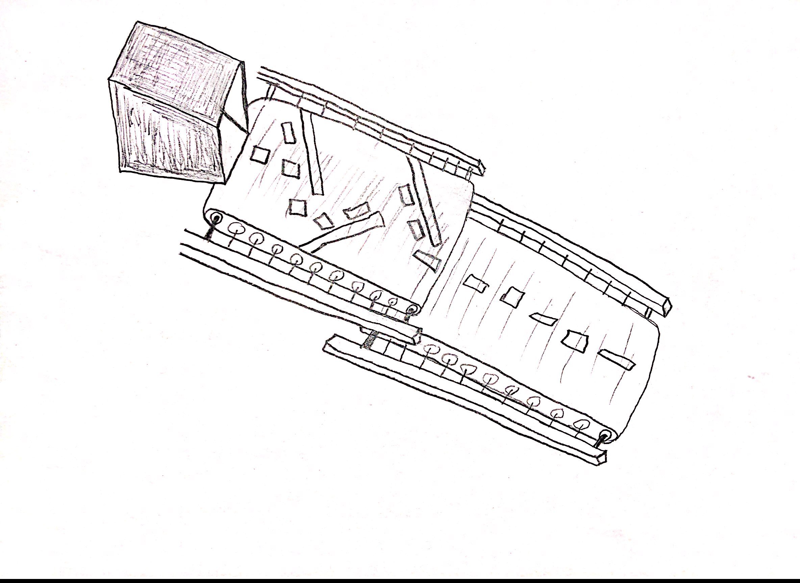
Transport Legos
3- Conveyor Belt with Hurdles
  Advantages
    More legos to sort
    More safe
    Easy movement
    Fast process
  Disadvantages
    N/A
Figure 9: Conveyor Belt with Hurdles
Abdulaziz Almaimony
Notes:
In this design idea, there are breaks present in the belt that make the que of the Legos and arrange them in one-line shape to make it easy to move.
More Legos to sort: it can move more legos and organize them to the next step
More safe: it safe because the lego will not fall down or the kid will touch them because it will have a glass in the top of the belt
Easy movement: the legos will move easily because the wall prevent them to get stuck
Fast process: it's gonna be a fast process because the legos will not stop moving

Slide 12
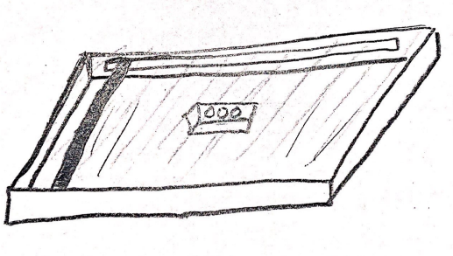
Classify Legos
1- Scanner
  Advantages
    Easy to operate
  Disadvantages
    Not accurate
    Cost too much
Figure 10: Scanner
Abdulaziz Almaimony
Notes:
This is the idea that scan the Lego and differentiate it from others to find its location where it need to go according to the associated space and the idea has shown below.

Slide 13
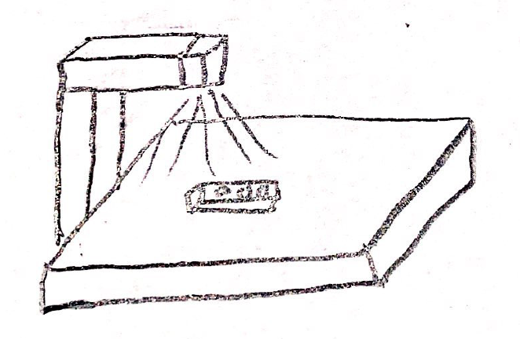
Classify Legos
2- Camera
  Advantages
    Easy to operate
  Disadvantages
    Slow process
    Costly
    Less efficient
Figure 11: Camera
Abdulaziz Almaimony
Notes:
Another option we have decided is the use of camera to do the differentiation between the Legos and recognize the Lego so it can move to its associated space.

Slide 14
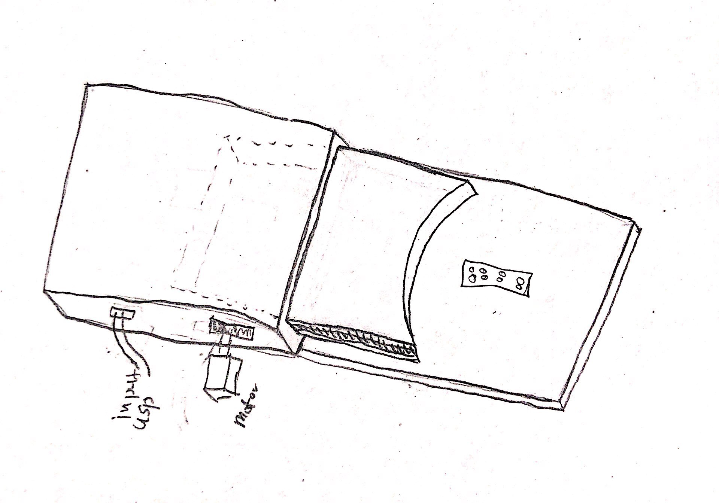
Classify Legos
3- Weight
  Advantages
    Very accurate
    Fast process
    Easy to use
  Disadvantages
    N/A
Figure 12: Weight
Abdulaziz Almaimony
Notes:
This is the idea that check the weight of each Lego and differentiate it from others and move to the space associated to that weight and it has shown below:

Slide 15
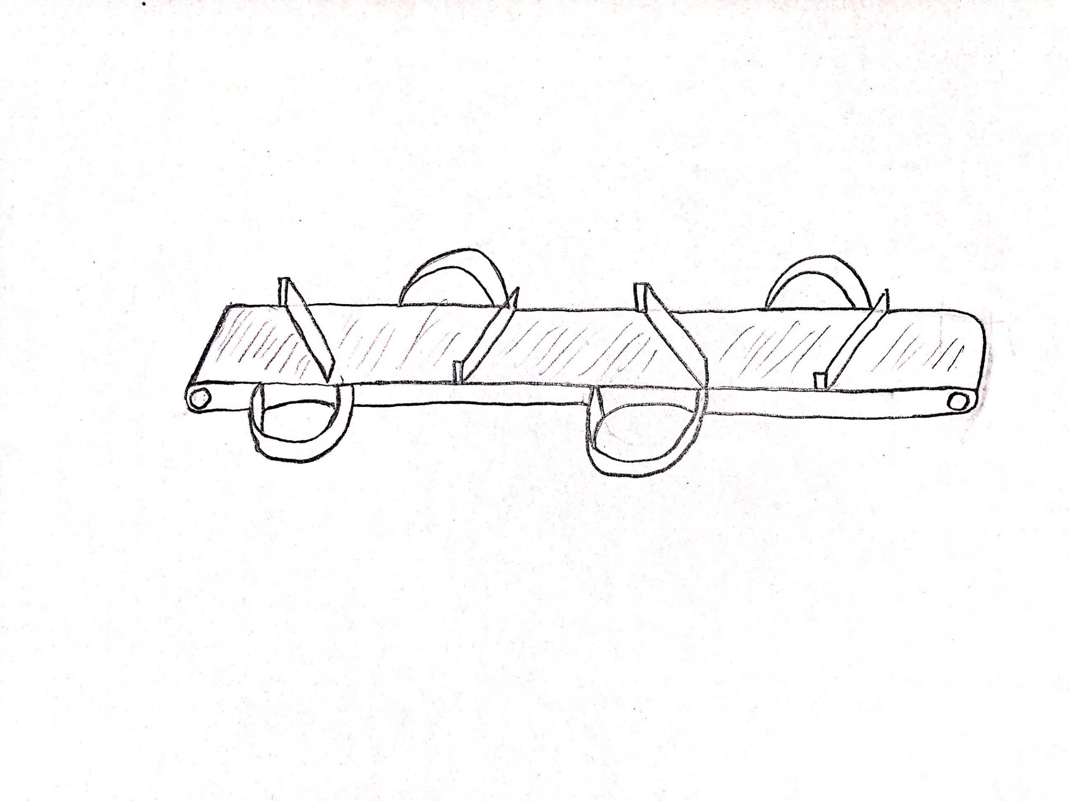
Sorting Lego
1- Tree Belt
  Advantages
    Safe
  Disadvantages
    Sorting is difficult
    Slow process
    Chance of sticking together
Figure 13: Tree Belt
Abdulaziz Almaimony
Notes:
In this design, Legos have lot of space to store so different Legos store in different portions of the branches, so this design can manage multiple shapes, multiple colors and multiple sizes as well as the design has shown below.

Slide 16
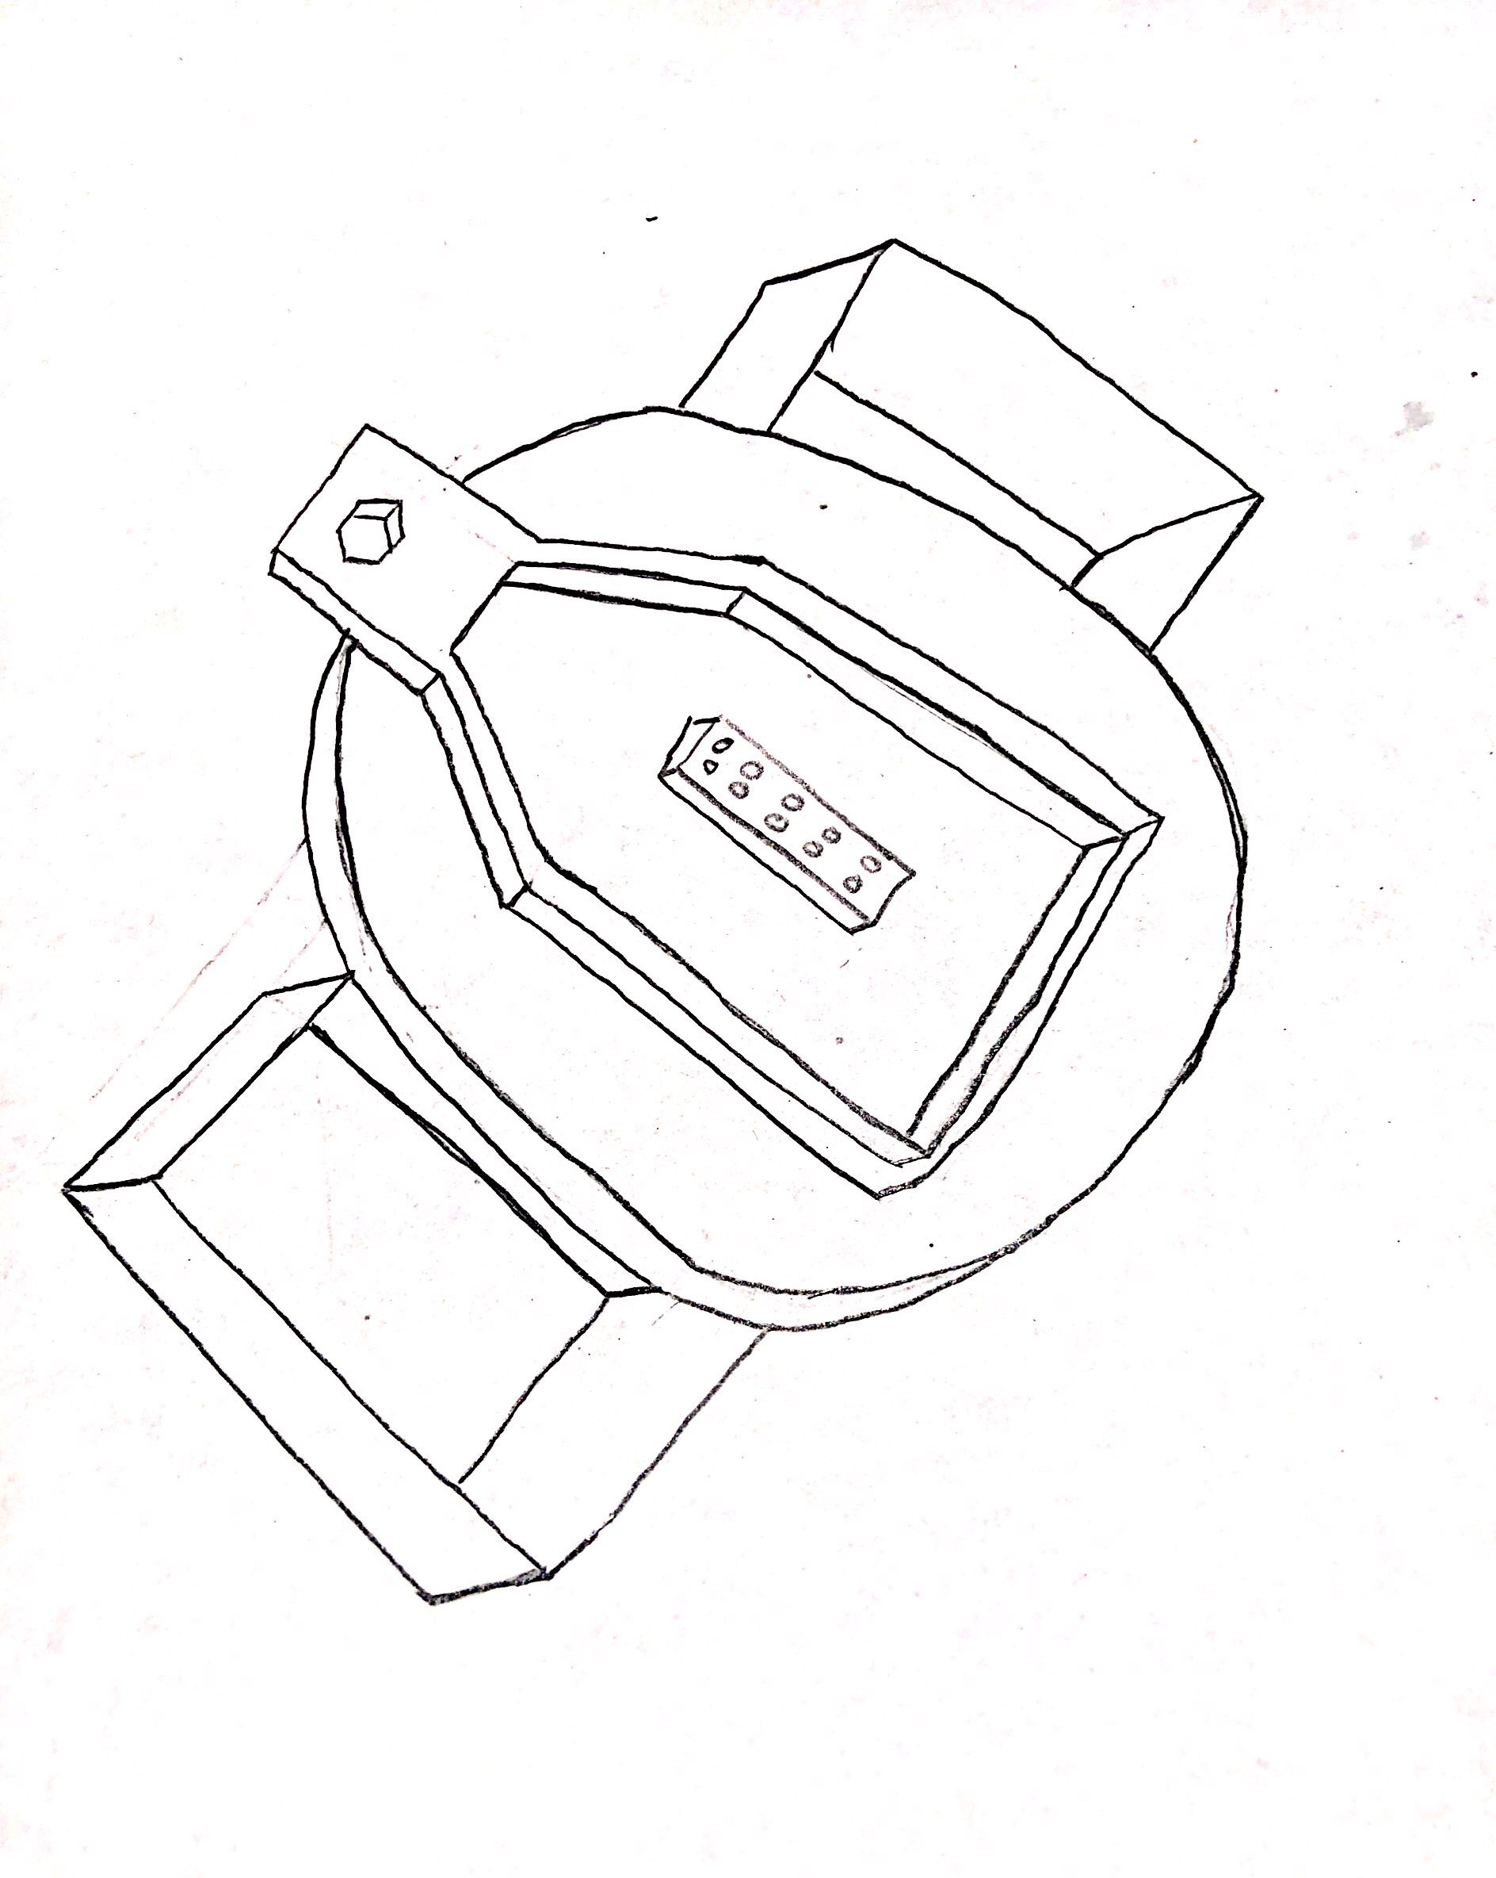
Sorting Lego
2- Round Boxes
  Advantages
    Accurate
  Disadvantages
    Less boxes
    Chance of falling down
Figure 14: Round Boxes
Abdulaziz Almaimony
Notes:
In this design, all the Legos will sort out in one round shape area with the hands outside it and these hands store the Legos. One hand will store one kind of Lego and other hand will store second kind of Lego and in this way all the Legos will sort in this round shape. The design has shown below.

Slide 17
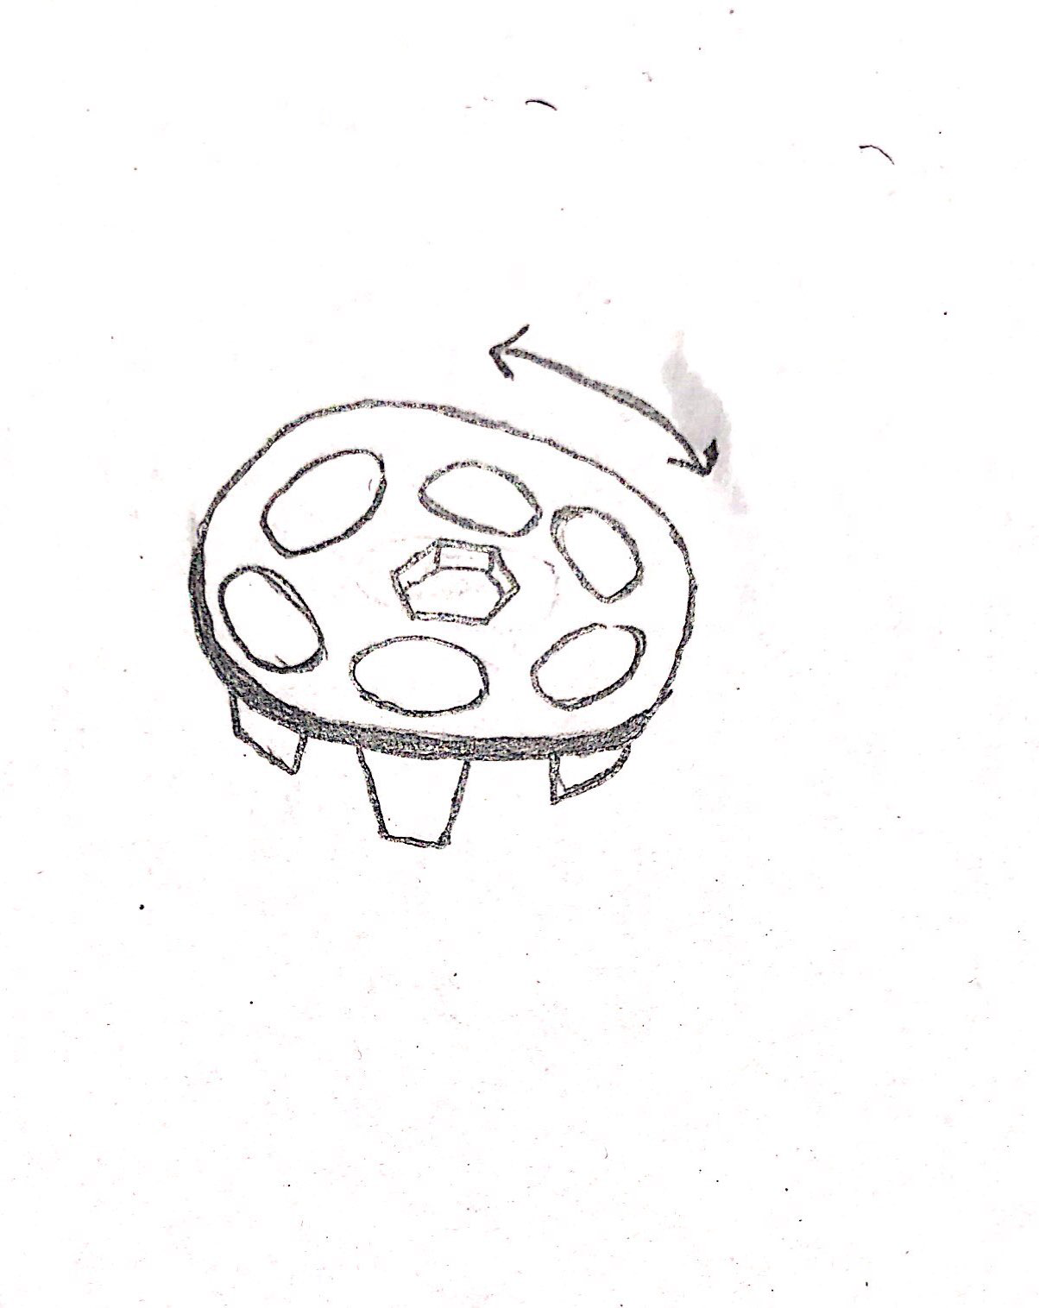
Sorting Lego
3- Rotational Boxes
  Advantages
    Sorting is easy
    More Boxes option
    Fast process
  Disadvantages
    N/A
Figure 15: Rotational Boxes
Abdulaziz Almaimony
Notes:
In this design there are boxes formed with the link from center box and all the Legos have their own box so each design will get its own box so lot space and it is easy as well to store the Legos and within small space. As the design has shown below

Slide 18
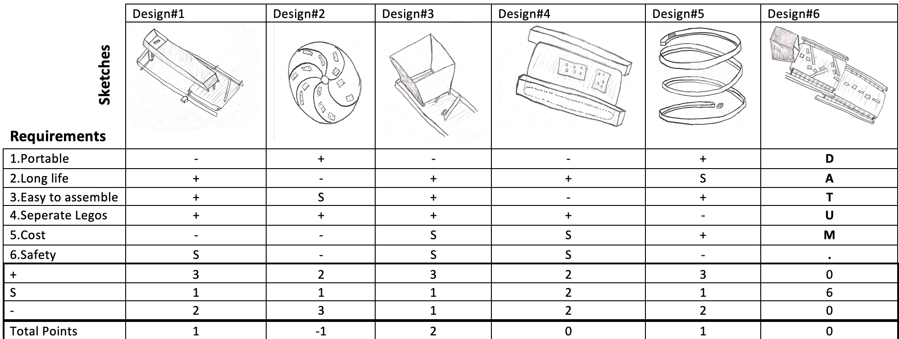
Pugh Chart
Figure 16: Pugh chart
Husain Alkandari

Slide 19
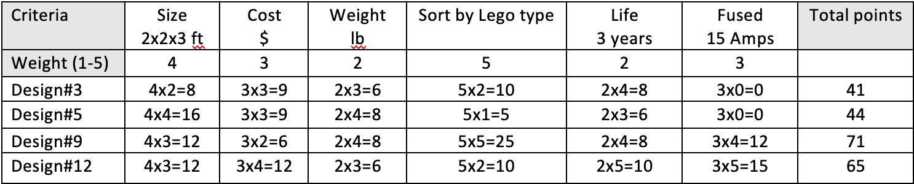
Decision Matrix
Figure 17: Decision Matrix
Husain Alkandari

Slide 20
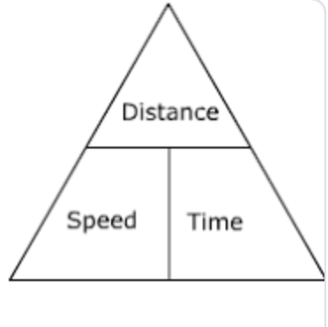
Calculations
Back of the envelope calculation
Time calculation
t= 0.78/0.4= 1.95s
Figure 18: Distance Speed Time Formula [7]
Abdullah Almutairi

Slide 21
Calculations
Each 0.78m sort 1 LEGO
Sort 1 LEGO takes 1.95s
Speed is 0.4 m/h for the process
Abdullah Almutairi

Slide 22
Calculations
Weight in grams [4], [5]
0.1 >>> 0.3g box A
0.4>>> 0.8g box B
0.9>>> 1.2g box C
1.3>>> 1.7g box D
1.8>>> 2.1g box E
Abdullah Almutairi

Slide 23
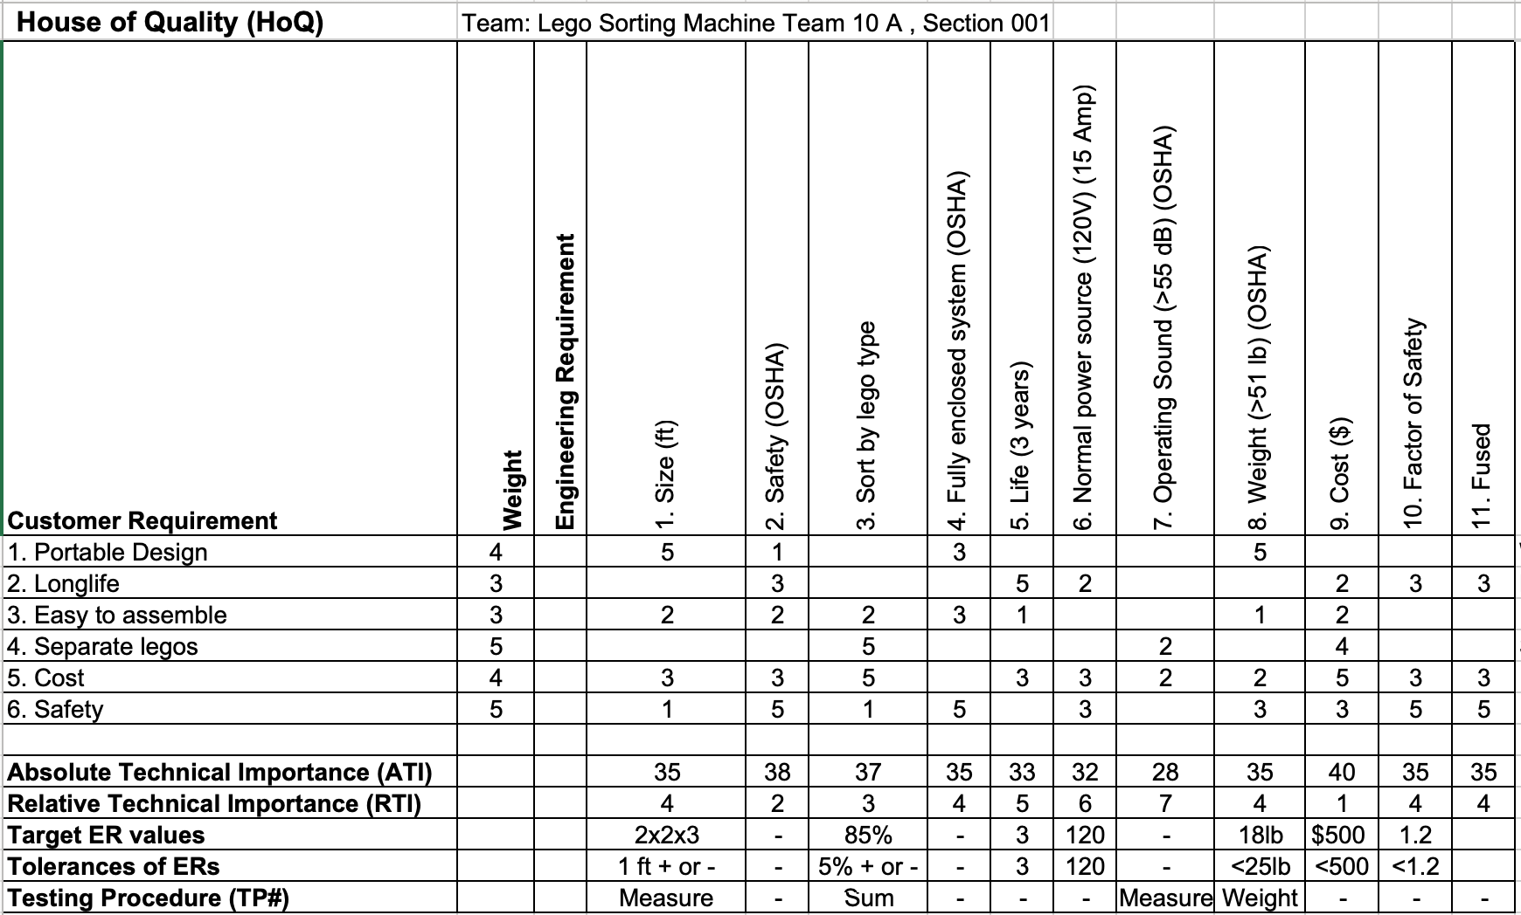
Finalized HoQ
Figure 19: QFD
Husain Alkandari

Slide 24
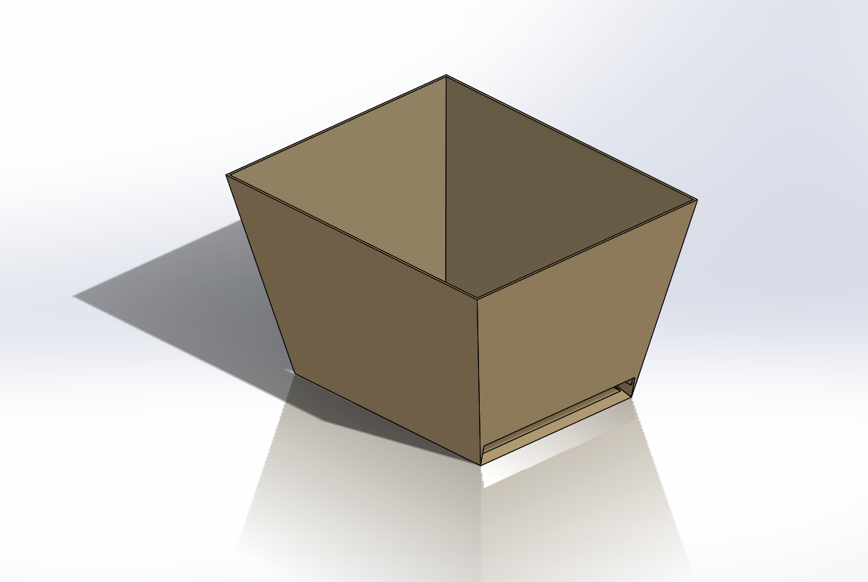
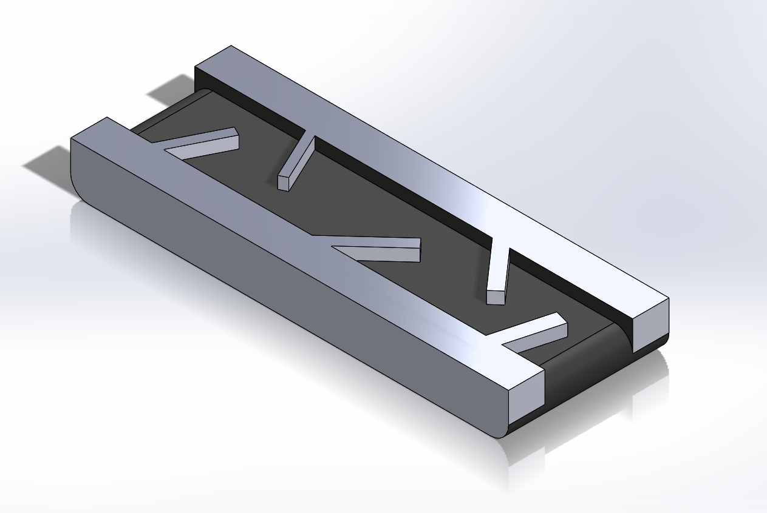
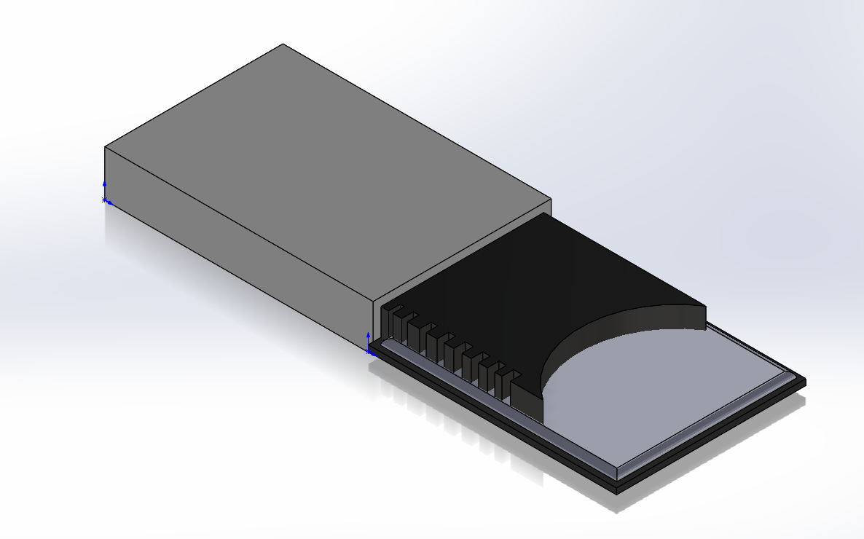
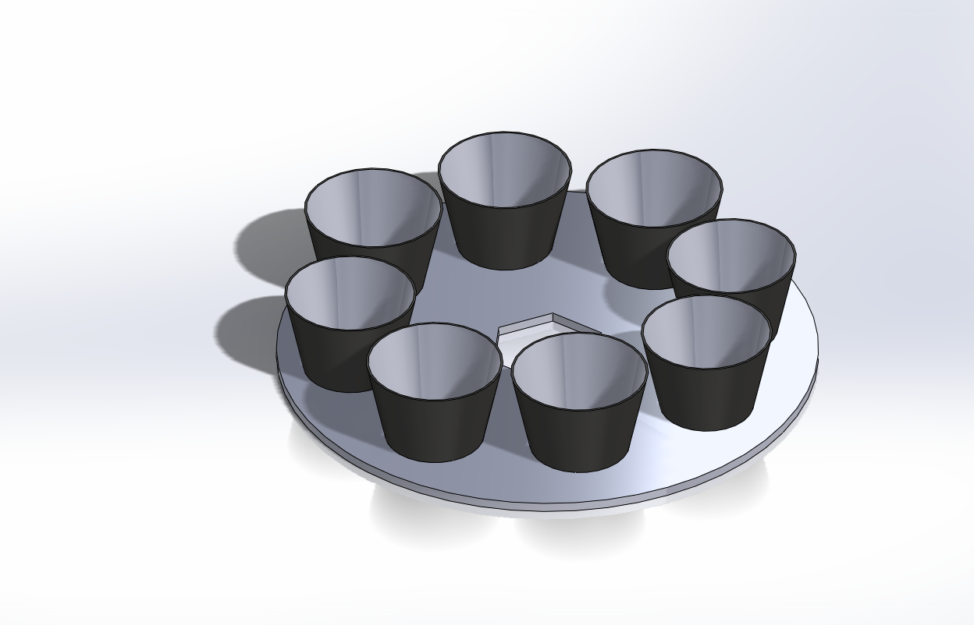
Final Design Concept
Final full Design system
  The best Design comparing to the others
Figure 20: CAD
Abdullah Almutairi

Slide 25
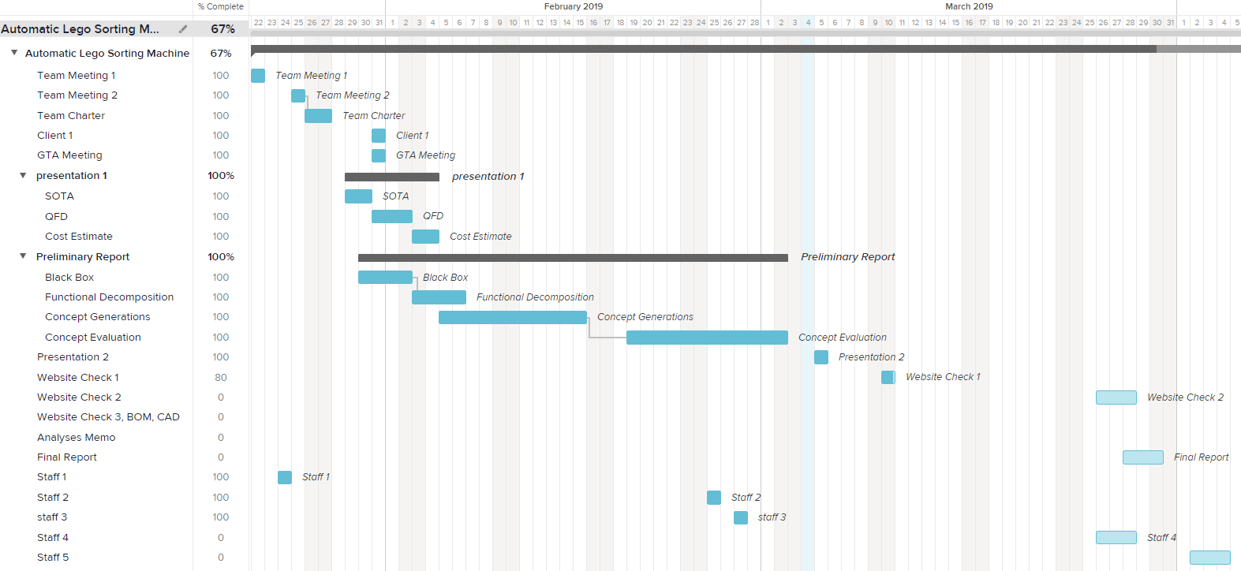
Figure 21: Gantt Chart
Schedule
Sultan Alharbi

Slide 26
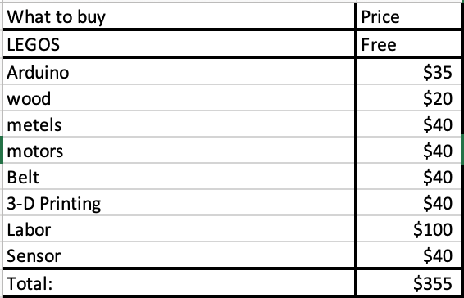
Budget
Table 1: Cost [3]
Project budget
  $500 USD
Project needs
  Materials
In what it will be used in
  Assemplation
Abdullah Almutairi
Notes:
Describe the project’s budget including total dollars available, anticipated expenses, actual expenses to date, and the resulting balance. Note anticipated expenses will still be estimates at this point.

Slide 27
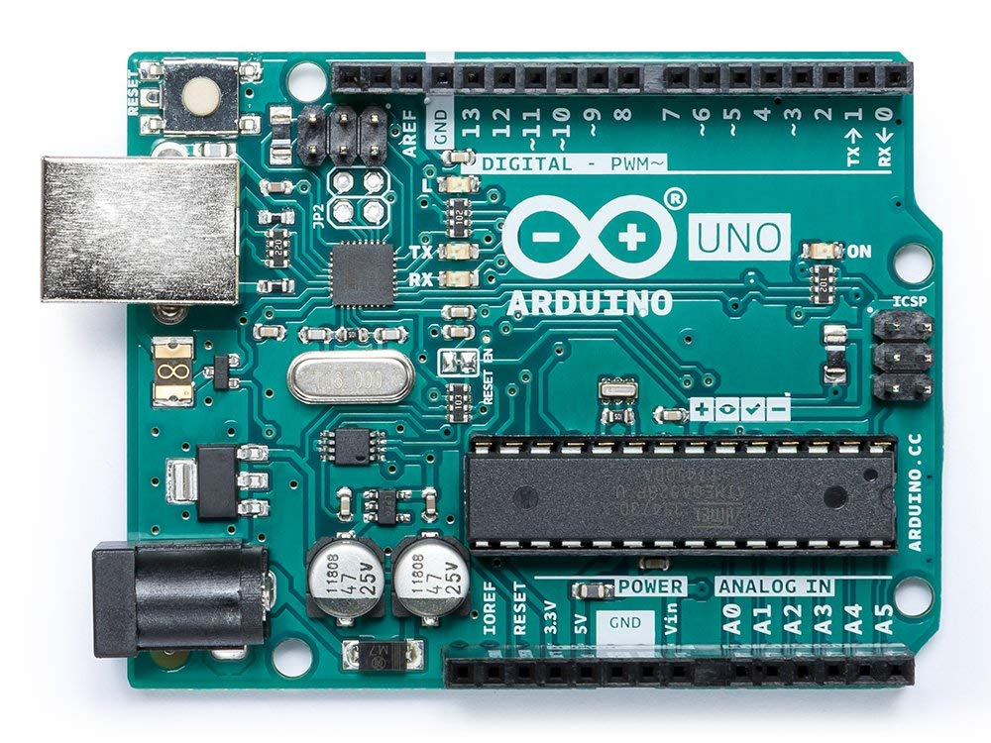
Arduino
How it works
  Programming
What does it do
  Control
How it will help our project
  Make it works
Figure 22: Arduino [2]
Abdullah Almutairi

Slide 28
Conclusion
Result Summary
Acknowledge Achieved
Abdullah Almutairi

Slide 29
[1] Pymnts, “Everything Is Not Awesome As LEGO Sales Decline,” PYMNTS.com, 08-Mar-2018. [Online]. Available: https://www.pymnts.com/news/retail/2018/lego-toys-r-us-toy-industry-sales/. [Accessed: 02-Feb-2019].
[2] MONK, SIMON. Programming Arduino: Getting Started with Sketches. Mcgraw-Hill Education, 2016.
[3] Amazon.com. (2019). Amazon.com: Online Shopping for Electronics, Apparel, Computers, Books, DVDs & more. [online] Available at: https://www.amazon.com/ [Accessed 5 Mar. 2019].
[4] BrickLink, BrickLink - Minifig poc007 : Lego Blackbeard [Pirates of the Caribbean] - BrickLink Reference Catalog. [Online]. Available: https://www.bricklink.com/catalogTree.asp?itemType=P. [Accessed: 03-Mar-2019].
[5] Martin, Fred G. "The art of LEGO design." The Robotics Practitioner: The Journal for Robot Build rs 1.2 (1995): 1-19.
[6] “ARDUINO UNO R3 [A000066],” Amazon. [Online]. Available: https://www.amazon.com/Arduino-A000066-ARDUINO-UNO-R3/dp/B008GRTSV6. [Accessed: 04-Mar-2019].
[7] Softschools.com. (2019). Distance Speed Time Formula. [online] Available at: http://www.softschools.com/formulas/physics/distance_speed_time_formula/75/ [Accessed 5 Mar. 2019].
References

Slide 30
Thank You,
Questions?

Slide 31
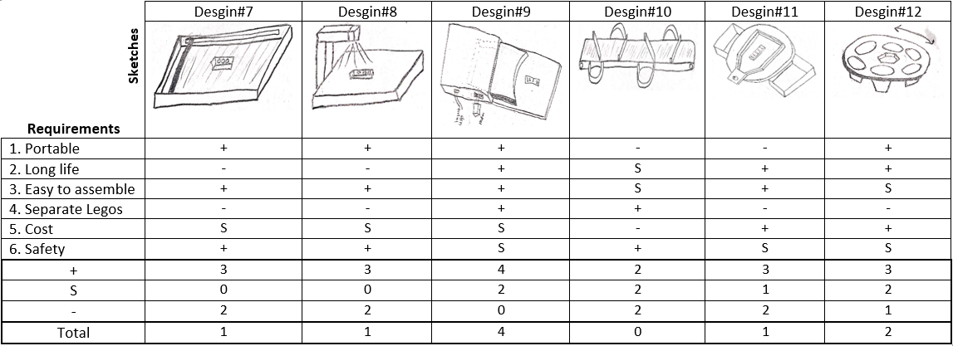
Appendix A

