Slide 1
Team 1: Automatic Lego Sorting Machine
Team Members: Abdullah, Fahad , Sultan, Abdulaziz and Husain
Roles: Alternating roles

Slide 2





Team Members
Fahad Alotaibi
Abdullah Almutairi
Sultan Alharbi
Husain Alkandari
Abdulaziz Almaimony
Fahad is the team’s client contact. He has good skills in organizing group work.
Abdullah is the Budget Holder. He knows where to spend our budget.
Sultan is the team manager. He is a great in communication with people and he has a decent background with designing.
Husain is the team secretary/document manager. He has good skill in thinking out of the box with good editing skills.
Abdulaziz is the team website developer. He has a great knowledge of the computer skills.
Fahad Alotaibi

Slide 3

Project Description
The Goal:
  Sorting lego by size and functionality.
Constrains:
  Device size ( fits on classroom table)
  Finance ($500 USD)
  Lifespan ( last for 3 years)
Objectives:
  Performance (99%)
  Aesthetics
Figure 1: Lego [1]
Fahad Alotaibi

Slide 4
Customer Background and Description
Client, Stakeholder and sponsor:
  Client: Dr. Willy
  Stakeholders: Parents, Children and NAU
  Sponsor: NAU
Importance of the project:
  Time.
  Effort.
Fahad Alotaibi

Slide 5
Research
The Art of LEGO[2]:
  Sizes
  Shapes
Solid Work[3]:
  Drowing
Scanning automated Sorting System[4]:
  Learn and more understanding
Abdullah Almutairi

Slide 6
Research
Mechanical Engineering Design[6]:
  Choosing the best materials
  Knowing the property
Proximity Sensors[7]:
  Leaser
  Picture
  Weight
Abdulaziz Almaimony
Notes:
As the project is Automatic Lego sorting machine
This textbook is a good reference for helping in building
the project because it has lot of details regarding the materials, springs, and gears, which can
help in the project. As the project will sort the Legos so materials will help in understanding the
best materials for the Legos and identify the stress, materials can bear which are perfect to use
for Legos, springs will use to move the Legos from one place to another place, gears will also
help in moving the Legos for sorting them.
In materials, material strength and stiffness is useful to select the best material for the Lego
because the Legos must be strong enough to bear any external force or if drop down then don’t
get broken

Slide 7
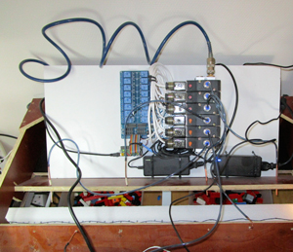
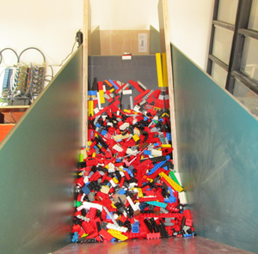
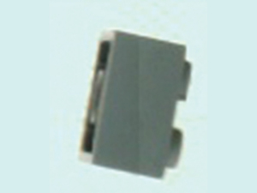
State of the Art Review
How I Built an Artificial Intelligence to Sort 2 Tons of Lego Pieces
  A software that is able to reliably classify across the entire range of parts in the market.
  Making sure the pictures were correctly labeled.
  Store 90% of the correctly labeled.
Figure 2: PC for identification [8]
Figure 4: Conveyor belt [8]
Figure 3: Magnifying camera [8]
Sultan Alharbi

Slide 8
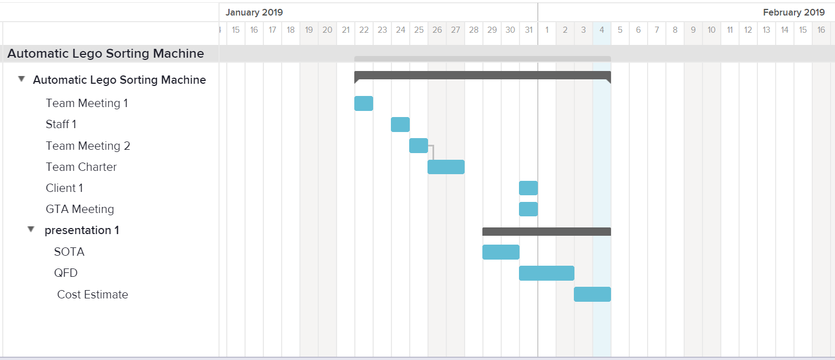
Gantt Chart
Table 1: Gantt Chart
Sultan Alharbi

Slide 9
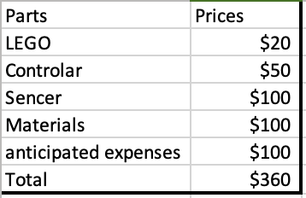
Rough Budget
Table 2: Rough Budget
Project budget:
  $500 or under
Features:
  The quality of the parts
Abdullah Almutairi

Slide 10
Customer Requirements Engineering Requirements
Safe
Portable
Durable
Light wight
Affordable
Function
Warranty
Separate non-lego
Easy to carry
House friendly
Fit normal desktop
Run on normal power source
Separate lego by weight or size
Scanning sensor
Dvice last for at least three years
Good legos load amount
Husain Alkandari

Slide 11
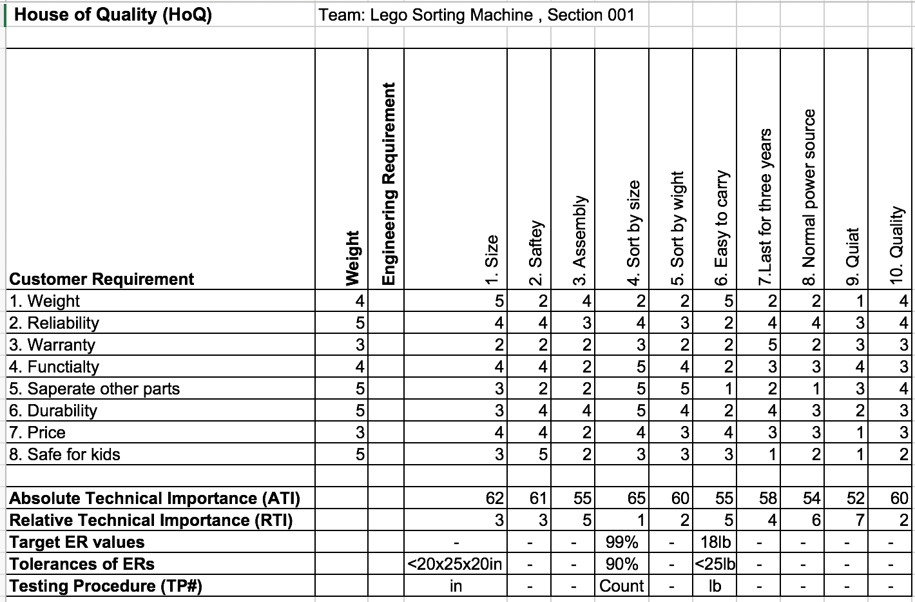
HoQ:
ATI:
  Sort by size
  Size
  Safety
Husain Alkandari

Slide 12
Future Work
Concept generation
Project Evaluation
Husain Alkandari

Slide 13
Conclusion
Result Summary
Knowledge achieved
Abdulaziz Almaimony

Slide 14
[1] Pymnts, “Everything Is Not Awesome As LEGO Sales Decline,” PYMNTS.com, 08-Mar-2018. [Online]. Available: https://www.pymnts.com/news/retail/2018/lego-toys-r-us-toy-industry-sales/. [Accessed: 02-Feb-2019].
[2] Martin, Fred G. "The art of LEGO design." The Robotics Practitioner: The Journal for Robot Builders 1.2 (1995): 1-19.
[3] Lombard, Matt R. SolidWorks 2011 Assemblies Bible. 1st ed. Indianapolis, Ind.: Wiley, 2011. Bible. Web.
[4] Mampe, John J., and Oscar L. Avant. "Remote video scanning automated sorting system." U.S. Patent No. 4,992,649. 12 Feb. 1991.
[5] “LEGO City Great Vehicles Diving Yacht 60221 Building Kit , New 2019 (148 Piece),” Amazon. [Online]. Available: https://www.amazon.com/LEGO-Great-Vehicles-Diving-Building/dp/B07GVYMLWJ/ref=sr_1_1_sspa?s=toys-and-games&ie=UTF8&qid=1549332661&sr=1-1-spons&keywords=LEGO&psc=1. [Accessed: 05-Feb-2019].
[6]R. G. Budynas, J. K. Nisbett, “Mechanical Engineering Design”, 9ThEdition, by Shigley
[7]E. Frank, N. Siegfried, “Proximity Sensor”, published by FESTO, 2003, Germany
References

Slide 15
References
[8]J. Mattheij, “How I Built an AI to Sort 2 Tons of Lego Pieces,” IEEE Spectrum: Technology, Engineering, and Science News, 23-Jun-2017. [Online]. Available: https://spectrum.ieee.org/geek-life/hands-on/how-i-built-an-ai-to-sort-2-tons-of-lego-pieces. [Accessed: 05-Feb-2019].
[9]“CanaKit Raspberry Pi 3 B (B Plus) Ultimate Starter Kit (32 GB Edition, Clear Case),” Amazon. [Online]. Available: https://www.amazon.com/CanaKit-Raspberry-Ultimate-Starter-Clear/dp/B07BC567TW/ref=sr_1_1_sspa?s=toys-and-games&ie=UTF8&qid=1549332808&sr=1-1-spons&keywords=raspberry pi&psc=1&smid=A30ZYR2W3VAJ0A. [Accessed: 05-Feb-2019].

Slide 16
Thank You,
Questions?

