Slide 1


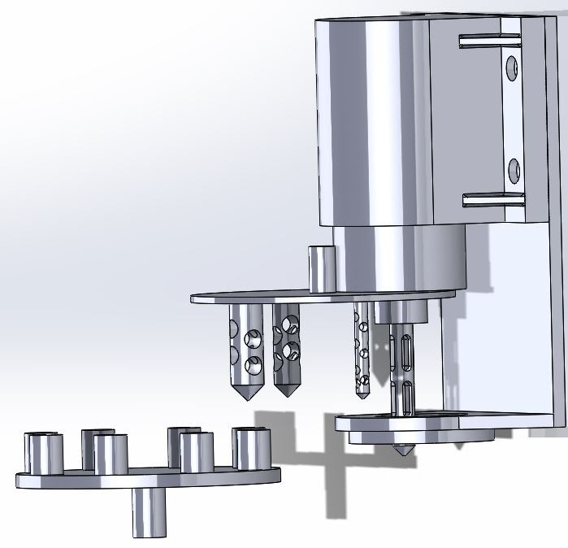
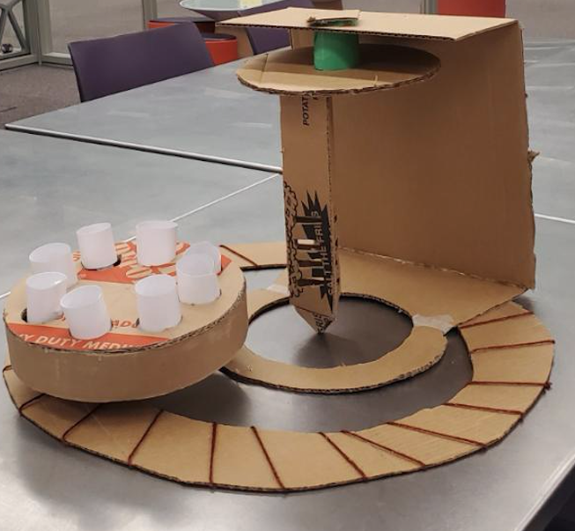
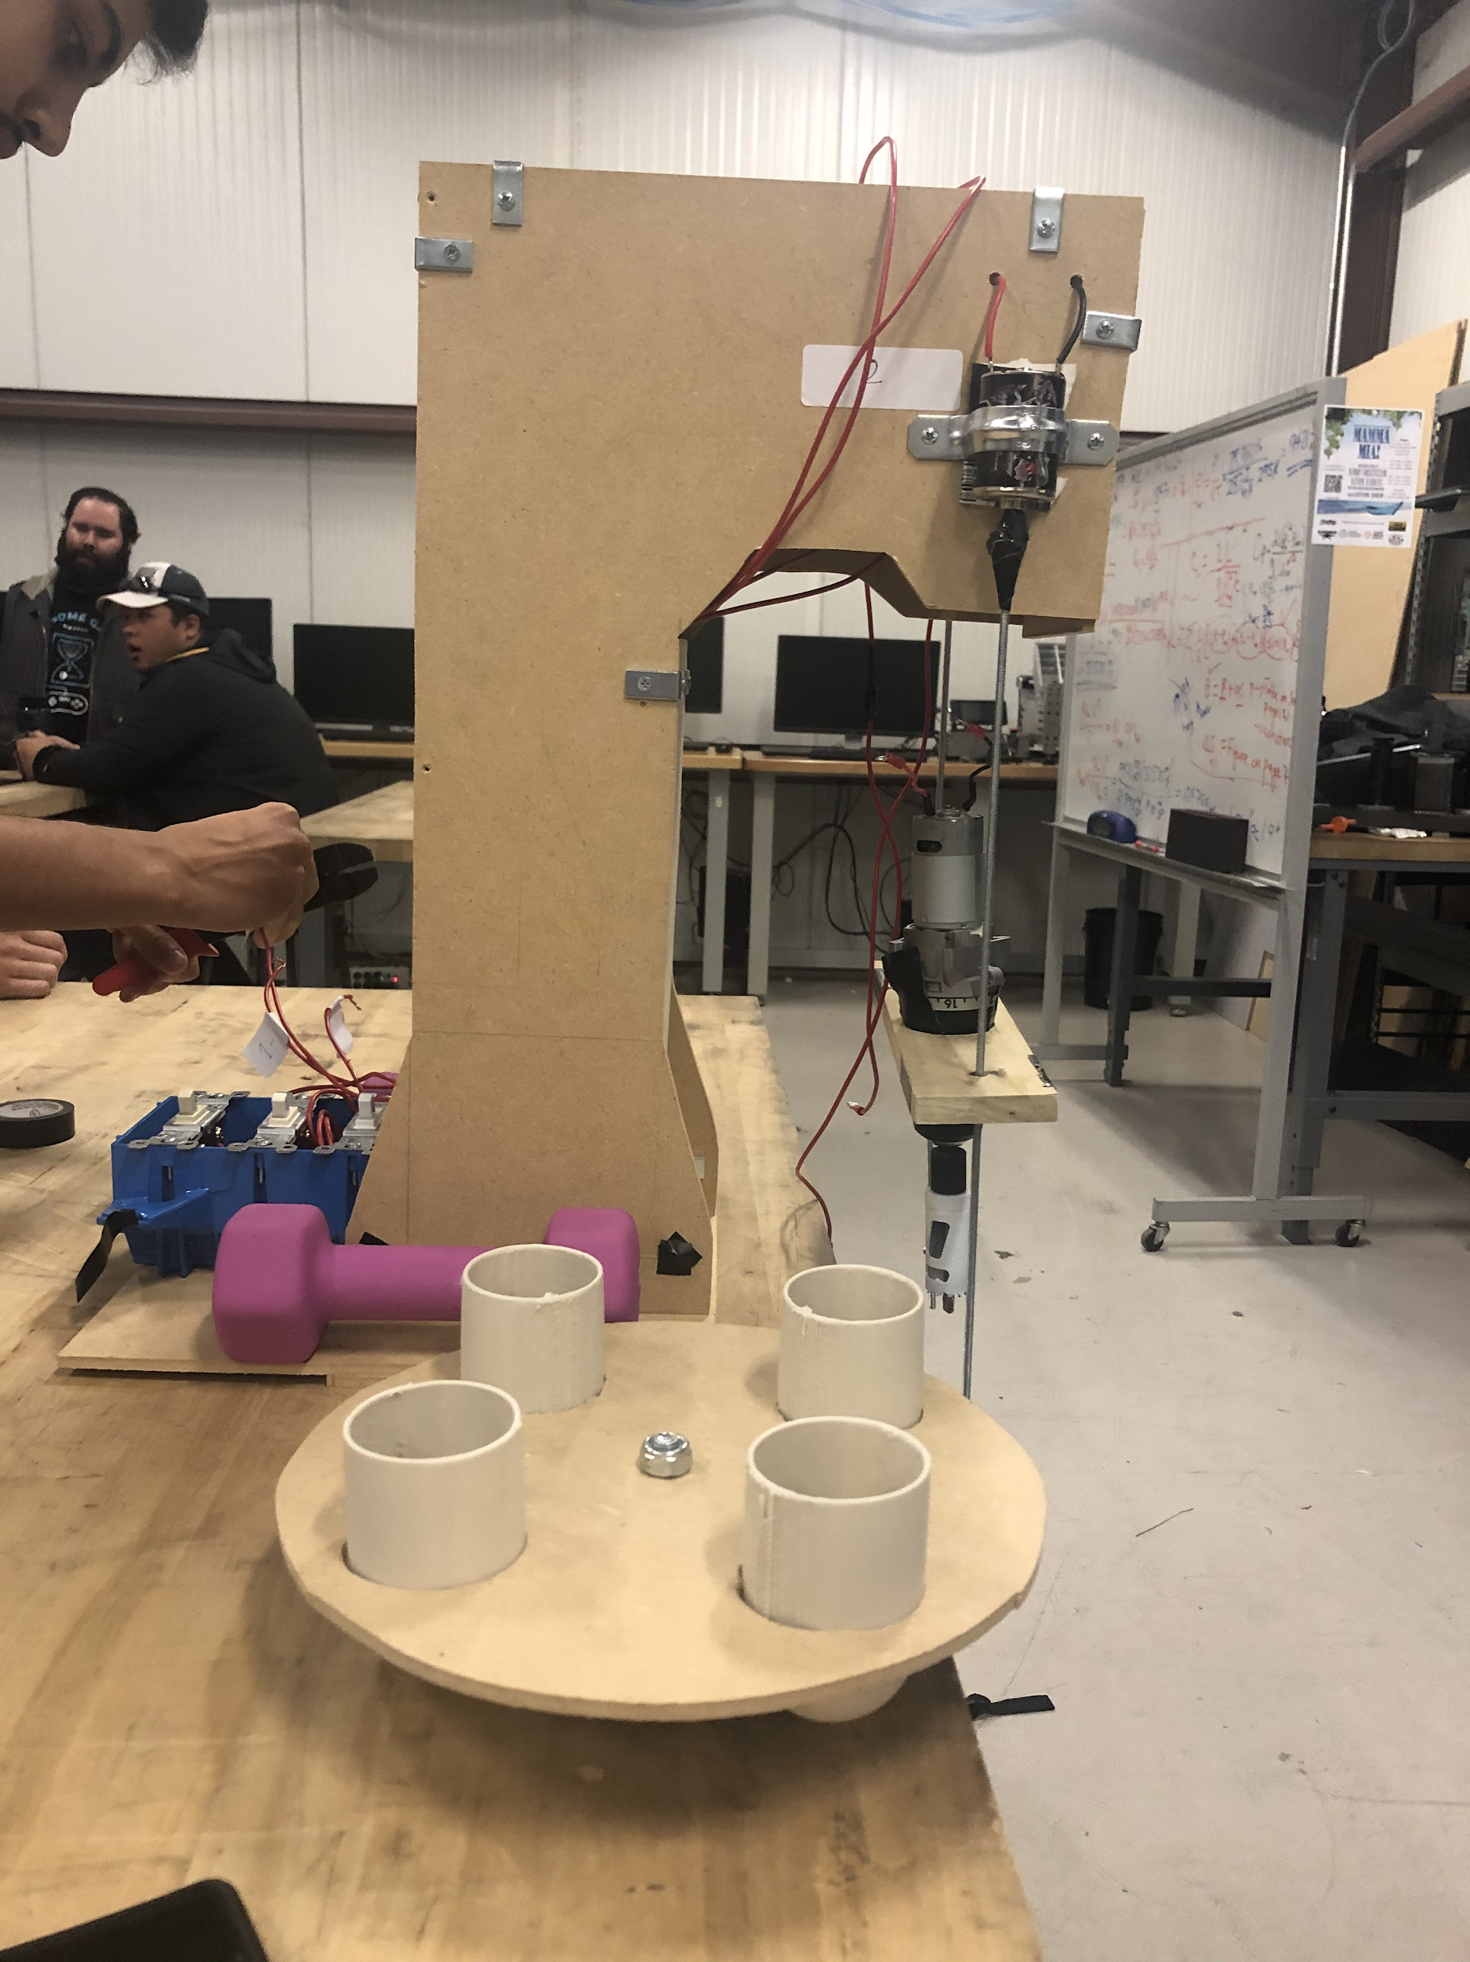
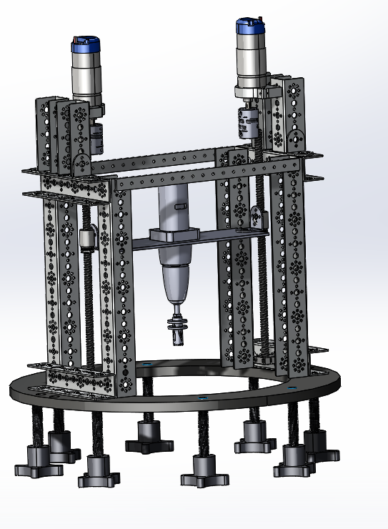
A JOURNEY TO (16) PSYCHE:
Sampling the Surface of a Metallic Asteroid
Andrew Acosta, Sultan Almarzouqi, Samuel Armstrong, Karissa Barroso, Scott Sprauer
Faculty Advisor - Dr. Sarah Oman & Dr. David Trevas
College of Engineering, Informatics & Applied Sciences, Northern Arizona University, Flagstaff, AZ 86011
Abstract
Design for Practice Process
Results & Conclusion
The NAU Psyche Sampling Team was tasked with creating a sampling device that could be operable on the surface of the Psyche asteroid. Psyche is an asteroid positioned in the asteroid belt between Mars and Jupiter and is the first asteroid to be explored that has a hypothesized composition of mixed metal and low-iron silicate rock. This capstone project, sponsored by the National Aeronautics and Space Administration and Arizona State University’s School of Earth and Space Exploration, works towards creating a model of a future sampling system that would be capable of operating under the environmental conditions of the asteroid. It is important to note that the Psyche surface has not yet been explored, therefore the true composition and topography of this asteroid is still fully unknown. The team was able to work closely with their client, Dr. Cassie Bowman, to develop a unique and effective design that meets all customer requirements developed by the team’s client for a successful product. The team has been able to create a physical, small scale sampling system model that is capable of autonomously drilling into hard and metallic materials and can transfer and store the collected samples.
From the given customer & engineering requirements, the team began the design for practice process, by defining the following crucial subsystems for their final system: drilling, storage, collecting/distribution, and stability. Using various creative design techniques, the team then narrowed their design to three drawn concepts for each of the four subsystems. To decide on a final design, the team rated each subsystem design using the decision matrix and Pugh chart processes.
The final concept, first developed in a CAD modeling software, contained a magnetic base for stability, a rotating plate to collect the samples, and a drill that is attached to the tower that can horizontally to drill the surface. After developing the initial CAD design, shown in Figure 1, the team first created a beta prototype, consisting of basic materials, shown in Figure 2. They then assembled the alpha prototype, as seen in Figure 3, which consisted of wood and was powered through electrical wires and switches that activated the drill and the supporting motors on the side. These side motors allows for the drill to move up and down. After the alpha prototype phase was completed, the team created the final product, shown in a CAD model in Figure 4, which consisted of aluminum and steel and is controlled by a coded Arduino set.
Over the first semester, the team researched sampling techniques and available hardware in order to create a preliminary sampler design. After the first semester, the team was able to begin construction and make the design more practical and advantageous. The final design of the sampling system culminated the strongest designs for each sub-system. During the second semester, the team focused on making each subsystem function as desired. The magnetic base, sample ejection, and caching arm were all in the process of being constructed. Unfortunately, due to the COVID-19 outbreak, the team was unable to complete the physical device and conduct testing on its operability. The team instead created a full CAD model of the final design and conducted various analyses to test the final product. Analytically, the device worked as intended and was able to operate autonomously using pre-coded Arduino power. The chosen motors allowed for a drill force strong enough to drill through hard surfaces with a diamond-grade coring bit and the electromagnetic force was large enough to keep the system stable on a metallic surface. In an ideal world, the team would have been able to complete their final product construction and would have conducted real-world testing with various materials of different hardness.
Customer & Engineering Requirements
All the customer requirements (CR) follow the project demands that were originally provided. The team has created seven customer requirements, as seen in Table 1, and used them to create quantifiable engineering requirements that were used while creating the final product.
Table 1: Customer Requirements and Importance
From the customer requirements, the team developed engineering requirements (ER) to have values that the team can test and measure against, shown in Table 2. They developed a goal value for each requirement and set a tolerance value for each goal.
Table 2: Engineering Requirements and Target Values
Weight can be controlled by minimizing the amount of material in the project, as well as selecting components whose density is lower. The team will focus on the weight to ensure that the system is not too big and/or heavy. The second engineering requirement the team created is the maximum hardness the drill can collect. The hardness can be controlled by choosing a material that can penetrate multiple surfaces while remaining rigid and sharp. The team started looking into diamond drill and coring bits to achieve this requirement but was unable to achieve due to cost and availability. The team was given a starting budget of $1000, however more funds were needed. The final engineering requirement was force acting on drill because the force the drill creates against the surface must be less than the force the electromagnetic creates.
Customer Requirements | Weights
Reliable | 12
Durable | 8
Safe | 10
Inexpensive | 12
Functional on Different Surfaces | 16
Sample Caching | 10
Stability under Orbital Rotation | 5
References
[1] Elkins-Tanton, L., “Possible Surface Characteristics of (16) Psyche”, Psyche Science Team, August 2019.
[2] Unknown, “ Psyche Science” Psyche / Journey to a Metal World, ASU Psyche, Oct. 2019. [Online] Available: https://psyche.asu.edu/science
[3] Valentine, K., “ASU - Led NASA Psyche Mission to offer courses to learn about Space Exploration”, ASU - School of Earth and Space Exploration, April 18, 2019.
[Online] Available: https://sese.asu.edu/about/news/article/3970
[4] Elkins‐Tanton, L. T., Asphaug, E., Bell, J. F., III, Bercovici, H., Bills, B., Binzel, R., et al. (2020). Observations, meteorites, and models: A preflight assessment of the composition and formation of (16) Psyche. Journal of Geophysical Research: Planets, 125, e2019JE006296. https://doi.org/ 10.1029/2019JE006296/
Figure 1: Initial CAD Development
Figure 2: Beta Prototype
Engineering Requirements | Goal | Tolerance | CR Correlations
Weight | 18 kg | ±2 kg | Durability, Safety, & Sample Caching
Max Material Hardness | 150 HB | ±50 HB | Reliability, Durability & Functionality on Different Surfaces
Cost | $1000 | ± $200 | Inexpensiveness
Force acting on the Drill | 5N | ± 0.2 N | Stability and Functionality on Different Surfaces
Acknowledgements
Special thanks to our faculty advisors, as well as, our client and Psyche Mission Co-Investigator, Dr. Cassie Bowman, for her support and guidance. We would also like to thank Arizona State University’s School of Earth and Space Exploration (ASU-SESE) and the National Aeronautics and Space Administration (NASA) for their sponsorship of this project.
DISCLAIMER: This work was created in partial fulfillment of Northern Arizona University’s Capstone Courses “ME 476C & ME 486C″. The work is a result of the Psyche Student Collaborations component of NASA’s Psyche Mission (https://psyche.asu.edu). “Psyche: A Journey to a Metal World” [Contract number NNM16AA09C] is part of the NASA Discovery Program mission to solar system targets. Trade names and trademarks of ASU and NASA are used in this work for identification only. Their usage does not constitute an official endorsement, either expressed or implied, by Arizona State University or National Aeronautics and Space Administration. The content is solely the responsibility of the authors and does not necessarily represent the official views of ASU or NASA.
Figure 3: Alpha Prototype
Figure 4: Final Product (CAD)

