Slide 1
Oil Chip Detector Housing
Capstone Team Honeywell
July 24, 2019
Test Readiness Review
Honeywell Internal

Slide 2
Test Overview
Funding
TRR Purpose
Test Purpose & Requirements
Risk & Mitigation
Unit Under Test (UUT)
Testing Schedule and Status of Engine
Test Procedure
Instrumentation
Facility Control System Safety
Testing Protocols
Problem Reporting
Deliverables
Action Items
Honeywell Internal

Slide 3
Funding
Funding provided by Honeywell

Slide 4
Readiness Review Purpose
Introduce and provide information on:
  OCDH Background
  Testing Systems
  Facility Requirements
  Safety Systems
  Schedule
  Deliverables

Slide 5
Testing Purpose & Requirements
Pertaining to:
Shock and Vibration
Pressure
Flow
Temperature / FireProofing
Weight / Size
In order to satisfy:
Cycle Durability
System Safety against overpressure
OCD sensor environment
System safety against Fire / Leaks

Slide 6
Risk Mitigation
Two-piece housing design for greater manipulation of interior and exterior dimensions
At least 0.2-inch-thick walls to allow a burst pressure of 20,000 psig
304 Stainless steel chosen for durability and corrosion resistance
Fireproof gasket material, that will be shield by the stainless-steel lid
Altogether risk of structural failure is low due

Slide 7
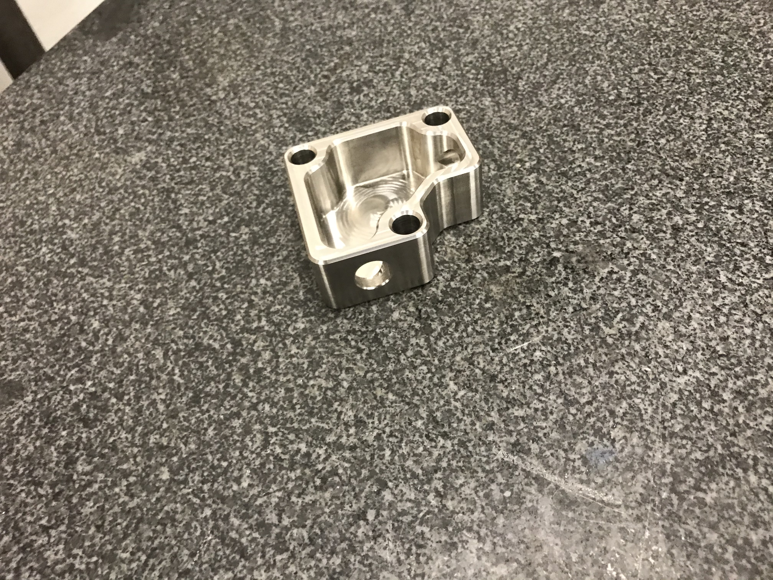
Unit Under Test
One unit provided by NAU Capstone Team
  Housing, main body
  Housing, Lid
  Gasket
  3 x 304 M10 socket cap screws

Slide 8
Testing Schedule
Testing to be completed on-site at Honeywell
Testing will be completed at a future date TBD

Slide 9
Testing Procedure
See accompanying document
  F1901-0001 Benchtop Testing Procedure for the Oil Chip Detector Housing

Slide 10
Instrumentation
General
Digital Scale
Calipers
Flow Related
Oil compatible pump
Dial Pressure Gauge
Data Acquisition System
Transducer
Specialized
Vibration Testing Table
Also referenced in F1901-0001

Slide 11
Facility Control System Safety
Fire Extinguisher
Splash / Burst Shield
Solvent / Oil Disposal

Slide 12
Testing Protocol
PPE
Fixture Priming
Testing Procedure
Requirement Validation
Clean Up / Disposal

Slide 13
Problem Reporting
All problems will be documented during the tests
Problems will be compiled into a full report
The report will be used to correct any problems found during testing

Slide 14
Deliverables
Test Procedures Document
Problems During Test Document

Slide 15
Action Items
Assemble a Flow Testing Fixture (Document F1901-0001)
Data Collection

