Slide 1
Team Honeywell
Jered Deal
Ilenn Johnson
Cullen Matillano
John Selee
Jacob Vedder

Slide 2

Project Description
Design, analyze and prototype an oil chip detector housing for a small turboprop engine.
Client: Honeywell
Keeping oil free of debris during engine operation.
Figure 1. Honeywell logo [1]

Slide 3
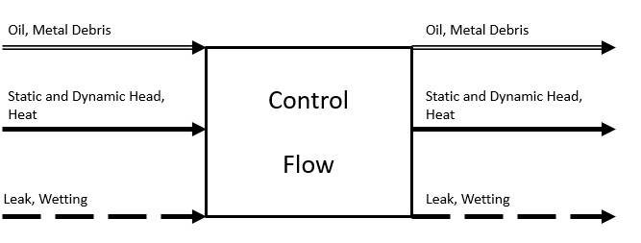
Concept Generation- Black Box Model
Figure 2: A black box model detailing the three flows of the housing (material, energy, signal)

Slide 4
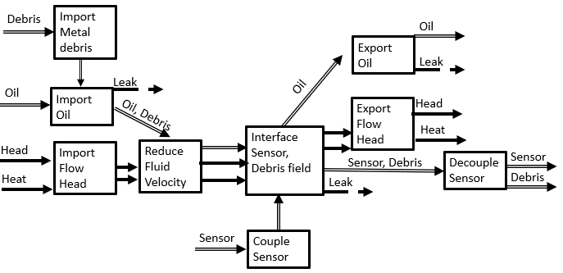
Modeling- Functional Decomposition
Figure 3: A functional decomposition model for the oil chip detector (sensor) housing

Slide 5

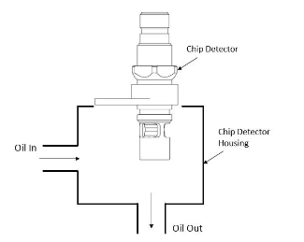
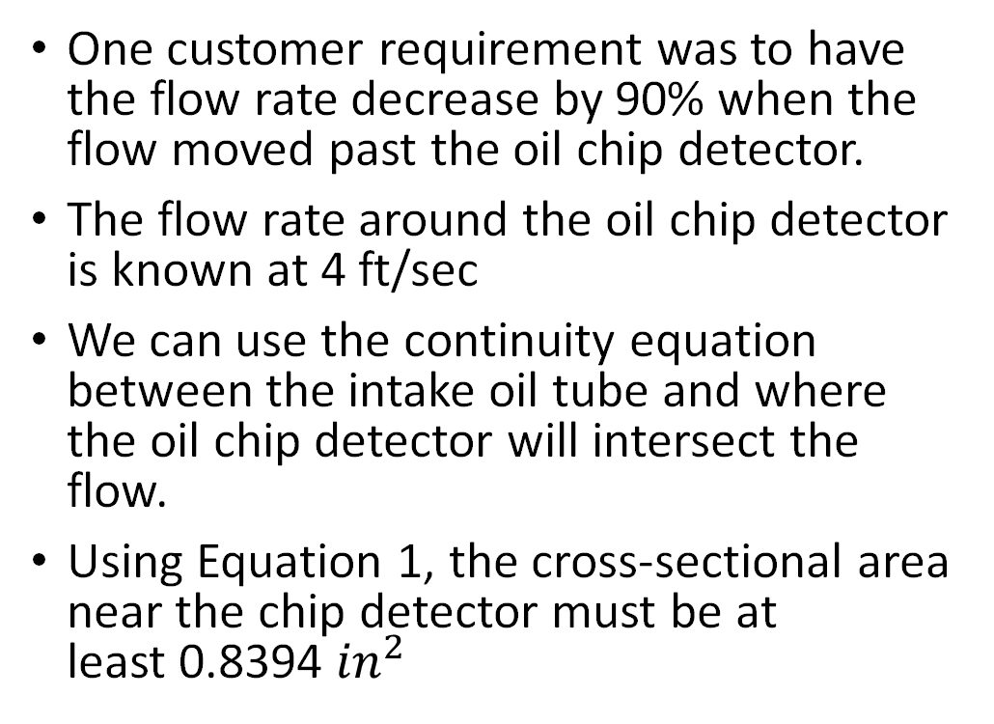
Calculations
Equation 1: Continuity Equation flow inlet and oil chip detector [2]
One customer requirement was to have the flow rate decrease by 90% when the flow moved past the oil chip detector.
The flow rate around the oil chip detector is known at 4 ft/sec
We can use the continuity equation between the intake oil tube and where the oil chip detector will intersect the flow.
Using Equation 1, the cross-sectional area near the chip detector must be at least 0.8394 ${in}^{2}$
A1
A2
Figure 4: Location of flow areas in housing [3]

Slide 6
Concept Generation and Variation
Based upon preliminary data concepts that will fit within a 3 x 3 x 2 inch. Envelope
Material selection was a major portion of concept generation
Preliminary Sealants were chosen based upon temperature requirements

Slide 7
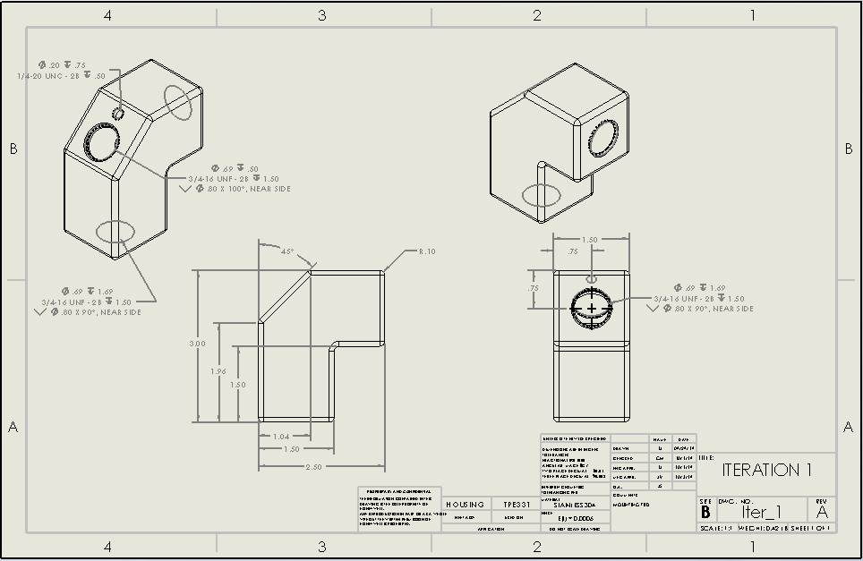
Concept 1 Two Part Design
Pros:
Satisfies 90% velocity reduction through expansion
Orients the sensor ideally
Relatively simple millwork
Cons:
Necessitates 2-piece machining
Increases potential for leaks
Figure 5: Preliminary drawing for this design

Slide 8
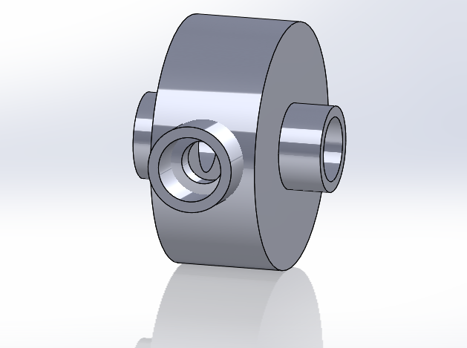
Concept 2 In-line design
Pros:
Under weight limit
Sensor is perpendicular to fluid flow
Expansion chamber reduces fluid velocity by 90%
Fits within design envelope dimensions
Cons:
Difficult to machine
Figure 7: In-line Housing

Slide 9
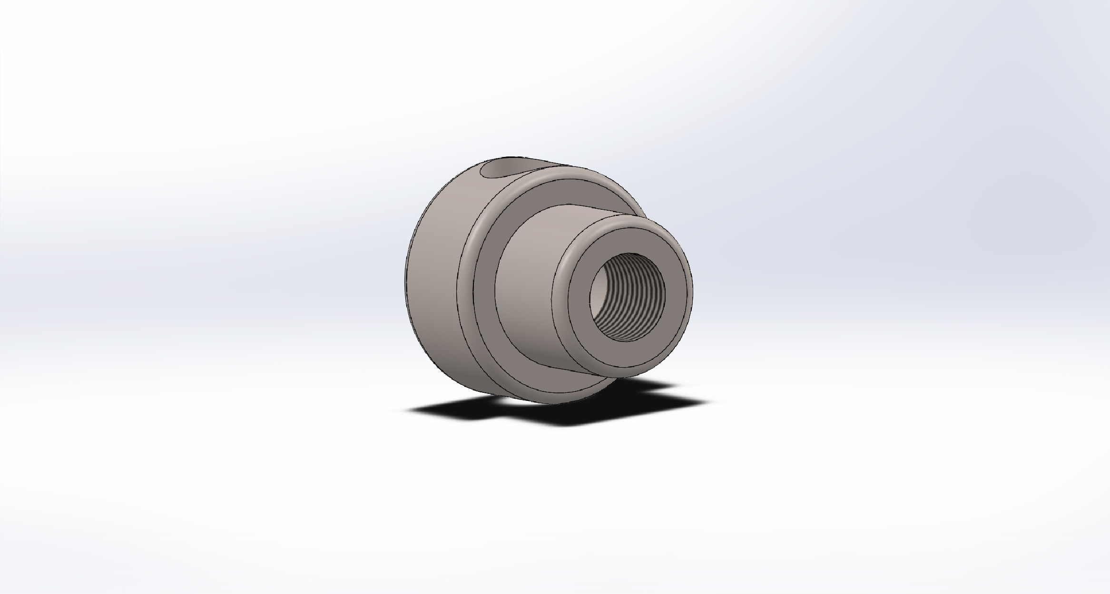
Concept 3 Single part design (Small Cylinder)
Pros:
Under weight limit
Single machined part
Easily manufactured
Fits within design envelope dimensions
Stainless steel able to withstand corrosion
Cons:
More expansion space needed to lower velocity
Figure 6: Single Body Housing

Slide 10

Concept Evaluation
Concepts were evaluated using a Pugh Chart and Decision Matrix
Customer needs help guide the decisions

Slide 11
Pugh Chart
Ranks designs based upon customer requirements
Compares them to a “datum” benchmark design
Uses a Same (S), better (+), or worse (-) based upon the benchmarked design

Slide 12
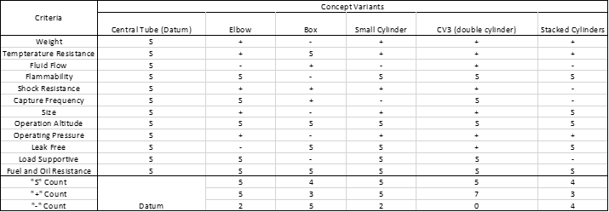
Pugh Chart
Table 1. Pugh Chart

Slide 13
Pugh Chart
Double Cylinder performed the best in the Pugh Chart
Cylinders perform well against the datum due to the customer requirements
Rigid platforms do not work well against the datum

Slide 14
Decision Matrix
The decision matrix is a quantitative evaluation of customer requirements and concept variations
The decision matrix helps rank the most important concept variations based upon the customer requirements

Slide 15
Decision Matrix
Table 2. Decision Matrix

Slide 16
Decision Matrix
Small Cylinder performs the best based upon the customer needs
Cylinders performed very highly well in the decision matrix
Cornered ideas are less practical due to vibration damages

Slide 17
Preliminary Bill of Materials
Cost of multiple possible materials
Cost of possible approved Sealants
Cost of Pipe fittings
Cost of machining of machining the part in house at NAU

Slide 18
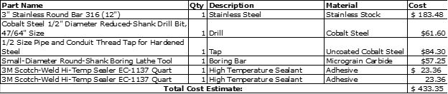
Bill of Materials
Table 3: Preliminary Bill of Materials.

Slide 19
Bill of Materials
Stock material is the highest cost in the budget
Machine Tooling is expensive taking up considerable portions of the budget
In house machining will cost nothing saving money
High temperature sealants are inexpensive but require large quantity purchases

Slide 20


Questions?

Slide 21
References
[1]“Honeywell,” Honeywell. [Online]. Available: https://www.honeywell.com/. [Accessed: 10-Sep-2019].
[2]R. W. Fox, A. T. McDonald, and P. J. Pritchard, Introduction to fluid mechanics, 8th ed. New Delhi, India: J. Wiley, 2012.
[3] "Procurement Specification for the Oil Chip Detector Housing," Honeywell. Phoenix, Arizona, September 11, 2019

