Slide 1
Team Honeywell
Jered Deal
Ilenn Johnson
Cullen Matillano
John Selee
Jacob Vedder

Slide 2


Project Description
Design, analyze and prototype an oil chip detector housing for a small turboprop engine.
Client: Honeywell
Keeping oil free of debris during engine operation.
Figure 1. Honeywell logo [1]

Slide 3
Project Description
Honeywell has asked Team Honeywell to design the housing for an oil chip detector sensor on an engine.
The oil chip detector and input and output lines have already been designed.
The design will be mounted on an engine and will have the other parts installed into it.
There will be an oil flow through the device, and the goal is to maximize the rate at which the oil chip detector picks up impurities in the oil.

Slide 4
Design Requirements
Table 1. Customer Requirements
Customer Requirement | Comment
Weight | (0.95 lbs.),Less than the assigned limit (1.00 lbs.)
Leak Free | Assured by material choice and machining quality
Fuel, Oil Resistant | Nonreactive and impermeable material choice
Temperature Resistant | 304 Stainless Steel; a ductile material with T_{m} > 2000°F
Size | Fits the given envelope of 3x3x2 inch.
Fitting Quality | Milled form and machined threads
Appropriate Material | Stainless; nonreactive, nontoxic, noncorroding
Slows Flow by 90% (to 4ft/s) | Satisfied by cross sectional area expansion

Slide 5

Manufacturing
The OCDH was created in the Northern Arizona University Machine shop located in building 98C.
All parts were created using a Computer Numerical Control (CNC) Mill.
The gasket will be fitted into the OCDH and cut using a laser cutter.

Slide 6
Bill of Materials
Material | Cost
Stainless 304/304L 0.75”x3”x16” | $73.94
Stainless 304/304L 1.5”x3”x16” | $142.83
Graphite Nitrile gasket | $98.16
-8 Stainless-steel weld bung | $18.86
Tooling | $627.99
Tig Welding rod | $33.63
Total | $995.41

Slide 7
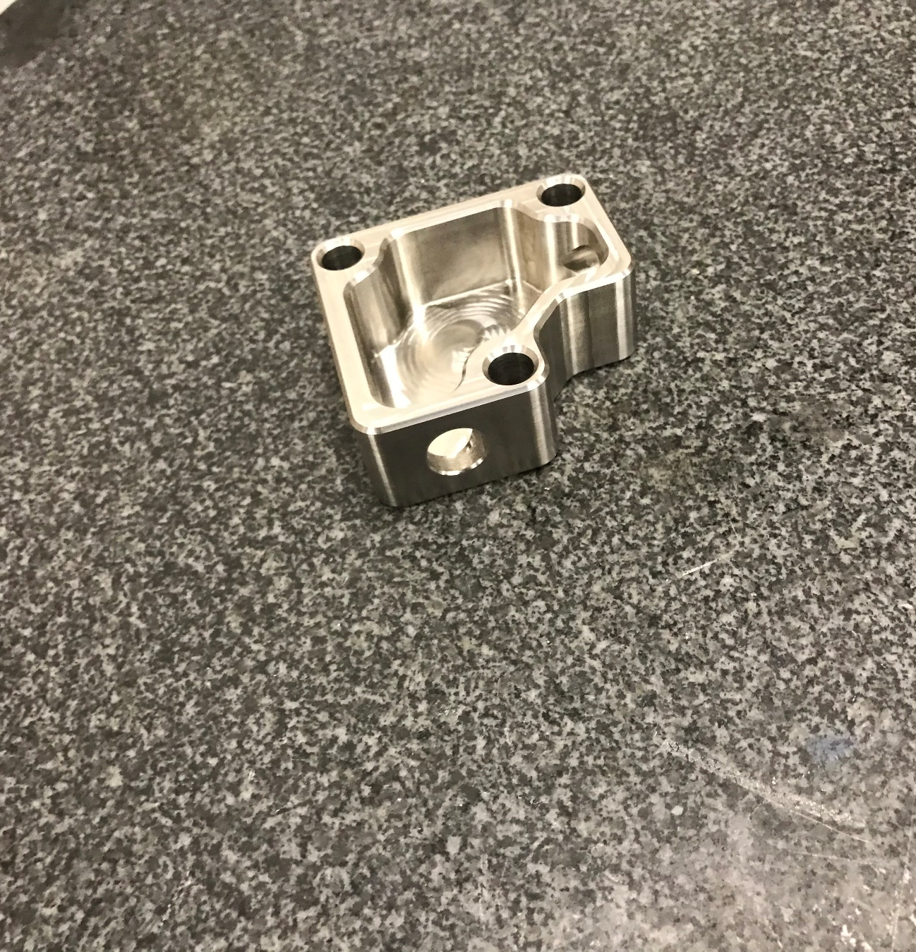
Final State
1.2 lbs.
304L Stainless Steel
~4ft/s by the probe(10 gpm, 30psig inlet).
Overall dimensions 2.74 x 2.86 x 1.50 in.
Nitrile Graphite gasket(0.063 in.).
M10 main mounting holes(25/64", counterbored 0.39±0.010" for socket cap screws).
M6x15 stud for the sensor
Probe sealed with s.113 O-ring.
Mounting Bolt Torque specs: 11.5 lb.-ft minimum, 45 lb.-ft preferred to hit 4100psi.
Figure 2: OCDH Body section

Slide 8
Testing
Weight Test
Proof Pressure Test
Burst Pressure Test
Flow Test
Tests will be performed by Honeywell

Slide 9
Weight Test
The weight test will determine whether the OCDH meets the weight requirement set by Honeywell.
A simple scale will be used to determine the overall weight of the OCDH.

Slide 10
Proof Pressure Test
Proof Pressure will determine whether or not the OCDH will leak during usage.
Any leakage on the housing will result in a test fail.
A pitot tube will be used to measure pressure over a 12 hour period to evaluate total pressure within the housing.

Slide 11
Burst Pressure Test
The burst pressure test will determine whether the OCDH fails under extreme pressure.
Any leakage or ruptures in the housing will result in a test failure.
The same set will be used from the proof pressure testing.

Slide 12
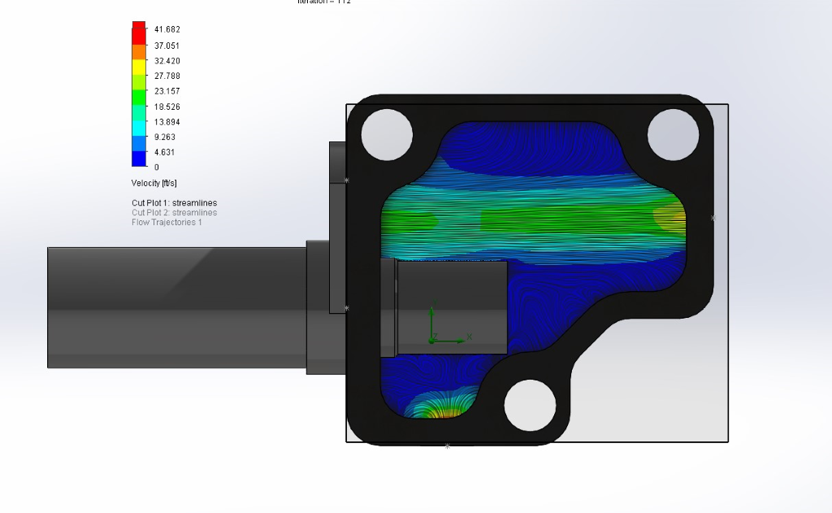
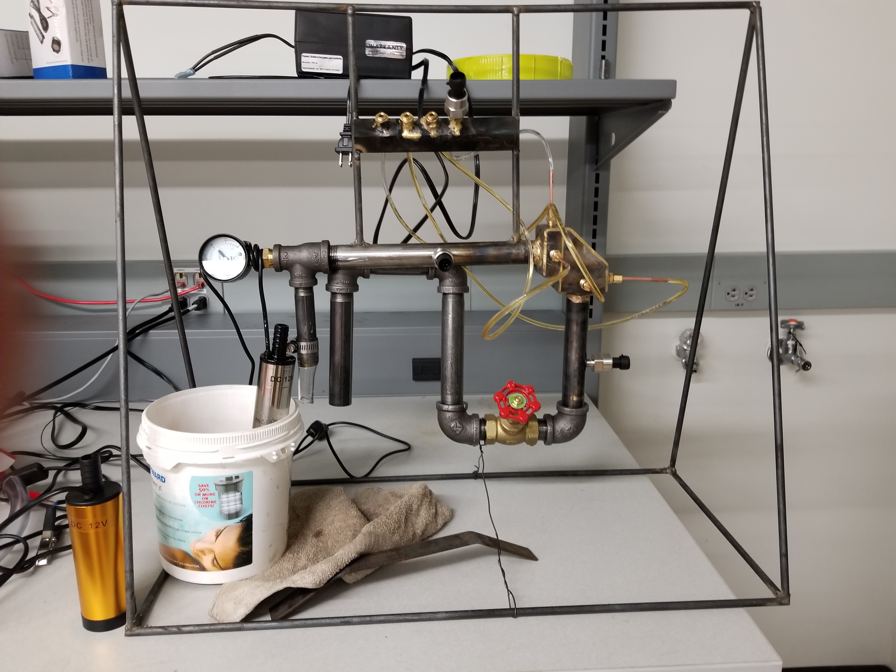
Flow Testing
Figure 4: Flow Simulation
Flow testing will be used to verify flow models around the sensor on the final prototype.
Pressures can be recorded using transducers
Velocities at points of measured pressure are calculated and plotted.
Recommended 5 measurements for each point
Figure 3: Flow Testing Apparatus with an early prototype

Slide 13
Questions?

Slide 14
References
[1]“Honeywell,” Honeywell. [Online]. Available: https://www.honeywell.com/. [Accessed: 10-Sep-2019].
[2] Honeywell, "Procurement Specifications for the Oil Chip Detector Housing," Honeywell Aerospace, Phoenix, 2019.
[3] Federal Aviation Administration, "14 CFR Parts Applicable to Engines & Propellers," Federal Aviation Administration, 22 March 2016. [Online]. Available: https://www.faa.gov/aircraft/air_cert/design_approvals/engine_prop/engine_prop_regs/regs/. [Accessed 31 March 2020].

Slide 15
Applicable Documents
Document Number | Document Name
24-PSC-XXXXXXXX | Procurement Specification for the Oil Chip Detector Housing
14-CFR-Part 33 | Airworthiness Standards: Aircraft Engines
F1901-0001 | Test Procedure: Bench Testing for the Oil Chip Detector Housing

