Slide 1



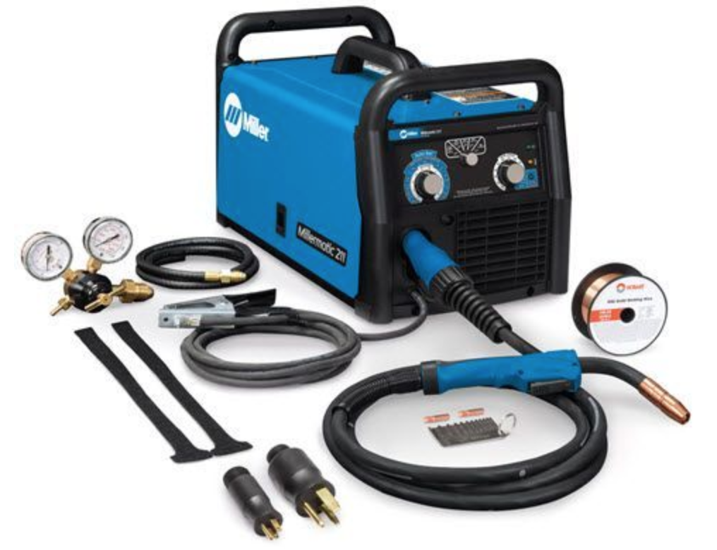
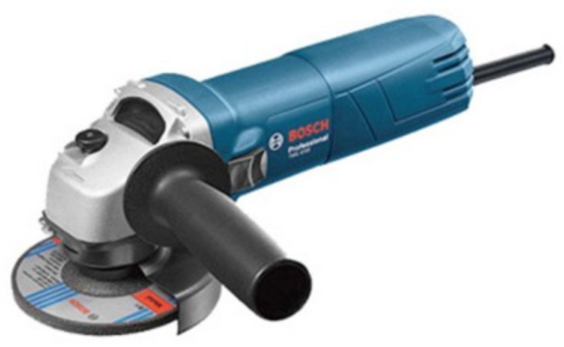
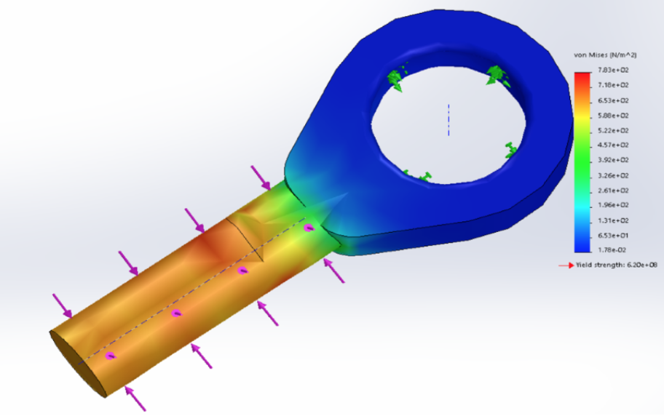
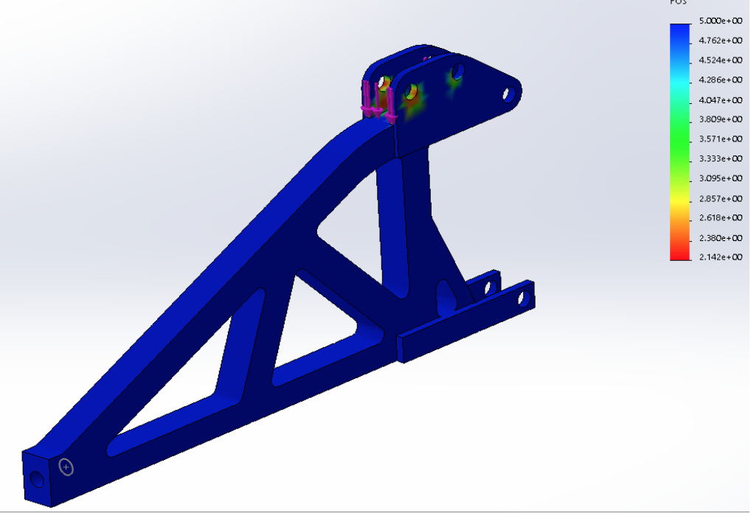
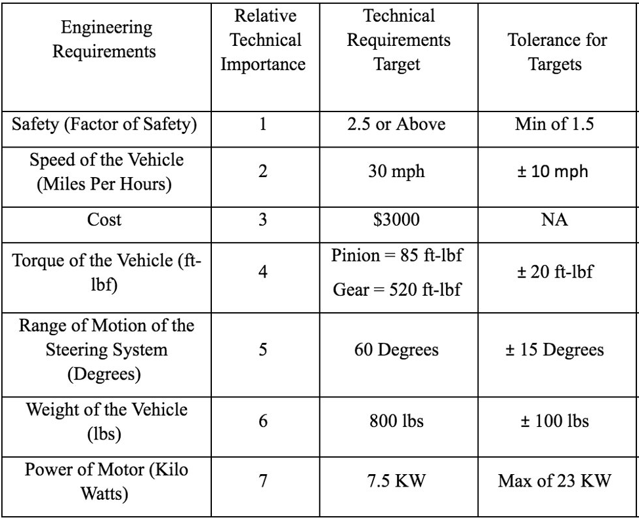
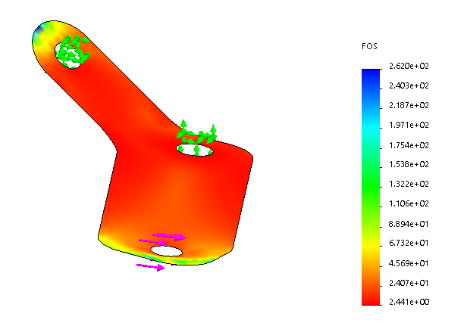
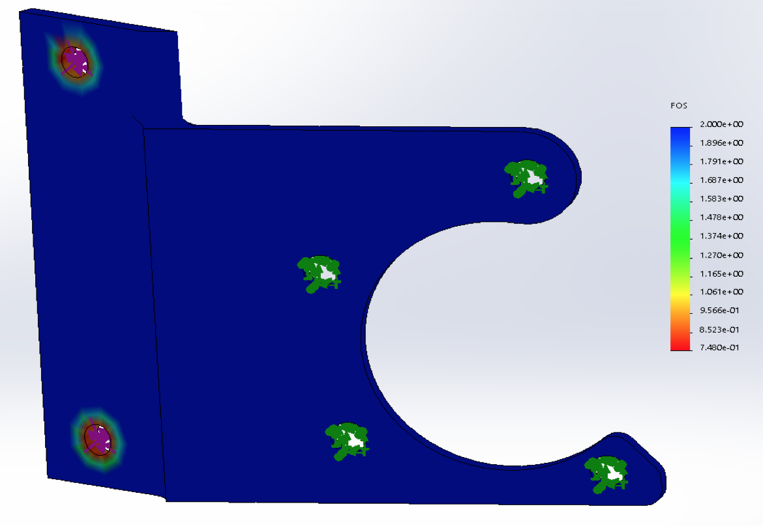
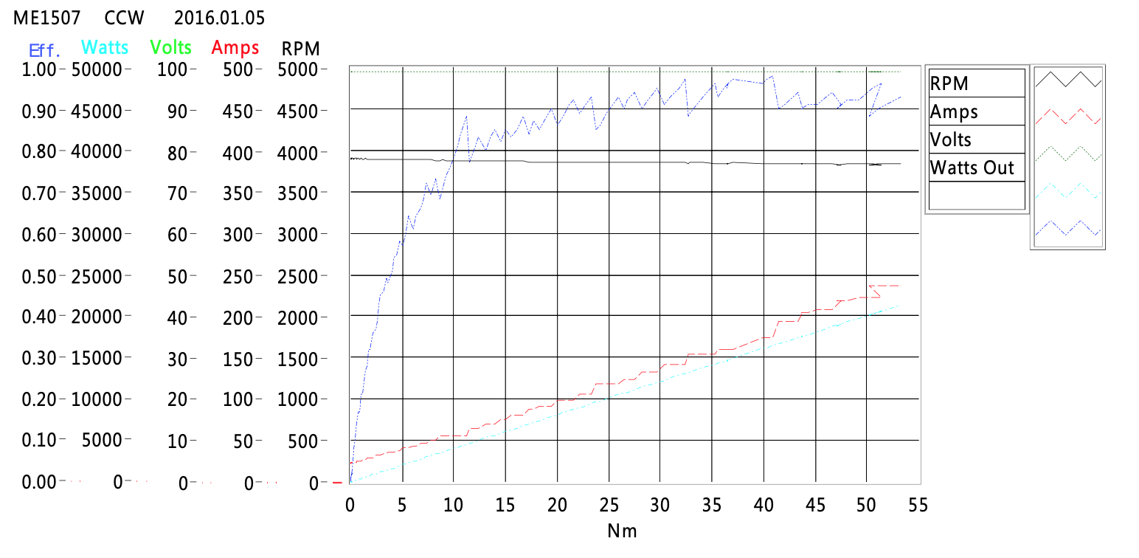
First NAU Electric Vehicle
Shamlan Albahar, Fahad Alhowaidi, LeAlan Kinlecheenie, Drew Stringer
Department of Mechanical Engineering, Northern Arizona University, Flagstaff, AZ 86011
Abstract
Methods (THIS WILL PROBABLY BE TESTING BELOW RESULTS)
T
Conclusion
Northern Arizona University’s (NAU) Mechanical Engineering Department has a student chapter under the Society of Automotive Engineers (SAE) and every year, these students design, build, test and compete in the SAE Baja competitions. After the students have competed, their Baja vehicle is used as educational purposes or scrapped for the next year to use. As of the Fall semester of 2019, the Engineering Department has decided to allow a team of Engineering students to use a previous year’s Baja vehicle and convert it into a full electric Baja vehicle. The team is divided into two sub-teams, Mechanical Engineering (ME) students and Electrical Engineering (EE) students. The ME team are focused on bringing the vehicle up to safety standards, repairing parts such as adding functional brakes, steering, front suspension, designing the rear suspension and a new gear box to set up with an electric motor, along with fabrication to mount the electrical components. The EE team is focused on all electrical components such as the batteries, charging, motor, power electronics and controls. The two teams will combine their resources and knowledge to design a full electric Baja vehicle. This is a first-year project and a first step to designing electric vehicles at NAU. The project is advised under the project’s clients, David Willy (ME team) and Dr. Venkata Yaramasu (EE team). The project is financially sponsored by W. L. Gore and more to come in the project’s year.
Results
References
[1] U. R. -. B. SAE, "UCSB Racing - Baja SAE," 31 October 2015. [Online]. Available: http://ucsbracing.blogspot.com/. [Accessed 14 October 2019].
[2] G. Ippolito, "Camaro Performance Suspension," Camaro Tech: Performance Suspension, [Online]. Available: http://www.camarotech.com/suspension.html. [Accessed 14 October 2019].
[3] "Camber, Castor & Toe," July 2012. [Online]. Available: http://www.gomog.com/allmorgan/CAMBER_CASTOR_TOE.html. [Accessed 14 October 2019].
[4] T. Schlereth and S. Sparks, "2010 Baja SAE Suspension," Auburn University, 2010.
[5] A. Thosar, "Design, Analysis and Fabrication of Rear Suspension System for an All Terrain Vehicle," International Journal of Scientific & Engineering Research, vol. 5, no. 11, pp. 258-263, 2014.
[6] R. Crawler, "Youtube," 13 August 2014. [Online]. Available: https://www.youtube.com/watch?v=ic3yWV_rlQY. [Accessed 17 October 2019].
[7] R. B. Inc., "Rod Ends, Sphericals, Rolling Element Bearings," RBC Bearings, 2012.
[8] D. Shrivastava, "Designing of All Terrain Vehicle," International Journal of Scientific and Research Publications, vol. 4, no. 12, pp. 1-16, 2014.
[9] Bearing and Heim Data, Quality Bearings & Components.
[10] R. Kalkar, S. Chakrabarty, S. Bhandarkar, A. Singh, S. Gabhane, D. C. Handa and P. S. Bawne, "Design and Analysis of Suspension in Baja ATV," International Journalfor Research in Applied Science & Engineering Technology, vol. 6, no. 4, pp. 879-885, 2018.
[11] J. C. Dixon, Suspension Geometry and Computation, United Kingdom: Wiley, 2009.
[12] E. Wessels, "2017 Bearcats Baja SAE - Steering System," University of Cincinnati, Cincinnati, 2017.
Requirements
Acknowledgements
David Willy (Client) Discount Tire (Tire Donation)
Sarah Oman (Capstone Advisor) Ace Hardware (Nut and Bolt Donation)
Constantin Ciocanel (ME Department Chair) Coconino High School (Material Donation)
Perry Wood (Shop Manager)
Tanner Gill (Shop Advisor)

