Slide 1
Team Apollo Photo-Orientation Device Project: #6 Programming and Sensors
Esmael Abdullah Trenton Black Fahad Esmaeil
Dakota Hanks Andres Rodriguez

Slide 2
Project Description
Problem:
Using an external light source to determine the orientation of a small circuit.
Objectives:
Client: Using a solar collecting device calculate the azimuth and zenith angles for the position of the sun using Irradiance values.
Team: From the Calculated Position of the sun with respect to time, an algorithm that will use the azimuth and zenith angles to perform a rotations about the X,Y,Z axis to orient the device about the sun.
First Semester Goal: Have an accurate solar zenith and azimuth measuring device accompanied by an algorithm to calculate the respective rotations to determine the orientation.
Second Semester Goal: Attain daylight operation, smaller circuit, power and operational autonomy and data interpretation program/simulation.

Slide 3
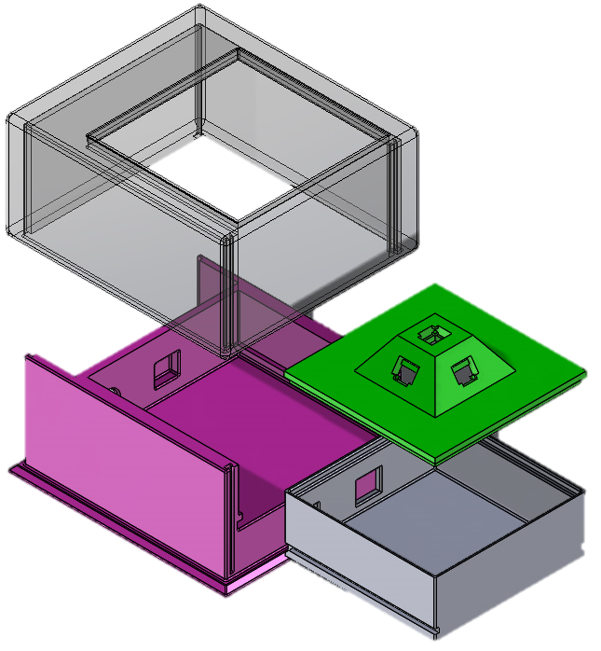
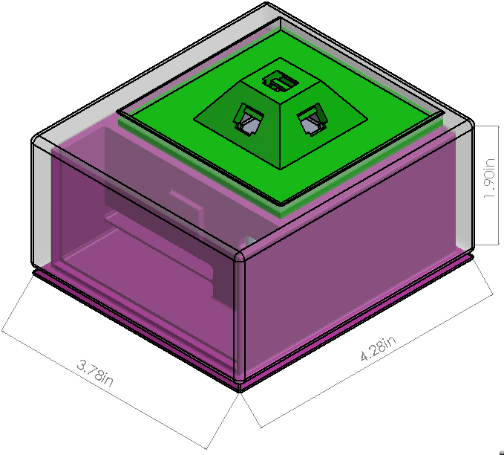
Manufactured Design
Cover
Solar Array
Arduino Housing
Battery Tray

Slide 4


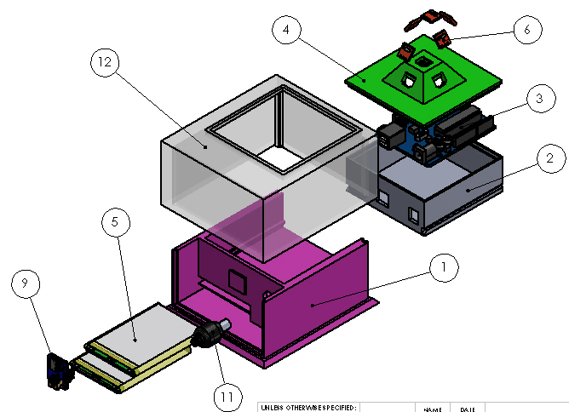
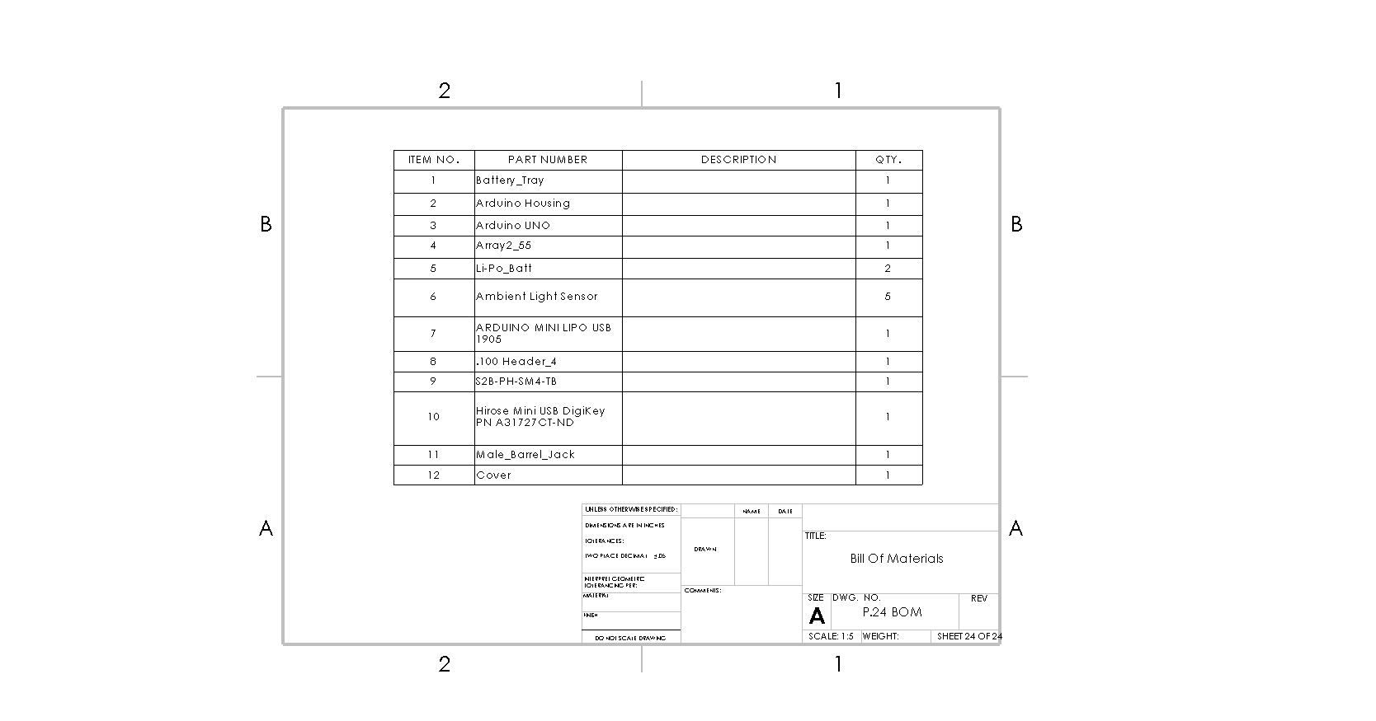
Assembly

Slide 5
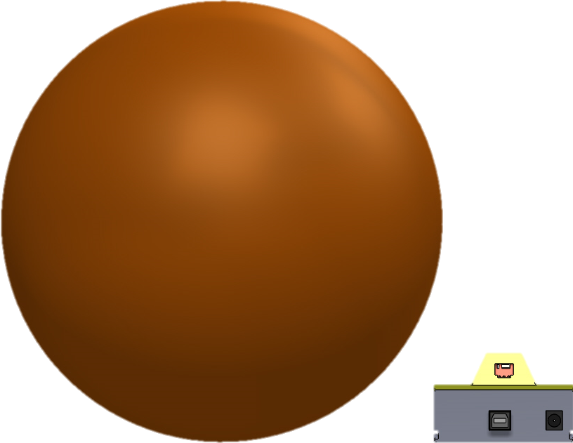
Scale: Full-size Men's basketball

Slide 6
Updates
Accomplished:
Revised CAD package
Working draft of Simulation Program
Determined Power Saving Mode algorithm
Solar Panels Selected
Design Changes:
Phased out IXYS mini solar cells
Removal of data-logging
Addition of light filtering film (Reduces irradiance intensity, also looking further into spectral filters)lj

Slide 7
Analytical Progress
MATLAB simulation
Power Saving Mode
Solar battery charging
Light reducing film & Arduino Program
Solar Panel Sub-Circuits

Slide 8
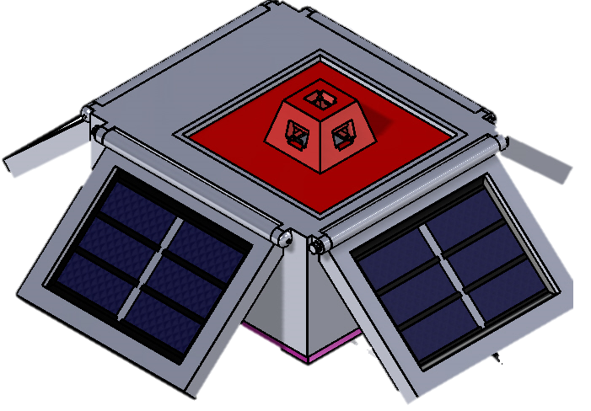
Design Changes
Solar Panel Incorporation
-This Design does not provide
Any infrastructure for wiring
Or decreasing the footprint.
-However, the effectiveness
is a top priority.

Slide 9
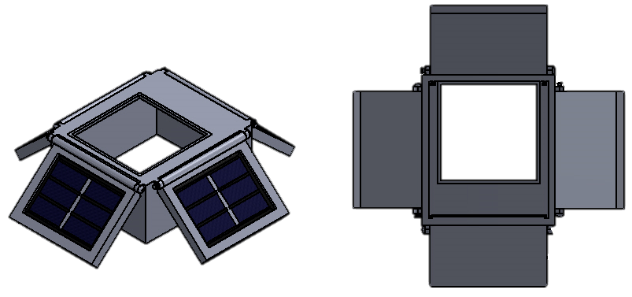
Remaining Manufacturing
3D printed part(s) are currently at the RapidLab
A Solar Panel Mountable Cover is Still in Prototyping

Slide 10
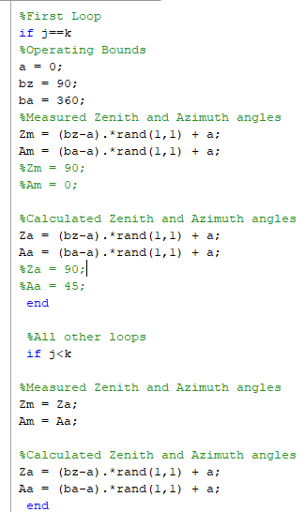
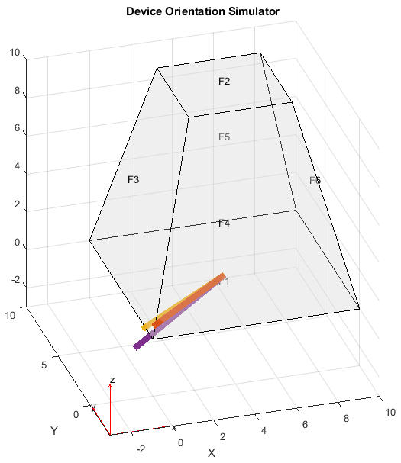
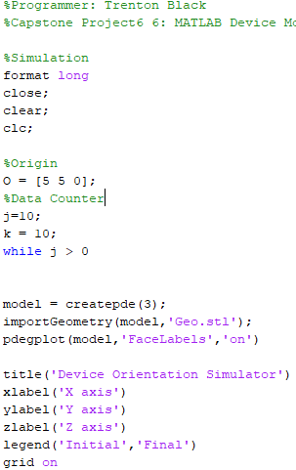
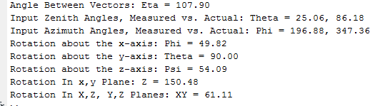
Simulation
Outputs:
-Graphical Solid
Figure with plotted Vectors
-Code Results
Occurring Errors:
-Create visible rotations of the views[] using getframe() takes an axial frame as shot/movie
Start projection using initial calculated, then from previous.
While loop:

Slide 11
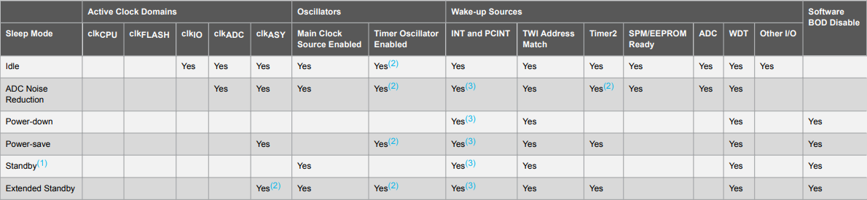
Power Saving
Work all day, sleep all night.
Sleep Mode Power Down.
WDT “Watchdog Timer” as Wake-up Source.
WDT is an internal module in software.
WDT checks the code every 8 seconds.

Slide 12
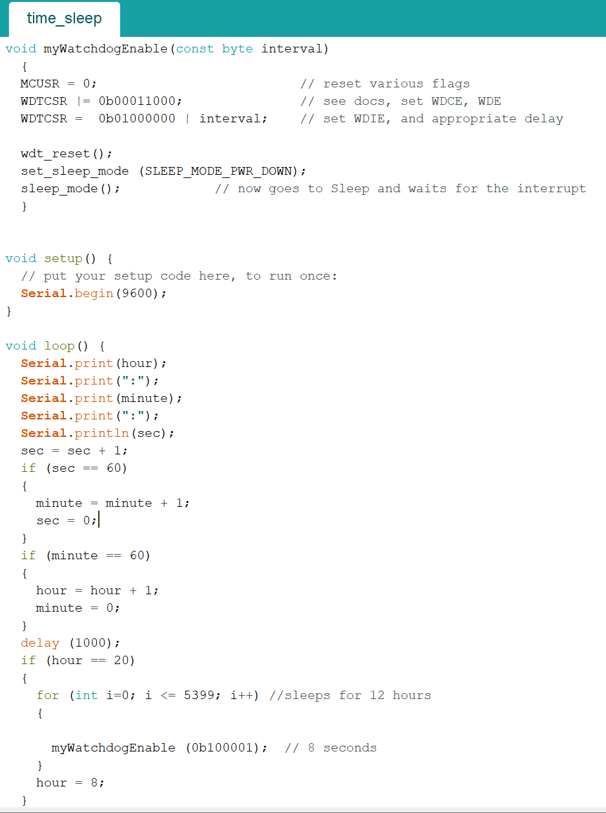
Updates to Arduino Program
Few changes to the Arduino code since the last hardware review
Implementation of an on board clock that is used with telling the position of the sun at each interval
Implemented a sleep mode that activates at 8:00 PM and turns off at 8:00 AM

Slide 13
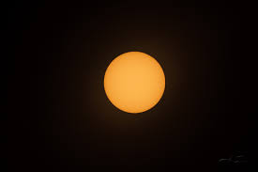
Increasing Outside Accuracy.
When testing outside the solar cells are maxed out and are giving inaccurate readings.
We have tried color filter paper to reduce the intake. However the amount needed to have any effect makes the system to bulky.
We are currently looking into using a solar filter sheet to reduce the diffused irradiance. However we have not been able to test this yet.
Having a steeper angle for the base will allow for the base to cast a shadow on the sensors farther away from the light source.
[2]

Slide 14
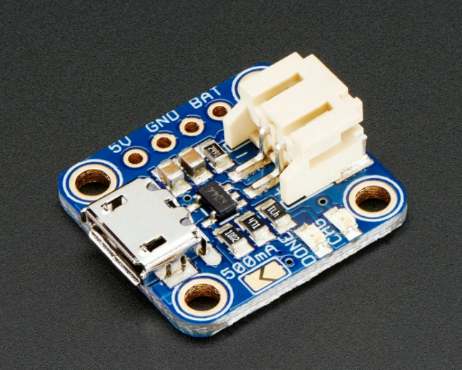
Adafruit Li-po charger
Constant current/Voltage
Charge going from the solar panels to the battery
Without the li-po charger creating a regulated voltage, charge could leave the battery. The difference in voltage would cause current to travel from high to low voltage
Cost $6.95
Micro-B USB connector

Slide 15
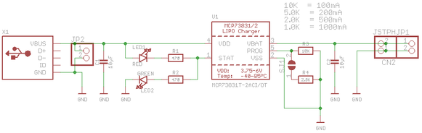
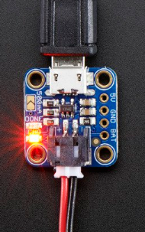
ADAFRUIT LIPO charger Schematic

Slide 16
Calibration goal
Determine how to connect the solar cells to the micro B- USB
Determine how to incorporate into the design allow both charging and use of the battery for the CPU

Slide 17
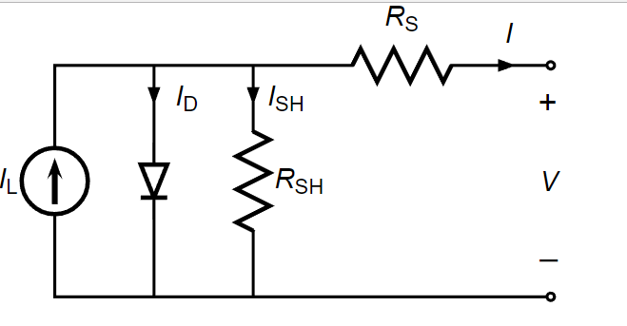

Solar Cell Electrical schematic
The purpose of the circuit is to regulate the flow of electricity and create an electrical potential so that charge can move from the solar cell to the battery.
$I_{D}$ and $I_{SH}$ represent the current that flows to the one way diode and the shunt current that flows into the resistor that is in parallel ($R_{SH}$) with the cell and diode.
The purpose of the diode is to ensure that current flows in a single direction and not backward. $I$the output current is the result after charge crossed the resistor in series ($R_{S}$). And $V$ represents the total voltage of the circuit.

Slide 18
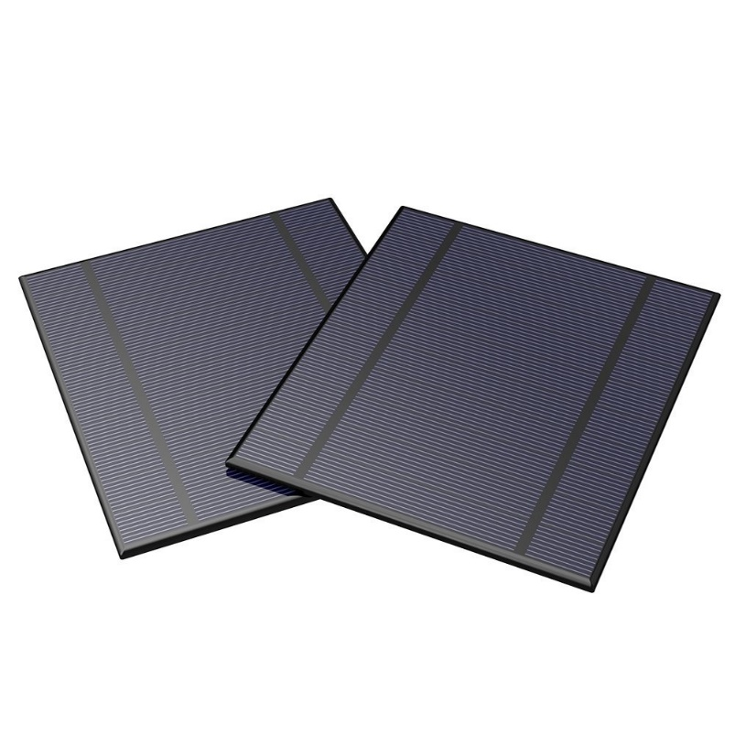
Solar Cell
2.5W solar panel
manufactured by ALLPOWERS
unit price $8.49
dimensions of 130 x 150 mm.

Slide 19
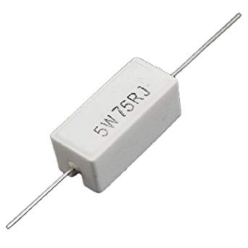
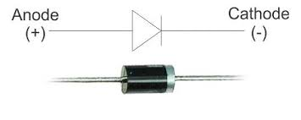
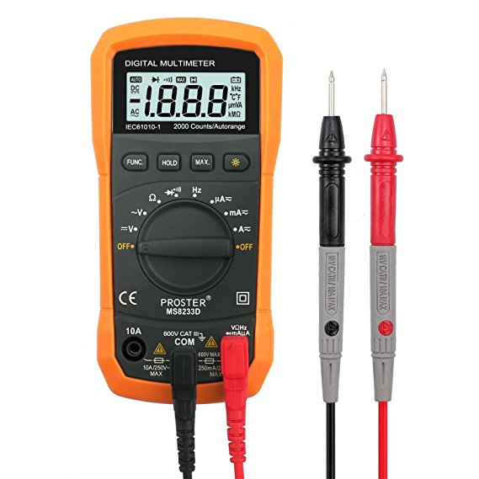

Solar cell calibration
Determine necessary power capacity
Actual current and power of solar cell
Determine necessary $R_{S}$ value to feed into the Li-Po charger

Slide 20
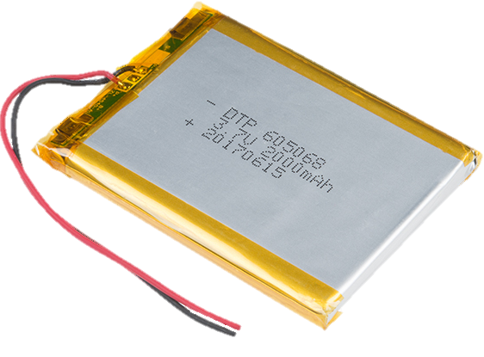
Moving Forward
(BOM and Budget are included as separate Handouts)
Testing the multisystem components
Project Status and redesign flexibility
Testing
Arduino Code
Simulation
Power Supply

Slide 21
Testing Procedure: Algorithm
Arduino Code:
-Establishing Datum, that is known, then verified by Arduino outputs.
-Then moving the POD to a distinct new location with a single axis rotation for each axis’ to confirm 3D operation.
Simulation:
-The MATLAB simulation is currently programed to run through a set of 10 randomly generated values between 0-360⁰. Where the results of the code are visually observed.
-However, an array of known and easy to identify values are provided in a congruent array that will act as a check to determine proper execution of the display and calculations

Slide 22
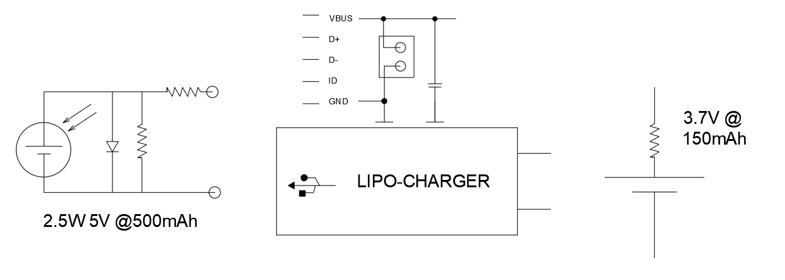
Solar Charger Design Testing/Calibration
1. Connect solar panel in an open circuit configuration with the voltmeter.
2. Set the multimeter to measure power in watts.
3. measure power, current and voltage across nodes using the multimeter.

Slide 23
Plans for Manufacturing
Complete CAD printing, and Solar Panel Mounting Cover
Install Light sensors Circuitry.
Configure Li-Po battery charger and Arduino hook-up
Analyze need for Voltage regulator discussed prior

Slide 24
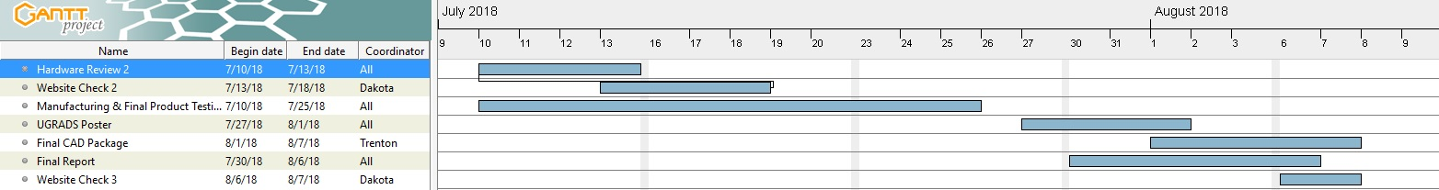
Gantt Chart
Project Status: AHEAD
-Therefore a great amount of time for redesigns are possible considering the main components subject to change are the macroscopic components made in the Rapid labs that as of now have taken roughly 20hours to print to completion.
-However, if the components can be made smaller, and less complex, manufacturing time will decrease to roughly 12-15hours

Slide 25
Hardware Review 2
Identify and explain new subsystems
Demonstrate of new subsystems (Sleep mode Arduino Code, Simulation)

Slide 26
Key Subsystems
Power Saving Mode - Arduino Library Function
Simulation Algorithm - Original system code with help of MATHWORKS
Li-Po Battery power supply - Information Provided by Arduino Forums
Solar Panel Li-Po charging - Information Provided by Arduino Forums

Slide 27

Question?
Trenton Black Project: #6 Programming & Sensors
7/11/2018
23

Slide 28
Thanks you, For Your Time
Team Apollo
Trenton Black Project: #6 Programming & Sensors
7/11/2018
23

Slide 29
References
[2] Alder, Jayson. “TWIP Creating A Solar Filter DIY.” Alder Images, 1 Jan. 1970, blog.alderimages.com/2017/07/twip-creating-solar-filter-diy.html.
[1] C. (2018). Can you charge and use a LiPo battery at the same time?. [online] Arduino Stack Exchange. Available at: https://arduino.stackexchange.com/questions/39805/can-you-charge-and-use-a-lipo-battery-at-the-same-time [Accessed 10 Jul. 2018].
[1] “Moshi Clock - Voice Activating and Talking Alarm Clock.” Velvet Cushion, www.velvetcushion.com/home-accessories/moshi-clock-voice-activating-and-talking-alarm-clock.
[3] Industries, A. (2018). Adafruit Micro Lipo w/MicroUSB Jack - USB LiIon/LiPoly charger. [online] Adafruit.com. Available at: https://www.adafruit.com/product/1904?gclid=EAIaIQobChMI0faEz_fy2wIVkcDACh1eTgcIEAQYASABEgK2cvD_BwE [Accessed 27 Jun. 2018].

