Slide 1
Team APOLLO
Trenton Black
Esmael Abdullah
Fahad esmaeil Dakota Hanks
Andres Rodriguez

Slide 2
Photo-Orientation Device (POD)
Project #6

Slide 3


Project Description
The goal of the project at this point is to create a device that takes light inputs from the sun, and tells the operators which why is up.
Zenith (Phi)
North
Azmith (Psi)
West
East

Slide 4
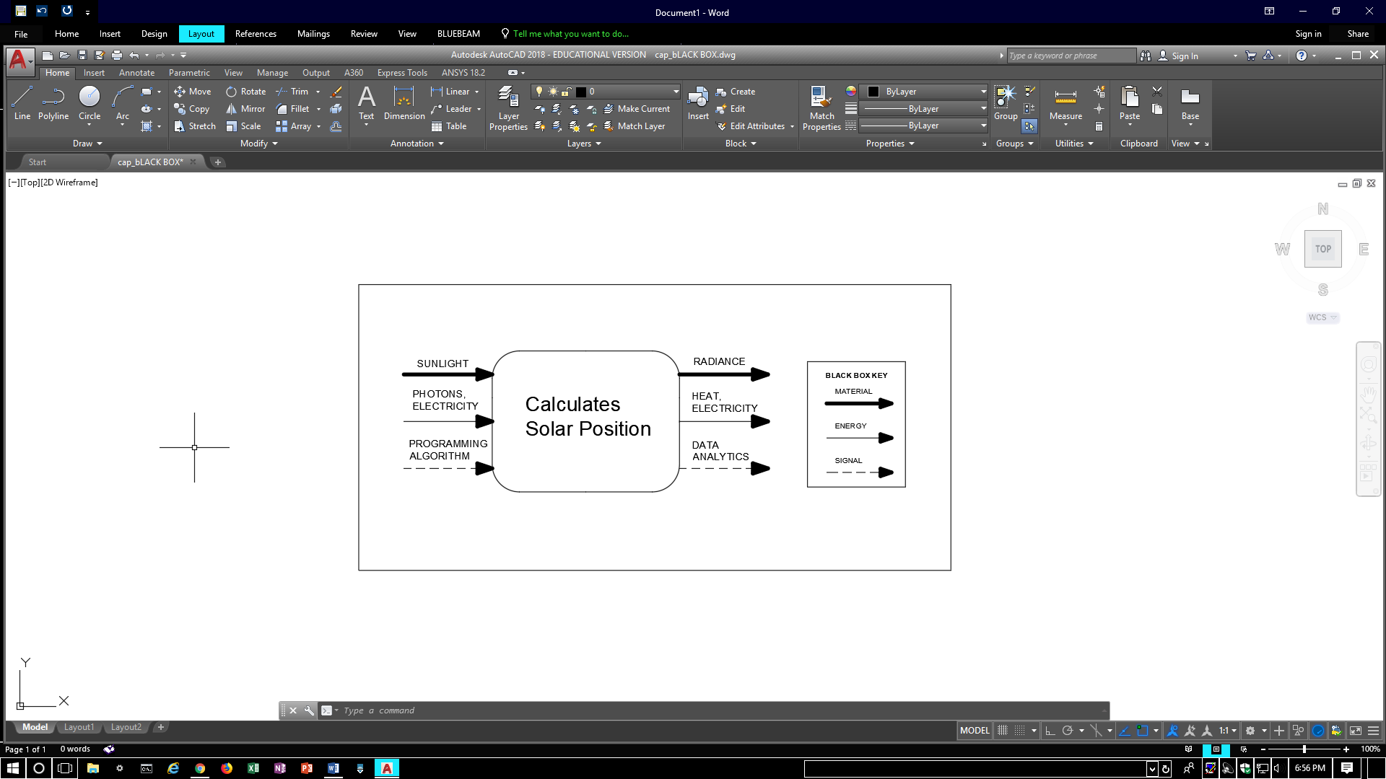
function

Slide 5


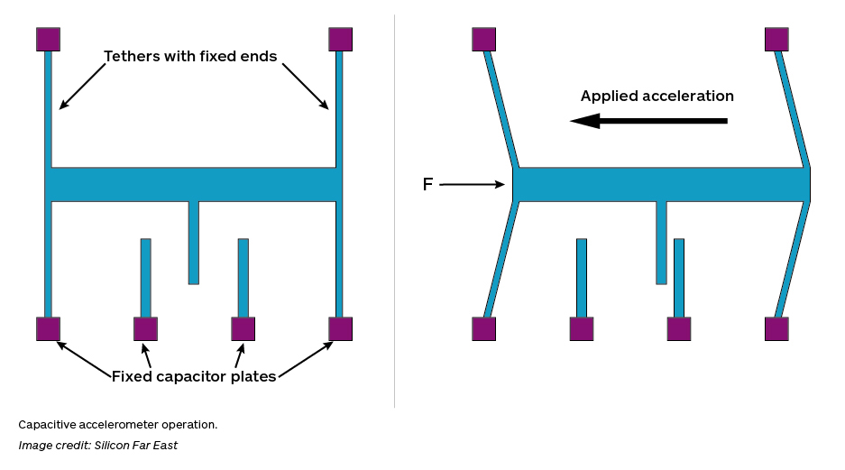
Why does this matter?
The program:
-Solar collection fields maximize efficiency
-Positioning with only a light input
-Is independent of forces or accelerations

Slide 6

Client
Professor Michael Shafer is the
volunteer client for project-6:
Goal:
Find a reliable and consistent alternative
to accelerometers.

Slide 7
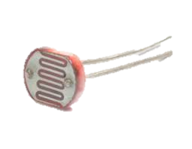
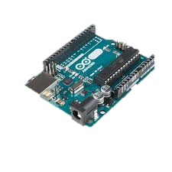
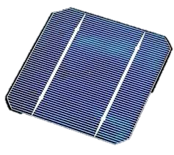

Background
Photo sensors
Processor
Power Source
Data output

Slide 8
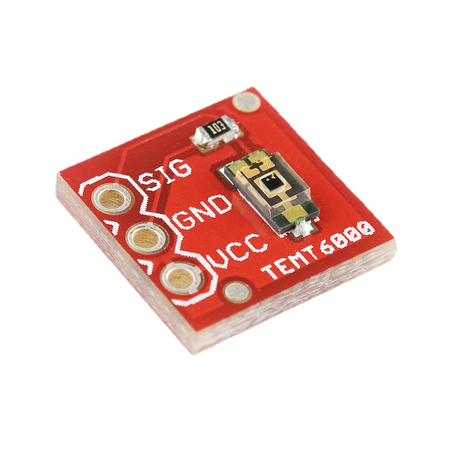
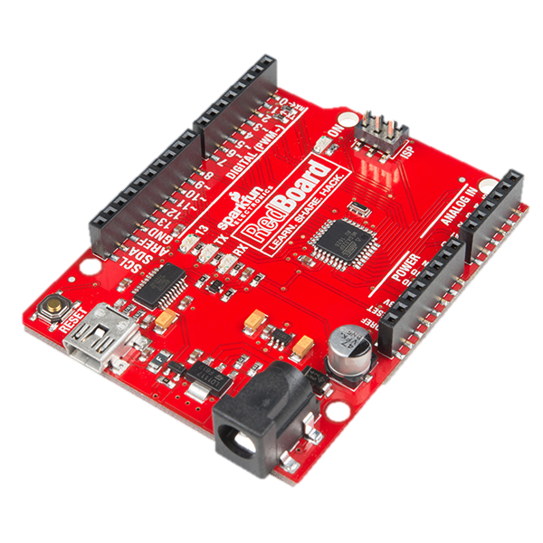
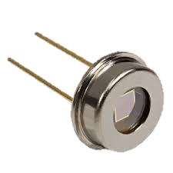

State of the art
Photocell: Ambient light sensor Breakout [5]
Microcontroller: Arduino redboard [1]
Solar cell/Diode:
User display:

Slide 9
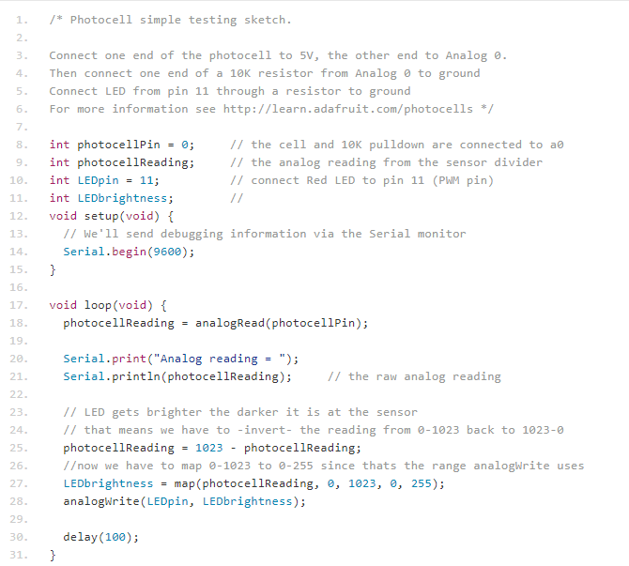
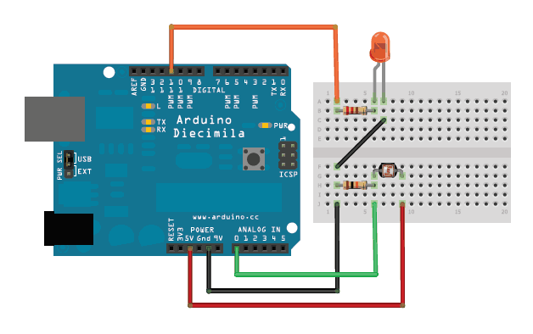
Benchmarking
[7]

Slide 10
Customer Requirements
Sufficient Solar Array
Program to analyze data to determine:
Solar Zenith and Azimuth
Output vertical vector

Slide 11
Engineering Requirements
Strategic geometric panel configuration.
Organize the data inputs in a program
Distinguish sensor outputs based on their geometry and positioning
Run the inputs as a whole data set for a single output
Determine Power source
Determine amount of sensors for accurate data.
Redundancy for safety.

Slide 12
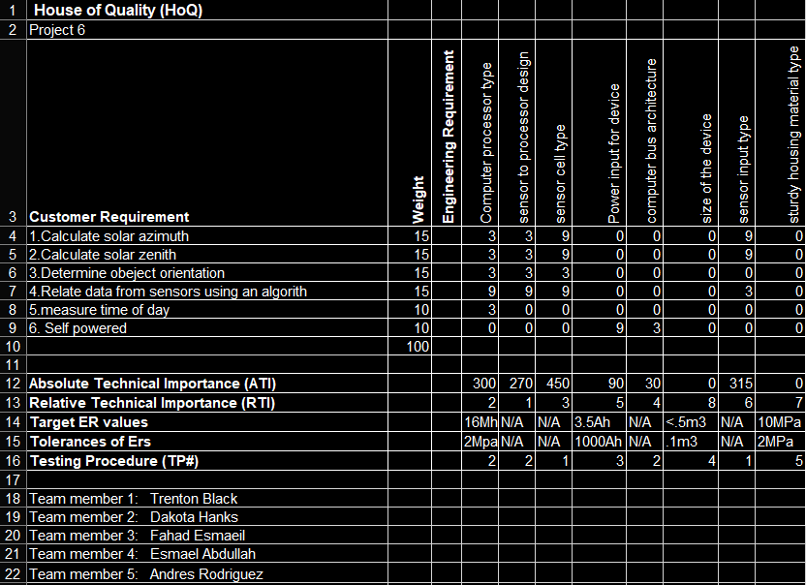
Hoq:

Slide 13
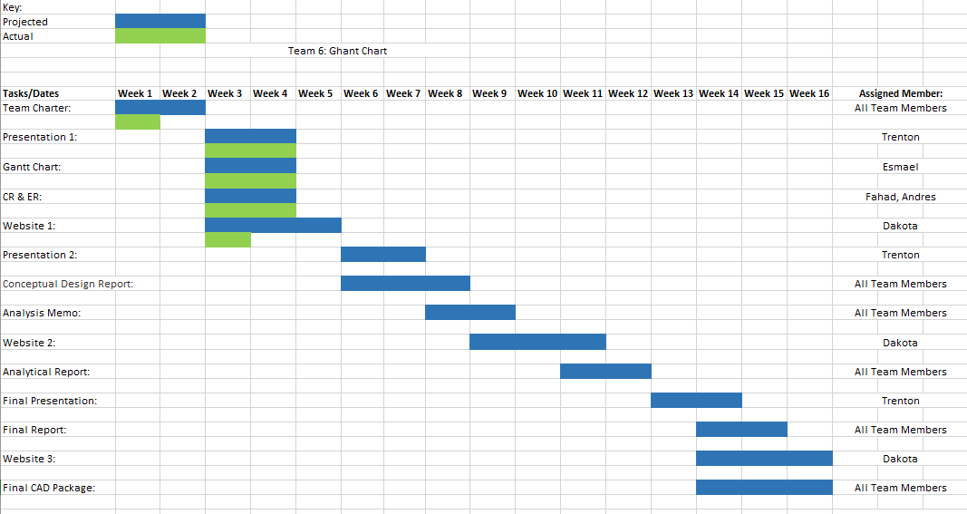
Schedule

Slide 14
Budget
Based on the magnitude of the project, which is reserved to programing and small electrical components.
Predicted development cost: $500
For over shooting.
Expected costs: < $200

Slide 15
Questions
Comments?

Slide 16
References
[1] Arduino, S. (2018). SparkFun RedBoard - Programmed with Arduino - DEV-13975 - SparkFun Electronics. [online] Sparkfun.com. Available at: https://www.sparkfun.com/products/13975 [Accessed 6 Feb. 2018].
[2] Anon, (2018). [online] Available at: http://lacrossetribune.com/content/tncms/live/#1 [Accessed 6 Feb. 2018].
[3] Google.com. (2018). Image: from space with sun. [online] Available at: https://www.google.com/imgres? [Accessed 6 Feb. 2018]
[4] Learn.adafruit.com. (2018). Using a Photocell | Photocells | Adafruit Learning System. [online] Available at: https://learn.adafruit.com/photocells/using-a-photocell [Accessed 6 Feb. 2018].

Slide 17
[5] TEMT6000, S. (2018). SparkFun Ambient Light Sensor Breakout - TEMT6000 - BOB-08688 - SparkFun Electronics. [online] Sparkfun.com. Available at: https://www.sparkfun.com/products/8688 [Accessed 6 Feb. 2018].
[6] http://insights.globalspec.com/article/1263/specifying-an-accelerometer-function-and-applications. (2018). [image].
[7] http://www.roboticmagazine.com/robot-parts/sensors/what-is-an-accelerometer. (2018). [image].

