Slide 1


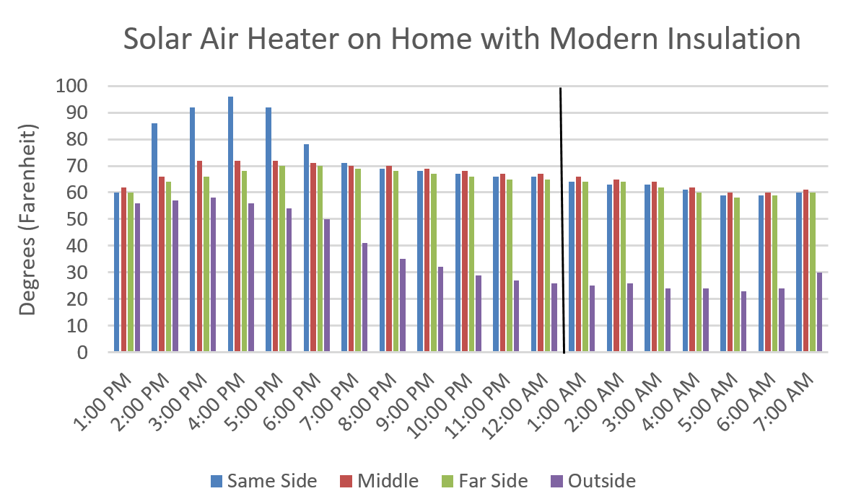
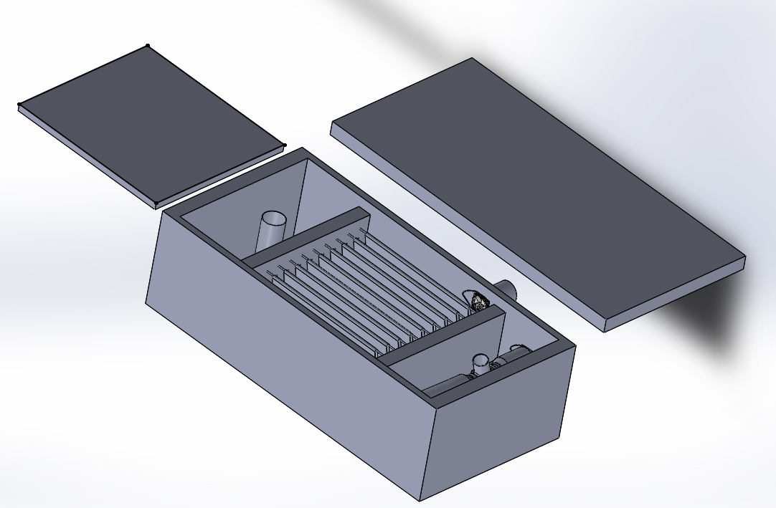
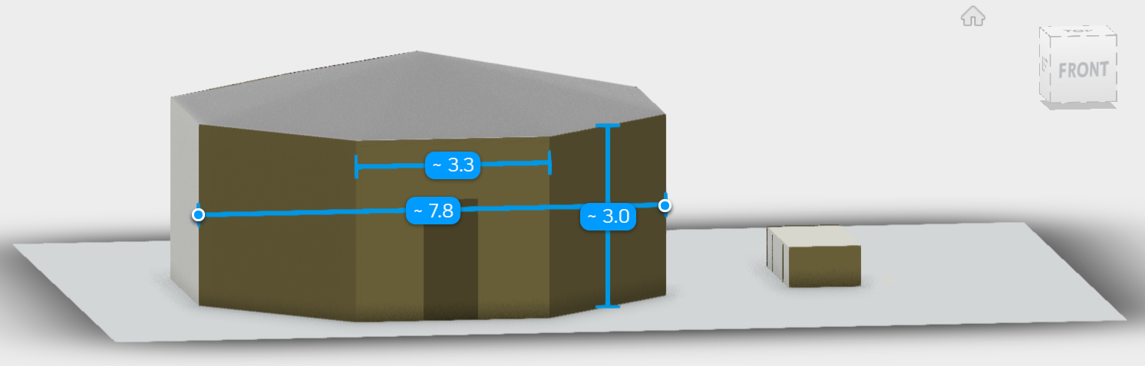
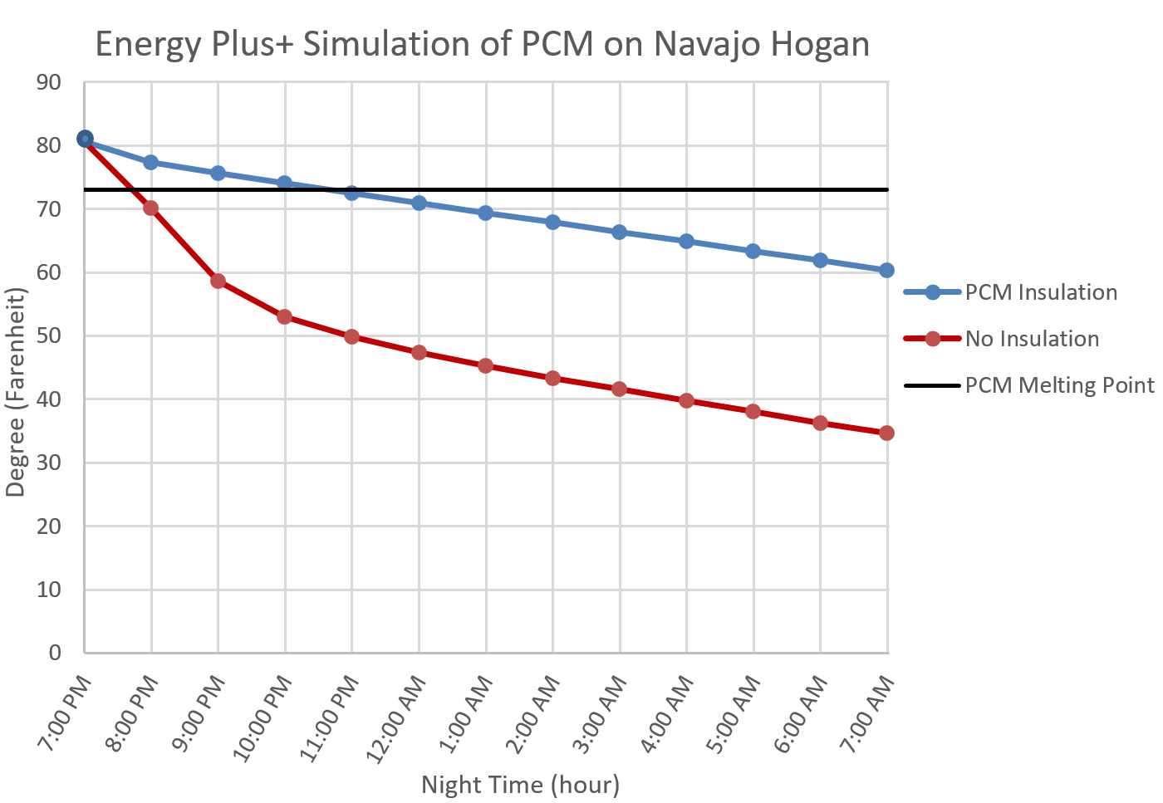
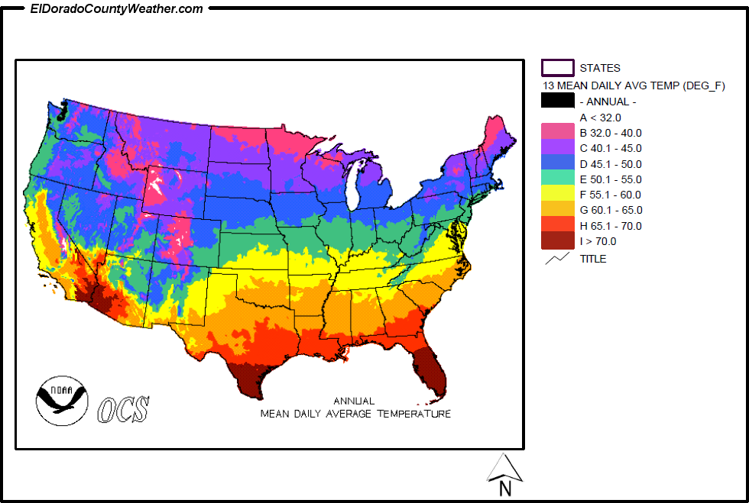
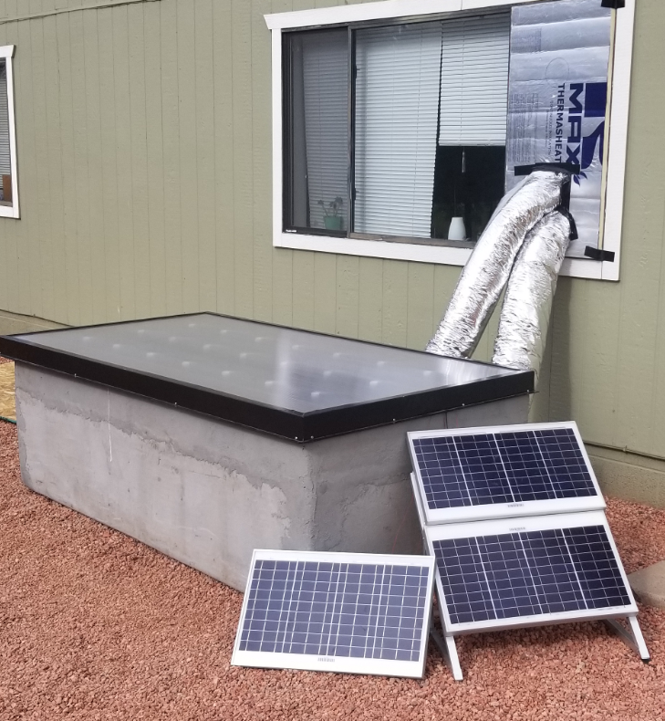
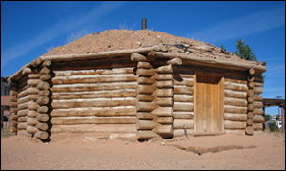


Salt River Project Solar Air Heater
Tatum Begay, Taylor McCormack, Wyatt Bain, William Senseman, Brandon Dunn, Alonzo Bizahaloni, Ahmad Abuouf, Carl Aaker
Department of Mechanical Engineering, Northern Arizona University
Flagstaff, AZ
    Abstract
Design
Testing
Results
Residents of the Navajo Reservation live in a modern Hogan or use one for traditional ceremonies. A Hogan is an octagonal shaped house made out of wood and clay. During the winter months, the Navajo Reservation can reach below freezing temperatures. To keep warm during these months, residents use coal, gas, and wood to heat their homes as most families have little to no access to electricity. These methods release harmful toxins into the Hogan. To combat the toxins, phase change material (PCM) can be used to store and release heat. Salt River Project proposed to our team to research and test the efficiency of pairing a solar air heater with PCM. This project aims to provide a clean renewable energy source that can provide heat for a Hogan during the night and to reduce toxic smoke from nonrenewable sources.
Design Specifications:
The box is made of industrialized foam with a concreate outside layer. A thermal box is inside to keep the PCM warm.
The fans on the system distributes the warm air out of the solar air heater into the house.
Throughout the day, the box heats the home, and at night, the PCM releases the stored energy to keep the home warm.
Testing Procedure 1:
Installed the solar air heater box to a window on a 535 sq. ft. modern insulated room.
Measured the heat throughout the home as the box heated it throughout the day and the PCM kept the temperature higher throughout the night.
Testing Procedure 2:
Used weather data from Farmington, New Mexico.
Used EnergyPlus+ software to model a Hogan. The Hogan is made of piñon or ponderosa pine and clay.
Tested the efficiency of the PCM to keep it warm over night time.
Results 1: Data displays heat on the same side of the heating unit, the middle of the room, the far side of the room, and outside from 1 to 7 PM.
PCM Solidified
Figure 6: Results from Testing Thermal Box
.
Introduction
Results 2:
Shows the PCM efficiency in a Navajo Hogan. Shows temperatures with PCM Insulation and No Insulation.
Outside average of 32 degrees Fahrenheit with a low of -4 degrees Fahrenheit.
Purpose: To research and test the efficiency of pairing a solar air heater with PCM.
Method 1: Combining a SolarThermiX STX7000 Solar Air Heater and PCM to create a thermal battery.
Method 2: Testing the efficiency of the PCM by using EnergyPlus+ software.
Background Information: A modern Navajo Hogan is a octagonal shaped structure that is usually made with piñon or ponderosa pine logs [1].
Figure 4: 566 sq. ft. Modeled Hogan in EnergyPlus+
Figure 2: Final CAD Drawing
Figure 7: Results from EnergyPlus+
Figure 5: Weather data for reference [3]
Acknowledgments
References
Technical Advisor: Dr. Sarah Oman
Sponsors: Salt River Project, Green Rhino Building Systems, and SolarThermiX
Figure 1: Modern Navajo Hogan [2]
[1] Navajo People. (2011) Navajo Homes – Hogans [Online]. Available: http://navajopeople.org/navajo-hogans. [Accessed: Oct. 11, 2017]
[2] Cronkitezine.asu.edu. (2018). Beautiful Land, Beautiful Me. [Online]. Available: http://cronkitezine.asu.edu/spring2006/navajo.html. [Accessed: Apr. 11, 2018].
[3] Drought. (2018). 3C: Maps that Describe Climate. [Online]. Available: https://serc.carleton.edu/eslabs/drought/3c.html. [Accessed: Apr. 11, 2018].
Engineering Design
Figure 3: Constructed Design

