Slide 1
SRP Solar Air Heater
Carl Aaker
Ahmad Abuouf
Wyatt Bain
Tatum Begay
Alonzo Bizahaloni
Brandon Dunn
Taylor McCormick
William Senseman

Slide 2

Project Description
We are examining the effectiveness of phase change material (PCM) and a solar air heater for houses off the grid on the Navajo Nation.
Salt River Project (SRP) is our sponsor for this project.
Our goal is to reduce or eliminate the coal, wood, or propane heaters currently used.
This should impact the lives of Navajo Nation by providing a warm, healthy, and safe environment for those who may use it.

Slide 3
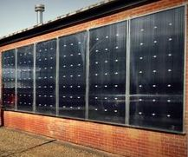
Background
Our team is given a SolarThermiX STX 7000, a solar air heater panel, which we will be combining with PCM, something that has not been done before [1].
One current use of the solar air heater is in the ROTC building in the middle of NAU campus.
Figure 1: NAU ROTC Building solar air heater [2]

Slide 4
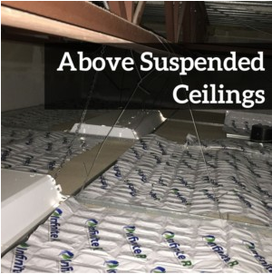
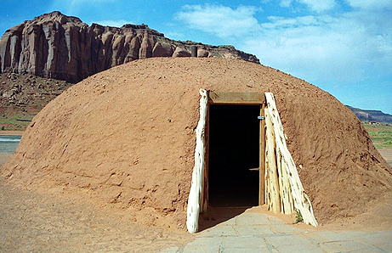
Background Cont.
PCM is currently used in the north campus Blome building in order to aid in insulation and provide heat to the building throughout the night [2][3].
A hogan is a traditional Navajo dwelling which is usually made from clay, wood, and stone.
Figure 2: PCM above suspended ceiling [4]
Figure 3: Female hogan [5]

Slide 5
Design Requirements
Must be able to heat a hogan or Navajo home off the grid
Solar heater for a modern hogan
Must be able to heat home overnight
Implement PCM material to store heat for dissipation
Must be able to heat home in harsh weather conditions
  Snow
  Rain
  Wind

Slide 6
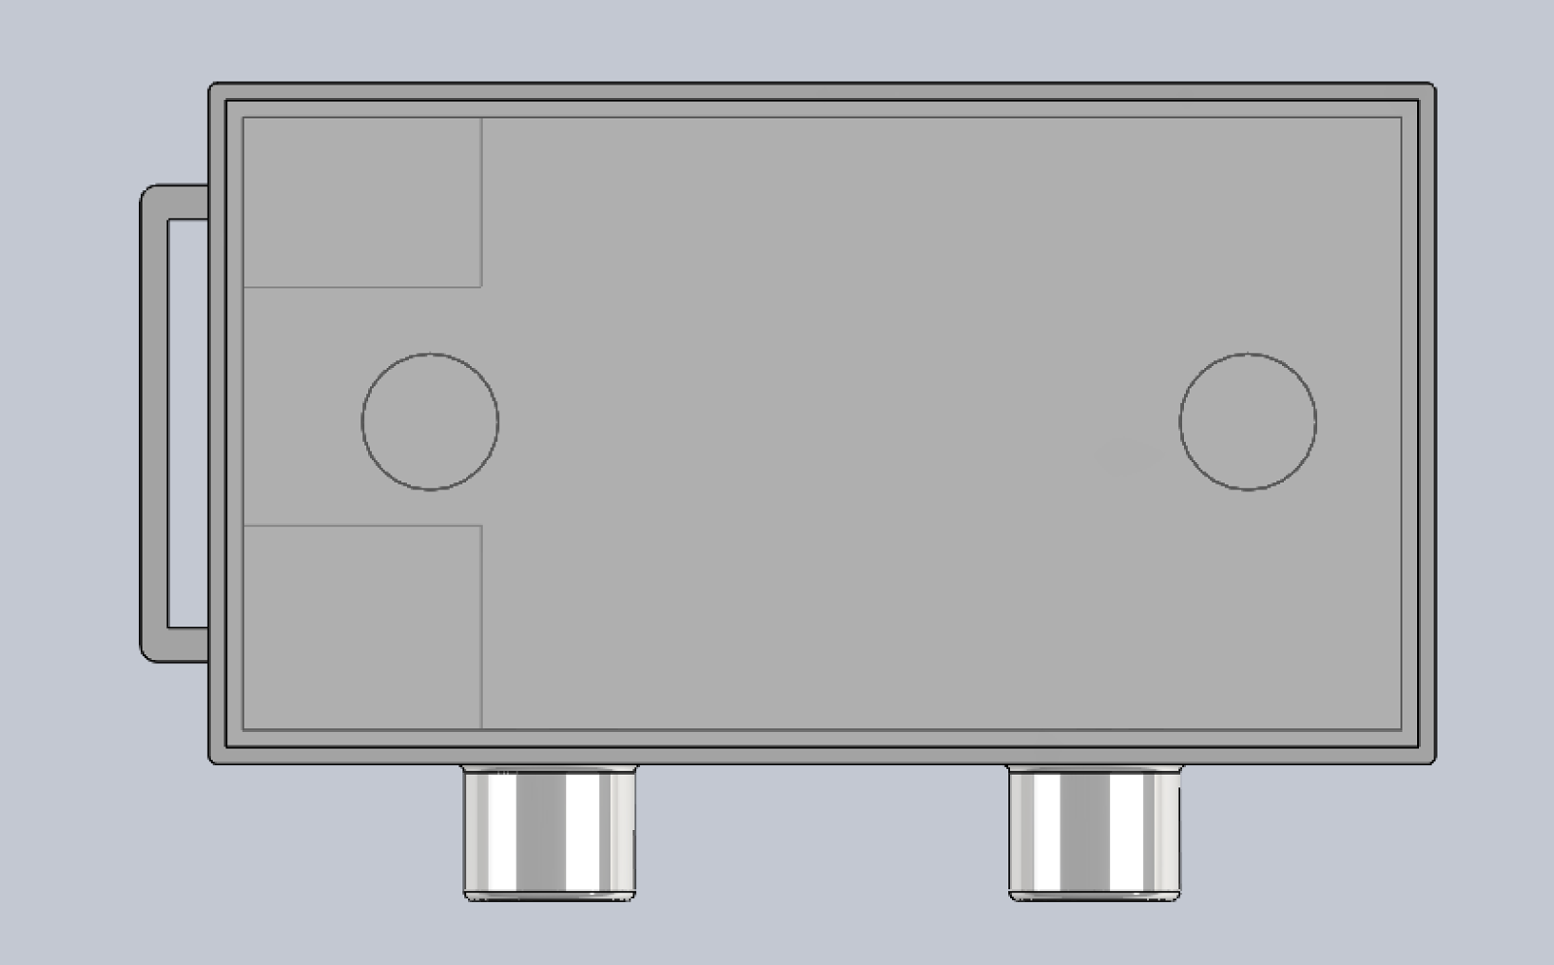
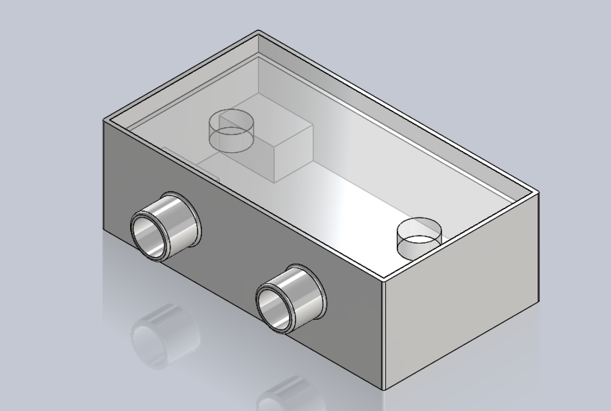
Final Design Description
Box made from Green Rhino building material [6]
Circulates warm air through the solar heater and the house
Empty space reserved for phase change material (PCM)
Figure 4: Outside Concept View
Figure 5: Inside Concept View

Slide 7
Consumer Requirements
Table 1: Customer Requirements
Customer Requirements | Weight (Total = 63) | Rationale
Ease of Use | 9 | Ensures that the solar air heater can be operated and maintained by the average consumer.
Simplicity of Design | 9 | The simplicity of the design would reduce costs for prototyping and testing.
Low Cost | 9 | By having a low cost, this ensures that Navajo families can heat their home safely and can be accessible to everyone.
Safety | 9 | This ensures that the PCM would not put the contents of the home at risk for fires or damages.
Feasibility | 9 | This ensures that the operation of the solar heater can be operated by all ages.
Efficiency | 9 | Shows how much energy the solar air heater can produce and how much energy can be converted to heat the home.
Size | 5 | The size of the SolarThermiX STX 7000 is 4x8x2 ft. and must be able to be place outside the home.
Aesthetics | 4 | The overall design must fits client’s needs and blend within the desert landscape.

Slide 8
Engineering Requirements
Table 2: Engineering Requirements
Engineering Requirements | Target | Tolerance | Rationale
Size | 4x8x2 ft. | N/A | To maximize the dimensions of the SolarThermiX STX 7000 solar air heater.
Cost | $2,000 | N/A | The allowance given by SRP. The cost of design, prototyping, and testing should not exceed $2,000.
Weight | 50 lbs. | +10 lbs. | To be able to safely lift the PCM off the SolarThermiX heater and bring inside the home.
Heat Absorption | 73° to 80° Fahrenheit | -3° Fahrenheit | PCM must be able to heat up the home within this temperature range.
Ease of Assembly/Installation | ≤2 hours | N/A | Assembly of the solar air heater and placement of the PCM should not exceed 2 hours.
Lifespan | 10 years | +1 year | The solar air heater and PCM must have a lifespan of 10 years as specified by SolarThermiX.
Heat Storage | 8 hours | +2 hours | PCM must be able to heat up the home for at least 8 hours.
Flow of Energy | 7.9 MJ/hr. | N/A | The flow of energy specified by SolarThermiX STX 7000.
Maintenance | $300 | N/A | The cost of repair of the solar air heater or replacement of the PCM should not exceed $300.

Slide 9
Schedule
Updated Gantt chart shows the team's task from October 30 to the end of the semester
The team is currently on schedule

Slide 10
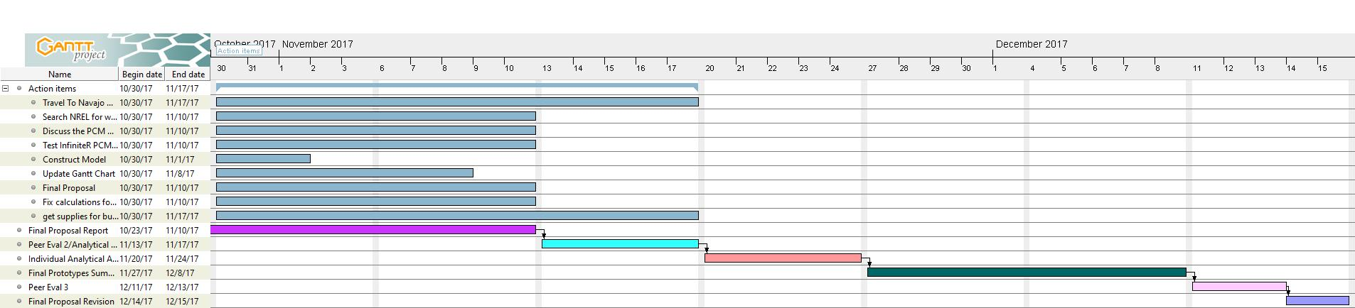

Slide 11
Budget
Our proposed total budget is $2000.00
Table 3: Budget Proposal
SRP Budget Proposal
 | Item | Cost | Quantity
 | Solar Air Heater | $1,500 | 1
 | PCM(Phase Change Material) | $205.20 | 9 (2 ft by 4 ft)
 | Travel | $200
 | Stainless Steel | $52.98 | 4
 | 12V Battery | $97.89
 | Coil | $7.00
 | Fan | $92 | 1
Optional
 | Styrofoam | $25.16 | 2
 | Wood (2inx4inx10ft) | $105.60 | 30
 | Total budget | $2,286

Slide 12
References
[1] M. Daly. (2017, Sept.) Solar Air Heater – SolarThermiX [Online]. Available: www.solarthermix.net/heat. [Accessed: September 21, 2017].
[2] Green NAU. (2015, Jan.) NAU Installs Novel Solar Thermal | Green NAU [Online]. Available: https://www2.nau.edu/green-p/index.php/2015/01/29/nau-installs-novel-solar-thermal/. [Accessed: November 5, 2017].
[3] M. Daly. (2017, Sept.) Phase Change Material – SolarThermiX [Online]. Available: http://www.solarthermix.net/phase-change. [Accessed: September 21,2017].
[4] Insolcorp. (2015, Jan.) Infinite R™ | Phase Change Materials | Thermal Storage | Insolcorp, Inc [Online]. Available: http://www.insolcorp.com/. [Accessed 7 Nov. 2017].
[5] M. Bertola. (1996, Jan.) Hogan [Online]. Available: http://www.so-utah.com/features/hogan/. [Accessed: November 5,2017].
[6] GR Building Systems LLC. (2017, Jan.) GR Building Systems [Online]. Available: http://grbuildingsystems.com/. [Accessed: September 18, 2017].

Slide 13
Any Questions?

