Slide 1


Equinus Exoskeleton
Brandon Begay, Azalea Grant, Robert Libby, Ethan Michel, Hannah Rentschler

Slide 2
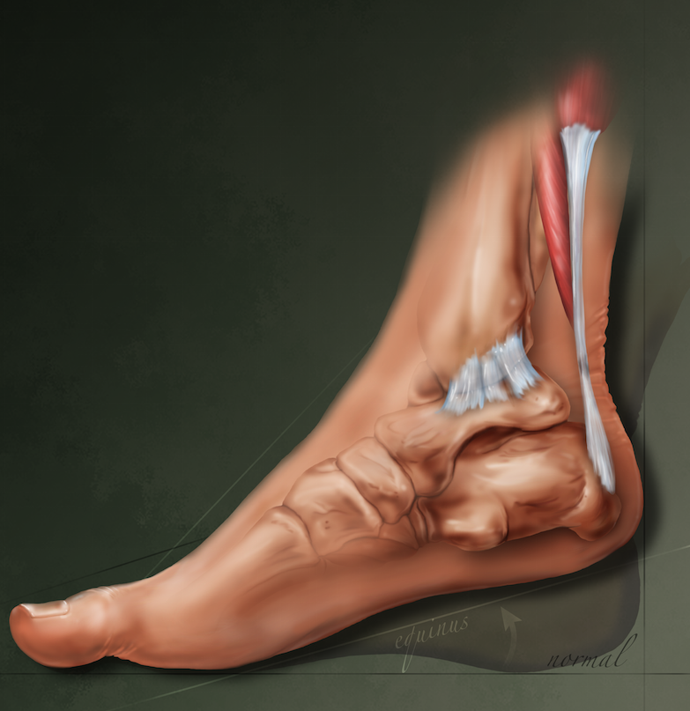
Project Description: Objective
Objective: Design exoskeleton to assist individuals with equinus deformity
Equinus is a condition in which the patient’s ankle lacks the ability to dorsiflex
Our device should:
Provide propulsive force to bottom of foot
Provide heel support
Client:
Dr. Zachary Lerner (NAU Biomechatronics Lab)
Faculty Advisor:
Dr. David Trevas
Ethan
April 27th, 2018
Ethan Michel
April 27th, 2018

Slide 3
Project Description: Requirements
Customer Requirements | Engineering Requirements
Must use Bowden Cable system Must interface with footwear Measure applied torque Easy on/off Compliant with heel-strike | Lightweight (.25 kg per limb) - not met Scalable for different severity levels (5-30 degrees) - met Provide 10-15Nm of propulsion - met Provide 5 degrees of rotation - met
Ethan
April 27th, 2018
Ethan Michel
April 27th, 2018
Notes:
‘In future work the device would be lighter for a child’s size’
Anticipate that the weight would be less

Slide 4
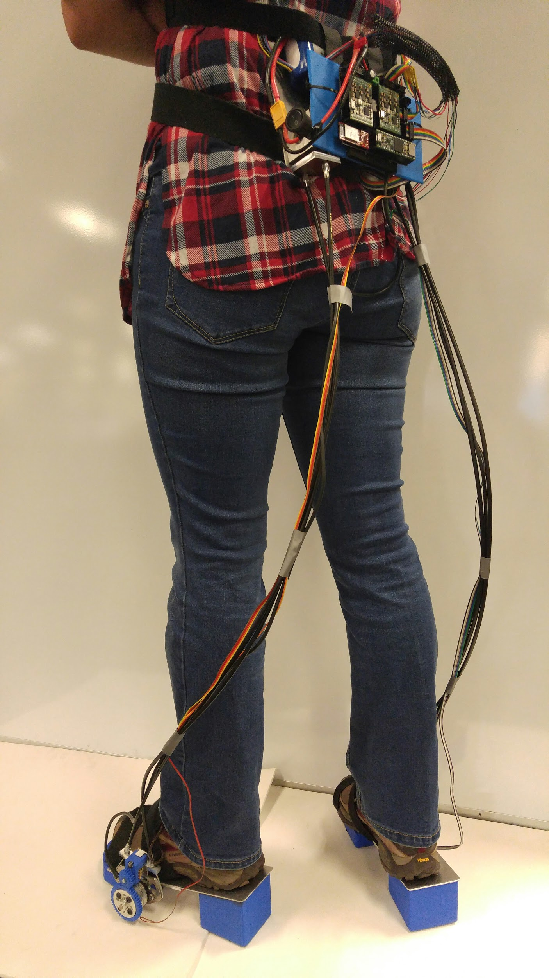
Final Product
Motor assembly
Bowden Cables and Sensor Wires
Foot assembly
Azalea
April 27th, 2018
Ethan Michel
April 27th, 2018

Slide 5
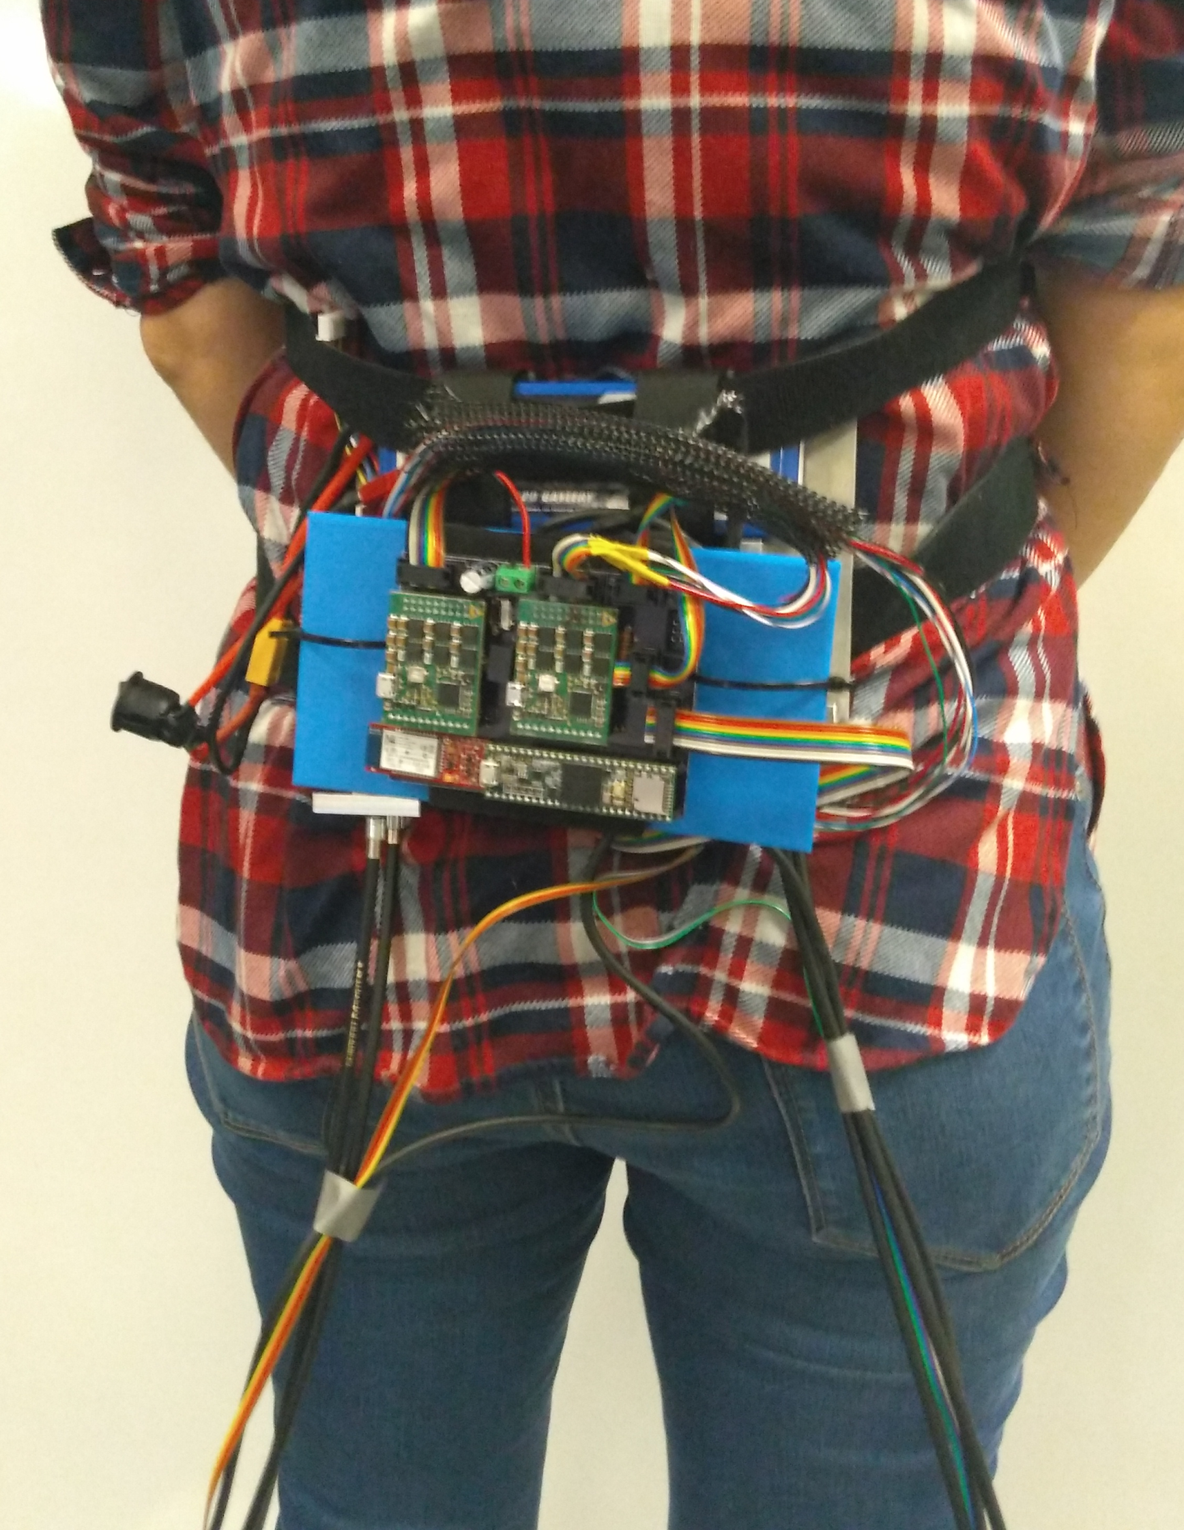
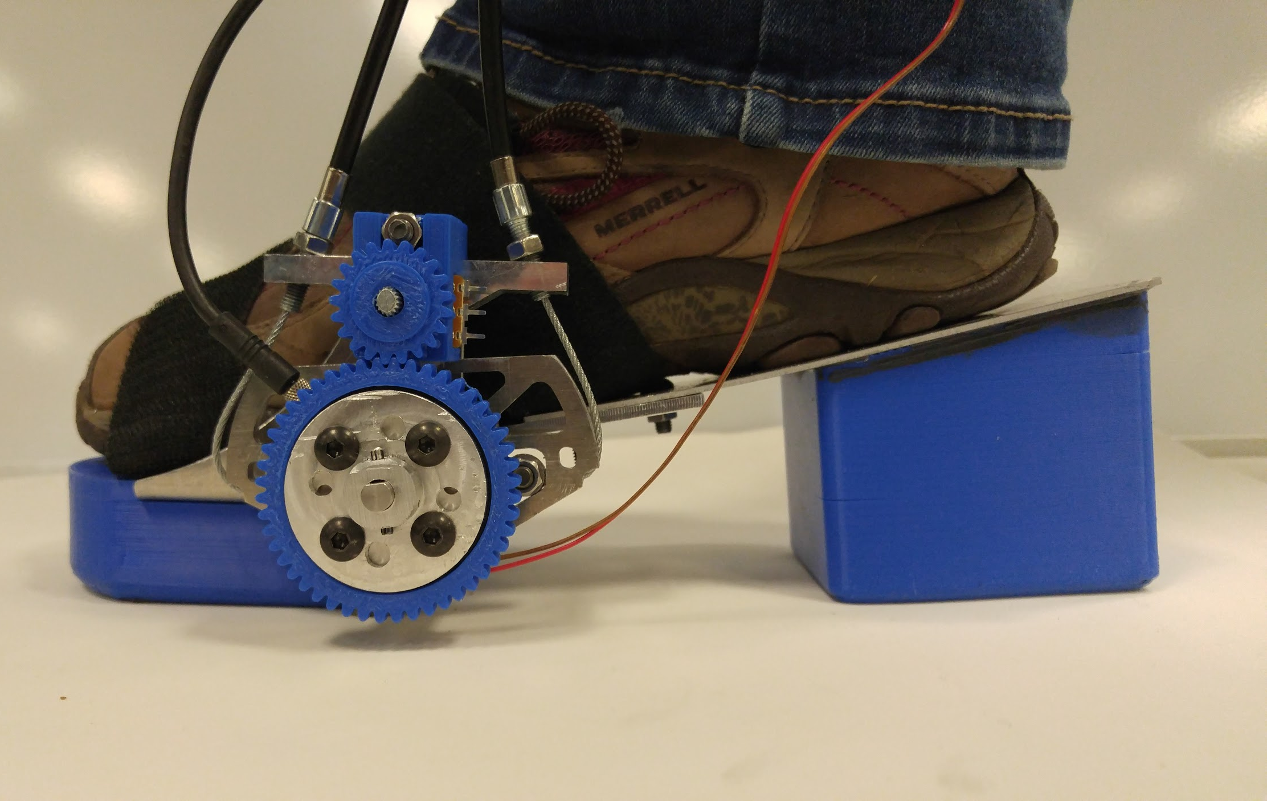
Final Product
Foot assembly
Motor assembly
April 27th, 2018
Ethan Michel

Slide 6
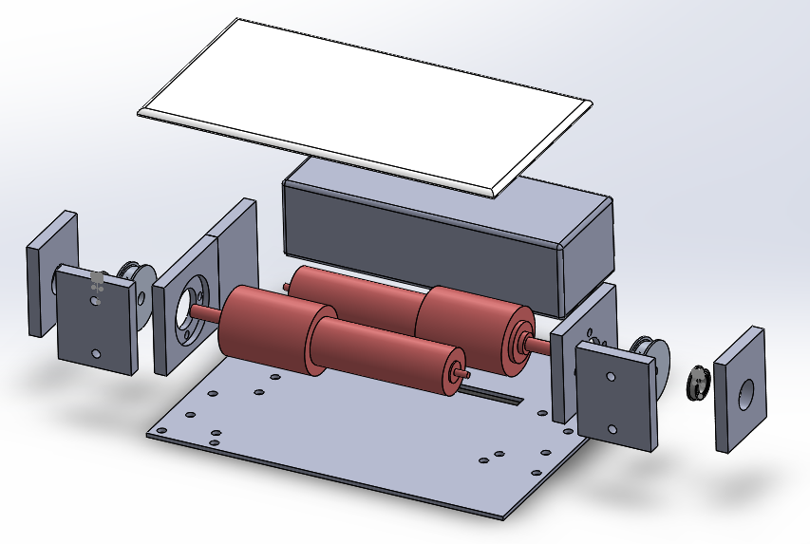
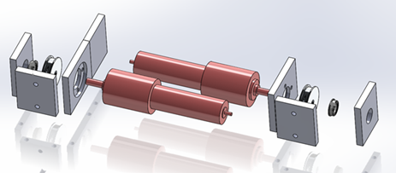
Design Solution
3D printed board
Battery
Shaft support
Motors
Supported by motor mounts
Shaft supports
To prevent motor shaft bending
Motor pulley
Couples bowden cables to the motor
Secured to motor by a set screw
Connects cables to pulley by a set screw
Battery
3D printed board
For mounting circuit board
Motors
Brandon
Motor pulleys
April 27th, 2018
Brandon Begay
April 27th, 2018
Notes:
Radial force

Slide 7
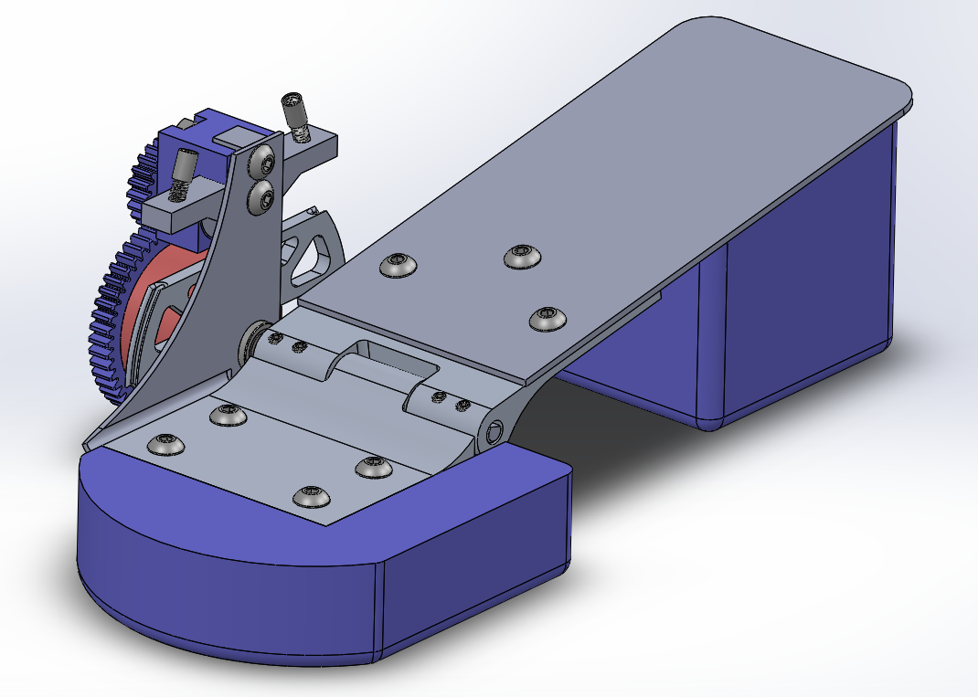
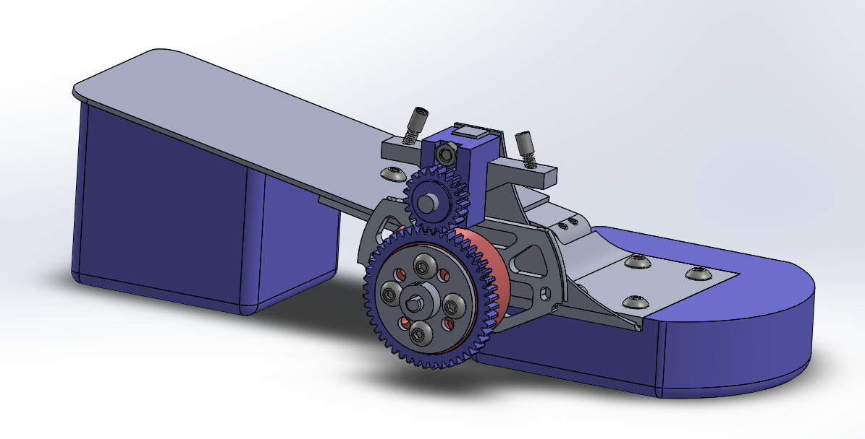
Design Solution
Foot plate
3D printed heel and toe-support
Adjustable from 0 to >30 degrees
Hinge
Transmits force to lift the heel
L-Bracket
Hinge
Foot plate
Provides support
L-Bracket
Mounts the drive system
Heel and toe support
April 27th, 2018
Hannah Rentschler
April 27th, 2018

Slide 8
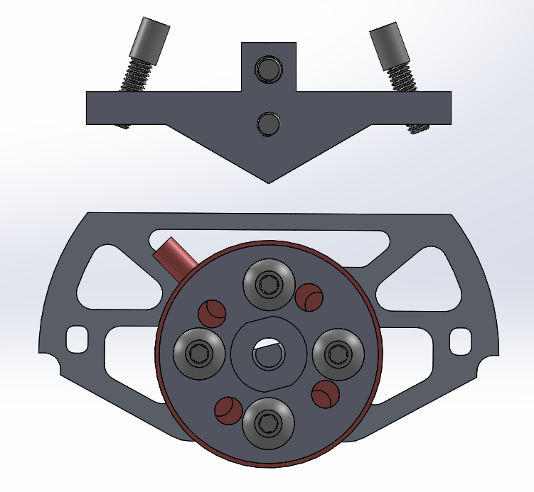
Design Solution
Pulley
Transmits force from cables to hinge
Limits the current draw
3:1 gear ratio with motor pulley
T-Bracket
End point for cable housing
Mechanical stop
Torque sensor attachment
Transmits torque to the shaft
Adjusts according to the equinus angle
T-Bracket
Torque sensor attachment
Pulley
April 27th, 2018
Hannah Rentschler

Slide 9
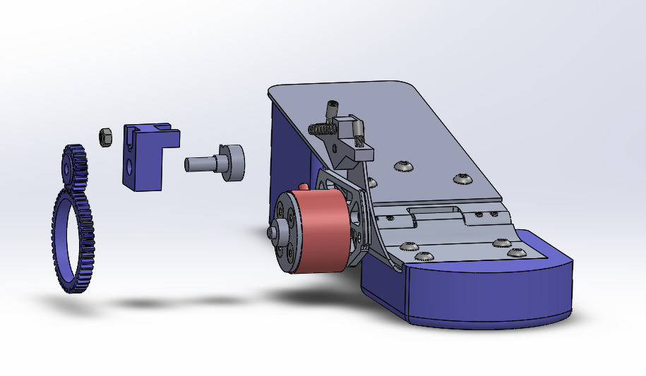
Design Solution
Potentiometer
Torque sensor
Reads torque at the toe joint
Force sensitive resistor
Reads ground reaction force
Potentiometer
Reads the angle of rotation
Potentiometer assembly
Couples the potentiometer to the T-Bracket
Potentiometer
assembly
Torque sensor
Hannah
April 27th, 2018
Hannah Rentschler
April 27th, 2018

Slide 10
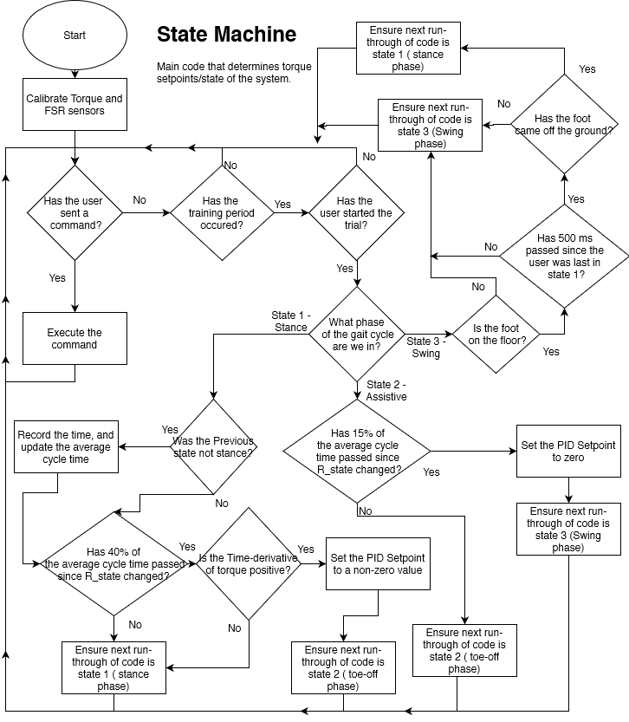
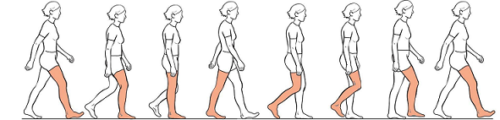
Design Solution
Healthy Gait Cycle
Robert
April 27th, 2018
Robert Libby
April 27th, 2018

Slide 11
Design Solution
Stance Phase
Heel Strike
Healthy Gait Cycle
April 27th, 2018
Robert Libby

Slide 12
Design Solution
Assistive Phase
Healthy Gait Cycle
April 27th, 2018
Robert Libby

Slide 13
Design Solution
Swing Phase
Healthy Gait Cycle
April 27th, 2018
Robert Libby

Slide 14
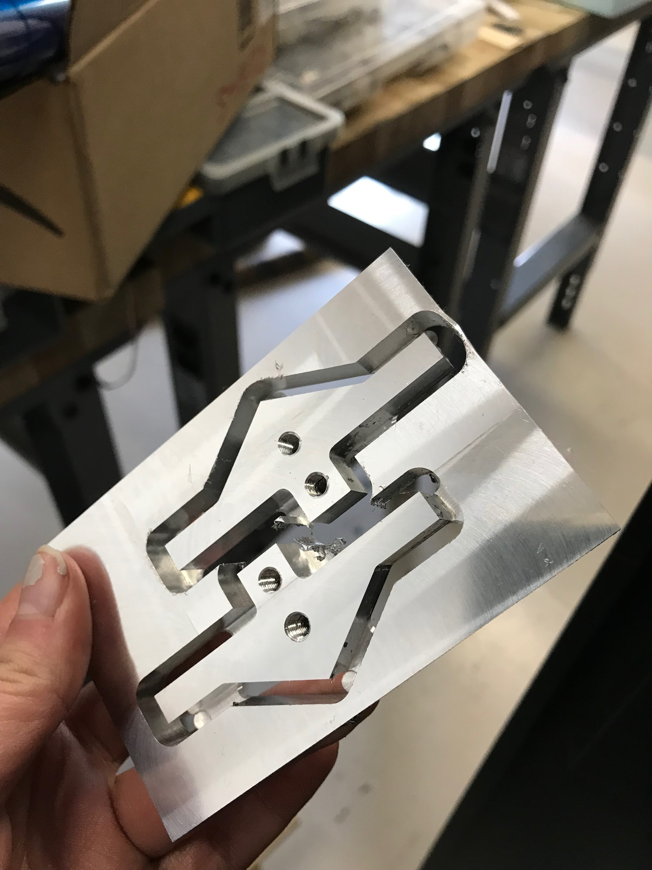
Manufacturing
CNC
Pulleys
T- and L-brackets
Hinge components
Torque sensor attachments
3D Printed
Potentiometer mount
Heel and toe support
Potentiometer gear interface
Sheet metal
Foot plate
L-bracket
Mills
Motor assembly
Azalea
April 27th, 2018
Azalea Grant
April 27th, 2018

Slide 15
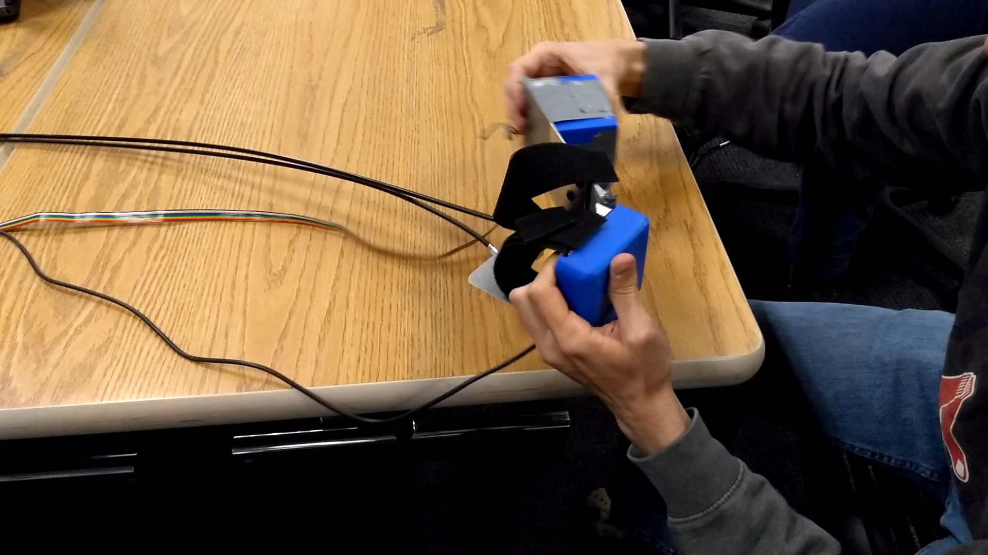
Testing
Robert
April 27th, 2018
Azalea Grant
April 27th, 2018

Slide 16
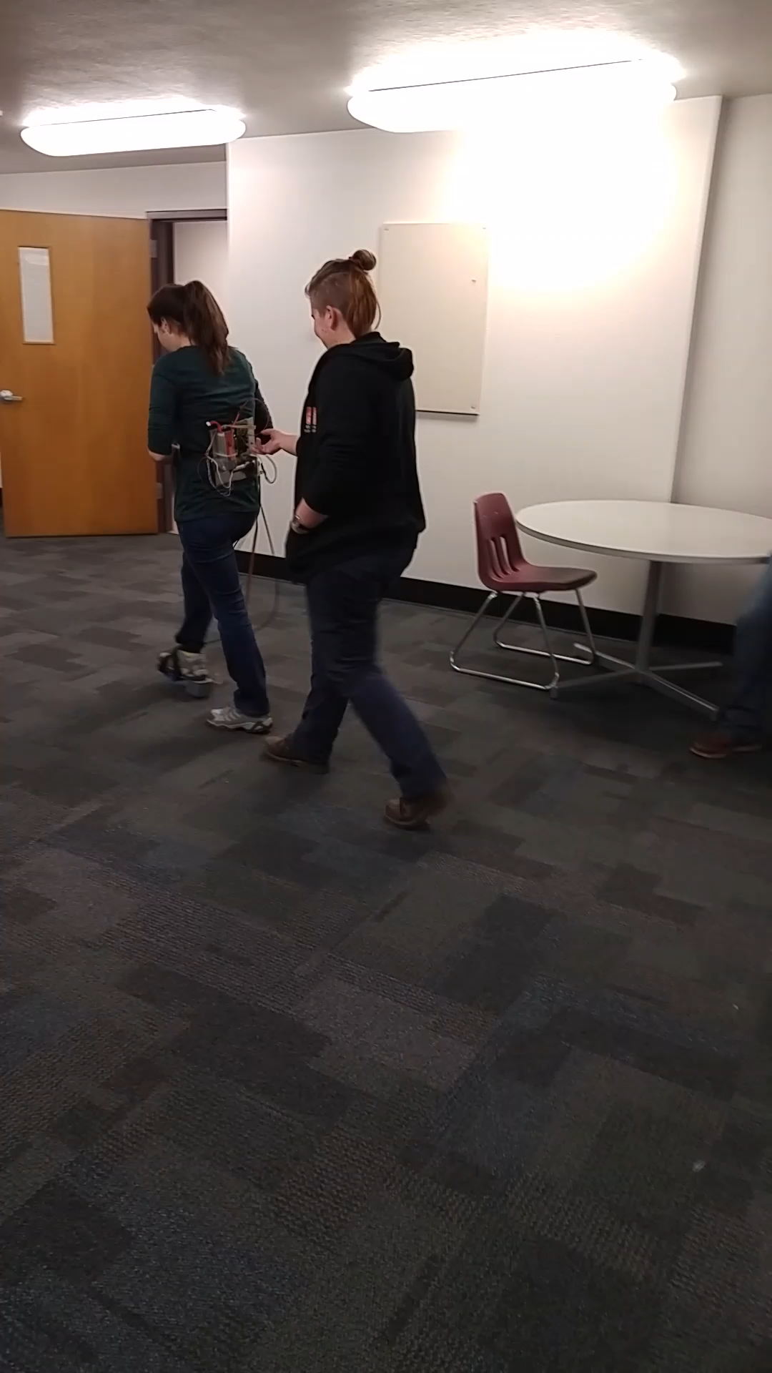
Testing
April 27th, 2018
Azalea Grant

Slide 17
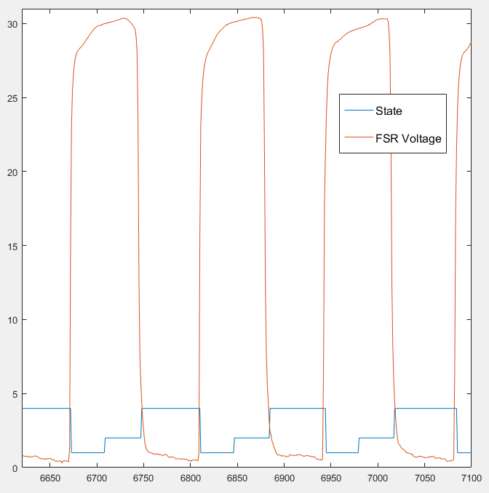
Results of Testing
Established
System functioned mechanically
Timed walking controls functioned over treadmill walking
Further testing is required
April 27th, 2018
Robert Libby
Stance
Toe-off
Swing

Slide 18
Future Improvements
Motor pulley design and manufacturing
Aluminum
Machined D-hole
Hinge
Pin hinge to the shaft
A more intelligent control scheme
Reaction Torque Control scheme
Feed-Forward Feature
Azalea
April 27th, 2018
Azalea Grant
April 27th, 2018

Slide 19
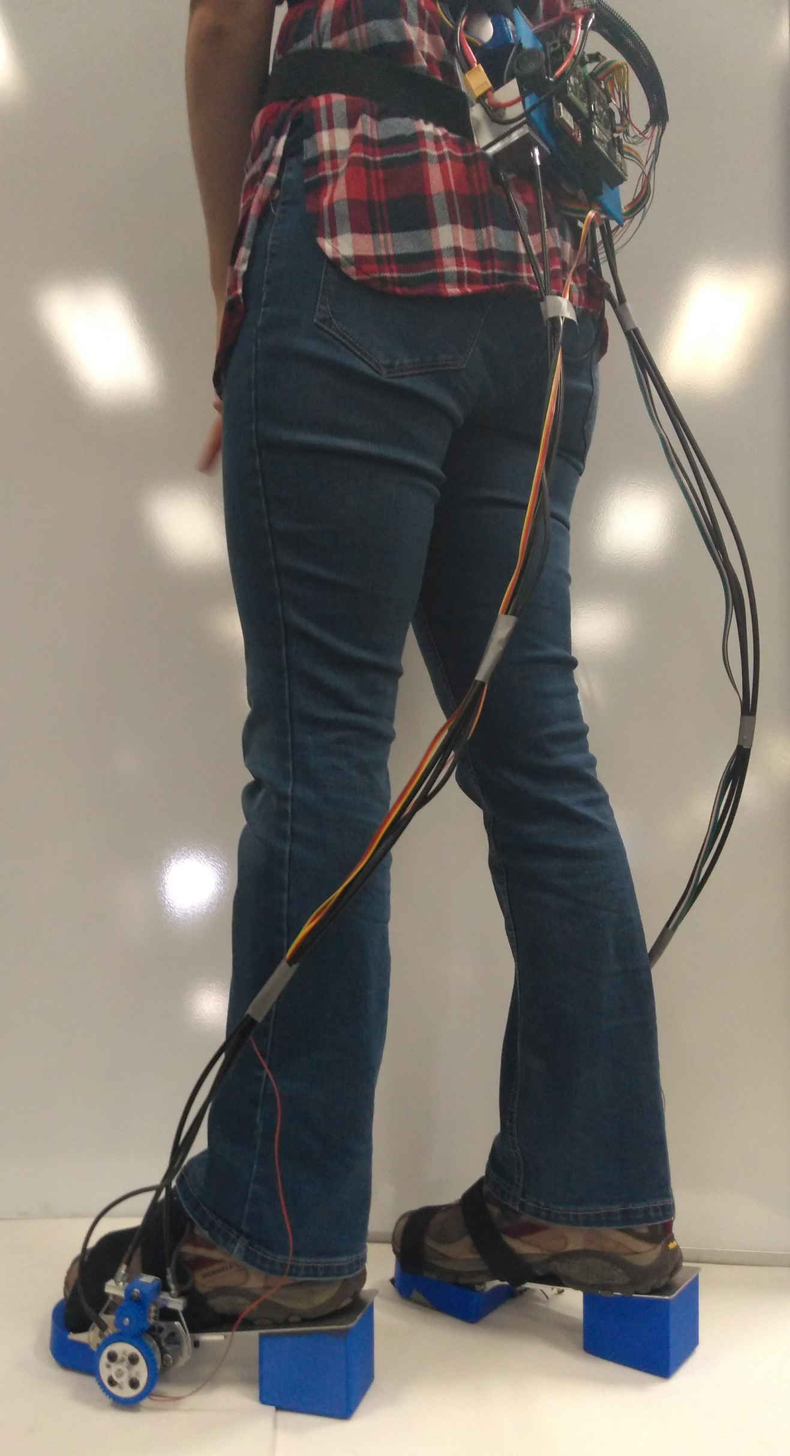
Conclusion
Personal experience gained
Machining
Robotic systems
Biomechanics
Torque transfer systems
Potential application for other biomechanical systems
April 27th, 2018
Brandon Begay

Slide 20


Acknowledgements
W.L. Gore
NAU Biomechatronics Lab & Dr. Lerner
Copper State Bolt and Nut Co.
Michael Bair
Dr. Gian Gasparri
April 27th, 2018
Brandon Begay

Slide 21
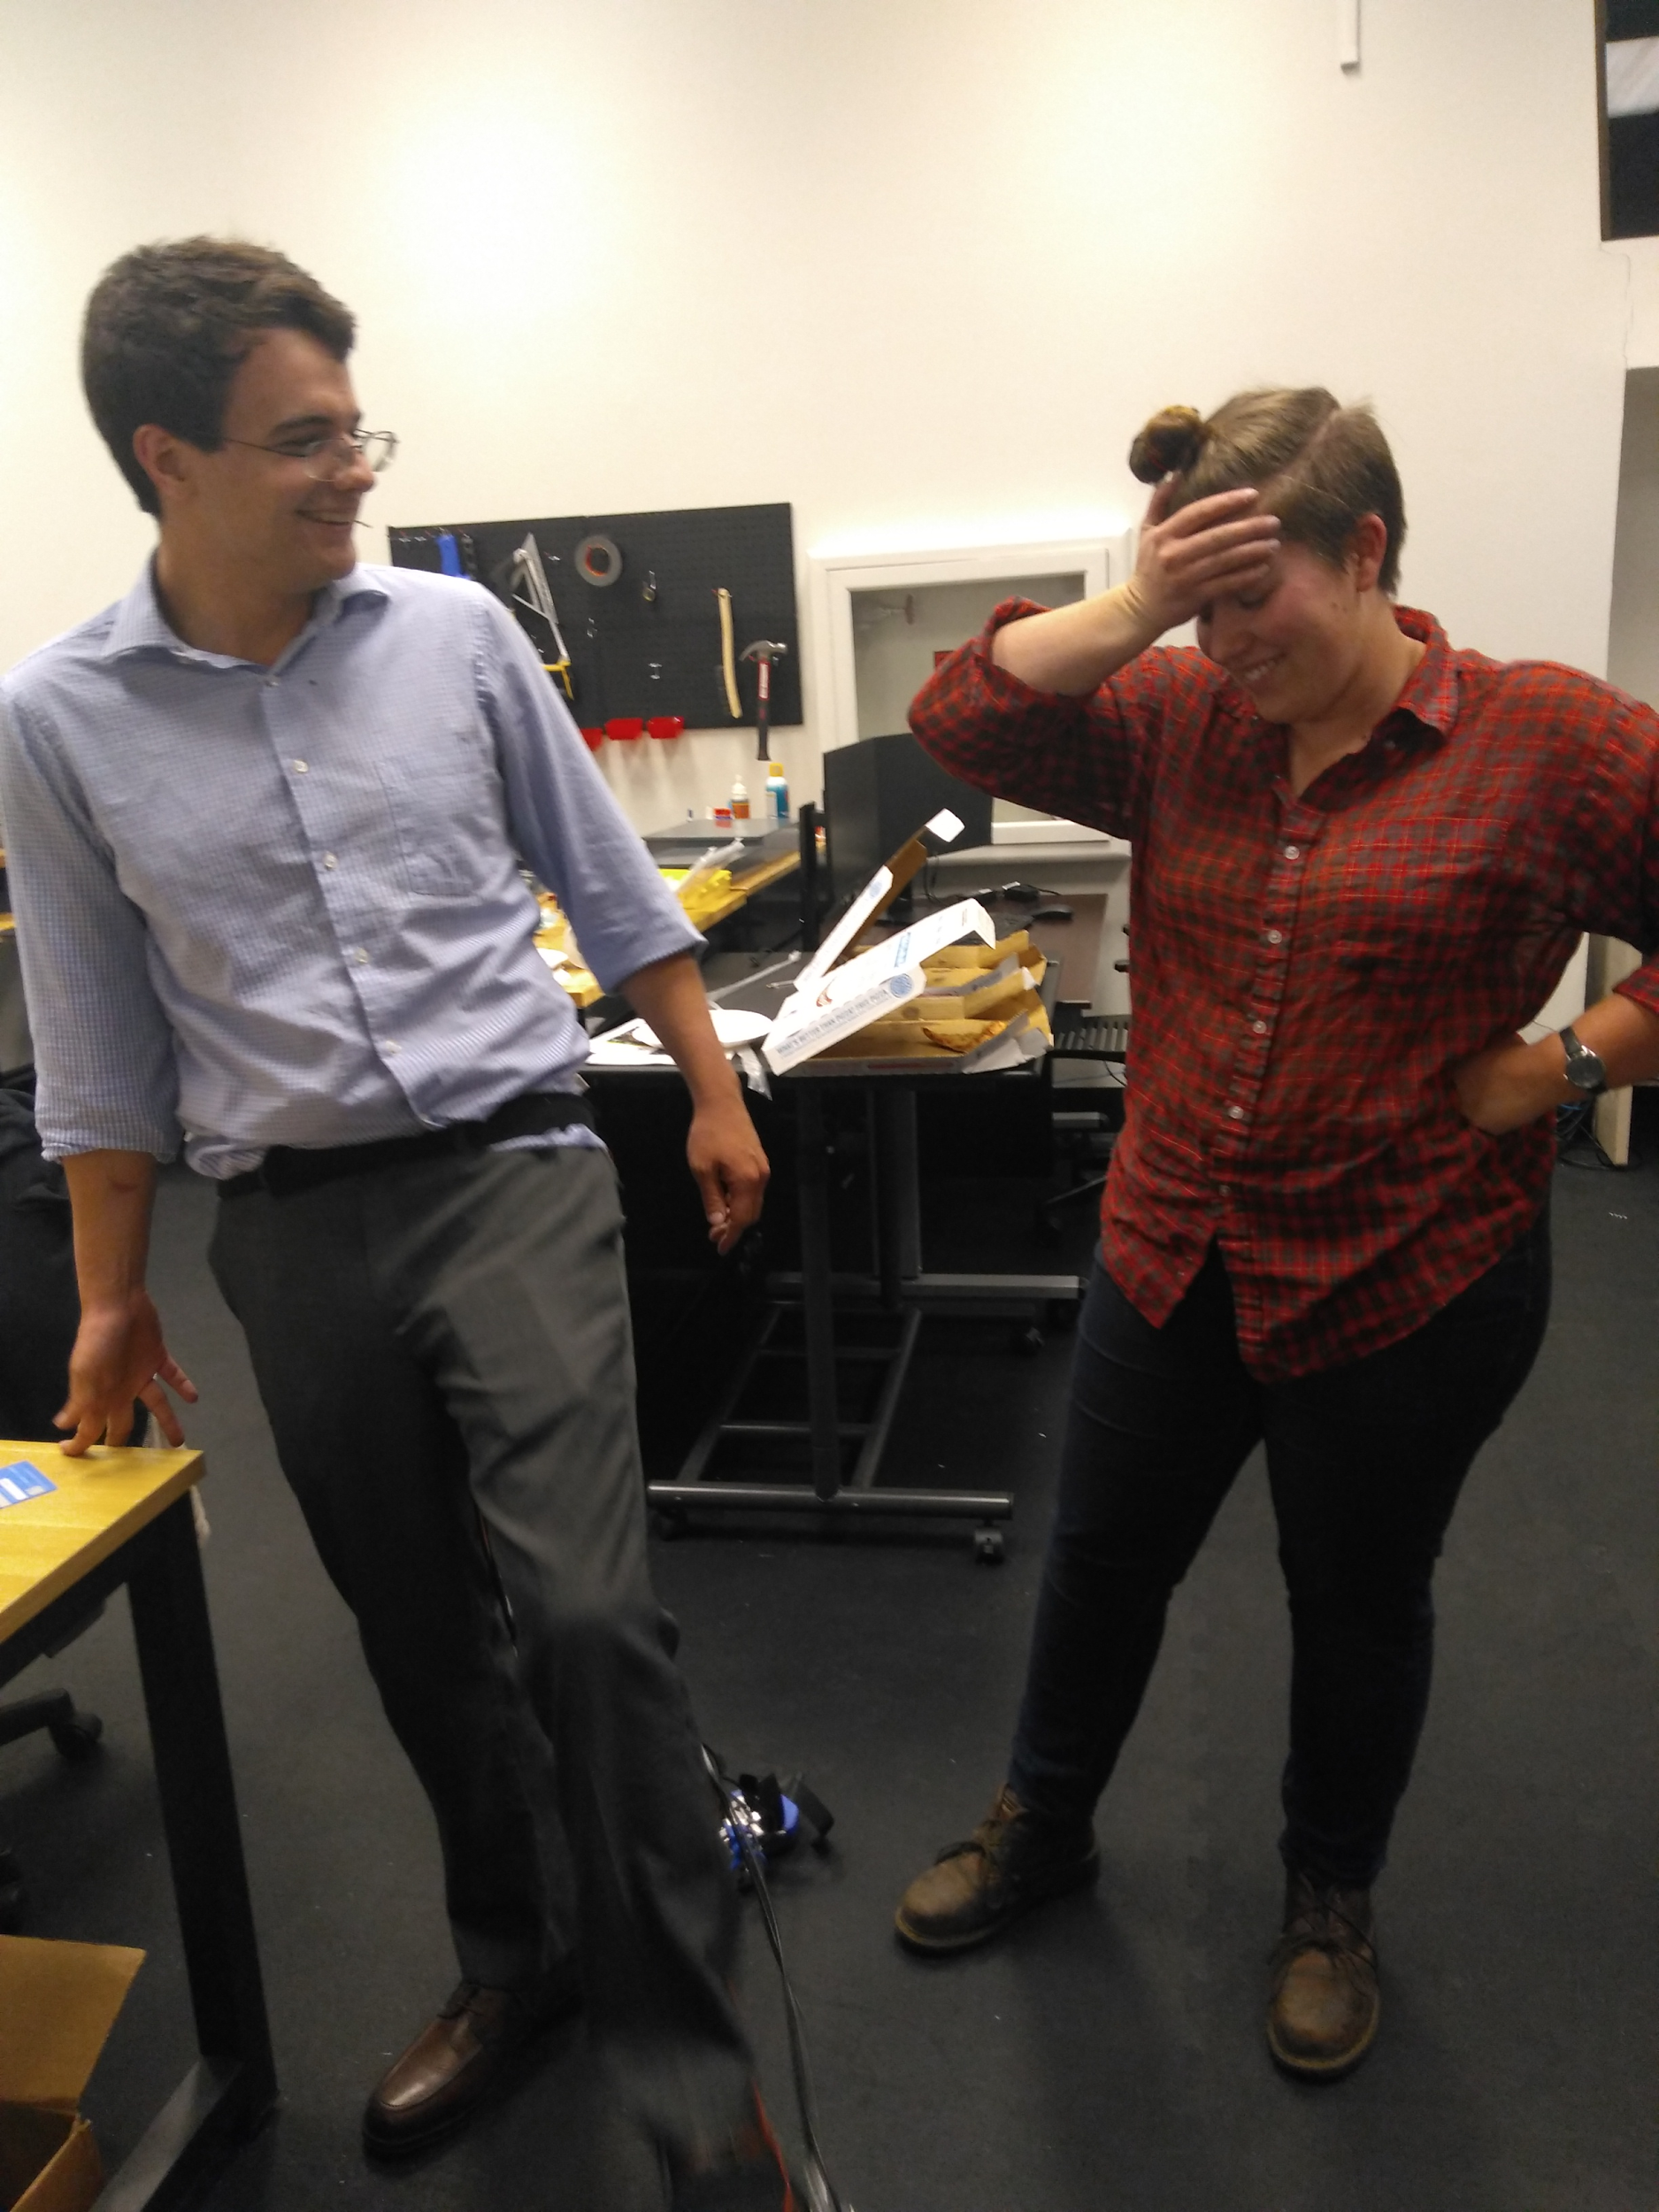
Questions?

Slide 22
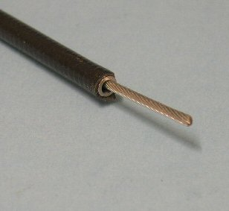
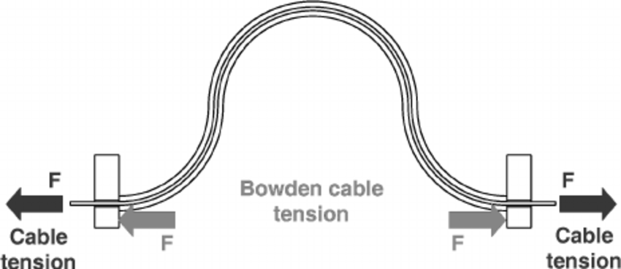
Bowden Cables
http://www.daviddarling.info/encyclopedia/B/bowden_cable.html
https://www.researchgate.net/figure/Working-principle-of-the-Bowden-cables-in-the-static-condition-the-forces-exerted-by-the_fig8_220671712

Slide 23
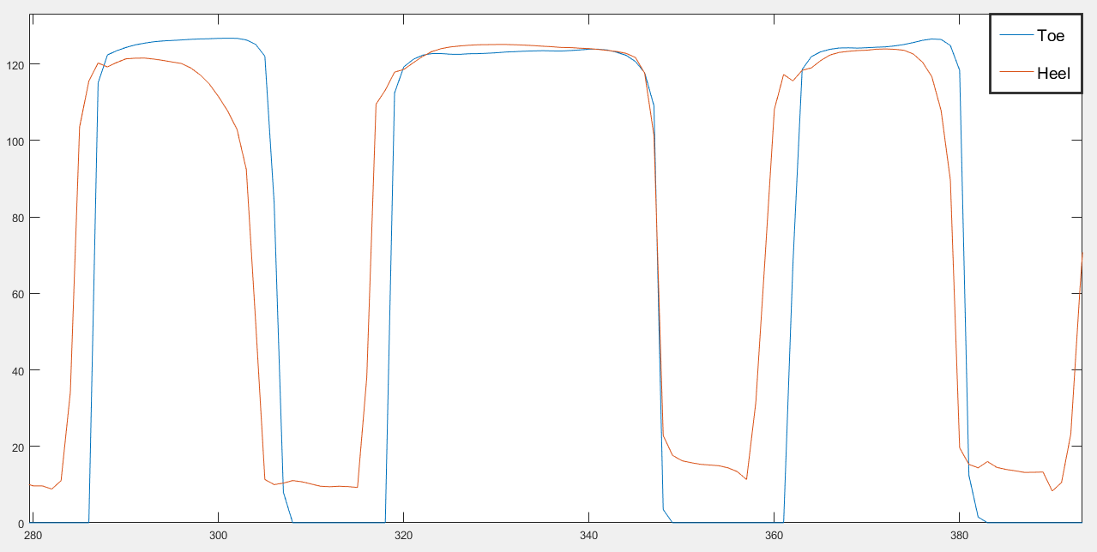
Ground Reaction Force

Slide 24
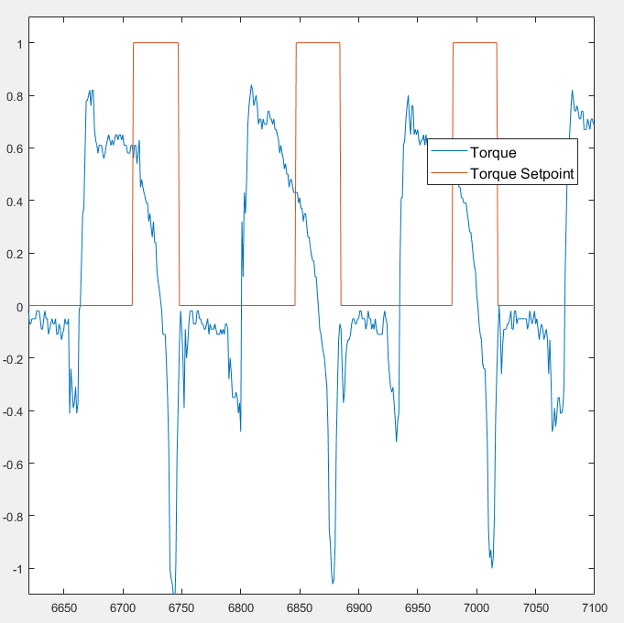
State Machine

Slide 25
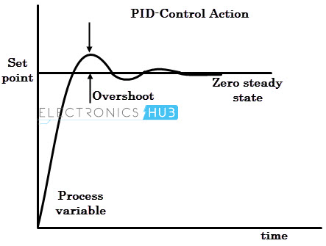
PID Control
https://www.electronicshub.org/pid-controller-working-and-tuning-methods/

Slide 26
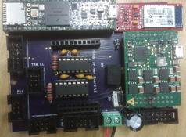
Printed Circuit Board

Slide 27
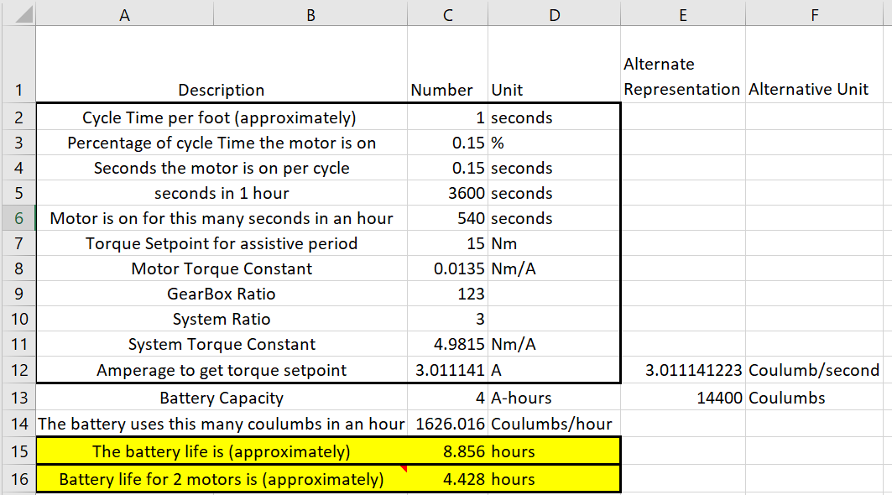
Motors and Battery Life

