Slide 1
Hydraulics Demonstrator
Cal Skilsky,
Mosaed Aljebly,
Sultan Alenezi, Fawaz Alenezi

Slide 2
Presentation Outline
Project Description
Background and Benchmarking
Customer and Engineering Requirements
Design Considered
Schedule and Budget

Slide 3
Project Description
Create a hydraulics demonstration unit
Funded by the university with the purpose of having a hydraulics trainer in the thermal-fluids lab
Utilize a fluid reservoir, a pump, a pressure-safety valve (PSV) and cylinders of varying diameter
Write an instruction manual and a lab procedure

Slide 4
Project Description
Additional features:
Add an accumulator to store energy and smooth out the motion
Install an electronically-controlled on-off valve to do basic motion control
Install a proportional valve to do closed-loop motion control using PID (proportional-integral-differential) control schemes.

Slide 5
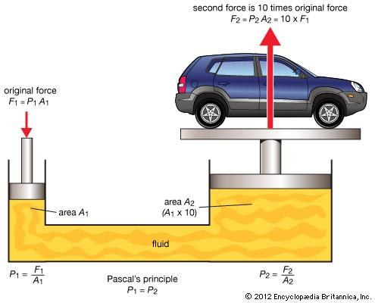
Project Description
Use instruments to measure fluid velocity, fluid pressure, and force at the inlet and exit to show Pascal’s Principle
[1]

Slide 6
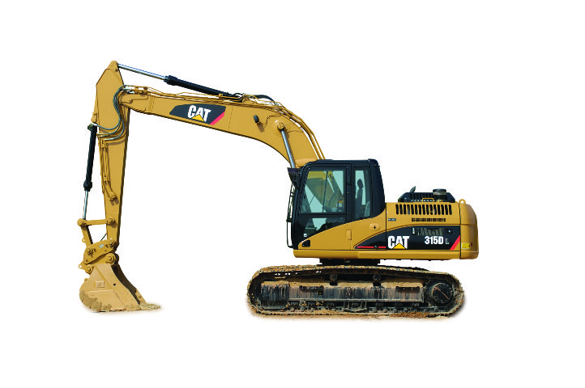
Background And Benchmarking
What hydraulics are used for:
High force applications
Holding objects still without using energy
Large scale applications where electric motors become inefficient
[2]

Slide 7
Background And Benchmarking
Examples
Industrial robots
Excavators
Car brakes
Car jacks
Forklifts

Slide 8
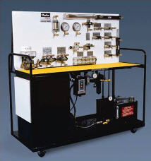
Background And Benchmarking
Examples of hydraulic training systems:
1. Hydraulic Training Systems (Parker)
Double sided panels allow two people to use the unit
Held on storage cart that can be rolled in and out of a room
Includes 13 hydraulic hoses
Manifold includes multiple pressure, tank, and drain ports
[3]

Slide 9
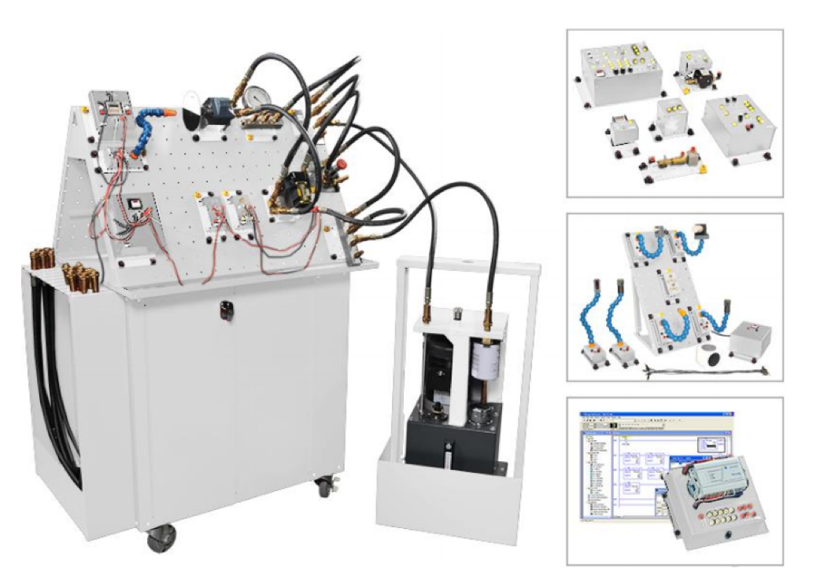
Background And Benchmarking
2. Hydraulics Training System (FESTO 6080)
The training program is divided into the following subsystems:
Hydraulics Fundamentals
Electrical Control of Hydraulic Systems
Hydraulics Applications
Programmable Logic Controller
Troubleshooting Hydraulic Circuits
Servo Control of Hydraulic Systems
Sensors
[4]

Slide 10
Customer Requirements
Hydraulics demonstrator must be suited for thermal-fluids lab:
System must be easy to use
Must be portable and a moderate size for a lab
Must include several training modules that enable students to learn about hydraulics
Must include a clear lab manual

Slide 11
Engineering Requirements
This project includes many engineering requirements that must be satisfied:
Hydraulic hoses and fittings should all be compatible
Stand for the demonstrator must be wide and sturdy
The noise level must be at minimum
System should have a weight limit
System should have a power limit

Slide 12
Design Considered
Design 1:
Includes a vertical frame that stands on a cart
Each hydraulic component is attached to the main frame
Fluid reservoir
Pump
Pressure-safety valve (PSV)
Check valve
Cylinders of varying diameter
Hydraulic hoses and fittings

Slide 13
Design Considered
Design 2:
Hydraulic parts are attached to the vertical frame including:
Fluid reservoir
Pump
Pressure-safety valve (PSV)
Cylinders of varying diameter
Hydraulic hoses and fittings
Accumulator
Electronic on/off valve
Proportional valve
Electronic measurements of pressure, velocity, and force

Slide 14
Schedule and Budget
Schedule:
9/25: Come up with all customer and engineering requirements
10/1: Research state-of-the-art hydraulic demonstrators
10/4: Brainstorm design ideas and compare advantages and disadvantages
10/20: Come up with final design
11/6: Complete final proposal
11/15: Purchase all parts
11/20: Complete BOM
11/25: Complete CAD package
12/4: Complete prototype

Slide 15
Schedule and Budget
Current budget of 1000 dollars provided by the university:
Proposed costs:
Fluid reservoir: $50
Pump: $250
Pressure safety valve: $30
Cylinders: $100 each
Hose: $20 each
Accumulator: $500
Pressure gauge: $10 each

Slide 16
References
[1] https://www.britannica.com/science/Pascals-principle
[2] http://www.cat.com/en_US/products/new/equipment/excavators.html
[3] Parker Hannifin Corporation, Motion & Control Training W3MC01.
http://www.parker.com/
[4] FESTO Training Systems, FESTO Company, Hydraulics.
https://www.labvolt.com/solutions/3_fluid_power/98-6080-00_hydraulics_training_system

Slide 17
Questions ?

