Slide 1

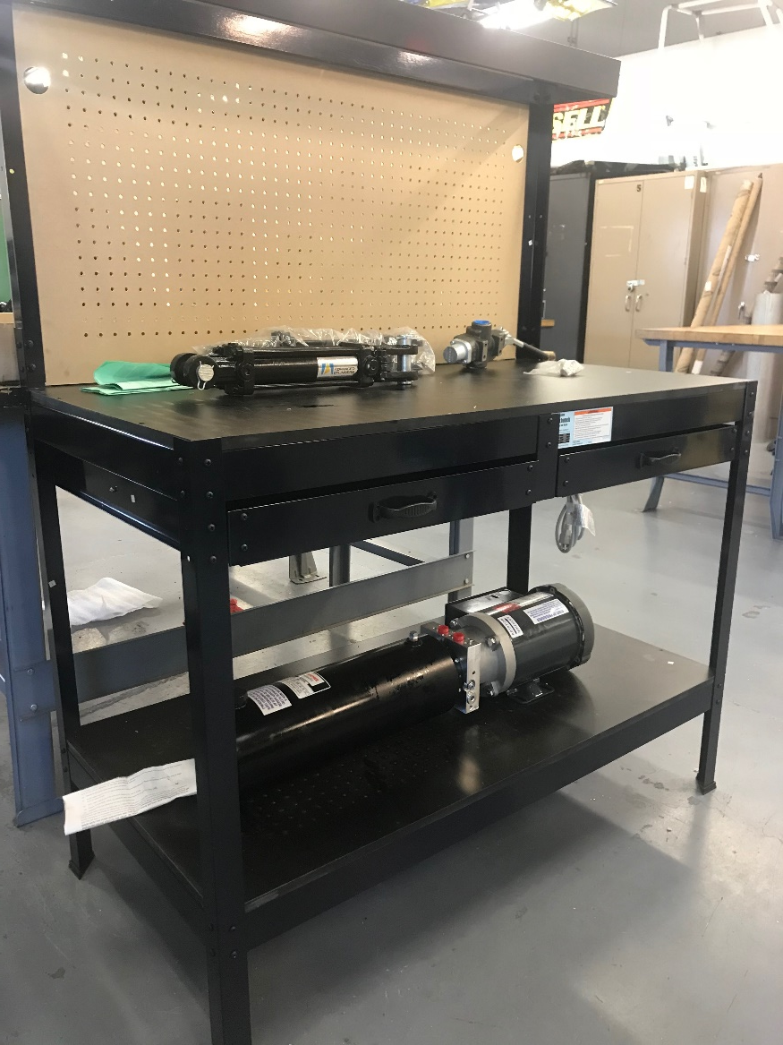
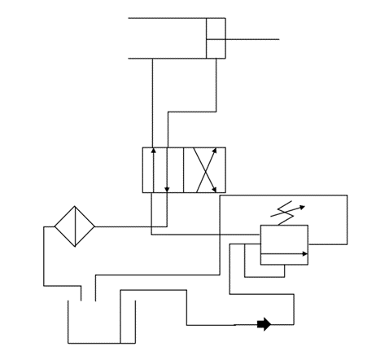
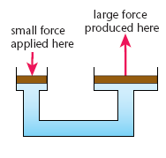

Hydraulics Demonstrator
Cal Skilsky, Sultan Alenezi, Fawaz Alenezi, Mosaed Aljebly
Department of Mechanical Engineering, Northern Arizona University
    Abstract
Design Selection
Lab Experiments
Our team had the goal of designing and building a hydraulic demonstration unit suitable for experiments in the thermal fluids lab. The goal of hydraulic systems is to utilize Pascal’s Law to create a higher force at the output than the input. Hydraulics are used in many industrial applications that require a high force output. To demonstrate Pascal’s Law and other hydraulics principles, our team created a portable hydraulics demonstrator with several lab experiments. These lab experiments cover material anywhere from hydraulic system setup, to hydraulic efficiency testing. In designing the demonstrator, it was crucial to make sure the unit is safe and durable. Many calculations went into selecting hydraulic components and designing the mounts that connect these components to the unit.
The hydraulic trainer includes the following lab experiments to enable engineering students to learn the fundamentals of hydraulics:
1. Explain hydraulics uses and how to set up a hydraulic system.
2. Test system to see if Pascal’s Principle applies by measuring the pressure inside the hydraulic hose and inside the cylinder.
3. Relate pressure and piston area at both ends of the actuator to calculate the difference in force.
Conclusion
Background
Figure 2: Physical Model
Figure 3: Hydraulic Circuit Diagram
This project initiated from the need of engineering students to learn about hydraulic systems. Since hydraulics are used in many industrial applications, it is important that mechanical engineering students learn the fundamentals of hydraulics. The design solution uses a double acting actuator, a power unit, and a four way control valve to demonstrate a hydraulic system. At each critical point in the system, there is a pressure gauge to measure the pressure differences in the system. The demonstrator includes three lab experiments to help engineering students learn about hydraulics. For future design changes, either a load cell or a spring and Arduino kit can be used to measure the force output, which will add more depth to the lab experiments.
This design, as shown in Figure 2, uses a table with a vertical pegboard attached on top. The motor, pump, and reservoir will sit on the base of the cart while the control valve and actuator will be on the top of the cart. The measurements are displayed on the pegboard. Figure 3 shows the circuit diagram of the system, which includes the actuator, control valve, pressure safety valve, filter, pump, and reservoir.
The power unit of the system, which includes the pump, motor, and reservoir, is made by Bucher Hydraulics [2]. The pump provides a pressure of 2000 psi to the control valve. The 4-way control valve has a built-in pressure safety valve which is set at 400 psi. The actuator, made by G-Force Hydraulics [3], has a 2 in bore and a 6 in stroke. Using the bore and pressure values, the force output of the actuator is calculated to be 1,240 psi.
The hydraulic components are connected using Auto Valve [4] hoses and fittings. There is a pressure gauge at each side of the cylinder and between the input of the control valve and the pump. These pressure readings are used in the lab experiments.
Each hydraulic component would be attached using a specifically designed mount. These mounts are designed to handle the 1,240 lb force output. However, due to time and budget constraints, these mounts were not able to be machined.
Originally, our goal was to measure force output in addition to pressure to add more depth to the lab experiments. We first decided to use a load cell for this measurement, but then decided load cells are too expensive and provide more accuracy than we need. We decided to use a heavy duty spring and an Arduino kit to calculate the force. The Arduino would provide the displacement measurements, which combined with a known spring rate, the force could be calculated. However, without the mounting brackets, the spring cannot be mounted and therefore the force cannot be calculated. This leaves our project with pressure measurements, while forces need to be calculated from Pascal’s Principle. Future designs of this demonstrator can included direct force measurements to add more depth to the lab experiments.
Hydraulic systems are centered on Pascal’s Principle, which states that the pressure throughout a system is the same if the fluid is incompressible. Based on the formula,
$$P=\frac{F}{A}$$
using a smaller area at the inlet than the outlet will result in a larger force at the output. This principle is illustrated in Figure 1 below.
References
[1] Revision World Staff, “Pressure” 2013. [online]. Available: https://revisionworld.com/a2-level-level-revision/physics/force- motion/some-effects-forces/pressure [Accessed Feb. 8, 2018].
[2] Bucher Hydraulics Staff, “Hydraulic Power Packs” 2017. [online]. Available: https://www.bucherhydraulics.com/47809/Products/Mobile-and- Industrial-Hydraulics/Products/Power-Units/Hydraulic-Power-Packs,- Series-UP/index.aspx [Accessed Mar. 17, 2018].
[3] Gforce Hydraulics Staff, “Tie Rod Hydraulic Cylinder” 2017. [online]. Available: http://gforcehydraulics.com/11401_2x6_tie_rod_cylinder [Accessed Nov. 7,2017].
[4] Auto Valve Staff, “Hydraulic System Components” 2017. [online]. Available: http://www.autovalve.com/system-hydraulic.shtml [Accessed Apr. 3, 2018].
Figure 1: Hydraulic Illustration [1]
Design Requirements
The hydraulic trainer is to be designed in a way that makes it safe, easy to use, and portable in the thermal-fluids laboratory. The specific requirements are given in Table 1 below.
Requirement | Measurement | Purpose
Maximum force output | 800 lb – 1300 lb | Safety
Stroke length | 6 in | Portability
Maximum pressure in actuator | 500 psi | Safety
Number of levers to operate system | 1 | Ease of use
Number of pressure gauges | >2 | Ease of use
Acknowledgements
Instructor and Client: Dr. David Trevas
Table 1: Design Requirements

