Slide 1

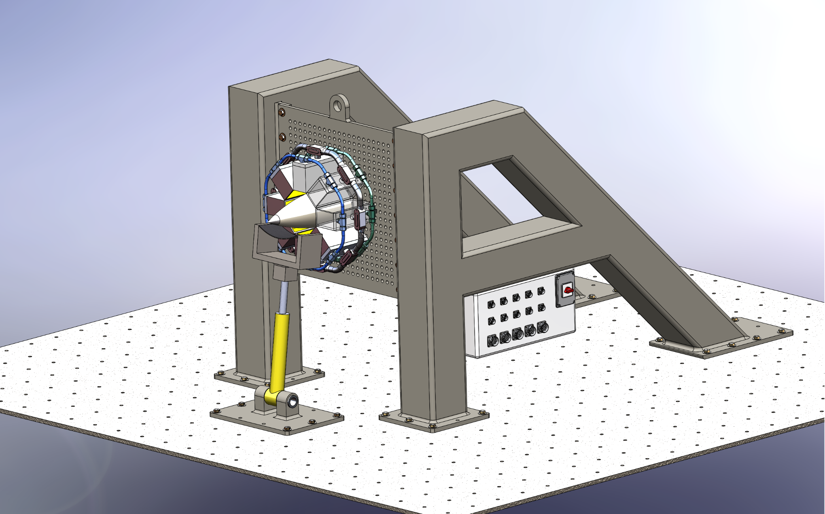
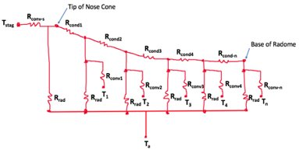
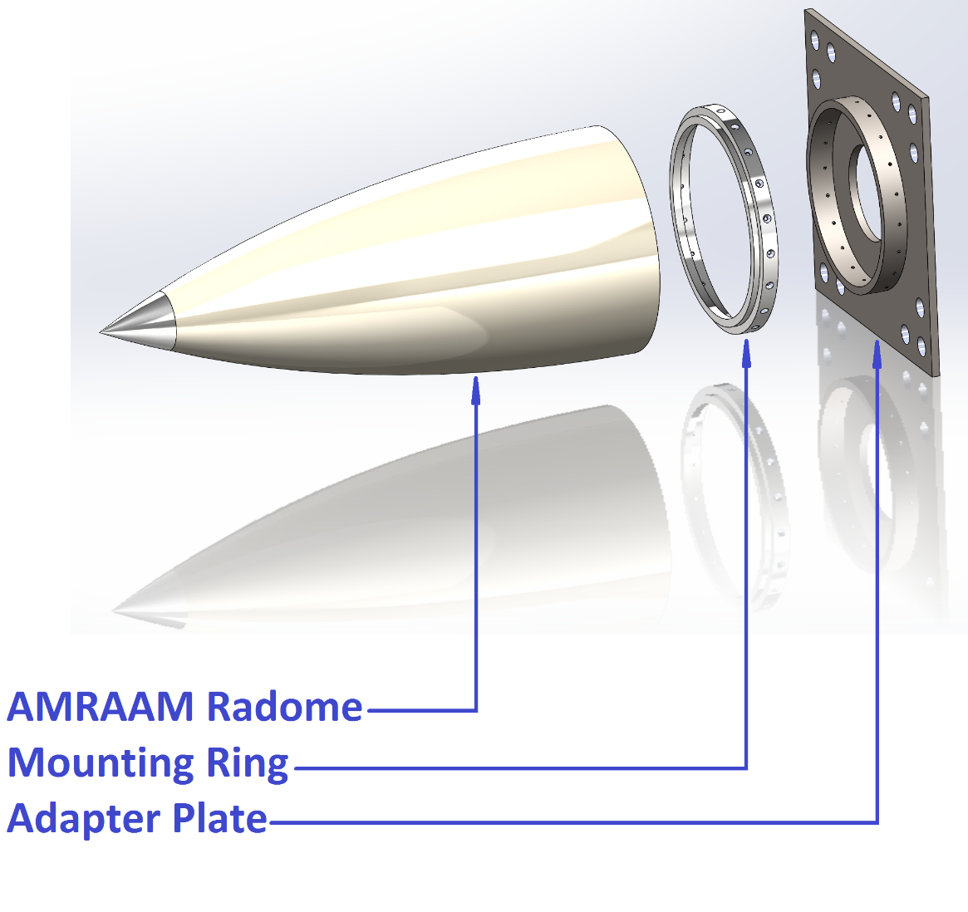
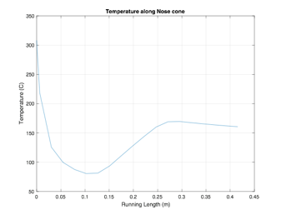
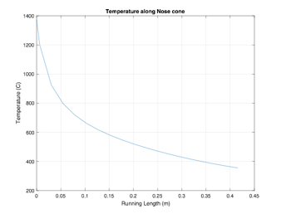
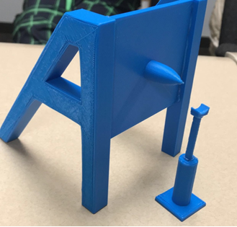
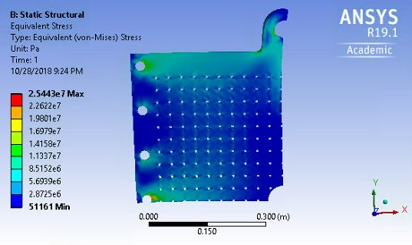
Test Fixture for Flight Components
Abdulaziz Alzaid, Shanna Lechelt, Israel Sotelo, Alexandra Spotts
College of Engineering, Informatics, and Applied Sciences
Department of Mechanical Engineering, Northern Arizona University
Initialize Variables
Calculate Heat Flux at Each Point
Calculate Surface Area and Volume of Each Slice
Calculate Avg. Flux for Each Slice
Calculate Temperatures at Each Slice for Every Time Step
Abstract
CAD Images
Analyses (continued)
The purpose of this project was to design a test fixture for missile components that simulates supersonic conditions. In the defense industry, it is necessary to test missile radomes and leading edges due to the extreme gravitational forces and temperatures the parts experience during flight. The team’s client, Chuck Vallance, indicated that most existing test systems require significant time and labor investments. The design chosen includes a universal plate that the radome attaches to, two A-frames to support the plate, quartz lamps to apply thermal loading, and a hydraulic ram to apply mechanical loading to the radome. Once the design was chosen, the team validated the design analytically.
The following CAD images show the final design of this project.
One example analysis was determining heat flux and temperature distribution in order to optimize the quartz lamp spacing around the radome.
Figure 5: Temperature Distribution Analysis Flow Chart
Introduction
Figure 2: Isometric View of the Entire System
Figure 6: Resistive Network for Heat Flux Summation
The team began by researching comparable existing fixtures and brainstorming ideas. The fixture needed to apply a thermal and mechanical load simultaneously, reduce labor and set-up times, and adapt for different sizes and orientations of parts. The team chose the A-Frame design because of it was the most universal and unique.
Figure 3: Connector Plate Subassembly
Figure 7: Temperature in Flight and Test versus the Length along the Radome
Analyses
Figure 1: Proof of Concept Prototype
The following analyses were completed to validate that our design fulfilled all engineering requirements and hypothetically could be manufactured.
Compressible Flow/Mechanical Loading Calculations​
Quartz Lamp Spacing Calculations​
Box Beam Dimension Calculations​
Threaded Fastener and Bolt Dimension Calculations​
Universal Plate Stress Analysis​
Quartz Lamp Power and Water Requirements​
Assembly Time Study
Customer and Engineering Requirements
Based on discussions with our client, the team came up with customer and engineering requirements that the design needed to fulfill.
Table 1: Engineering Requirements
Figure 8: Results of Ray Tracing – Heat Flux Distribution
Engineering Requirement | Target Value
Transports quickly from storage | 1 hr
Assembles quickly | 2 hrs
Mounts to a standard bolt pattern | 6 inches
Applies and withstands extreme loads | 10⁶ in-lb
Applies and withstands heat flux | 75 W/m²
Ability to test parts up to 3 feet long | 3 ft
Safety Factor | 4
Small storage space | 100 ft³
Results
The results of this project include specifications of the team’s design and analyses validating every major subsystem and supporting each design choice.
    Acknowledgements
Chuck Vallance
Dr. Sarah Oman
David Willy
Brandon Lurie
Amy Swartz
Figure 4: Universal Plate Stress Results Utilizing Symmetry

