Slide 1

Test Fixture for Flight Components (Willy)
Abdulaziz Alzaid – Website Developer
Shanna Lechelt – Budget Liaison
Israel Sotelo – Client Contact
Alexandra Spotts – Project Manager
Capstone – Fall 2018

Slide 2

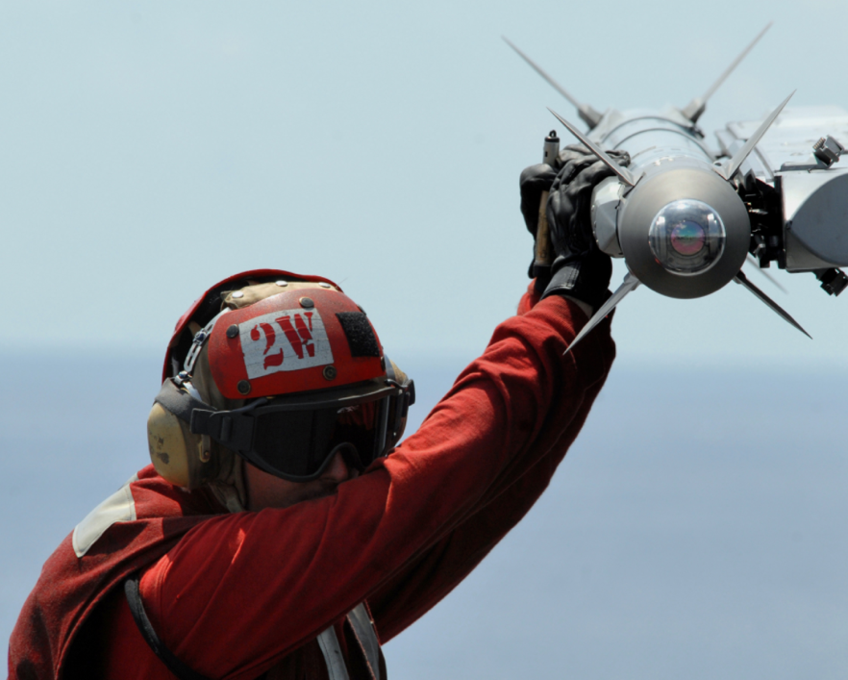
Project Description
The goal of this project is to improve upon a test fixture utilized by Raytheon.
The test fixture simulates flight conditions experienced by supersonic missiles.
Our intention is to design a universal test fixture that has quicker assembly.
Our Client is Chuck Vallance
formerly of Raytheon.
Client Deliverables
1)Parameters of Missile Parts
2)Test/Flight Conditions
3)CAD Model & Simulation
4)Scale Model
[1] Raytheon
Test Fixture for Flight Components ● Aziz Alzaid ● September 2018

Slide 3
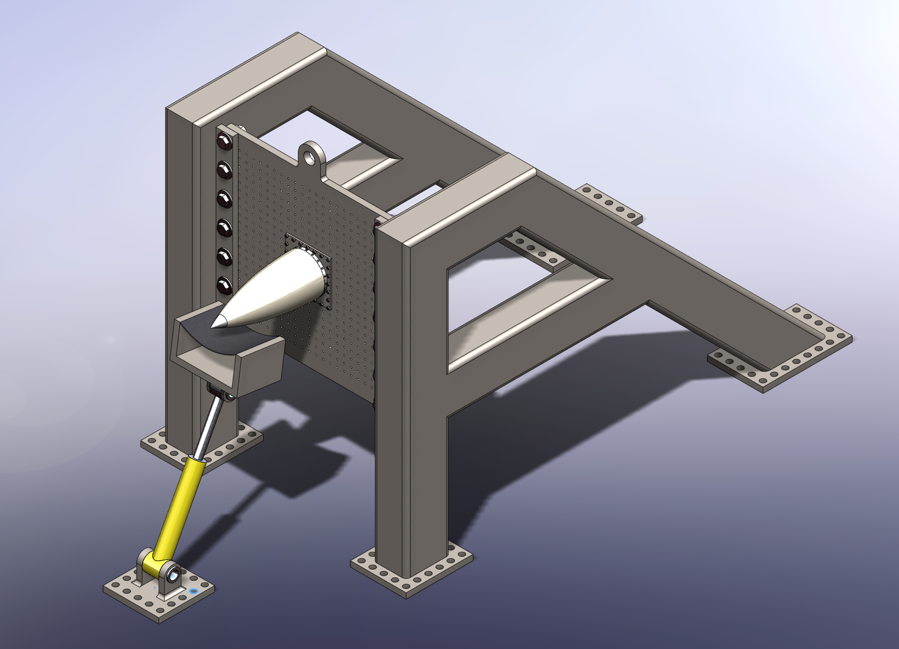
Design Description
Primary Structure Universal Plate
AMRAAM Radome
Mounting Ring
Mounting Plate
Loading Strap
Hydraulic Ram
* Heat Lamps Not Shown
Test Fixture for Flight Components ● Israel Sotelo ● September 2018

Slide 4
Design Functions
Transfer fixture from storage and assemble it
Set the sensors in missile component
Attach missile part to the test fixture
Apply mechanical and thermal loadings
Cool heat lamps
Get sensor readings from control room
Disassemble fixture and return to storage
Test Fixture for Flight Components ● Aziz Alzaid ● September 2018

Slide 5
Engineering Requirements
Engineering Requirement | Target Value | How We Predict That Our Design Meets It
Transports quickly from storage | 1 hr | Easy to transport using fork lift
Assembles quickly | 2 hrs | Minimal pieces required for assembly
Mounts to a standard bolt pattern | 6 inches | Met by design specifications – universal mounting plate
Applies and withstands extreme loads | 10⁶ in-lb | Verified through calculations – applied by hydraulic ram
Applies and withstands heat flux | 75 W/m² | Verified through calculations – applied by quartz lamps
Ability to test parts up to 3 feet long | 3 ft | Met by design dimensions
Safety Factor | 4 | Verified though calculations – robust design
Sensors read out to a different location | ohm | Met by design specifications
Load driven from an alternate location | Volt | Met by design specifications
Small storage space | 30 ft³ | Met by design dimensions – parts store flat
Test Fixture for Flight Components ● Shanna Lechelt ● September 2018
Notes:
The whole point of this semester’s work

Slide 6
Analysis Strategy
To validate our design, the following analyses will be completed:
Mechanical Loading Calculations
Thermal Loading Calculations
Heat Lamp Orientation
Box Beam Calculations (to decrease weight and size)
Adapter Plate and Floor Threaded Fastener Calculations
Power and Water Requirements
Assembly Time Study
Calculations will be completed by hand, ANSYS, and MATLAB.
Test Fixture for Flight Components ● Lexie Spotts ● September 2018

Slide 7
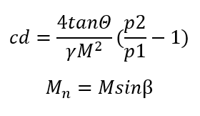
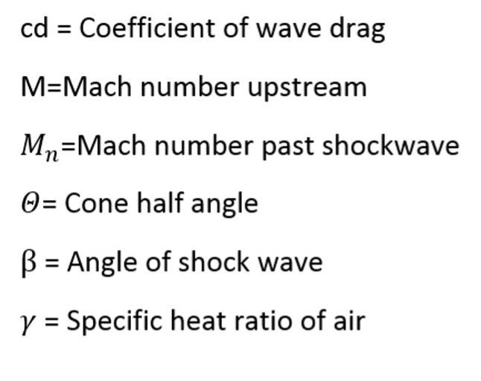
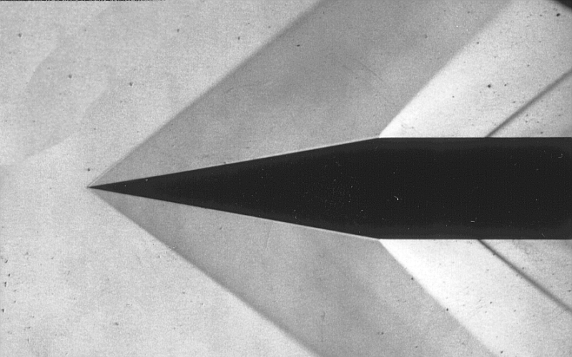
Analysis Thus Far - Mechanical Loading
Compressible Flow Analysis Part 2
Goals:
Determine pressure drop across oblique shock wave
Determine drag force create by oblique shock wave
Outputs
Inputs
Oblique Shock Waves
[2] J.D. Anderson, Jr., Fundamentals of Aerodynamics.
Test Fixture for Flight Components ● Israel Sotelo ● September 2018

Slide 8
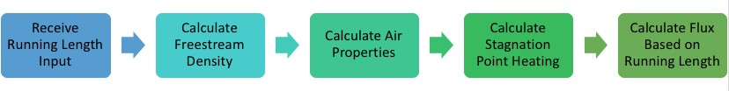
Analysis Thus Far - Thermal Loading
Simplified heat flux analysis was used to determine heating on the nose cone and along the radome
Inputs: freestream density, freestream velocity, nose cone radius
Output: Maximum heat flux – approx. 75 W/cm^2
The figure shows the steps in the analysis (performed in MATLAB)
10 quartz lamps will be utilized to replicate this heat flux
Test Fixture for Flight Components ● Lexie Spotts ● September 2018

Slide 9
Schedule
2nd Semester Tasks | Estimated Completion Date
Progress Presentation | September 17th, 2018
Hardware Review 1 | October 1st, 2018
Calculations / Design – 2nd Iteration | October 5th, 2018
Individual Analysis II | October 8th, 2018
Midpoint Report & Presentation, Hardware Review 2 | October 22nd, 2018
Final Product Testing Proof | November 12th, 2018
Final Presentation and Poster | November 26th, 2018
Final Report and CAD Package | December 3rd, 2018
Test Fixture for Flight Components ● Shanna Lechelt ● September 2018

Slide 10
Budget
Available Capstone funds: $800
Actual Expenses to Date: $25
Remaining Funds: $775
Anticipated Full-Scale Expenses: $9563.93 + Labor
Anticipated Model Expenses: $40 - 3D printed
# | Item | Unit Cost | Units | Total | Purchase Location
1 | 4-40 X ¼” FH | $3.75 | 20 | $75.00 | https://www.mcmaster.com/#93401a100/=1cgj2mz
2 | ¼-20 X 1 ¾” HH | $1.06 | 24 | $25.44 | https://www.mcmaster.com/#92245a548/=1cgkjhp
3 | ¼” Washer | $0.99 | 48 | $47.52 | https://www.mcmaster.com/#94191a100/=1cgl7bj
4 | ¼” Nut | $0.30 | 24 | $7.29 | https://www.mcmaster.com/#94191a100/=1cgl7bj
5 | 1-8 X 3 ½” HH | $5.50 | 75 | $412.50 | https://www.mcmaster.com/#92198a918/=1cgmm7w
6 | 1” Washer | $6.34 | 75 | $475.50 | https://www.mcmaster.com/#98019a530/=1cgmpf5
7 | 1” Nut | 1.29 | 14 | $18.06 | https://www.mcmaster.com/#90499a847/=1cgmqis
8 | 8x6x3/16” A550 Box Tube | $42.30 | 25 | $1057.50 | https://www.metalsdepot.com/steel-products/steel-rectangle-tube
9 | Quartz Heat Lamps | $679.00 | 10 | $6790.00 | http://www.infratechheatersusa.com/lighting/
10 | Hydraulic Ram | $655.12 | 1 | $655.12 | http://www.tooldiscounter.com/
 | Total |  |  | $9563.93
Test Fixture for Flight Components ● Shanna Lechelt ● September 2018

Slide 11

Conclusion
In the upcoming months, the team will continue to validate this design through targeted analyses. It is our goal to reduce the materials utilized within the design while maintaining a factor of safety of 4. The reduction of materials will decrease assembly time and cost.
References
[1] Raytheon.com, ‘Mission, Global Defense’, 2017. [Online]. Available: https://www.raytheon.com/capabilities/missiledefense. [Accessed 2/7/2018]
[2] J.D. Anderson, Jr., Fundamentals of Aerodynamics. New York, NY: Mc Graw Hill, 2011. pp. 555-776, 1053-1057

