Slide 1

Test Fixture for Flight Components
Shanna Lechelt – Budget Liaison
Israel Sotelo – Client Contact
Alexandra Spotts – Project Manager
Abdulaziz Alzaid – Website Developer
Capstone – Spring 2018

Slide 2
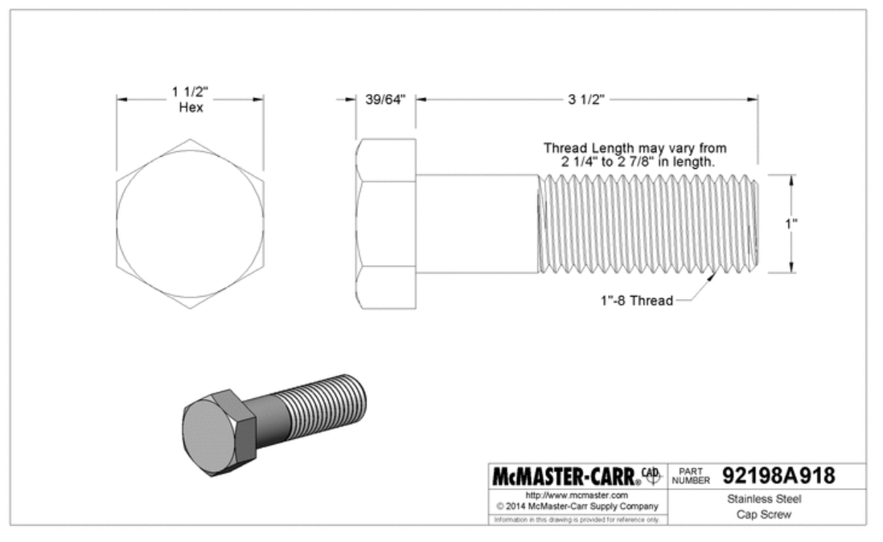
Project Description
The goal of this project is to design a test fixture which improves upon Raytheon’s existing fixture.
The new fixture will
Simulate the conditions of supersonic flight
Have a quicker assembly time
Have the ability to test a wide range of components
Test Fixture for Flight Components ● Aziz Alzaid ● 19 April 2018

Slide 3
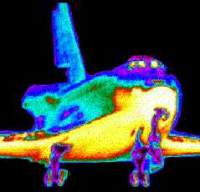
Heat Flux Calculations
Simplified heat flux analysis used to determine heating on the nose cone and along the radome
Inputs: freestream density, freestream velocity, nose cone radius
Output: Maximum heat flux – approx. 200 W/cm^2
8 – 10 quartz lamps will be utilized to replicate this heat flux
Test Fixture for Flight Components ● Lexie Spotts ● 19 April 2018

Slide 4
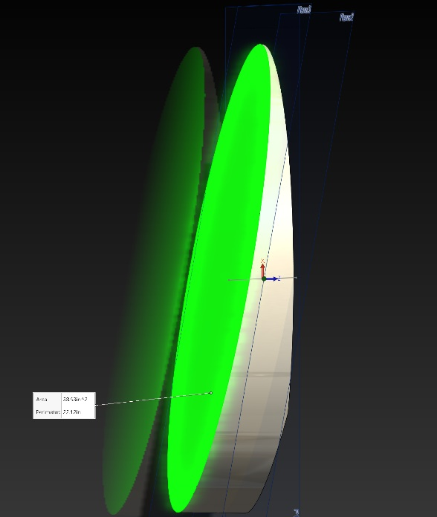
Loading Calculations
Compressible flow stagnation pressure model used to determine forces on radome
Inputs: atmospheric pressure at altitude, velocity, angle of attack & cross sectional area
Output: stagnation pressure - 5,500 Pound of force
This force will be replicated in the test fixture
Test Fixture for Flight Components ● Israel Sotelo● 19 April 2018

Slide 5
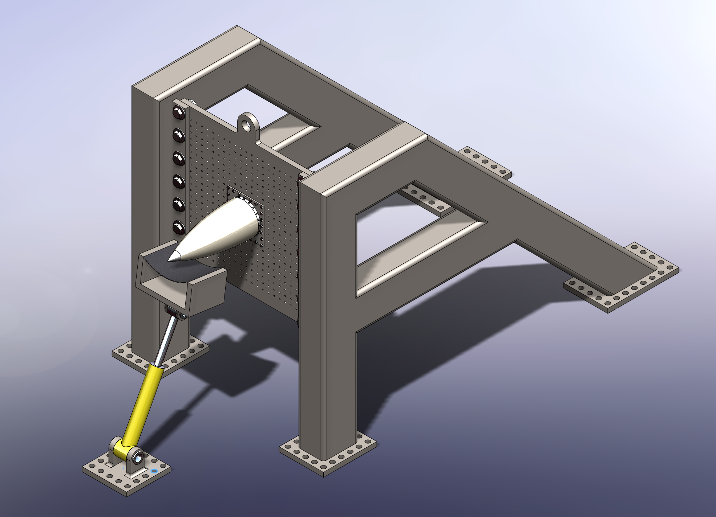
Design Description
Primary Structure
Universal Plate
AMRAAM Radome
Mounting Ring
Mounting Plate
Loading Strap
Hydraulic Ram
* Heat Lamps Not Shown
Test Fixture for Flight Components ● Israel Sotelo ● 19 April 2018

Slide 6
Design Requirements
Customer Requirement | How Our Design Meets It
Simulates supersonic and hypersonic conditions | Calculations validate that the fixture applies appropriate loading
Tests a variety of parts | Universal mounting plate
Applies varying thermal and mechanical loading | Adjustable ram and heat lamps
Measures loads, strain, and temperatures | Sensors located inside/outside radome
Quick Assembly | 4 parts, threaded fasteners
Minimal Labor for Setup | Fewer parts = less labor
Easily stored | Parts store flat
Portable | Lifting eyelet and strap accessible
Safe | Cooling mechanisms, heat shields, external operation
Test Fixture for Flight Components ● Lexie Spotts ● 19 April 2018

Slide 7
Schedule
Schedule
2nd Semester Tasks | Estimated Completion Date
Progress Presentation | September 10th, 2018
Hardware Review 1 | September 24th, 2018
Calculations / Design – 2nd Iteration | October 15th, 2018
Midpoint Report & Presentation, Hardware Review 2 | October 15th, 2018
Individual Analysis 2 | October 22nd, 2018
Calculations / Design – 3rd Iteration (if required) | November 5th, 2018
Final Presentation and Poster | November 26th, 2018
Final Report and CAD Package | December 5th, 2018
Remaining Weeks of Current Semester:
Refine analysis calculations
3D model finalization
Final Proposal
Test Fixture for Flight Components ● Shanna Lechelt ● 19 April 2018

Slide 8
Budget
Available Capstone funds: $800
Actual Expenses to Date: $0
Remaining Funds: $800
Anticipated Full-Scale Expenses: $9563.93 + Labor
Anticipated Model Expenses: $40 - 3D printed
# | Item | Unit Cost | Units | Total | Purchase Location
1 | 4-40 X ¼” FH | $3.75 | 20 | $75.00 | https://www.mcmaster.com/#93401a100/=1cgj2mz
2 | ¼-20 X 1 ¾” HH | $1.06 | 24 | $25.44 | https://www.mcmaster.com/#92245a548/=1cgkjhp
3 | ¼” Washer | $0.99 | 48 | $47.52 | https://www.mcmaster.com/#94191a100/=1cgl7bj
4 | ¼” Nut | $0.30 | 24 | $7.29 | https://www.mcmaster.com/#94191a100/=1cgl7bj
5 | 1-8 X 3 ½” HH | $5.50 | 75 | $412.50 | https://www.mcmaster.com/#92198a918/=1cgmm7w
6 | 1” Washer | $6.34 | 75 | $475.50 | https://www.mcmaster.com/#98019a530/=1cgmpf5
7 | 1” Nut | 1.29 | 14 | $18.06 | https://www.mcmaster.com/#90499a847/=1cgmqis
8 | 8x6x3/16” A550 Box Tube | $42.30 | 25 | $1057.50 | https://www.metalsdepot.com/steel-products/steel-rectangle-tube
9 | Quartz Heat Lamps | $679.00 | 10 | $6790.00 | http://www.infratechheatersusa.com/lighting/
10 | Hydraulic Ram | $655.12 | 1 | $655.12 | http://www.tooldiscounter.com/
 | Total |  |  | $9563.93
Test Fixture for Flight Components ● Shanna Lechelt ● 19 April 2018

Slide 9
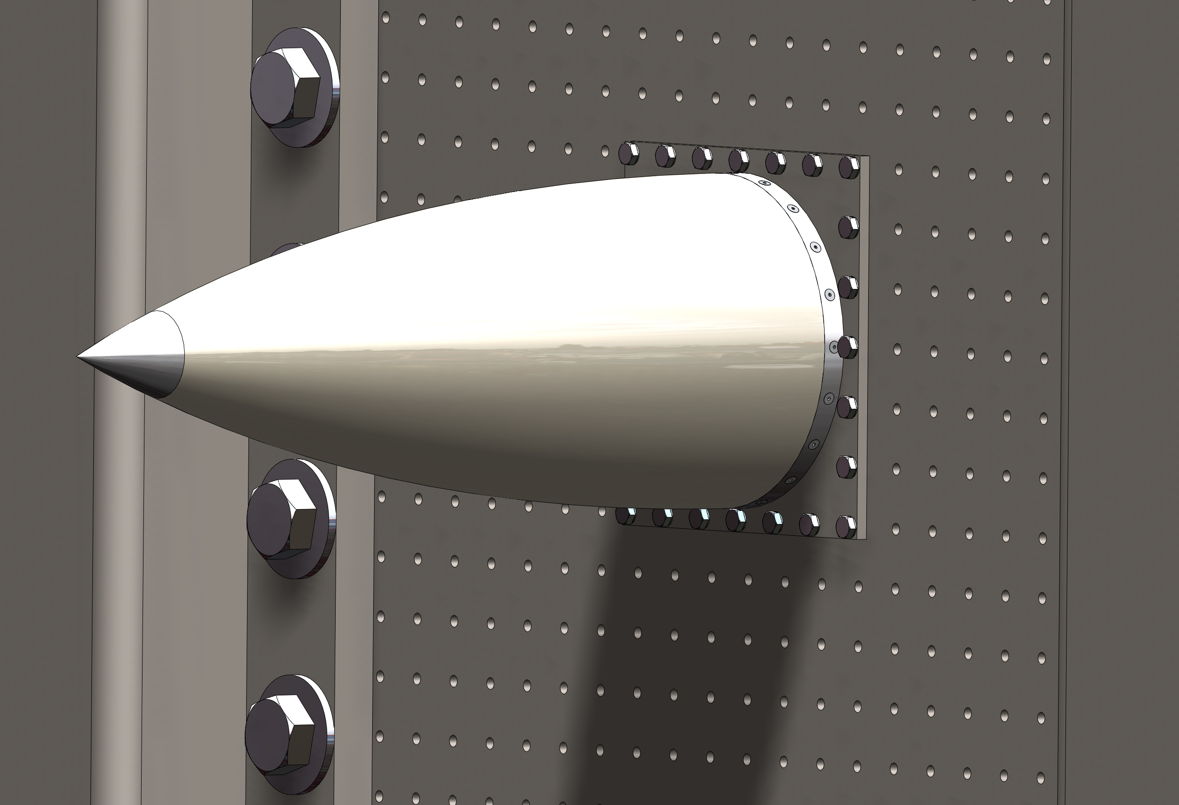
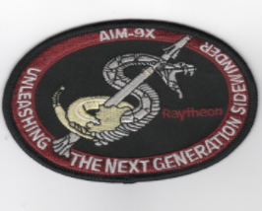
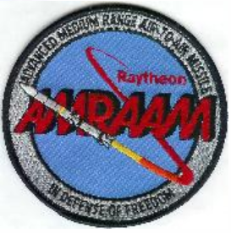
Conclusion
As this Project progresses throughout the next semester we intend to continue to refine our calculations and simulations. With several iterations of the design process we hope to find an adequate means to improve this aerospace test fixture.
7
Test Fixture for Flight Components ● Shanna Lechelt ● 19 April 2018

Slide 10

Questions ?
References
[1] Raytheon.com, ‘Mission, Golbal Defense’, 2017. [Online]. Available: https://www.raytheon.com/capabilities/missiledefense. [Accessed 2/7/2018]
[2] Airforce.com, ‘MiG-35 Fulcrum – F Fighter Multirole fighter’, 2007. [Online]. Available: https://www.airforce-technology.com/projects/mig35/.
[Accessed 2/24/2018]

