Slide 1

Test Fixture for Flight Components
Shanna Lechelt
Israel Sotelo
Alexandra Spotts
Abdulaziz Alzaid
Capstone – Spring 2018

Slide 2
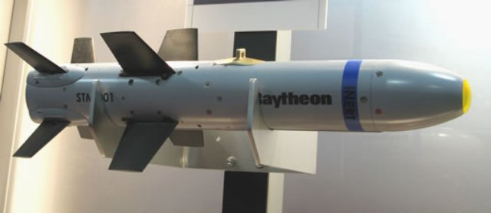
Project Description
The goal of this project is to improve upon a test fixture utilized by Raytheon.
The test fixture simulates flight conditions experienced by supersonic missiles.
Our intention is to design a test fixture which is more diverse and has quicker assembly.
Our Client is Chuck Vallance
formerly of Raytheon.
Client Deliverables
1)Parameters of Missile Parts
2)Test/Flight Conditions
3)CAD Model & Simulation
4)Scale Model
[1] Raytheon
1
Test Fixture for Flight Components ● Lexie Spots ● 8 Feb 2018

Slide 3
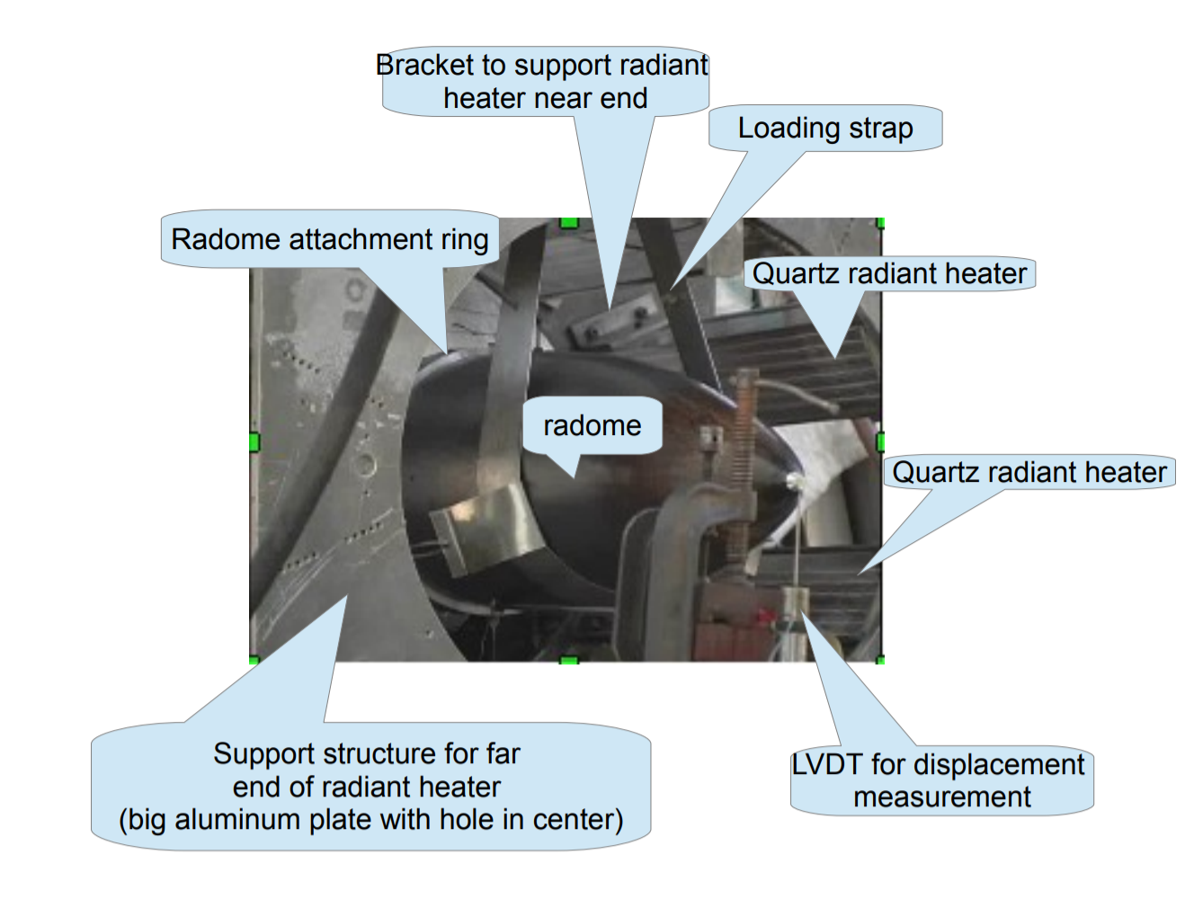

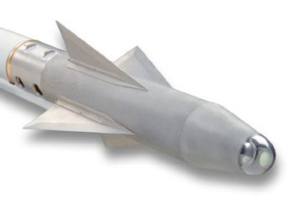
Background & Benchmarking
Raytheon’s test fixture takes several days to transport from storage and assemble.
Testing a variety of parts is challenging for many test fixtures.
We are limiting the scope of this project to radomes and leading edges.
Raytheon’s Radome Test Fixture
AMRAAM Radome
Leading Edge
Sidewinder Radome
[1] Raytheon
Test Fixture for Flight Components ● Aziz Alzaid ● 8 Feb 2018
2

Slide 4

Background & Benchmarking
[2] Gulfstream Aerospace
3
Test Fixture for Flight Components ● Aziz Alzaid ● 8 Feb 2018

Slide 5
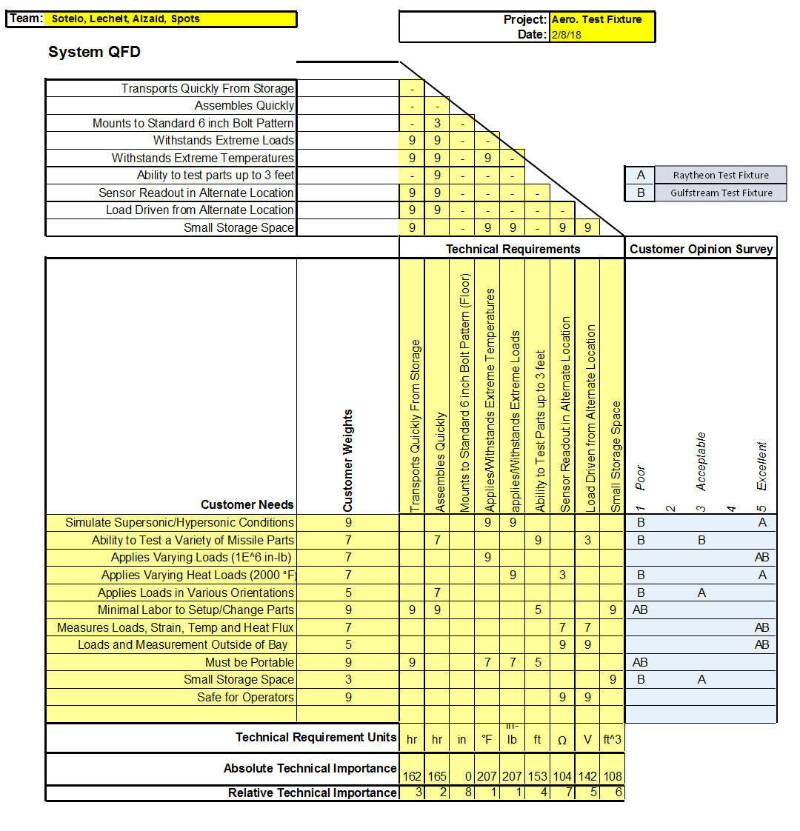
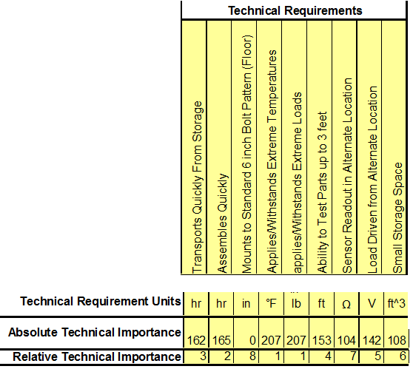
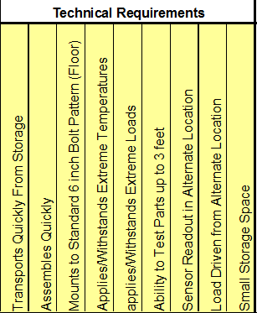
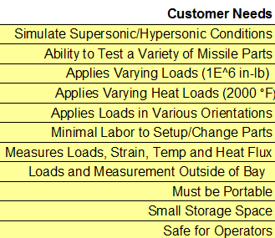
Customer and Engineering Requirements
4
Test Fixture for Flight Components ● Israel Sotelo ● 8 Feb 2018

Slide 6
Schedule
Schedule
First Semester Key Tasks / Deliverables | Estimated Date of Completion*
Select Specific Components to Test | February 11th – February 17th
Research Materials, Missiles & Relevant Equations | February 25th – March 3rd
Determine Environmental Loading & Flight Conditions | March 4th – March 10th
Establish Assumptions (Will Require Periodic Revision) | March 11th – March 17th
Compute Preliminary Calculations (Back-of-the-Envelope) | April 1st – April 7th
Concept Generation & Evaluation | April 15th – April 21st
Produce Preliminary Design Model Based on Preliminary Calculations | April 22nd – 28th
Second Semester Key Tasks / Deliverables
In-depth Hypersonic, Compressible Flow Calculations
Determine Final Specifications
Create Bill of Materials
Generate a SolidWorks Model & Run Test Simulations
Produce Scaled Model
Currently on schedule for first semester
*Completion dates are tentative and subject to change
Test Fixture for Flight Components ● Shanna Lechelt ● 8 Feb 2018
5

Slide 7
Schedule
Schedule Continued
Team Member | Project Roles and Resposibilities
Lexie | Project Manager / Meeting Minutes
Aziz | Secretary / Meeting Agendas
Israel | Client Contact / Website Development
Shanna | Budget Liaison / Document Revision
The nature of our project calls for modified deliverables and deadlines
All team members will contribute to almost all areas of the project
List of assumptions, specifications, and design related decisions are made as a team
Test Fixture for Flight Components ● Shanna Lechelt ● 8 Feb 2018
5

Slide 8
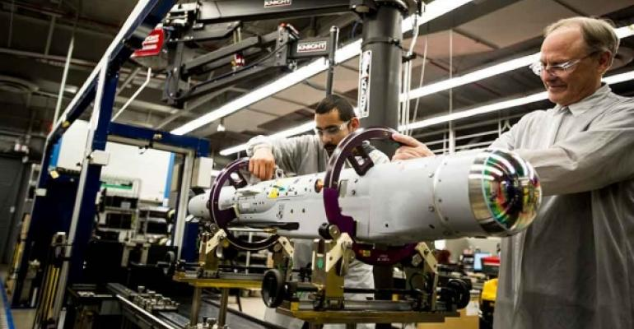
Budget
Available funds: $800 (roughly $200 each)
Anticipated total expense: $200
Mostly 3D printed, small scale model
Existing test fixtures: $100,000 or greater
A full-sized prototype of our design would cost roughly the same amount as existing fixtures
[1] Raytheon
6
Test Fixture for Flight Components ● Shanna Lechelt ● 8 Feb 2018

Slide 9
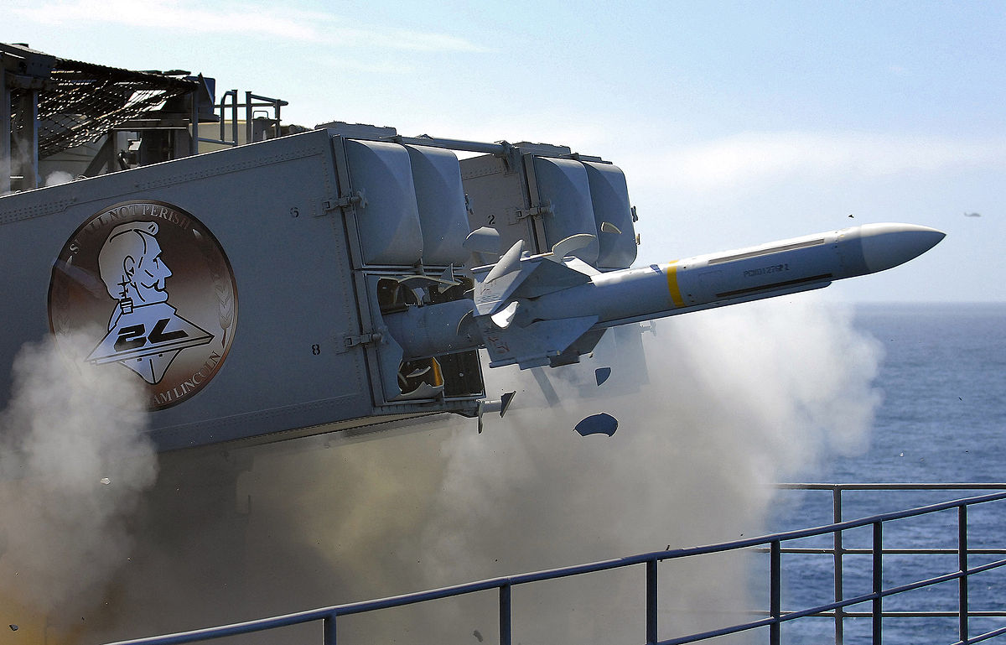
Conclusion
This project is mostly analytical, however, designing a test fixture which satisfies all of our clients needs will be extremely challenging.
It is our intention to utilize all the tools we have learned thus far to decompose this problem and improve on Raytheon’s existing design.
[1] Raytheon
7
Test Fixture for Flight Components ● Israel Sotelo ● 8 Feb 2018

Slide 10

Questions ?
References
[1] Raytheon.com, ‘Mission, Golbal Defense’, 2017. [Online]. Available: https://www.raytheon.com/capabilities/missiledefense. [Accessed 2/7/2018]
[2] Gulfstream.com, ‘Ultimate Load Test 1’, 2016. [Online]. Available: https://www.youtube.com/watch?v=UGFZ7OWlNpo . [Accessed 2/7/2018
8

