Slide 1
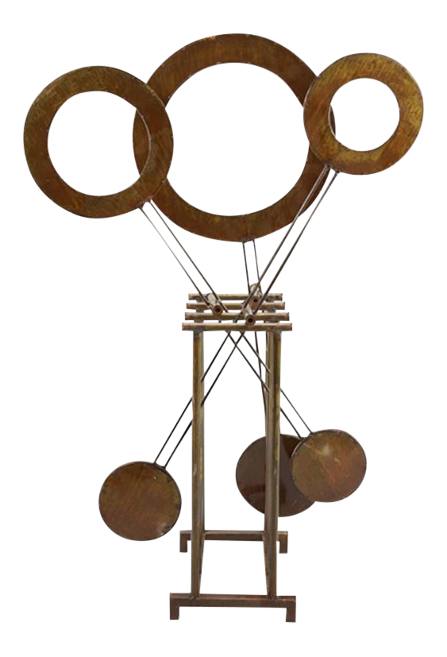
KINETIC SCULPTURE
Project Manager : Mahmoud Shaban
Documents Manager : Abdulaziz Hussain
Client Contact: Ahmad Altheyaib
Web Designer: Ahmad Alharbi
Budget Manager: Mishary Alhooli

Slide 2
Introduction
Project aim is to make a Kinetic Sculpture
Sculpture
An artificial man-made structure for any living or non-living thing
Kinetic
Any item in motion or moving
Kinetic Sculpture
An artificial structure which shows movement

Slide 3
Description
Team is working on Kinetic Sculpture with aim to show some interest towards the Mechanical Engineering Department
To provide physical example of Mechanical Engineering Principles
Using the Fun and Entertainment for interactive display
Its more like making a display item which can show some movement either some of its parts moves or it moves fully

Slide 4
Client and Sponsor
Client
Dr. Sarah Oman
Lecturer, Northern Arizona University
Capstone coordinator, Mechanical Engineering professor
Sponsor By
Department of Mechanical Engineering, NAU
Project is important to show the Mechanical Engineering Principles and illustrate the Engineering Building and represent the ME department in a positive and marketable way to inspire the people towards engineering .

Slide 5
Background
Initial Thoughts:
Intellectual Design
Interlocking Gear System
Torque motor

Slide 6
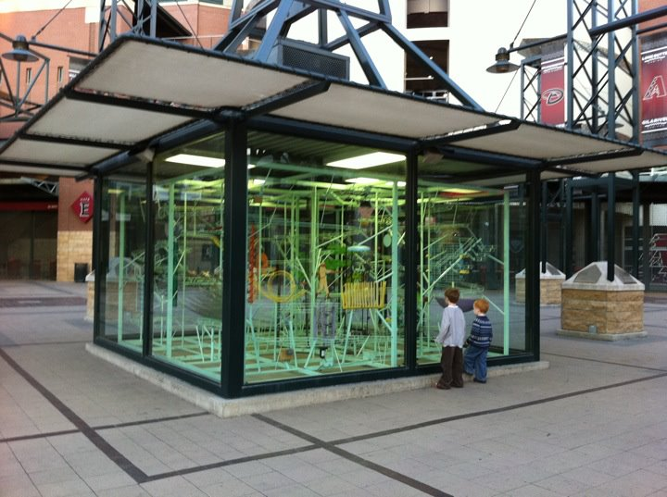
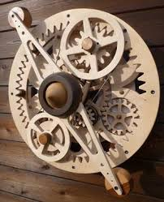
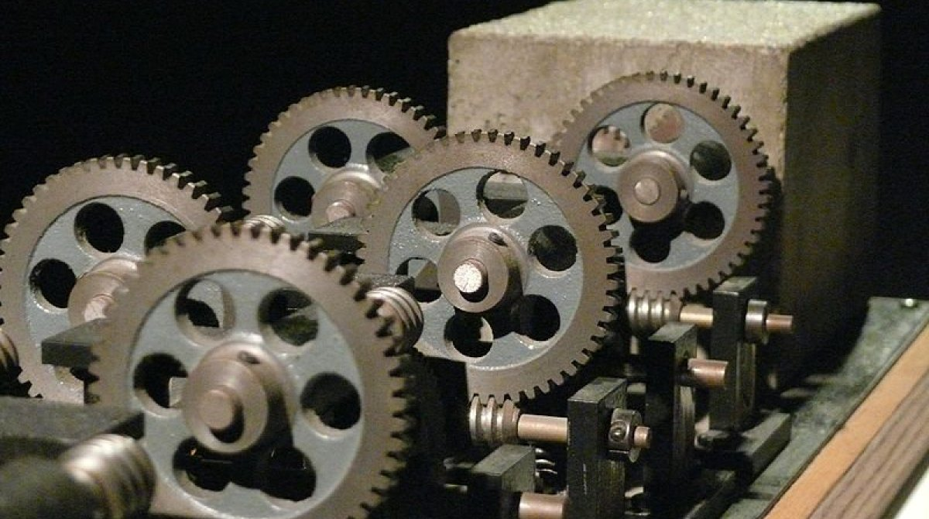
Benchmarking
Design inspirations
Chase Field Kinetic Sculpture [1]
Tom Brodman [2]
Alex Hamill [3]
Arthur Ganson [4]
Alan Rath [5]
[1]
[3]
[5]

Slide 7
Design Requirements
Create Kinetic Sculpture
For Engineering Building at NAU
Physical example of Mechanical Engineering
Fun and Entertainment
Robust System
Room to Room movability
At-least three Engineering Principles
Present to ME department
Positive and Inspirational

Slide 8
Customer Requirements
Based on the design requirements that we have proposed with our client. Our client decided that our customer needs would be:
Customer Requirements
Fits into the Door
Two person can carry
Durable
Entertaining
Robust
Interactive
Portable

Slide 9
Engineering Requirements
All the technical requirements abstract from customer requirements are Engineering Requirements
Movability means easy to carry
Easy to carry create light weight requirement and 50 lb. is easy to carry by two persons
Room to Room movement
Volume should be small to move from doors create volume requirement
Kinetic Sculpture
Motor and other requirements generated from motion

Slide 10
Engineering Requirements
Engineering Requirements | Targets
Light Weight | 50 lb.
Volume | 4 x 4 x 5 feet^3
Gear System | 5 gears
Torque | Up to 2.5 Nm

Slide 11
House of Quality (QFD)
Customer Requirements and Engineering Requirements relates to each other
Our matrix includes CR’s on left and ER’s on top
Our customer requirements taken from our client (Dr. Sarah Oman) compare with each engineering requirement and assign the value according to the importance
Our QFD represent our initial design
Absolute Raw Score calculates using the summation of (Weightage*Assigned Value)

Slide 12
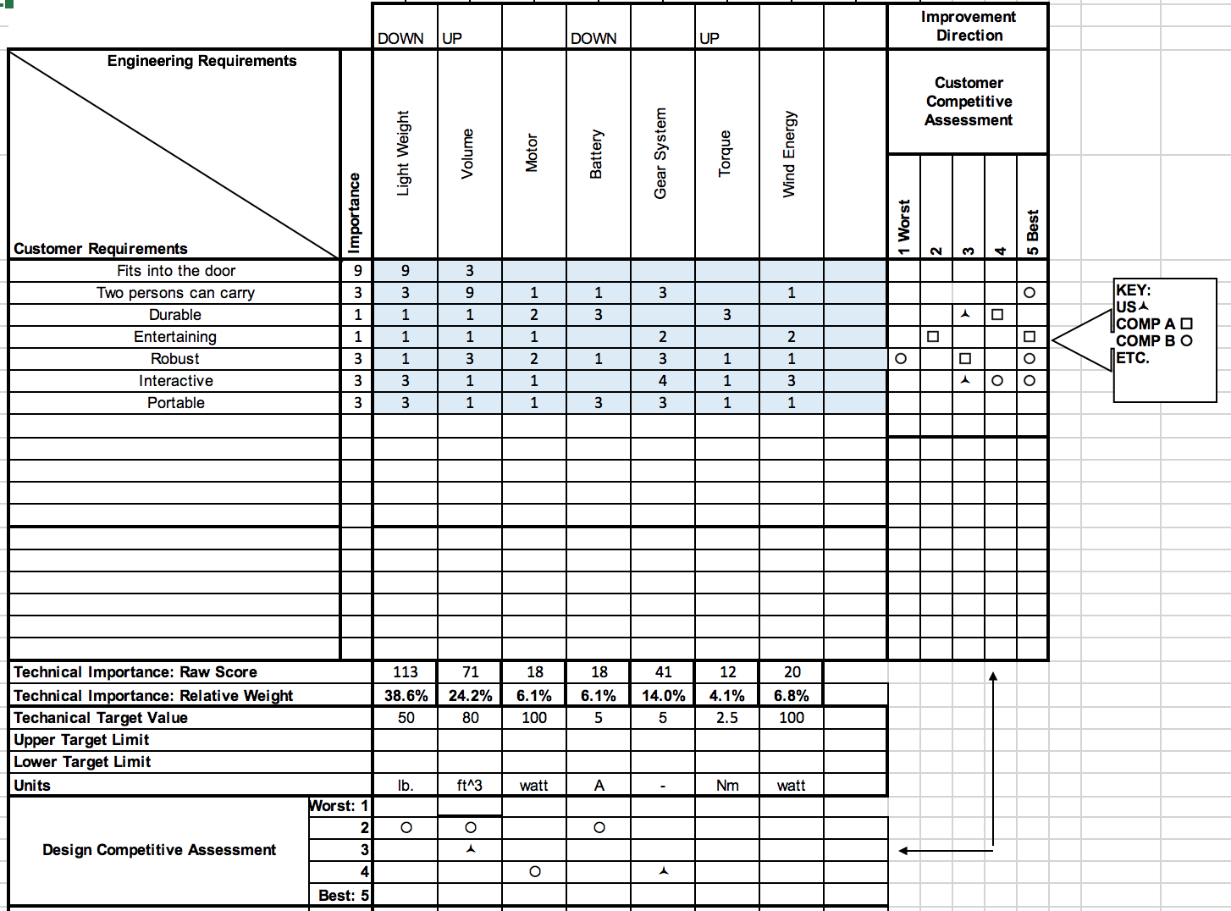
QFD

Slide 13
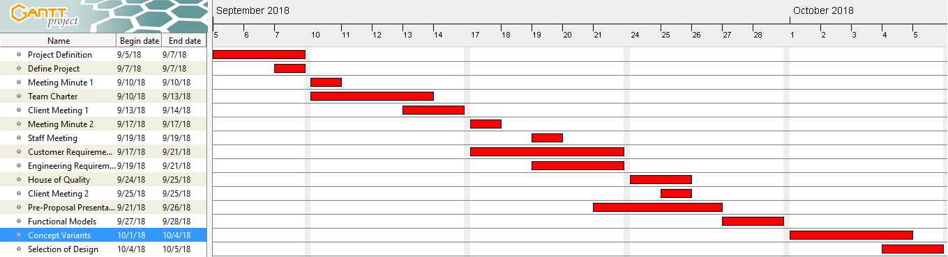
Gantt Chart - Schedule
Gantt Chart
Work Division

Slide 14
Budget
Budget Description | Price
Total Budget | $850
Anticipated Expenses | $550
Actual Expenses | $0
Remaining Budget | $300

Slide 15
Conclusion
Conclusion
Clients meetings have done to understand the project description
Team is working on the project details of Kinetic Sculpture
Benchmarking has done to find different similar projects
CR’s and ER’s have developed along with the QFD
Future Work
Functional models will develop
Concept variations will generate
Final Design will select

Slide 16
References
[1] k8librarian, “Chase Field Kinetic Ball Sculpture,” K8 Librarian, 20-Jan-2012. [Online]. Available: https://k8librarian.wordpress.com/2012/01/17/chase-field-kinetic-ball-sculpture/. [Accessed: 26-Sep-2018].
[2] “Tom Boardman,” Engineered Sculptures. [Online]. Available: http://www.engineeredsculptures.com/tomboardman/. [Accessed: 26-Sep-2018].
[3] Google Search. [Online]. Available: https://www.google.com/search?q=Alex hamill kinetic&biw=930&bih=612&tbm=isch&source=iu&ictx=1&fir=MPXptk8_gRAWbM:,iftQGuM0-SXC8M,_&usg=AI4_-kQOiTtFdd103e2RQfflvxYSxrb-hw&sa=X&ved=2ahUKEwjz_5G7gNrdAhWlMX0KHfl-CcwQ9QEwBXoECAQQDA#imgrc=MPXptk8_gRAWbM: [Accessed: 27-Sep-2018].[4] “Arthur Ganson,” Wikipedia, 05-Sep-2018. [Online]. Available: https://en.wikipedia.org/wiki/Arthur_Ganson. [Accessed: 26-Sep-2018].
[5] “Alan Rath,” Wikipedia, 13-Apr-2018. [Online]. Available: https://en.wikipedia.org/wiki/Alan_Rath. [Accessed: 26-Sep-2018].

Slide 17
Any Questions?

