Slide 1
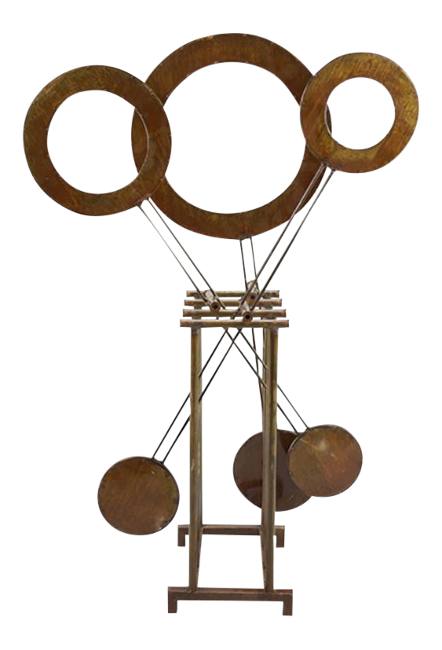
KINETIC SCULPTURE
10/24/2018
Ahmad Alharbi
Mishary Alhooli
Ahmad Altheyaib
Abdulaziz Hussain
Mahmoud Shaban

Slide 2
INTRODUCTION
Project aim is to make a Kinetic Sculpture
Sculpture
An artificial man-made structure for any living or non-living thing
Kinetic
Any item in motion or moving
Kinetic Sculpture
An artificial structure which shows movement

Slide 3
DESCRIPTION
Team is aiming to get the kinetic sculpture working efficiently into putting down the calculations required
To provide physical example of mechanical engineering principles
Making a display item which can show some movement either some of its parts moves or it moves fully
We are demonstrating physical principles towards the Engineering Department
We seperated the calculations into:
Springs
Fatigue
Torque
Stability
More details on these calculations will be on the report

Slide 4
CLIENT AND SPONSOR
Client
Dr. Sarah Oman
Lecturer, Northern Arizona University
Capstone Coordinator, Mechanical Engineering Professor
Sponsor
Mechanical Engineering Department, NAU
Project is important to show the Mechanical Engineering principles and illustrate the engineering building and represent the ME Department in a positive and marketable way.

Slide 5
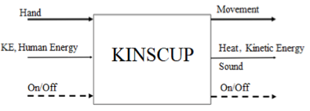
BLACK BOX MODEL
Black Box Model WithThree I/O’S
Material
Energy
Signal

Slide 6
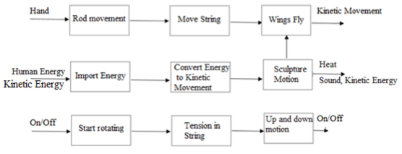
FUNCTIONAL MODEL

Slide 7
CONCEPT GENERATION FROM FUNCTIONAL DECOMPOSITION
Inputs and output have defined by Black Box Model
Functional model have defined all the steps to perform inside the project
Each design has generated by taking the defined inputs and defined the process
Design has generated and check with the models to make sure its working

Slide 8
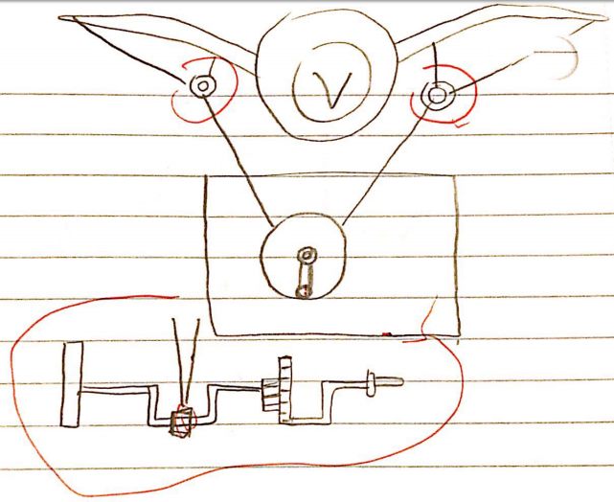
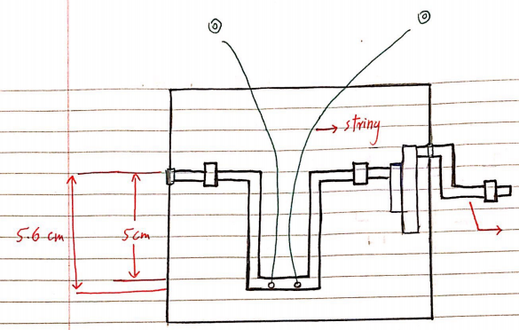
DESIGN CONSIDERED
Bird Sculpture
Kinetic motion of wings to show flying process
Rotational movement of crankshaft
Pros
Easy to operate
Easy to move from one location to another
Cons
Restrict movement of wings

Slide 9
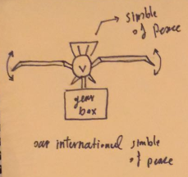
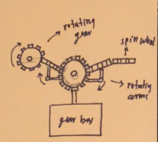
DESIGN CONSIDERED
International peace symbol
Movement of wings
Difficult to balance
Large extended body
Rotating gears system
Interlocked gears
Interlocking can malfunction in time

Slide 10
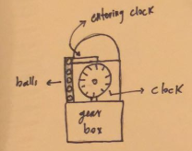
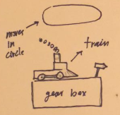
DESIGN CONSIDERED
Rolling Balls Clock
Rolling Balls
Minimum interactivity
Train message
Display message
Minimum interactivty

Slide 11
DECISION MATRIX
Decision Matrix | Fits into the door | Two can Lift | Durable | Entertaining | Robust | Interactive | Portable | Total
Weight | 7 | 6 | 5 | 4 | 3 | 2 | 1
Bird Sculpture | 6x7=42 | 6x6=36 | 4x5=20 | 6x4=24 | 6x3=18 | 4x2=12 | 5x1=5 | 157
Rolling Ball Clock | 4x7=28 | 3x6=18 | 2x5=10 | 4x4=16 | 3x3=9 | 2x2=4 | 2x1=2 | 87
Train Message Sculpture | 2x7=14 | 3x6=18 | 3x5=15 | 3x4=12 | 2x3=6 | 2x2=4 | 3x1=3 | 72

Slide 12
DESIGN SELECTED
Top three designs from pugh chart
Bird Sculpture
Rolling Ball Clock Sculpture
Train Message Sculpture
Pugh Chart presented in Appendix A

Slide 13
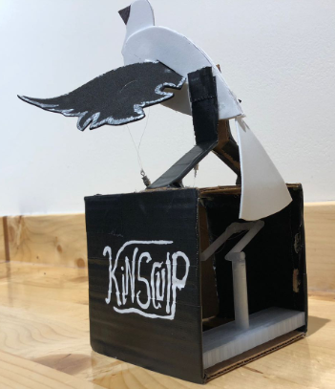
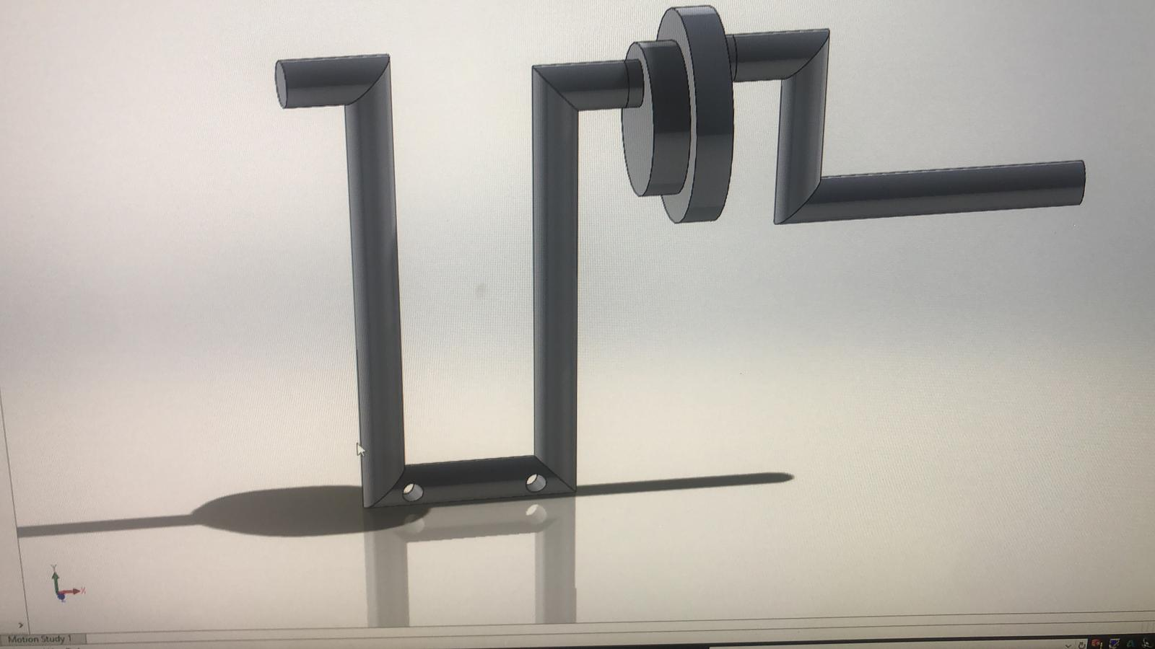
DESIGN SELECTED
Bird Sculpture has been selected as our final design
It followed all the customer requirements
This sculpture can fits into the door easily
Two person can carry bird sculpture
It will be durable because of selected materials
It Is entertaining
Bird sculpture is robust
It is interactive
It is portable

Slide 14
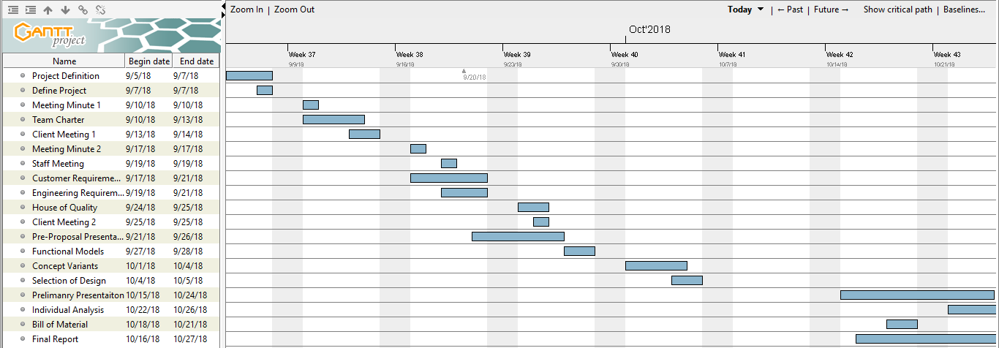
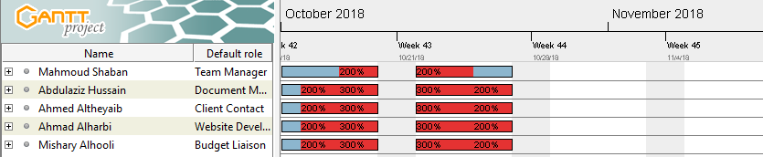
GANTT CHART

Slide 15
BUDGET
Budget Description | Price
Total Budget | $1300
Anticipated Expenses | $1280
Actual Expenses | $20
Remaining Budget | $1280

Slide 16
CONCLUSION
Conclusion
Clients meetings have been done to understand the project description
Team is working on improving the Project by adding more details and ME principles.
Cr’s and Er’s have been developed along with the QFD
Final design has selected using Pugh Chart and decision matrix
The design needs improvements ( dimensions and rotation ) based on current sculpture.
Gantt has been updated.
Currently ahead of schedule.
Future Work
Improvements to current design.
Bill of materials
Technical analysis
Final report

Slide 17
REFERENCES
[1] fine monument, available [online], https://www.google.com.pk/url?sa=i&rct=j&q=&esrc=s&source
[2] d. able, “dulut kindetic sculpture”, available [online], https://www.pinterest.com/pin/401242648032617772/
[3] aedas, “building sculpture”, available [online], https://www.pinterest.com/pin/401242648027205631/
[4] l. bridge, “bridge”, available [online], https://www.pinterest.com/pin/401242648032617707/

Slide 18
APPENDIX A – PUGH CHART
KINETIC SCULPTURE | Weight | Catapult Sculpture | Bird Sculpture | KINETIC SCULPTURE DATUM | Rotating Gears | Clock Rolling | Train Message | International Symbol | Football Sculpture | Walking Robot | Balls Rolling
Fits into the Door | 7 | + | + | D | + | - | - | - | + | + | -
Two can lift | 6 |  | + | D | - | + |  | + | + | + | +
Durable | 5 | - | + | D | + | - | - |  | + | + | -
Entertaining | 4 | + | + | D | + | - |  | - | - | +
Robust | 3 | + | + | D | S | - | + | - | + | +
Interactive | 2 | + | + | D | - | + | - | + | - |  | +
Portable | 1 | - | + | D | + | - | - | - | + | - | -
Pluses |  | 4 | 7 | - | 4 | 2 | 1 | 2 | 5 | 5 | 2
Minus |  | 2 | 0 | - | 2 | 5 | 4 | 4 | 2 | 1 | 3
Total |  | 2 | 7 | - | 2 | -3 | -3 | -2 | 3 | 4 | -1

Slide 19
Questions ?

