Slide 1
Biomimetic Fish
The Aquamen
Abdulrahman Alnebari
Shuaib Alshuaib
James Brooks
Nathan Servis
Concept Generation and Evaluation

Slide 2
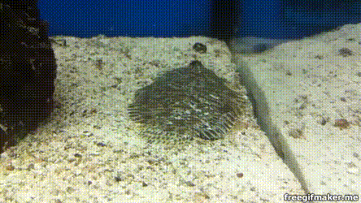
Project Description: Client & Goals
James
Dr. Alice C. Gibb
Gibb Lab, NAU, Wettaw Building
Utilize high frame rate cameras to analyze motion in fish
Electromyography to analyze the sequence which muscle cells activate
Client Need
Build Test equipment which can mimic the reactions needed to force water into sand-- a process called fluidization.
Test Equipment Goals:
Best shapes for rapid burial
Which substrates are too heavy for body size
Fig 1 Flounder burying itself in sand [1]
James Brooks

Slide 3
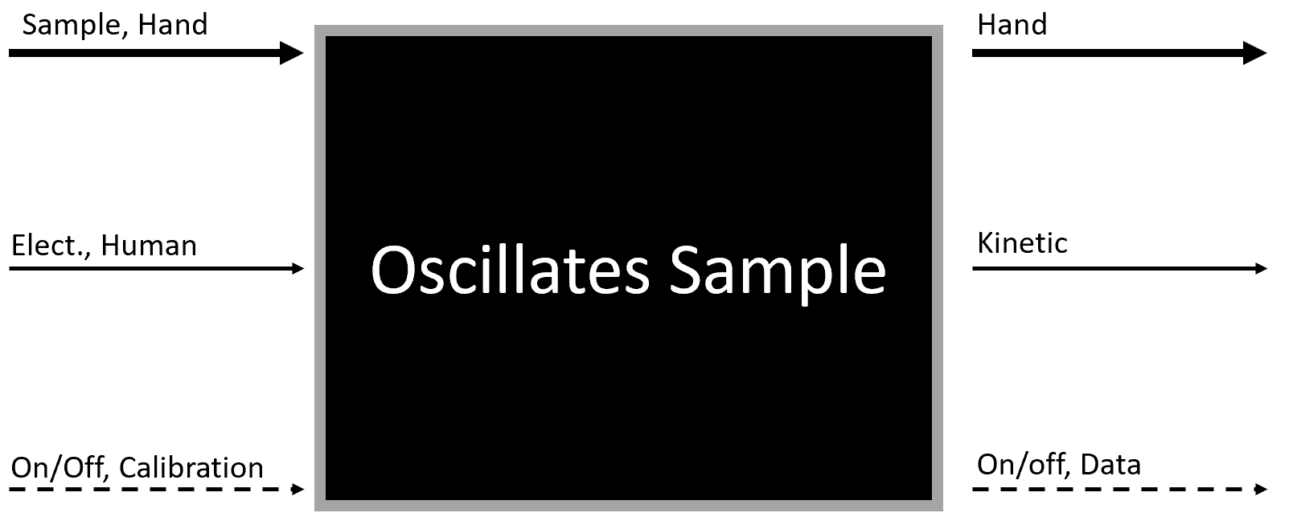
Black Box Model
James
Inputs
Material
Energy
Signal
Outputs
Material
Energy
Signal

Slide 4
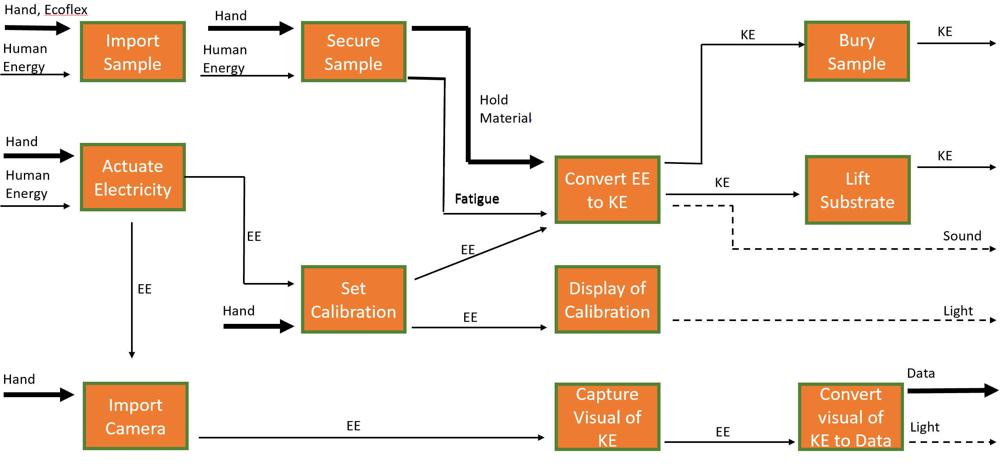
Functional Model
James
Steps
Import and Actuate
Secure and Calibrate
Oscillate and Capture
Lift Substrate, Bury Sample, Convert visual of KE to Data

Slide 5
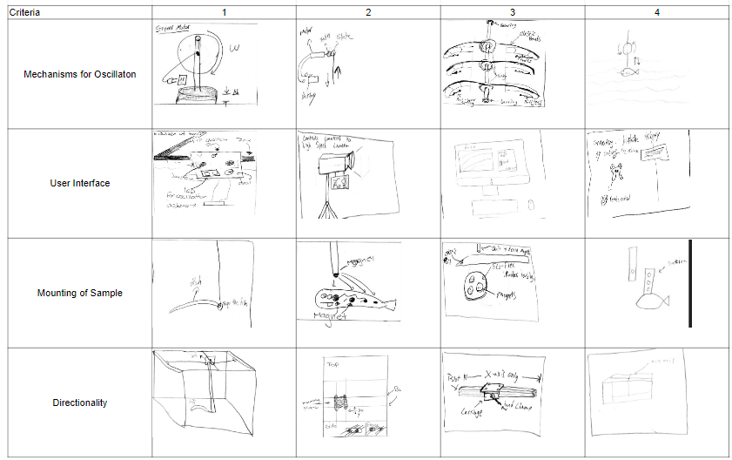
Initial Concept Generation: 3-5-1 method
Nathan

Slide 6
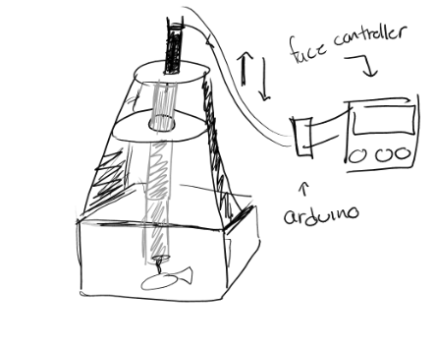
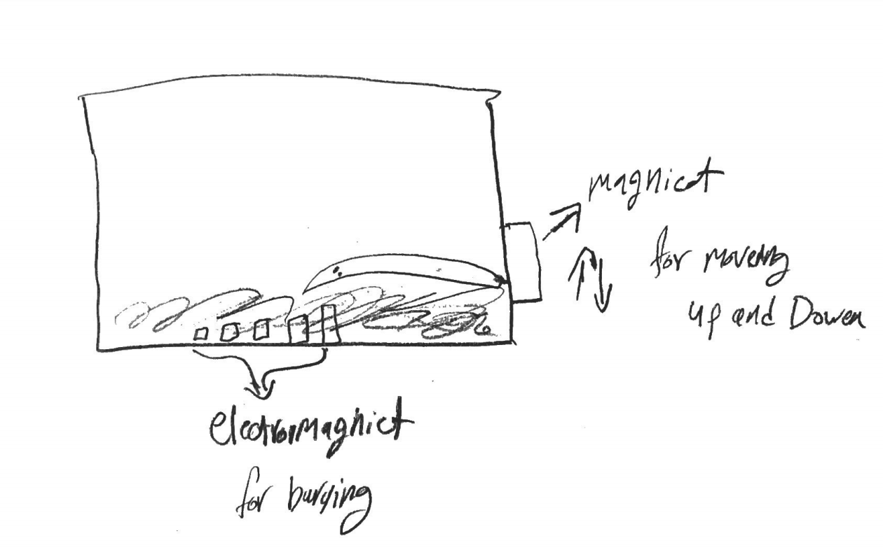
Motor Designs
Nathan
Uses linear motor and a large mount to actuate.
Switches polarity very fast to actuate up and down.

Slide 7
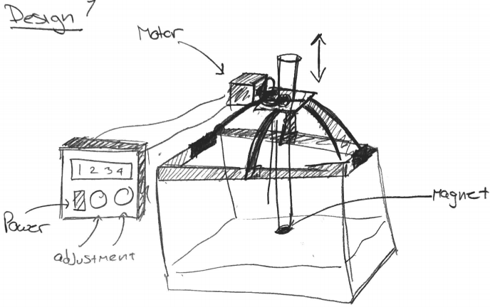
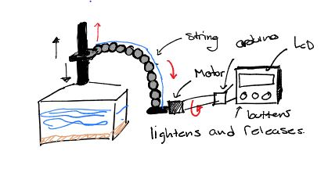
Bio-Inspired
Nathan
Uses spherical supports similar to eggs or coconuts.
Mimics the movements of a prehensile tail.

Slide 8
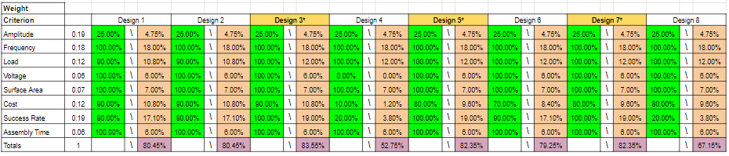
Design Selected: Decision Matrix
Shuaib
Table 1: Decision Matrix
Top Designs are 3,5,7

Slide 9
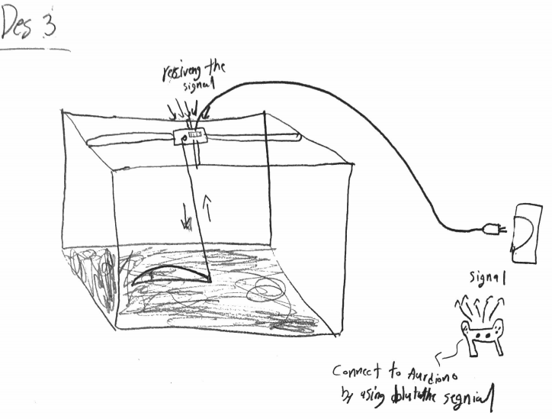
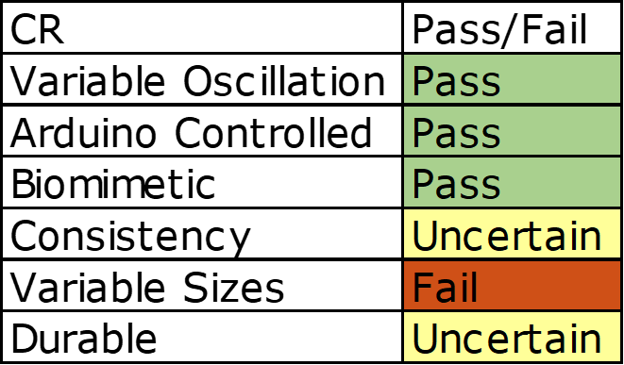
Design 3
Shuaib

Slide 10
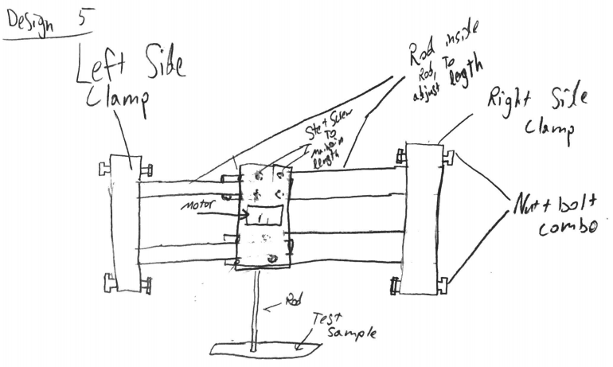
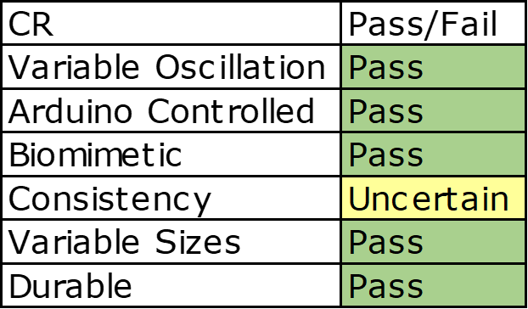
Design 5
Shuaib

Slide 11
Design 7
Shuaib

Slide 12
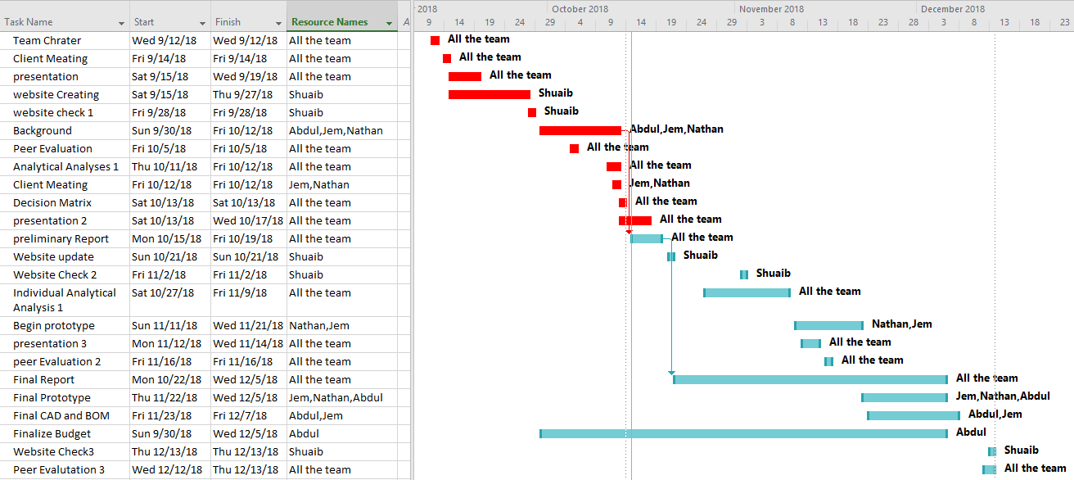
Gantt Chart - Currently on schedule!
Abdul

Slide 13
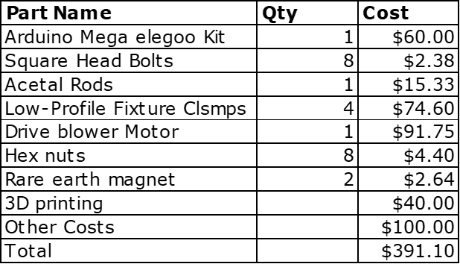
Budget
Abdul
Table 2: Estimated Budget based on design 5
The team has an anticipated expense of $400
The team has no expenses to date but will buy the arduino kit soon

Slide 14
References
Richmondreefer, YouTube, 05-Jun-2012. [Online]. Available: https://www.youtube.com/watch?v=0HDH9pox1j4. [Accessed: 17-Oct-2018].
“McMaster-Carr,” McMaster-Carr. [Online]. Available: https://www.mcmaster.com/. [Accessed: 17-Oct-2018].

