Slide 1

Helium Micro Air Vehicle
Fawaz Alenezi, Hamoud Alkhaldi, Abdulrahman Almuqhawi, Matthew Kohr, Conrad Nazario and Randal Spencer
Department of Mechanical Engineering
April 29, 2016

Slide 2
Overview
Introduction
Project Needs and Goals
Objective
Helium Blimp
  Steering System
  Power Source
  Enclosure Designs
  Camera Connections and Setup
  Electronic Setup
Testing and Results
Bill of Materials
Conclusion

Slide 3
Introduction
Dr. Srinivas Kosaraju, our client, is a lecturer in the department of Mechanical Engineeering at Northern Arizona University
Dr. Kosaraju has requested to design and test a Helium Micro Air Vehicle (MAV) device to fly over fires and contaminated areas
The MAV will be designed to carry electronics and collect pictures while in flight

Slide 4
Project Needs and Goals
Need
  Conventional micro air vehicles are not suitable for long duration flight for surveying
Goals
  Develop a Micro Air Vehicle (MAV) that can ascend, descend, and survey areas more efficiently while using helium as its main source of lift
  Limit energy consumption during flight so that the MAV’s power source will last longer than commercial MAVs

Slide 5
Objectives
Objective | Measurement | Units
Reduce Weight | Mass | kg
Optimize Flight Time | Time | sec
Minimize Cost | Currency | $
Maximize Thrust | Force | N
Easy to Store | Volume | m³

Slide 6
Constraints
Reach a minimum height of 30.5 m (100 ft)
Must have mounted camera
Remote controlled guidance system
Must move forward, ascend, descend and hover at a specified altitude
$2000 budget

Slide 7
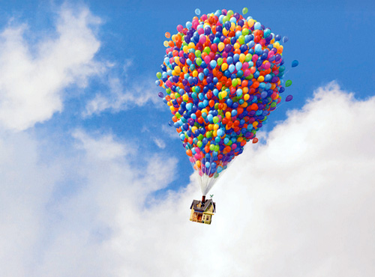
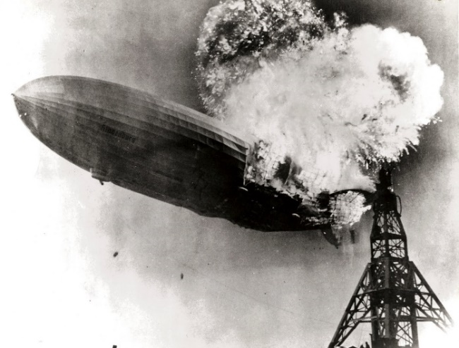
Helium vs Hydrogen
Advantages
  Inert gas/nonflammable
Disadvantages
  More expensive than hydrogen
  Weighs twice as much as hydrogen
    Hydrogen can lift about 8-11% more
Source: © Disney. All rights reserved
Source: smithsonianmag.com

Slide 8
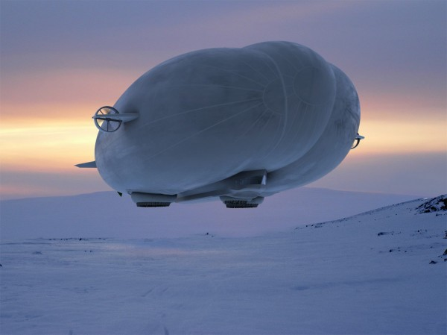
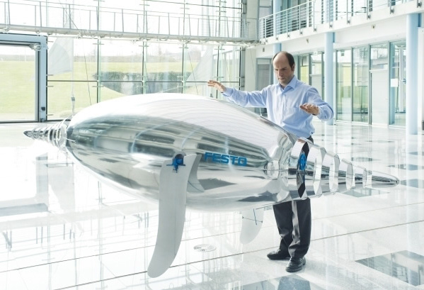
State of the Art Research
Airlander 10
Air Penguin
Source: .hybridairvehicles.com
Source: festo.com
Volume: 38,000 m³
Kevlar, Mylar, and Vectran
Payload capacity: 10,000 kg
Flight duration: 5 days
Length: 3.70 m
Aluminium-Metallised Foil
Li-Po battery, 2000 mAh, 4.2 V
Ultrasound Receiver Capsules

Slide 9
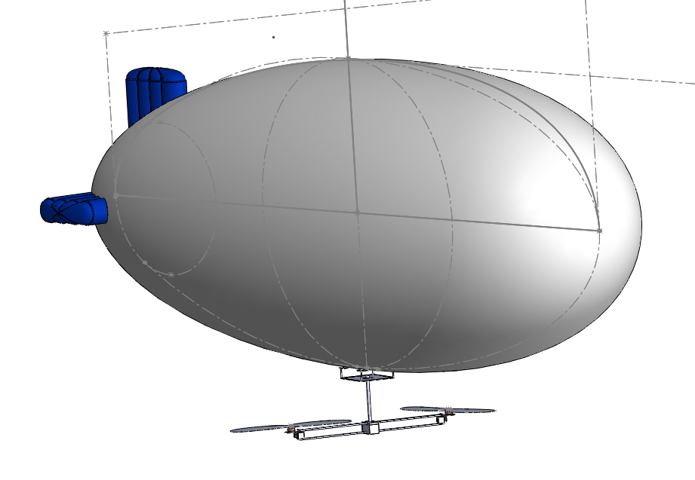
Final Design

Slide 10
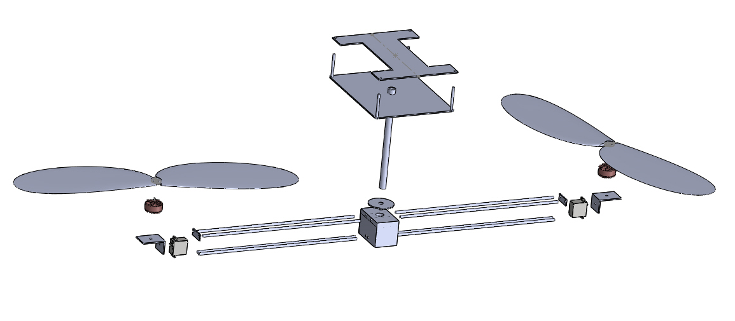
Final Design
Enclosure
Bolts
Propellers
PVC Shaft
Flange
Spacers
Motors
L-Bracket
Carbon Fiber Rods
Servo
Electric Box

Slide 11
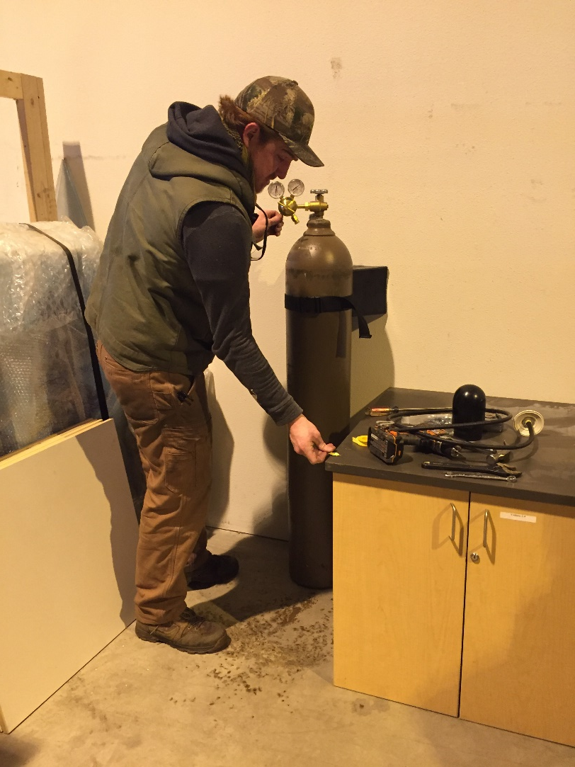
Blimp Testing Procedure
Filled the blimp with Helium gas
Used an entire tank of Helium ~ 6.14 m³
Attached testing enclosure to the bottom of the blimp
Added weights in increments to measure maximum carrying capacity
Measured dimensions of the blimp

Slide 12
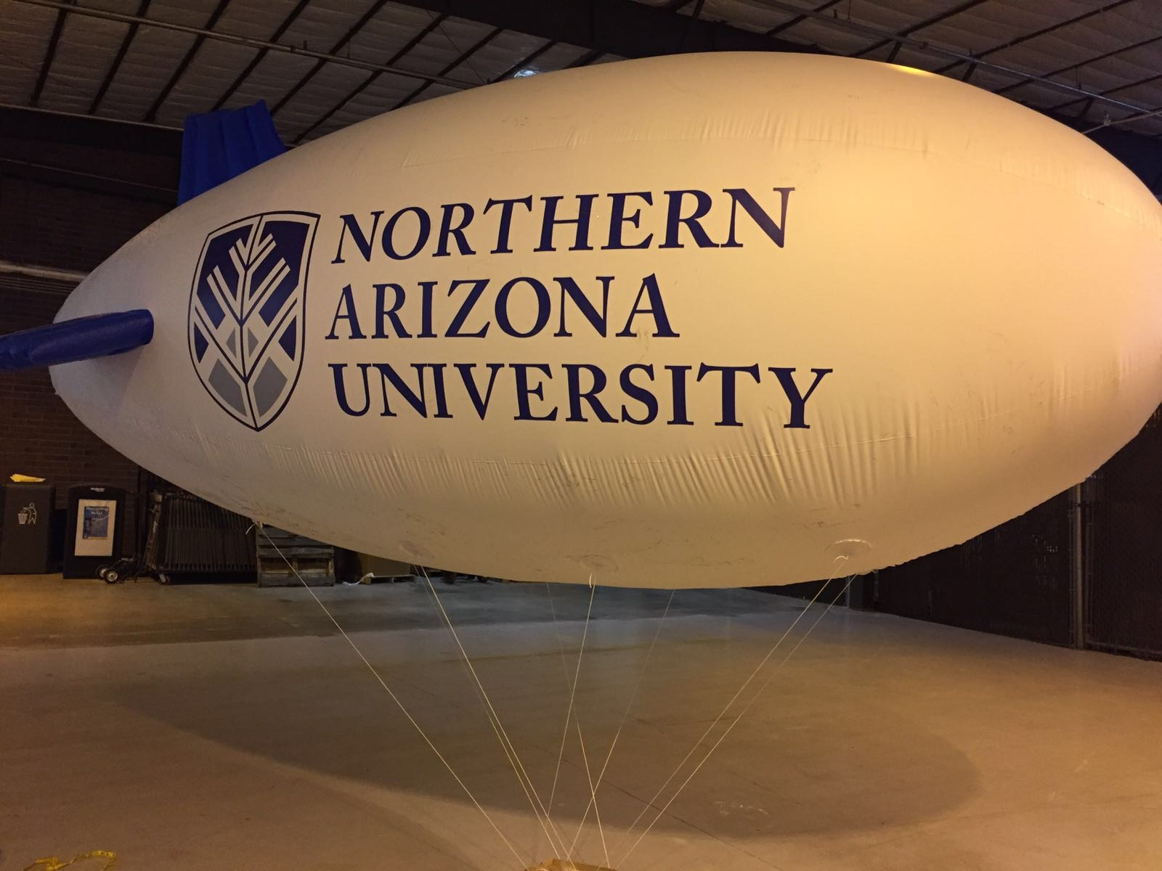
Helium Blimp
Length: 4.88 m
Center Blimp Diameter: 1.91 m
Carrying Capacity: 3.11 kg

Slide 13
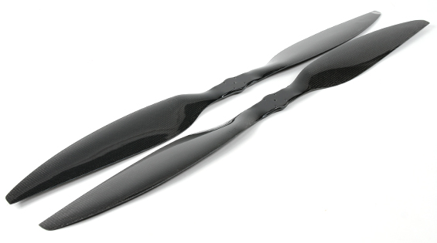
Propellers
High thrust is needed to counter the Helium lift force
Propeller selection was based on two parameters:
  Large diameter
  Small pitch
Dynam Carbon Fiber Propellers
Source: hobbyking.com
Diameter: 30 in.
Pitch: 5.5 in.

Slide 14
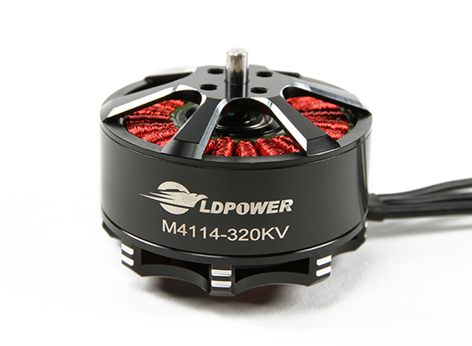
Motors
Motor with a low KV provides optimal thrust
Using LDPOWER M4114-320KV Brushless Motor (CW)
  999W
  320KV
  14.8V-22.2V (4S-6S)
Battery with 6 cells (6S), each cell 3.7V, has been chosen to maximize the thrust
Source: hobbyking.com

Slide 15
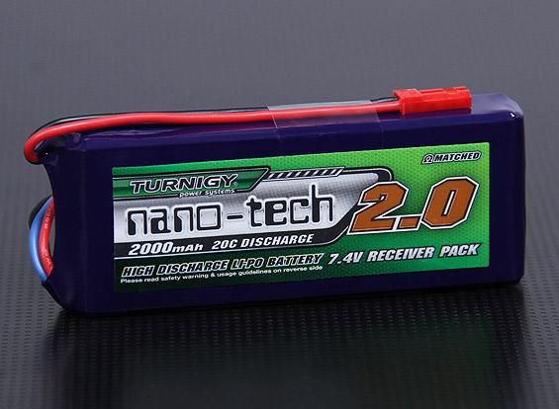
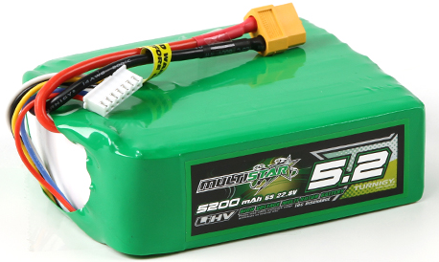
Power Source
Turnigy nano-tech 2000mAh 2S(7.4V)1P 20~40C to power the servos
  Weight: 0.098 kg
MultiStar LiHV High Capacity 6S(22.8V) 5200mAh Multi-Rotor to power the motors and electronic speed controllers
  Weight: 0.613 kg
  Thrust: 10.5 N
Source: hobbyking.com
Source: hobbyking.com

Slide 16
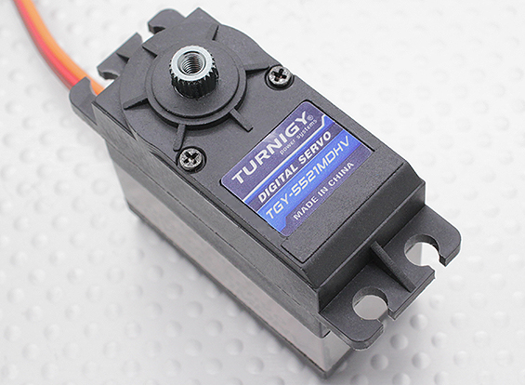
Servos
Servo
  Turnigy™ TGY-5521MDHV
  Light Servo at weight of: 0.0635 kg
  Torque at 22kg/cm
  Operates at a maximum of 8.4 V
Source: hobbyking.com

Slide 17
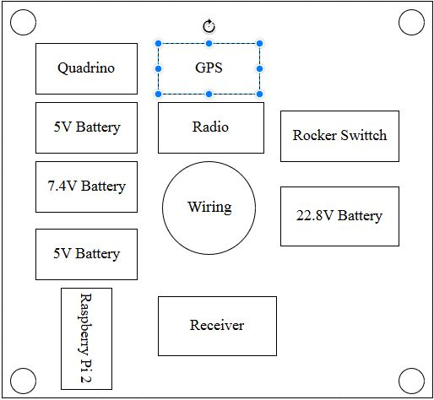
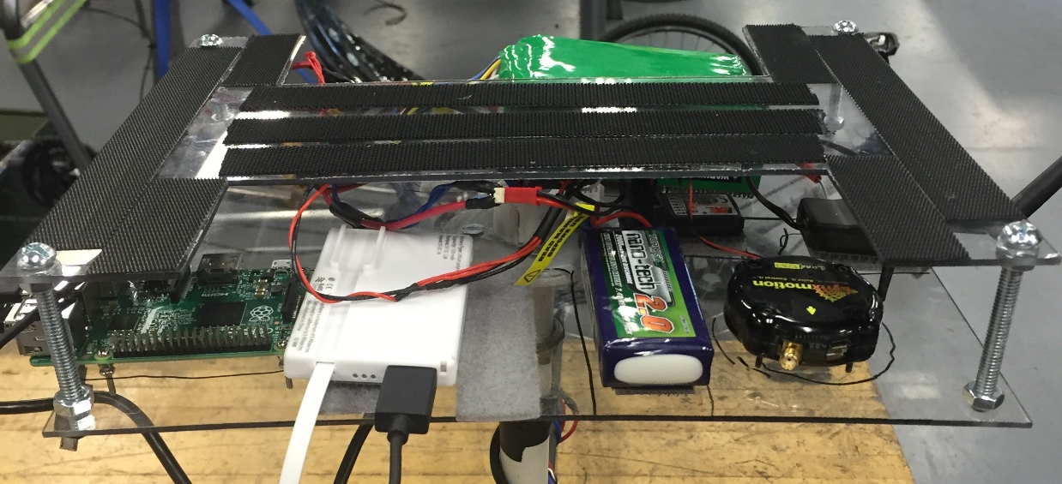
Enclosure Design
The enclosure is made of polycarbonate
Velcro attached to the top
Bolt in each corner to adjust height

Slide 18
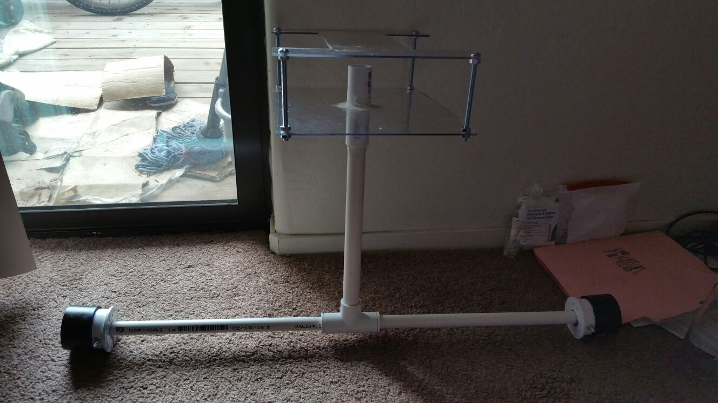
Initial Frame Design
The shaft design is made of PVC
Final weight: 3.2 kg
Exceeds maximum carrying capacity

Slide 19
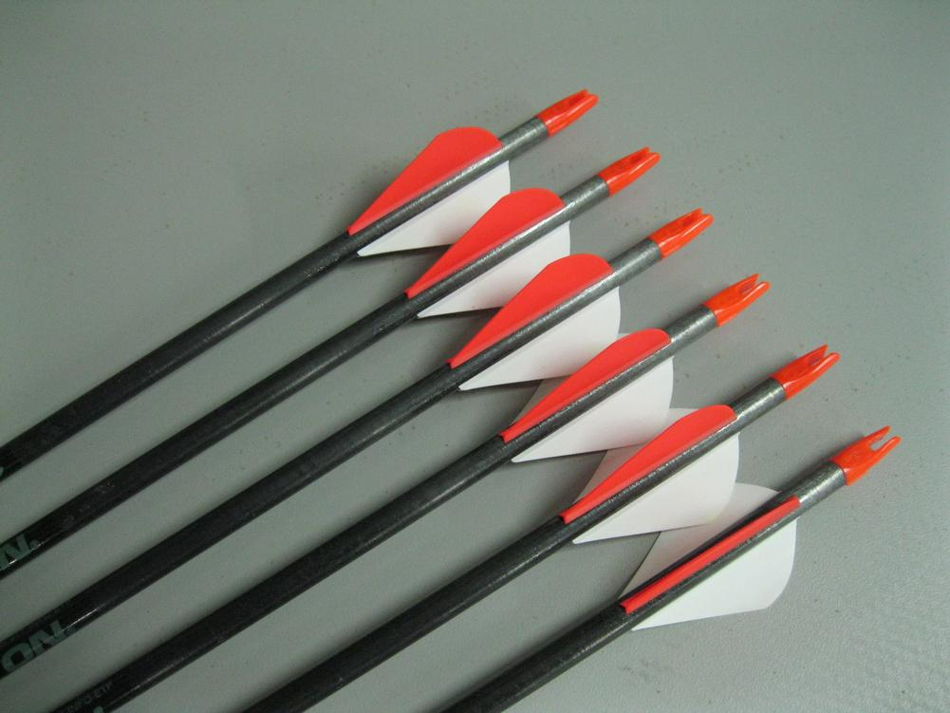
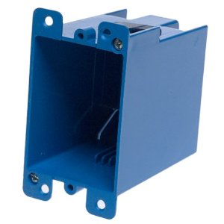
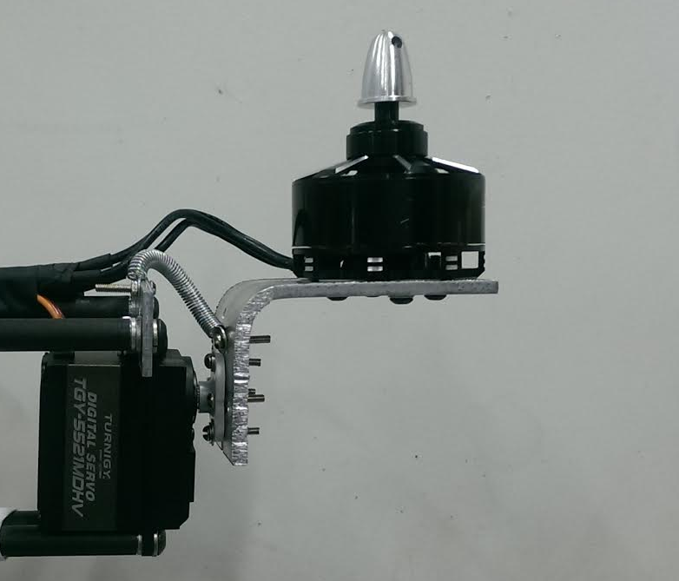
Frame Design Modifications
PVC shafts, replaced with carbon fiber hollow shafts
The PVC Tee fitting, replaced with a plastic electric box
L brackets were added to support the motors
L bracket attached to the plastic casing where the camera will be mounted
Springs attached to L brackets to minimize strain on the servos’ motor
Source: easton.com
Source: homedepot.com

Slide 20
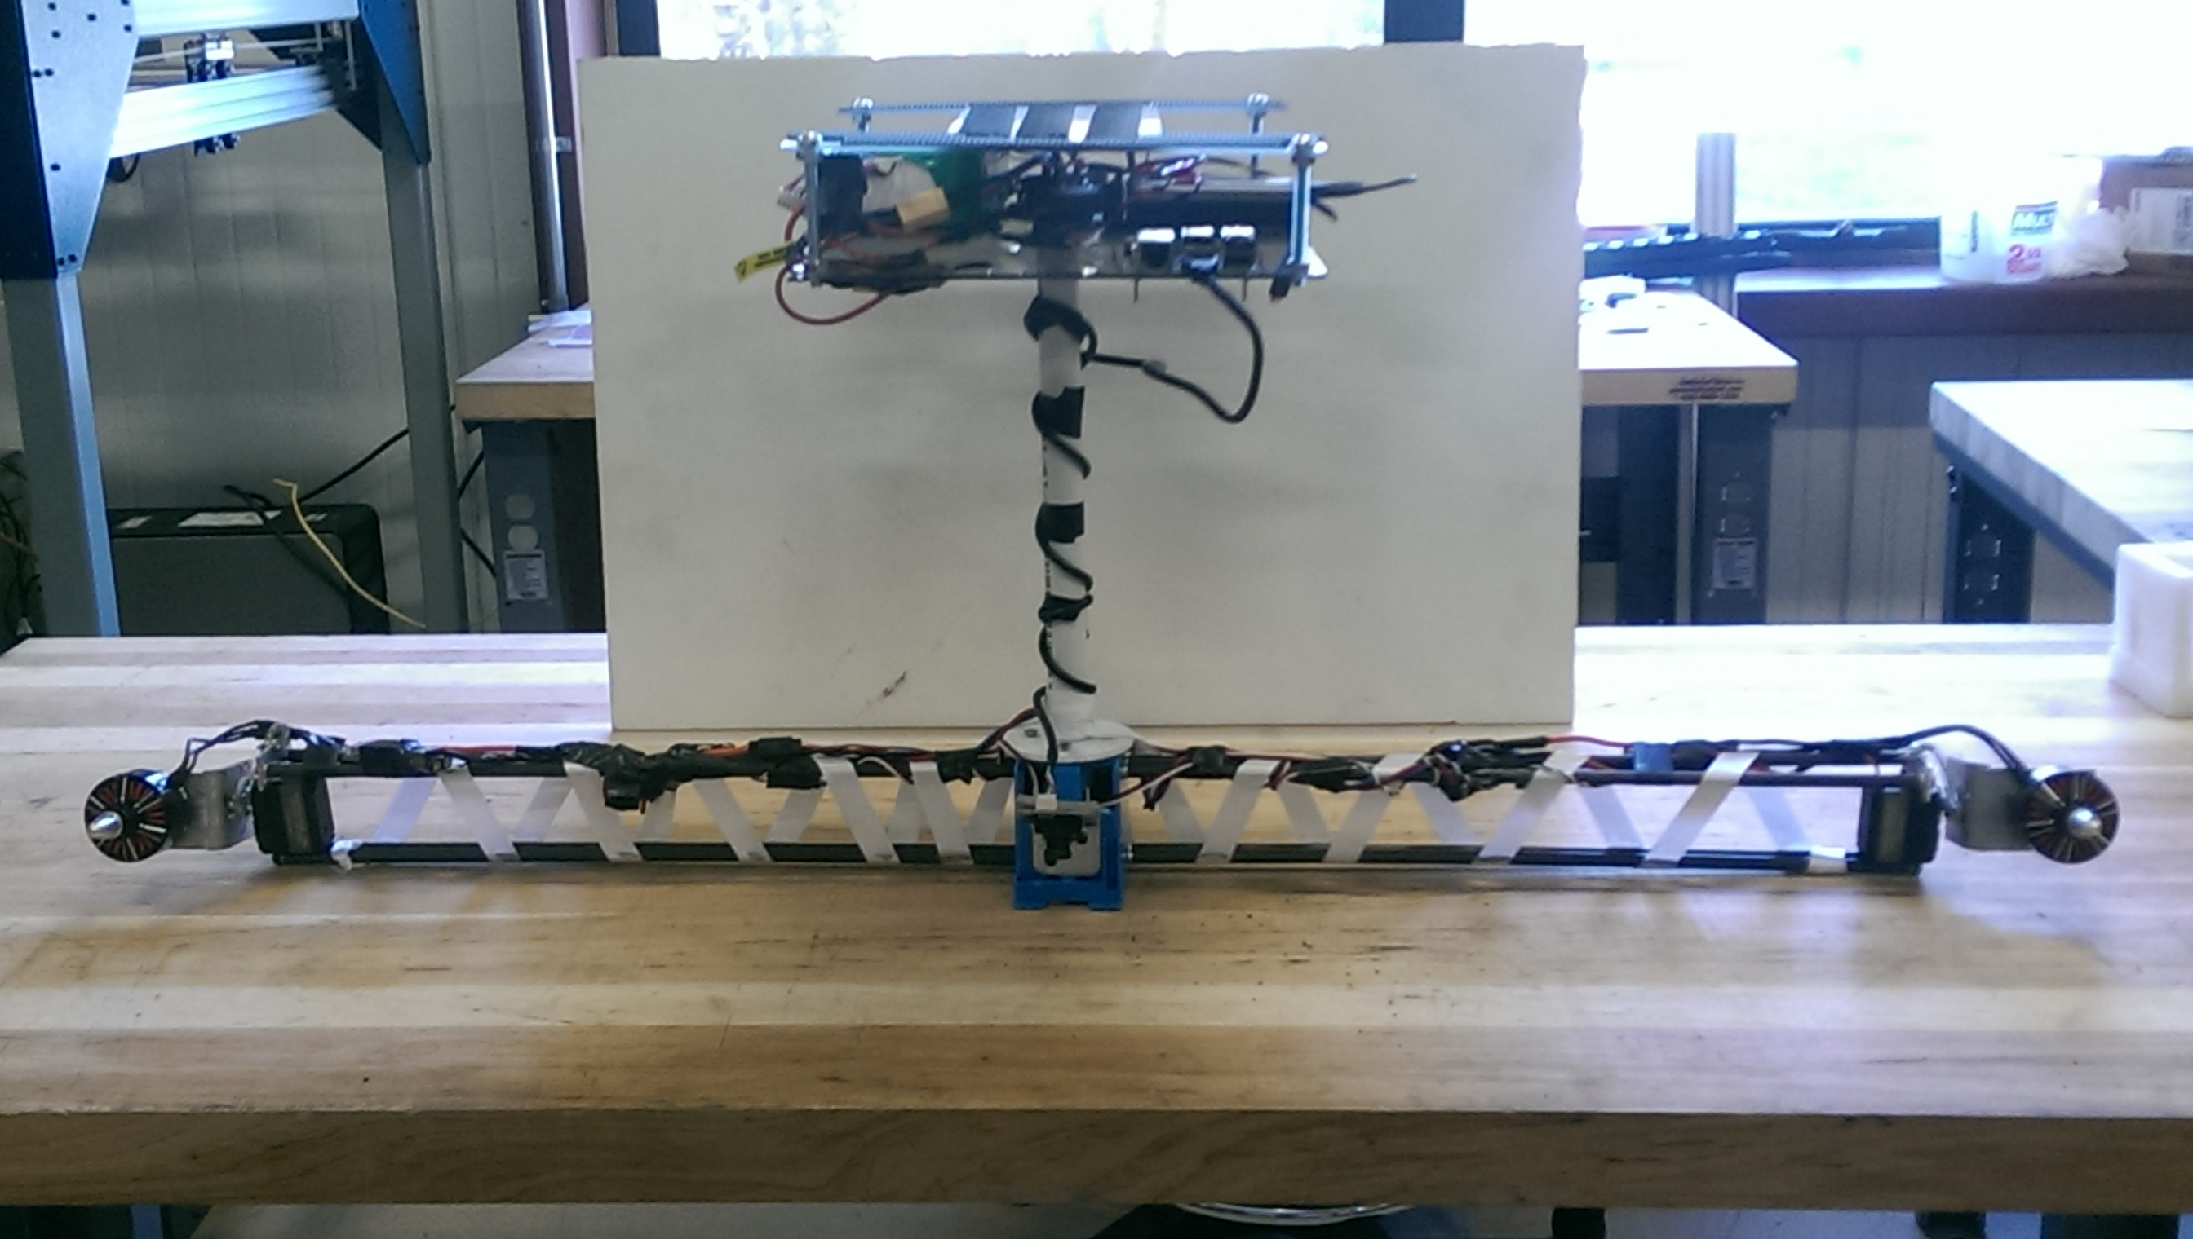
Final Frame Design
Ribbons used to reinforce bottom Deflection
Wiring wrapped along shafts

Slide 21
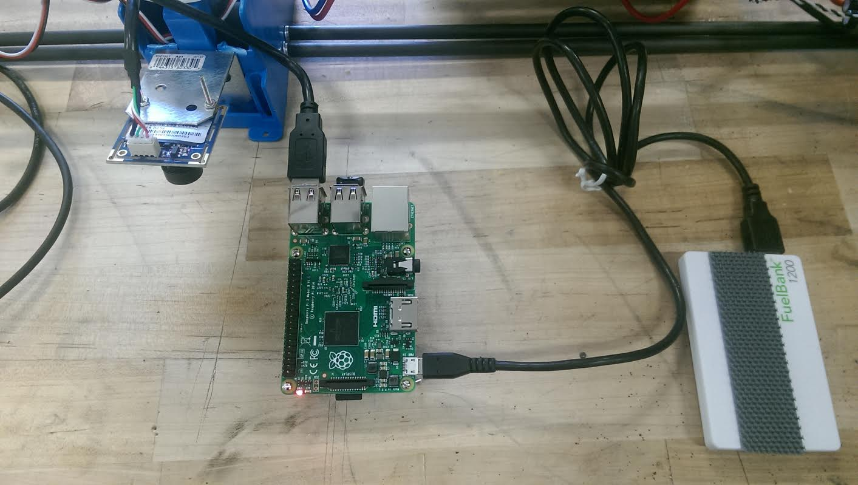
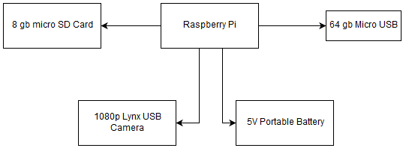
Camera Setup
Lynx 1080p
Raspberry pi 2
64 GB Micro USB
Delay and range functions
Skip function
Automatic Startup when power is applied

Slide 22
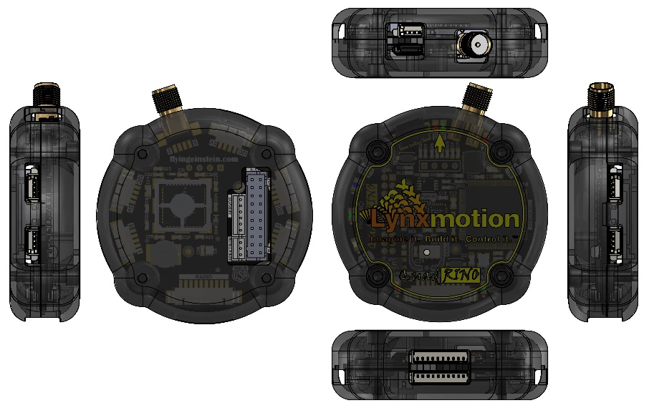
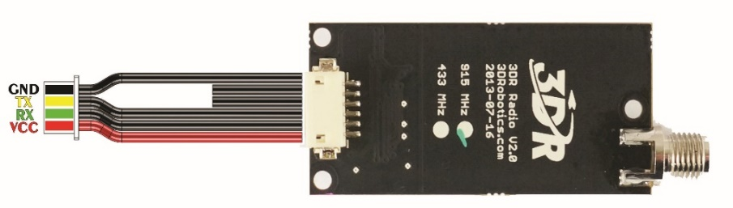
Quadrino and Radio Transmitters
Flight Controller
In flight communication
GPS
Telemetry data
Source: Lynxmotion
Source: Lynxmotion

Slide 23
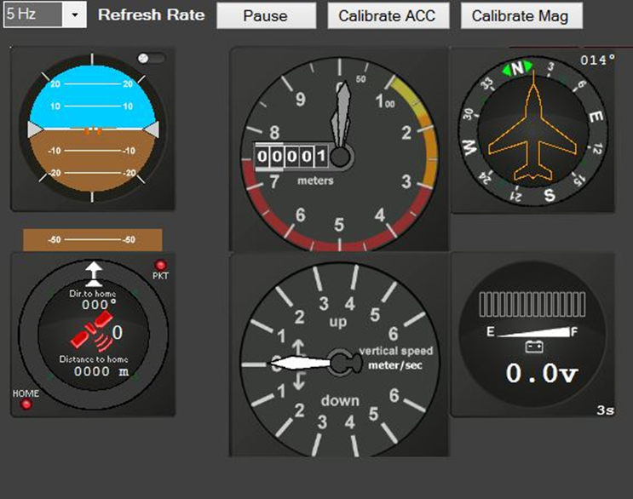
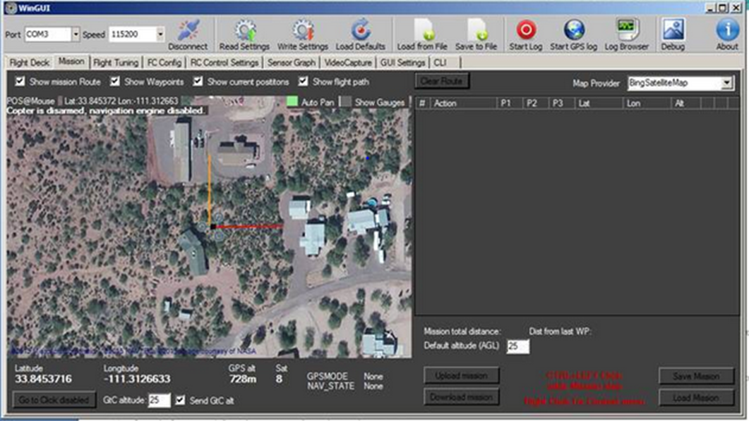
Quadrino Interface

Slide 24
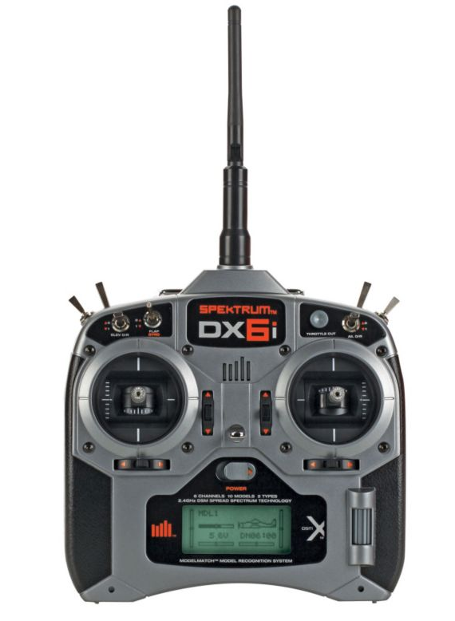
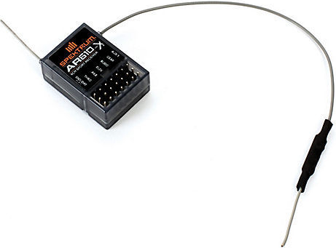
Receiver
Spektrum AR610 channel receiver
Communicates with Spektrum DX6i Transmitter
Powered by the Quadrino
Source: hobbyking.com

Slide 25
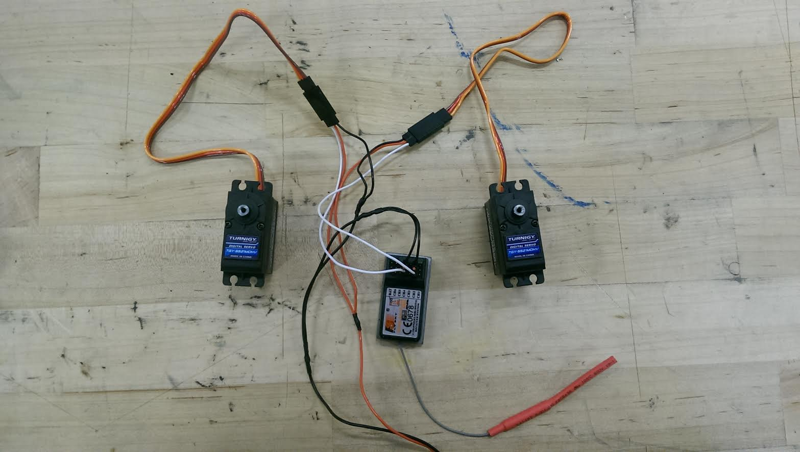
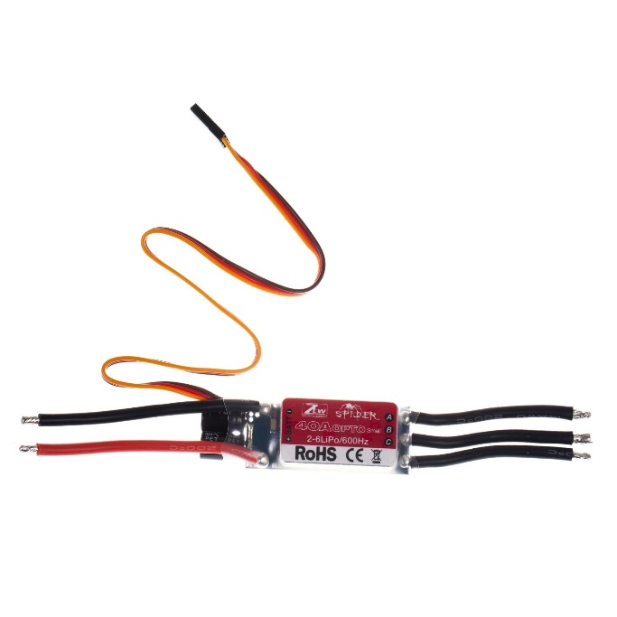
Electronic Speed Controller (ESC)
Connection point between battery and signal output for motors
ESC will directly connect to receiver
Going with the ZTW Spider 40 amp
Servo split cable
Connects to throttle channel
Source: amazon.com

Slide 26
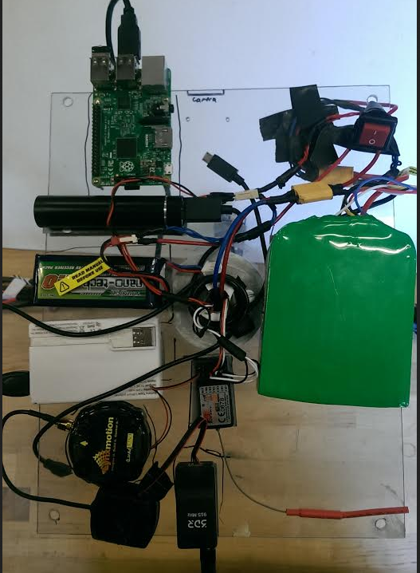
Electronic Setup
Rocker Switch
  Able to turn off and on power supply
  Centralized power supply
  Outputs to servos and motors
Quadrino operates by a separate 5V battery

Slide 27
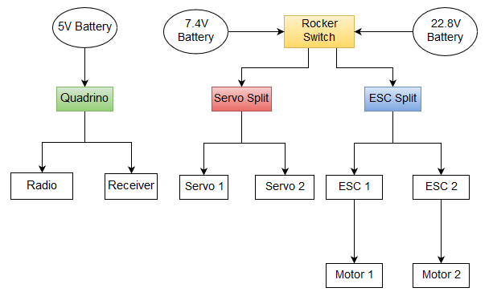
Power Schematic

Slide 28
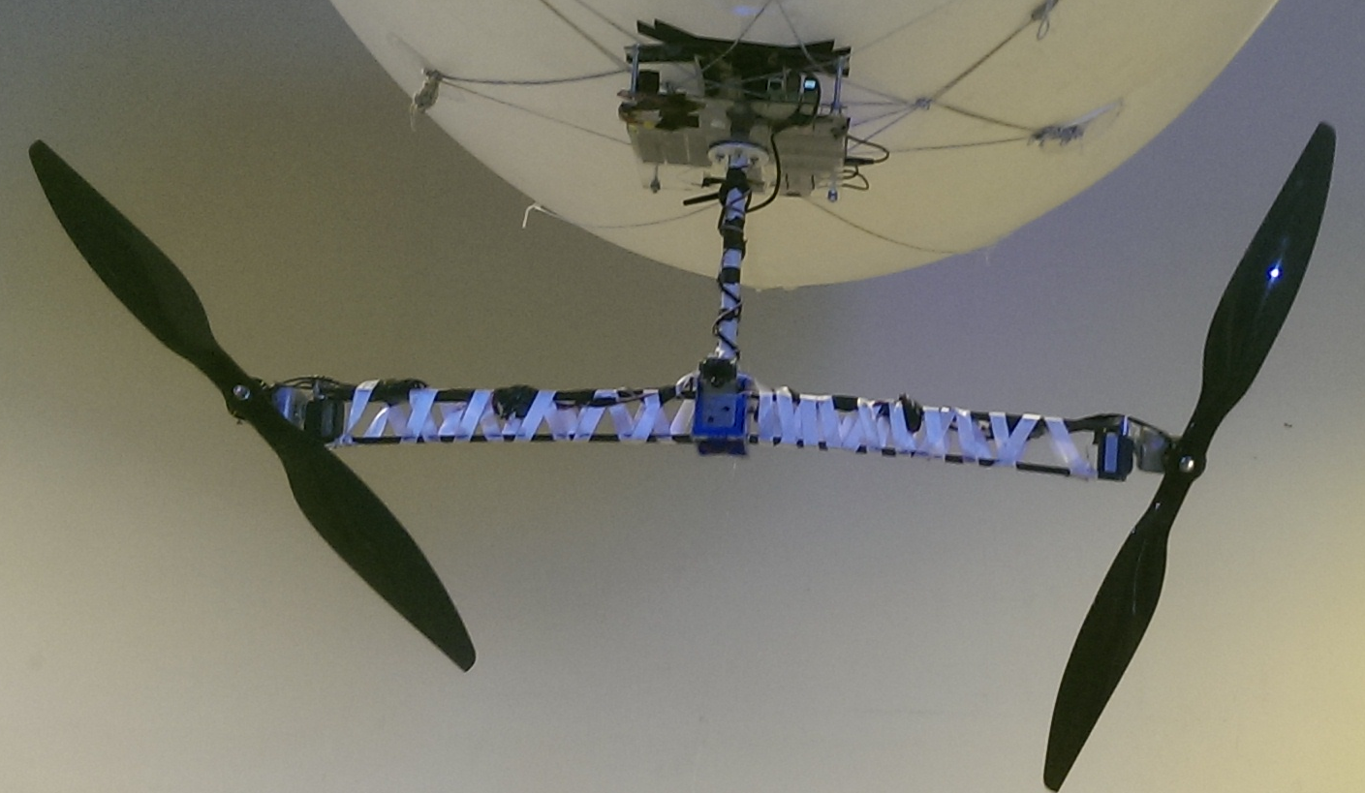
Final System

Slide 29
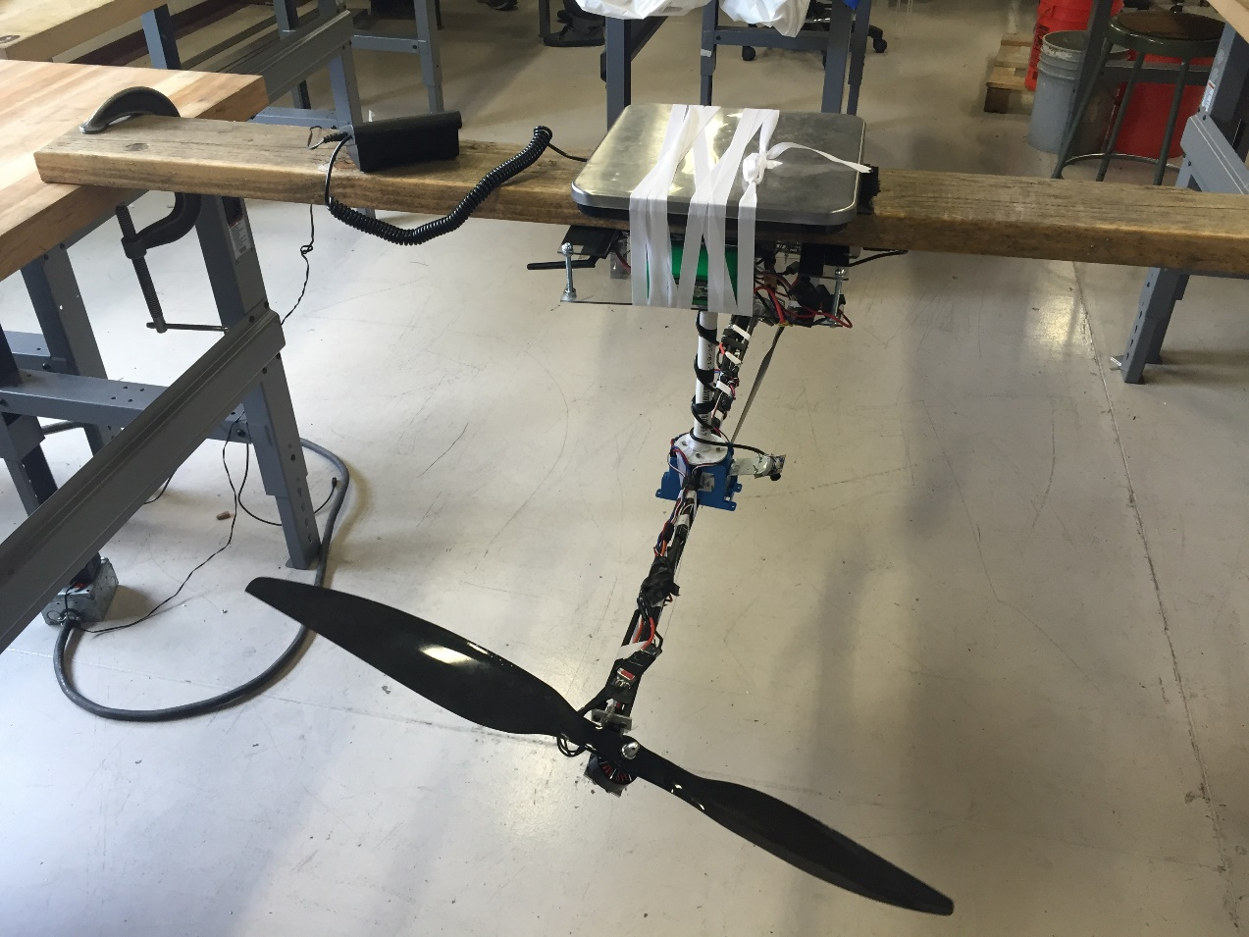
Thrust Testing Setup
Determining thrust force
Equipment used
  Long wood board
  Cargo Scale
  Ribbons
  Clamps
  Velcro

Slide 30
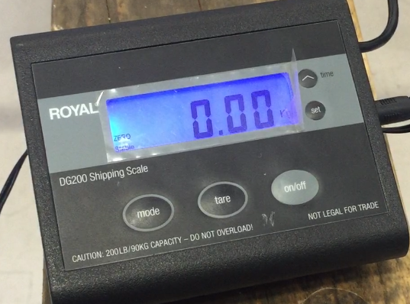
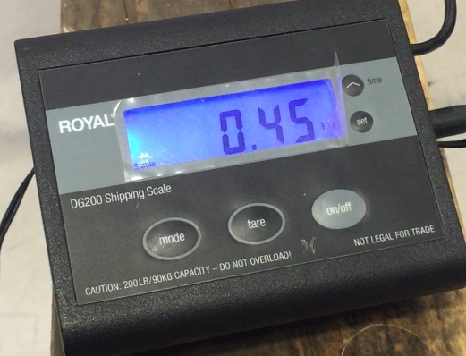
Thrust Calculations

Slide 31
Results
Blimp carrying capacity: 3.11 kg
The system weight: 2.85 kg
Force Required (3.11-2.85)kg= 0.26 kg = 2.55N
Force generated: 0.45 kg = 4.41N

Slide 32
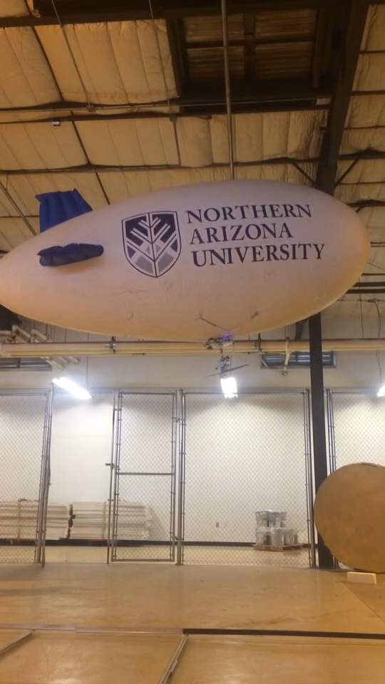
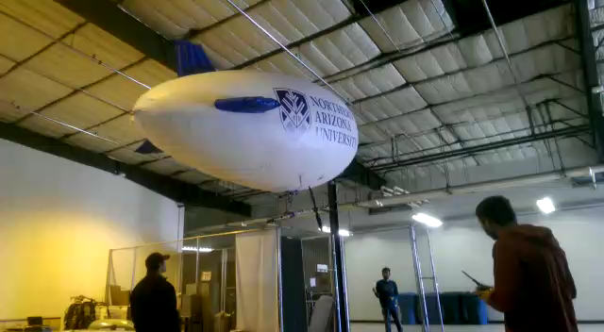
Flight Testing

Slide 33
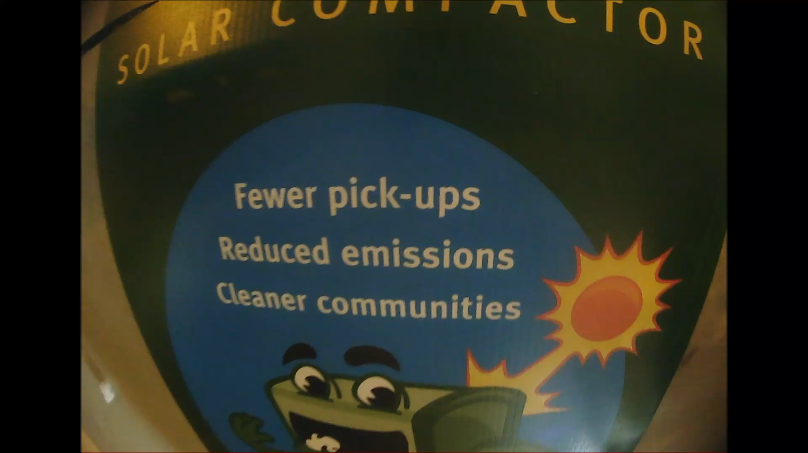
Mounted Camera Footage

Slide 34
Bill of Materials
Name | Cost ($) | Weight (kg)
Surveillance System | 126.03 | 0.122
Blimp/ Maintenance | 751 | NA
Propulsion System | 285.56 | 1.217
Attachments | 19.98 | 0.062
Enclosure System | 16.97 | 0.733
Telecommunication System | 441.22 | 0.171
Steering System | 70.43 | 0.220
Total | 1811.19 | 2.85

Slide 35
Conclusion
The client requested to design and test the Helium MAV
The final design performed as designed, with no testing flaws from the enclosure
Team obtained camera footage from the test flight
Final design came under weight of the payload capacity, with approximately .26kg of excess lift capacity
The net force obtained after testing was 1.86N of extra thrust capability

Slide 36
Acknowledgments
NAU Machine Shop
  Tom Cothrun
  Zach Goettle
  Perry Wood
  Zach Rischar
Peers
  William Richie
Professors
  Dr. Srinivas Kosaraju

Slide 37
References
[1] "Nano-Tech 2.0," Turnigy, 2016. [Online]. Available: http://www.hobbyking.com. [Accessed 1 April 2016].
[2] Carlon, 15 January 2016. [Online]. Available: http://www.homedepot.com/. [Accessed 2016].
[3] Lynx Motion, 26 January 2016. [Online]. Available: http://www.lynxmotion.com/. [Accessed 2016].
[4] "Spider Multirotor ESC," ZTW, January 2016. [Online]. Available: http://www.buddyrc.com. [Accessed 28 March 2016].
[5] "Physical Computing," Python, 2016. [Online]. Available: https://www.raspberrypi.org/. [Accessed April 11 March 2016].
[6] "6 channel Receiver," Flysky, January 2016. [Online]. Available: http://www.hobbypartz.com/. [Accessed 2016].
[7] H. M. Capstone, Interviewee, Dr. Srinivas Kosaraju. [Interview]. 18 April 2016.
[8] "Transmitter and Reciever," Exceed RC, [Online]. Available: http://www.hobbypartz.com. [Accessed April 2016].
[9] "Turnigy TGY-20c, Turnigy Battery Pack," 13 February 2016. [Online]. Available: http://www.hobbyking.com/. [Accessed 28 May 2016].
[10] H. A. A. A. M. K. C. N. R. S. Fawaz Alenezi, "Helium Micro Air Vehicle," NAU, [Online]. Available: http://www.cefns.nau.edu/capstone/d4p/.
[11] "Voltage ESC," RoHS, 2016. [Online]. Available: www.amazon.com. [Accessed April 2016].
[12] "Hindenberg Disaster," Smithsonian, [Online]. Available: www.smithsonianmag.com. [Accessed April 2016].

Slide 38
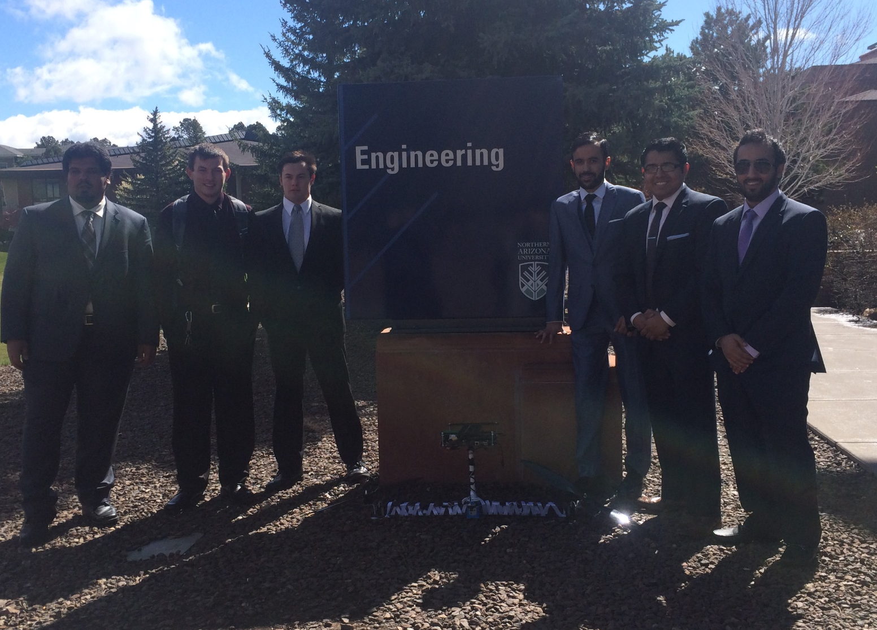
Questions?

