Slide 1
MSMA Lateral Loading Device
Presented by:
Matthew Batten, Cody Burbank,
Jonathan McCurdy, Thaddeus Grudniewksi,
& Joy Weber
April 14, 2014

Slide 2
Overview
Background
Goals
Problem Identification
Project Description
Design Concepts
  Actuation
  Force Sensing
  Improvised Design Changes
Feedback System
Updated Budget
Project Planning
  Gantt Chart
Conclusion
2
Matthew Batten

Slide 3
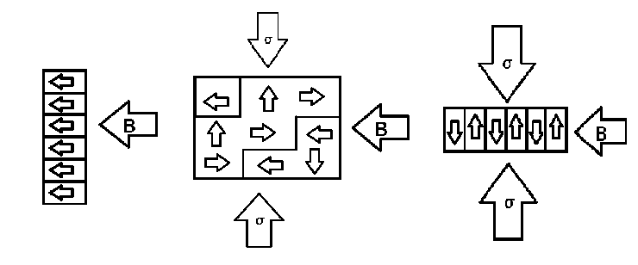
Magnetic Shape Memory Alloy (MSMA)
  Ni₂MnGa
  Magnetization vector rotation
  Actuating vs. power harvesting
  Variant Reorientation Model

Slide 4
Problem Definition
Goal
  To design a piece of equipment that will facilitate the already established testing procedure and enable forces in the lateral direction.
Design Objectives
  Cost-efficient
  Precise
  Reliable

Slide 5
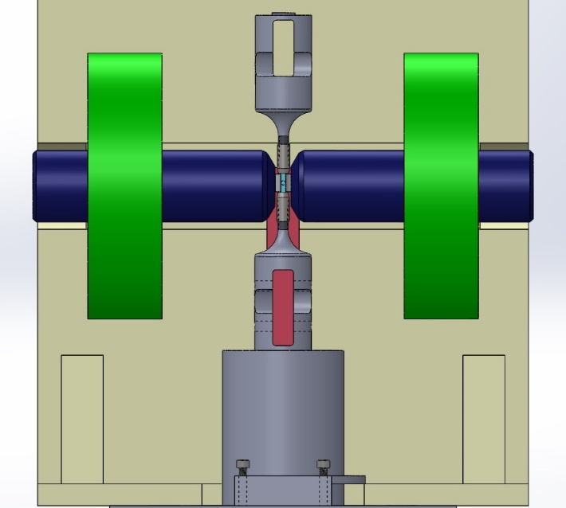
Problem Identification
Dr. Ciocanel
      Conducts research on Smart Materials
      Wants to expand his testing process to include compressive force in the third dimension
      Operates at room temperature in a laboratory setting
Solidworks Model of Instron Machine
Matthew Batten
3

Slide 6
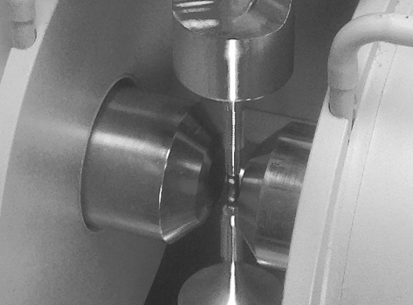
Project Description
    Construction of a device capable of laterally loading up to 200 N
    Work within a $2500 budget
    Fit within 10mmx12mm area under a magnetic field
    Provide feedback control
Experimental Setup for MSMA Testing
Joy Weber
4

Slide 7
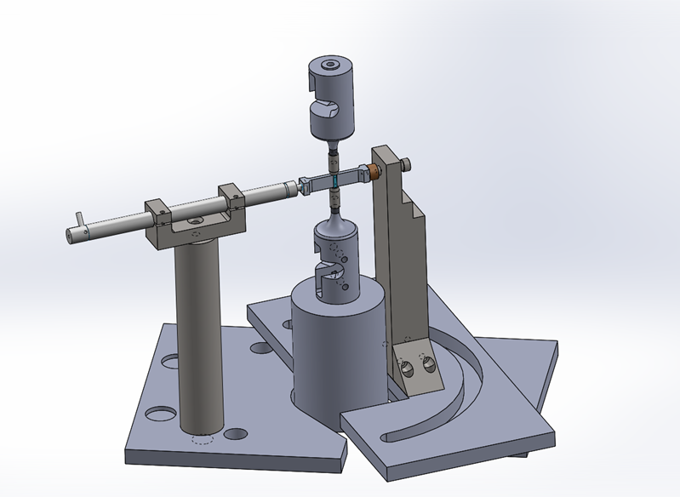
Design Concept
Joy Weber
5

Slide 8
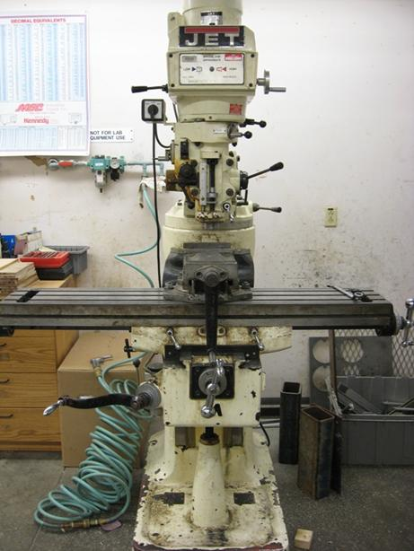
Fabrication
  This device was primarily fabricated using aluminum and 303/304 stainless steel.
  Due to the high strength of this type of steel several design changes had to be made to facilitate the available tools.
    The bottom brackets were modified so that only one side had to be tapped instead of both.
    Plastic covers for the space where the actuator sits were added to reduce wear.
    During testing it was determined that the plastic covers allowed for deformation of the actuator assembly which was remedied by adding a hard stop at the end of the assembly that the actuator butts up against.

Slide 9
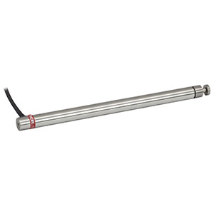
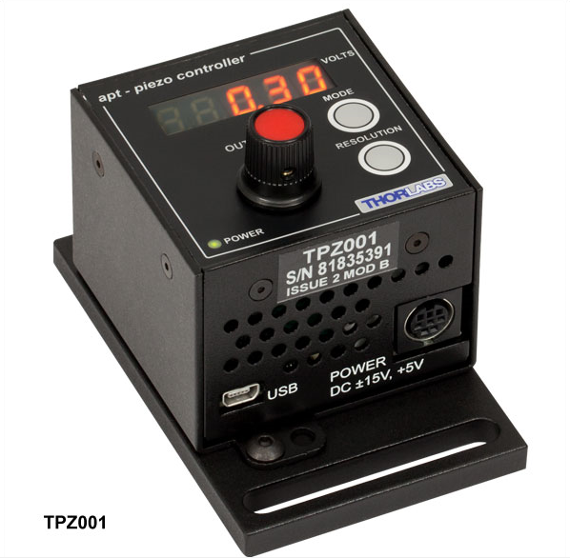
Piezoelectric Actuator
THORLABS PAS015
T-Cube Piezo Controller
Joy Weber
6

Slide 10
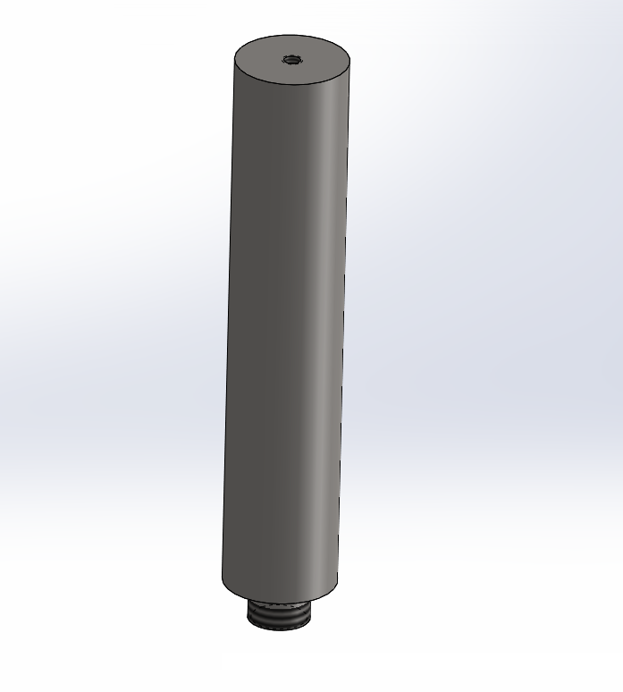
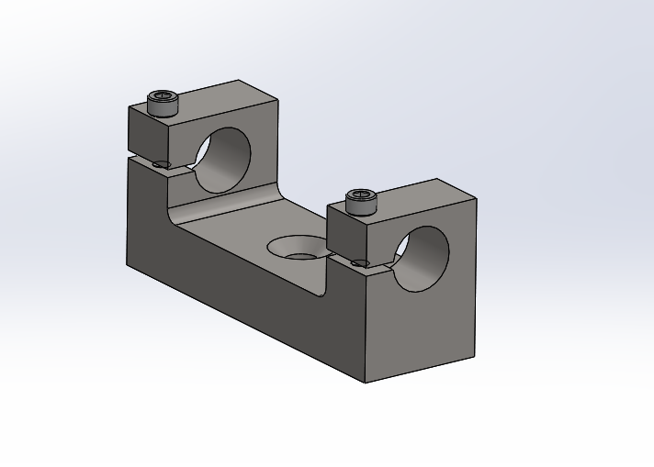
Piezoelectric Actuator Mount
Thaddeus Grudniewski
7

Slide 11
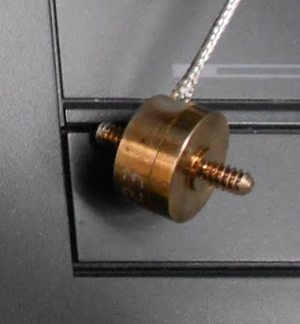
Strain Gauge Force Sensor
Measures strain through voltage via deflection of wires attached to material.
The selected strain gage is the Honeywell Model 11.
Thaddeus Grudniewski
8

Slide 12
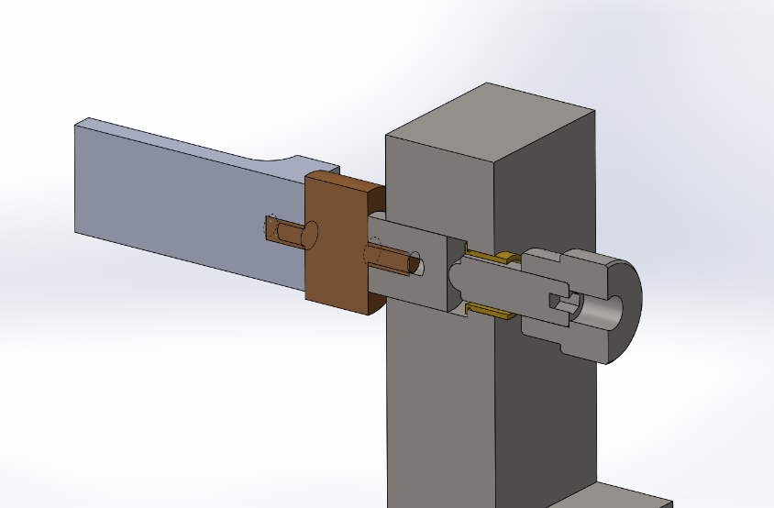
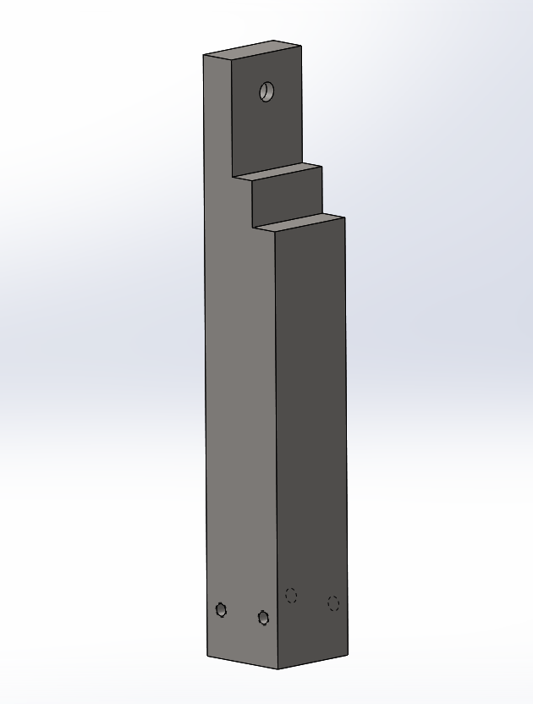
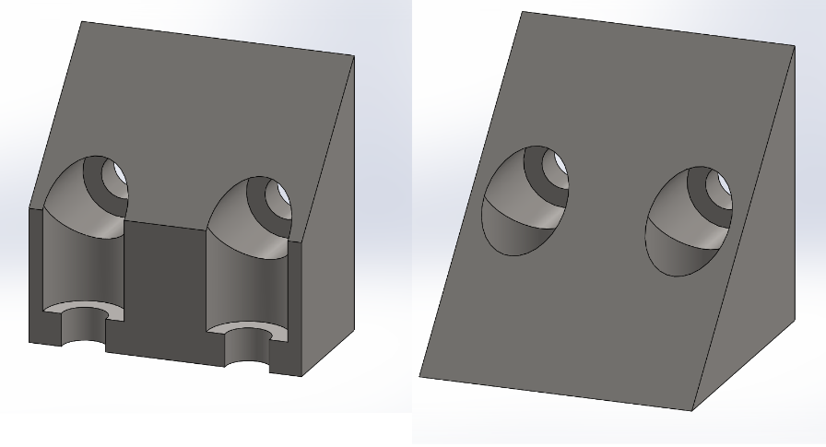
Strain Gauge Force Sensor Mount
Thaddeus Grudniewski
9

Slide 13
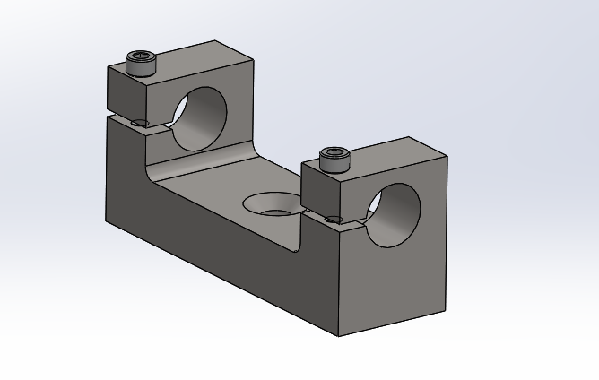
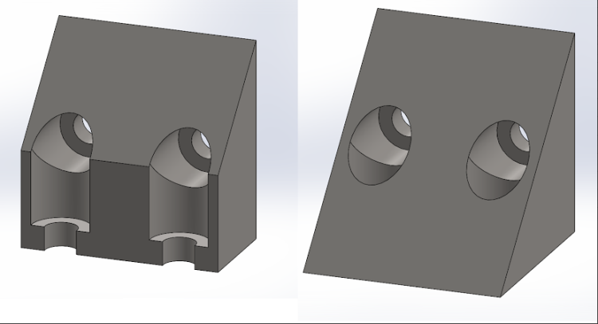
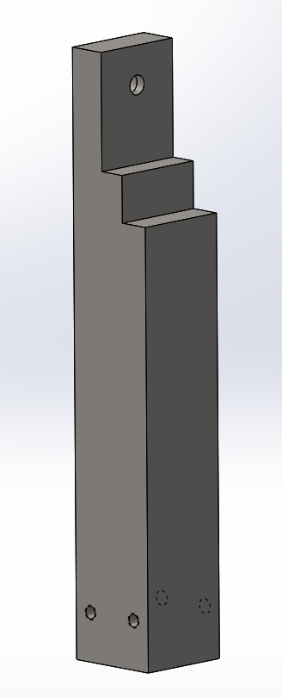
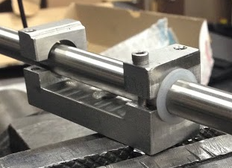
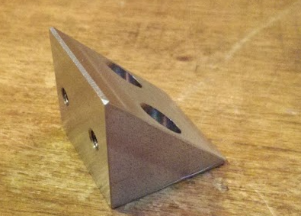
Improvised Design Changes
Cody Burbank
10

Slide 14
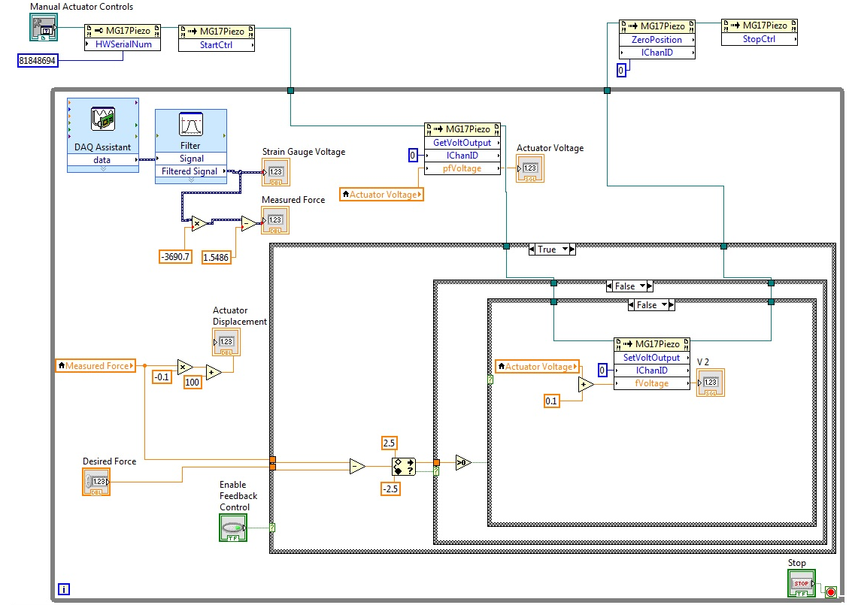
Feedback System
Set Initial Force
While loop
GetPosition set using force sensor
Cody Burbank
11

Slide 15
Updated Budget
Material | Cost
1.5" dia (1' length) 304 SST | $25.00
1" x 1.25" (3" length) 303 SST | $19.14
1.125" X 1.125" (11" length) 303 SST | $12.50
0.5" x 0.5" (3" length) 6061 extruded Alum. | $2.90
TB187-100-313 3/16 and 1/4 Fine Adjustment Carrier and Bushings | $3.75
KB187-100 Knob | $4.00
TS187-100-625 3/16-100 TPI Screw | $4.35
96006A259 6-32, 3/4" long Stainless Steel Socket Head Cap Screw | $0.86
90585A144 1/4"-20, 9/16" long Stainless Steel Flat Head Socket Cap Screw | $1.18
92220A173 10-32 1/2" Low Profile Socket Head Cap Screw | $9.44
UHMW Bearing, Flanged, for 1/2" Shaft Diameter, 5/8" OD, 1/2" Length | $15.96
THORLABS PAS015 Piezo-Actuator entire system | $2,370.26
Sales Tax | $4.96
Shipping | $24.50
Total | $2,498.80
Cody Burbank
12

Slide 16
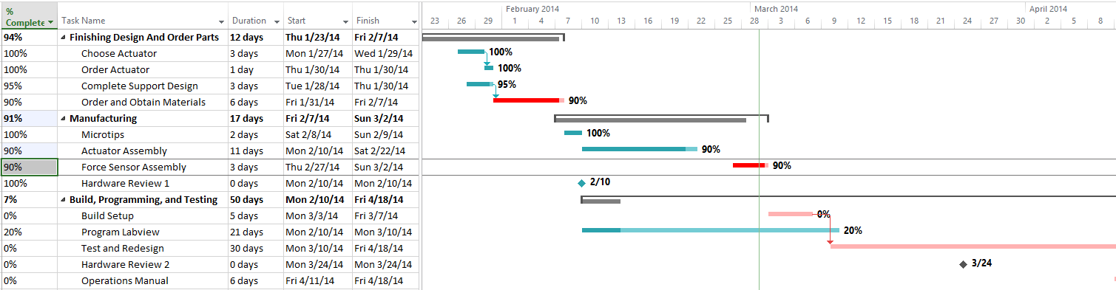
MSMA Lateral Loading Device Time Line
Jonathan McCurdy
13

Slide 17
Conclusion
Must create a feedback controlled device that laterally loads a MSMA up to 200 N within a small area for under $2500.
Jonathan McCurdy
14

Slide 18
References
[1] Leo, Donald J. Engineering Analysis of Smart Material Systems. Hoboken, NJ: John Wiley & Sons, 2007.
[2] Garcia, Matt, Randy Jackson, Jeremy Mountain, Qian Tong, and Hui Yao. Material Testing Fixture. Material Testing Fixture. Dr. Ciocanel, 2012. Web. 15 Nov. 2013. <http://www.cefns.nau.edu/capstone/projects/ME/2013/DFMTM/index.html>.
[3] "Model 11." Model 11. Honeywell International Inc, 2013. Web. 6 Nov. 2013.
[4] "Piezo Driver Bandwidth Tutorial." Thorlabs. N.p., n.d. Web. 12 Jan. 2014.
Jonathan McCurdy
15

Slide 19
Questions?

